Slide 1
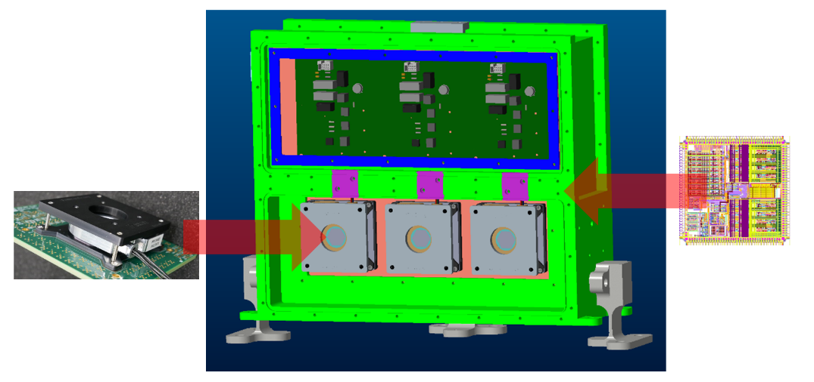
Gigahertz Photon-counting Array Detector (GigaPAD)
PI: John A. Smith, NASA LaRC
3-channel detector subassembly
Design, fabricate and test a detector subassembly, capable of counting and timing photons at gigahertz rates, that will:
Enable retrieval of vertical profiles of ocean particulate backscatter (b_{bp}) and diffuse attenuation (K_{d}) from space for the first time, enhancing studies of ocean biology and the ocean carbon cycle
Enable retrieval of cloud properties that will improve cloud microphysical models, and enable detection of tenuous aerosol layers that play an important role in Earth’s radiative budget
This development addresses the visible wavelength channel detector requirements for the Clio space-based high spectral resolution lidar mission concept developed by LaRC, and recommended for implementation by the Aerosol and Cloud, Convection and Precipitation (ACCP) mission panel.
MCP-PMTs convert photons to small-amplitude electrical impulses that are converted to logic level transitions by custom ROICs, then counted, binned, and averaged into ready-to-downlink lidar profiles by a built-in FPGA
Combine an advanced microchannel plate photomultiplier tube (MCP-PMT) detector with state of the art reconfigurable logic, and custom-developed integrated circuit electronics, to enable a massively parallel, high speed photon counting detector. Key components include:
Custom PHOTONIS multi-anode MCP-PMT with reduced anode crosstalk, enhanced linearity, greatly extended lifetime, and 2x the detection efficiency at 532 nm compared to the state of the art
Custom, high performance Freedom Photonics readout integrated circuit (ROIC) that converts small amplitude charge impulses from the MCP-PMT into logic levels compatible with a downstream FPGA
A state of the art, path to flight FPGA with firmware that instantiates an array of gigahertz-class counters that bins and averages counts to the desired vertical resolution for downlink
Demonstrate single channel 05/18 COMPLETE
Demonstrate multiple channel 08/18 COMPLETE
Characterize MCP 1 06/19 COMPLETE
Hold preliminary design review 06/19 COMPLETE
Hold critical design review 08/19 07/21
Fabricate engineering unit 05/20 10/21
Characterize MCP 2 06/20 09/21
Characterize engineering unit 10/20 02/22
Complete vibration testing 03/21 11/21
Pivot to ROIC approach, COVID impacts
Co-Is/Partners: Richard J. Hare (NASA LaRC), PHOTONIS (Roden, NL), Freedom Photonics (Santa Barbara, CA)
TRL_{in} = 2
TRL_{current} = 4
04/21
ACT-17-0088

