Slide 1
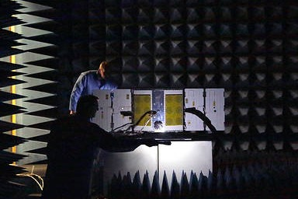
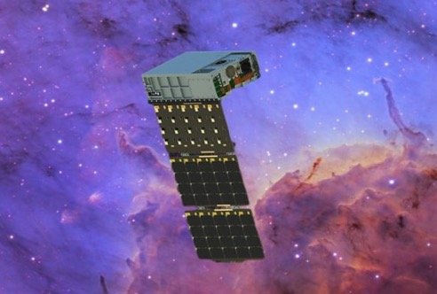
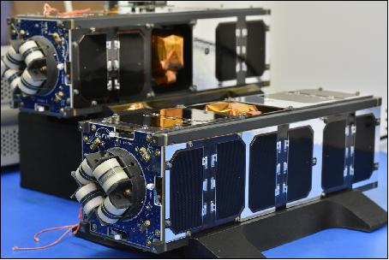
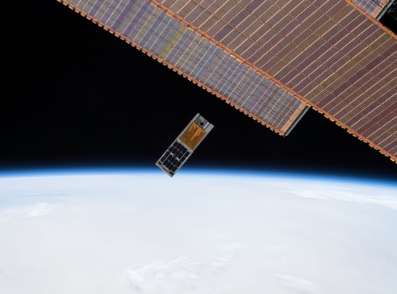
NASA Heliophysics and Astrophysics SmallSat/CubeSats
2021 NASA PI/PM Forum
March 26, 2021 Approved for public release; distribution is unlimited.
Thomas Johnson
Small Satellite Project Manager Thomas.E.Johnson@nasa.gov

Slide 2
GSFC Small Satellite and Special Projects Office
We Support the following Heliophysics and Astrophysics Programs
Heliophysics Flight Opportunities in Research and Technology (H-FORT):
  Cubesats
  Hosted Rideshare Payloads
  International Space Station (ISS)-attached payloads
Astrophysics Research and Analysis (APRA) Program
  Cubesats
Astrophysics Pioneers
  Perform compelling science at a lower cost (<$20M) than Explorers
  SmallSats, Balloon payloads, and ISS attached payloads
ALL MISSIONS MANAGED PER NPR 7120.8, NASA Research and Technology Program and Project Management Requirements

Slide 3
GSFC Small Satellite and Special Projects Office
SMD Heliophysics and Astrophysics Portfolio Mission Management
“Light Touch” mission management for the Astrophysics Pioneers and APRA and Heliophysics H-FORT Programs
  Status reporting interface/liaison between PI and HQ
  Maintain portfolio database
Grants management
Engineering and Project support as necessary and requested
  Engineering Peer Review (EPR)
  Engineering Tech Authority (ETA)
  Consultation, Analysis, Testing
  FCC/NTIA licensing, CSLI interface
Insight into the Smallsat community
  Technology developments
  Industry awareness/interaction

Slide 4




Overall Mission Status
Phase | Astrophysics APRA | Astrophysics Pioneers | Heliophysics | Total
Work-In-Progress | 4 | 4 | 17 | 25
On-Orbit | 0 | 0 | 3 (5 spacecraft) | 3
Decommissioned | 1 | 0 | 3 | 4
Canceled | 1 | 0 | 0 | 1
Total Missions = 33
Legend for Mission Status
X
On-Orbit
Work-In-Progress
Decommissioned
Canceled

Slide 5
Astrophysics Division
SmallSat/CubeSat Missions

Slide 6
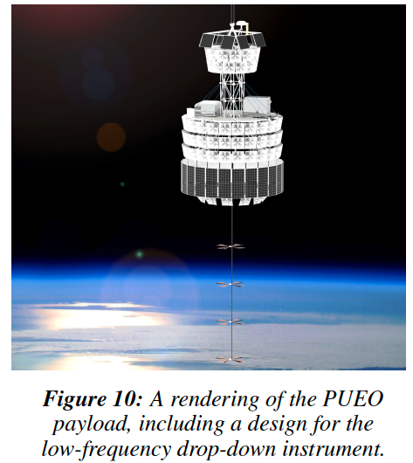
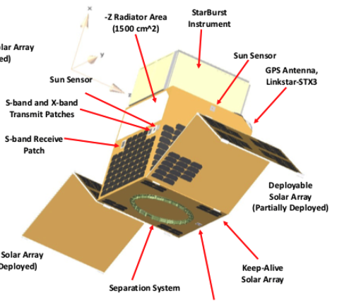
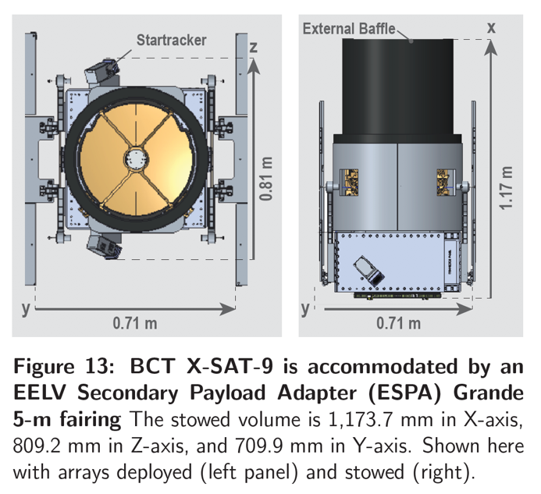
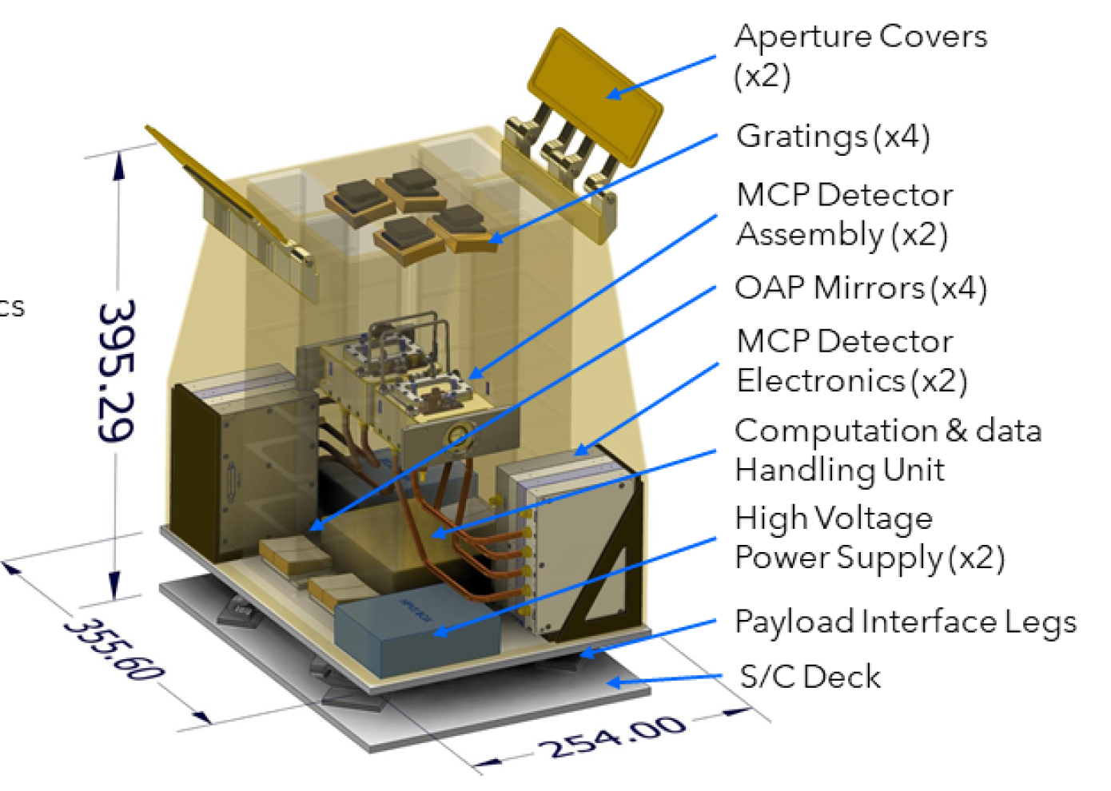
Astrophysics Pioneers-2020 Selections
  New ROSES-2020 Program, $20M PI cost cap, 39 NOI, 24 Proposals, 22 selectable! Community excited and engaged! The future is bright. Four selected this year:
PUEO: A Long-duration Balloon-borne Instrument for Particle Astrophysics at the Highest Energies
PI- Abigail Vieregg, University of Chicago
Start date 2/1/21
StarBurst: Gamma-ray ASM, Simultaneous detection of NS/NS mergers with LIGO
PI - Daniel Kocevski, MSFC
Start Date 4/1/21
Pandora: Multiwavelength Characterization of Exoplanets and their Host Stars
PI - Elisa Quintana, GSFC
Start date 2/1/21
Aspera: IGM Inflow/outflow from galaxies via OVI 10⁵K emission line imaging.
PI -Carlos Vargas, Univ. of Arizona, Start date 3/1/21
R&A, Technology, Operating Missions, Explorers, Infrastructure
R&A, Technology, Operating Missions, Explorers, Infrastructure
Notes:
Note: Flagships can take longer than 10 years

Slide 7

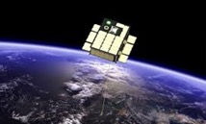
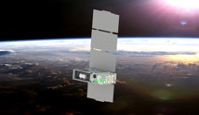
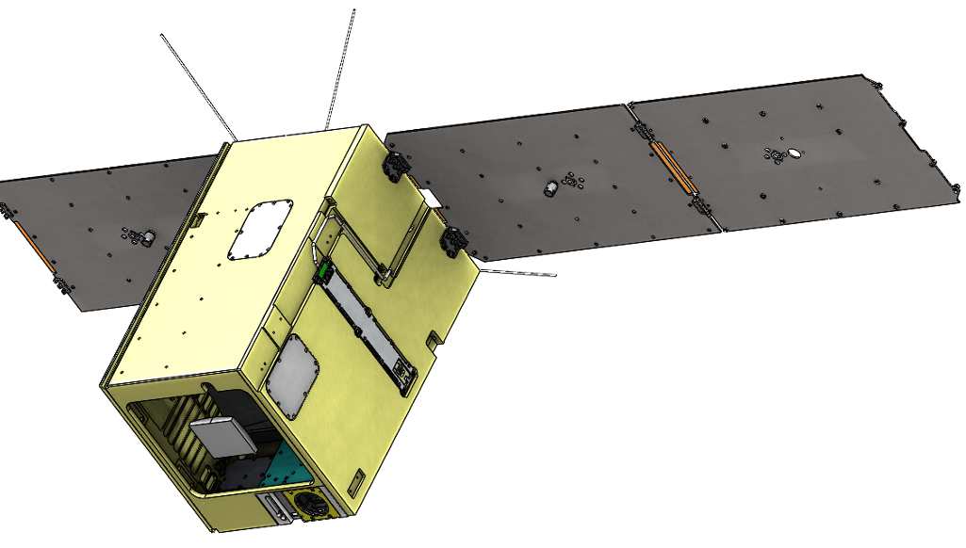
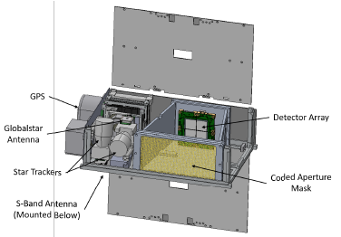
Astrophysics – APRA
NASA
GSFC
6U
Goals:
Detect and localizing gamma-ray bursts generated by amalgamation of orbiting neutron stars and collision of giant stars.
Status:
Building flight instrument and spacecraft.
PI: Jeremy Perkins
BurstCube
University of Colorado, Boulder
6U
Goals:
Use near-ultraviolet transmission spectroscopy to characterize composition and mass-loss rates of exoplanet atmospheres.
Status:
In final I&T. Delivery to launch provider in July with launch in September.
PI: Kevin France
CUTE
University of Colorado, Boulder
12U
Goals:
A SmallSat mission to measure ionizing radiation escape from galaxies, map supernova regions, and demo LUV imaging
Status:
In final preparation for CDR. All long lead items on order.
PI: Brian Fleming
SPRITE
Pennsylvania State University
Goals:
A Soft X-ray Sky Monitor, Transient Finder, and Burst Detector for
High-energy and Multimessenger Astrophysics
Status:
Completed Concept Study Report and authorized to continue in January 2021.
PI: Abe Falcone
6U
BlackCAT

Slide 8
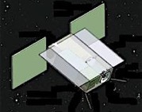
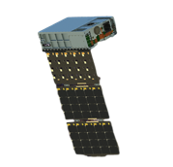
Astrophysics – APRA
X
Arizona State University
6U
Goals:
Monitor the flares and sunspots of M dwarf stars to determine how habitable the space environment is for planets orbiting them.
Status:
Canceled in March 2020 due to cost overruns and ASU not meeting proposed commitments.
PI: Evgenya Shkolnik
SPARCS
University of Iowa
& NASA/GSFC/WFF
6U
Goals:
Mapping oxygen line emission to constrain the mass and spatial distribution of hot gas around Milky Way.
Status:
Re-entered on January 4, 2021 after conducting science operations for over 2 years.
PI: Philip Kaaret, University of Iowa
HaloSat

Slide 9
Heliophysics Division
SmallSat/CubeSat Missions

Slide 10
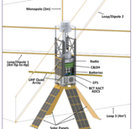

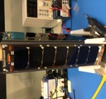


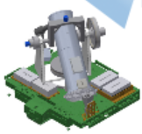
Heliophysics
MIT Haystack Observatory
6U
Goals:
To advance our knowledge by examining radio emissions from the auroral acceleration region in near-Earth space.
Status:
Building flight instrument and spacecraft (Nano Avionics).
PI: Philip J. Erickson
AERO
University of Colorado, Boulder
6U
Goals:
Perform a comprehensive measurement of Energetic Electron Precipitation
Status:
CDR being held on March 25
PI: Robert Marshall
AEPEX
Goals:
To examine how radiation belt electrons are energized and lost, particularly during events called microbursts.
Status:
Launched December 2018. Failed to maintain communication after the first week on orbit.
PI: Shri Kanakel
NASA
GSFC
3U
CeREs
Laboratory for Atmospheric and Space Physics
3U
Goals:
To provide some of the first advanced resolution of one of Earth’s two Van Allen belts.
Status:
Manifested on STP S285 with launch in June 2022
PI: Xinlin Li.
CIRBE
NASA
GSFC
ISS
Inst.
Goals:
An ISS payload mission to study physical conditions in the solar wind acceleration region.
Status:
Heading to CDR in Fall 2021
PI: Jeff Newmark
Codex

Slide 11
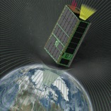
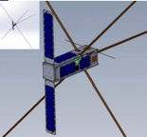
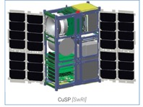

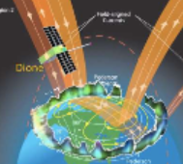
Heliophysics
Boston University
6U
Goals:
To study the transfer of energy from the sun’s solar wind to the Earth’s space environment. will carry a wide field-of-view soft X-ray telescope.
Status:
In final I&T. Delivery to launch provider in July with launch in September.
PI: Brian Walsh
CuPID
University of California, Berkley
6U
(2 x 3U)
Goals:
To use radio interferometry to study radio burst emissions from solar eruptive events such as flares and coronal mass ejections (CMEs) in the inner heliosphere
Status:
Scheduled for launch in
December 2021.
PI: David Sundkvist
CURIE
Southwest Research Institute
6U
Goals:
To study the sources and acceleration mechanisms of solar energetic particles that are harmful to astronauts as well as Earth-based technologies.
Status:
Delivery to KSC in May for Artemis launch in Fall 2021
PI: Mihir Desai
CuSP
Aerospace Corporation
6U
(1x6)
Goals:
To improve the accuracy of operational models for both the neutral density and the ionosphere and will help further the study of wave propagation and transport processes in the lower thermosphere.
Status:
Manifested for launch on NG-16 in July 2021
PI: James Hecht
DAILI
Goals
A pathfinder mission for understanding the Ionosphere-Thermosphere responses to magnetospheric forcing
Status:
Critical Design activities underway
PI: Eftyhia Zesta
NASA
GSFC
6U
Dione

Slide 12
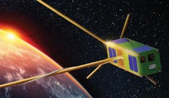

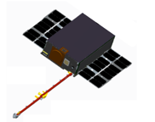
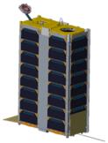
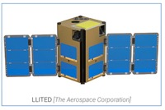
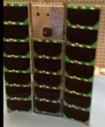
Heliophysics
University of California, Los Angeles (UCLA)
3U
(2X)
Goals:
To measure how precipitated electrons vary across space and time
Status:
ELFIN’s A&B launched in September 2018 and both are operational.
PI: Vassilis Angelopoulos
ELFIN
NASA
GSFC
6U
Goals:
To measure high-energy particles that likely originate from solar wind and cosmic rays.
Status:
In Development and working to obtain a launch manifest.
PI: Larry Kepko
GTOSat
Virginia Tech &
University of Illinois
6U
Goals:
Atmospheric gravity wave studies.
Status:
Refurbishing flight hardware in preparation for flight rebuild
PI: Greg Earle, Virginia Tech
LAICE
Aerospace Corporation
1.5U
(2X)
Goals:
To provide first coincident measurements of Earth’s dusk-side at lower altitudes, providing a detailed examination of equatorial temperature and wind anomaly.
Status:
In final I&T and awaiting launch manifest.
PI: Rebecca Bishop
LLITED
University of Colorado
3U
Goals:
To better understand the energy distribution of solar flare SXR (Soft X-ray) emissions and its impact on the Earth’s Ionosphere, Thermosphere, and Mesosphere.
Status:
Deployed from ISS in May 2016. Operated for 1 year as planned.
PI: Tom Woods
MinXSS-1

Slide 13
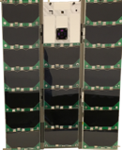
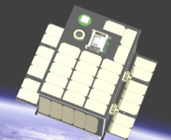

Heliophysics
University of Colorado
3U
Goals:
To better understand the energy distribution of solar flare SXR (Soft X-ray) emissions and its impact on the Earth’s Ionosphere, Thermosphere, and Mesosphere.
Status:
Launched in December 2018 Experience an on-orbit anomaly approximately 2 weeks later.
PI: Tom Woods
MinXSS-2
University of Colorado, Boulder
Hosted Payload
Goals:
To better understand the energy distribution of solar flare SXR (Soft X-ray) emissions and its impact on the Earth’s Ionosphere, Thermosphere, and Mesosphere.
Status:
Integrated on INSPIRESat-1 with delivery in April for launch on PSLV C-52 in June 2021
PI: Tom Woods
MinXSS-3
NASA
GSFC
6U
Goals:
To study density irregularities in the mid and low-latitude ionosphere, which occupies a tiny fraction of the atmosphere.
Status:
Manifested on ELaNA 37 for launch in late Fall 2021
PI: Jeff Klenzing
petitSat
Dartmouth University
3U
Goals:
To improve our understanding of physical mechanisms responsible for scattering radiation belt electrons into Earth’s atmosphere.
Status:
Flight instrument and spacecraft builds underway.
PI: Robyn Millan
REAL

Slide 14
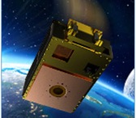
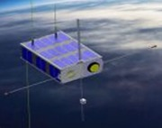
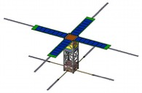
Heliophysics
Atmospheric and Space Technology Research Associates
6U
Goals:
To study the complex challenges in discovering the wave-like plasma perturbations in the ionosphere.
Status:
Deployed from ISS in Feb 2020. Science operations ongoing.
PI: Geoffrey Crowley
SORTIE
Utah State, MSFC, & Brazil
6U
Goals:
To address the compelling but difficult problem of understanding the preconditions leading to equatorial plasma bubbles.
Status:
Preparing to deliver 4 US instruments to Brazil in April 2021
PI: Charles Swensen
SPORT
University of Michigan
3U
(2x)
Goals:
To provide a better understanding of the physics that controls the day-to-day variability in development of EPBs (space weather).
Status:
Currently on-orbit and expected to demise in April 2021
PI: Roland Tsunoda
TBEx
MIT Haystack Observatory
6U
Goals:
Uses AERO to advance our ability to perform radio interferometry using cubesats in space
Status:
Building flight instrument and spacecraft (Nano Avionics).
PI: Frank Lind
VISTA

