Slide 1



National Aeronautics and
Space Administration
Introduction to Gateway
Dina Contella
Manager, Mission Integration and Utilization Office, Gateway Program
Utilization Integration Lead for Advanced Exploration Systems (AES)
Decadal Survey on Planetary Science and Astrobiology:
Panel on Mercury and the Moon

Slide 2
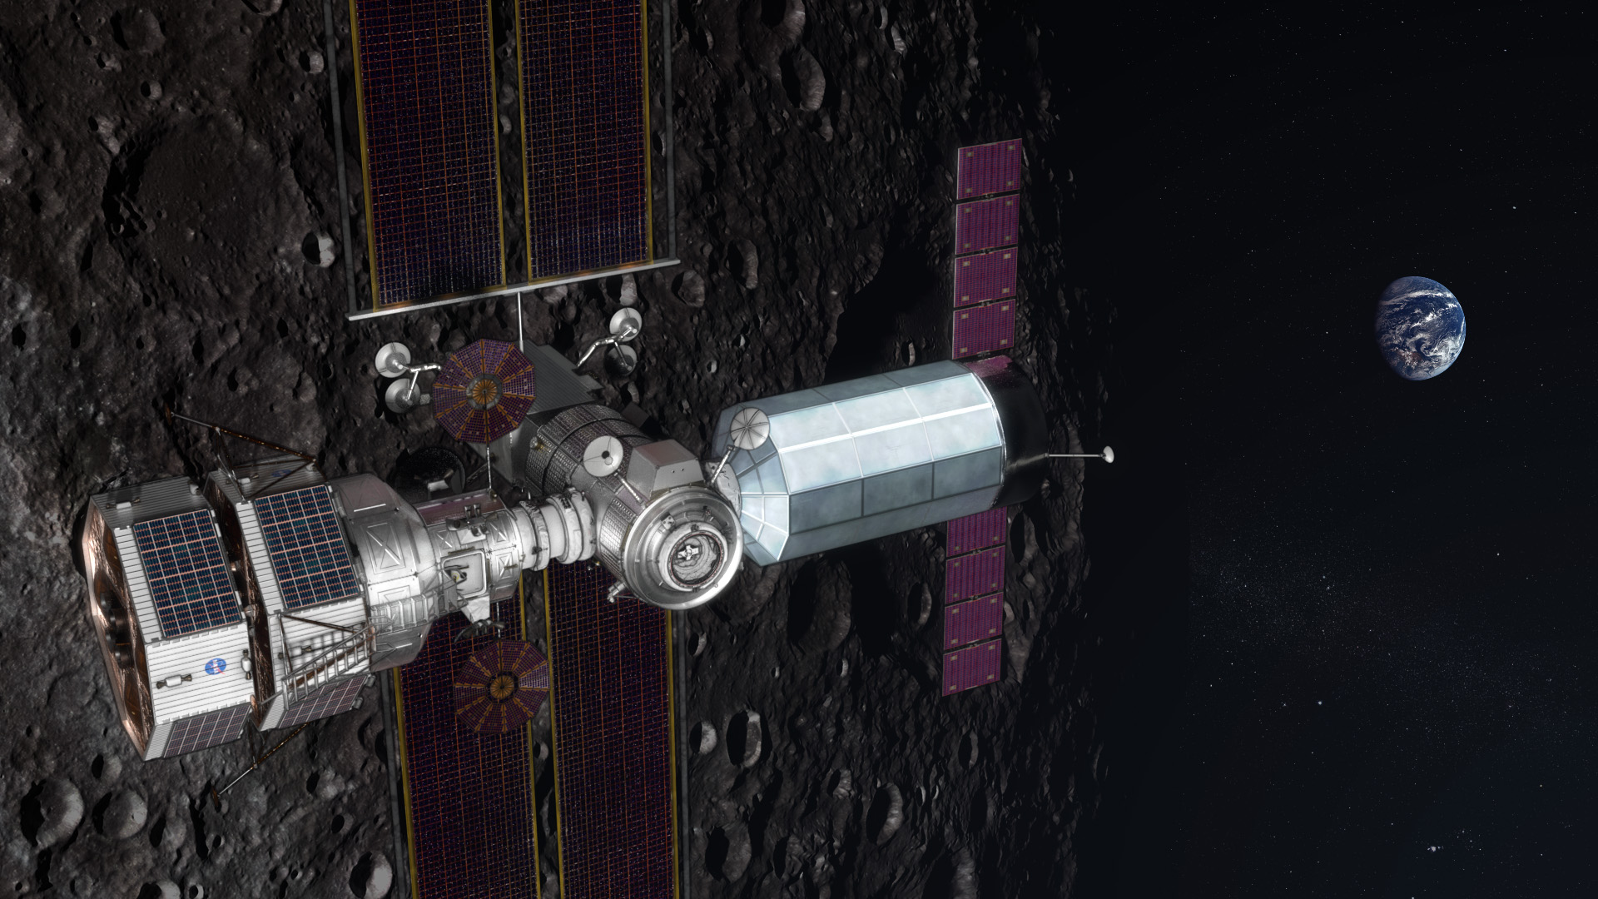
THE ARTEMIS GATEWAY
  A platform to establish a ​sustained human presence ​on and around the Moon in this decade
  Includes living quarters for astronauts, a lab for science and research, and more
  Components will be built by U.S. companies and international partners

Slide 3
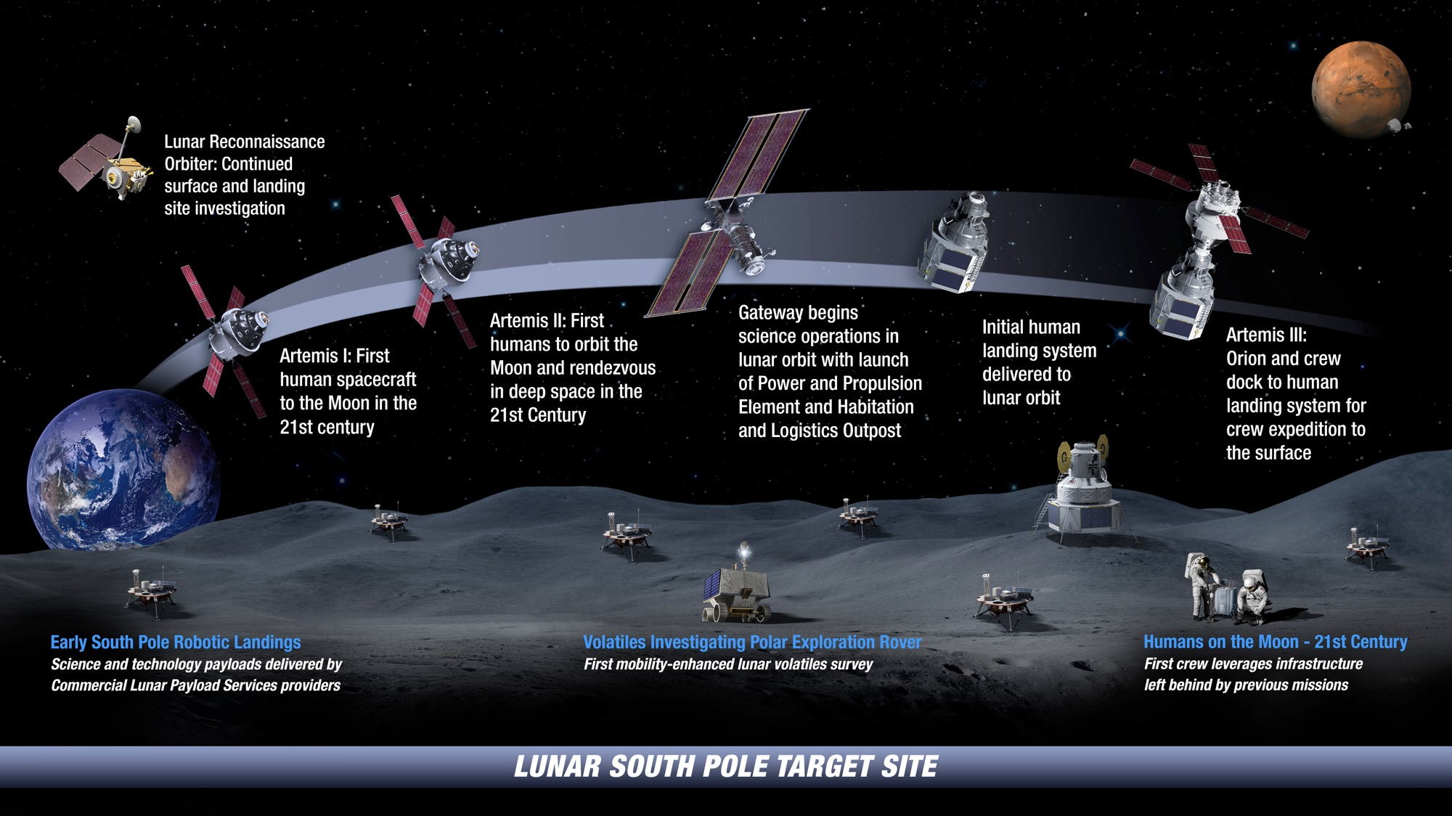

: LANDING HUMANS ON THE MOON

Slide 4
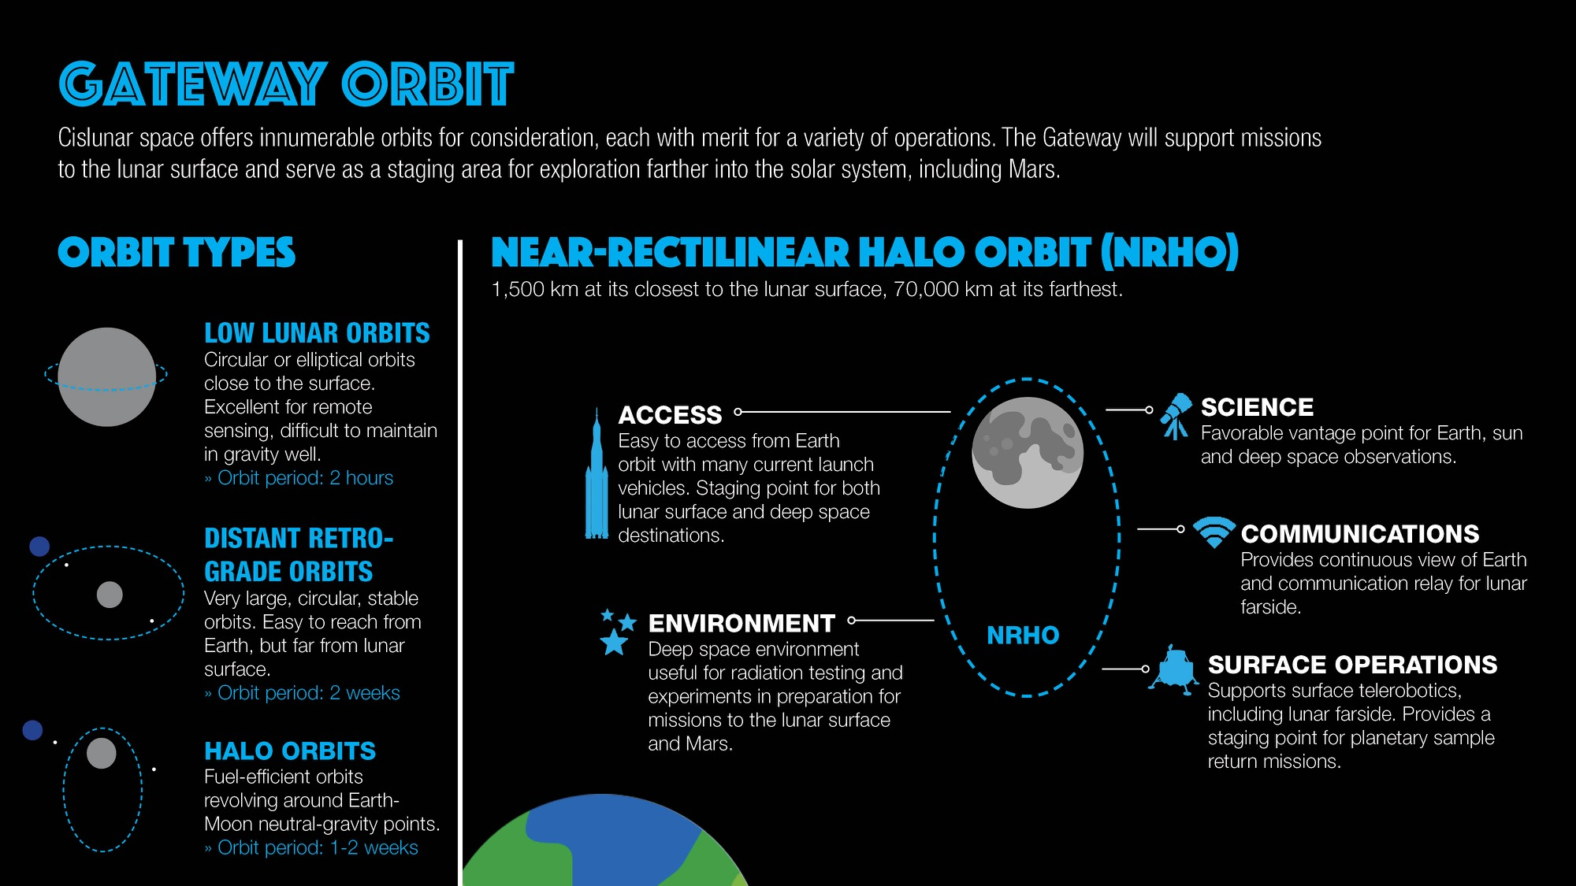
GATEWAY ORBIT

Slide 5
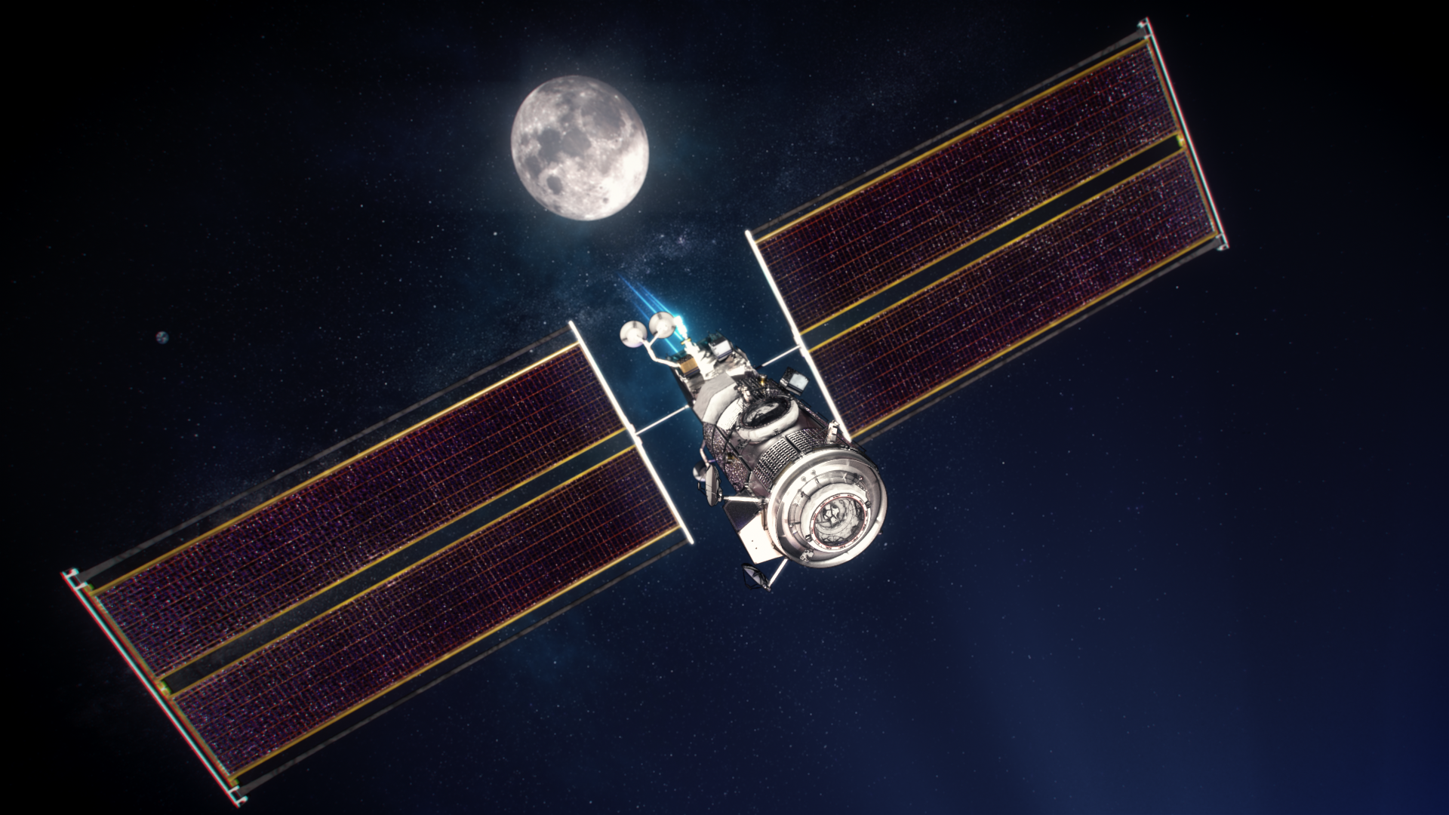



FIRST GATEWAY COMPONENTS INTEGRATED
FOR LAUNCH IN 2023
POWER AND PROPULSION ELEMENT (PPE)
60 kW-class spacecraft with 50kW dedicated to the solar electric propulsion engine and the other 10kW dedicated to spacecraft power, communications, experiments
Provides Gateway with electrical power, propulsion, and communication capabilities
Accommodates science and technology
demonstration payloads
HABITATION AND LOGISTICS OUTPOST (HALO)
Initial crew cabin for astronauts visiting the Gateway
Multiple docking ports for visiting spacecraft
Cargo space for science and stowage
Accommodates science and technology
demonstration payloads

Slide 6
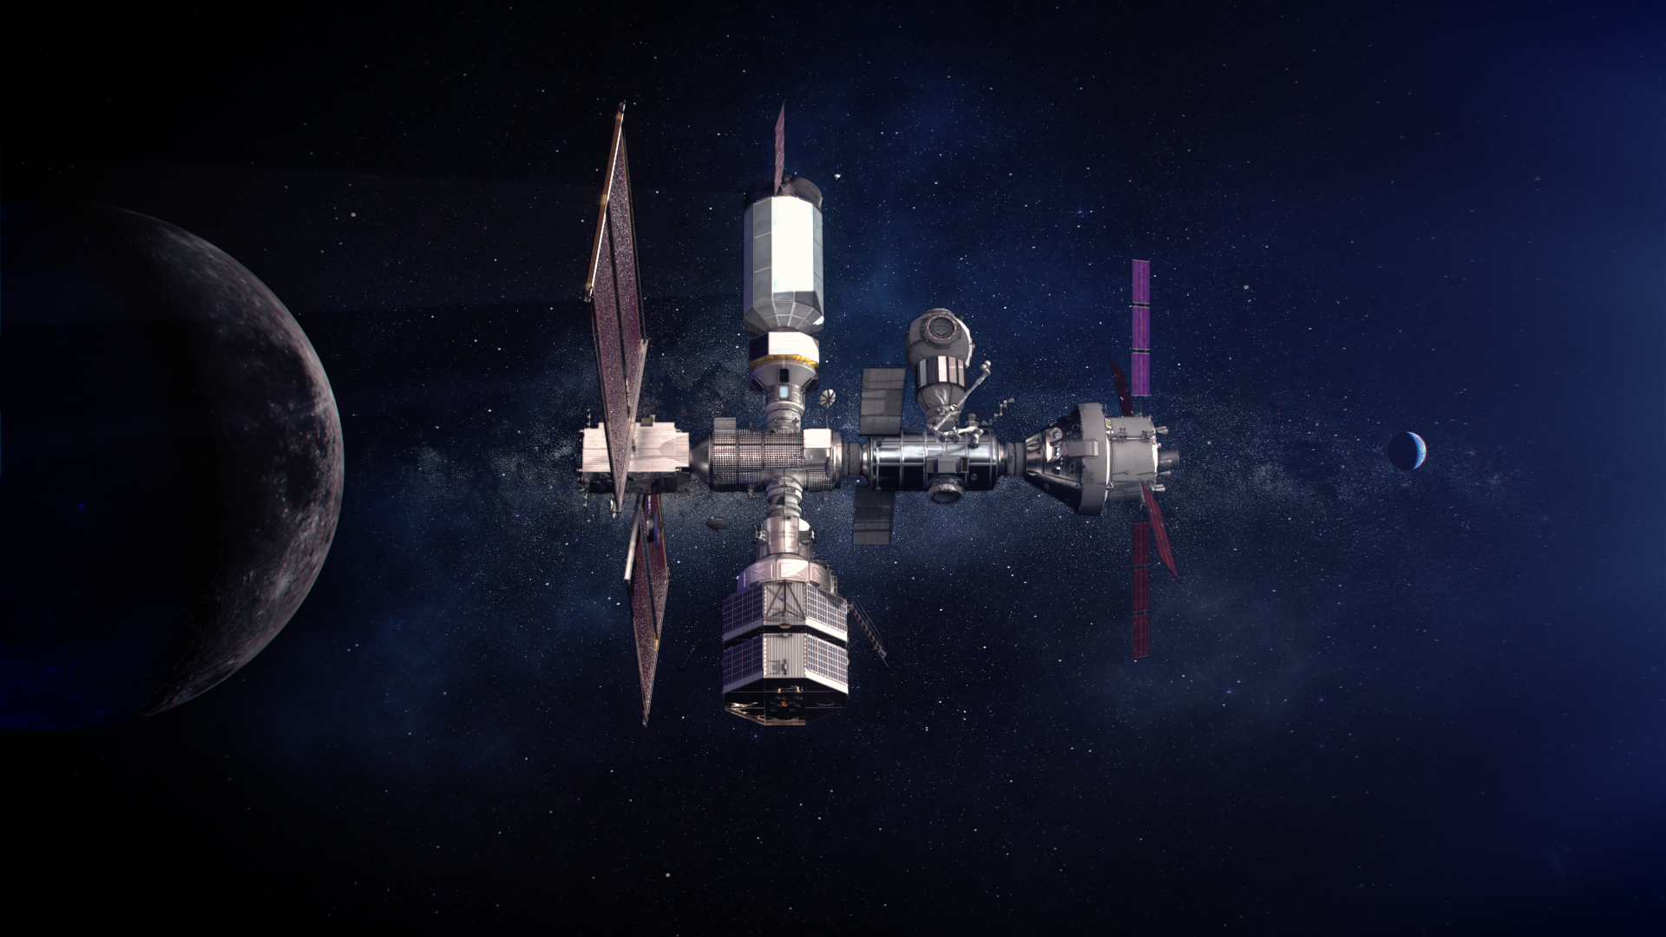




GATEWAY INTERNATIONAL PARTNERS
Building on ISS partnerships to expand deep space capabilities

Slide 7
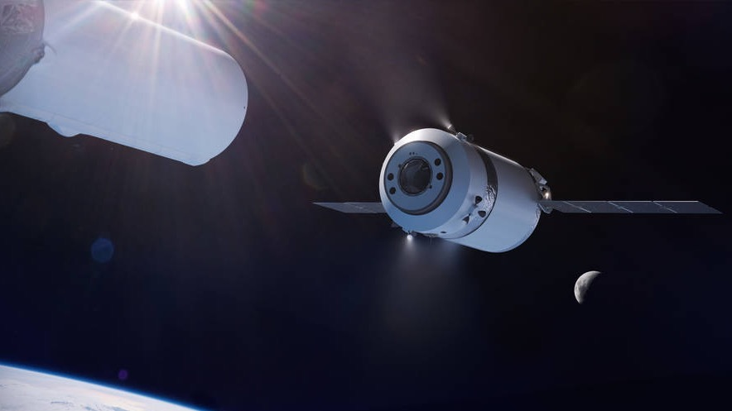

GATEWAY LOGISTICS SERVICES (GLS)
SpaceX selected as the first U.S. commercial provider under the Gateway Logistics Services contract to deliver cargo, experiments and other supplies to the Gateway in lunar orbit
Multiple supply missions are planned in which the cargo spacecraft will stay at the Gateway for up to several months at a time
  5 MT delivered cargo capability
  Power to internal and external payloads
  Disposal of equipment and trash

Slide 8

GATEWAY UTILIZATION – UNIQUE ASPECTS
NASA’s agreements with the Gateway international partners require significant multilateral collaboration
  Must minimize or eliminate redundancy in experiments and develop multilateral utilization plans to coordinate and integrate each Gateway partner’s high-priority utilization objectives
Number of utilization opportunities are much more limited than with the International Space Station (ISS)
  Significantly smaller vehicle, limited crew time, fewer cargo flights, less return capability, less stowage
  Emphasizing collaborative multilateral payloads, data sharing, equipment sharing
Payloads may be operated on/in logistics module, even post-Gateway departure
Gateway uncrewed for many months/year, but sending telemetry when no crew present
New modules, vendors and interfaces - intending to make interfaces consistent
The unique location in Cislunar space results in new areas of research focus
  Focused on objectives that cannot be met from other locations/platforms (e.g., ISS)

Slide 9
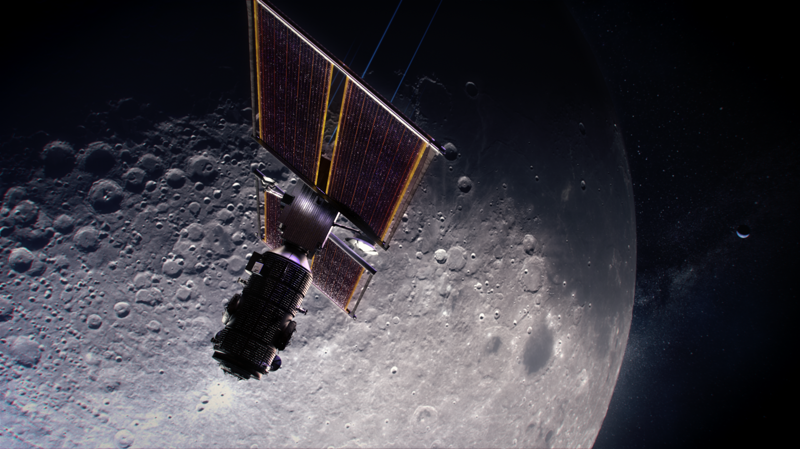
EARLY GATEWAY SCIENCE PAYLOADS – INTERNATIONAL ENDEAVOR
The first payloads to launch on and in Gateway (PPE/HALO) will be led by NASA’s Science Mission Directorate and ESA (European Space Agency), with science participation from all Gateway international partners

Slide 10

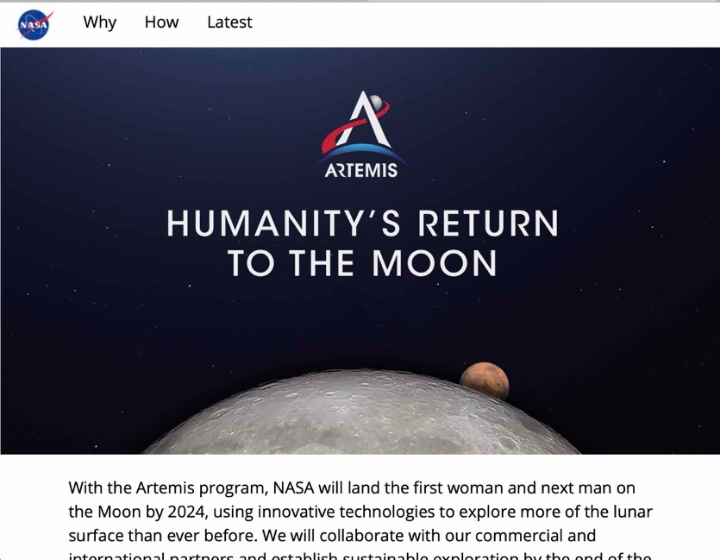



CONNECT WITH US
@NASAExplores
@NASA_Johnson
@ExploreNASA
@NASAJohnson
@NASAExplores
@NASA’s JSC
blogs.nasa.gov/artemis
Sign up for updates at nasa.gov/subscribe
nasa.gov/artemis
www.nasa.gov/suitup

Slide 11



