Slide 1
Engineering Software For Flight
Alwyn E. Goodloe
NASA Langley Research Center

Slide 2
Background
I am a computer scientist with a background in logic, algebra, formal methods, and programming languages.
I have been at NASA Langley in the Safety-Critical Avionics Systems Branch (D320) in the research directorate for over a decade primarily working on Formal Methods.
I have been working in the area of Runtime Verification (RV) for almost thirteen years.
I am one of the developers of the Copilot RV framework.
We had been flying our generated monitors on NASA UAS test flights.
Like most NASA software research projects, it was developed for research and is NASA Class E software.
  Minimal process requirements consistent with research.

Slide 3
Runtime Verification
“Runtime verification is the discipline of computer science/engineering that deals with the study, development, and application of those verification techniques that allow checking whether a run of a system under scrutiny satisfies or violates a given correctness property” Leucker et.al.
Runtime verification (RV) refers to the use of monitors to observe the behavior of a system and detect if it is inconsistent with a given specification.
Lightweight formal methods complement design time approaches .

Slide 4
Copilot: RV Framework
Haskell-based Embedded Domain Specific Language (DSL).
  Takes advantage of the wonderful Haskell type system.
Abstract functional specifications written in a Lustre-like language.
Synthesize monitors targeting real-time embedded systems.
Generates Misra-like C monitors.
  Constant time, constant memory.
Minimum instrumentation of system under observation source code.
Samples the system under observation.
  Can miss state changes if not sampled.

Slide 5
More Rigor in Flight Software
Updated flight rules dictate that flight software be NASA Class C software.
Class C –Intended for Mission Support or Aeronautic Vehicles.
NASA Software Engineering Requirements (NPR- 7150.2 C).
Copilot generates the code that must be certified to be Class C, but as a code generator the RV framework itself must be NASA Class D.
Class D – Basic Science/Engineering Design and Research Technology Software.

Slide 6
From Class E to Class D
Designated manager (in this case me) will be responsible for ensuring documentation is sufficient and processes followed.
More documents are required, but for smaller projects like mine it is possible to satisfy many of the requirements in a single document.
Challenge is to remain a research organization while in selected cases having to incorporate more software engineering.
Langley has a flight software branch and they have provided very useful guidance.

Slide 7
Lifecycle Thinking
Manage the entire lifecycle.
  Requirements, specification, design, development, testing, deployment, operations, retirement.
Select/tailor a lifecycle process model.
  Waterfall - Not very flexible to change.
  Spiral – Very good for large projects.
  Agile – Best when quick user feedback available.

Slide 8
Plans and Documents
Lifecycle plan.
Requirements document.
Design document.
Test plan.
Configuration management plan.

Slide 9
Specifying an EDSL
How to specify an EDSL is a research challenge.
Copilot is embedded in Haskell.
We focus on the core operators.
BNF Syntax.
Typing rules.
Denotational semantics under development.
There is an interpreter that can act as an operational semantics.

Slide 10
Support for Level C
We are evolving the Copilot RV framework to support assurance arguments for Class C.
  Proof that generated code is free of memory and numerical overflows.
  Traceability from monitor to specification.
  Evidence that the generated C code does indeed meet the specification.

Slide 11
Static Analysis Tools
We plan to apply a collection of analysis tools to generated C code to ensure no memory and numerical overflows.
  Abstract interpretation.
  Dynamic Analysis (RV Match).
  Investigate worst case timing analysis tools.

Slide 12
Traceability
ANSI C Specification Language (ACSL) is an assertion language for C.
  Hoare triples.
We plan on generating comments and ACSL assertions that will make it easy relate to the specification.

Slide 13
Equivalence Checking
We plan on applying Galois’ Software Assurance Workbench (SAW) to show that the generated C monitors are indeed equivalent to the Copilot specification.
  Spec and C code get translated to an intermediate language that SMT solvers can apply equivalence checking.
  C code is compiled to LLVM, symbolic execution is used to unroll loops, etc. and then translate to intermediate language.
  Copilot is typed functional language making the translation to the intermediate language very straightforward .
Creating a denotational semantics of Copilot to facilitate these efforts.

Slide 14
Support for Testing
Property based testing.
  Generating tests from specs.
Unit testing for each C module generated.
Coverage analysis.

Slide 15
Questions?
Contact Information:
Alwyn E. Goodloe
a.goodloe@nasa.gov

Slide 16
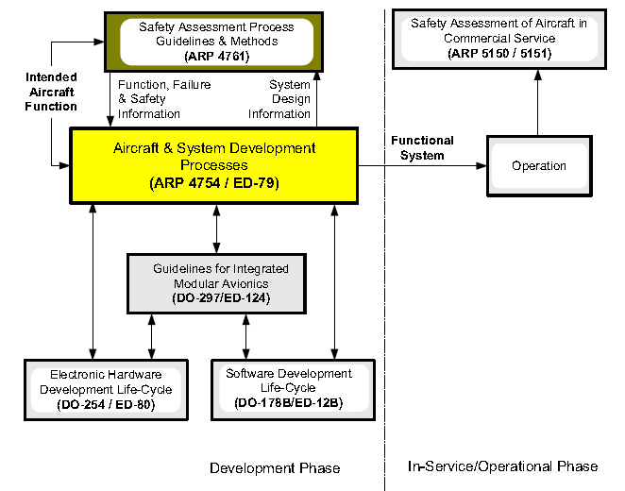
Civil Transport certification

