Slide 1
Cognitive Work Analysis
From System Requirements to Validation and Verification
And Establishing Operational Test Expectations
Matthew Miller, Ph.D.
Exploration Research Engineer, Jacobs/NASA Johnson Space Center

Slide 2
Outline
General Message:
In order to effectively test, expectations of system outcomes should already be clearly defined in terms of work domain goals with the willingness cope with unexpected behavior
Getting situated within the system context (Slides 3-4)
Methods to model/represent complex sociotechnical systems (Slides 5-6)
Cognitive Work Analysis (CWA) overview (Slide 7)
Making Work Requirements apparent to inform design and testing (Slide 8-9)
Testing against requirements (Slide 10-11)
Summary (Slide 12)

Slide 3
You Can’t Test A System You Didn’t Appropriately Define
Human System Interaction Session Prompt
Mission outcomes are heavily determined by how effectively operators interact with systems under operational conditions as decided by their objective performance and their perceived performance. In order to effectively assess these systems, we need to observe team dynamics to predict how changing operating conditions will affect the dynamic and therefore productivity. Sessions with this theme will discuss methods used to collect and model the quality of human-system integration and its impact on operational performance, survey development and test design, scale validation, and network analysis.
Sociotechnical System
In order to better assess ‘operators interact with systems’ we need to shift our definition of ‘system’ to one that directly recognizes complex sociotechnical dimensions
This sociotechnical system perspective is rarely incorporated into the development process
People
Tools
Work
References: Waterson et al., 2015

Slide 4
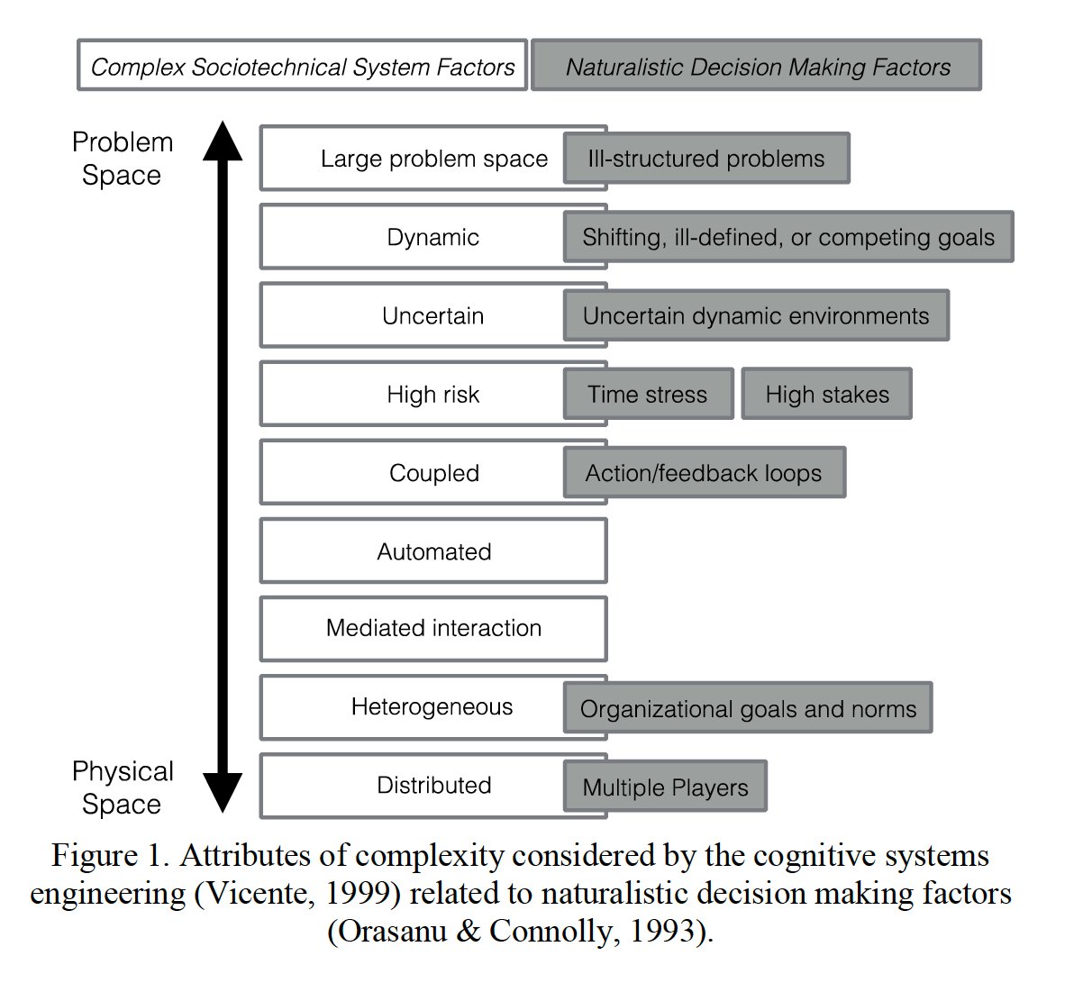
Complex Sociotechnical System Factors
all nine factor levels are simultaneously at play when considering the performance of complex systems.
appropriate system boundaries/constraints must be established by considering how all factors present themselves in the system of interest, in order to understand how they collectively influence the behaviors of the system.
These factors will always be present in any complex system, you can’t ‘design & test them away’
References: Canellas et al., 2017

Slide 5
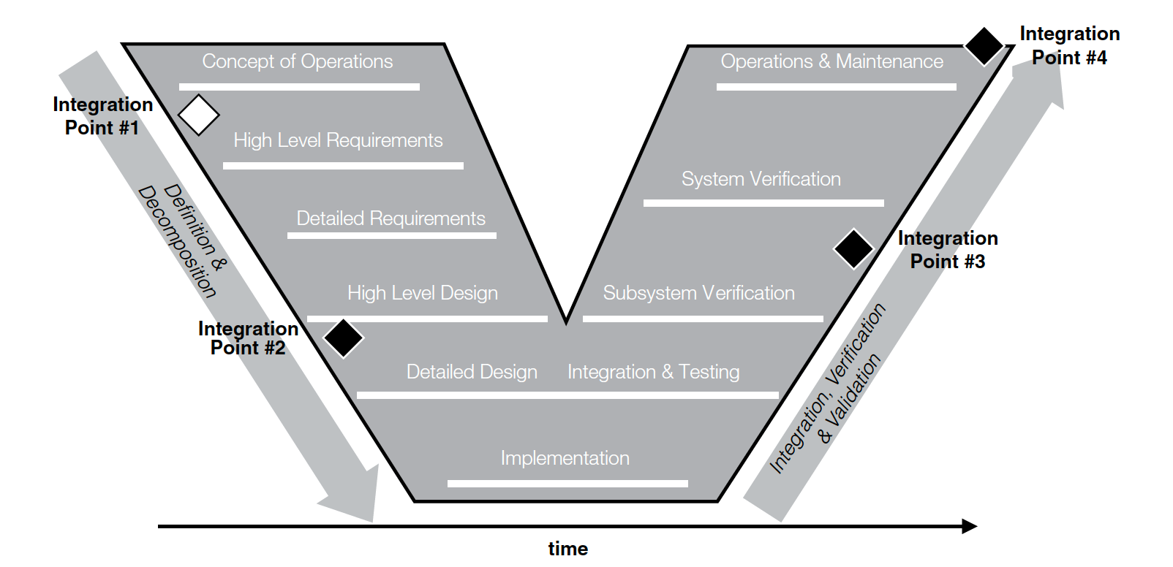
Influencing the Traditional Systems Engineering Process
How can we get realistic work expectations in the form of requirements early in the design process to inform system development and V&V efforts?
Methods to represent complex sociotechnical systems need to be employed early and imposed throughout the entire process
References: Elm et al., 2008, Miller et al, 2017
Notes:
Complex, software aspects emphasis

Slide 6
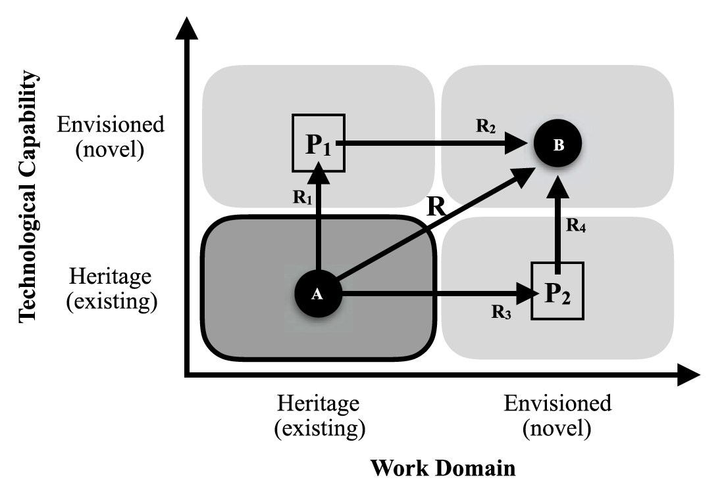
Matching Methods to the Needs of the System Development Process
Are you trying to augment an existing work domain?
Pathway 1 (P1) is the ‘Technology Driven’ Approach
  Current acquisition process, ‘conops’ are adaptively developed ‘tools will evolve’
Pathway 2 (P2) is the ‘Work Domain Driven’ Pathway
  Let the work domain demands inform what opportunities new technology could be built
Where in the design process are you?
Normative Model/Methods
  Emphasis on prescribing how a System should behave
    e.g. Hierarchical Task Analysis
  Typically applied when the system design has reached a state that is incredibly difficult to change/influence/redesign
    Workarounds & patches are developed from testing results to get the ‘system out the door’
Formative Model/Methods
  Emphasis on describing how a System could behave to cope with changing and unanticipated work demands
    e.g. Cognitive Work Analysis
  Generally missing from the design process altogether (currently there is a lack of implementation examples)
References: Miller et al, 2019

Slide 7
Formative Method - Cognitive Work Analysis
A formative method that establishes a framework for work analysis based on the concept of behavior-shaping constraints and includes the following modelling tools:
  Work Domain Analysis identifies the high-level purposes, values and priorities, functions and physical resources of a system.
  Control Task Analysis focuses on the problem-solving or decision-making activity that is required in the work domain.
  Strategies Analysis identifies the different ways in which this activity or work can be accomplished.
  Social Organisation and Cooperation Analysis focuses on how the work is coordinated and distributed.
  Worker Competencies Analysis identifies the competencies required by workers to perform this work effectively
This is intended to overcome the task-artifact cycle (i.e. Pathway P1 where technology leads the design narrative) by discovering the intrinsic work constraints that influence the work domain
Also need to address the Envisioned World Problem more directly
  Concepts of Plurality, Underspecification, Ungrounded, Overconfident
References: Vicente 1999, Online Resource, Woods (2000)

Slide 8
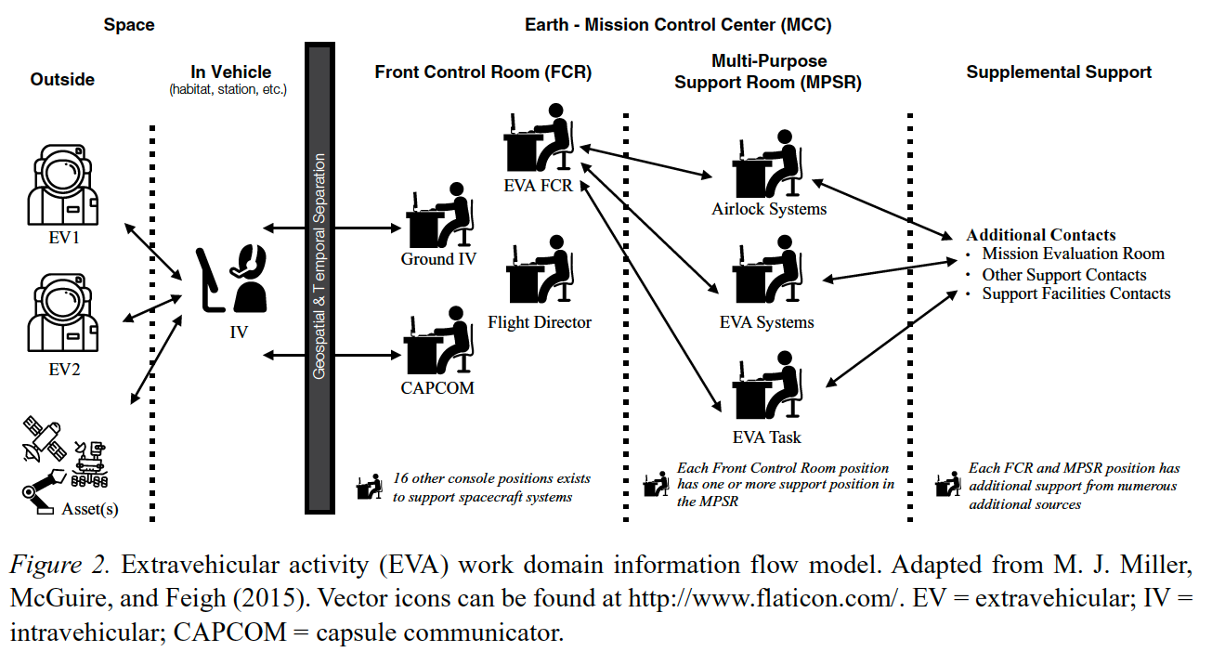
Envisioning the Future of Human Spaceflight Extravehicular Activity
Case Study: How will future spaceflight missions successfully perform planetary extravehicular activity (EVA)?
Hypothesis: Can we create a decision support system for crew to operate locally that performs some of the existing work functions found within the existing EVA work domain?
References: Miller et al, 2015
Notes:
Designer hat and tester hat
How did my earlier work enable me to be a proficient tester?

Slide 9
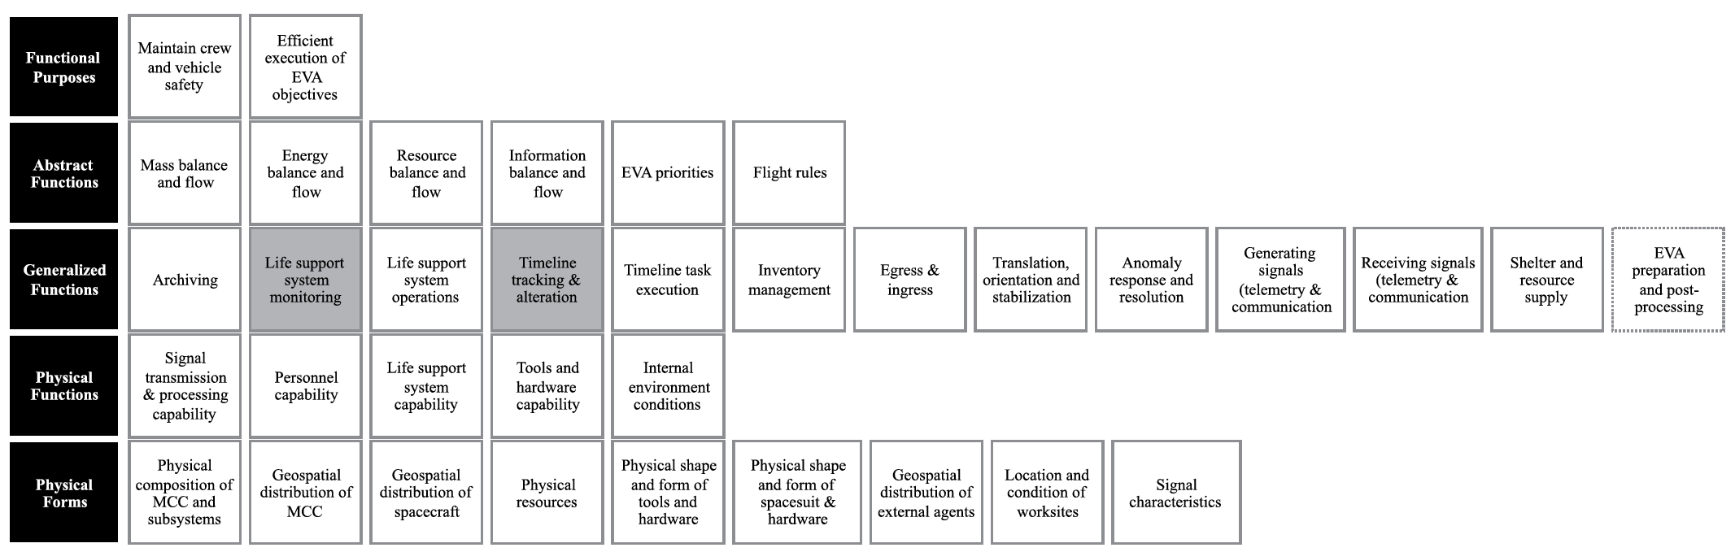
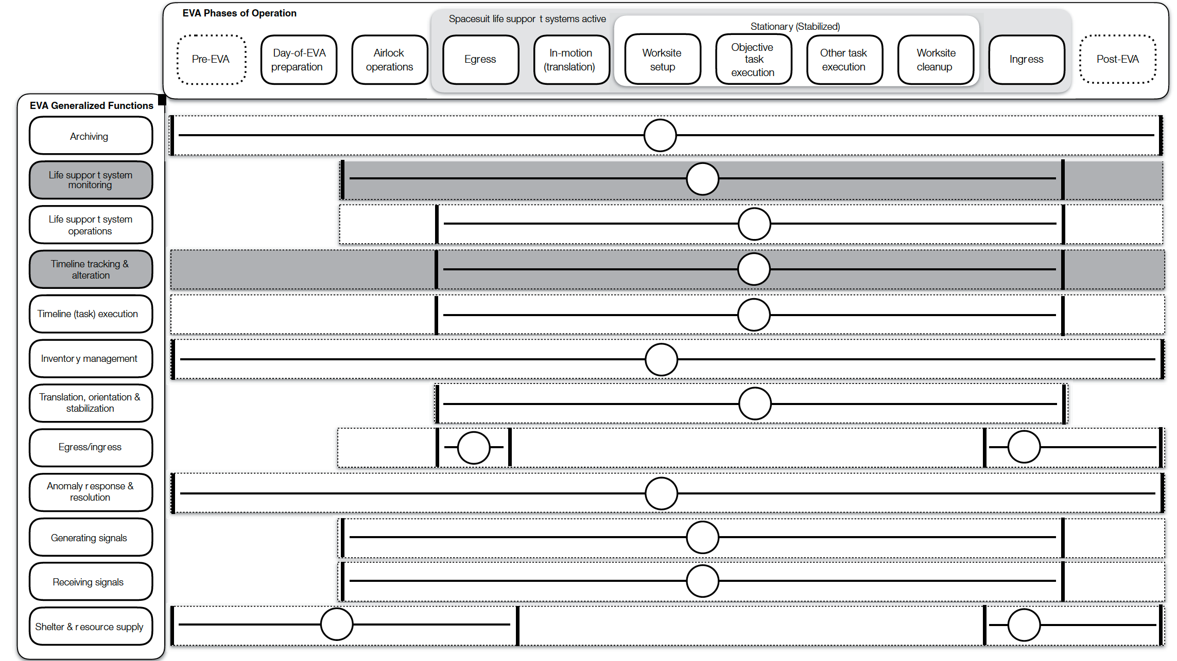
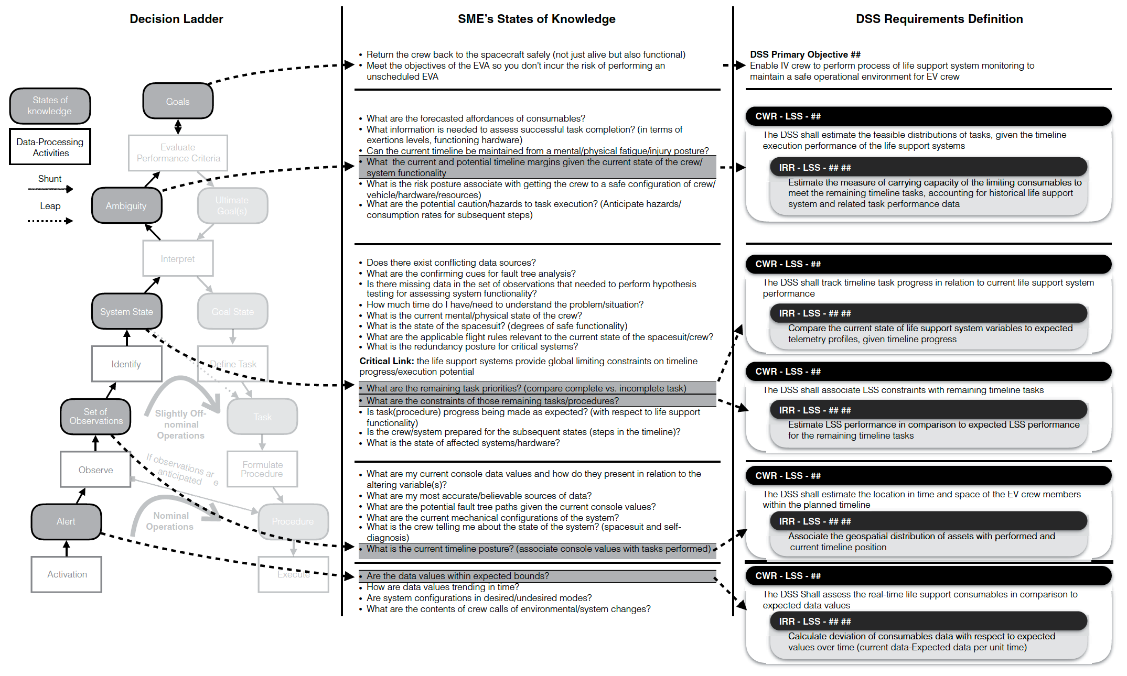
CWA Models that Yield Intrinsic Work Constraints
Abstraction Hierarchy
Phase 1: Perform an Work Domain Analysis to model the work domain of interest
Phase 2: Perform a Control Task Analysis on a subset of work domain functions found in the previous phase to situate functions in modes of operations
Phase 3: Derive Cognitive Work and Information Relationship Requirements from Control Task Analysis model insights
Contextual Activity Template
Decision Ladders linked to Cognitive Work and Information Relationship Requirements
References: Miller et al, 2017
Notes:
methods/approaches exist but highlighting the trail of thought

Slide 10
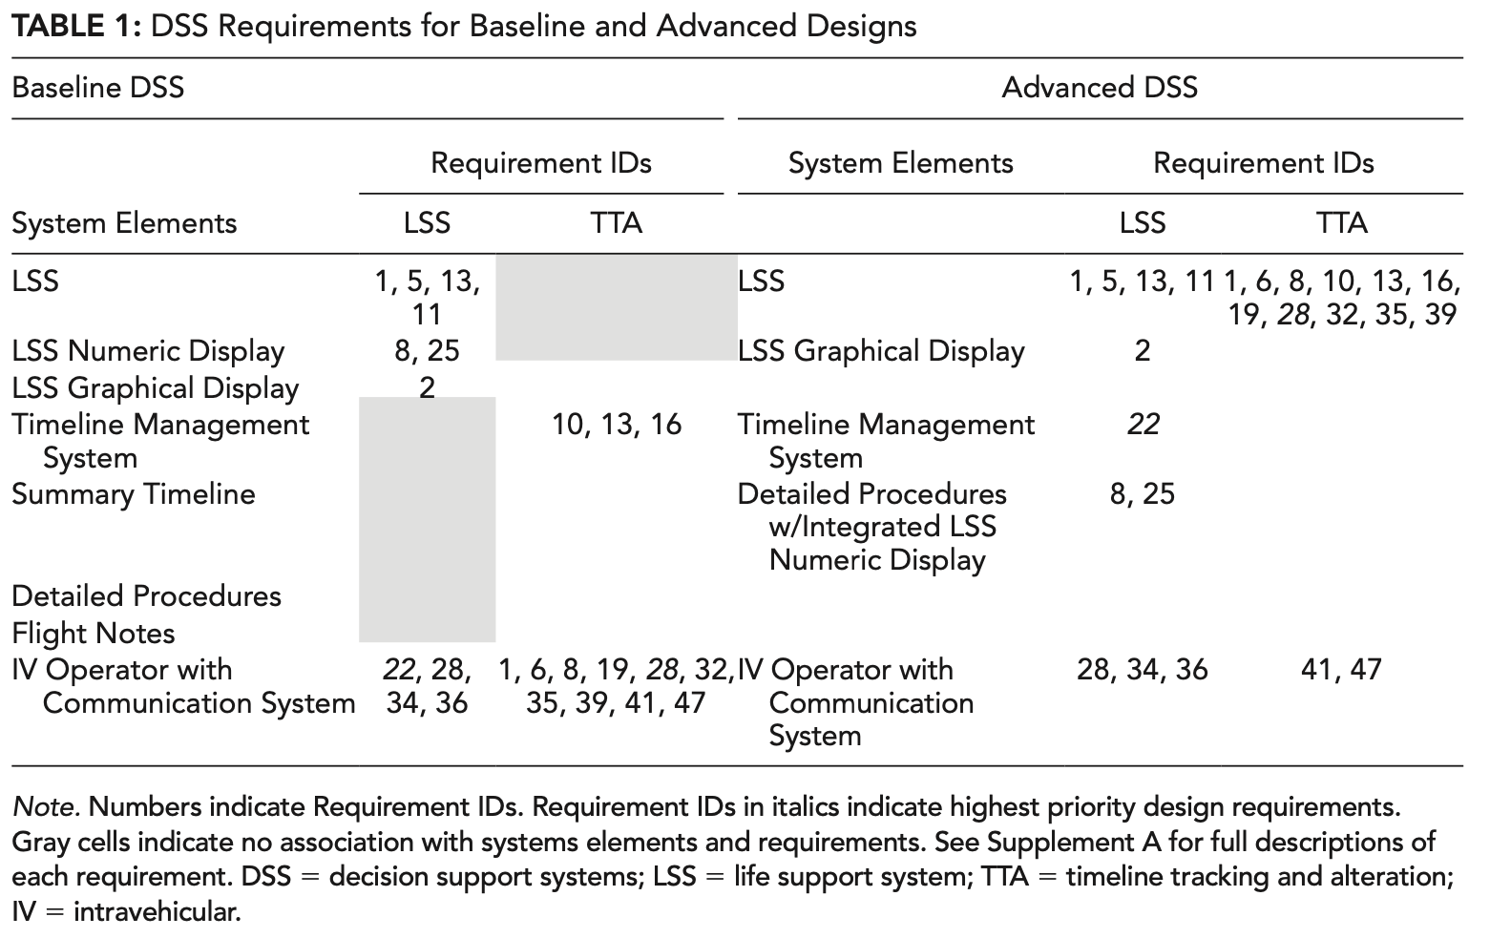
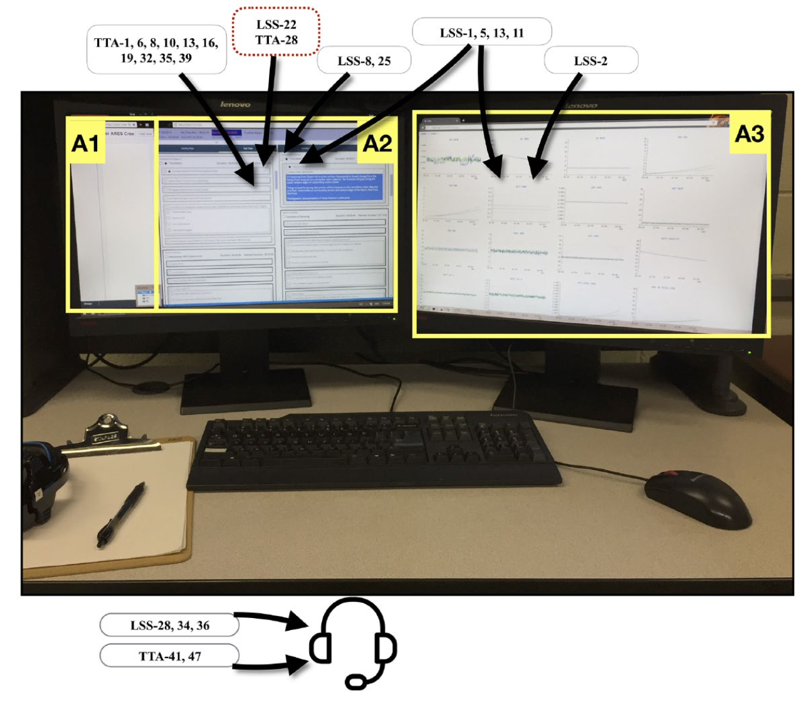
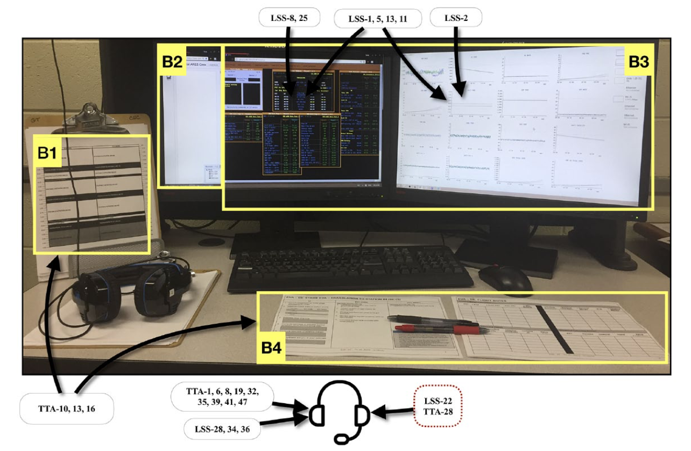
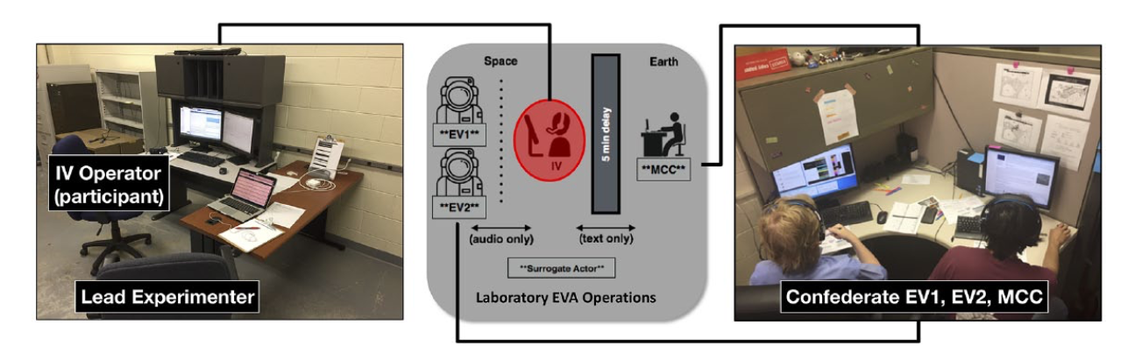
Reflecting Work Domain Expectations in the Design and Testing Efforts
Advanced
Same requirements inform multiple realities of what the future work design could be
Situate users in operationally relevant scenarios
Establish measures and metrics that operationally relevant to test against
Baseline
References: Miller et al, 2020
Notes:
Designer hat and tester hat
How did my earlier work enable me to be a proficient tester?
By having a model of the work domain, gave me leg up for the design factors for the experiment itself? I knew what was important
Great reason to get testers involved early, reduces the burden to entry

Slide 11
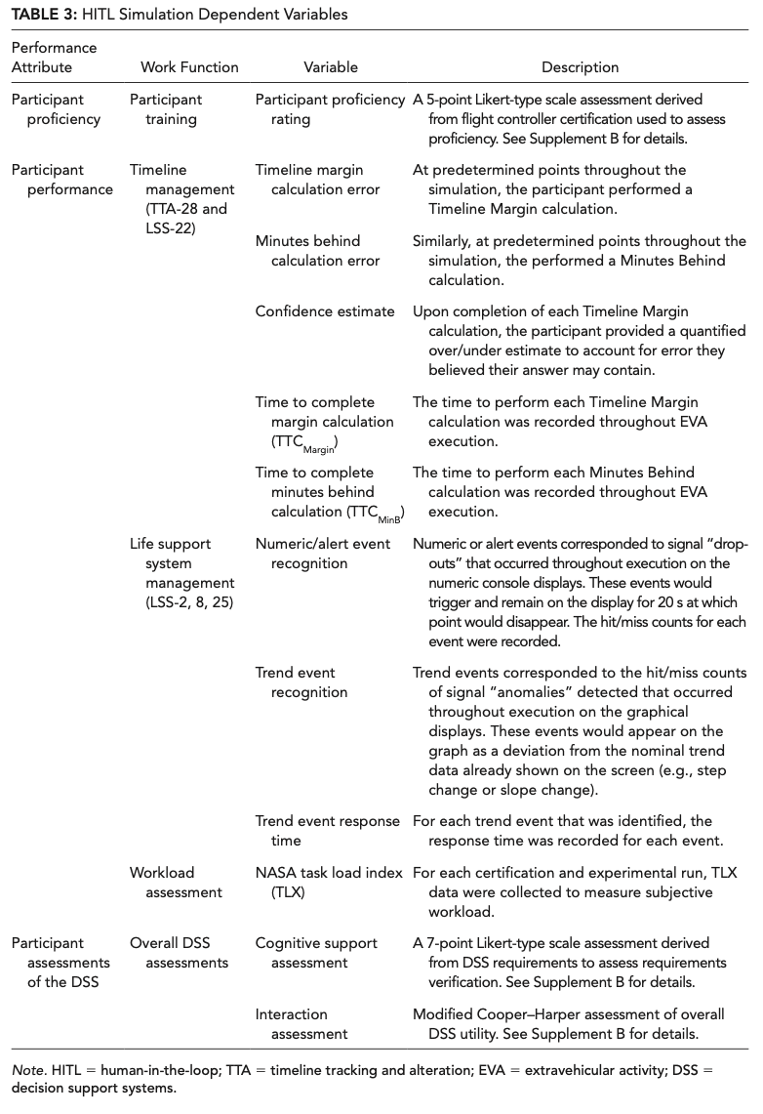
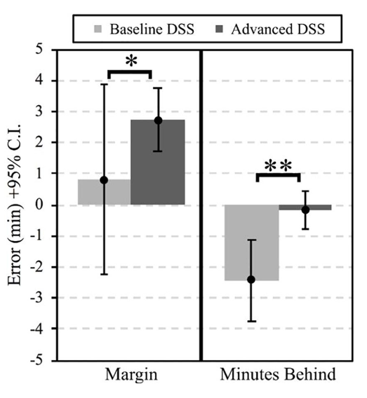
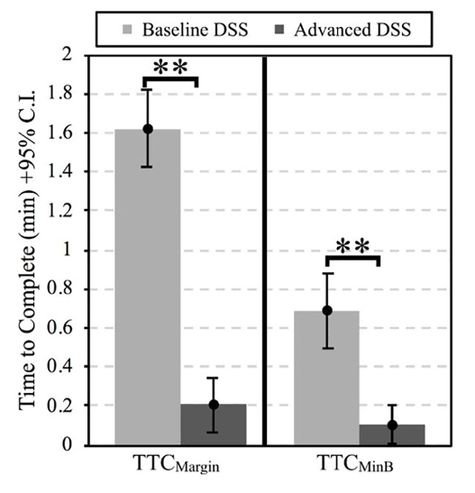
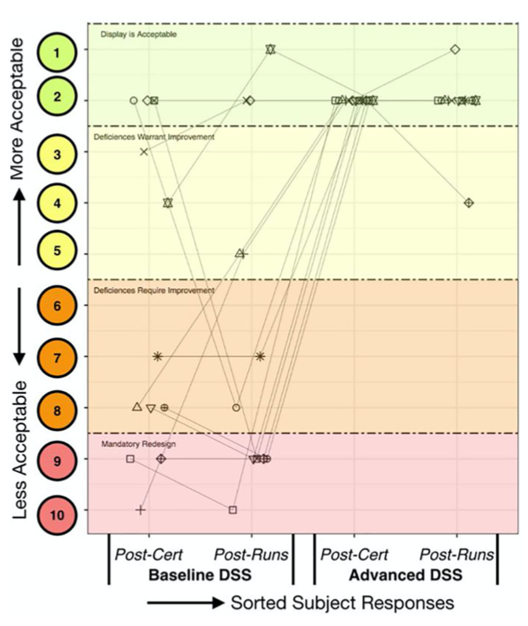
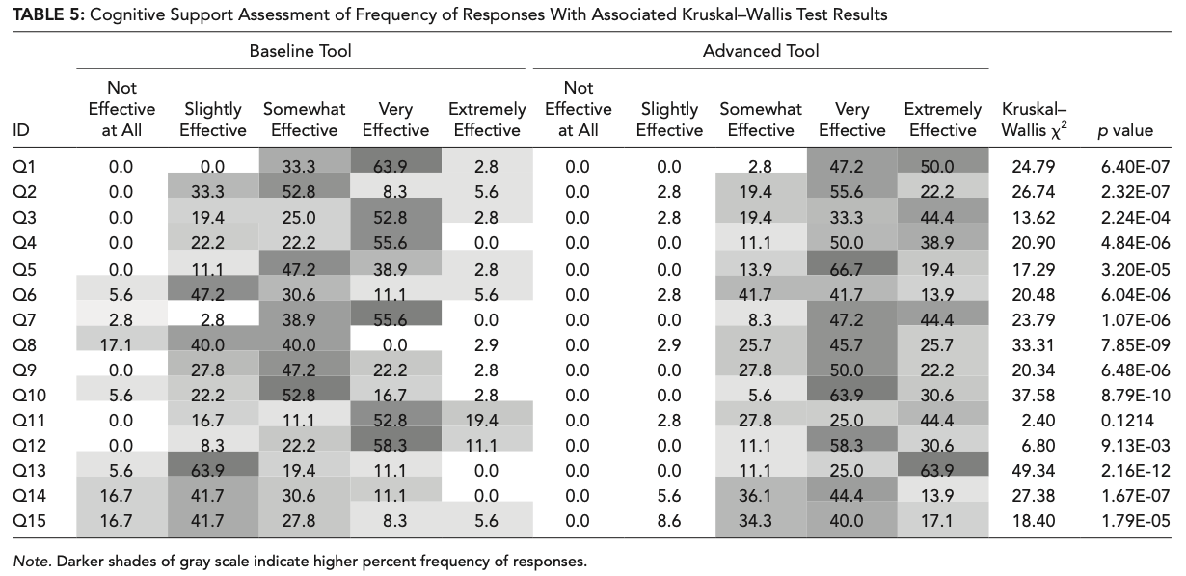
Linking the Test Outcomes to Requirements
Measure variables that are operationally relevant to the requirements of interest
Objectively compare multiple solutions to learn what each solution offers
References: Miller et al, 2020
Notes:
Both solutions ‘meet the requirements’ but one does so with a much less ‘painful experience’ with more reliable work performance
What are you buying - what the priorities were in the testing out comes - no full factorial - to determine the top priorities

Slide 12
So What Now?
In order to effectively test, expectations of system outcomes should already be clearly defined in terms of work domain goals with the willingness cope with unexpected behavior
Advocate for “Shifting Left” Testing Efforts to Link Systems Expectations with System Performance Early and Often
  Establish a sociotechnical view of the system
  Infuse formative methods earlier in the design process to set expectations for system
  Derive intrinsic work domain requirements from the formative methods to have a seat at the table to influence system design
  Work domain demands should inform technology solutions, not the other way around
Testing environments need to cover a greater range of dimensions
  Incorporate Envisioned World Problem aspects
    Let the work needs drive the system development, not the technology
  Carry forward multiple versions of the work domain and possible solutions via Concept of Operations/Scenario definitions
    Incorporate operational realities where possible
  Explicitly test against system requirements/work expectations
    Test what you think matters, rather worrying about ‘full factorial’ study designs

Slide 13
References
Canellas et al., (2017) Framing Human-Automation Regulation: A New Modus Operandi from Cognitive Engineering. We Robot 2017 at Yale School of Law: https://papers.ssrn.com/sol3/papers.cfm?abstract_id=3567175
Dekker, S. W. A., Woods, D. D., & Mooij, M. (2002). Envisioned practice, enhanced performance: The riddle of future (ATM) systems. Journal of Applied Aviation Studies, 2, 23–32.
Miller, M. J., McGuire, K. M., & Feigh, K. M. (2015). Information Flow Model of Human Extravehicular Activity. Presented at the In Proceedings of the IEEE Aerospace Conference, Big Sky, MT. http://doi.org/10.1109/AERO.2015.7118942
Miller MJ, McGuire KM, Feigh KM. Decision Support System Requirements Definition for Human Extravehicular Activity Based on Cognitive Work Analysis. Journal of Cognitive Engineering and Decision Making. 2017;11(2):136-165. doi:10.1177/1555343416672112
Miller, M., & Feigh, K. (2019). Addressing the envisioned world problem: A case study in human spaceflight operations. Design Science, 5, E3. doi:10.1017/dsj.2019.2
Miller MJ, Feigh KM. Assessment of Decision Support Systems for Envisioned Human Extravehicular Activity Operations: From Requirements to Validation and Verification. Journal of Cognitive Engineering and Decision Making. 2020;14(1):54-74. doi:10.1177/1555343419871825
Vicente, K. J. (1999). Cognitive work analysis: Toward safe, productive, and healthy computer-based work. CRC Press.
Waterson, P., Robertson, M. M., Cooke, N. J., Militello, L. G., Roth, E. M., & Stanton, N. A. (2015). Defining the methodological challenges and opportunities for an effective science of sociotechnical systems and safety. Ergonomics, 58(4), 565–599. http://doi.org/10.1080/00140139.2015.1015622
Woods, D. D., & Dekker, S. W. A. (2000). Anticipating the effects of technological change: A new era of dynamics for human factors. Theoretical Issues in Ergonomics Science, 1(3), 272–282. http://doi.org/10.1080/14639220110037452
Additional Foundational References:
Hollnagel, E., & Woods, D. D. (1983). Cognitive Systems Engineering: New Wine in New Bottles. International Journal of Man-Machine Studies, 18, 583–600.
Woods, D. D. (1998). Designs are hypotheses about how artifacts shape cognition and collaboration. Ergonomics, 41(2), 168–173. http://doi.org/10.1080/001401398187215

Slide 14
Back Up

Slide 15
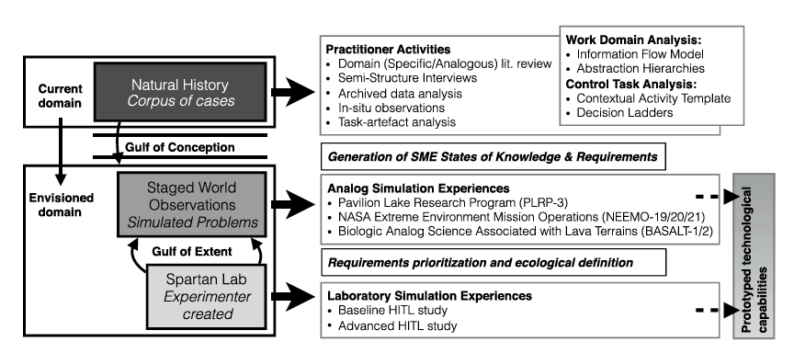
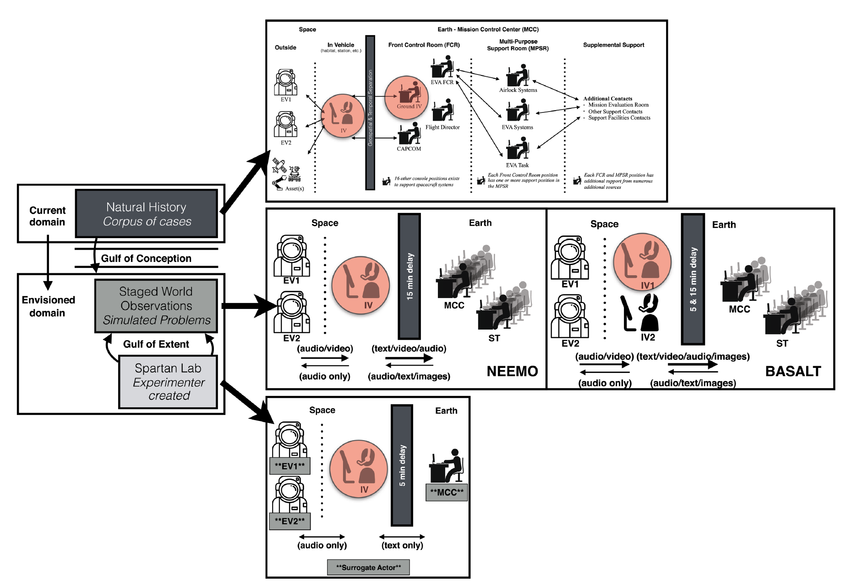
Testing in Multiple Versions & Stages to Refine Assumptions
References: Miller et al, 2019

