Slide 1

Cultivating Plants in a Controlled Environment
“Feeding Exploration and Enabling Earth Independence”
Gioia Massa and Ralph Fritsche
NASA, Kennedy Space Center, FL

Slide 2

Space Crop Production Challenges
Deep Space
Water Recycling
Radiation
Pressure
Micrometeorites
Surface
Microgravity
Fluid movement
No convection
Dust
Partial gravity
Plant Size
High CO₂
Nutrient output
Microbiome & Food Safety
Sustainability
Abiotic stresses
Vehicle resources
Crew time
Waste
Productivity
Stress tolerance
Crop scheduling
Current focus areas
Crop

Slide 3
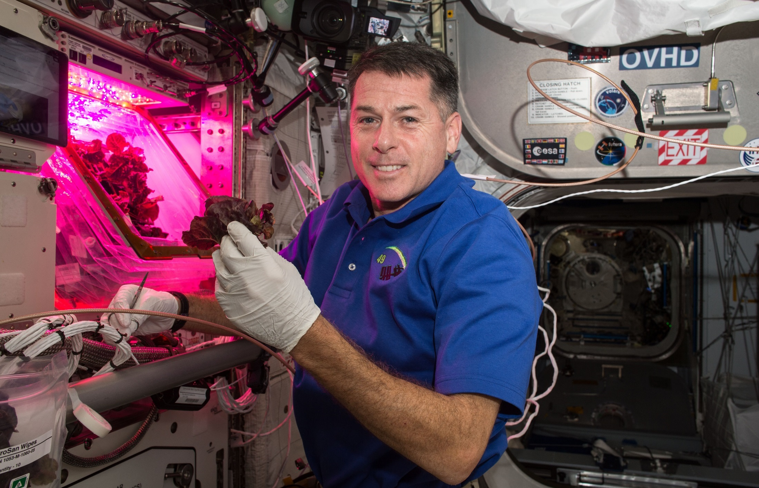
Veggie
Shane Kimbrough
Expedition 49/50

Slide 4
Crop Production Challenge
Identify and demonstrate effective options to provide both water and oxygen to the root zone in microgravity.

Slide 5
Crop Production Challenge
Investigate the relationship between microbiomes and food safety:
  Effectively sanitize produce with few consumables and low inputs
  Control biotic stresses and pathogens
  Use the microbiome to protect crops or enhance growth.

Slide 6
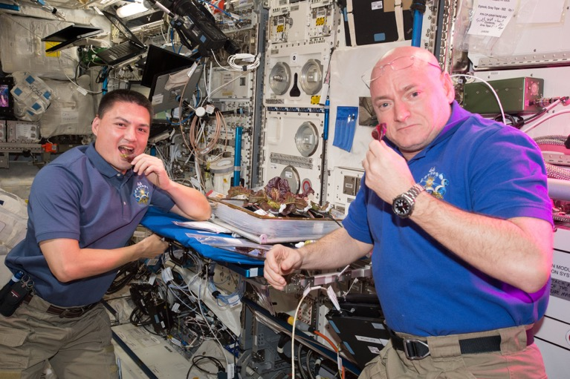
Crop Production Challenge
Identify potential crops:
  Yield verses volume, edible biomass
  Nutrition, organoleptic attributes, psychosocial benefits
  Elevated CO₂
  Genetic engineering
  Healthy microbiome
  Food Safety

Slide 7
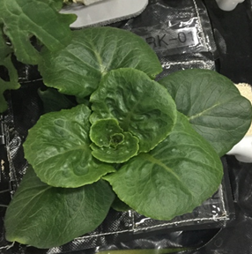
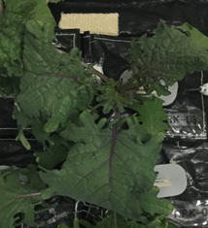
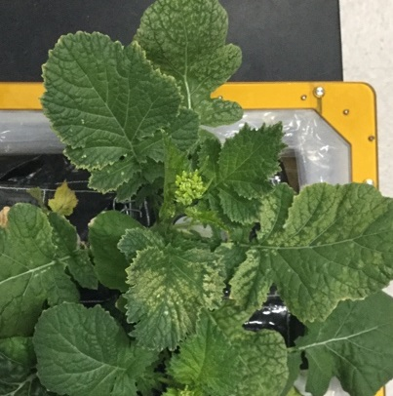
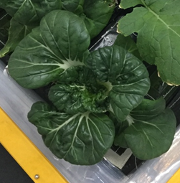
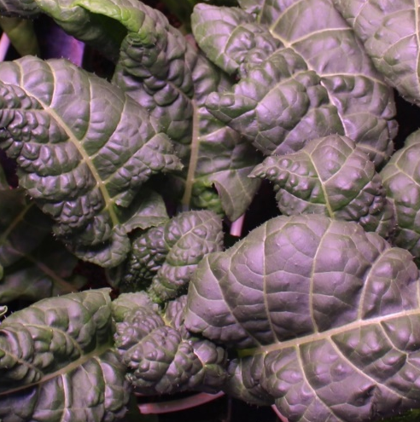
Recent New Crops on Orbit
Red Russian Kale
*Dragoon Lettuce
Wasabi Mustard
*Extra Dwarf Pak Choy
Amara Mustard
Grown in different combinations with Amara Mustard and Extra Dwarf Pak Choi harvested this week on ISS!
*= Student Selected Crops!

Slide 8
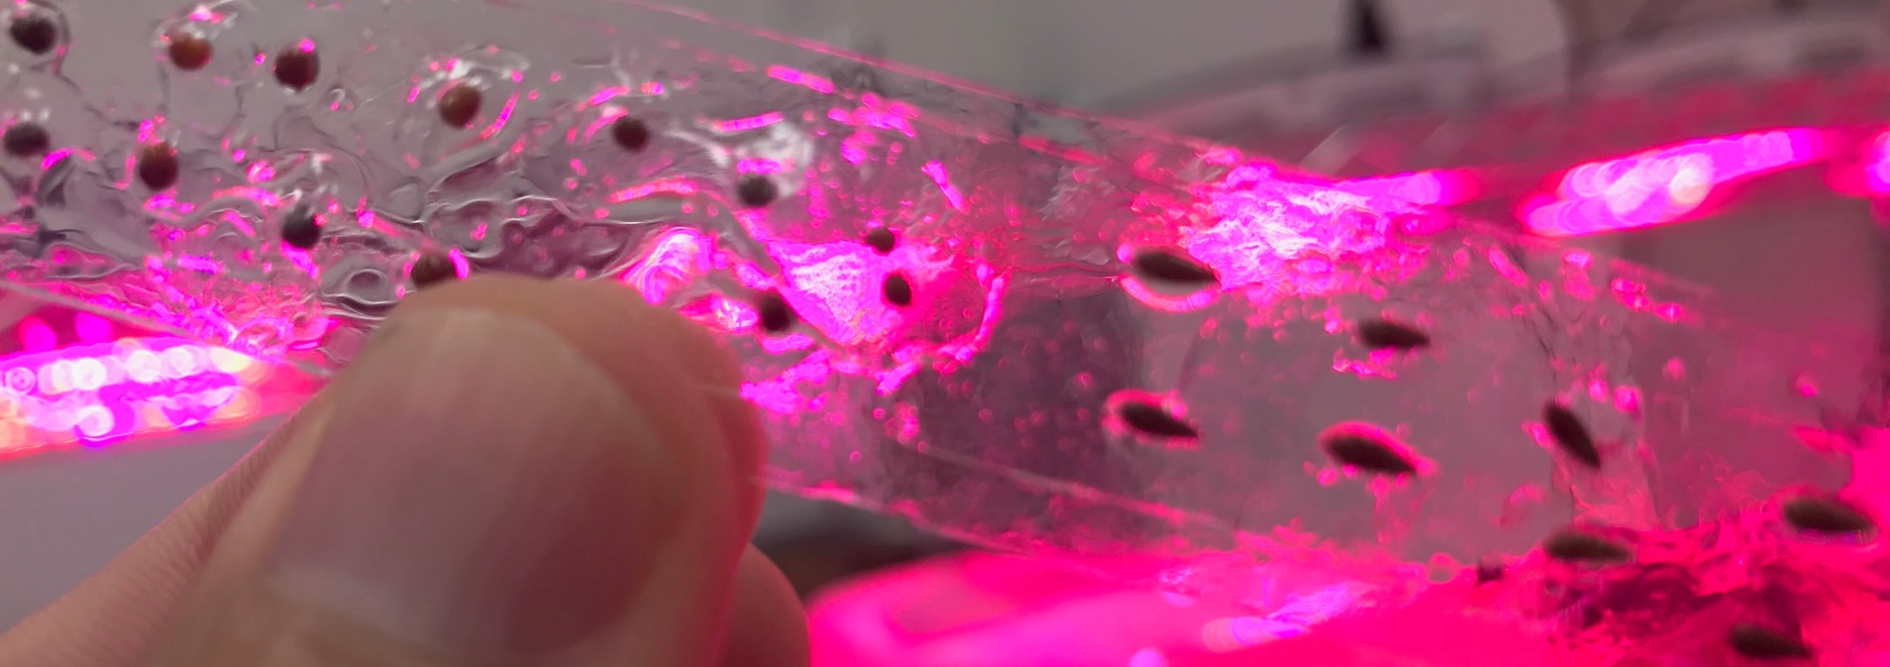
Crop Production Challenge
Storage and handling of seeds to ensure they are viable, free of contaminants and long-lived.
Seed Film technology tested successfully in VEG-03 J, January 2021

Slide 9
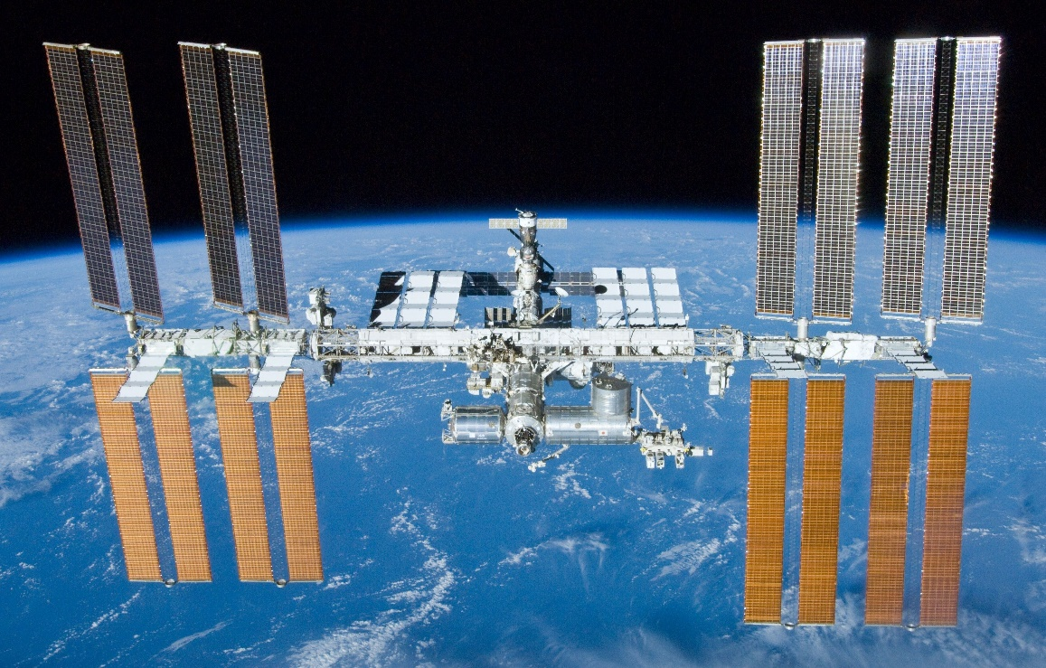
Low Earth Orbit (LEO) Operations
Spares are sent from the ground
Operations are led from the ground with flight crew in a supporting role
Continuous presence
of crew is assumed

Slide 10
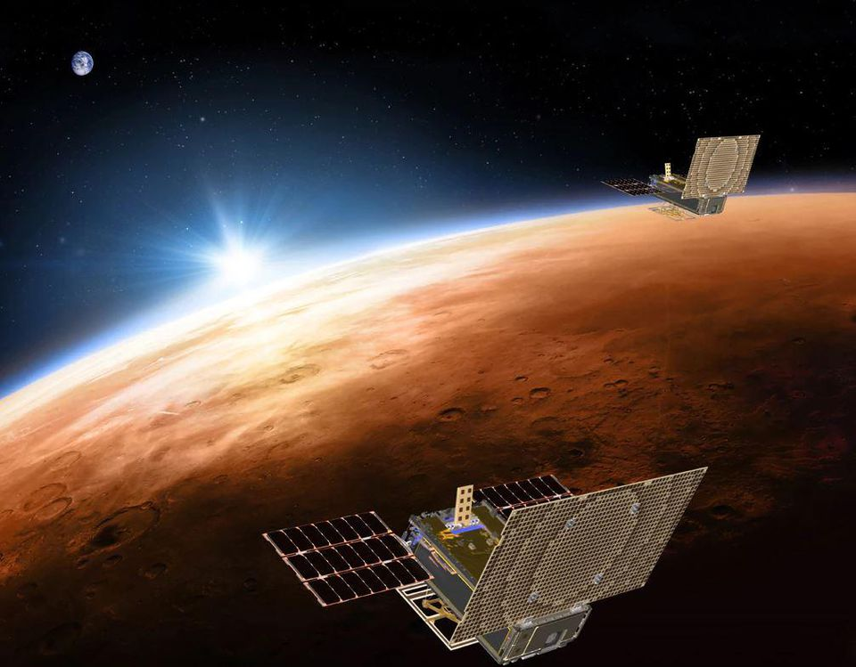
As Distance from Earth Increase
Access Decreases
  The return journey from ISS takes hours
  From the moon days
  From Mars years
Communications are delayed
  Low Earth Orbit instantaneous
  Moon 2.5 seconds round trip
  Mars up to 46 minutes round trip

Slide 11
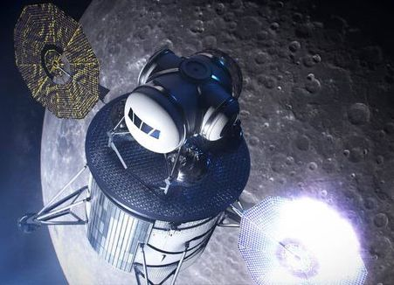
As Distance from Earth Increase
Vehicle Dormancy will be a Design Driver
  Early exploration missions will have long periods without crews present, systems may be powered down
  Provides unique challenges for systems that use water and support biology

Slide 12
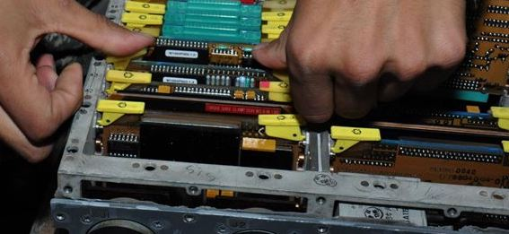
As Distance from Earth Increase
Focus changes from Replacement to Repair
  Systems designed with repair in mind
  Leverage in space manufacturing
  Minimize use of consumables
  Manage logistics by using common components and interfaces

Slide 13
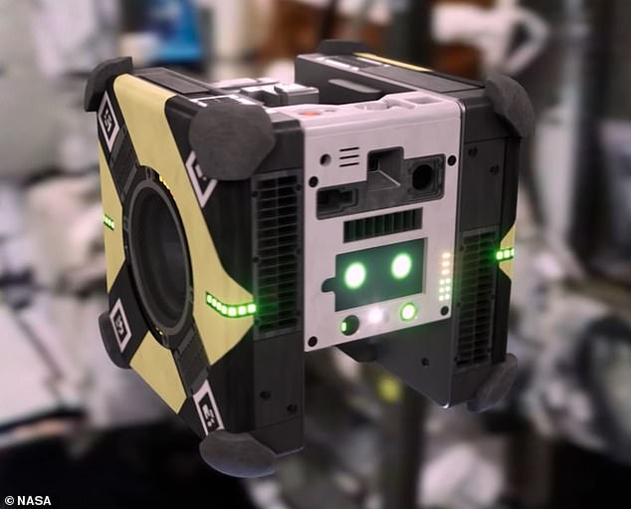
As Distance from Earth Increase
Systems and Software Controls will need to Detect, Decide, and Do
  Common operations will be automated
  Automated fault detection and failure recovery

Slide 14
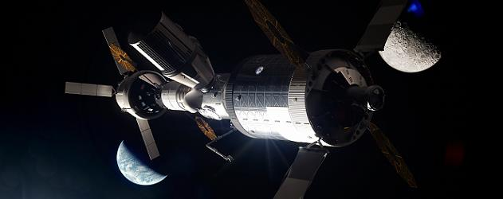
As Distance from Earth Increase
Systems will need to be Evolvable
  Initially provided core functions
  Enhancements should be iterative and not require complete system replacement
  Hardware designs should start with the end in mind

Slide 15
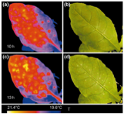
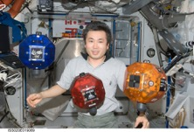
    Technology Infusion
Imaging systems for plant health and food safety (NDVI, Multispectral, Hyperspectral, Fluorescence)
Advanced lighting
Sensor development
Sensor Integration
Autonomy/Robotics

Slide 16
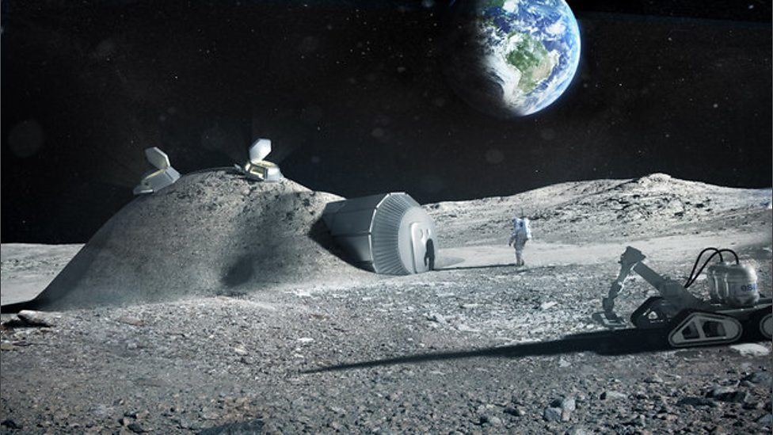
    The Moon as an Analog for Mars
    Early opportunities to perform research in the radiation and partial gravity environment are a priority
    Initial crop production capability will likely be adaptated from microgravity hydroponic systems developed on the ISS
    Demonstrate technologies
    for future Mars habitat

Slide 17
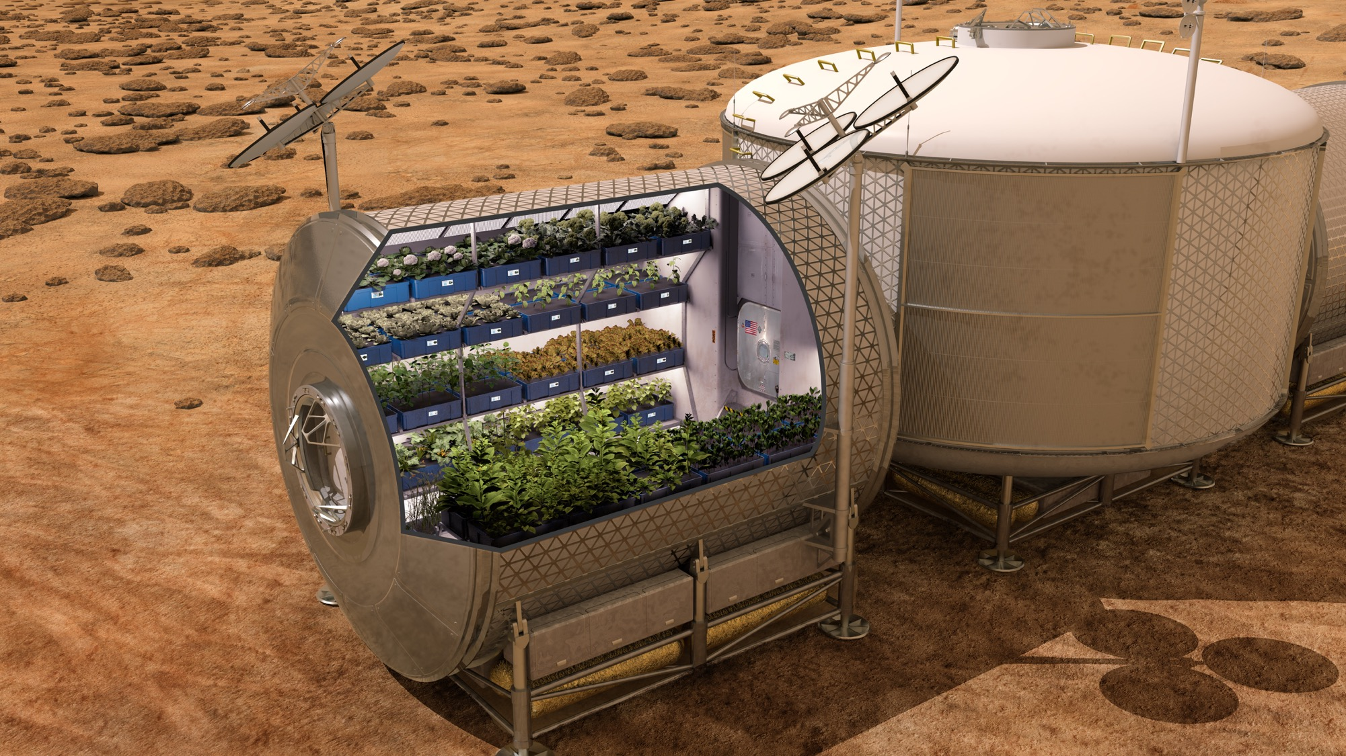
    Crop Production Challenges on Mars
    Crew time
    Hydroponic verses regolith systems
    Staple crops
    Dedicated module(s), food prep and storage hardware
    Long term radiation effects on nutrition and palatability

Slide 18
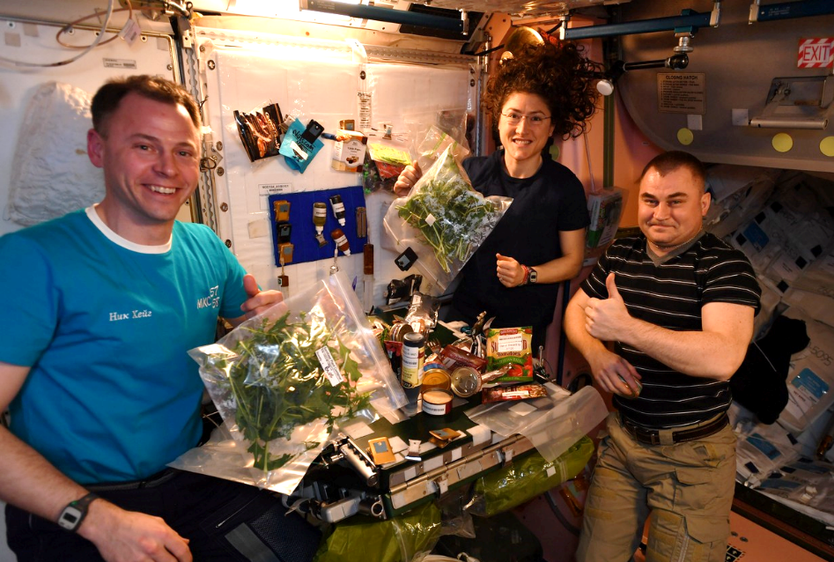
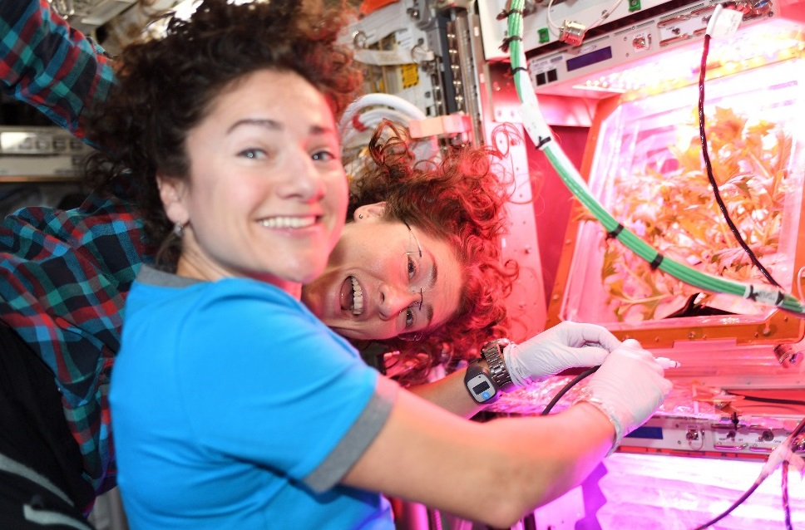
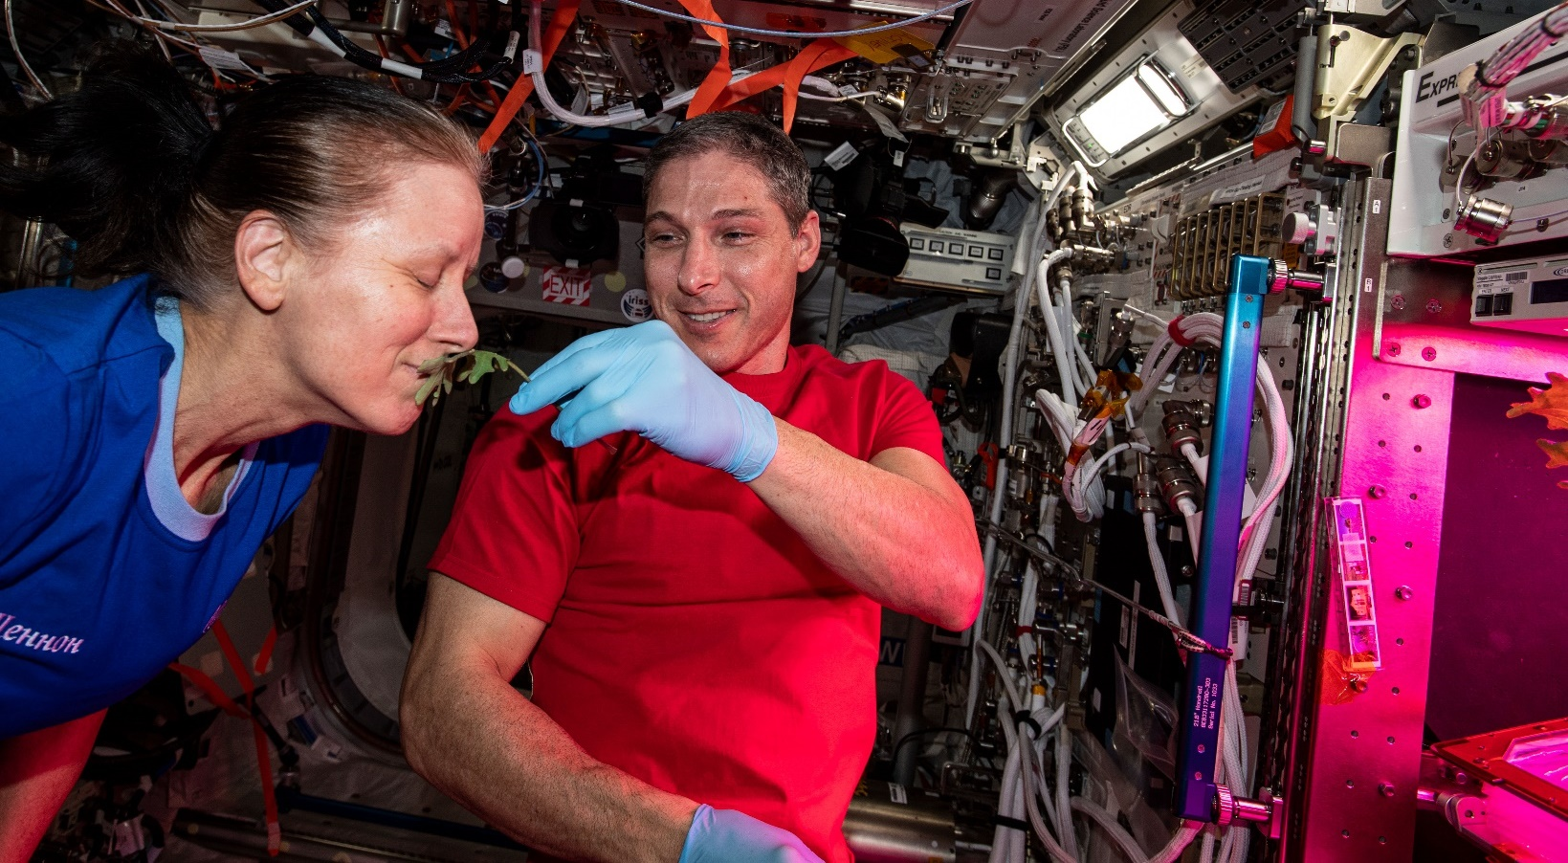
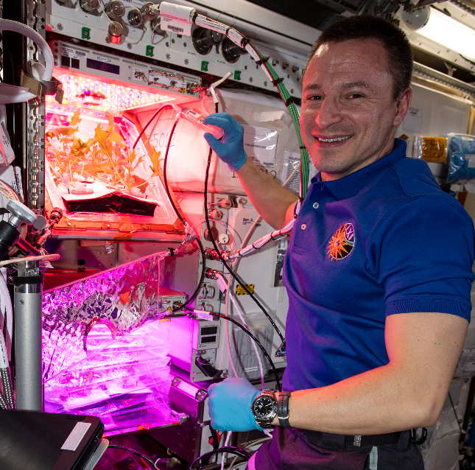
Thank You!

