Slide 1
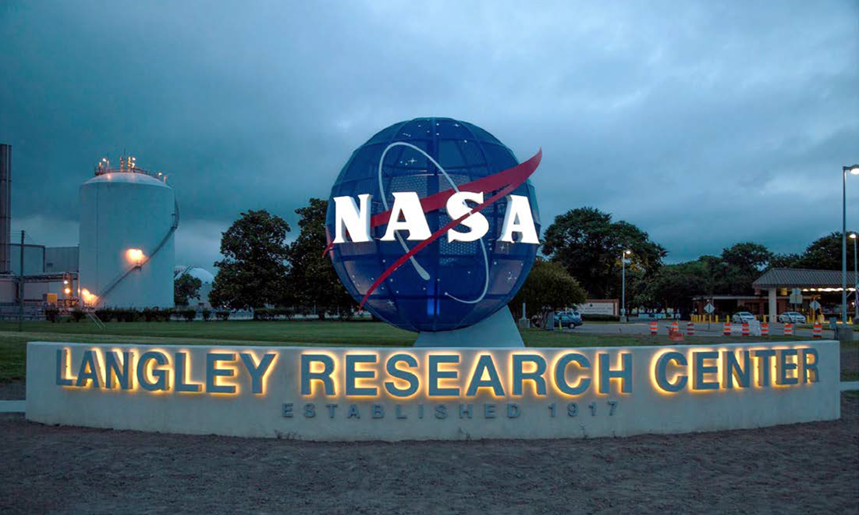

LARC Wind Tunnel Test Capabilities
Tunnel For Hire
Roman Paryz
Branch Head – Subsonic / Transonic Testing Branch (STTB)
LARC Center Integration Manager (CIM) - Aerosciences Evaluation and Test Capabilities (AETC) Portfolio

Slide 2

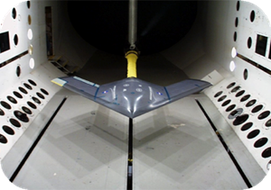
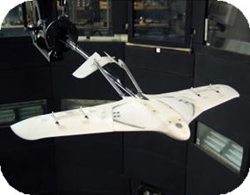
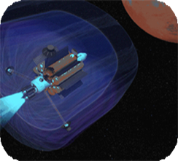
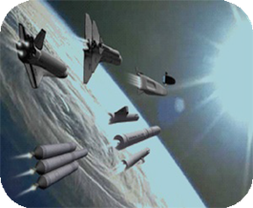

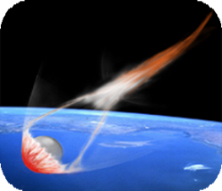
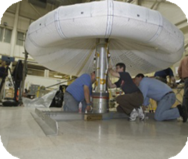
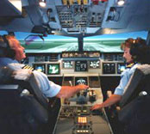
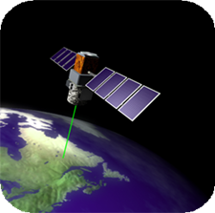
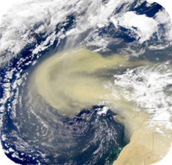
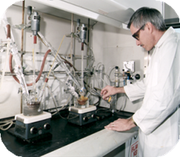
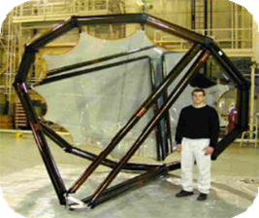
NASA Langley Product Lines
Aerosciences
Systems Analysis & Concepts
Measurement Systems
Entry, Descent & Landing
Intelligent Flight Systems
Atmospheric Characterization
Advanced Materials & Structural Systems
Notes:
Langley has recognized expertise in aerosciences – flying through all atmospheres, structures and materials, systems analysis and atmospheric science. We continue to be involved in ground-breaking research with important implications for the future in such critical areas as global climate change, future air travel, and this nation as a leaders in space.
Vehicle Level Design, Integration & Analysis
Integrated advanced technologies w/ new vehicle concepts to improve performance & capabilities
Hypersonic Technologies
Air-breathing propulsion & Impact on PAI on vehicle performance
Aeroelasticity / Aeroservoelasticity Technologies
Understanding & controlling aeroelastic effects on air vehicles
Acoustic Design, Analysis & Control Technologies
Understand, predict & control acoustics to reduce aircraft noise & vibroacoustic response
Flow Control Technologies
Understand & control of steady & unsteady flow phenomena to enhance vehicle performance
Physics-Based Modeling, Simulation, Validation & Verification
Develop rapid/accurate multidisciplinary design & analysis tools with known uncertainty

Slide 3
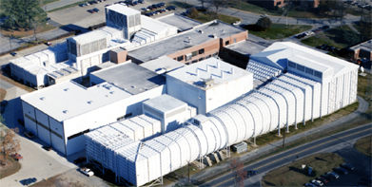
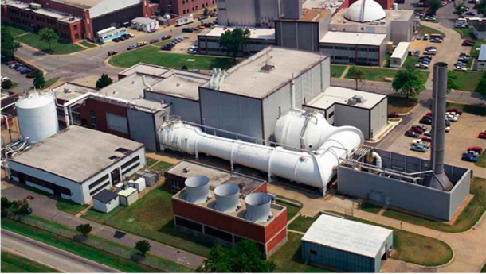
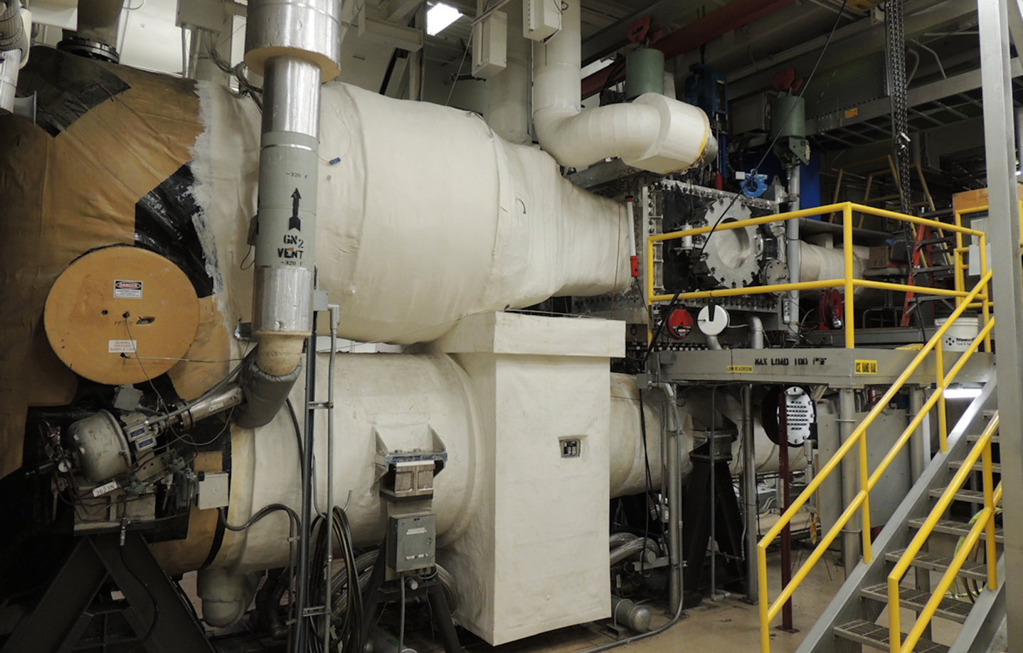
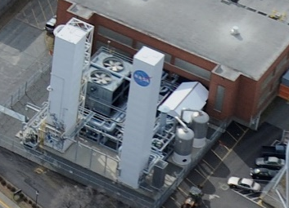
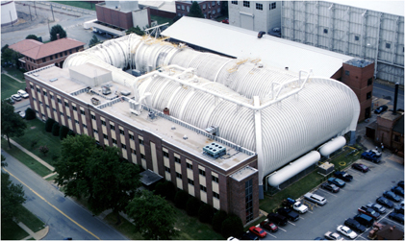
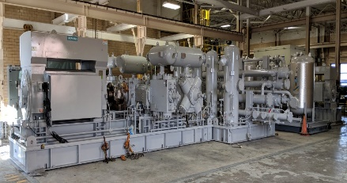
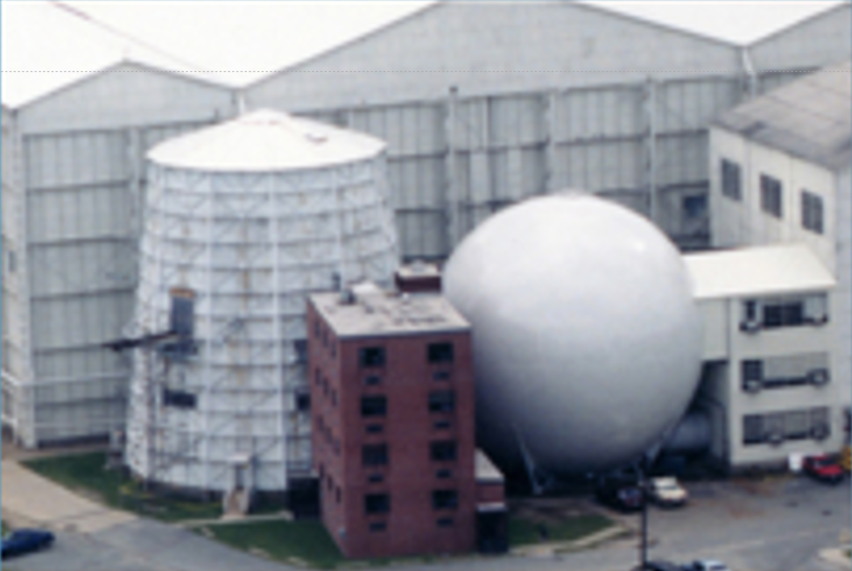
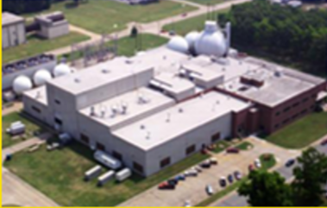
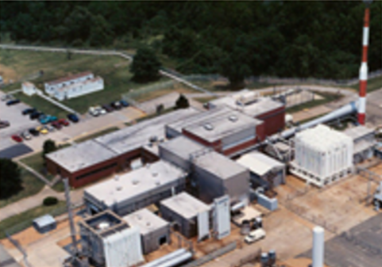
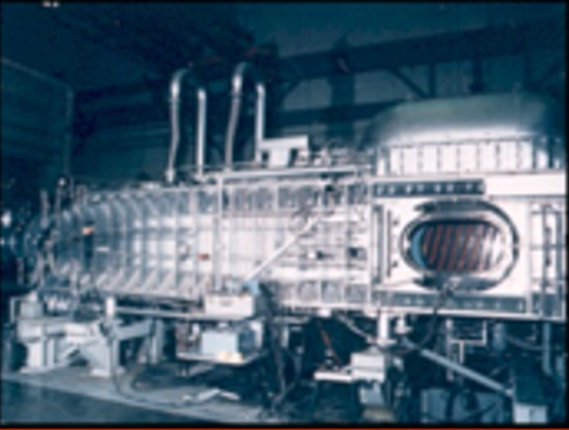
NASA Langley AETC Facilities
CRV $2,010K
Staff 74 / 144
Subsonic / Transonic Testing Branch
Roman Paryz – Branch Head / Rich White & Joe Falzone – ABH
CRV $1,083K
Staff 31 / 101
NCI
NCI
14 x 22 Foot Subsonic Tunnel
Subsonic, Aero-Acoustics
Frank Quinto - FM
National Transonic Facility
High Reynolds Number Flow
Air & Cryogenic Test Ops
Nationally Unique
0.3m Transonic
Cryogenic Tunnel
Flow Diagnostics
Liquid Nitrogen Plant
430 Tons per Day
(128K Gal per Day)
NASA Unique
Transonic Dynamics Tunnel
Aeroelasticity & Flutter
Air & Heavy Gas Test Ops
Vic Tumwa– FM
World Unique
Compressor Station &
Air Distribution
LaRC High Pressure Air
2M lbm per Day
Tom Mills - FM
Don Saxer – FM
National Transonic Complex
Subsonic
Transonic
Supersonic
Hypersonic
0 0.6 1.4 4.0 10.0+
Flight Dynamics Branch
Corey Diebler – Branch Head / Tom Ivanco – ABH
CRV $186K
Staff 3 / 2
Supersonic / Hypersonic Testing Branch
Mike DiFulvio– Branch Head / Mike Foretich & Jason Healy – ABH
CRV $741K
Staff 40 / 41
NCI
Vertical Spin Tunnel
Spin Testing, Forced Oscillation
Tom Ivanco - FM
4ft Supersonic Wind Tunnel
Two Test Sections
Roger Wagner - FM
8ft High Temperature Tunnel
Hypersonic Propulsion Testing
Aaron Fuchs - FM
Langley Aerothermodynamic Laboratory
Hypersonic Aerothermal Testing
Karen Berger - FM

Slide 4
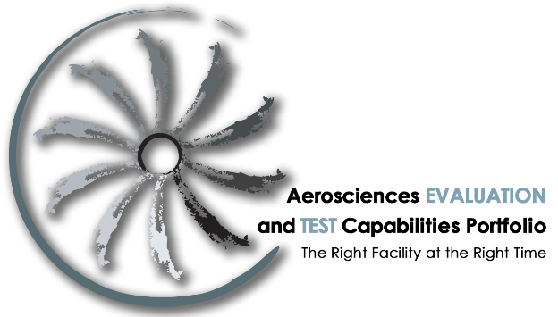
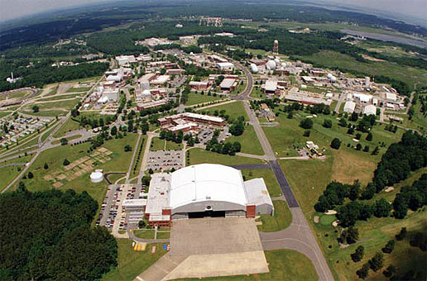
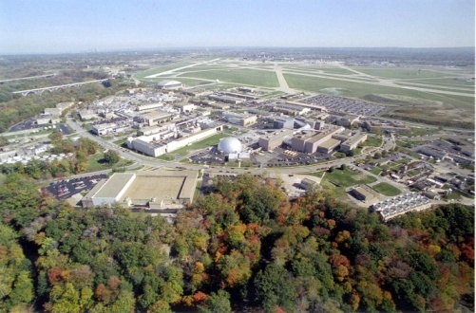
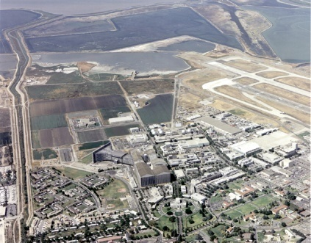
The Aerosciences Evaluation and Test Capabilities (AETC) Portfolio
“…Improve access to our facilities, putting them back in the hands of our researchers and engineers to execute the Agency’s missions, programs, and projects…” NASA Aerosciences Capability Leadership Team
“…facilities and capabilities will continue to evolve in support of the research necessary to address the Strategic Thrusts…” NASA Aeronautics Strategic Implementation Plan
Mission
Sustain and improve test capabilities and test technologies in support of Agency testing requirements
  “The right facility at the right time”
Scope
Aerosciences ground test facilities deemed critical to the Agency
Operations, maintenance, new capability and test technology advancements
Complementary computing capabilities in conjunction with ground experimentation capabilities
AETC Investment Categories
Operations
Maintenance
Capability Advancement
Test Technology Improvement
CFD & Wind Tunnel Test Integration
Langley Research Center
Glenn Research Center
Ames Research Center

Slide 5
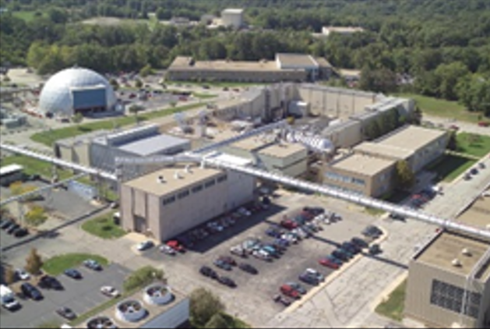
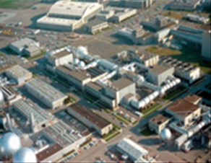
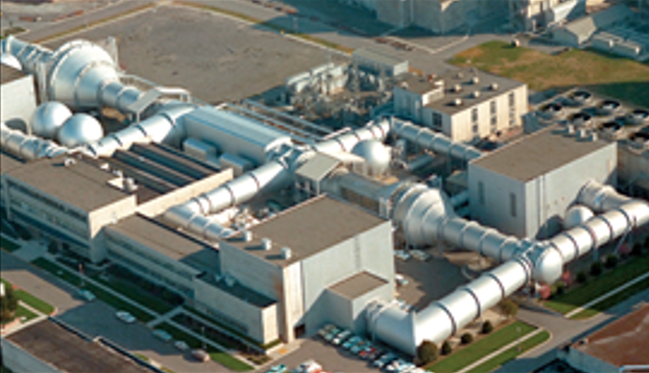
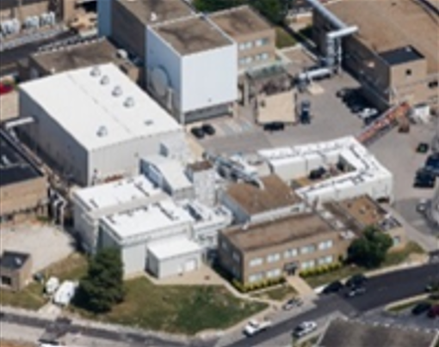
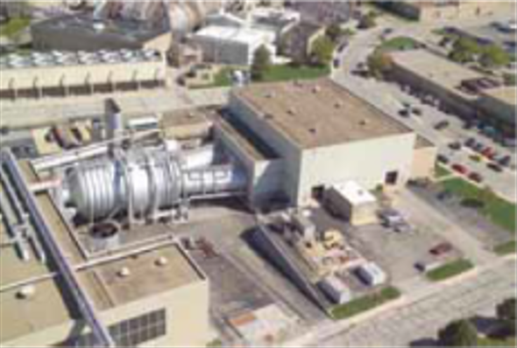
NASA Ames & Glenn AETC Facilities
GRC 9’x15’ Low Speed Wind Tunnel
Low Speed Propulsion / Acoustic
GRC 8’x6’ Supersonic Wind Tunnel
Supersonic Propulsion
ARC Unitary Plan Wind Tunnel
11’x11’ Transonic Wind Tunnel
9’x7’ Supersonic Wind Tunnel
GRC 10’x10’ Supersonic Wind Tunnel
Large Scale Supersonic / Propulsion
Subsonic
Transonic
Supersonic
Hypersonic
0 0.6 1.4 4.0 10.0+
GRC Icing Research Wind Tunnel
Aircraft Icing Condition Simulation
GRC Propulsion Systems Laboratory
Engine (and Icing) Simulation at Altitude
Tony Doglio– GRC CIM
216-433-2402
james.a.doglio@nasa.gov
Ron Colantonio – AETC Portfolio Manager
216-433-6370
ron.colantonio@nasa.gov
Frank Kmak – ARC CIM
650-604-1463
frank.j.kmak@nasa.gov

Slide 6
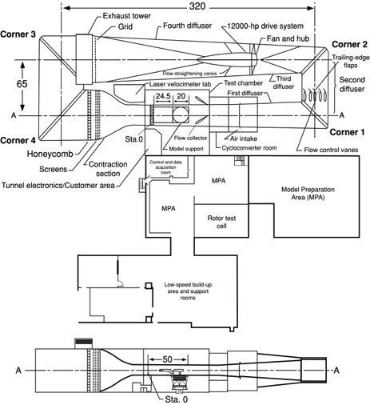
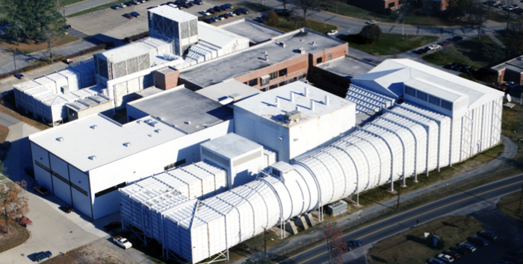
14- by 22-Foot Subsonic Tunnel – 14x22
Characteristics:
Closed circuit, single return, atmospheric
Closed and open test section configurations
Speed, foot per second……… 348 (closed), 283 (open)
Unit Reynolds number, per feet….. 0 to 2.2 x10⁶
Test gas……………………... Air
Test section size, feet……….. 14.5 x 21.75
Test Section Length, feet…… 50
Drive power, horsepower…… 12000 continuous
Model build-up in large Model Preparation Areas
Model support on different Model Carts
Dimensions are in feet.

Slide 7
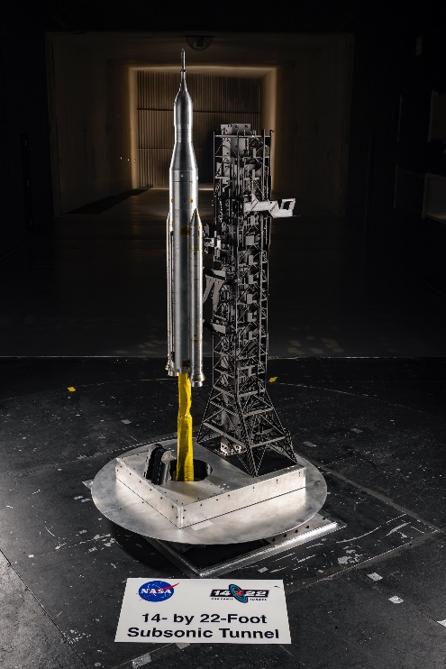
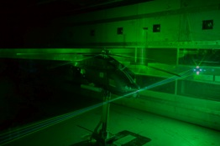
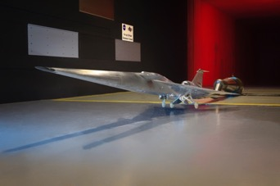
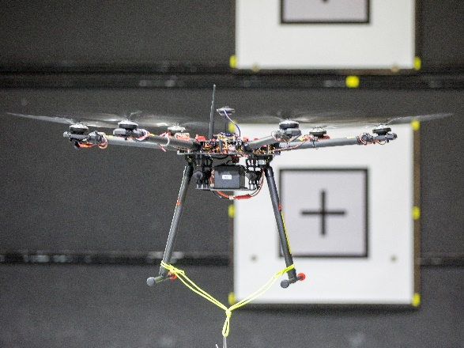
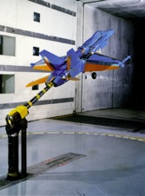
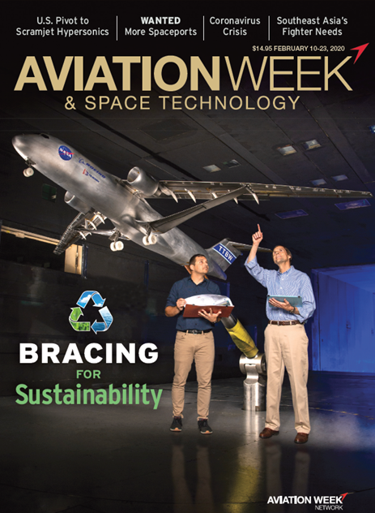
14- by 22-Foot Subsonic Tunnel – 14x22 Test Types / Features
ROTORCRAFT WITH LDV and PIV
FORCE & MOMENT
ON VERTICAL STRUT
GROUND EFFECTS
LIFTOFF TRANSITION ON LAUNCH VEHICLES
AIRCRAFT ACOUSTICS
SEMISPAN
UNMANNED AERIAL SYSTEMS
HIGH ANGLE OF ATTACK

Slide 8
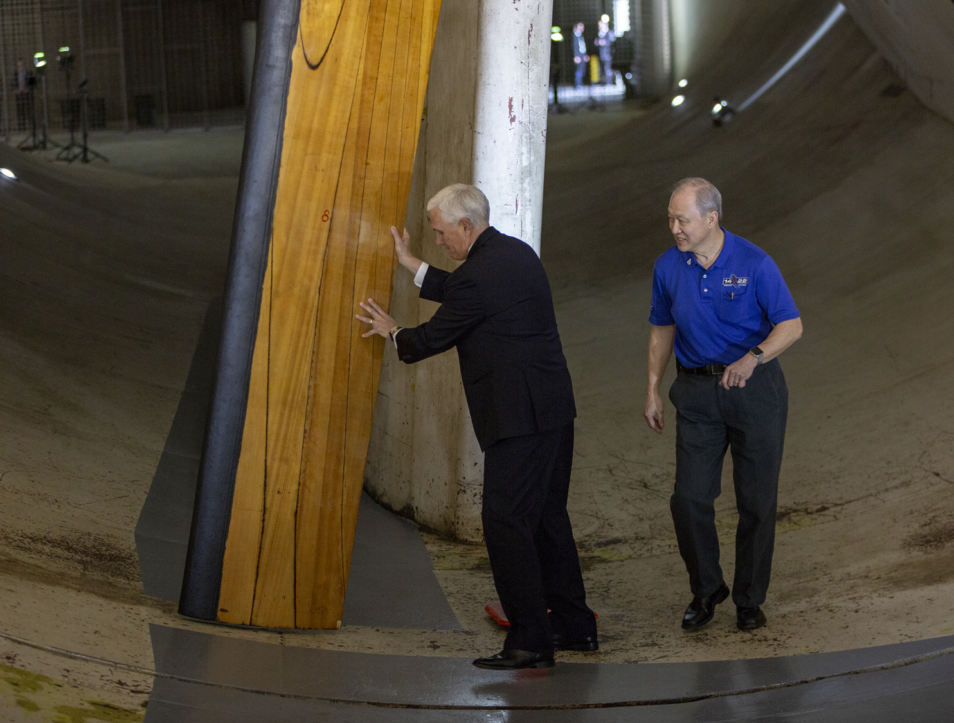
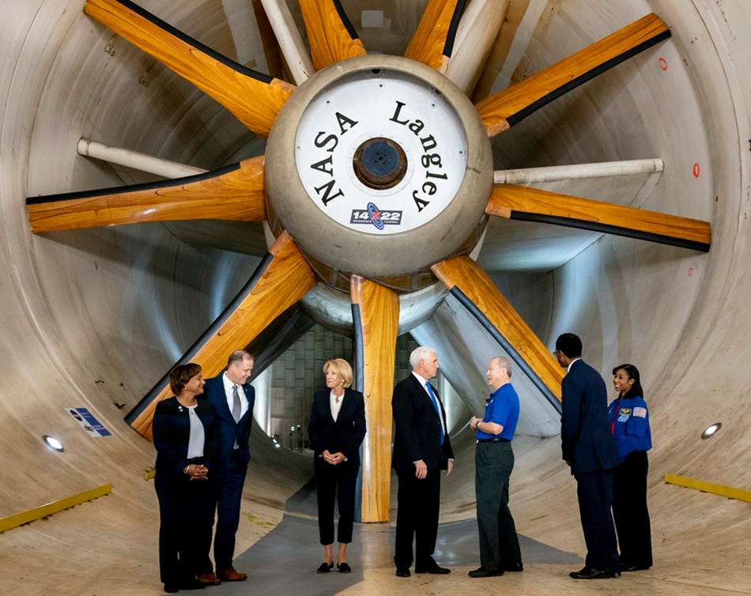
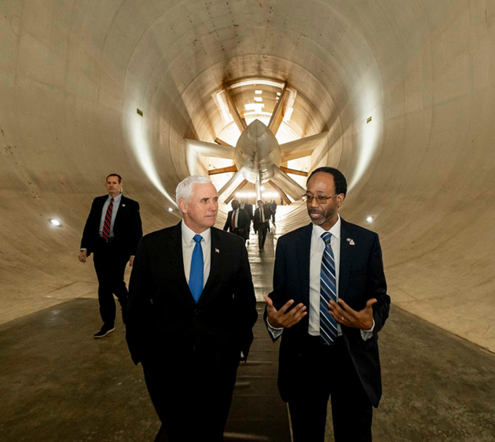
Former Vice President Mike Pence Helping with Blade Work
8

Slide 9

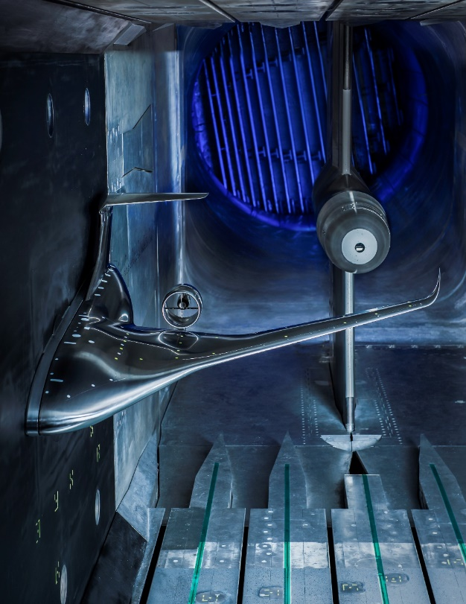
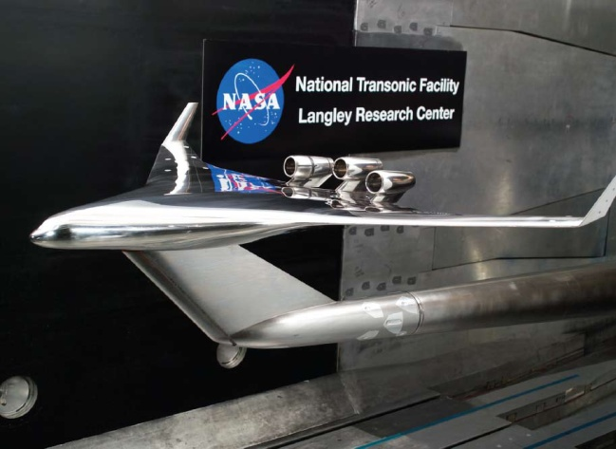
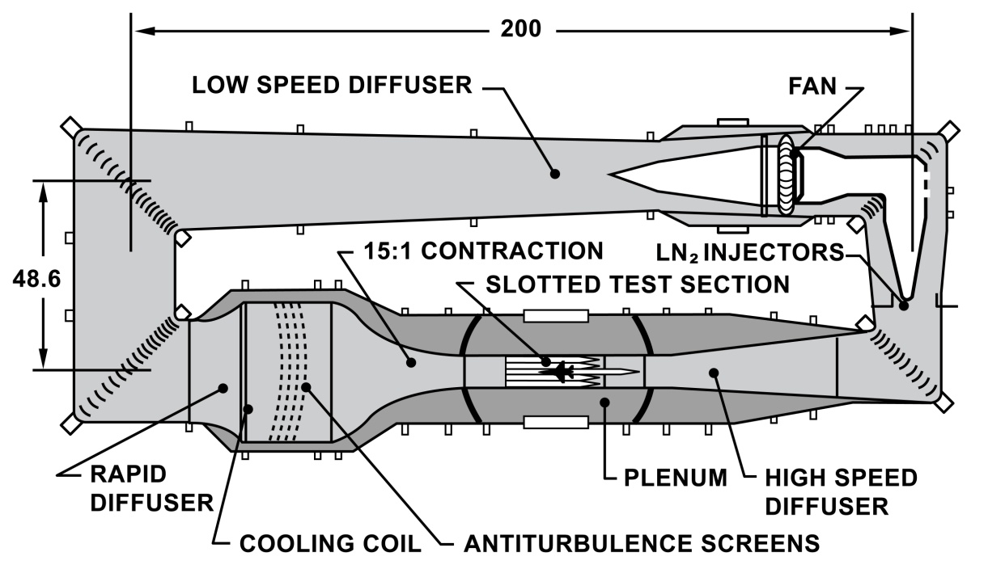
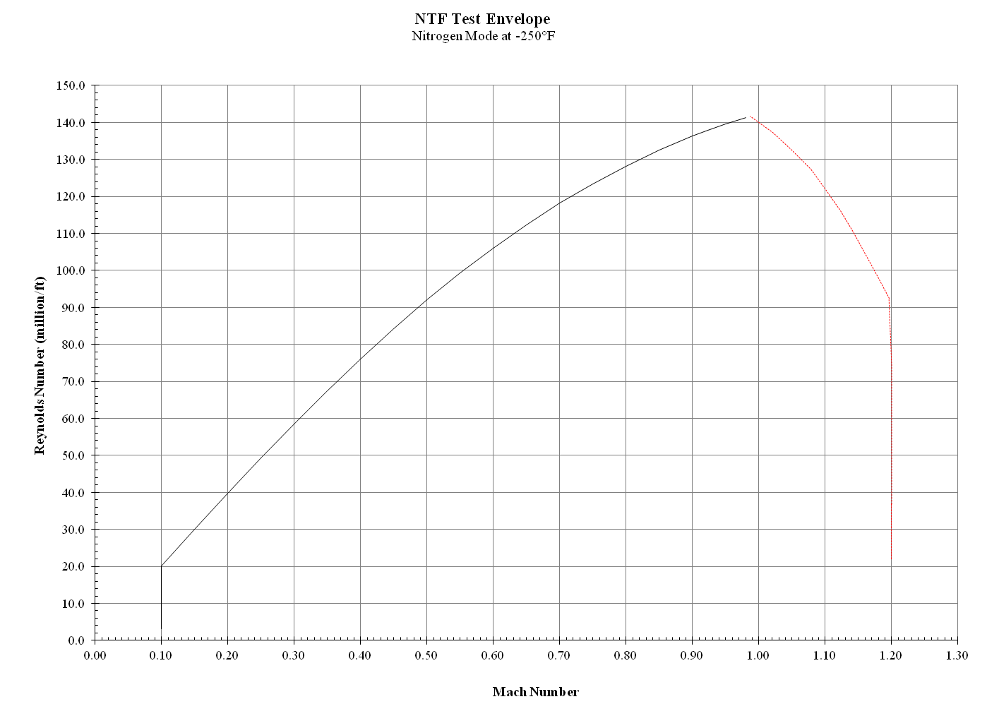
National Transonic Facility – NTF
38 Years of High Reynolds Number RDT&E
The Highest Reynolds Number Transonic Facility Operating in Air
The Highest Reynolds Number Transonic Facility Operating Cryogenically
Test Section | 8.2 x 8.2 x 25 Feet ( 2.5 x 2.5 x 7.6 meters)
Pressure | 14.7 to 133 psia; 1 to 9.0 atm.; 1.01 to 9.1 bar
 | Air Operations | N₂ Operations
Mach No. | 0.2 to 1.05 | 0.2 to 1.20
Unit Reynolds No. Max | 20x10⁶ / ft (65x10⁶ / m) | 145x10⁶ / ft (475x10⁶ / m)
Temperature | 90° to 150°F (32° to 65°C) | -50° to -250°F (-45° to -157°C)
150
Q
6,000 PSF
140
-250°F
N₂
130
120
110
Q
5,500 PSF
-200°F
N₂
100
90
80
-150°F
N₂
Reynolds Number (Millions / Ft)
Q
5,000 PSF
70
60
Q
4,500 PSF
-50°F
N₂
50
40
+120°F
Mixed Mode
30
Q
2,900 PSF
20
+120°F
Air
10
0
0
0.1
0.2
0.3
0.4
0.5
0.6
0.7
0.8
0.9
1.0
1.1
1.2
1.3
Mach Number

Slide 10
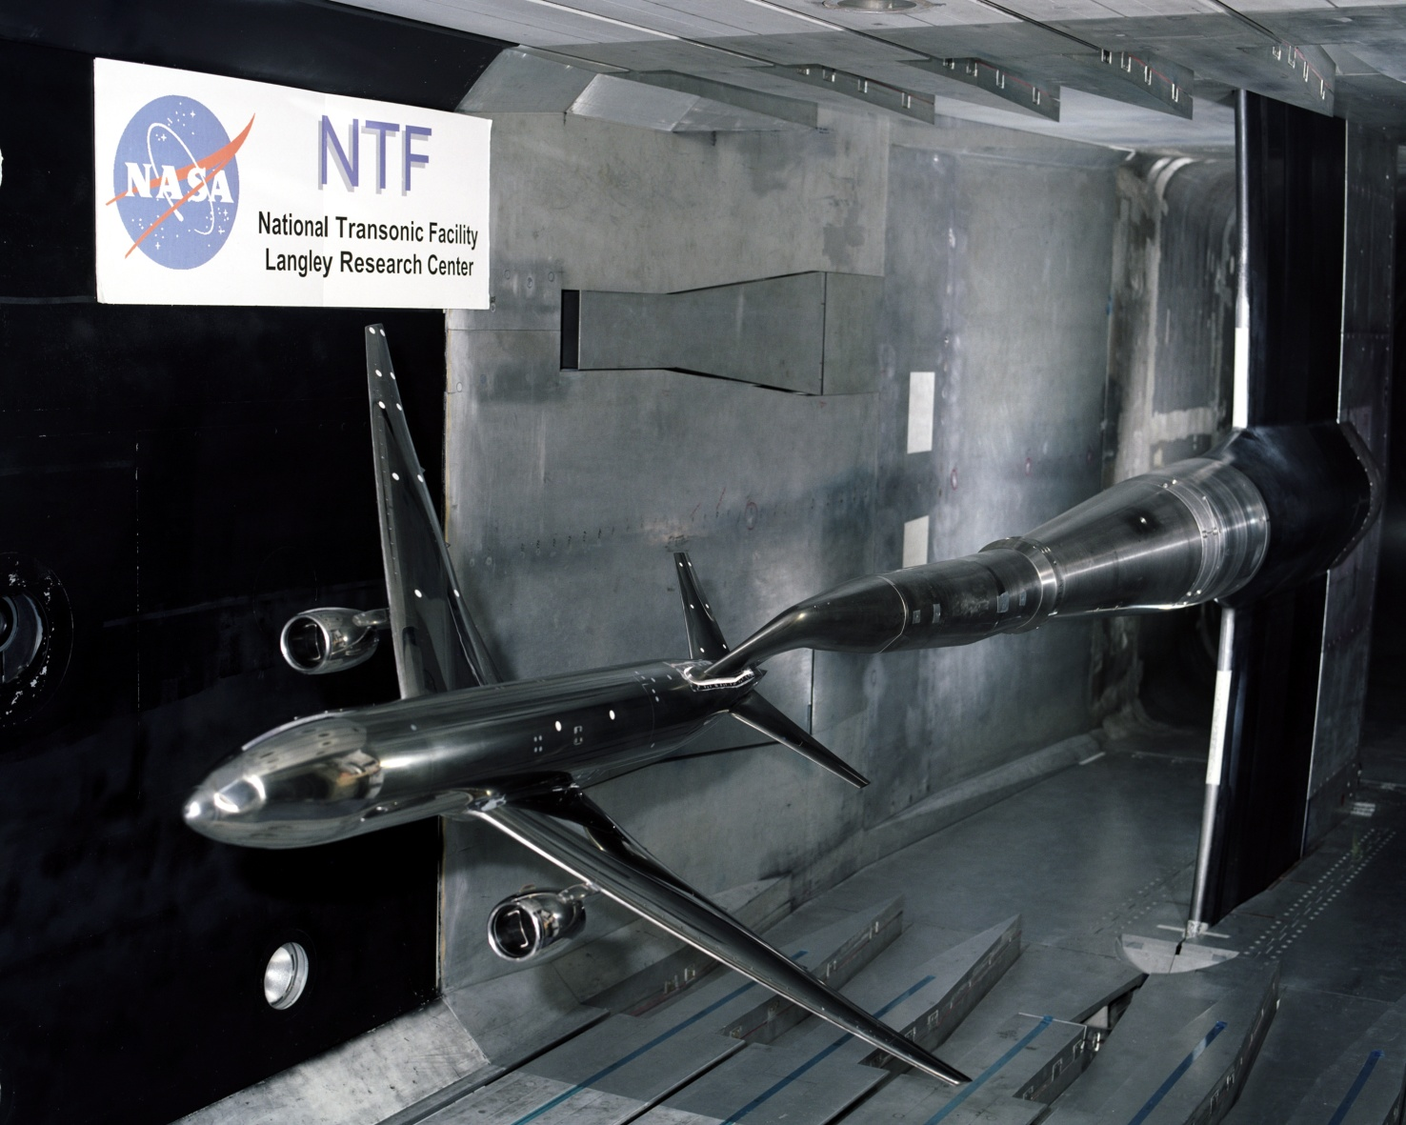
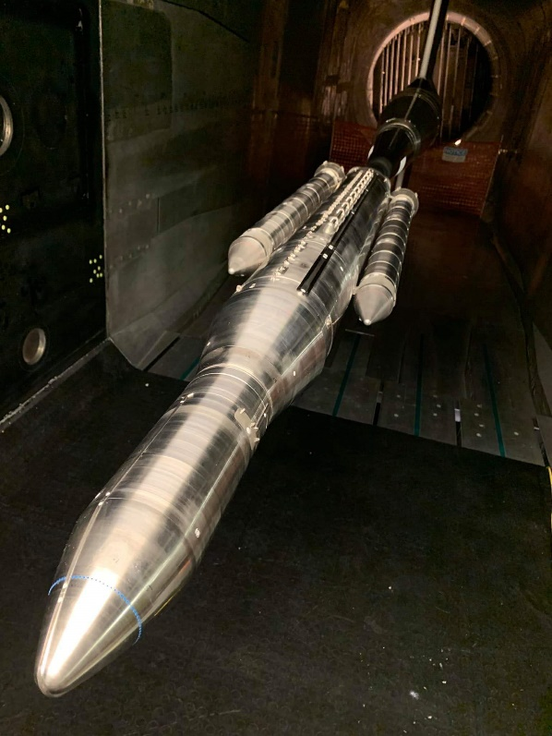
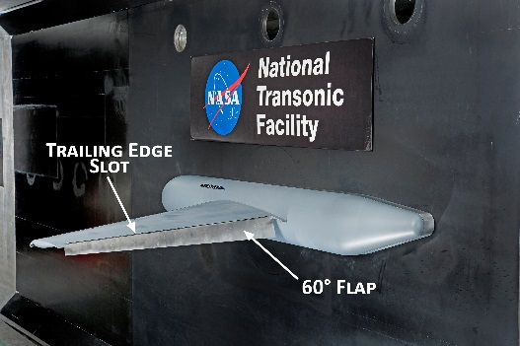
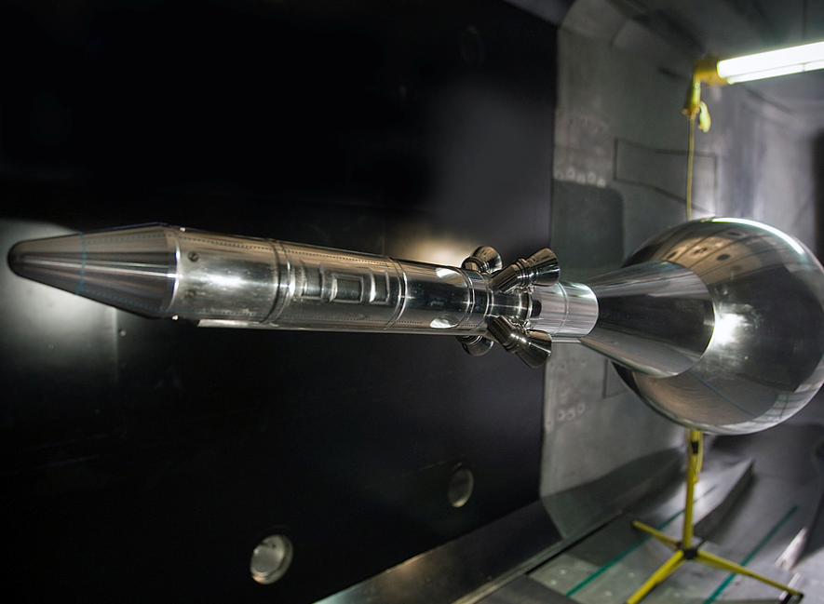


National Transonic Tunnel – NTF Test Types / Features
The National Transonic Facility provides testing to support studies of stability and control, cruise performance, stall buffet onset, and configuration aerodynamics validation for both full-span and half-span models.
  Precision force and moment testing
  Static and dynamic pressure measurements
  Strain gauges, Accelerometers
  Model deformation / wing twist
  Pressure Sensitive Paint (PSP)
  Temperature Sensitive Paint (TSP)
  FLEET - Femtosecond Laser Electronic Excitation and Tagging
  Retroreflective background-oriented schlieren
  Minitufts

Slide 11





0.3m Transonic Cryogenic Tunnel - TCT
Characteristics:
Closed circuit, single return,
Test section size, feet… 1.083 ft x 1.083 ft
Mach Number Range… 0.1 to 0.9
Unit Reynolds number (max), per ft. 100 x10⁶ / ft
Test gas… Air or Nitrogen
Pressure Range… 1 to 5 Atm.
Temperature Range… -300°F to +130°F
Flexible floor & ceiling
Typical uses
  Airfoils
  TSP, PSP flow diagnostics for boundary layer transition and shock location
  Traversing wake rake fro drag measurements

Slide 12





Transonic Dynamics Tunnel - TDT
A Unique Facility
Dedicated to identifying, understanding and solving relevant aeroelastic problems: flutter, divergence, buffet, active controls, gust response, rotorcraft dynamics, ground wind loads and unsteady aerodynamics
TDT Characteristics
Wind Tunnel | Large, Closed-circuit, Continuous-flow, Single-return
Test Section | 16 feet x 16 feet
Test Medium | R-134a or Air
Main Drive Power | 30,000 HP, Two Speed Ranges
Mach Number Range | 0 to 1.2, Continuous
Total Pressure Range | 0.01 to 1.0 Atmosphere
Unit Reynolds Number R-134a (Max) | 9.6 x 10⁶ per foot
Unit Reynolds Number Air (Max) | 3.0 x 10⁶ per foot
Dynamic Pressure R-134a (Max) | 550 psf
Dynamic Pressure Air (Max) | 320 psf
Features
1 Excellent model visibility from control room
2 Rapid tunnel shutdown for model safety
3 Safety screens for fan protection
4 Several model support (mount) systems
5 Heavy gas reclamation / purification system
6 Test section / plenum isolation valves
7 Synchronous data system, high channel-count and scan-rate
8 Optical techniques (shadowgraph, photogrammetry, PMI)
9 Flow oscillation system
FROM TDT (OCT 2014) TO MARS (2021)

Slide 13




Transonic Dynamics Tunnel – TDT Test Types / Features
Test Techniques
Aeroelastic
Performance
Forced Oscillation
Stability & Control
Rotorcraft
Ground Wind Loads
Parachute

Slide 14




4ft Supersonic Unitary Plan Wind Tunnel - 4ft UPWT
Mach
LaRC NTF* & TDT**

Slide 15




4ft UPWT - Test Types / Features
Closed-circuit, continuous-flow, variable-density supersonic tunnel
  Two 4-ft by 4-ft by 7-ft test sections
  Real-time customer data access; classified capable
Typical tests include
  Force and moment, surface pressure measurements, flow visualization, on & off surface flow patterns,
  Jet effects, dynamic stability, model deformation, global surface & off-body flow measurements, heat transfer
  Propulsion simulation system

Slide 16


Langley Aerothermodynamic Laboratory – LAL
31-Inch Mach 10 Tunnel and 15-Inch Mach 6 High Temperature Tunnel
 | 31” Mach 10 | 15” Mach 6 High Temp
Mach Number | 10 | 6
Gas | Air | Air
Unit Reynolds Number | 0.25 - 2.1x10⁶/ft | 0.5 - 8.0x10⁶/ft
Pressure (psi) | 150 - 1450 | 100 – 550
Temperature (ºF) | 1300 - 1320 | 400 – 810
Angle of Attack (deg) | ± 45 | -10 to +50
Yaw Angle (deg) | ± 10 | ± 10
Run Time | 2 min | 90 sec
Runs per Day | 5 – 8 | 4 – 8
Test Section | Closed Jet | Open Jet
Tunnel Core Size | 14 x 14 in | 9 - 14 in

Slide 17

Langley Aerothermodynamic Laboratory – LAL
20-Inch Mach 6 Tunnel
 | 20” Mach 6
Mach Number | 6
Gas | Air
Unit Reynolds Number | 0.5 - 8.3x10⁶/ft
Pressure (psi) | 30 - 475
Temperature (ºF) | 410 – 475
Angle of Attack (deg) | -5 to + 50
Yaw Angle (deg) | ± 10
Run Time | 5 min
Runs per Day | 8 – 12
Test Section | Closed Jet
Tunnel Core Size | 14 x 14 in

Slide 18
Langley Aerothermodynamic Laboratory – LAL Test Types / Features
Benefits
Flexibility | Run-by-run decisions
Productivity | - Fast paced - multiple runs/day, - Near real-time data reduction, - Ideal for parametric screening and benchmarking computational codes
Security | Proprietary, ITAR, classified testing
Capability | Demonstration of new/innovative test techniques and instrumentation
Model Fabrication | In-house rapid/inexpensive phosphor thermography model fabrication
Test Techniques
Static Aerodynamics | Force and Moment Strain Gage Balances
Discrete Pressure | ESP, Druck, Kulite, PCB
Global Pressure | Pressure Sensitive Paint
Discrete Temperature | Thermocouple, Thin Film, Thin Skin
Global Temperature | Phosphor Thermography, Infrared, Temperature Sensitive Paint
Discrete Heat Flux | Schmidt-Boelter, Atomic Layer Thermopile
Surface Diagnostic | Oil Flow Visualization
Flow Field Diagnostics | Schlieren, Planar Laser-Induced Fluorescence, Focused Laser Differential Interferometry

Slide 19


8-Ft. High Temperature Tunnel – 8ft HTT
Largest hypersonic aerothermal test facility in the US
  One of two calibrated facilities in this speed range
Facility tied to NASA’s premier hypersonic CFD team
  Mach 3, 4, 5, 6, 7
  20,000 – 120,000 ft. altitude
  True flight enthalpy (temperature up to 3600°R)
Matched flight conditions for
Hyper-X, HyFly, X-51
New Mach 6, water cooled, nozzle in design & fabrication
X-51

Slide 20



8-Ft. High Temperature Tunnel – 8ft HTT Test Types / Features
Test Features:
Propulsion Testing
  Ignition testing
  Operability testing
Material/Structure Testing
Force Measure System (FMS) data
Jet fuel delivery system
  Heated fuel delivery system
  Chilled fuel delivery system
Visual data
  IR imaging (high speed and low speed)
  Photogrammetry
  Engine diagnostic imaging
Radiant preheat lamps
Engine diagnostic imaging
Force Measurement System
6 – Coil JP fuel heater

Slide 21


Vertical Spin Tunnel -VST
Specifications
Type: Atmospheric, closed throat annular return
Test section: 12-sided, 20 feet wide, 25 feet long
Dynamic pressure: up to 8.5 psf
Unit Reynolds number: up to 550,000 per ft
Static force and moment: 0 to 90 degrees alpha, +/- 45 degrees beta
Static Force & Moment, Surface pressures
Sinusoidal forced oscillation
Rotary balance
Combined rotary / forced oscillation
Dynamic data acquisition systems
Only wind tunnel in the Western Hemisphere configured for free-spin tests using dynamically-scaled models
  The largest test section of any vertical research tunnel in the world
VST significantly reduces risk during airplane flight tests by identifying potential spin modes, control techniques required for spin recovery, and spin chute size requirements
  These capabilities have been fundamental in characterizing dynamic stability of entry vehicles and aircraft systems
Nearly every US-built fighter aircraft and many commercial trainer aircraft have been tested in the VST
Notes:
The Langley 20-Foot Vertical Spin Tunnel (VST) is the only wind tunnel in the Western Hemisphere configured for free-spin tests using dynamically-scaled models, and it has the largest test section of any vertical research tunnel in the world. This unique capability is used to significantly reduce risk during airplane flight tests by identifying potential spin modes, control techniques required for spin recovery, and spin chute size requirements. Other capabilities include static force and moment, surface pressures, rotary balance, and forced oscillation measurements. These capabilities have been fundamental in characterizing dynamic stability of entry vehicles and aircraft systems. Recent tests include force and moment measurements of transport configurations for modeling high-alpha and post-stall characteristics, forced oscillation tests of the Orion Crew Module with drogue chutes deployed, dynamic stability tests of the Mars Sample Return Earth-Entry Vehicle, and the Dragonfly capsule for the NASA Science mission to Titan. As a result of its unique abilities and simulation of spin recovery, nearly every US-built fighter aircraft and many commercial trainer aircraft have been tested in the VST. These are just some of the experiments conducted to support the vital missions of NASA, other Federal agencies, and the aerospace industry.

Slide 22





Vertical Spin Tunnel - VST Test Types / Features
Test Examples
Free-flight, dynamic stability testing using optical motion tracking
Closed-loop position commands for free-flight model using optical sensors
Rotary balance simulates spin with a captured system to measure force/moment
Free-flight spin test complements rotary balance
Forced oscillation with a dynamic balance determines dynamic stability derivatives
15.2 m/s
Free-flight Dynamic Stability Assessment
Closed-loop Position Feedback
Optical Sensing of Position
14.2 m/s
Forced Oscillation Motor
Flow

Slide 23



Air Compressor Station and Air Operations
Major Supported LaRC Facilities
National Transonic Facility
8-Foot High Temperature Tunnel
Transonic Dynamics Tunnel
14x22 Foot Subsonic Tunnel
Unitary Plan Wind Tunnel
31-Inch Mach 10 Tunnel
20-Inch Mach 6 Tunnel
Supersonic Low Disturbance Tunnel (SLDT)
Systems
  Two Reciprocating compressors
  One Centrifugal /Reciprocating (CR) Compressor
    Two Additional CR compressors being installed / designed
  All compressors produce 8 lb/sec @ 6000 psig
  Three Dryers to maintain final dewpoint at -60°F
  Two cooling towers

Slide 24


Air Compressor Station and Air Operations
Systems
JT Heater room (steam)
Mach 6 heater
Mach 8 heater
3000 psi
1800 psi
600 psi facilities (Colts, 1221 complex)
Steam ejector
Vacuum systems
Hydraulic systems, etc
Facility projects
Vital projects
Steam ejector FY19
Mach 8 quiet flow Tunnel
New steam ejector
B-wing replacement pumps
Retrofitting 3 current pump rooms
In-House Projects
Control room upgrade FY22
Bottle fields for storage (1.7 Million Lbs) + Miles of distribution piping
Supported Facilities
1247 Complex 1221 Complex
20 Inch Mach 6 DCSCTF
20 Inch SWT MSF
SLDT LSAWT
Probe Calibration Colts

Slide 25
Contact Info
Roman Paryz Branch Head : Subsonic / Transonic Testing Branch – STTB
LARC Center Integration Manager (CIM) - AETC
  Email: roman.w.paryz@nasa.gov Office: 1.757.864.7576
Frank Quinto Facility Manager - 14x22-foot Subsonic Tunnel
  Email: p.f.quinto@nasa.gov Office: 1.757.864.5068
Vic Tumwa Facility Manager – Transonic Dynamics Tunnel – TDT
  Email: vic.z.Tumwa@nasa.gov Office: 1.757.864.9551
Don Saxer Facility Manager – National Transonic Facility Complex NTF, 0.3m Transonic Cryogenic Tunnel (TCT), LN2 Plant
  Email: donald.r.saxer@nasa.gov Office: 1.757.864.8408
Tom Mills Facility Manager – Air Compressor Station and Air Operations
  Email: charles.t.mills@nasa.gov Office: 1.757.864.8127
Mike Difulvio Branch Head : Supersonic / Hypersonic Testing Branch - SHTB
  Email: m.difulvio@nasa.gov Office: 1.757.864. 5229
Karen Berger Facility Manager – Langley Aerothermodynamic Laboratories
  Email: karen.t.berger@nasa.gov Office: 1.757.864.2279
Aaron Fuchs Facility Manager – 8-Ft High Temperature Tunnel
  Email: aaron.w.fuchs@nasa.gov Office: 1.757.864.2878
Roger Wagner Facility Manager – Unitary Plan Wind Tunnel
  Email: roger.l.wagner@nasa.gov Office: 1.757.864.3060
Corey Diebler Branch Head : Flight Dynamics Branch
  Email: corey.diebler@nasa.gov Office: 1.757.864. 8447
Tom Ivanco Facility Manager (Acting) – VST & 12ft
  Email: thomas.g.ivanco@nasa.gov Office: 1.757.864.5092
LARC RD Facilities
https://researchdirectorate.larc.nasa.gov
AETC Facilities
https://www.nasa.gov/aetc

Slide 26


Any Questions?

Slide 27
Backup

Slide 28

NASA LARC (Main Campus)
UPWT & LAL
B1251
Compressor Station
8ft HTT
14x22 - B1212
TDT & FDRC
IESB - B2102
LN2 Plant
0.3m TCT
NTF - B1236
Main Gate

Slide 29

NASA LARC (East Campus)
14x22 – B1212
IESB - 2102
NTF –B1236
Joint Base Langley /Eustis
VST & 12ft – B644
TDT – B648

Slide 30

Strategic Alignment / Mission Support
NASA Strategic Alignment
Objective 3.2: Transform Aviation Through Revolutionary Technology Research, Development and Transfer
Objective 4.2: Enable Space Access and Services
Objective 4.6: Sustain Infrastructure Capabilities and Operations
Strategic Thrust Alignment
#2: Innovation in Commercial Supersonic Aircraft
#3: Ultra-Efficient Subsonic Transports
#4: Safe, Quiet and Affordable Vertical Lift Air Vehicle
Missions / Programs / Projects Supported
Advanced Air Vehicles Program (AAVP)
Advanced Air Transport Technology (AATT) Project
Commercial Supersonic Technology (CST) Project
Revolutionary Vertical Lift Technology (RVLT) Project
Transformational Tools & Technologies (TTT) Project
Convergent Aeronautics Solutions (CAS) Project
Space Launch System (SLS)

Slide 31
New Funding Model (NFM) Criteria for Testing in AETC Facilities
A New Funding Model (NFM) for AETC facilities was implemented FY17
  The primary objective of the NFM is to put the facilities back in the hands of our researchers & engineers to execute NASA’s missions, programs, and projects by improving access to our facilities
General guidelines
  User Occupancy Hours (UOH) & consumables (e.g. electricity, LN₂, R-134a, etc.) will be covered for approved NASA / NASA Partnership Tests only and within AETC budget
    Test specific costs will be charged to all facility users
  External customers (non-partners) and Other Government Agencies (OGA) will continue to pay hourly utilization rates plus consumables and test-specific costs.
    OGA must abide by all Economy Act regulations
NFM Example (Test and rates are notional)
Partnership Testing (with NASA) - qualify for covered operations testing if the following apply:
    Mutually beneficial interests only, and
    Sponsored by a NASA project or program, and
    Documented with a NASA Space Act or Interagency Agreement or NASA Research Announcements Cooperative Agreement, and
    One or more of the following apply to required data sharing:
      Enables and /or increases NASA technology readiness
      Supports Small Business Innovation Research (SBIR) or NASA Research Announcements (NRA)
      Lowers NASA research and/or development risks
      Accelerates NASA technology transfer
      Reduces risks of NASA contracted deliverables
      Enables and/or accelerates delivery of NASA contracted deliverable
Consumables / Test Specific Cost Examples
Consumables - pay actuals (what you use):
  Electrical Drive Power ($0.11/kWhr)
  High Pressure Air ($0.01/lb)
  LN2 from Plant ($80/ton)
  Propane Gas ($2.68/gal)
  R-134a ($8,000/day)
Models and Fabrication
Research Support Staff
Test Related Travel
Specific External Support – Non-operations staff (vendor Technicians, Engineers, Subject Matter Experts, etc.)
Special Testing and Procurements (Paints, Instrumentation, etc.)
Extended Operations (additional shifts)
Other (specific to Tunnels)
Center Management Overhead
Notes: All partnerships must still abide by the SAA or other agreement regulations, constraints, and processes (e.g., non-exclusivity). The NFM does not change how NASA generates partnership agreements.

Slide 32

Motivation for a High Rn Test Capability
C141 Example
20% change in shock location
11% change in nose-down moment
Reanalysis of structure required
9 month delay in operational capability
400 lb ballast required to move CG
Notes:
7

Slide 33



















Cryo: Series 17 – MMS Control @ Mach 0.85
(Choked for MN = 0.9, VGs)
Baseline
Better
Best
ΔC_{D}
Avg 1st 2 Sec
±0.00043
Conditional Sample
1st 2 Sec
Conditional Sample
1st 2 Sec Valid Frames
±0.00008
Conditional Sample
1st 12 Sec
Avg 1st 12 Sec
0.60
C_{L}
C_{L}
0.40
0.20
Mach
±0.0004

Slide 34



