Slide 1


NASA NTF CRM General Briefing
Tunnel For Hire
Roman Paryz
Branch Head – Subsonic / Transonic Testing Branch (STTB)
LARC Center Integration Manager (CIM) - Aerosciences Evaluation and Test Capabilities (AETC) Portfolio

Slide 2

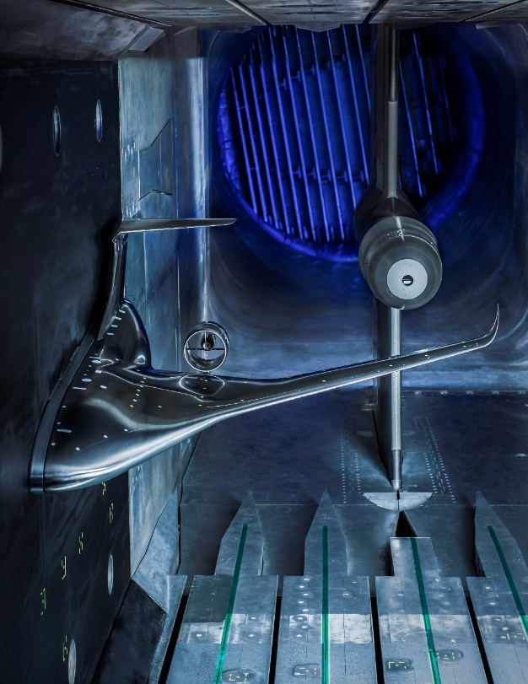
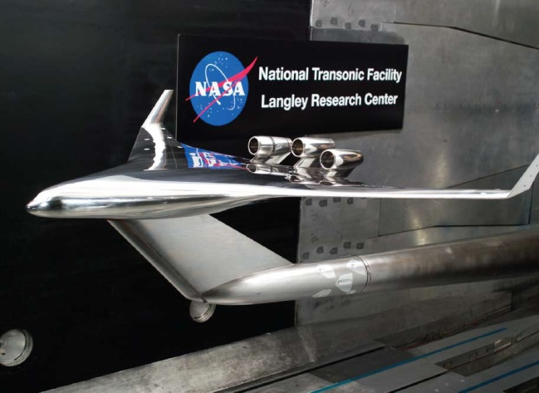
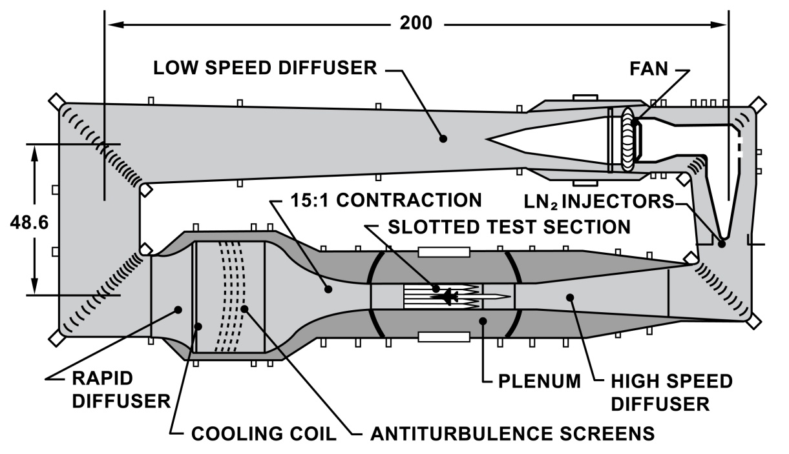
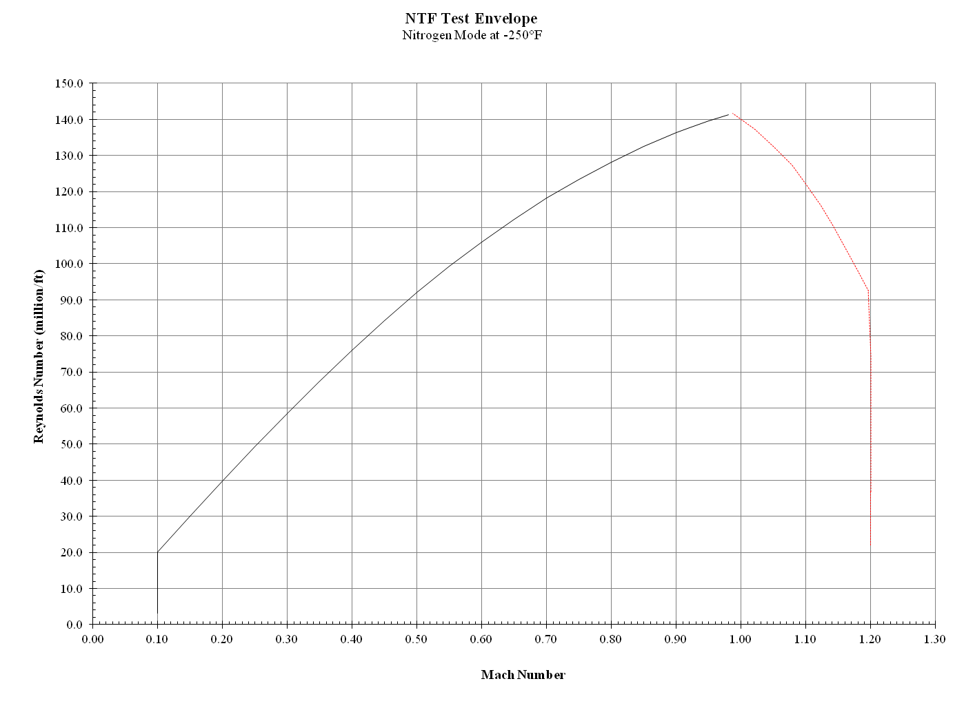
National Transonic Facility – NTF
38 Years of High Reynolds Number RDT&E
The Highest Reynolds Number Transonic Facility Operating in Air
The Highest Reynolds Number Transonic Facility Operating Cryogenically
Test Section | 8.2 x 8.2 x 25 Feet ( 2.5 x 2.5 x 7.6 meters)
Pressure | 14.7 to 133 psia; 1 to 9.0 atm.; 1.01 to 9.1 bar
 | Air Operations | N₂ Operations
Mach No. | 0.2 to 1.05 | 0.2 to 1.20
Reynolds No. Max | 20x10⁶ / ft (65x10⁶ / m) | 145x10⁶ / ft (475x10⁶ / m)
Temperature | 90° to 150°F (32° to 65°C) | -50° to -250°F (-45° to -157°C)
150
Q
6,000 PSF
140
-250°F
N₂
130
120
110
Q
5,500 PSF
-200°F
N₂
100
90
80
-150°F
N₂
Reynolds Number (Millions / Ft)
Q
5,000 PSF
70
60
Q
4,500 PSF
-50°F
N₂
50
40
+120°F
Mixed Mode
30
Q
2,900 PSF
20
+120°F
Air
10
0
0
0.1
0.2
0.3
0.4
0.5
0.6
0.7
0.8
0.9
1.0
1.1
1.2
1.3
Mach Number

Slide 3
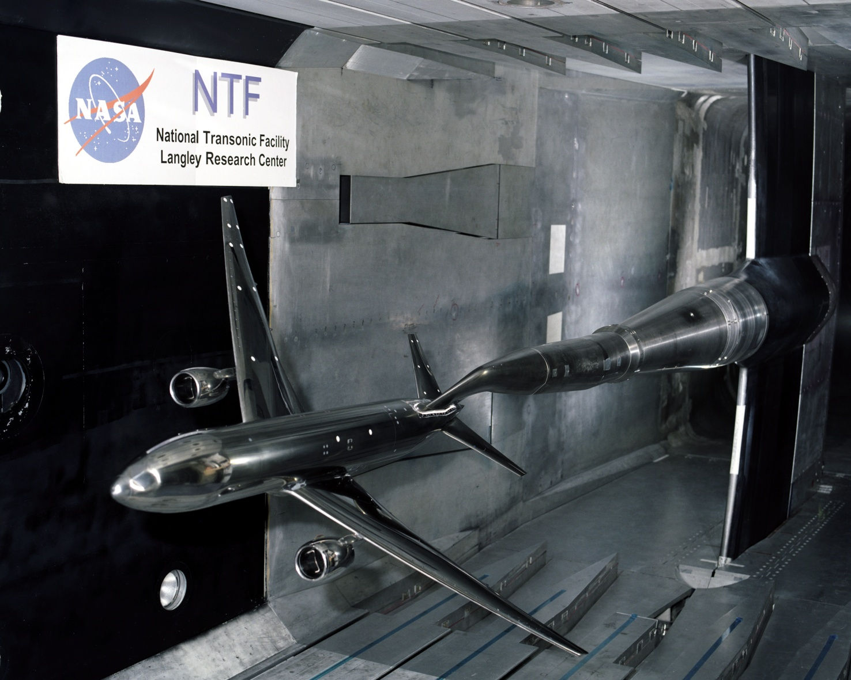
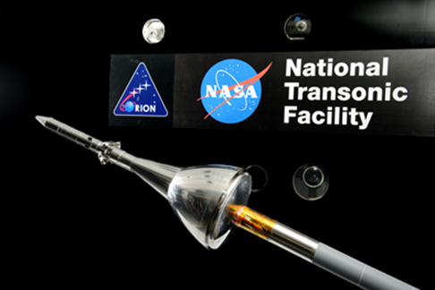
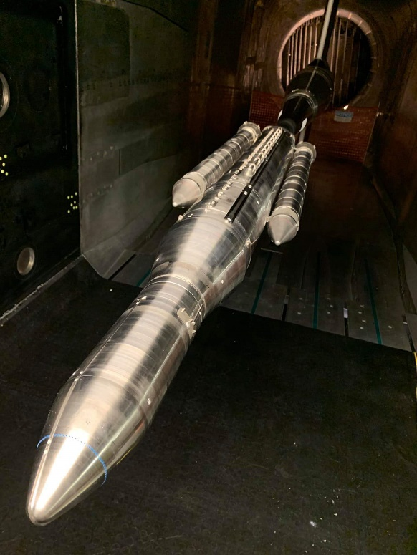
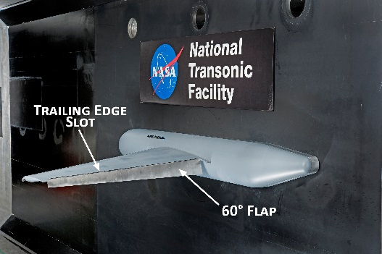
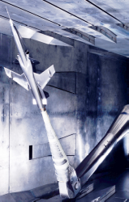
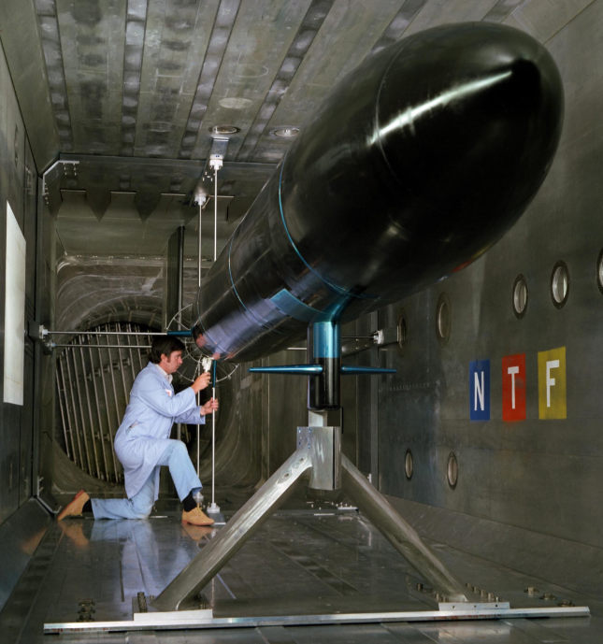
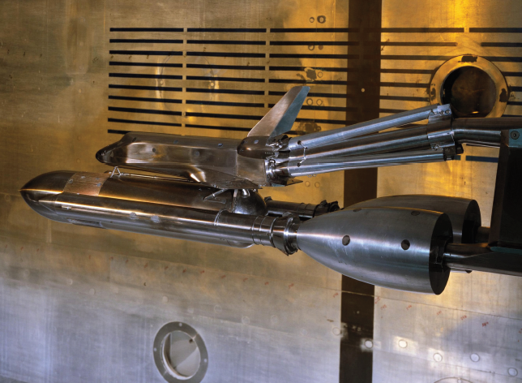
National Transonic Tunnel – NTF Test Types / Features
The National Transonic Facility provides testing to support studies of cruise performance, stability and control, stall buffet onset, and configuration aerodynamics validation for both full-span and half-span models at full scale flight Reynolds numbers
  Precision force and moment testing
  Static and dynamic pressure measurements
  Strain gauges, Accelerometers
  Model deformation / wing twist
  Pressure Sensitive Paint (PSP)
  Temperature Sensitive Paint (TSP)
  FLEET - Femtosecond Laser Electronic Excitation & Tagging
  Retro-reflective background-oriented Schlieren
  Mini-tufts

Slide 4
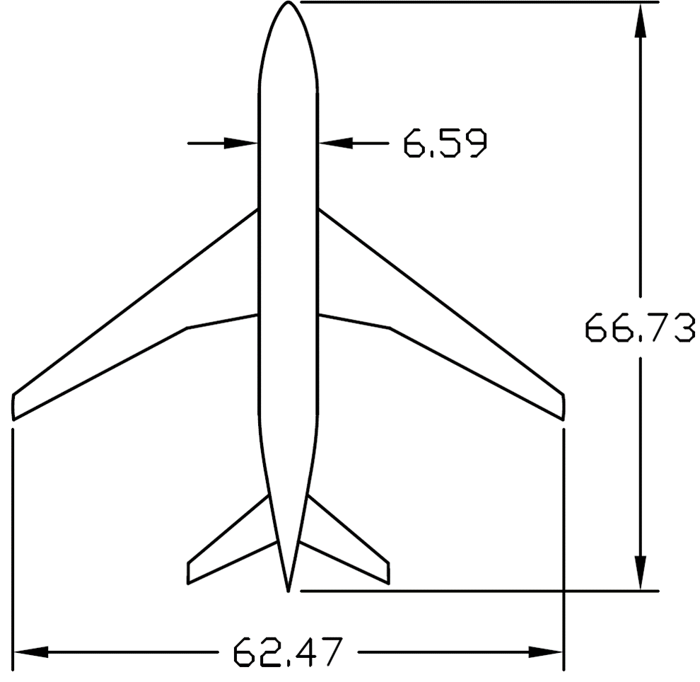
Common Research Model (CRM)
Modern & Relevant Geometry
  Discussions to design a model started in 2006 in an AIAA Technical Working Group
  The configuration would consist of a contemporary supercritical transonic wing and a fuselage that is representative of a wide-body commercial transport aircraft
Designed and fabricated circa 2008 / 2009 as an open geometry high-speed wing configuration to be used for CFD validation exercises as part of the AIAA CFD Drag Prediction Workshops #4 and #5
The CRM is designed for a cruise Mach number of M1 = 0.85 and a corresponding design lift coefficient of CL = 0.5
  Based on a Reynolds number of 40 million per reference chord
CRM is part of an ongoing international, collaborative effort
A NASA Technical Memorandum is being prepared to consolidate the CRM database
  Will contain all the data from all the wind tunnel tests thus far
  A website was created to obtain any wind tunnel / CFD data that has been released
Additional research being sought
  Model deformation
  Flow visualization data
  Aeroelasticity Workshop
  Other unique data that adds value to the overall CRM database
NTF CRM Model

Slide 5
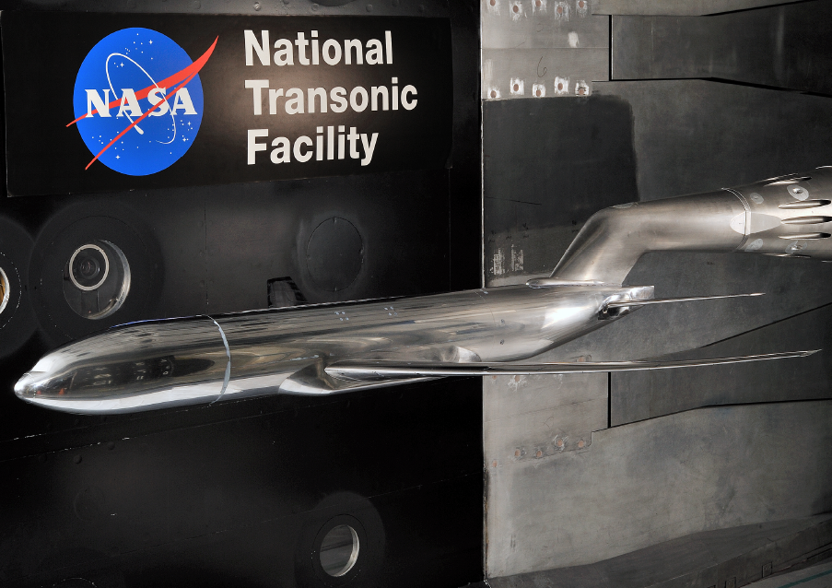
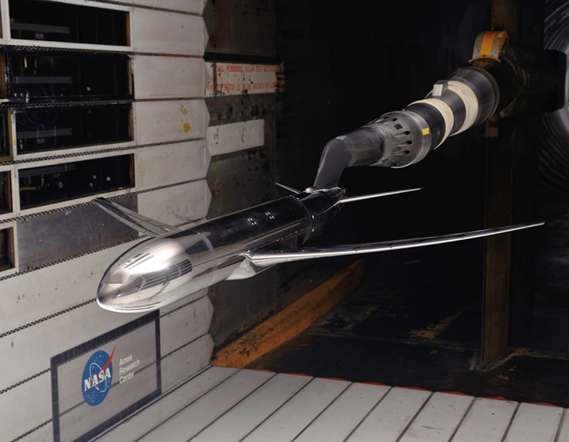
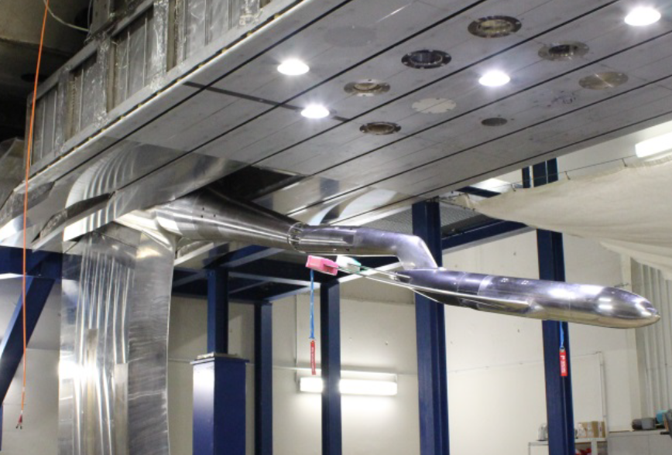
2.7% Scale CRM Installed in Several Tunnels
CRM IN LARC NTF
CRM IN ARC 11ft
CRM IN ETW
(Test Section Removed from Tunnel Circuit)

Slide 6
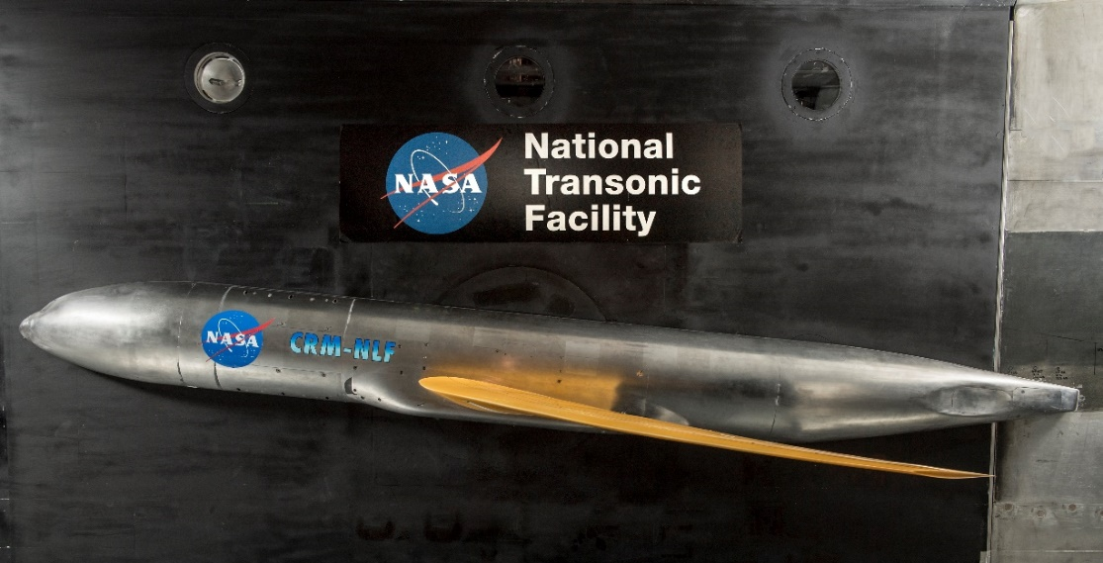
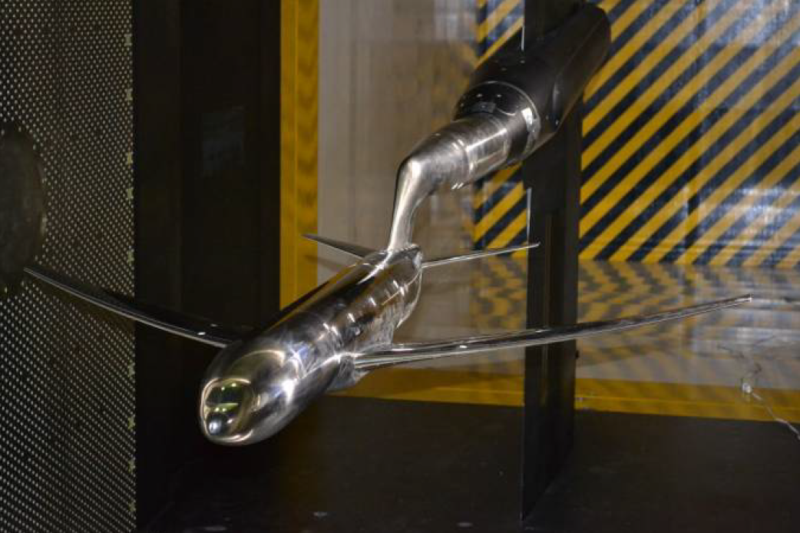
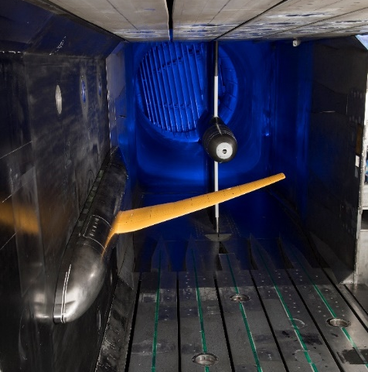
Other CRM Versions
2.2% CRM in JAXA JTWT
5.2% SCALE SEMISPAN CRM (NLF) IN NTF
5.9% SCALE CRM in ONERA S1MA
10% SCALE CRM (HIGH LIFT) SEMISPAN IN 14x22

Slide 7
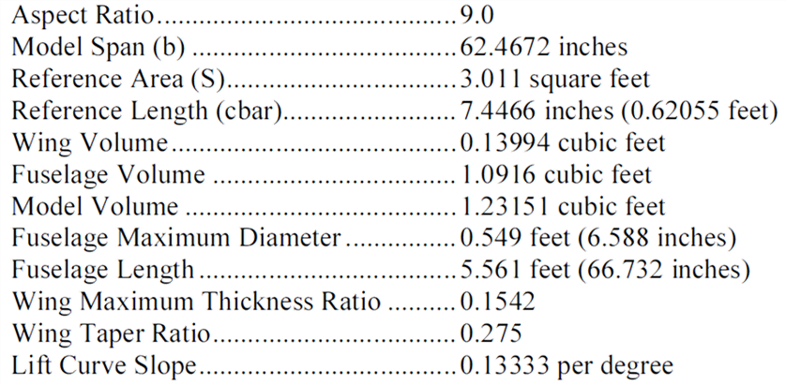
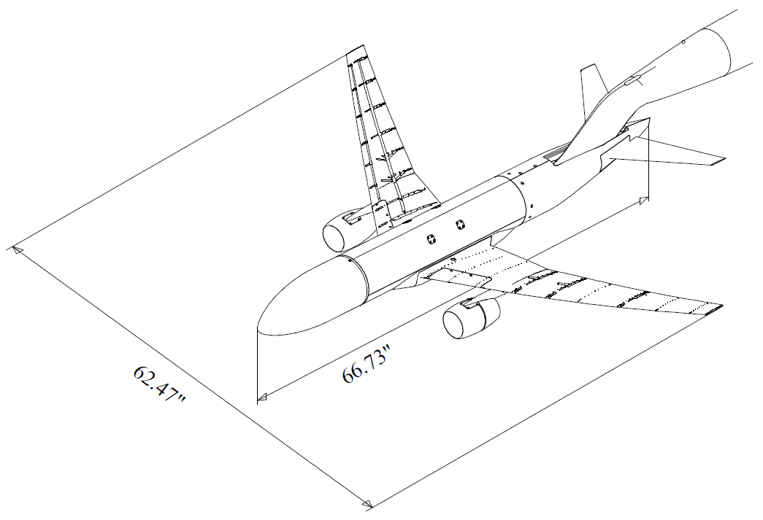
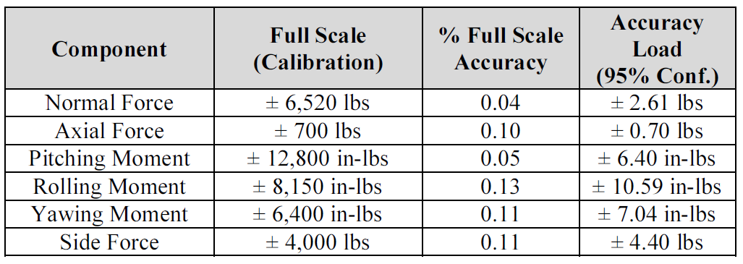
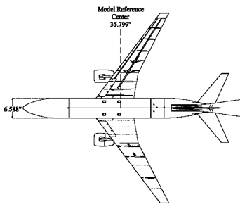
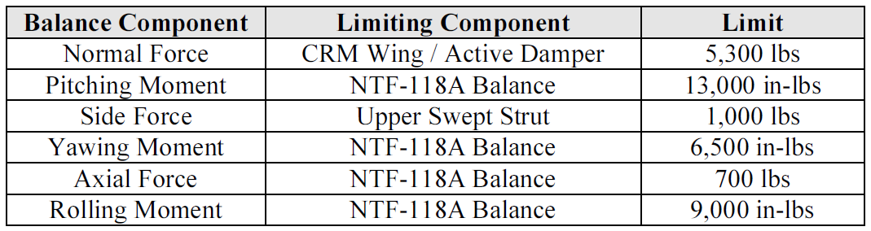
CRM REFERENCE DATA (2.7% SCALE)
NTF Typical Test
  Max Q (Dynamic Pressure) up to 2,150psf
  RN from 8M to 48M/ft
NTF-118 BALANCE
Instrumentation
  NTF 6-component main balance
  291 Wing pressures at 9 span-wise stations
  Wing root strain gages

Slide 8
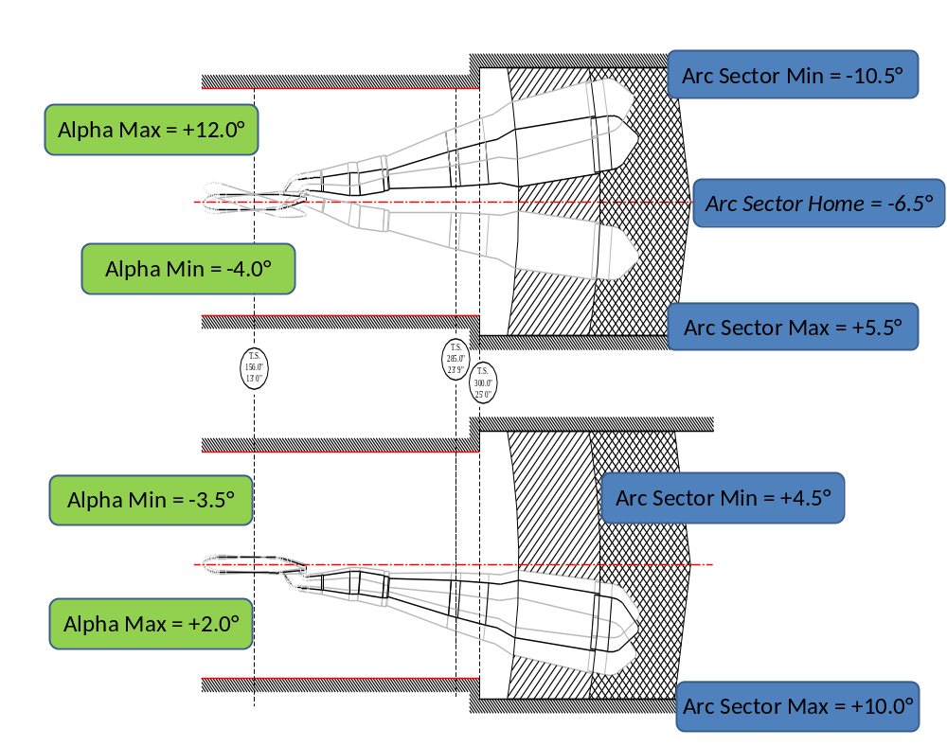
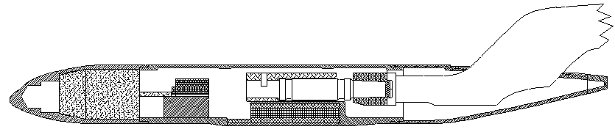
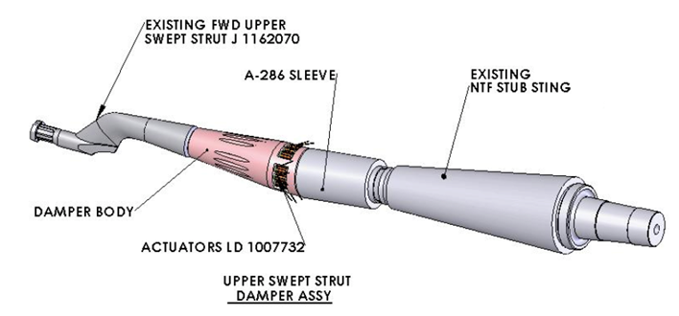
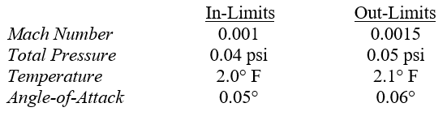
Typical NTF CRM Installation

Slide 9
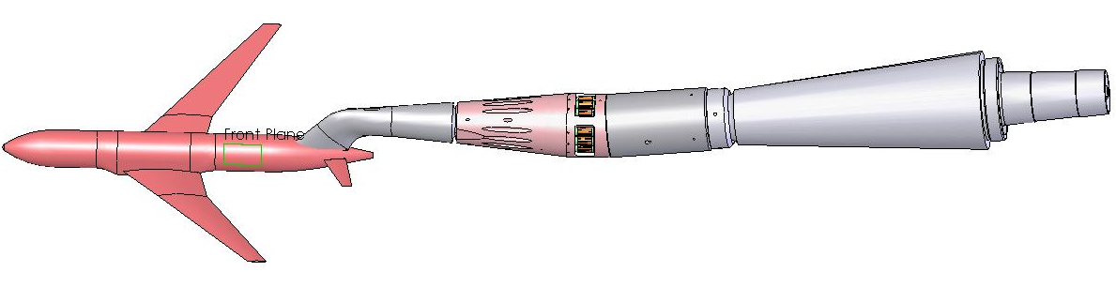
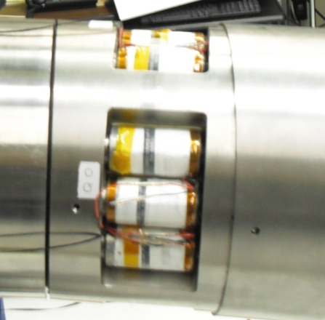
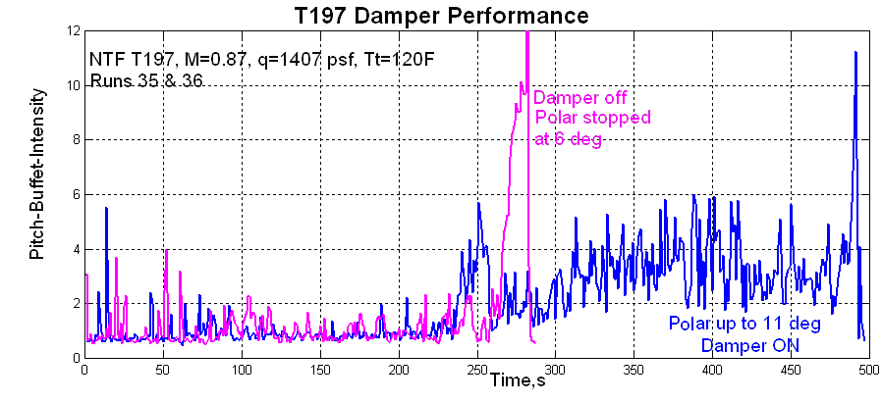
NTF Active Dynamic Damper
A model dynamics damping system has been developed
  Consists of twelve (12) 11,000-lb (48,930-N) piezoceramic actuators
  Orthogonally placed 4 groups of 3 actuators each driven by wide-band drive amplifiers
The system was successfully tested January 2010 using the NTF Common Research Model
  Damper OFF : Max AoA was ~6°
  Damper ON: Max AoA was ~12°
Increased AoA envelope available

Slide 10
Common Research Model Typical Collaboration Arrangements
A Space Act Agreement must be created for the test arrangement / model utilization
  NASA CRM testing at a non-NASA facility is on a no-cost basis to NASA
  NASA will support the test with labor, travel, shipping at NASA cost
Modifications to the NASA CRM are not allowed
  Model users can design and build new parts that attach to existing interfaces
  NASA must provide concurrence on how any new components interface with the NASA CRM
  Any new parts must not alter model component load capacities / current capability in any way
Test Facility must ensure flow quality (cleanliness) does not degrade the CRM surface finish in any way
  CRM surface finish specification is 8 micro-inches RMS or better on all flow surfaces
NASA considers the CRM data of value when the model user adds value to the database
  Facility to facility comparison
  A new or novel test / measurement technique
  Data not previously obtained for the database
  NASA must provide concurrence on the conditions for adding to the CRM database
A joint public publication (AIAA for example) after test completion would be required
  It does not have to include all data acquired, but should include something new for the CRM database
AIAA Refs: AIAA-2008-6919-dpw-crm-vassberg; AIAA 2018-JoA-Retrospective-CRM-WahlsRiversVassbergDeHaan-1.c034906

Slide 11
Some Database Expansion Ideas
Lateral directional data
  Wings horizontal data at constant AoA using the Double Roll Mechanism
Pause vs Sweep data
  Pitch
  Yaw
Comparison of test section / boundary layer control techniques
  Calspan has a perforated test section (22.5% porosity perpendicular holes) with active boundary layer removal (plenum evacuation system) for MN=0.6 and above
  NTF has a slotted (6% openness) passive boundary layer system
  Ames 11ft and ETW are also slotted
Low Reynolds Number data
  Calspan can’t test at typical minimum RN tested at the NTF (8M per foot)
Other ideas?

Slide 12
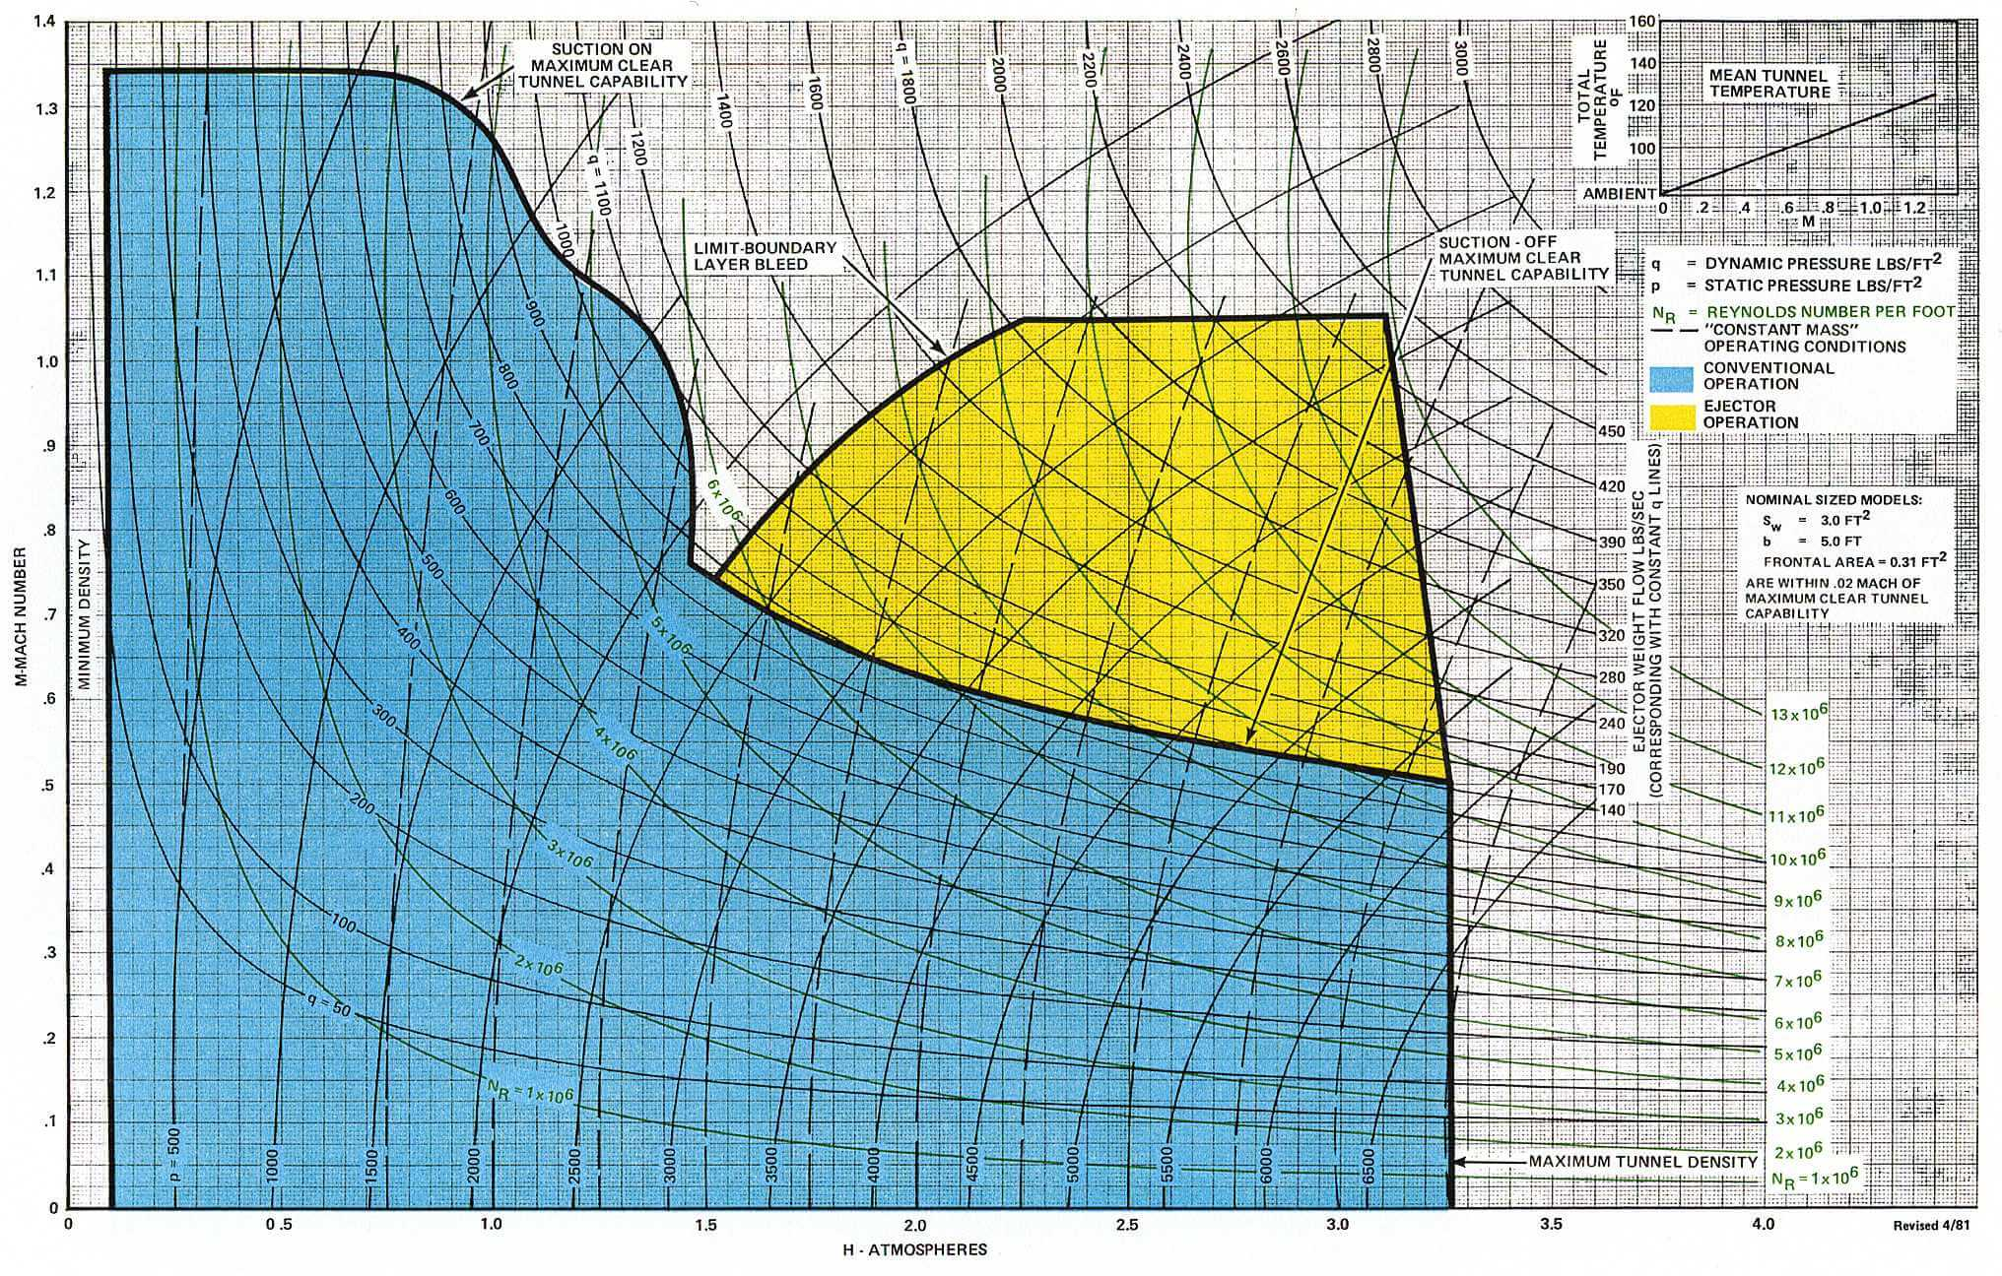
CRM Test Conditions
NASA
Calspan
CRM Cruise MN
RN=3.5 M / FT
P = 1 ATM
RN=8M / FT

Slide 13
One More Idea
AETC Face To Face (F2F) Meetings
The AETC holds quarterly F2F for the direct AETC staff
  Each quarter is held at the different NASA (AETC) centers (Ames, Glenn, Langley)
  The “4^{th”} quarter is held at a non-AETC center or another non-NASA location
  Meetings are typically two to three days in duration with 20 to 30 participants
  Presentations include report outs from each of the centers as well as any ongoing project updates
Would Calspan & CUBRC be open to allowing AETC to have a F2F meeting in Buffalo?
  Meeting could either be held at Calspan or off site in the Buffalo area
  Calspan & CUBRC could participate in the non-sensitive presentations
Potential Calspan & CUBRC Tours
  Transonic Wind Tunnel
  TIRF
  HyGe Sled
  Crash
  Flight Research
  LENS
Potential timeframe late CY21 or early CY22

Slide 14
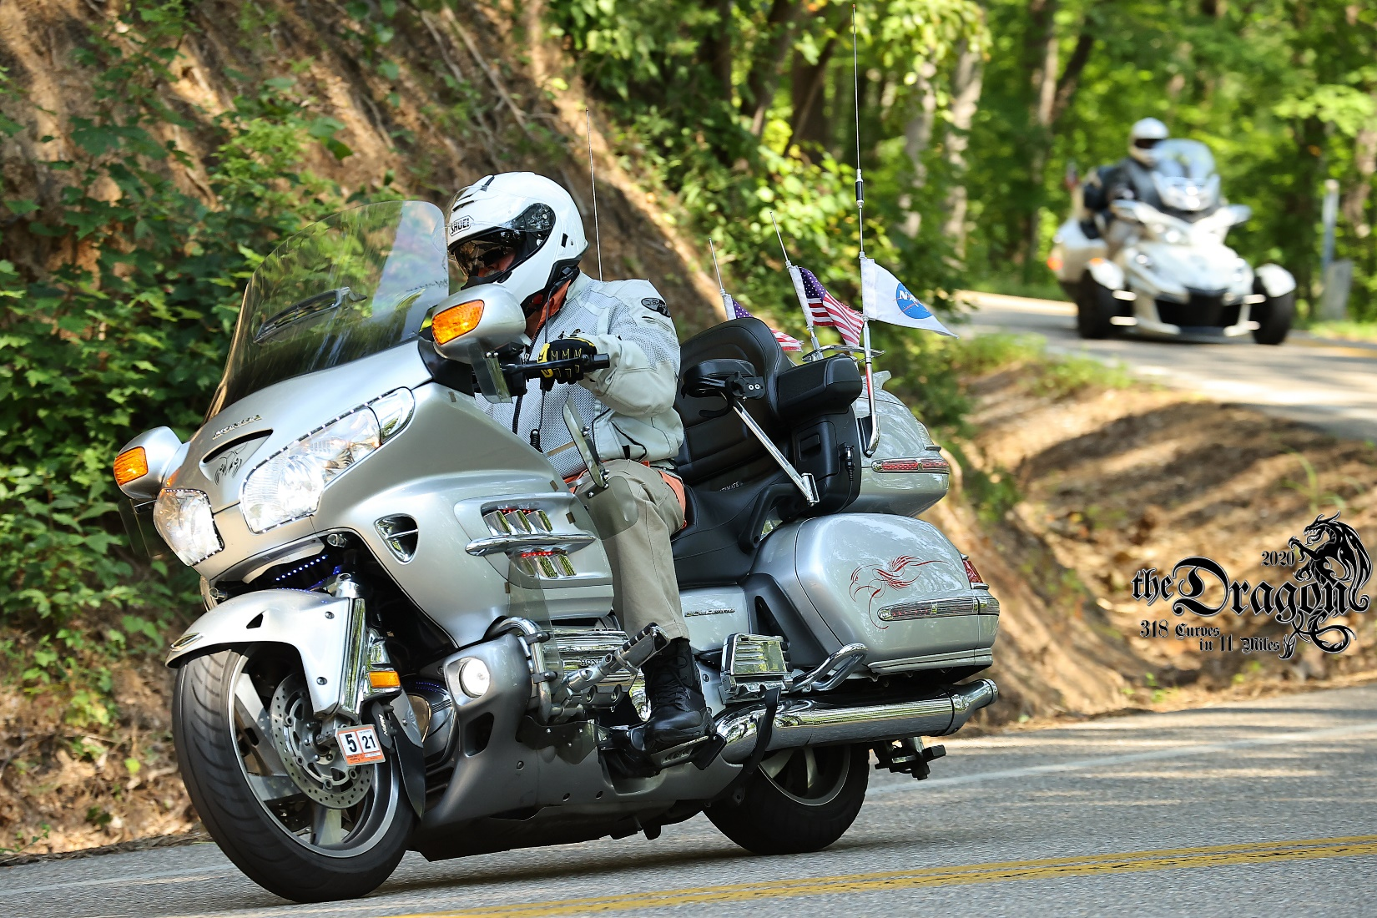

Any Questions?

