Slide 1
SpaceOps-2021,8,x1355
Application of Variable Data Rate (VDR) Towards Channel Optimization
Howard Garon, Victor Sank, Frank Stocklin, Nancy Huynh, Obadiah Kegege
NASA Goddard Space Flight Center, 8800 Greenbelt Road, Greenbelt, Maryland, 20771, USA. howard.garon@nasa.gov
16th International Conference on Space Operations, 3 - 5 May 2021.

Slide 2
Variable Data Rate (VDR) Demonstration
The Spacecraft:
A Pass Profile is currently uploaded to spacecraft, sometimes as much as a week in advance. Profiles are commonly loaded every week, even when the payload transmitter only works at a single rate. The spacecraft still needs to be told when to turn ON its transmitter, what areas of the recorder to dump, and how to point its antenna if it is not an omni.
The Pass Profile functions are based on the on board clock which is typically within about 10 ms of UTC, better if the spacecraft has a GPS receiver.
When the Flight Software and C&DH computer set up for the pass, they would set the initial data rate, and at some later preprogrammed time would make the data rate changes.

Slide 3
Variable Data Rate (VDR) Demonstration
The Ground Station:
When planning a pass, mission operators also need to inform the ground station of the time for acquisition of signal (AOS), the time for loss of signal (LOS), the data rate, the coding, and other parameters.
For a satellite with fixed data rate and fixed coding, not all of the information needs to be sent for each pass, but AOS and LOS still does. Some ground station set up is always needed.
Just as with the spacecraft, the ground station Pass Profile functions are based on UTC time. The station clock is typically within 1 ms of UTC. The same data rate schedule that is sent to the spacecraft would be sent to the ground station.
If the spacecraft already can be commanded to multiple data rates, no additional hardware is required for either the spacecraft or the ground to implement VDR. It may require software revisions but, as discussed in the spacecraft viewgraph, much of this has already been programmed for command/control of the spacecraft. The additional commands can be added to any spacecraft’s scheduler as required.

Slide 4
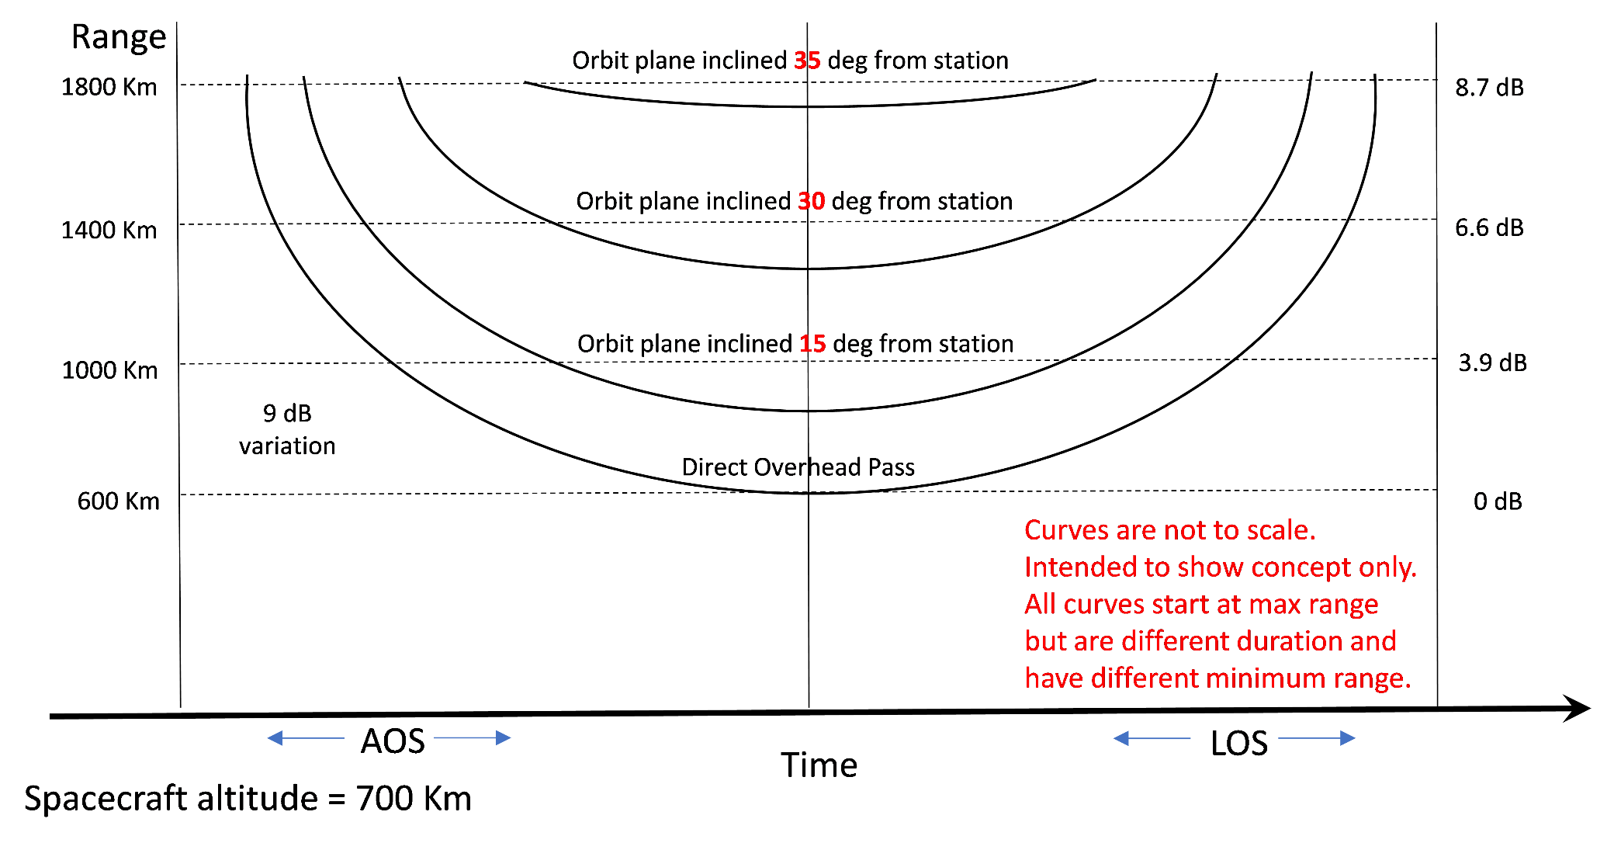
Variable Data Rate (VDR) Demonstration
Required Eb/No as a Function of Orbital Plane Inclination and Slant Range

Slide 5
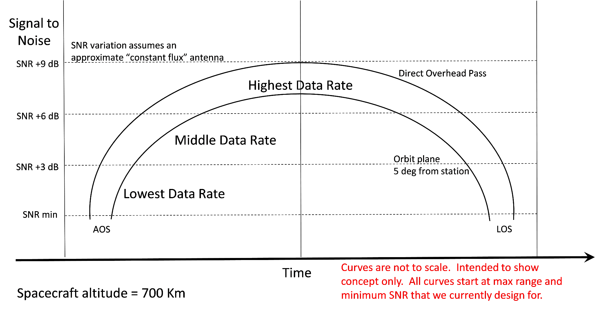
Variable Data Rate (VDR) Demonstration
SNR as a Function of Slant Range and Data Rate

Slide 6
Data Volume Variation During a LEO Pass
The next slide involves Orbit geometry. It is broken into 3 parameters:
(1) Data Rate, (2) Pass Time and (3) Data Rate increase factor (f = 1, 2, 4, …).
where “Data Rate = R” is the lowest rate used at AOS.
The total Data volume depends on the actual Data Rate but since we are
interested in the improvement gained by using variable data rates, the
nominal Data Rate is divided out so we can present the relative improvement which is
then in units of Effective seconds.
As an example, a direct overhead pass of 10 minutes (600 seconds) at a
single data rate would result in a data volume of
Total Data = R x Pass Time .
When the data rate increases during the pass, this would technically be an
Integral, i.e.,
Total Data = ∫ R x factor dt = R ∫ factor dt .
The Y axis is the Effective Pass Time = (Total Data/R) = ∫ factor dt
For the single Data Rate case = 600 seconds. See where and end up on next slide.

Slide 7
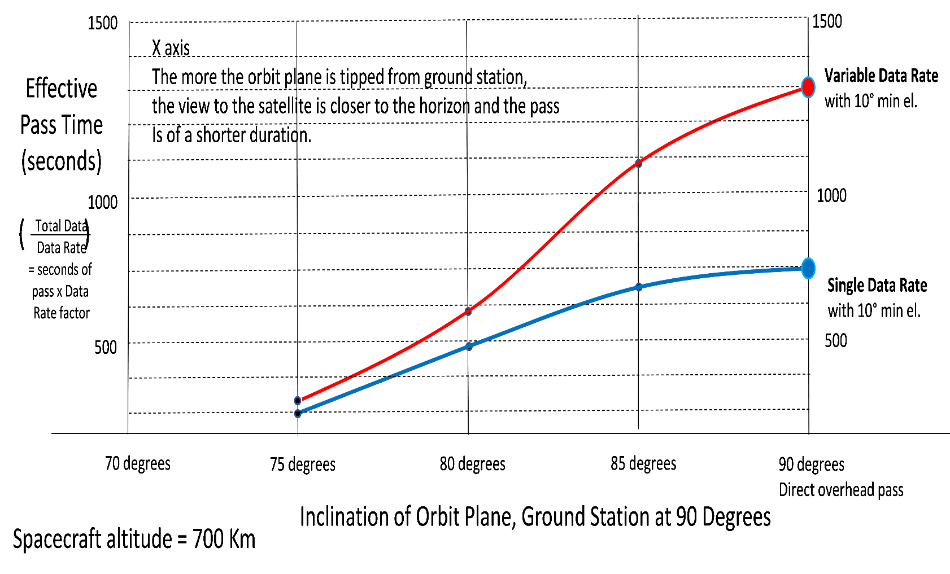
Data Volume Variation During a LEO Pass
We can accumulate almost twice as much data to the ground compared to a commonly designed link that uses a single data rate at maximum range (i.e., acquisition at smallest antenna elevation).

Slide 8
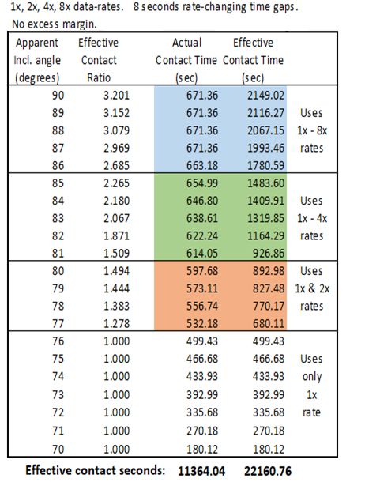
VDR Demonstration
When averaged over multiple passes for a typical sun-synchronous polar orbit at 700km, VDR could offer nearly twice the throughput when compared to using only a single (1x) downlink data rate.
Average contact ratio improves by a factor of 1.95

Slide 9
VDR Demonstration
1x, 2x, 4x, 8x data rates starting with 100 Mbps. Modulation is invariant at OQPSK (Mbps = Msps). Codec is LDPC 7/8 fixed.
You will see a total of 6 data rate transitions from AOS through LOS. The demonstration is designed to show how smooth the data rate transitions occur, even at relatively high data rates.
The equipment used for the demo consists of a ten year old Safran/Zodiac (Cortex) HDR-XXL and a specAn of similar vintage. The test modulator and demodulator of the Cortex are controlled by a multi-thread PC program written in C++. The output of the test modulator of the Cortex is tied directly to the Cortex receiver input at the 1.2GHz IF. The Cortex test modulator is set up to add AWGN noise to its output.
Actual operations will not require the multi-thread PC program written in C++. Existing ground station software will control the ground receivers, just as it now does to set up the pass.

Slide 10
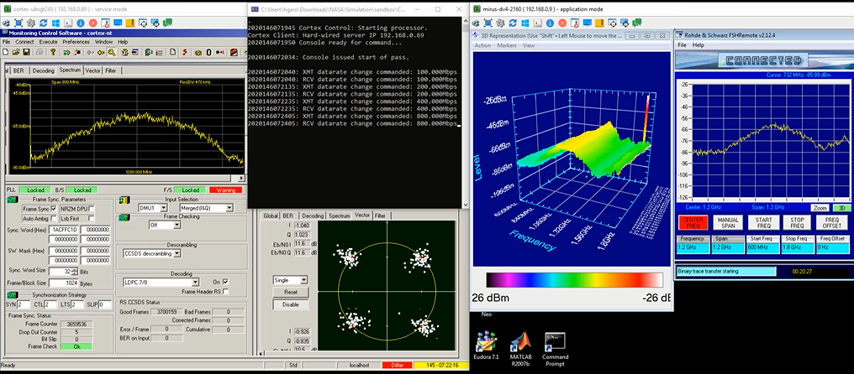
Orientation to Demo Video…
Safran/Zodiac/Cortex HDR-XXL
Command Console
R&S FSH-18 Spectrum Analyzer
Waterfall Display 2D Spectral Display
Good frames
Dropouts

