Slide 1
SpaceOps-2021,8,x1376
Gbps High Speed Antenna Arraying for Ground-Based Network
Howard Garon, Obadiah Kegege, David Caruth, Victor Sank, Frank Stocklin, Brent Andres, Nancy Huynh
NASA Goddard Space Flight Center, 8800 Greenbelt Road, Greenbelt, Maryland, 20771, USA. howard.garon@nasa.gov
16th International Conference on Space Operations, 3 - 5 May 2021.

Slide 2
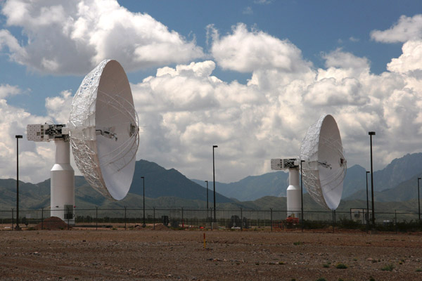
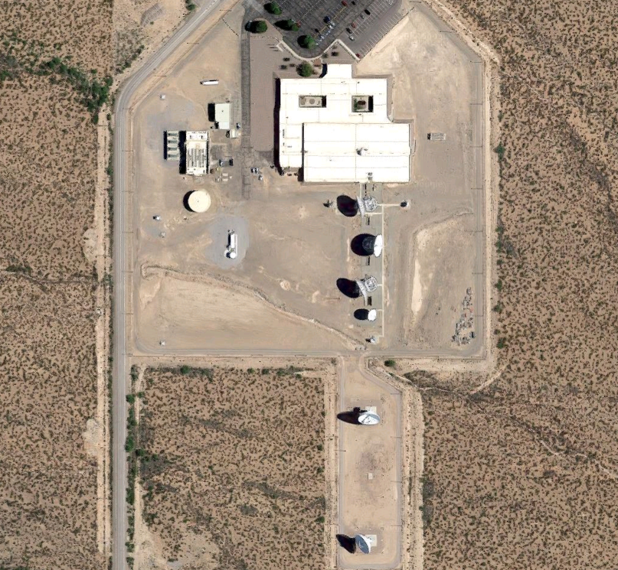
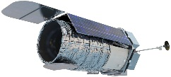
Overview
  Combine multiple signal inputs to improve gain performance at data rates up to, and beyond, 600 Mbps
    Provide the Near Space Network (NSN) with a critical capability for supporting high data volume cis-lunar missions, Roman Mission
    Greatly expand the Roman Mission science collection capability by providing complimentary ground infrastructure
Antenna 2
Ka-band Signal
Down Conversion
Antenna 1 (WS1)
Down Conversion
Intermediate Frequency
High Data Rate Signal Combiner (HDRSC) *
High Data Rate Receiver
Spacecraft Telemetry
*High Data Rate Signal Combiner (HDRSC) technology developed (orange box)

Slide 3
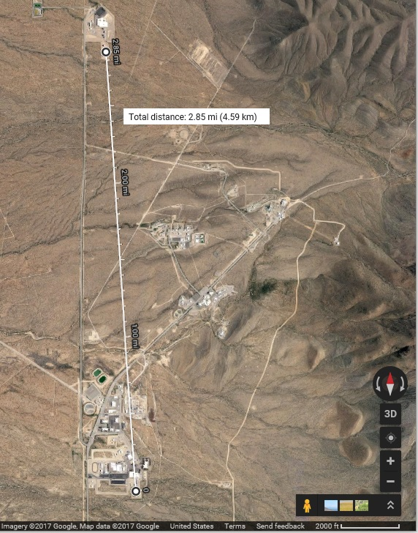
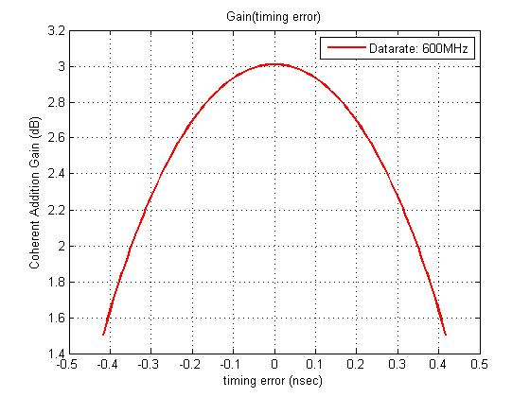

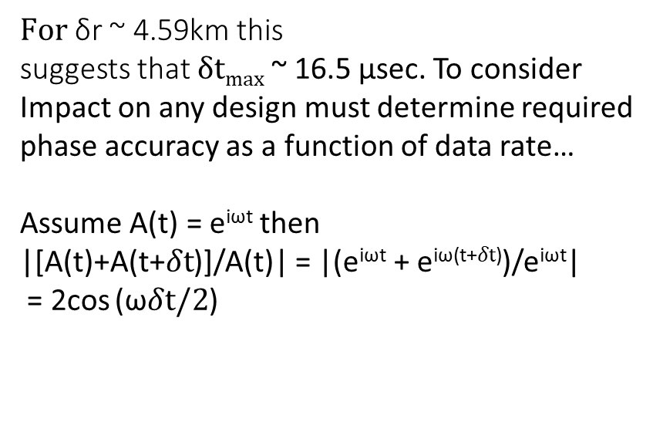
Arraying Objective
$δtmax=$δr/c
White Sands (WSGT and STGT)
$For$δr ~ 4.59km this
suggests that $δtmax$ ~ 16.5 μsec. To consider
Impact on any design must determine required
phase accuracy as a function of data rate…
Assume A(t) = e^{iωt} then
|[A(t)+A(t+$δt$)]/A(t)| = |(e^{iωt} + e^{iω(t+}$δt$⁾)/e^{iωt}|
= 2cos (ω$δt/2$)
Antenna 2
Antenna 1

Slide 4
Roman Mission 18-m Ka-band Downlink Margin Summary
Link ID | Description | Information Rate | Margin (Notes 1 & 2)
1A | Ka-band Downlink via NSN 18-m WS1 At 10° Elevation Angle and 95% Rain Availability | 293.1 Mbps | 1.0 dB
1B | Ka-band Downlink via NSN 18-m WS1 At 20° Elevation Angle and 95% Rain Availability | 451.9 Mbps | 1.0 dB
2A | Ka-band Downlink via NSN Upgraded 18-m Antennas at White Sands (with a New 50° K LNA) At 10° Elevation Angle and 95% Rain Availability | 422.7 Mbps | 1.0 dB
2B | Ka-band Downlink via NSN Upgraded 18-m Antennas at White Sands (with a New 50° K LNA) At 20° Elevation Angle and 95% Rain Availability | 801.7 Mbps | 1.0 dB
3A | Ka-band Downlink via NSN Arraying Two 18-m Antennas at White Sands At 10° Elevation Angle and 95% Rain Availability | 584.8 Mbps | 1.0 dB
3B | Ka-band Downlink via NSN Arraying Two 18-m Antennas at White Sands At 20° Elevation Angle and 95% Rain Availability | 801.6 Mbps | 1.0 dB
4A | Ka-band Downlink via NSN Arraying Two Upgraded 18-m Antennas at White Sands (with a New 50° K LNA) At 10° Elevation Angle and 95% Rain Availability | 751.6 Mbps | 1.0 dB
4B | Ka-band Downlink via NSN Arraying Two Upgraded 18-m Antennas at White Sands (with a New 50° K LNA) At 20° Elevation Angle and 95% Rain Availability | 1.41 Gbps | 1.0 dB
Notes: Modulation = OQPSK, Coding = Rate 7/8 LDPC, Roman Mission EIRP = 66.4 dBW The Ka-band downlink margin was calculated at BER of 10⁻⁸ at the output of the rate 7/8 LDPC decoder. Margin is relative to required BER for each scenario and does NOT include any required performance margin.

Slide 5
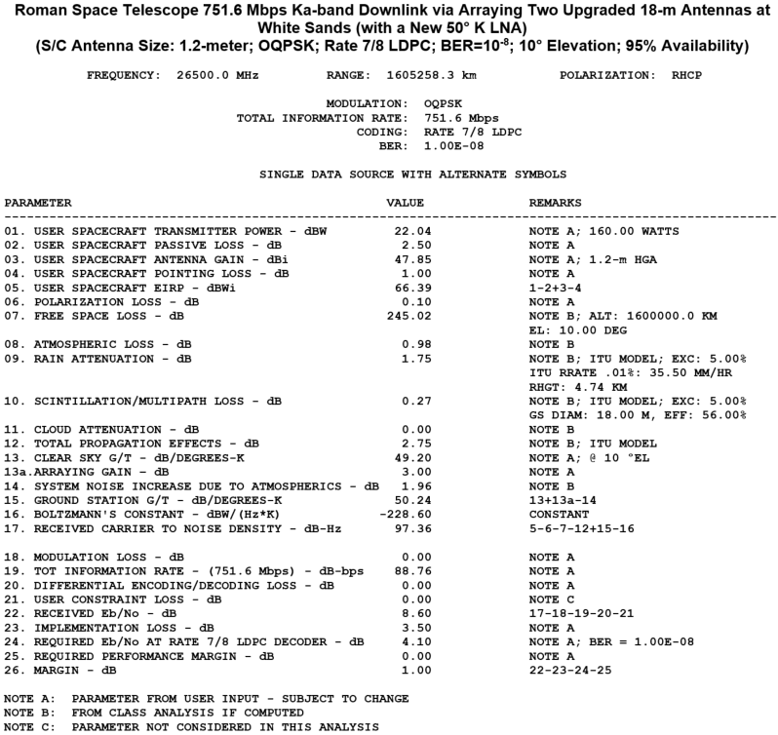
Roman Mission Link Calculation with Arraying

Slide 6
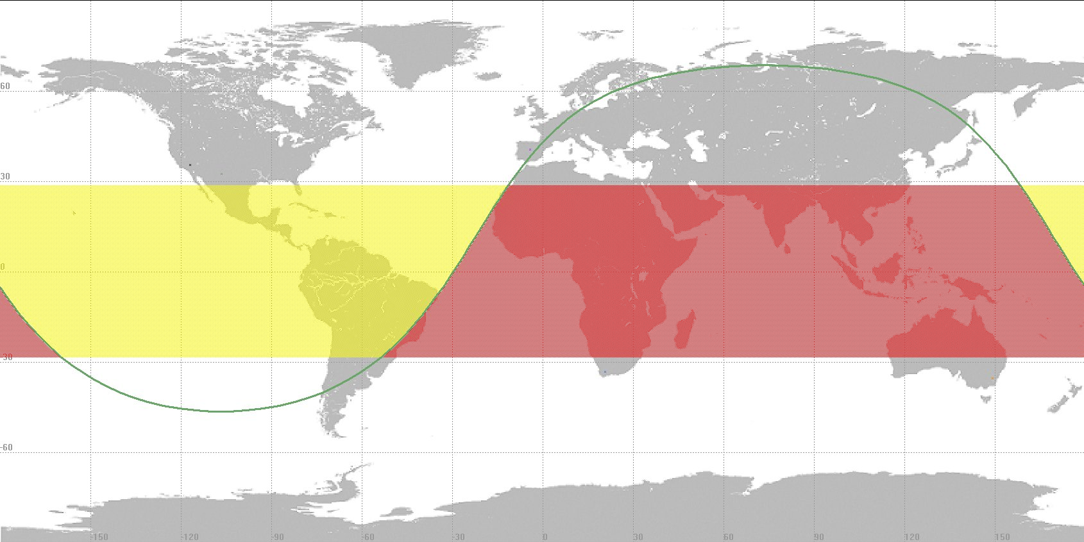

Mid-latitude/HEO Support Including Roman Mission
NSN WS1 Coverage Summary
WS1 will have daily coverage of Roman Mission throughout the year ranging from ~8 to ~16 hours per day based on time of the year
Coverage will be ~16 hour per day when Roman Mission is in the Northern part of its Orbit
White Sands
Roman Mission
Orbit Direction

Slide 7
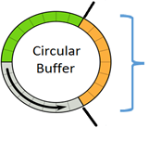

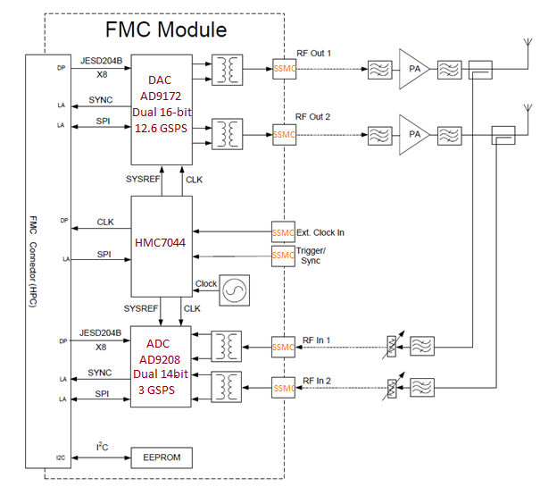




HDRSC Design
FPGA
High Data Rate Signal Combiner (HDRSC) *
RF Input 1
Sequence
f(n)
Each circular buffer:
2x64kx16bits deep
JESD204B
JESD204B
Cross correlation:
(f●g)[τ] ≈∑f*[n]g[n+ τ]
τ
ADC
14-bit ADC (3 GSPS)
JESD204B
JESD204B
RF Input 2
DAC
16-bit DAC (12.6 GSPS)
Sequence
g (n)
JESD204B
JESD204B
ADC
14-bit ADC (3 GSPS)

Slide 8
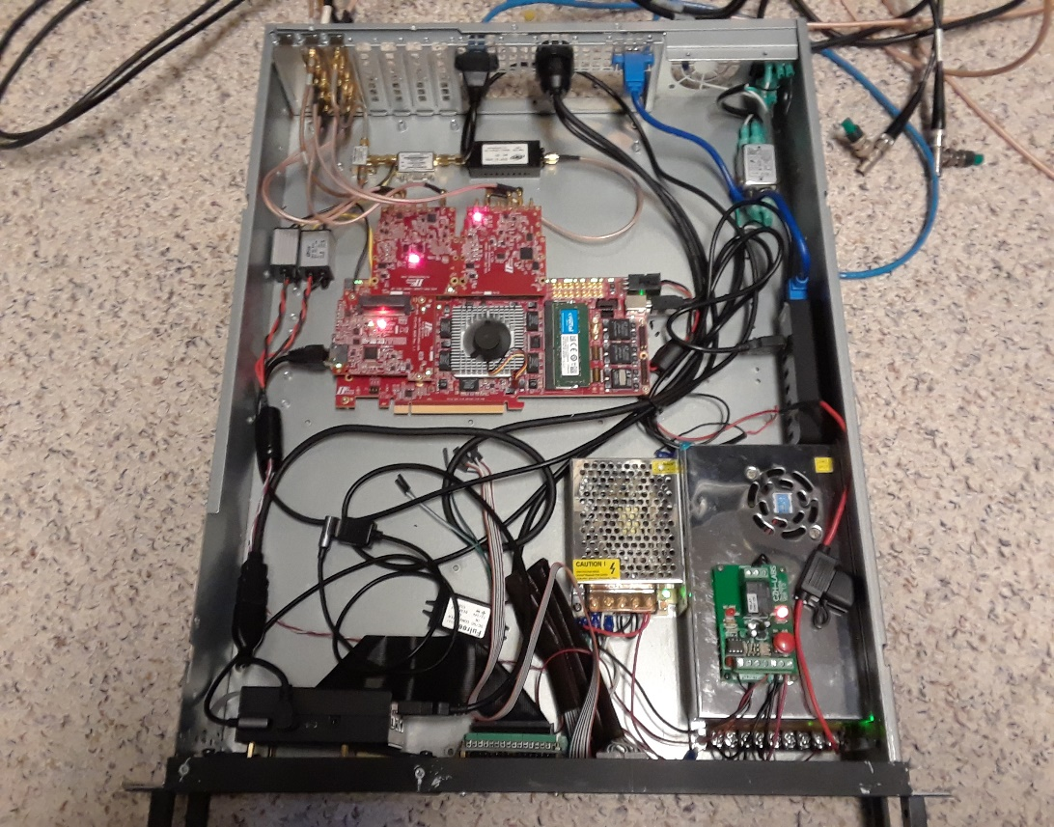
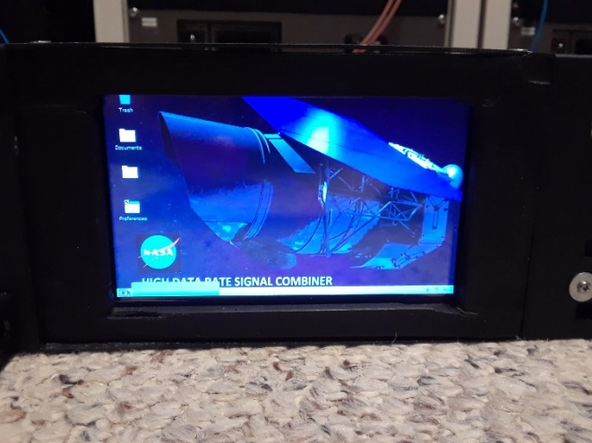
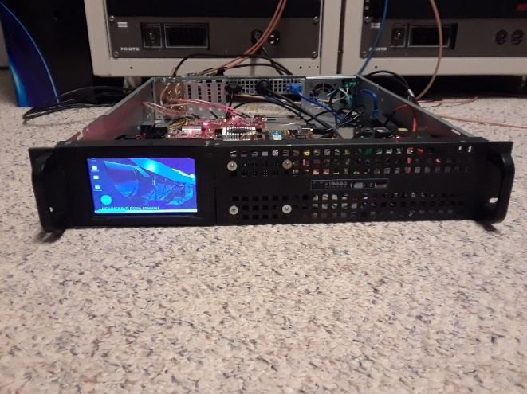
HDRSC Ver. 3 Design
(Stand-alone HDRSC)

Slide 9

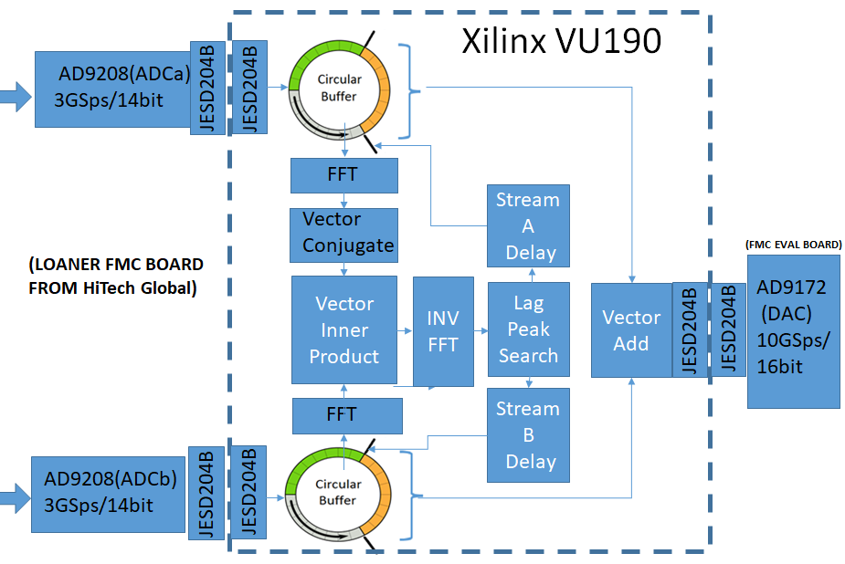
End-to End Testing to Replicate In-situ 1/3
High Data Rate Signal Combiner (HDRSC)
Digital Dual Channel mPSK Generator
Independent (uncorrelated) channel noise
2.4GHz carrier
LDPC 7/8
CCSDS Randomizer
1 Gbps datarate
Upconvert
to Ka-band
Downconvert
from Ka-band
To 2.4GHz IF
2.4GHz
IF
RFoF
TX
w/
3GHz BW
RFoF
RX
w/
3GHz BW
2.4GHz
IF
Ka-band
1km OTDR launch cable
Zodiac Bolt+
HDR-XXL
Receiver
2.4GHz
IF
Upconvert
to Ka-band
Downconvert
from Ka-band
To 2.4GHz IF
2.4GHz
IF
RFoF
TX
w/
3GHz BW
RFoF
RX
w/
3GHz BW
2.4GHz
IF
Ka-band
1km OTDR launch cable
Retuned to accommodate 2nd Nyquist reverse image

Slide 10
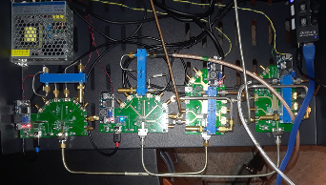
End-to End Testing to Replicate In-situ 2/3
Ka-band Down-converters
Outputs to RFoF (or directly to Safran/Zodiac HDR-XXL)
Inputs from antennas (either digital sources or Safran/Zodiac HDR-XXL)
Complete Phase III Test Chassis:
Ka-band Up-/Down-Converters
Ka-band Up-converters

Slide 11
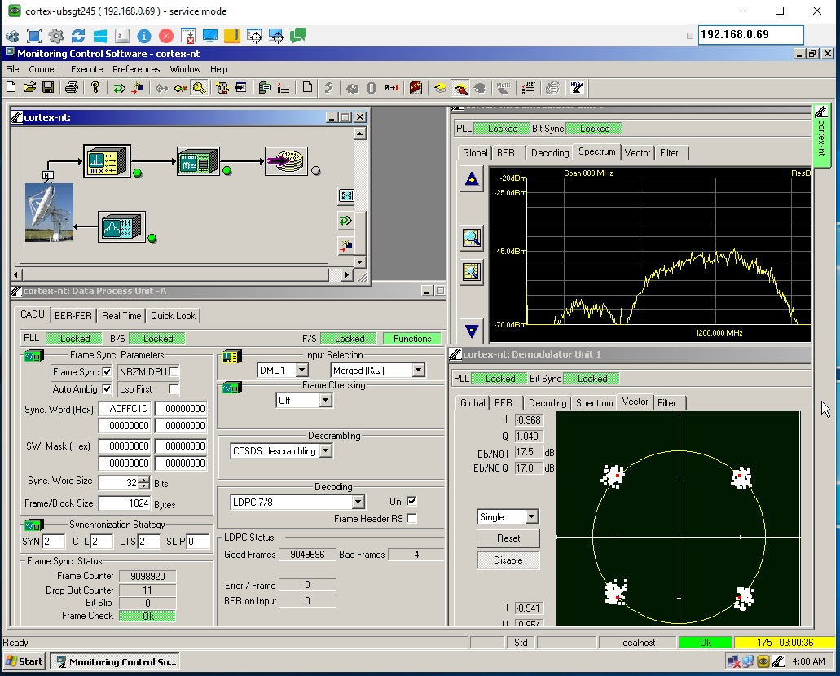
End-to End Testing to Replicate In-situ 3/3
Single channel performance test:
Zodiac Bolt+
HDR-XXL
Test
Modulator
Upconvert 6GHz IF
to Ka-band
Downconvert
from Ka-band
To 6GHz IF
Zodiac Bolt+
HDR-XXL
Receiver
IF
IF
RFoF
TX
w/
3GHz BW
RFoF
RX
w/
3GHz BW
IF
Ka-band
1km OTDR launch cable

Slide 12
Summary
Capability to coherently combine two antenna signals for modulation data rates up to (and beyond) 600Mbps. We specifically chose a case critical to Roman Mission where spacecraft is at antenna elevation 10° relative to ground station. Link budget indicates negative margin for single antenna. Here’s what you should understand from the first part of the demo…
    Basic demo source signal parameters: 2.4Ghz IF, 600Msymbols/sec, OQPSK modulated, LDPC 7/8 encoded with CCSDS randomization
    Automatic - Requires no prior operator setup – just point antennas and go.
    Super fast response (<140ms) for AOS as well as for extending LOS.
    Digital modulation mode agnostic (PSK, FSK, ASK, QAM)
    Spread spectrum agnostic (DSSS, CSS, FHSS)
    Fail safe. If either antenna drops the unit automatically reverts to remaining operational antenna.

