Slide 1
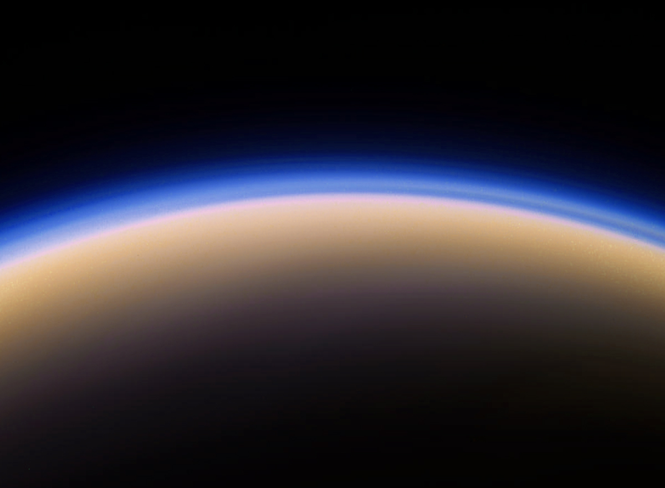

The Search for New Molecular Species in the Atmosphere of Titan
A. E. Thelen
A. E. Thelen¹, C. Nixon¹
M. Cordiner¹ , V. Vuitton², S. Charnley¹ , N. A. Teanby³, P. G. J. Irwin⁴, Z. Kisiel⁵, M. Y. Palmer⁶, E. M. Molter⁷, J. Serigano⁸, Y.-J. Kuan⁹
¹NASA Goddard Space Flight Center, ²Université Grenoble Alpes, ³University of Bristol, ⁴University of Oxford, ⁵Polish Academy of Sciences, ⁶University of Arizona, ⁷University of California, Berkeley, ⁸Johns Hopkins University, ⁹National Taiwan Normal University
American Chemical Society, Spring Meeting
04/08/2021

Slide 3
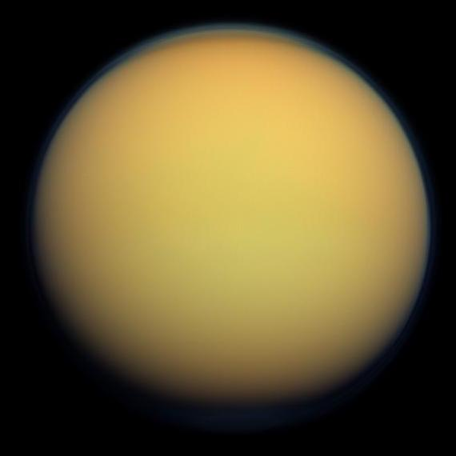
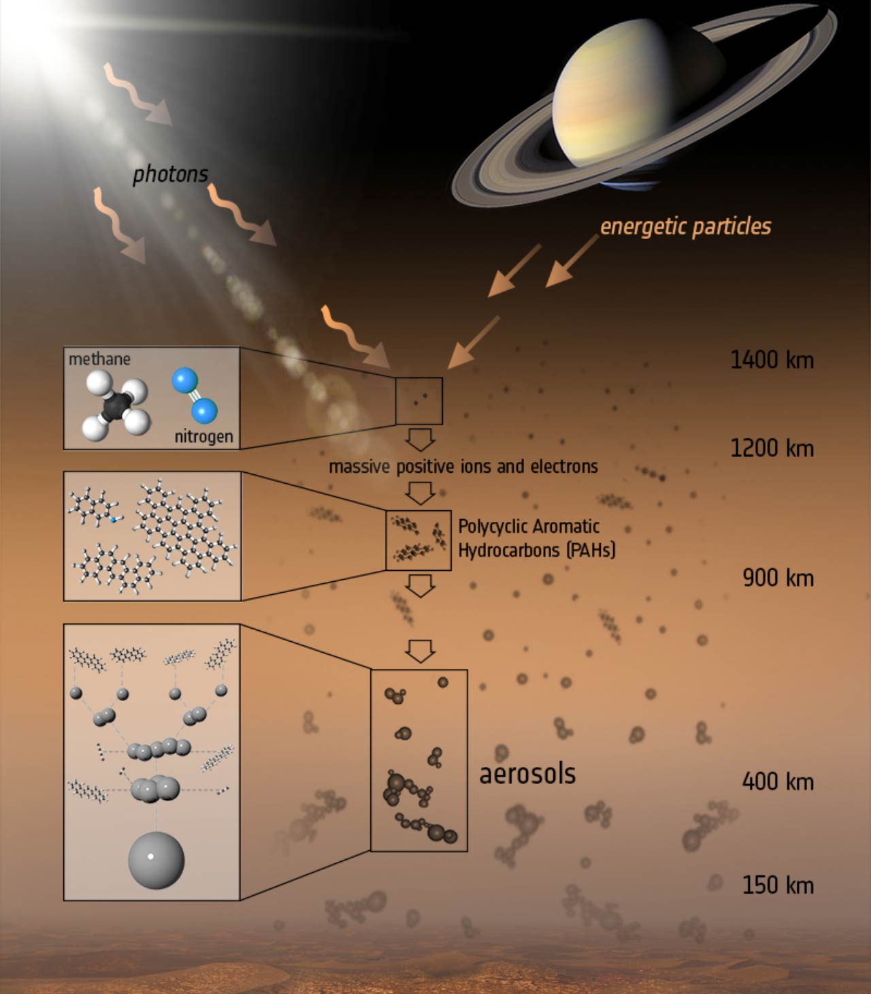
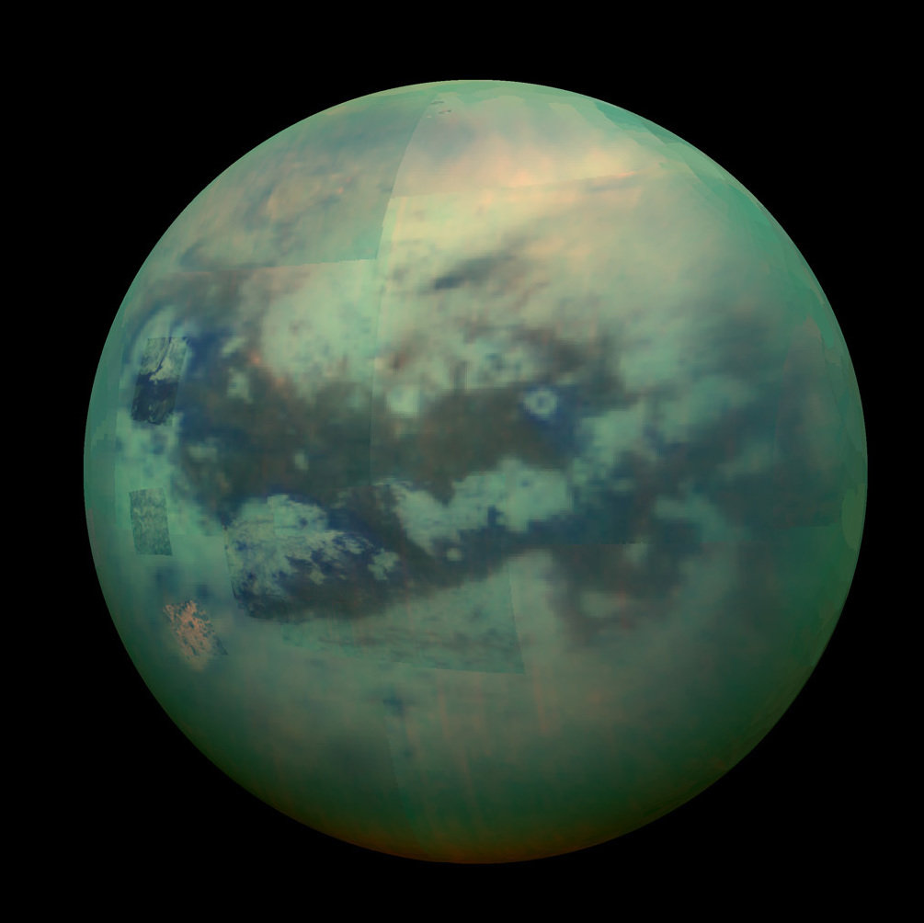
Titan’s Atmosphere
A. E. Thelen
Main constituents:
N2 ~ 94–98%
CH4 ~ 1–5%
H2 ~ 0.1%
Dissociation of N2 and CH4 leads to:
Ions
Hydrocarbons (CXHY)
Nitriles (CXHY[CN]Z)
Questions:
How extensive is the atmospheric chemistry/molecular inventory?
How are trace constituents distributed over space, time?
Are atmospheric species able to interact with the subsurface ocean?
[ESA/ATG Medialab]
ACS 2021 - 3550449
alexander.e.thelen@nasa.gov

Slide 4
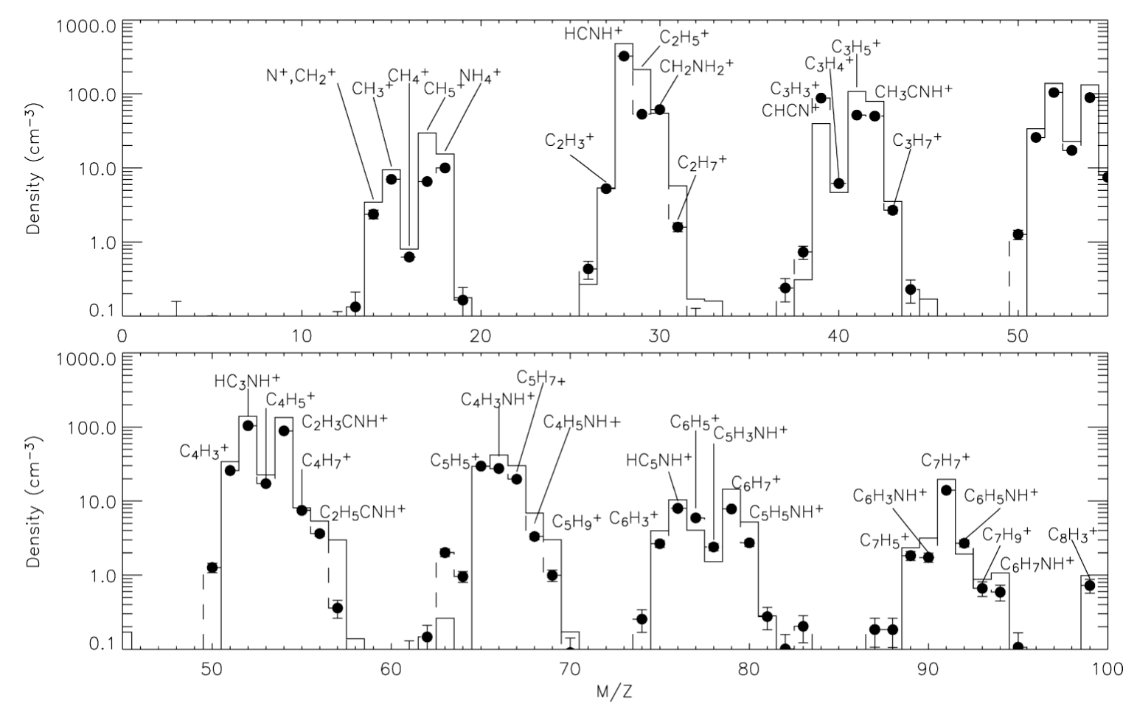
Titan’s Atmosphere
A. E. Thelen
Wealth of ionospheric species detected by Cassini mass spectroscopy:
How are these species incorporated into the neutral atmosphere?
Additional formation sites/mechanisms (e.g. cosmic rays)?
Cassini/INMS, >1000 km
[Vuitton et al., 2007]
ACS 2021 - 3550449
alexander.e.thelen@nasa.gov

Slide 5
Titan’s Atmosphere
A. E. Thelen
Wealth of ionospheric species detected by Cassini mass spectroscopy
How are these species incorporated into the neutral atmosphere?
Additional formation sites/mechanisms (e.g. cosmic rays)?
Cassini/INMS, >1000 km
[Vuitton et al., 2007]
ACS 2021 - 3550449
alexander.e.thelen@nasa.gov

Slide 6
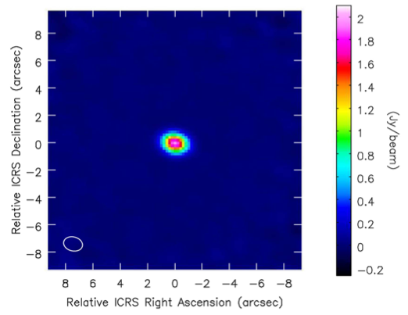
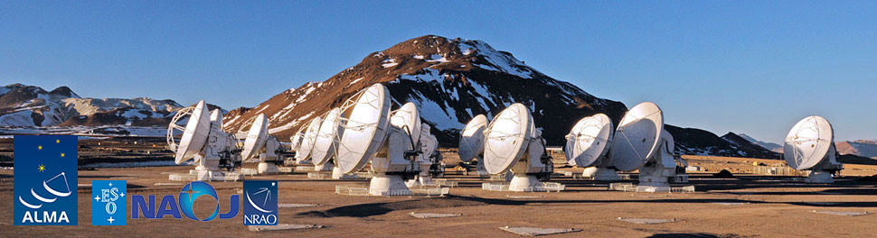
Atacama Large Millimeter/submillimeter Array (ALMA)
Located in Atacama desert, Chile, at 5,000 m altitude
Wavelength range: 0.3 – 9.6 mm (~84 – 950 GHz)
66 antennae: 54 12-m dishes + 12 7-m dishes
Baselines ranging from 150 m – 16 km
Early science observations in 2011, fully operational since 2013
Uses Titan + other SSOs as flux calibrators
A. E. Thelen
[Teanby et al., 2018]

Slide 7
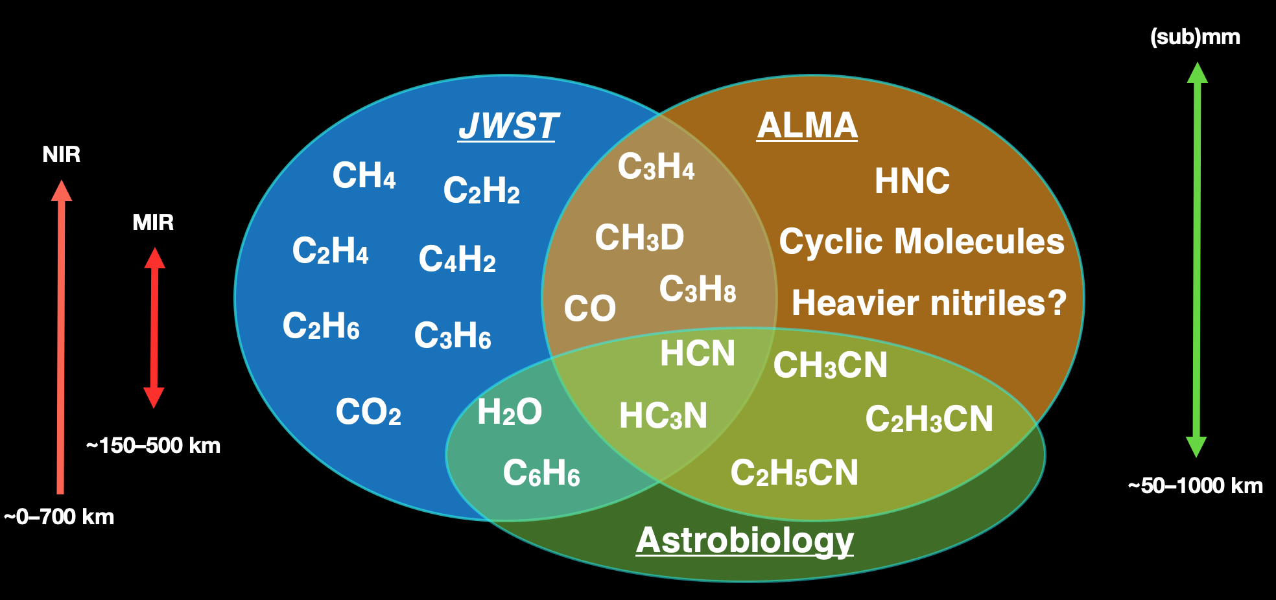
A. E. Thelen
Molecules observable in the IR and Radio/(sub)mm
Infrared
(sub)mm
ACS 2021 - 3550449
alexander.e.thelen@nasa.gov

Slide 8
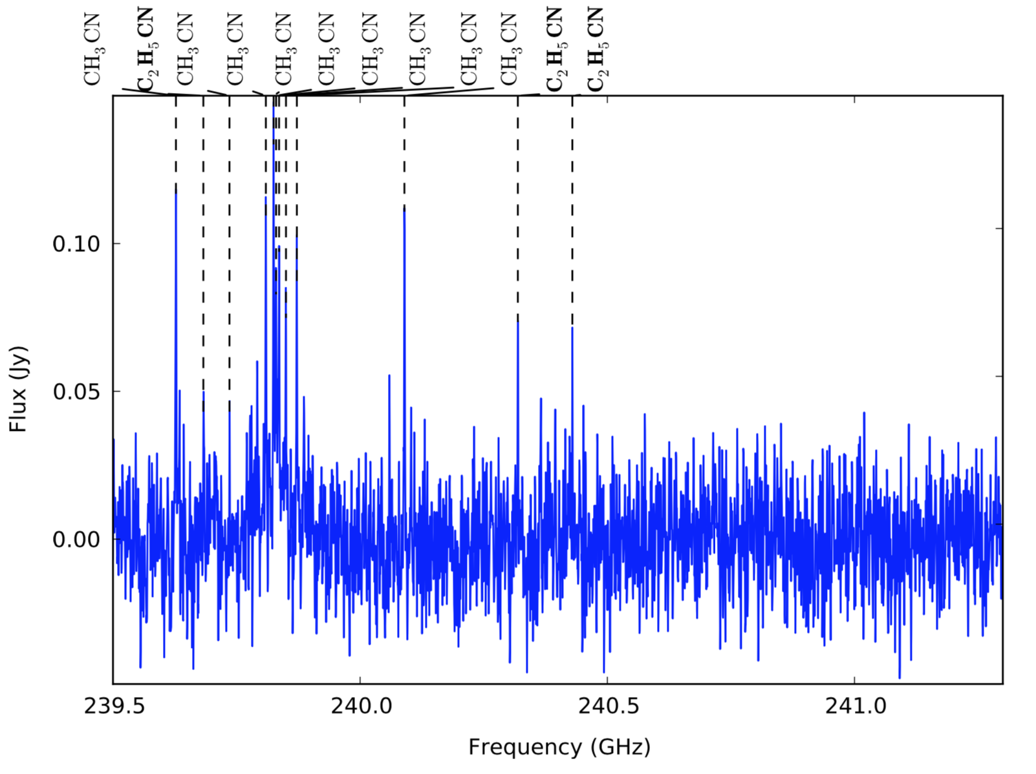
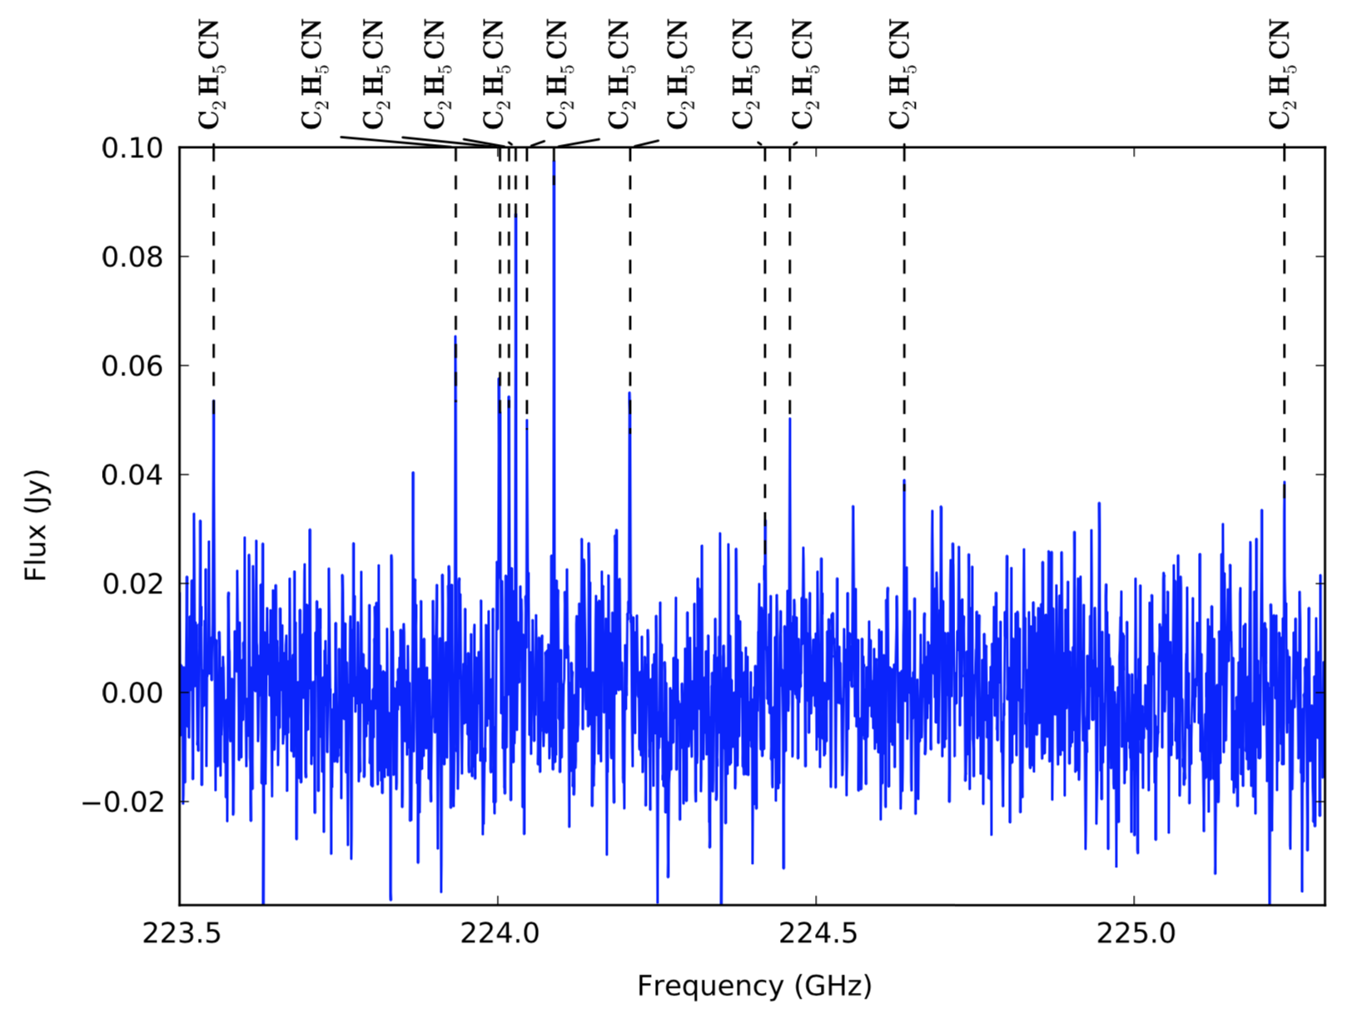
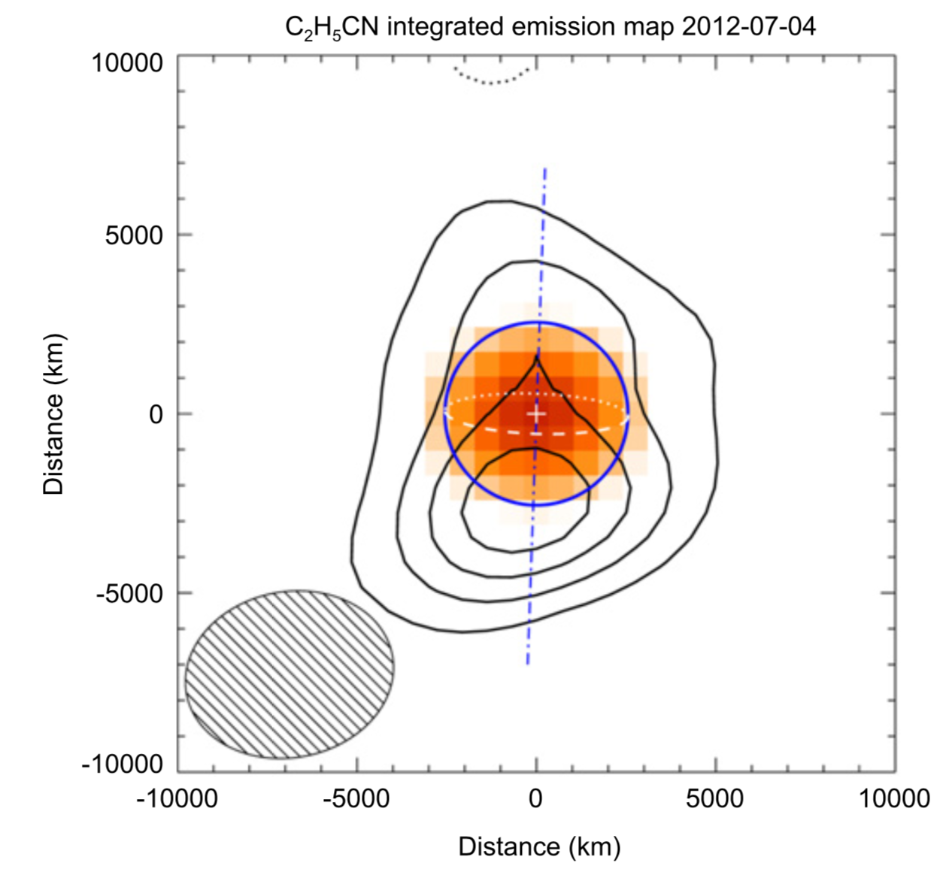
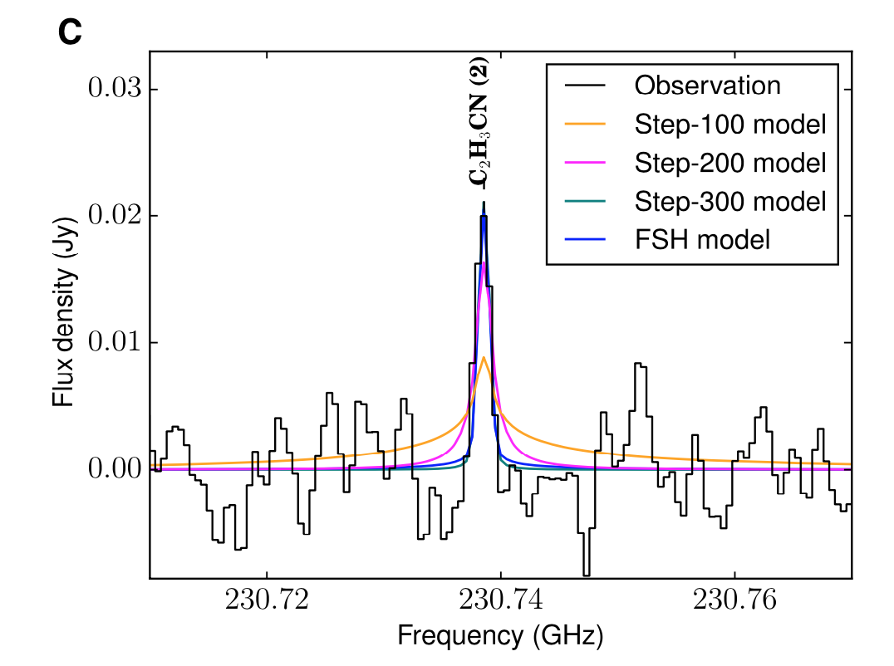
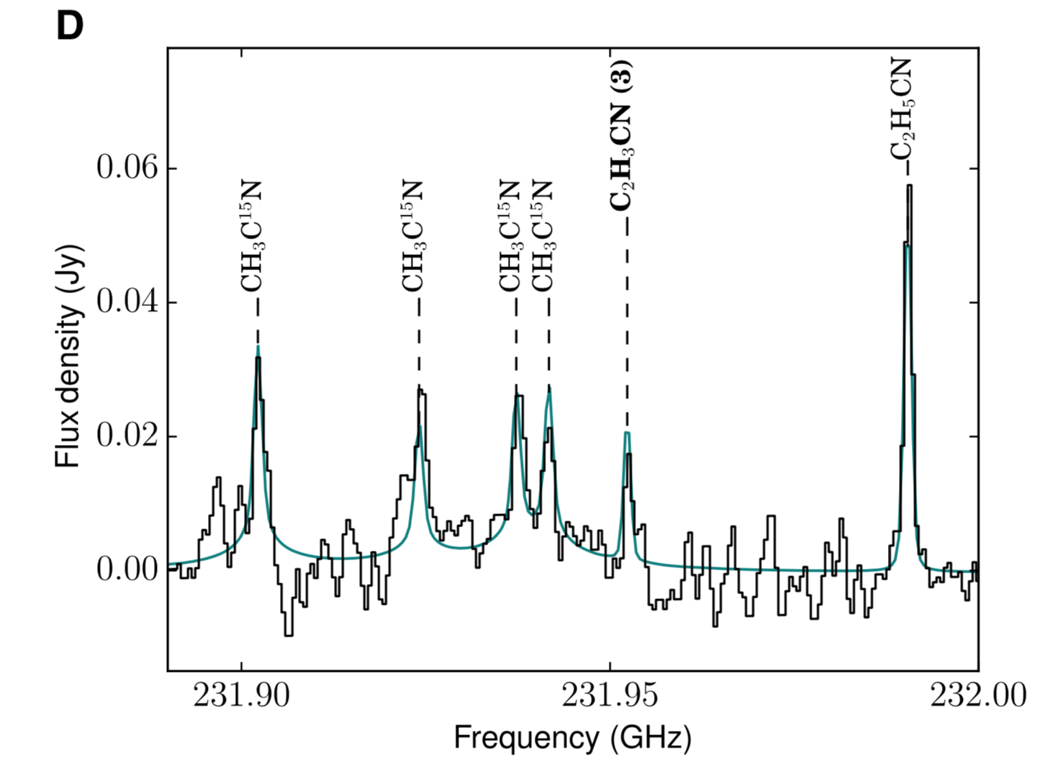
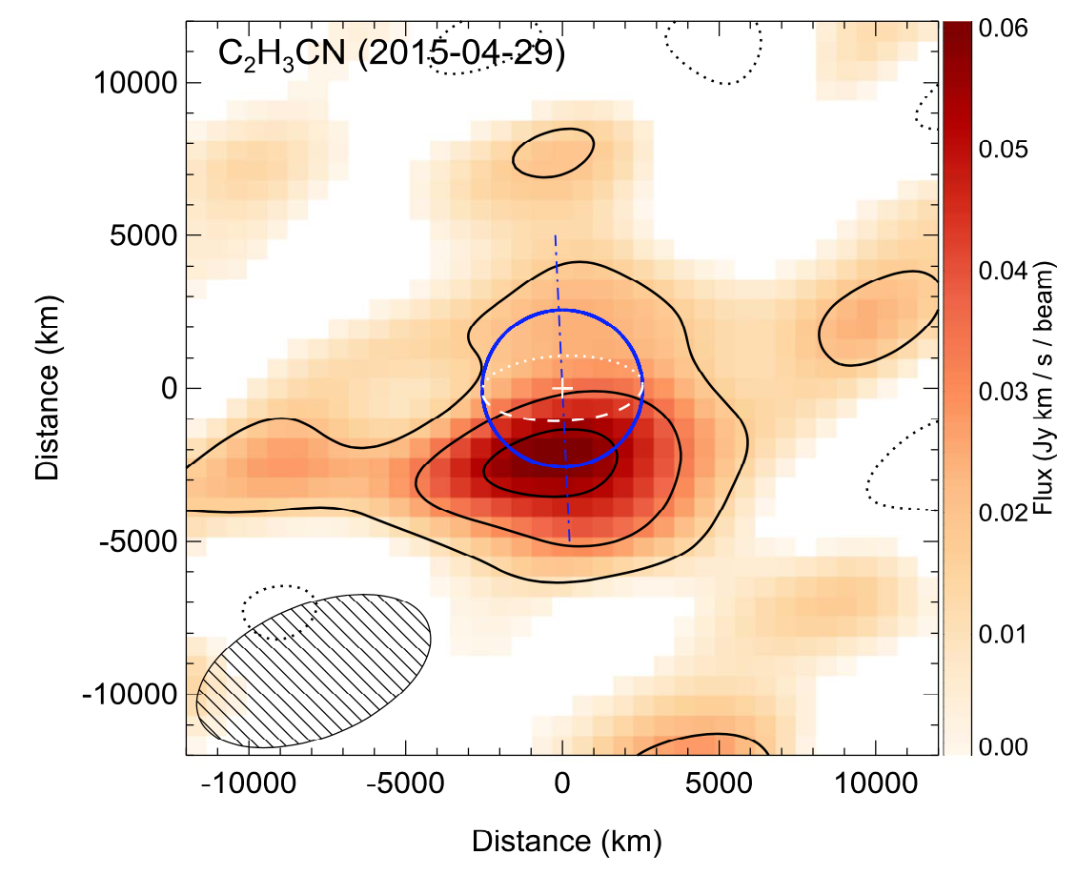
A. E. Thelen
Previous Molecular Detections
C₂H₅CN
(Cordiner et al., 2015)
VMR = 7 x 10⁻⁹
C₂H₃CN
(Palmer et al., 2017)
VMR = 3 x 10⁻⁹
CO (Serigano et al., 2016) and HCN (Molter et al., 2016) isotopes; C₂H₅CN ν₁₃ = 1, ν₂₁ = 1 (Kisiel et al., 2020); CH₃D (Thelen et al., 2019)

Slide 9
A. E. Thelen
Searching for new molecular species
Some known C₃ hydrocarbons
ACS 2021 - 3550449
alexander.e.thelen@nasa.gov

Slide 10
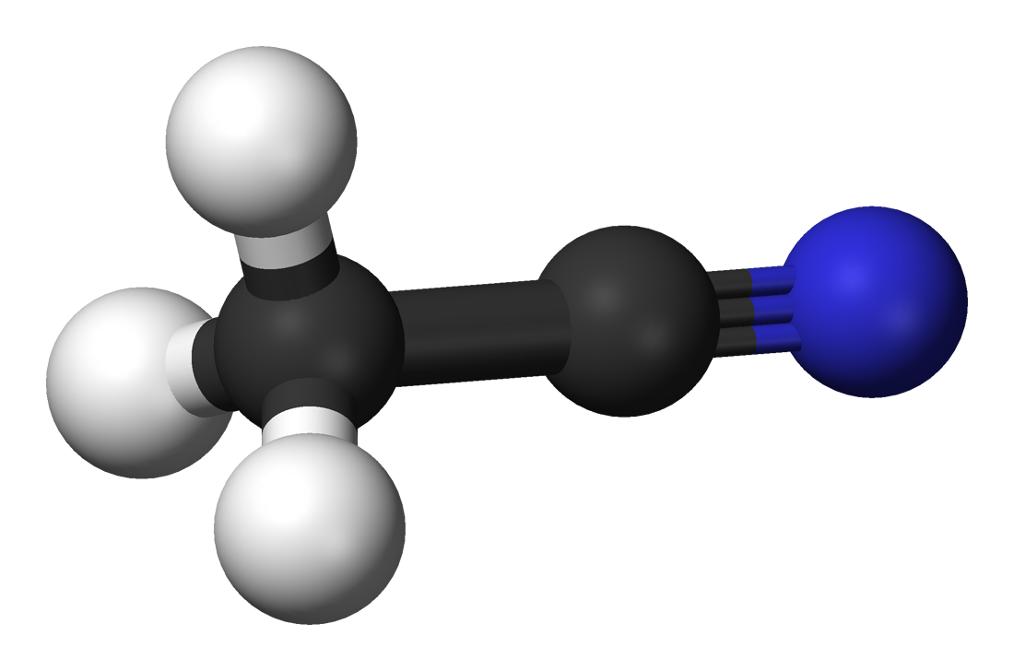
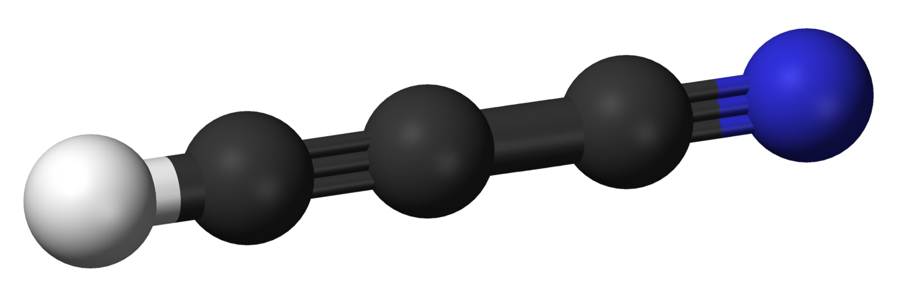
A. E. Thelen
Searching for new molecular species
Some known C₃ hydrocarbons
HC₃N
CH₃CN
Some known carbon-chain nitriles
Cyanoacetylene
Acetonitrile
ACS 2021 - 3550449

Slide 11
A. E. Thelen
Searching for new molecular species
c-C₃H₂
HC₃N
CH₃CN
Cyanoacetylene
Acetonitrile

Slide 12
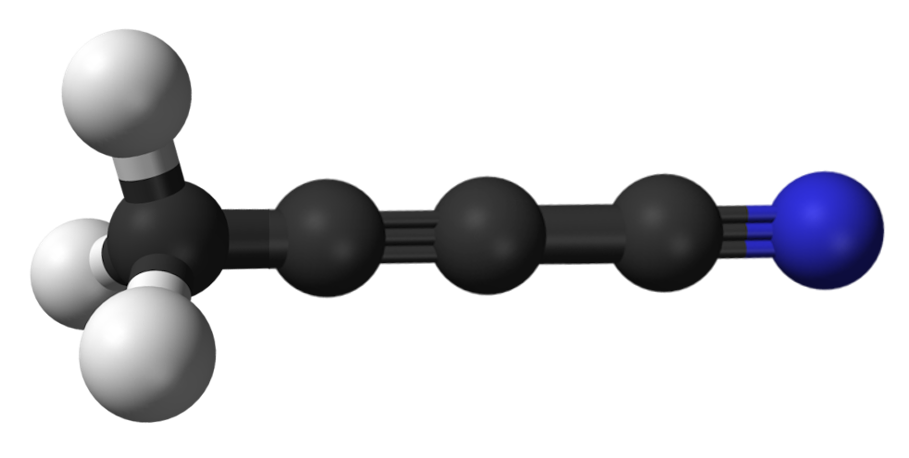
A. E. Thelen
Searching for new molecular species
c-C₃H₂
HC₃N
CH₃CN
CH₃C₃N
Cyanoacetylene
Acetonitrile
Methylcyanoacetylene

Slide 13
A. E. Thelen
Searching for new molecular species
ACS 2021 - 3550449
alexander.e.thelen@nasa.gov

Slide 14
ALMA Observations
A. E. Thelen
ALMA Cycle 4, 7, DDT observations of Titan from 2016, 2017, 2019
ALMA Band 6, Band 7 (211-275; 275-373 GHz)
Disk-averaged spectra here (DDT observations allow for spatially resolved mapping)
Long integrations for high sensitivity (~1 mJy)
Project Code | Observation Date | Time on Source (mins) | Frequency Coverage (GHz) | Spatial Resolution (") | Molecules | Publications
2015.1.00423.S | Mar. 2-4 2016 | 129 | 249.57 – 265.70 | 0.91 x 0.73 | c-C₃H₂, C₂H₅CN | Nixon et al., 2020
2016.A.00014.S | May 8-16, 2017 | 116 | 344.21 – 352.22 | 0.28 x 0.19 | c-C₃H₂, C₂H₃CN, CO, HC₃N, etc. | Cordiner et al., 2018; 2019; Nixon et al., 2020
2019.1.00783.S | Nov. 14 – Dec. 16, 2019 | 269 | 228.8 – 272.27 | 1.55 x 1.14 | CH₃C₃N, N-isotopes, CO | Thelen et al., 2020

Slide 15
Detection of CH₃C₃N
A. E. Thelen
Detection of 7 transitions in the
J=64-63, J=62-61 bands of CH₃C₃N between both spectral windows
All higher energy transitions (K>5) were not detected; some transitions (K=4) blended with other lines (e.g. C₃H₈, C₂H₅CN)
6 of 7 transitions were detected at >3σ
t = 2.9 hr on source
t = 1.3 hr on source

Slide 16
Detection of c-C₃H₂
A. E. Thelen
Detection of 4 J=10-9, J=9-8, J=7-6, J=6-5 transitions/blends
Individual detections ~4σ, combined for both bands = 6.3σ significance level
Utilized new C₂H₅CN line list (Kisiel et al., 2020) to include ν₁₃=1, ν₂₁=1 transitions
C₂H₅CN
c-C₃H₂
ACS 2021 - 3550449

Slide 17
Vertical Profiles
A. E. Thelen
c-C₃H₂
CH₃C₃N
Hebrard et al. (2013) profile
Constant step profiles >400 km
Linear gradient best fit
Linear gradient best fit
Loison et al. (2015) nomial profile
Vuitton et al. (2019) profile
Loison et al. (2015) scaled profile fit
Best fit volume mixing ratio profiles consist of step functions, linear gradients, and scaled photochemical models – unable to constrain profile shape from narrow, low signal lines
Resulting column densities ~ 1–5 x 10¹² cm⁻² depending on profile
ACS 2021 - 3550449
alexander.e.thelen@nasa.gov

Slide 18
Atmospheric Chemistry
A. E. Thelen
CH₃C₃N produced through:
  C₄H₃NH⁺ electron recombination
  C₃H₄ or C₃H₆ + CN
  C₂H₂ or C₂H₄ + CCN
Dissociation products, rates relatively unknown
ACS 2021 - 3550449
alexander.e.thelen@nasa.gov

Slide 19
Atmospheric Chemistry
A. E. Thelen
CH₃C₃N produced through:
  C₄H₃NH⁺ electron recombination
  C₃H₄ or C₃H₆ + CN
  C₂H₂ or C₂H₄ + CCN
Dissociation products, rates relatively unknown
c-C₃H₂ produced through:
  C₃H₃⁺ electron recombination
  C₂H₂ or C₂H₄ + CH
  C₃H₃ photodissociation
Ratios for linear/cyclic C₃H₂ not well known
Models for both molecules in agreement with upper atmosphere measurements of protonated molecules (C₄H₃NH⁺, C₃H₃⁺) by Cassini/INMS
ACS 2021 - 3550449
alexander.e.thelen@nasa.gov

Slide 20
Conclusions
A. E. Thelen
Detection of CH₃C₃N for the first time in a planetary atmosphere; one of the heaviest neutral molecules found in Titan’s atmosphere thus far!
Volume mixing ratio = 4 x 10⁻¹⁰ – 2 x 10⁻⁶ (400–1100 km);
total column density = (3.8–5.7) x 10¹² cm⁻²
Photochemical models require further kinetic data to improve CH₃C₃N vertical profile predictions for Titan
ACS 2021 - 3550449
alexander.e.thelen@nasa.gov

Slide 21
Conclusions
A. E. Thelen
Detection of CH₃C₃N for the first time in a planetary atmosphere; one of the heaviest neutral molecules found in Titan’s atmosphere thus far!
Volume mixing ratio = 4 x 10⁻¹⁰ – 2 x 10⁻⁶ (400–1100 km);
total column density = (3.8–5.7) x 10¹² cm⁻²
Photochemical models require further kinetic data to improve CH₃C₃N vertical profile predictions for Titan
Detection of c-C₃H₂ for the first time in a planetary atmosphere; the smallest cyclic molecule found in a planetary atmosphere thus far!
Volume mixing ratio = 2 x 10⁻¹¹ – 3 x 10⁻⁶ (300–1100 km);
total column density = (1.2–4.9) x 10¹² cm⁻²
Isomer branching ratios still unknown
No detections of larger cyclic molecules!
ACS 2021 - 3550449
alexander.e.thelen@nasa.gov

Slide 22
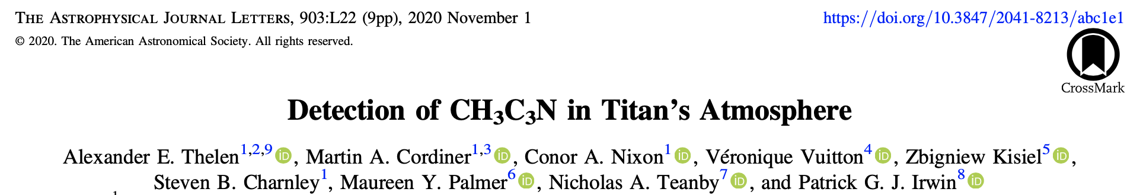
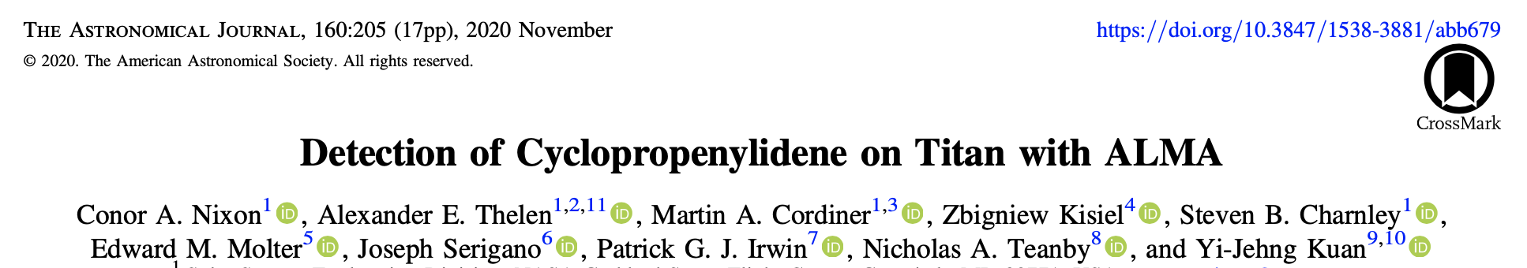
A. E. Thelen
Papers out now in AAS journals!
c-C₃H₂ press release: “NASA Scientists Discover ‘Weird’ Molecule in Titan’s Atmosphere” (Shekhtman, October 2020; nasa.gov)
ACS 2021 - 3550449
alexander.e.thelen@nasa.gov

Slide 23
Acknowledgements
A. E. Thelen
This work was supported by the NASA Astrobiology Postdoctoral Program in association with the NASA Astrobiology Institute (NAI) and the Universities Space Research Association, and the NASA Solar System Observations program.
This paper makes use of the following ALMA data: ADS/JAO.ALMA#2015.1.00423.S, 2016.A.00014.S, 2019.1.00783.S. ALMA is a partnership of ESO (representing its member states), NSF (USA) and NINS (Japan), together with NRC (Canada) and NSC and ASIAA (Taiwan) and KASI (Republic of Korea), in cooperation with the Republic of Chile. The Joint ALMA Observatory is operated by ESO, AUI/NRAO and NAOJ. The National Radio Astronomy Observatory is a facility of the National Science Foundation operated under cooperative agreement by Associated Universities, Inc.
ACS 2021 - 3550449
alexander.e.thelen@nasa.gov

Slide 24
A. E. Thelen
Backups

Slide 25
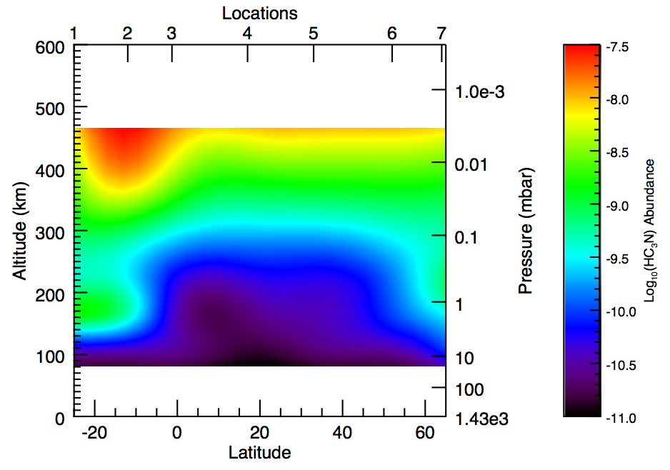
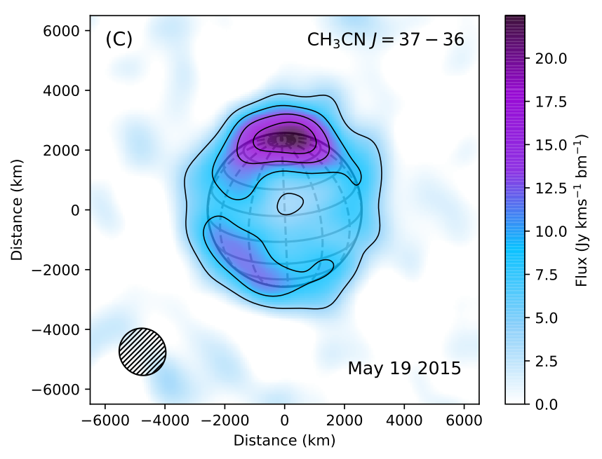
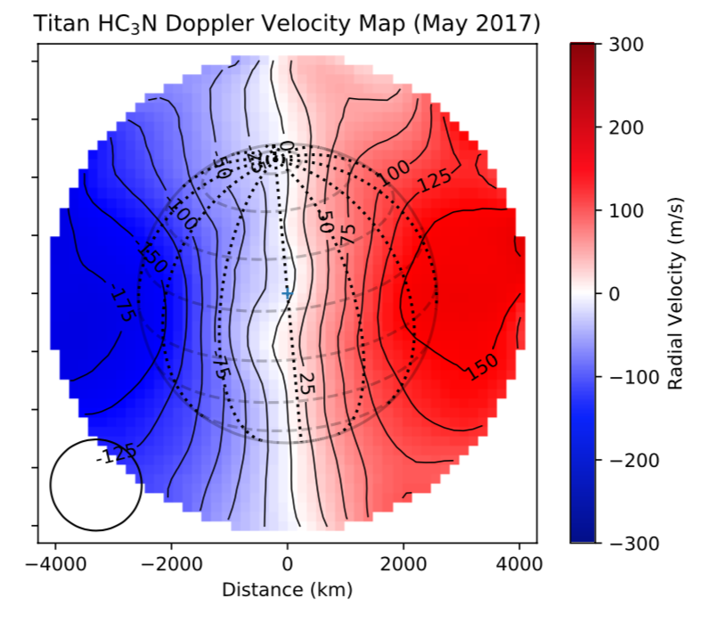
A. E. Thelen
ALMA Capabilities for Planetary Atmospheres
Coverage of numerous molecular species – enables studies of chemistry and isotopic ratios
High spectral resolution – wind speed measurements, temperature and abundance with altitude
Exceptional spatial resolution – maps of brightness temperature and chemical abundance
Unprecedented sensitivity – new molecular species detections
HC3N
Abundances
Spatial maps
Winds
New species and isotopes

Slide 26
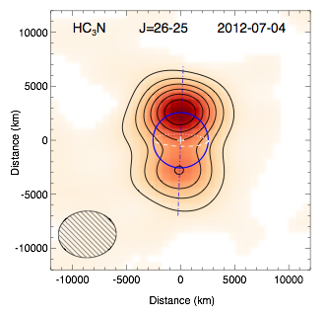
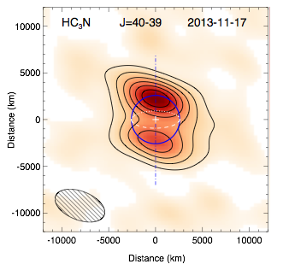
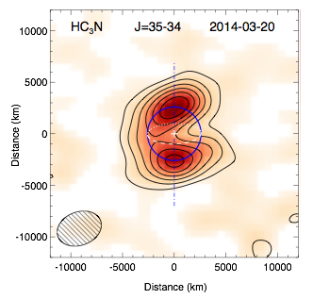
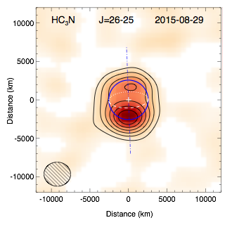
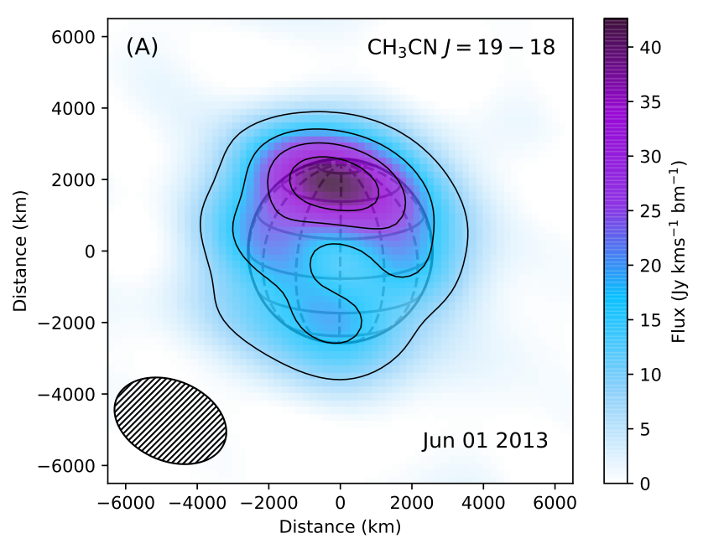
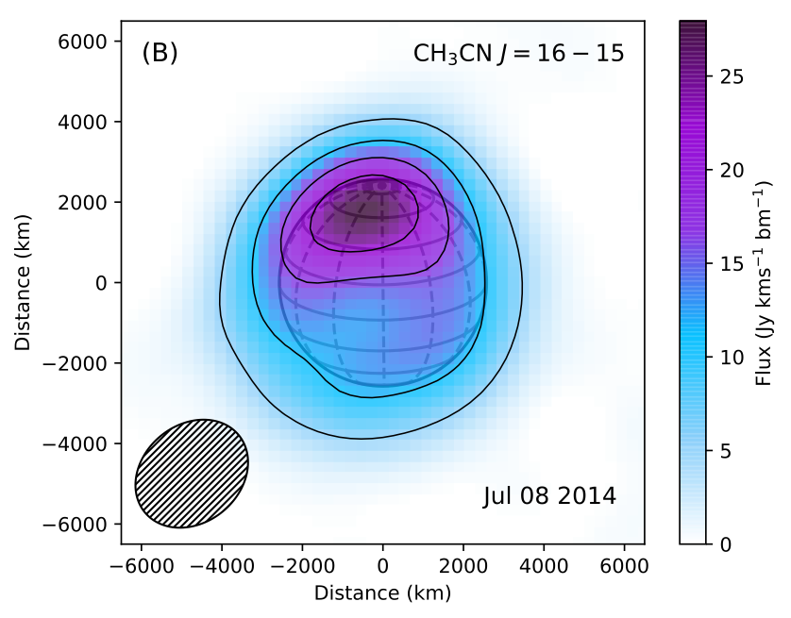
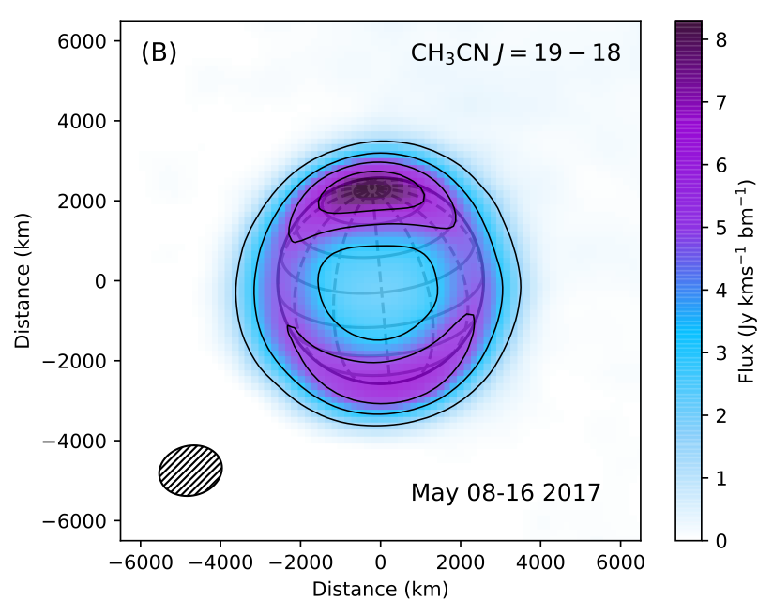
Seasonal Changes Revealed by ALMA
A. E. Thelen
[Cordiner et al., 2017; Thelen et al., 2019; Cordiner et al., 2019]

Slide 27
Spectral Modeling: CH₃C₃N
A. E. Thelen
Retrieved volume mixing ratio with NEMESIS radiative transfer package (Irwin et al., 2008)
Many vertical profiles produced similar spectral fits
Significant abundance below ~400 km resulted in line wings that were too broad to match data
ACS 2021 - 3550449
alexander.e.thelen@nasa.gov

Slide 28
Spectral Modeling: c-C₃H₂
A. E. Thelen
Sensitive to volume mixing ratio >300 km
Removal of C₂H₅CN lines (including vibrationally excited) required
ACS 2021 - 3550449
alexander.e.thelen@nasa.gov

Slide 29
Cyclic Molecules
A. E. Thelen
Non-detection of both molecules with 3σ significance at ~1 ppb
INMS mass peaks at m/z = 80, 81 could correspond to C₅H₅NH⁺ or C₄H₄N₂H⁺, but also linear conformers or other molecules

