Slide 1

TRUST, Trustworthiness and EOSDIS
April 21, 2021
Research Data Alliance Virtual Plenary Meeting (RDA P17)
Jeanne Behnke¹ and Hampapuram (Rama) Ramapriyan^{1,2}
¹ESDIS Project, NASA/Goddard Space Flight Center & ²Science Systems and Applications, Inc.

Slide 2
The Value of Being Trustworthy
NASA has invested in over 60 years of data and information systems
  But trustworthiness in our repositories is still a goal that we strive to achieve and even exceed
Why?
  Enables the success of any NASA science mission
  Inspires general science research and applications
  Justifies the cost of operations
  Contributes to the value of the Open Data Policy
  Influences the long term, historical view for the data collection
But what is TRUST and how does it apply to EOSDIS?

Slide 3

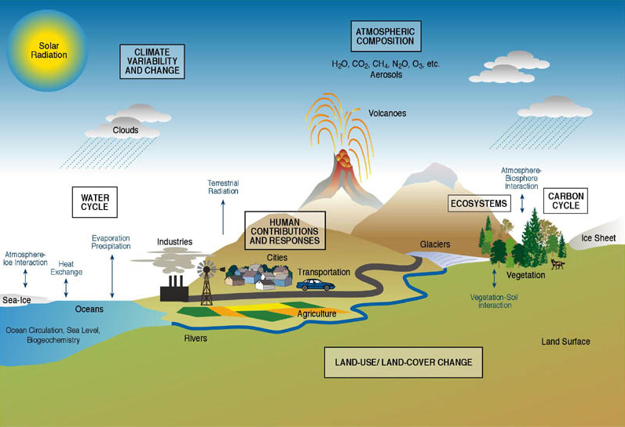
EOSDIS Comprises Data of the Whole Earth System
    Atmosphere
        Winds & Precipitation
        Aerosols & Clouds
        Temperature & Humidity
        Solar radiation
    Ocean
        Surface temperature
        Surface wind fields & Heat flux
        Surface topography
        Ocean color
    Cryosphere
        Sea/Land Ice
        Snow Cover
        Land
        Cover & Usage
        Soil Moisture
        Topography & elevation
        Temperature
        Human Dimensions
        Population & Land Use
        Human & Environmental Health
Notes:
image: www.agci.org/
FEL

Slide 4
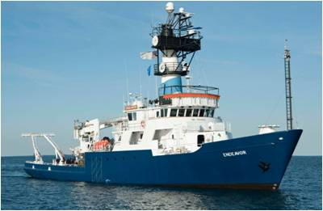
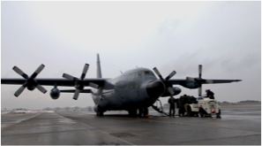
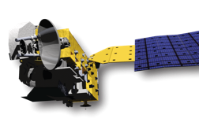
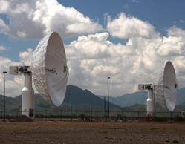
Earth Observing System Data and Information System (EOSDIS)
EOSDIS
Users
distribute
International
Partners
Research
Applications
subset
Education
archive
Public
data downlink
Process for Ingest
capture and clean
Generate Science Data Products

Slide 5
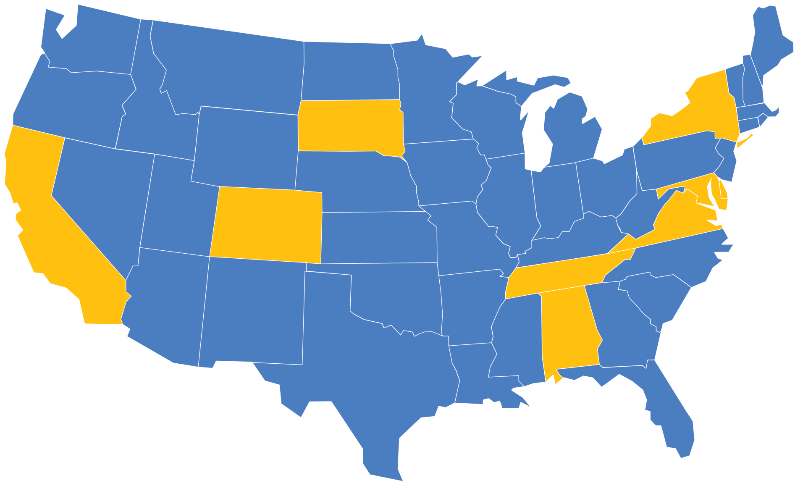
Trustworthy Repositories
Alaska Satellite
Facility DAAC
SAR Products, Sea Ice,
Polar Processes,
Geophysics
Socioeconomic Data and Applications Center
Human Interactions,
Land Use, Environmental Sustainability,
Geospatial Data
Goddard Earth Sciences
Data and Information
Services Center
Global Precipitation, Solar Irradiance,
Atmospheric Composition and Dynamics, Global Modeling
Land Processes
DAAC
Land Cover, Surface
Reflectance, Radiance,
Temperature, Topography,
Vegetation Indices
National Snow and Ice Data Center DAAC
Frozen Ground, Glaciers,
Ice Sheets, Sea Ice,
Snow, Soil Moisture
Physical
Oceanography DAAC
Gravity, Sea Surface Temperature, Ocean Winds, Topography, Circulation & Currents
Crustal Dynamics Data Information System
Space Geodesy, Solid Earth
Ocean Biology
DAAC
Ocean Biology,
Sea Surface
Temperature
Global Hydrology
Resource Center DAAC
Hazardous Weather,
Lightning, Tropical Cyclones and
Storm-induced Hazards
Level 1 and
Atmosphere
Archive and
Distribution
System (LAADS)
MODIS Level-1
and Atmosphere
Data Products
LaRC
Atmospheric
Science Data
Center
Radiation Budget,
Clouds, Aerosols,
Tropospheric
Chemistry
NASA Distributed Active Archive Centers
Oak Ridge National Laboratory DAAC
Biogeochemical Dynamics, Ecological Data, Environmental
Processes

Slide 6
TRUST Principles*
Principle | Guidance for repositories
Transparency | To be transparent about specific repository services and data holdings that are verifiable by publicly accessible evidence.
Responsibility | To be responsible for ensuring the authenticity and integrity of data holdings and for the reliability and persistence of its service.
User Focus | To ensure that the data management norms and expectations of target user communities are met.
Sustainability | To sustain services and preserve data holdings for the long-term.
Technology | To provide infrastructure and capabilities to support secure, persistent, and reliable services.
*From: Lin, D., Crabtree, J., Dillo, I. et al. The TRUST Principles for digital repositories. Sci Data 7, 144 (2020). https://doi.org/10.1038/s41597-020-0486-7

Slide 7
T - Transparency
All information about policies, practices, data holdings and capabilities are publicly available
An extensive, comprehensive and easy-to-traverse website: https://earthdata.nasa.gov/
Policies (Open data, software and services)
  https://earthdata.nasa.gov/collaborate/open-data-services-and-software
Practices
  Adding new data - https://earthdata.nasa.gov/collaborate/new-missions
    https://earthdata.nasa.gov/collaborate/new-missions/adding-orbital-airborne
    https://earthdata.nasa.gov/collaborate/new-missions/adding-competitive-other
  Requirements, Standards & References - https://earthdata.nasa.gov/esdis/eso/standards-and-references
Capabilities - https://earthdata.nasa.gov/eosdis

Slide 8
R - Responsibility
We are committed to ensure authenticity and integrity of data holdings and to provide reliable and persistent data services.
  Proven record of supporting new missions and data
  Data products accompanied by information about data quality
  Sustained funding support from NASA
  Focused attention on discipline-specific user needs; Repositories are collocated with scientific expertise
  Continuous review of data and metadata collection; migration to new technologies; implementation of new capabilities
  Commitment to FAIR principles

Slide 9
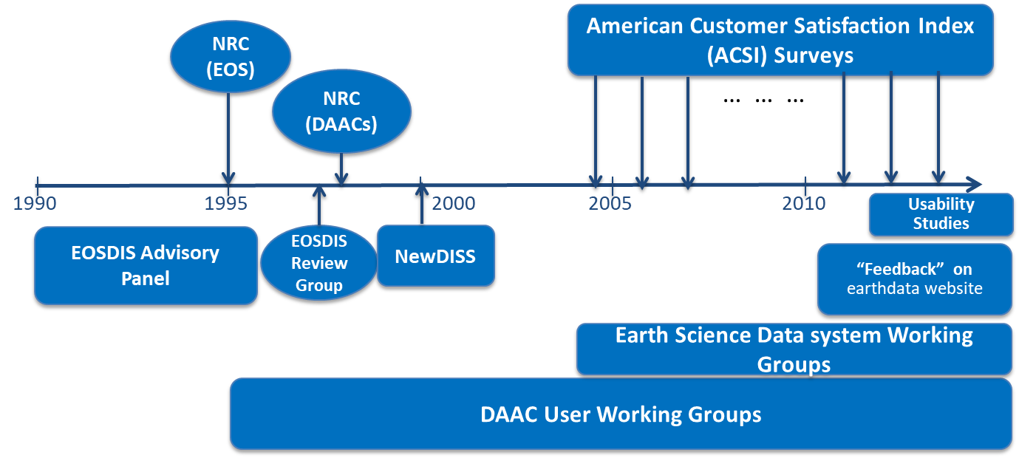
U - User Focus
We are committed to meet data management norms and expectations of target user communities.
Proven customer satisfaction as assessed through annual American Consumer Satisfaction Index (ACSI) surveys conducted by the CFI Group
EOSDIS has >30 years of user community input into design/development/operation
ESDIS Standards Office reviews and approves community standards for NASA Earth science data
Earth Science Data Systems Working Group/
ACCESS Program
Science Researchers & Application users
Data Needs
Opportunities
IT and Security Directives
NASA HQ Earth Science Division
Guidance,
Technology,
Re-use
National Needs
Foundational
EOSDIS System Architecture
Decadal Survey
Vision & Direction
New Missions
Existing knowledge
Improvements,
Technology,
Re-use
Shared
Data
Opportunities
ESA
NOAA
Mission Operations
USGS
Processing Centers
Collaborating Systems
Data Centers
EOSDIS Elements
Notes:
Figure from Ramapriyan, H. and Behnke, J., 2019. Importance and Incorporation of User Feedback in Earth Science Data Stewardship. Data Science Journal, 18(1), p.24. DOI: http://doi.org/10.5334/dsj-2019-024

Slide 10
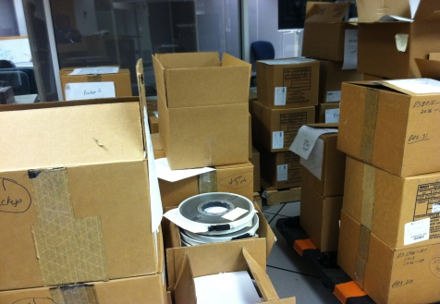
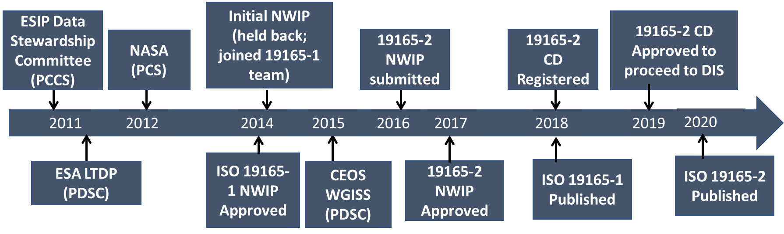

S - Sustainability
We are committed to sustain services and preserve data holdings for the long-term
Preservation Content Specification (in use since 2012) to ensure future understandability & reusability
Led ISO standard development – ISO 19165-2:2020
  Geographic information — Preservation of digital data and metadata — Part 2: Content specifications for Earth observation data and derived digital products
CoreTrustSeal certification for the network owner, NASA, and its repositories located at Centers of expertise
Sustained long-term commitment and funding from NASA
Earthdata
Cloud
1980s
2020s
Notes:
Picture taken by author

Slide 11
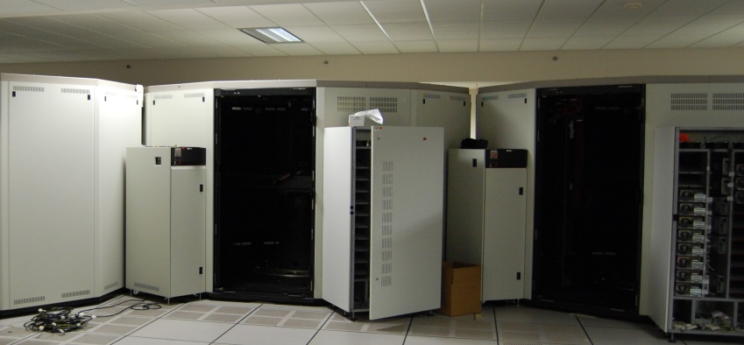
T - Technology
We provide infrastructure and capabilities to support secure, persistent, and reliable services.
  On-going evolution since the beginning to keep up with state-of-the-art and changes in users’ expectations
  User needs’ assessments, internal/external reviews, Earth Science Data System Working Groups’ recommendations help identify capability needs
  Lessons learned and information technology advances coupled with advice/comments from community supports a continuously evolving data system with growing capabilities
1990s
Earthdata
Cloud
2020s
1980s
Notes:
Pictures taken by author

Slide 12
EOSDIS – Operating and Evolving Since 1994
Federated active archives; loosely coupled
User Needs driven development
Common Metadata Repository + Unified Metadata Model
User registration with single sign-on
Collaboratively dev-eloped analytics software
Open Source software on GitHub
Commercial cloud usage
Easy access imagery
Continuous technology infusion
Figure from Ramapriyan & Lynnes, “Reusability in NASA’s Earth Observation System Data and Information System (EOSDIS)”, IN 21A-09, AGU Fall Meeting, 2019
Heterogeneous, distributed data providers
Minimal set of core standards + community standards
Coordinated websites
Preservation – content specifications
On-line archives and cross-system services
Near Real-Time access
Common data model
Expanded software tools and services
Some interoperability with external data sources
High data volume on nearline media
Improved access to heritage data
Cross-DAAC search / access interoperability
Common distribution format (HDF)
Some data on nearline media
Mission data systems
Few community standards
Cumbersome inter-use
Data on offline media
<1990
Mid-1990s
Late 90s +
2000s
2010s +
EOSDIS Operational
FAIR

Slide 13
Conclusion
As a network of trusted repositories, NASA’s EOSDIS has supported TRUST principles for over two decades
Trust is essential for users to have confidence in our data
Sustenance is essential to trust
Trust is essential to sustenance

Slide 14
Being a Trustworthy Example
The reputation of NASA and its Earth science data is golden and is built on the trust of its customers. There are several lessons learned in developing EOSDIS:
  developing and evolving trustworthy repositories
  building frameworks for keeping digital collections relevant in an environment that constantly changes
  being responsiveness to a broad user community with differing perspectives, motives, and cultures
  being forward-thinking on a flat budget
Thanks to all who make EOSDIS possible

Slide 15
References
Ramapriyan et al. “Standards and Best Practices – Two NASA Examples” IN21D-0876, AGU Fall Meeting, 2019
Ramapriyan, H. and Behnke, J., 2019. Importance and Incorporation of User Feedback in Earth Science Data Stewardship. Data Science Journal, 18(1), p.24. DOI: http://doi.org/10.5334/dsj-2019-024

