Slide 1
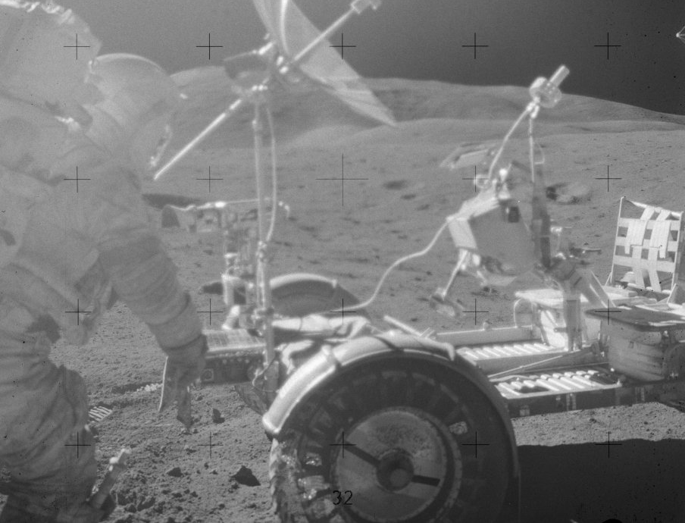
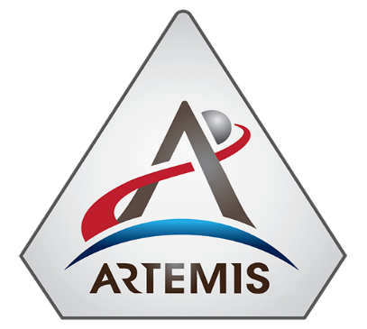


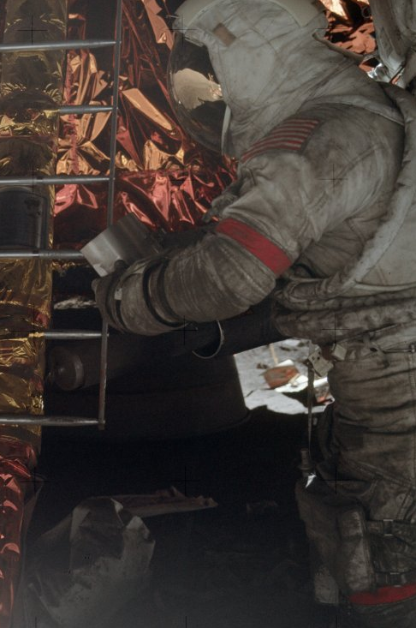
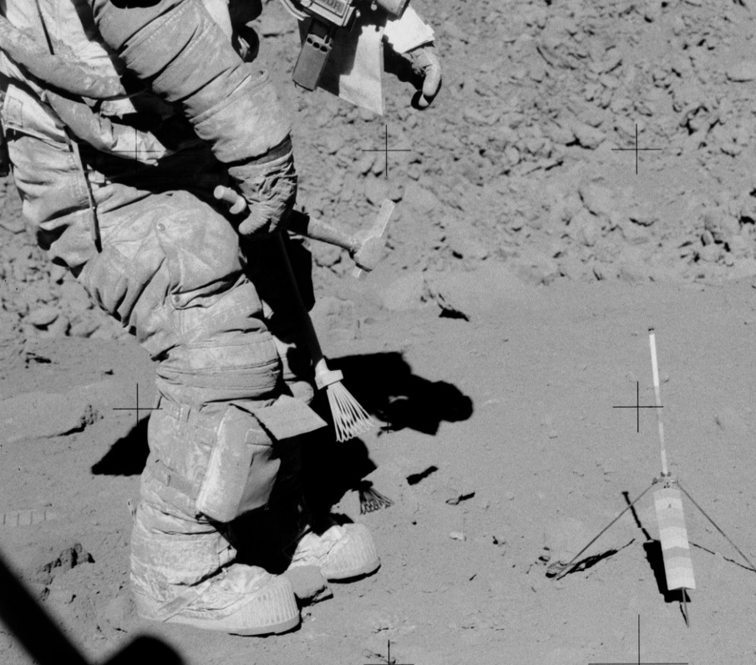
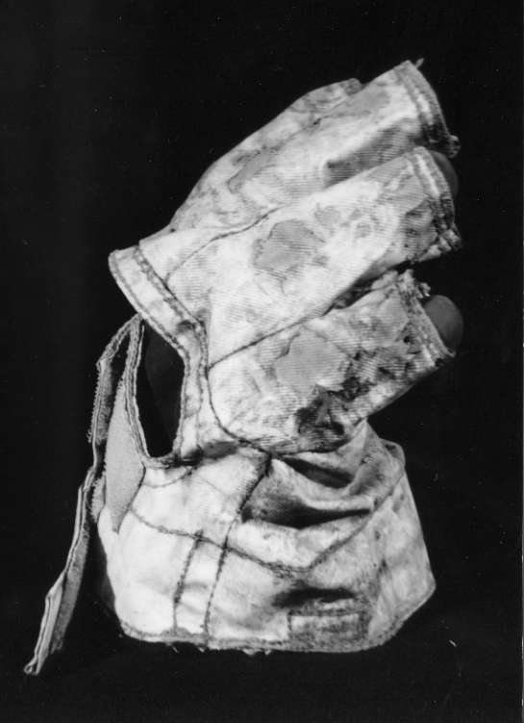
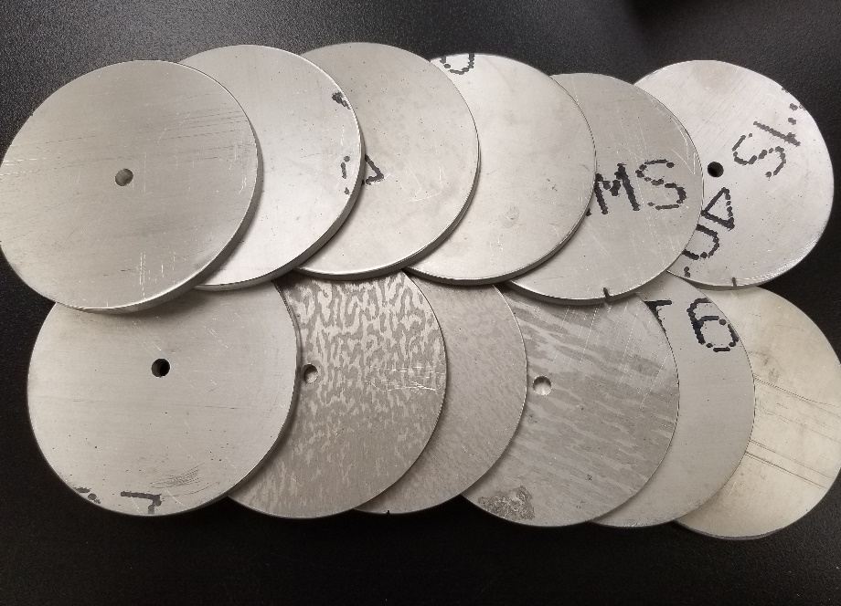
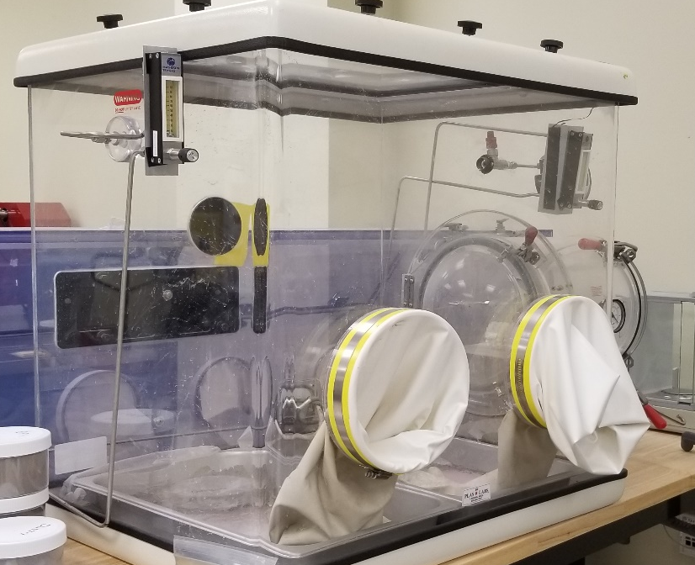
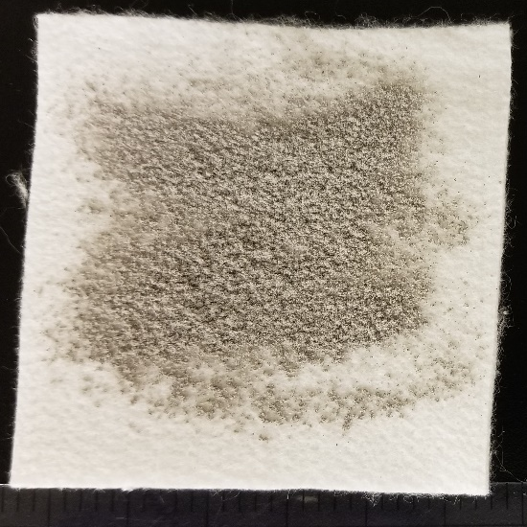
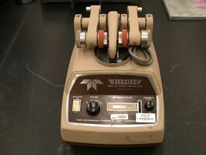
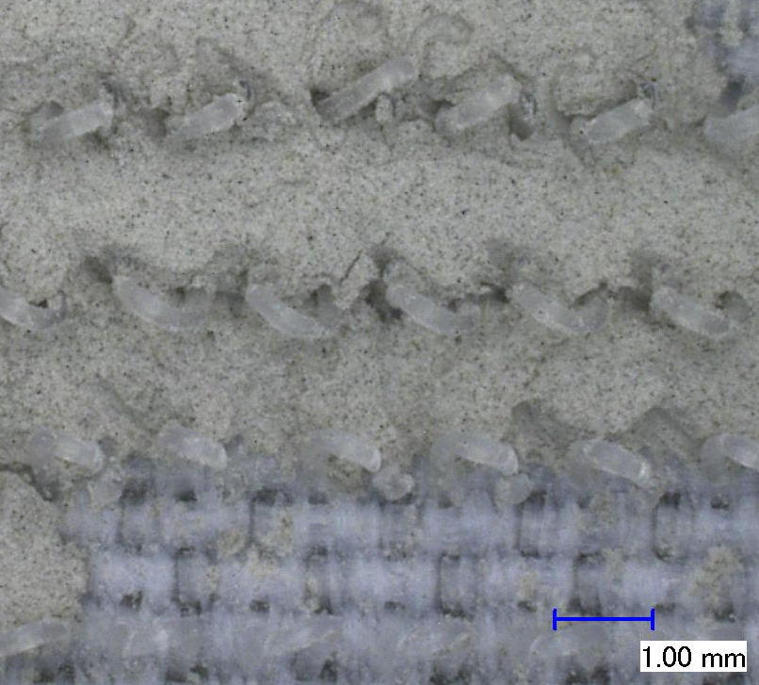
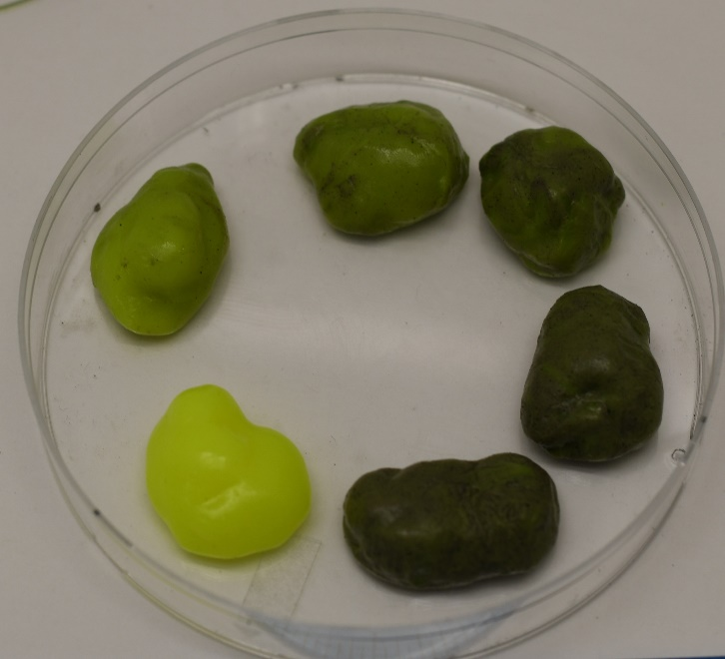
Dust Mitigation Technology Development for Future Lunar Missions with the Dust Solution Testing Initiative (DuSTI) Project
Angela Garcia¹, Sarah Deitrick¹, Mallory Sico²​, Kristen John², Jacquelyne Black³
¹Jacobs Technology, NASA Johnson Space Center, Houston TX 77058, ²NASA Johnson Space Center, ³University of Houston-Clear Lake. (angela.h.garcia@nasa.gov)
Motivation
Technology Testing
Dust is one of the most significant hazards to human lunar exploration
The safety of the crew members and sustainability of habitats, science, and supporting hardware depend on effective dust mitigation techniques & technologies (Fig. 1, 2, 3)
Hard Goods Surface Coatings
  Substrates of interest: polycarbonate, fused silica, aluminum
  Evaluate performance of coating adhesion to substrate, abrasion resistance, and dust adhesion resistance (e.g., Fig. 6)
Soft Goods Surface Coatings
  Substrates of interest: Ortho-fabric, Nomex felt, PBI
  Evaluate performance of coating adhesion to substrate, changes to flexibility after coating, cleaning easability (e.g., Fig. 7)
Pliable Cleaners
  COTS cleaning gel/putty that may liberate and store contaminants
  Evaluate the effectiveness of removing lunar simulant from hard and soft good substrates (Fig. 5, Fig. 8)
Fig.1 (left): Gene Cernan’s dust covered suit during an Apollo 17 extravehicular activity (EVA)
Fig. 2 (center): Cernan’s abraded glove after 3 EVAs on Apollo 17
Fig. 3 (right): Cernan outside the Lunar Module on Apollo 17 (Image credit Lunar Surface Journal)
Introduction
Fig. 6 (left): Aluminum substrate preparation for Taber Abrasion testing at JSC
Fig. 7 (center): Dirty glovebox intended for cleaning easability testing at JSC
Fig. 8 (right): Nomex felt covered in lunar simulant (upper) with correlated preliminary image processing of covered area via open-source software ImageJ (lower) to be used to quantitatively measure cleaning effectiveness in pliable cleaner testing
DuSTI’s goal is to increase the technology readiness level (TRL) of commercial off the shelf (COTS) technologies by validating components in relevant environments with relevant materials (i.e. lunar regolith simulant) (Fig. 4)
    Leverage terrestrial dust mitigation experiences for the Moon
These technologies support the passive dust mitigation requirements following NASA strategy [1]
Future Work
Results of DuSTI testing will be compiled into technology infusion report in Q4 of FY21
Technologies will be tested using NASA JSC, WSTF, and KSC test facilities
DuSTI is aligned to improve upon modern methods of lunar dust mitigation for upcoming Artemis missions
Acknowledgements: DuSTI funding provided by the FY21 Space Technology Mission Directorate (STMD) Center Innovation Fund (CIF) Independent Research and Development (IRAD) at NASA Johnson Space Center
Fig. 4 (left): Optical microscope image of hook fasteners covered in lunar simulant
Fig. 5 (right): Pliable cleaner allotments with varying degrees of lunar simulant saturation
References:
[1] Johansen M. R. (2020) Lunar Dust Workshop, No. 2141

