Slide 1
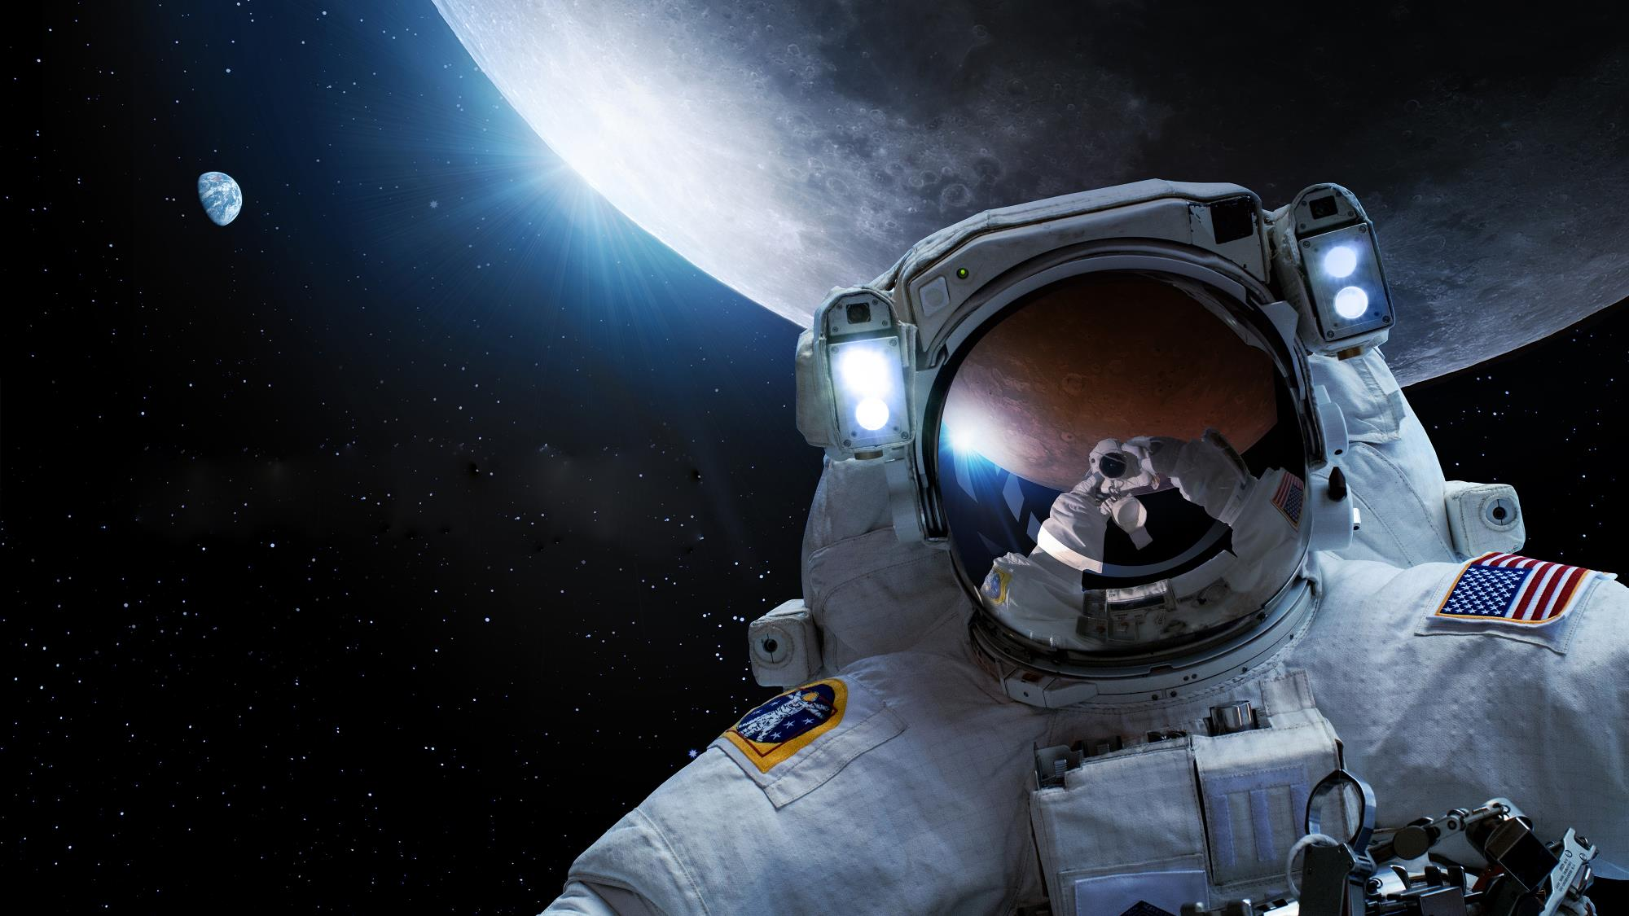

National Aeronautics and Space Administration
NASA Exploration Extravehicular Mobility Unit Overview and Status
Revision A
April 16, 2021
Jose Sanchez
Hardware Manager
NASA EVA Hardware Office (XX)
This document has been reviewed for Proprietary, SBU, and Export Control (ITAR/EAR) and has been determined to be non-sensitive. It has been released to the public via the NASA Scientific and Technical Information (STI) Process (Document ID 20210013671).

Slide 2

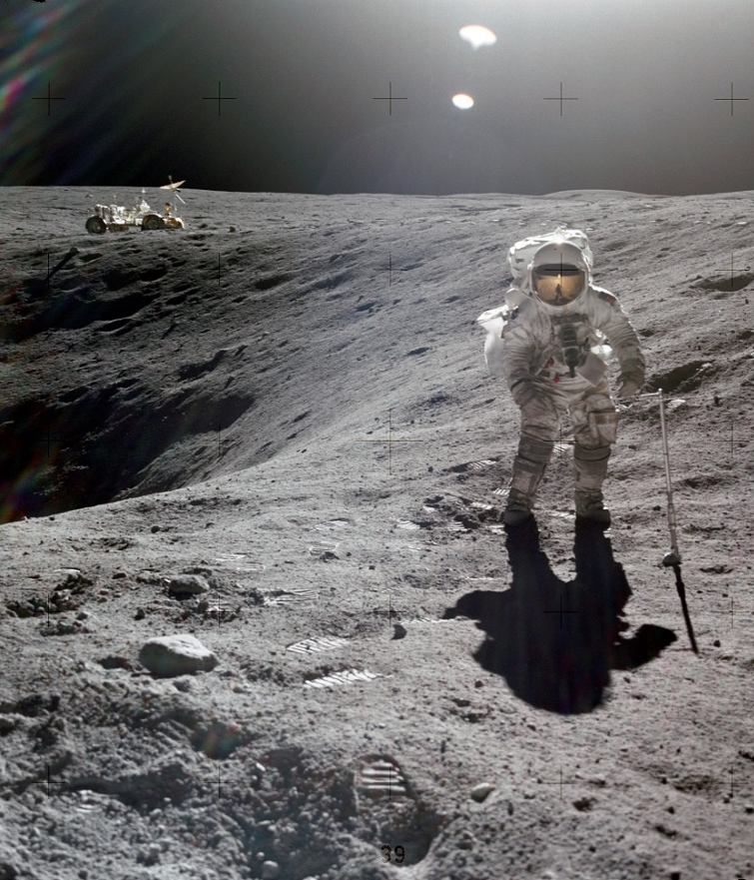
Agenda
Exploration Extravehicular Mobility Unit (xEMU)
xEMU Subsystems
Exploration Portable Life Support System
Pressure Garment Subsystem
Informatics Subsystem
Backup

Slide 3
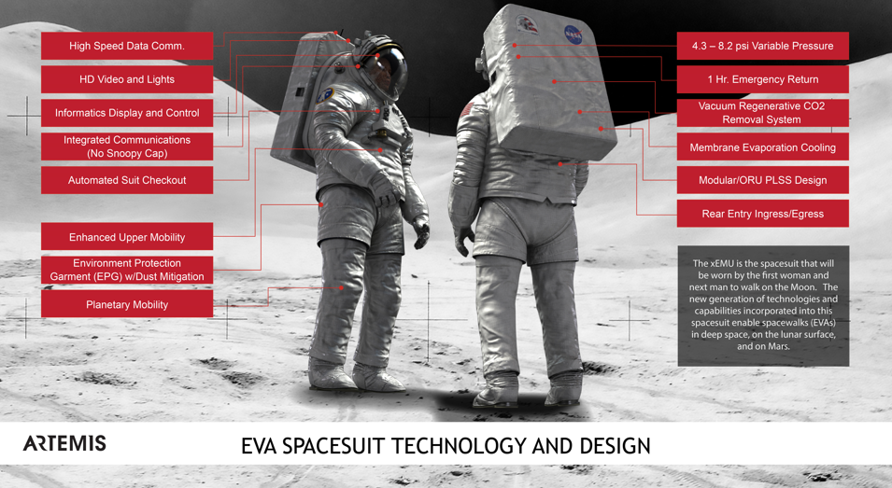
Exploration Extravehicular Mobility Unit (xEMU)
The Exploration Extravehicular Mobility Unit (xEMU) is the dedicated EVA suit system design for use during lunar flight dynamic phases (if needed), microgravity EVAs, and lunar surface excursions.
Reference the NASA Suit Up site: https://www.nasa.gov/suitup

Slide 4
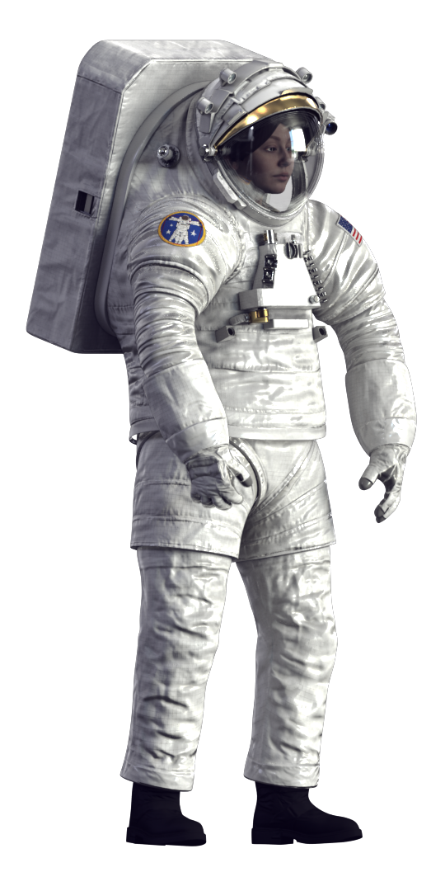
xEMU System Capability Overview
The xEMU will allow crewmembers to conduct excursions outside a vehicle in order to perform exploration, research, construction, servicing, and repair operations
A few key xEMU surface suit capabilities that will help accomplish the lunar science goals include:
  Supports EVAs of up to 8 hours in duration
  Capability to operate for up to 2 hours of contiguous exposure in a shadowed area, including Permanently Shadowed Regions (PSRs)
  Ability to perform tasks while standing and non-neutral postures (e.g., kneeling)
  Translation via walking, crawling on hands and knees (short distances with slow controlled motions), scrambling (traversing sloped terrain while using one's hands), and climbing steps and ladders
  Walking up/down/across a slope of up to 20° (Apollo 15 traversed on slopes of ~17°)
  Ambulating on traverses of up to 2 km away from the lander (Apollo 14 walked ~1.45 km from the lander)
  Improved lighting and cameras to support visual sight of ground ahead, EV partner in a PSR, lander, and the EV worksite

Slide 5
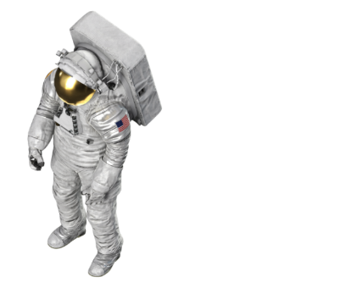
xEMU Subsystems
The xEMU System is comprised of the following subassemblies.
Portable Life Support Subsystem (xPLSS)
  Provides life support functions such as oxygen, thermal control and carbon dioxide removal
Pressure Garment Subsystem (xPGS)
  Provided anthropomorphic, pressurized, and protective structure worn by the crewmember
Informatics Subsystem (xINFO)
  Provides avionics and includes data processor, cameras and lighting that promotes crew autonomy and efficiency during EVAs.
xINFO
xPLSS
xPGS

Slide 6
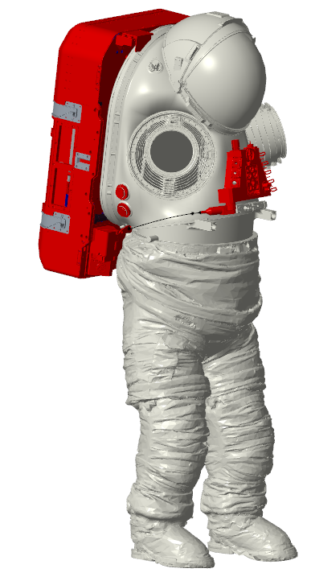
Exploration Portable Life Support System (xPLSS)
xPLSS – The Subsystem for xEMU
Portable Life Support System
  Oxygen storage
  Ventilation Loop
  Thermal Control Loop
  Power source
  Caution and Warning System
Display and Control Unit
  Provides control function switches to command attached PLSS controllers and CWS
PGS Mounted Items
  Pressure Relief Valves
PLSS
DCU
PGS Mounted Items
6

Slide 7
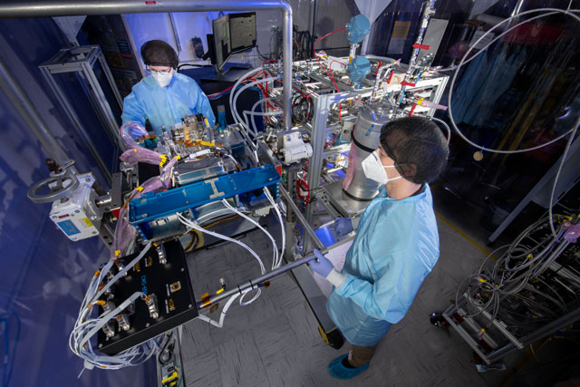
xPLSS Progress
Preliminary design complete and xPLSS team has been focused on completing component level design verification tests (DVT)
Assembly of the PLSS DVT unit is underway
Testing
  43 different tests planned to verify performance of the life support functions
  Perform 6 simulated 8hr EVAs with human-metabolic gas injection as well as thermal loop heat injection to verify entire system operation in the vacuum environment

Slide 8
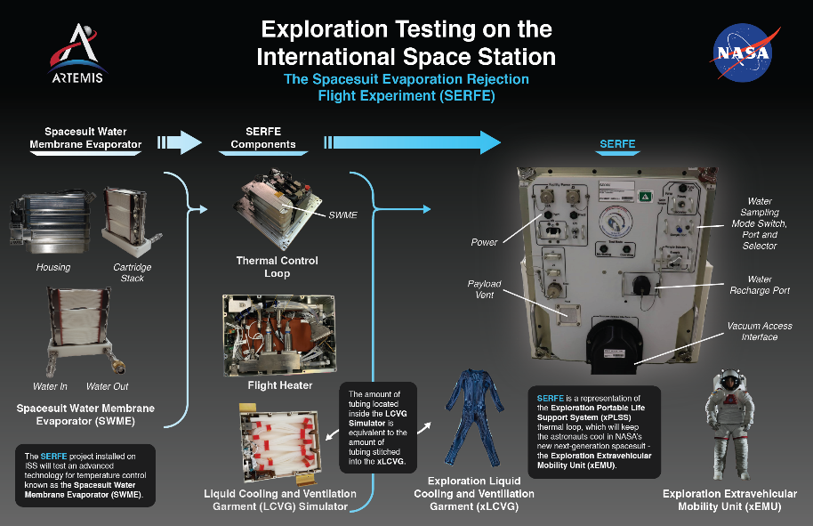
xPLSS - Spacesuit Evaporation Rejection Flight Experiment
Validating the xPLSS thermal loop system on ISS
Launched on NG-14 (Oct. 2, 2020)
Installed in ISS payload rack and 6 EVA series planned
  Each EVA Series simulates 4-5 EVAs at a time
  3 EVAs completed so far
Running a “sister” Ground unit in parallel
https://www.nasa.gov/suitup

Slide 9
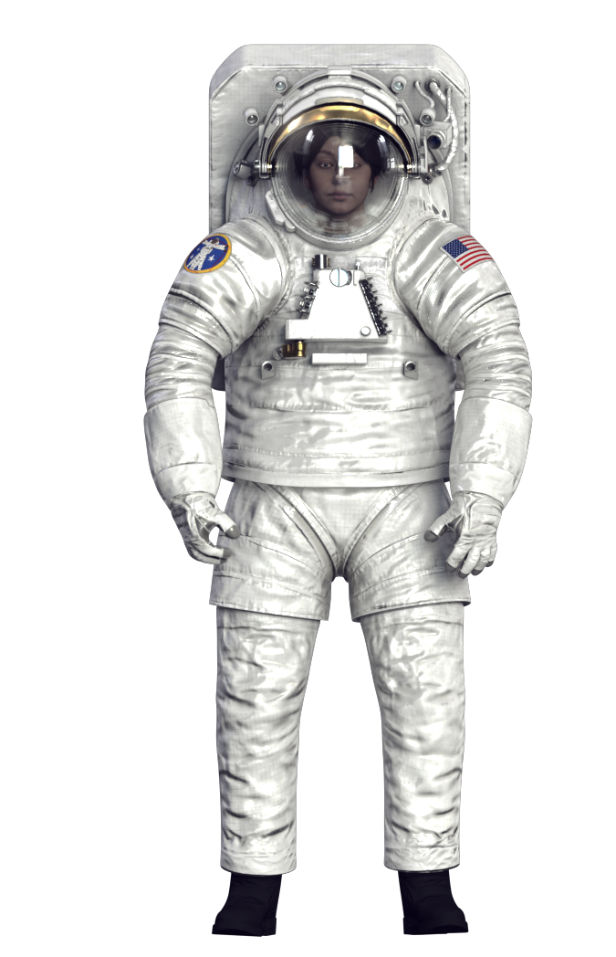
Pressure Garment Subsystem (xPGS) Subassemblies
Key Features
  Improved Mobility Design influenced by many years of EMU experience
  Designed to accommodate ~90% of female and male populations
  Integrated communication system
Upper Torso Assembly
  Comprised of the visor, helmet, Hard Upper Torso, shoulders, arms, and gloves.
Lower Torso Assembly
  Comprised of Waist/Brief/Hip Assembly, Leg Assembly and Boot Assembly
Supporting Components
  Liquid Cooling and Ventilation Garment, Wired Heart Rate Monitor

Slide 10
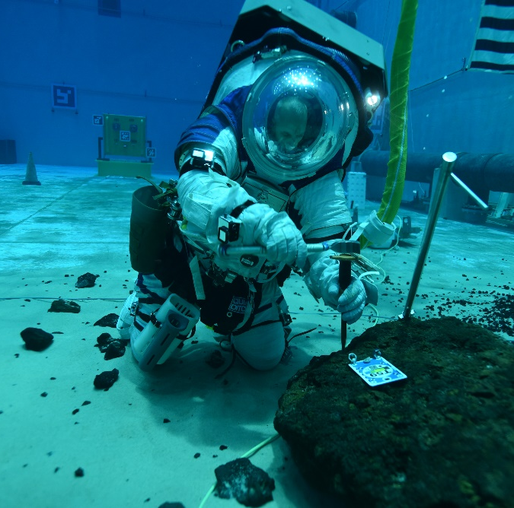
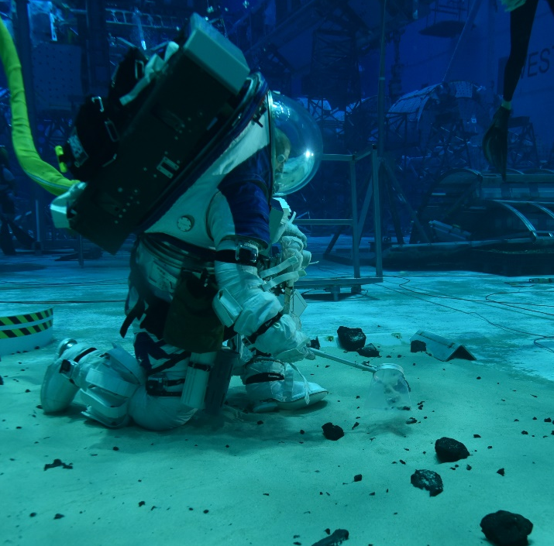
xPGS – Mobility Challenges
Suit must have the ability to:
  Kneel to perform rock and regolith sample acquisition
  Use EVA tools to remove pieces of rock forcibly from a larger rock
  Walk up and down slopes and distances up to 2km

Slide 11
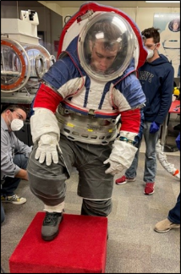
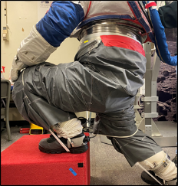
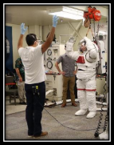
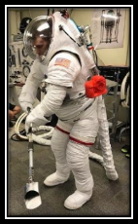
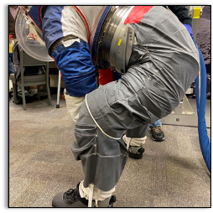
xPGS Progress
Performed numerous tests including 1/6-g NBL, HLS mockup evals, CO2 washout, “crewloads” testing, tool interface evals
Conducted multiple fit checks including the Hard Upper Torso (HUT), Lower Torso Assembly (LTA), and Waist Brief Hip (WBH)
Assembling flight-fidelity unit for testing

Slide 12
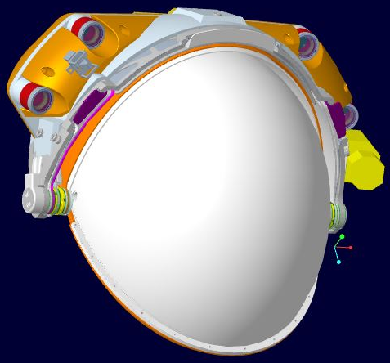
Informatics Subsystem (xINFO) Subassemblies
Work lights
The xINFO System is comprised of the following subassemblies;
  Informatics Lights and Band
    Upgraded nominal EVA task and translational lighting
  Informatics Camera
    HD Video recorded and streamed
  Informatics Antennas
    Provides two-way 802.11 wifi coverage to/from the vehicle
  Informatics Avionics
    Controls the xINFO lights and camera. Receives one-way voice and suit parameters from the Caution and Warning System. Records suit data and transmits to the ground via xINFO antennas.
Translational lights
Lights Toggle Switch
12
xINFO Camera

Slide 13
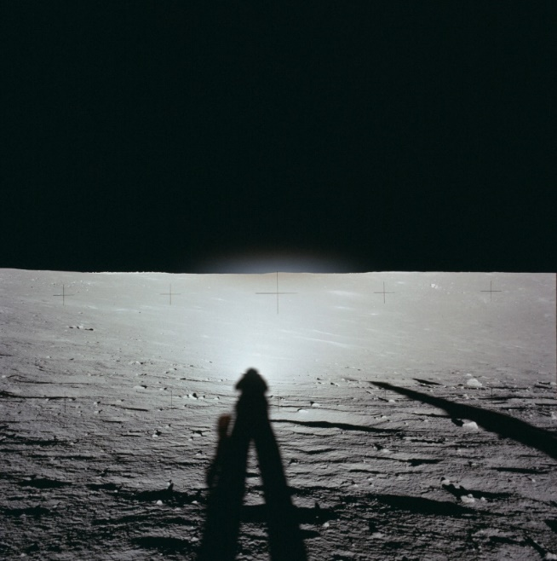
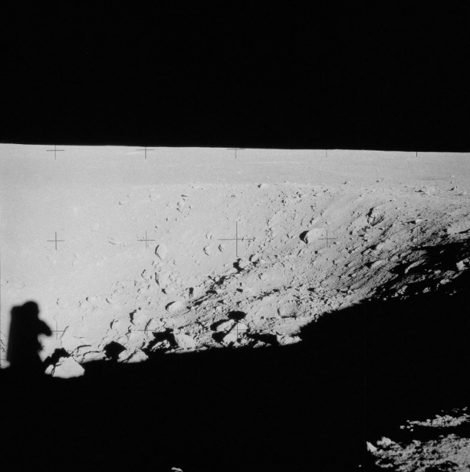
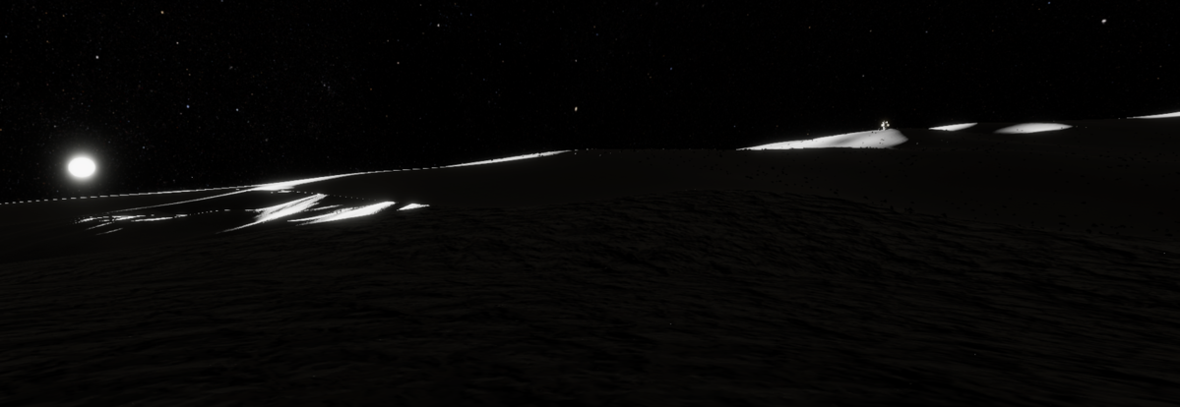
xINFO - Lighting Challenges
Lighting Design Background
Worksite volume increases compared to ISS worksite
Sample collection in Permanently Shadowed Regions (PSRs)
Low sun angle in Lunar South Pole means:
  Increased shadows
  Increased lighting for lunar translation
  Sample collection in shadowed regions
Facing down sun with low sun angle – Apollo 12
Shadow environment in crater – Apollo 12
VR Simulated view of lighting on the Lunar south pole

Slide 14
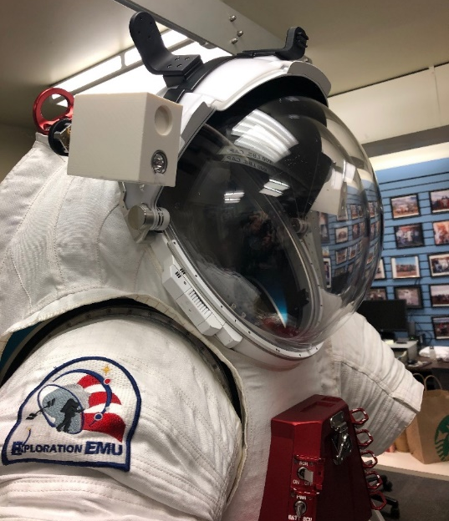
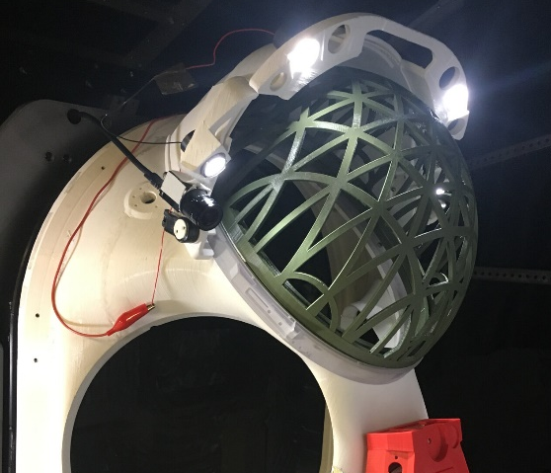
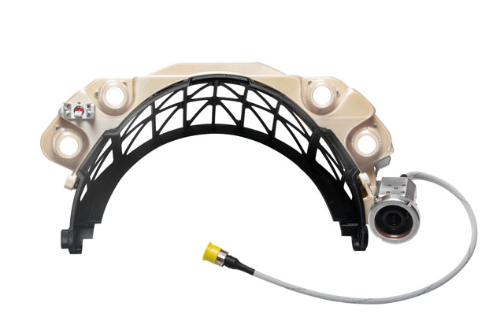
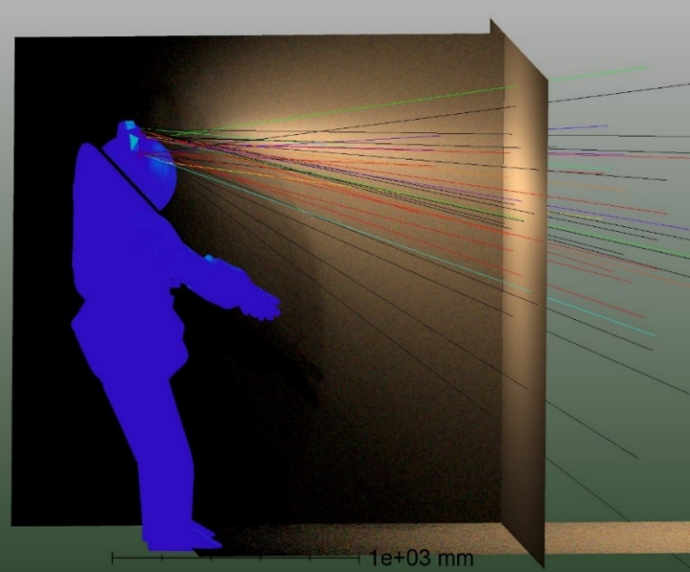
xINFO Lights Development
Analysis and hardware evaluations led us to a new design being required:
  Helmet structure limits pointing capability
  Light shines into helmet glass, creating glare
  Spot lights are too narrow (20 degree beam)
  Power consumption higher than allocated
New lights developed using iterative testing
  Explored multiple lighting options
  Built dark room for engineering evaluations
  Refining lighting requirements – illumination levels, lighted area, human factors, controls, etc.
This document has been approved for public release (ID 20210013671) and does not contain any export-controlled information

Slide 15
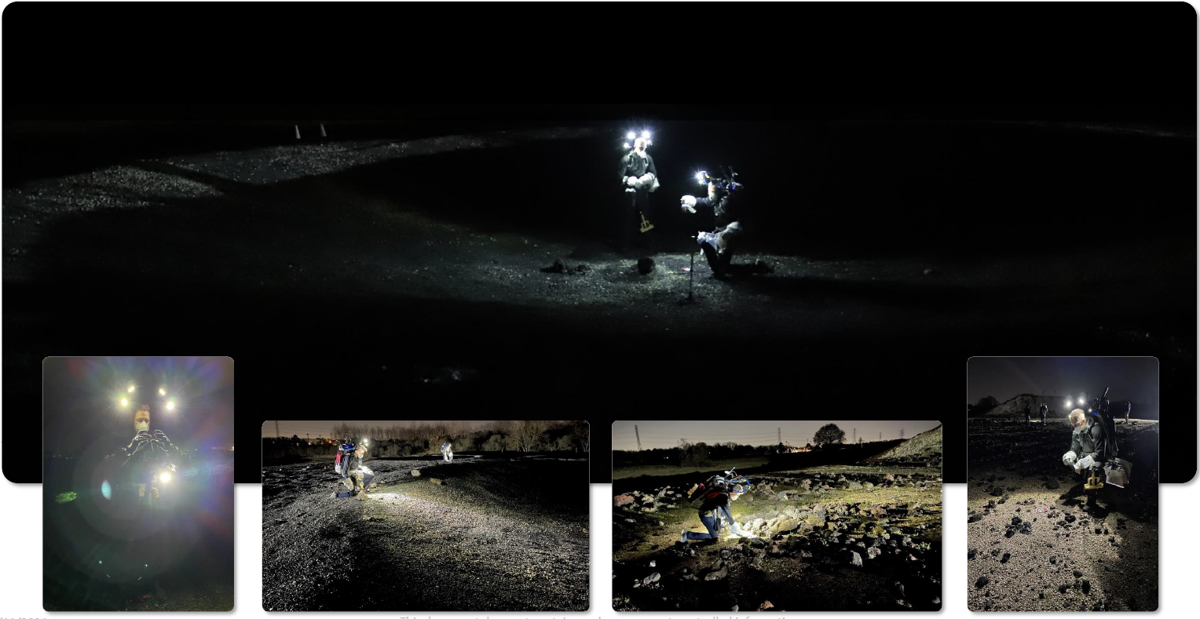
xINFO Lights Progress
Lighting Design Background
Development testing performed using representative lighting in the Rock Yard.
Testing of xINFO Lights in representative environment next.

Slide 16
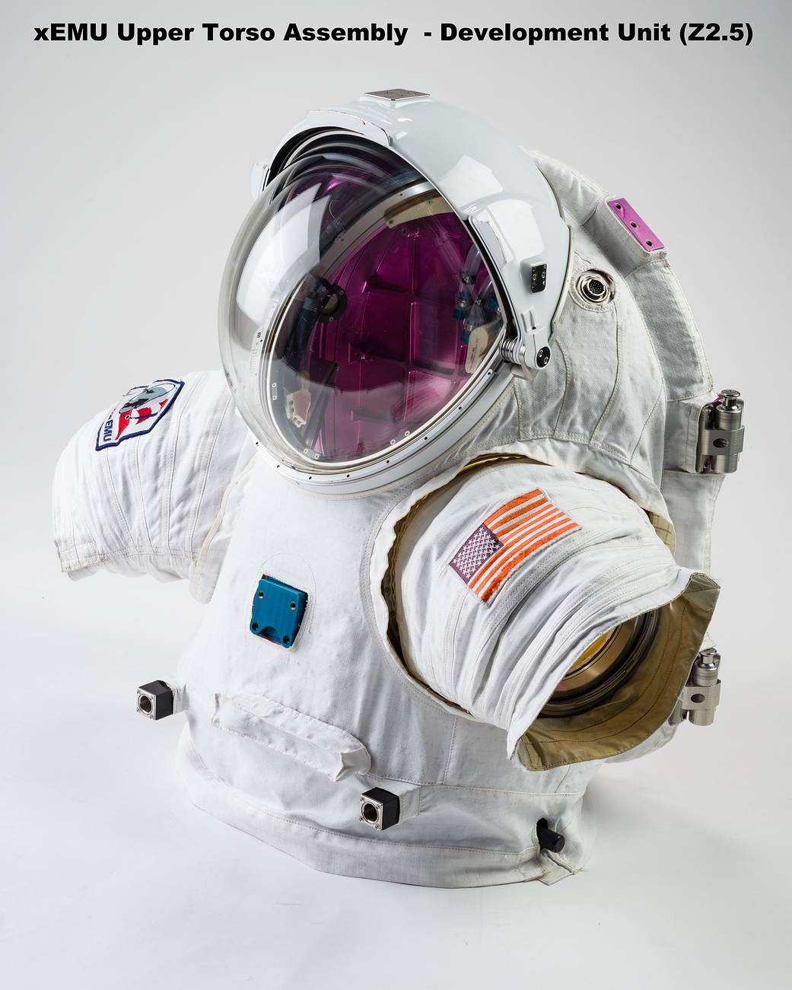
Forward path
xEMU Delta PDR completed Dec 2020.
Finish DVT Testing across all systems.
Execute Critical Design Review in 2022.
Complete ISS Demonstration of the xEMU
Continue EVA Support of ISS.
Continue development with HLS and US Industry for Lunar Surface Missions.

Slide 17
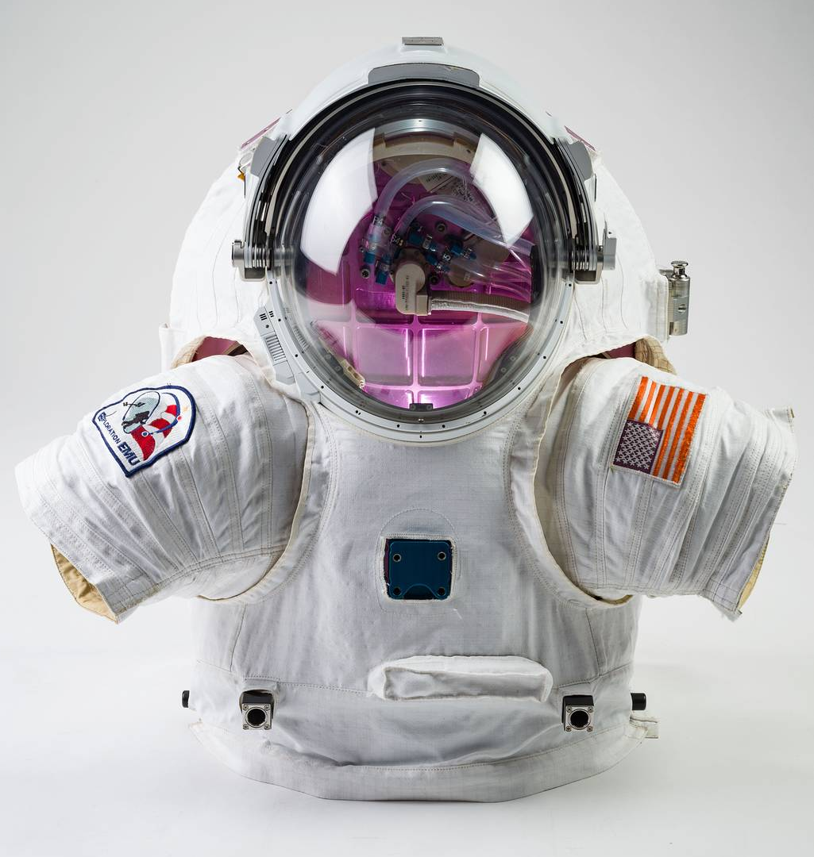
NASA Exploration Extravehicular Mobility Unit

