Slide 1
Phase transition energetics-based mass loss modeling of chondritic Near Earth Objects
Pratibha Raghunandan¹, Justin B. Haskins², Eric C. Stern²
¹ AMA, Inc., NASA Ames Research Center
² NASA Ames Research Center
April 26-30, 2021
e-Lightning Talk
7th IAA Planetary Defense Conference 2021

Slide 2
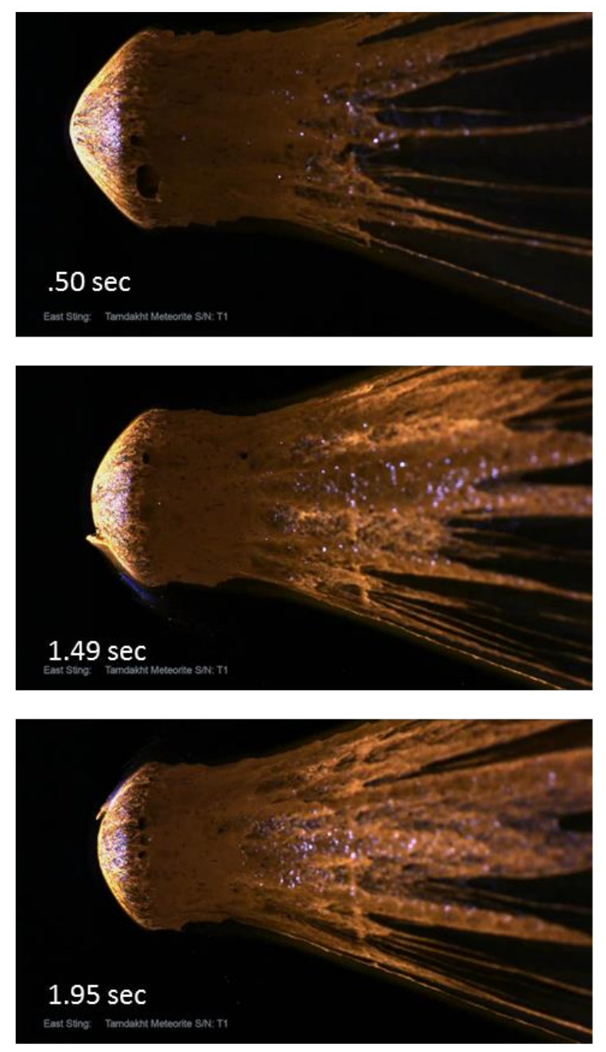
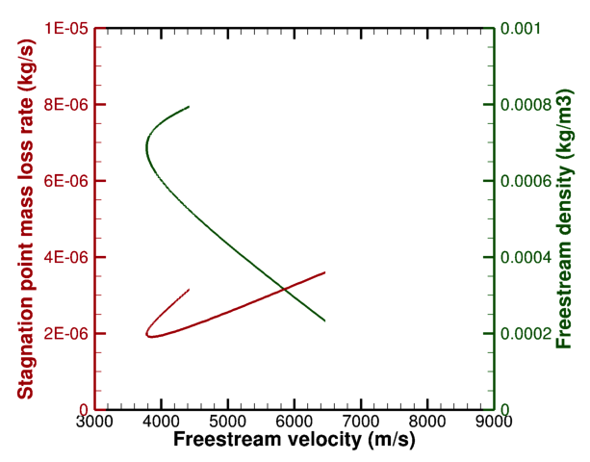
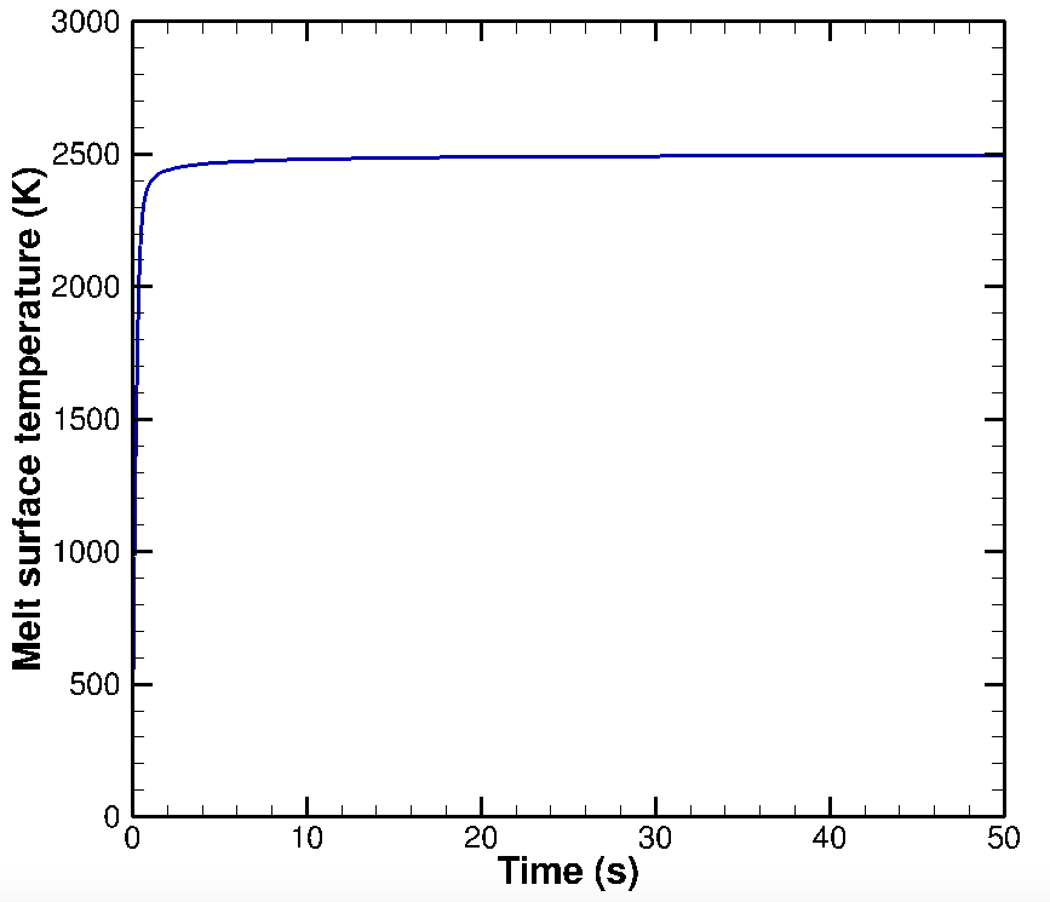
Phase-modified Material Response Modeling
Ab-initio modeling of viscosities
High-fidelity H-chondrite melting of small meteoritic samples using boundary layer formalism
Ref: AIAA 2018-4284
 | Quasi steady-state high-fidelity simulations with melting (R_{N} < 1 m) | Traditional estimates without phase change in literature (R_{N} > 1m)
C_{H}/Q (kg/J) | 1.1 - 1.43E-10 | 1 – 1.25E-08

Slide 3
Questions?

