Slide 1
Nuclear Space System Analysis & Modeling (NSSAM): A Software Tool to Efficiently Analyze the Design Space of Space Reactor Systems
Nuclear and Emerging Technologies for Space Conference (NETS) 2021
Analytical Mechanics Associates Inc.
April 27th, 2021
Kelsa Palomares, Christopher Harnack, Corey Smith, Reed Herner
Emanuel Grella, William Machemer, Samantha Rawlins
Notes:
Hi all,
I would like to take this time to overvoiw AMA\s approach to the SWOR assessment we are completing internally for thsi

Slide 2
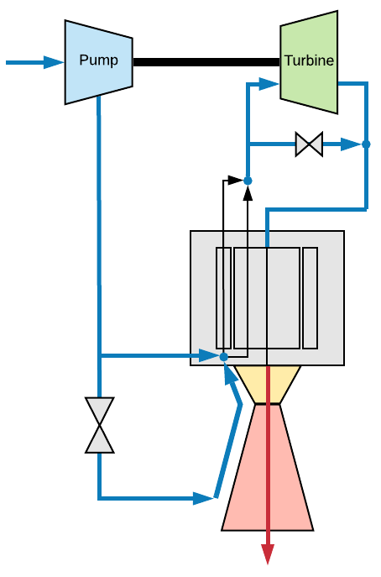
Motivation
During the industry flight demonstration (FD) study the “back and forth” exchange of designs between the reactor and engine was a barrier to understanding sensitivities in the design space
Analyses done to support the industry FD study showed that for the reactor:
  Average reactor behavior could be assessed via analysis of a representative “unit cell” based on the reactor configuration
  Performance limits of the reactor could be evaluated by representative hot channel and is based on fuel geometry and material properties
  Thermal hydraulic analyses based on reactor diffusion theory can provide low fidelity but acceptable analysis of the reactor performance space for rapid parametric analyses
We wanted to develop a tool that allowed systems engineers to explore the nuclear space system design space without the steep learning curve
  Reactor analysis was the largest hurdle that prevented performing parametric analyses and “apples to apples” comparison of designs
Nuclear Thermal Propulsion Engine Configuration

Slide 3
Development Needs, Goals, and Objectives
Intuitive and User Friendly
Modular, Scalable, Portable, and Extensible
High Fidelity and
Rapid Result Options
Why? Nuclear space systems require expertise from many areas for systems analysis.
How? Abstract away complex nuclear codes and thermal hydraulic physics, automate convergence of interface state points between reactor and engine models.
Why? Incremental improvement to capabilities based on resources and project needs.
How? Architecture supports constant improvements and easily adapted as modeling tools evolve.
Why? Nuclear analyses are valuable but typically computationally expensive, there was a desire to enable alternative use cases that could run quickly on a desktop.
How? Include multiple use case options that are compatible with high fidelity models or can be run quickly.
The software architecture was selected to enable the best chance at developing a tool which targeted these objectives

Slide 4
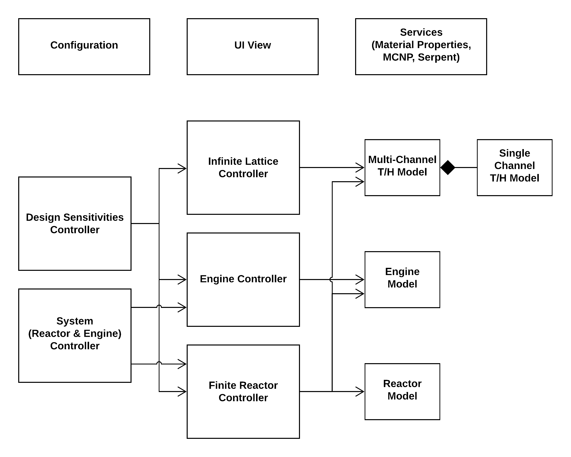
NSSAM Architecture
Programming language: python
  Most popular open-source language with substantial community support
  Significant performance advantage over MATLAB and similar tools
  Easily interfaces with nuclear physics software (MCNP, Serpent) and other external tools
  Portable to all operating systems
Architecture: object-oriented (e.g. model-view-controller pattern)
  Configurability/scalability – supports a wide range of system designs and user inputs
    Accomplished via model inheritance and abstractions
  Extensibility – easy to incorporate additional capabilities
  Modularity – models are analogous to physical components with their properties/attributes

Slide 5
How does it work?
Build Reactor Unit Cell, Working Fluid and Material Property Services Initiated, Cycle Controller Designated for Reactor Engine Convergence, Reactor Physics Service
User Interacts with Command Prompt
Convergence criteria not met:
Δk, ΔP_{i}, ΔT_{i}
Thermal Hydraulic Guess of Reactor Temperature & Power Profile
Convergence criteria not met:
T_{exit}, p_{exit}, ṁ_{tot}
Reactor Physics Analysis
Convergence criteria met:
T_{exit}
NSSAM writes and runs reactor physics input file
Engine Analysis
Convergence criteria met:
T_{exit}, Δk, ΔP_{i}, ΔT_{i}
NSSAM passes reactor fluid interfaces to engine models
Settings File
Convergence Criteria
Initial Boundary Conditions
Other assumptions necessary for the analysis
NSSAM Output
All Convergence Criteria Met
Relevant Views Prepared for the User

Slide 6
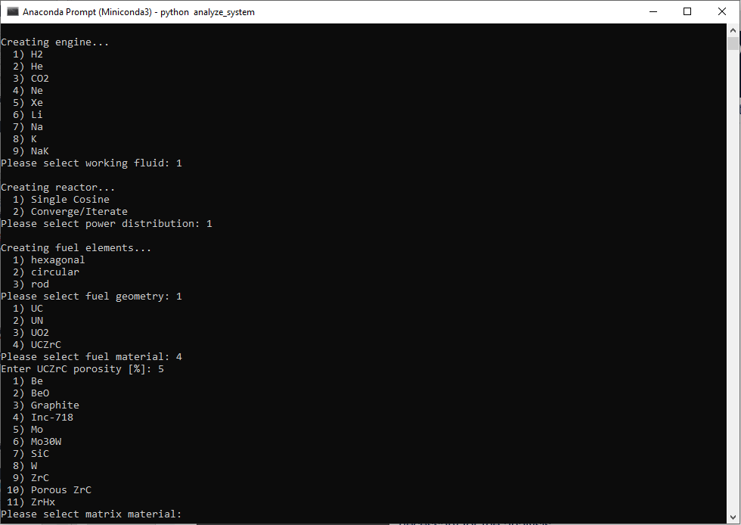
Step 1: User Supplies Information about the System They Want To Analyze
Build Reactor Unit Cell, Working Fluid and Material Property Services Initiated, Cycle Controller Designated for Reactor Engine Convergence, Reactor Physics Service
User Interacts with Command Prompt
Settings File
Convergence Criteria
Initial Boundary Conditions
Other assumptions necessary for the analysis

Slide 7
Step 2: NSSAM develops initial first guess of temperature distribution within the reactor and writes/runs reactor physics inputs
Build Reactor Unit Cell, Working Fluid and Material Property Services Initiated, Cycle Controller Designated for Reactor Engine Convergence, Reactor Physics Service
User Interacts with Command Prompt
Thermal Hydraulic Guess of Reactor Temperature & Power Profile
Convergence criteria met:
T_{exit}
NSSAM writes and runs reactor physics input file
Settings File
Convergence Criteria
Initial Boundary Conditions
Other assumptions necessary for the analysis

Slide 8
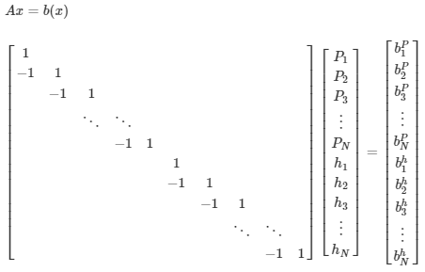
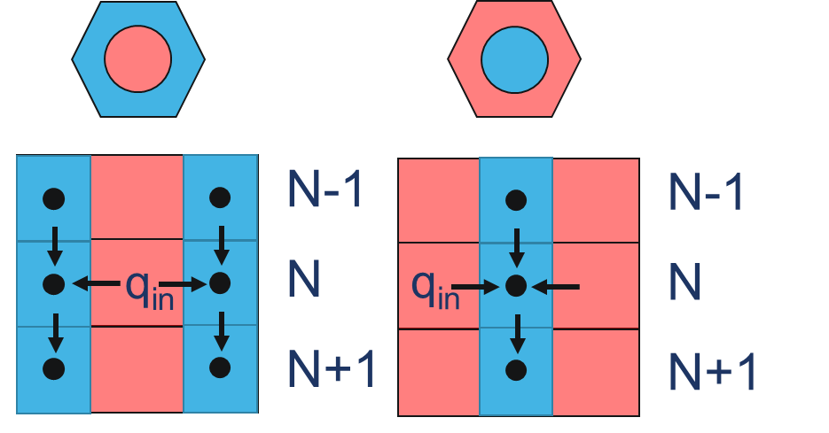

Thermal Hydraulics and Channel Models
1-D forward difference solution of conservation of mass, energy, and momentum
Working Fluid Options
H₂
He, HeXe, Xe, Ne, SCO₂
Liquid Metal: Na, K, Li, NaK
Don’t forget! Heat transfer correlations are dependent upon:
Channel geometry
Working fluid
Fluid property regime (T, p, v, T_{w}/T_{b})
Object oriented architecture really supports navigating these cases
Assume Cosine Power Profile
Calculate Bulk Fluid Temperature
User Defined Exit Condition for Convergence and Power Density
Fluid Exit Conditions Converged
Calculate Fluid Wall Temperature
Calculate Component Temperatures for Reactor Models

Slide 9
Step 3: NSSAM “reads” the reactor physics code outputs and recalculates temperature distribution. This process is repeated until convergence is met.
Build Reactor Unit Cell, Working Fluid and Material Property Services Initiated, Cycle Controller Designated for Reactor Engine Convergence, Reactor Physics Service
User Interacts with Command Prompt
Convergence criteria not met:
Δk, ΔP_{i}, ΔT_{i}
Thermal Hydraulic Guess of Reactor Temperature & Power Profile
Reactor Physics Analysis
Convergence criteria met:
T_{exit}
NSSAM writes and runs reactor physics input file
Settings File
Convergence Criteria
Initial Boundary Conditions
Other assumptions necessary for the analysis

Slide 10
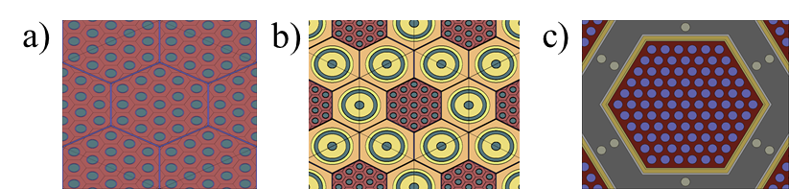
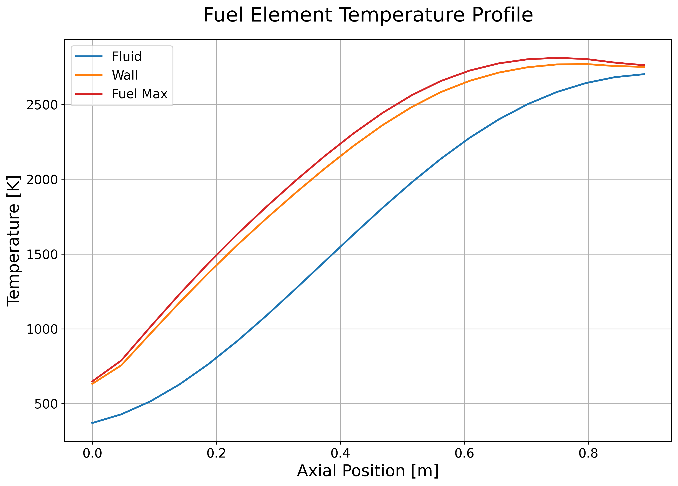


Reactor Component Models
This model is capable of evaluating a coupled thermal hydraulics-reactor physics solution of the engine
  Axial segments of each reactor component are used to designate axial temperature gradients, material densities, and detectors for component axial power profile
Unit Cell Options
Unmoderated
Moderator Block
Tie-Tube Moderated (multiple configurations)
Customizable Materials
Fuel Options: UO₂, UN, UC₂, (U,Zr)C
Fuel Matrix Options: Graphite, ZrC, Mo, W, MoW
Insulator Options: Porous Zirconium Carbide
Moderator Options: ZrH_{x}, Be, BeO, Graphite
Current Service Options for Reactor Physics
Monte Carlo N-Particle (MCNP) or Serpent 2
T/H model passes component temperature distribution
Reactor Physics Service Writes and Runs Inputs
Component Axial Temperature Profile Recalculated
Reactor Physics Service extracts component axial power profiles
Fluid Exit Conditions and Power Profile Converged
Calculate Interface Fluid Conditions for System Model

Slide 11
Step 4: Reactor fluid conditions at the interface are passed to engine component models and the process is repeated until convergence is met.
Build Reactor Unit Cell, Working Fluid and Material Property Services Initiated, Cycle Controller Designated for Reactor Engine Convergence, Reactor Physics Service
User Interacts with Command Prompt
Convergence criteria not met:
Δk, ΔP_{i}, ΔT_{i}
Thermal Hydraulic Guess of Reactor Temperature & Power Profile
Convergence criteria not met:
T_{exit}, p_{exit}, ṁ_{tot}
Reactor Physics Analysis
Convergence criteria met:
T_{exit}
NSSAM writes and runs reactor physics input file
Engine Analysis
Convergence criteria met:
T_{exit}, Δk, ΔP_{i}, ΔT_{i}
NSSAM passes reactor fluid interfaces to engine models
Settings File
Convergence Criteria
Initial Boundary Conditions
Other assumptions necessary for the analysis

Slide 12
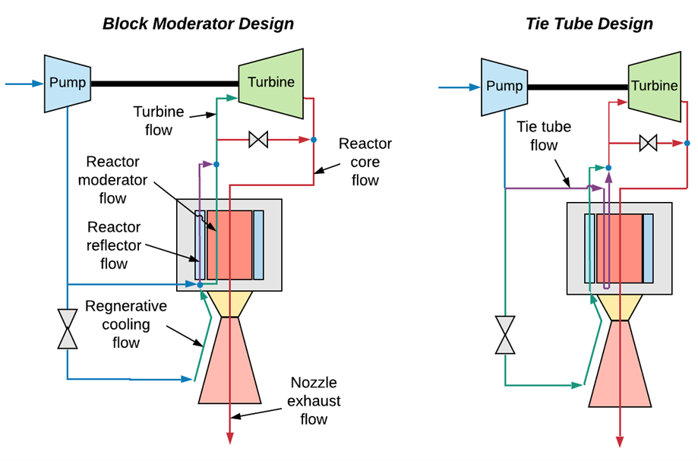
Non-nuclear Engine Models
System controller couples engine models with reactor calculations
Reactor configuration governs the interfaces between reactor and engine
Implemented engine components
Pump
Turbine
Thrust chamber
Nozzle, including regenerative flow channels
Piping and valves
Engine subsystem components
Reactor First Pass (Reflector and Moderator Models)
Turbine Model
Reactor Model Passes Fluid State Points and Power Profiles
Chamber Model
Regen Nozzle Model
Fuel Model
Chamber Model
Fluid Exit Conditions Converged

Slide 13
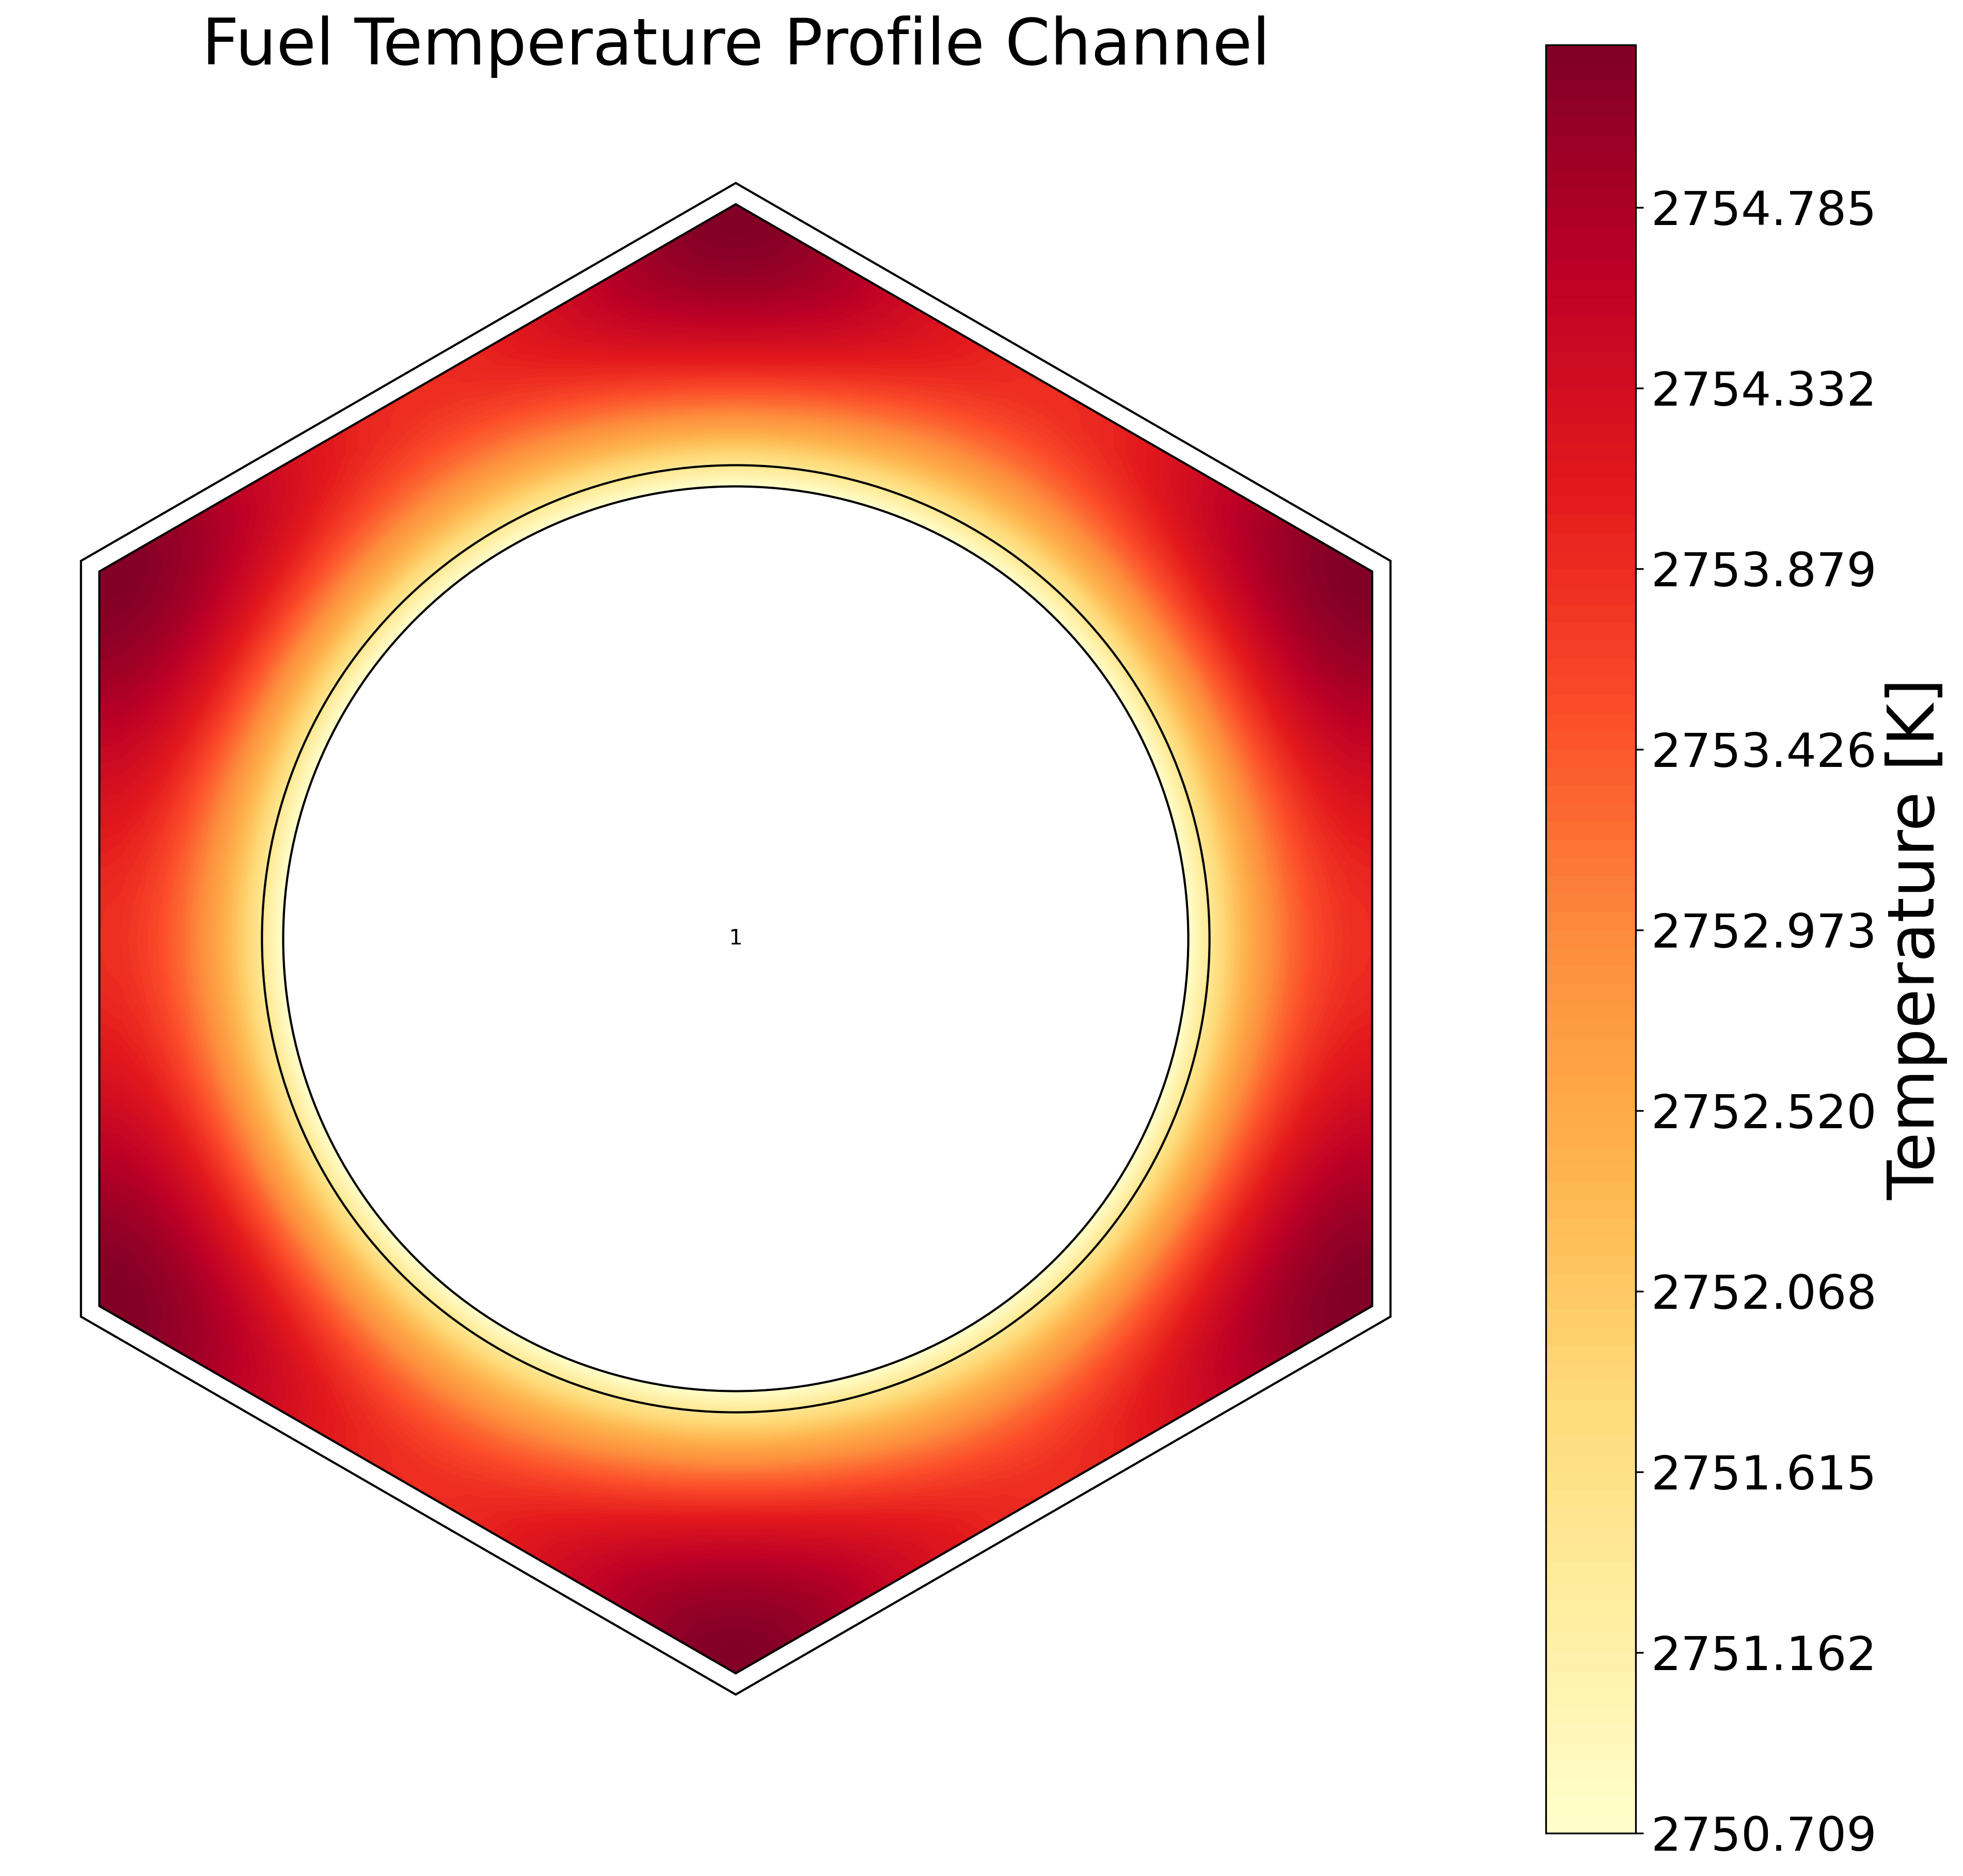
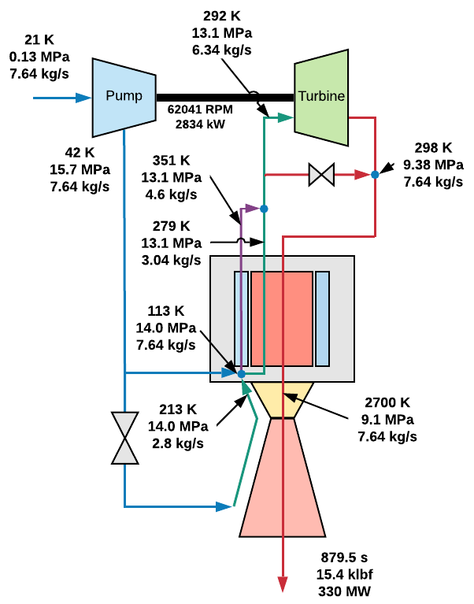
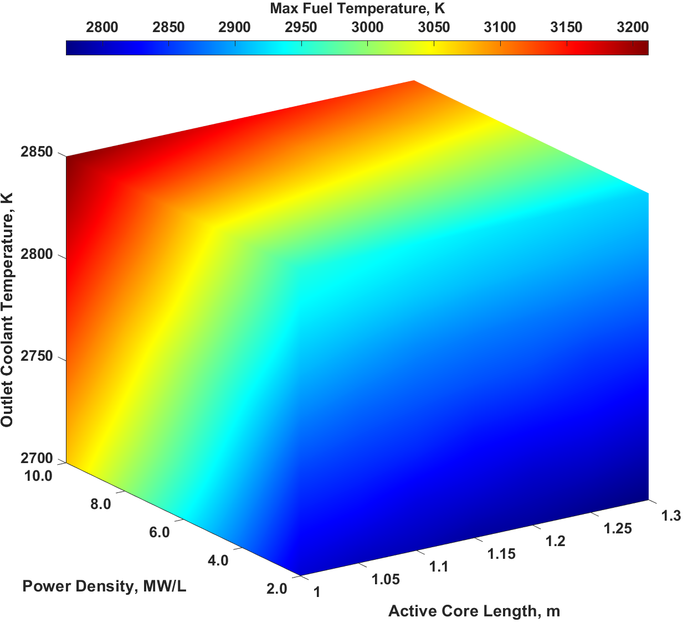
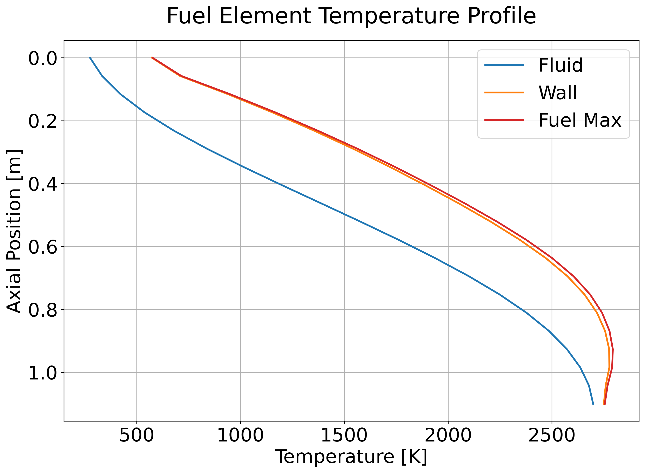
NSSAM outputs available to the user are customized to different use cases
Analyze Infinite Lattice
Analyze System
Analyze Sensitivities
Fluid, fuel, moderator temperature profile
Axial power profile
Pickle file stores all calculated values and variables
Unit cell fluid, fuel, moderator temperature profile
Power balance
Reactor sizing estimate
Pickle file stores all calculated values and variables
MATLAB visualization of NSSAM Analyze Sensitivities output
Pickle file stores all calculated values and variables
Matrixed output of critical variables

Slide 14
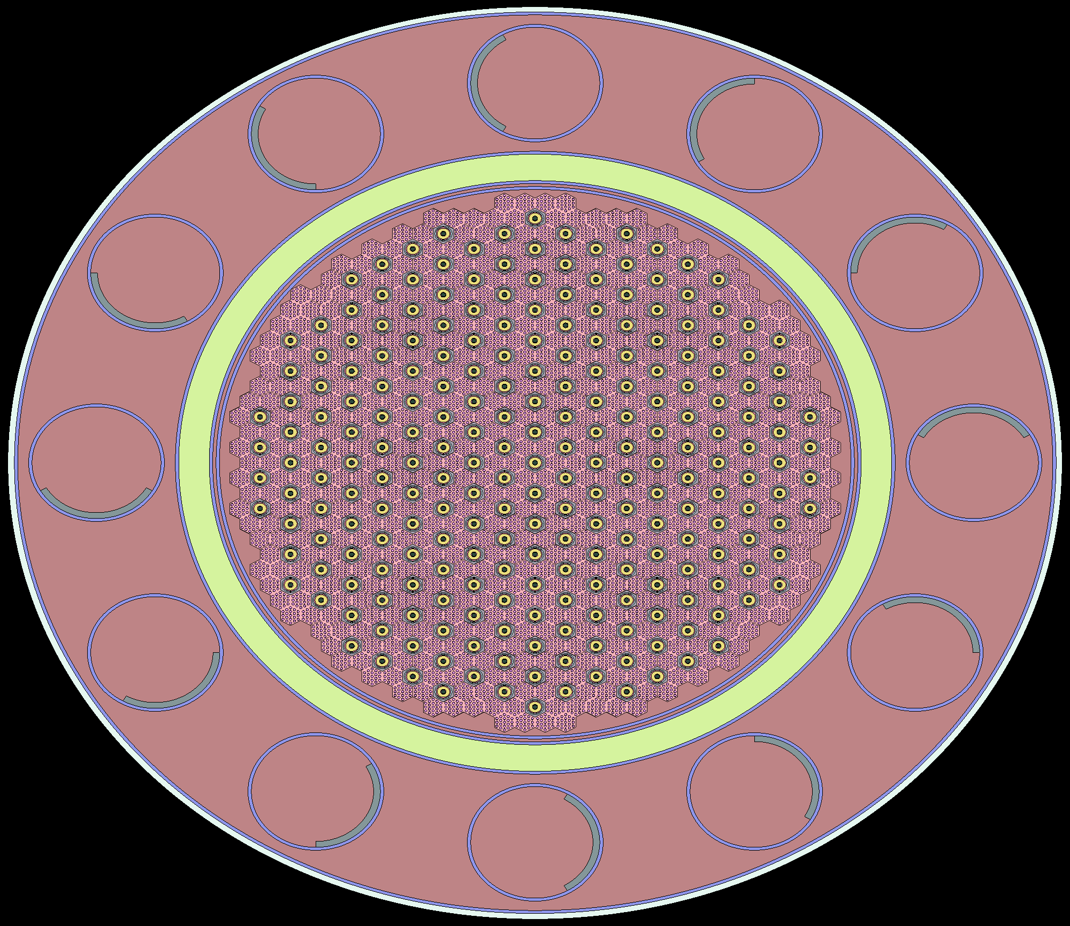
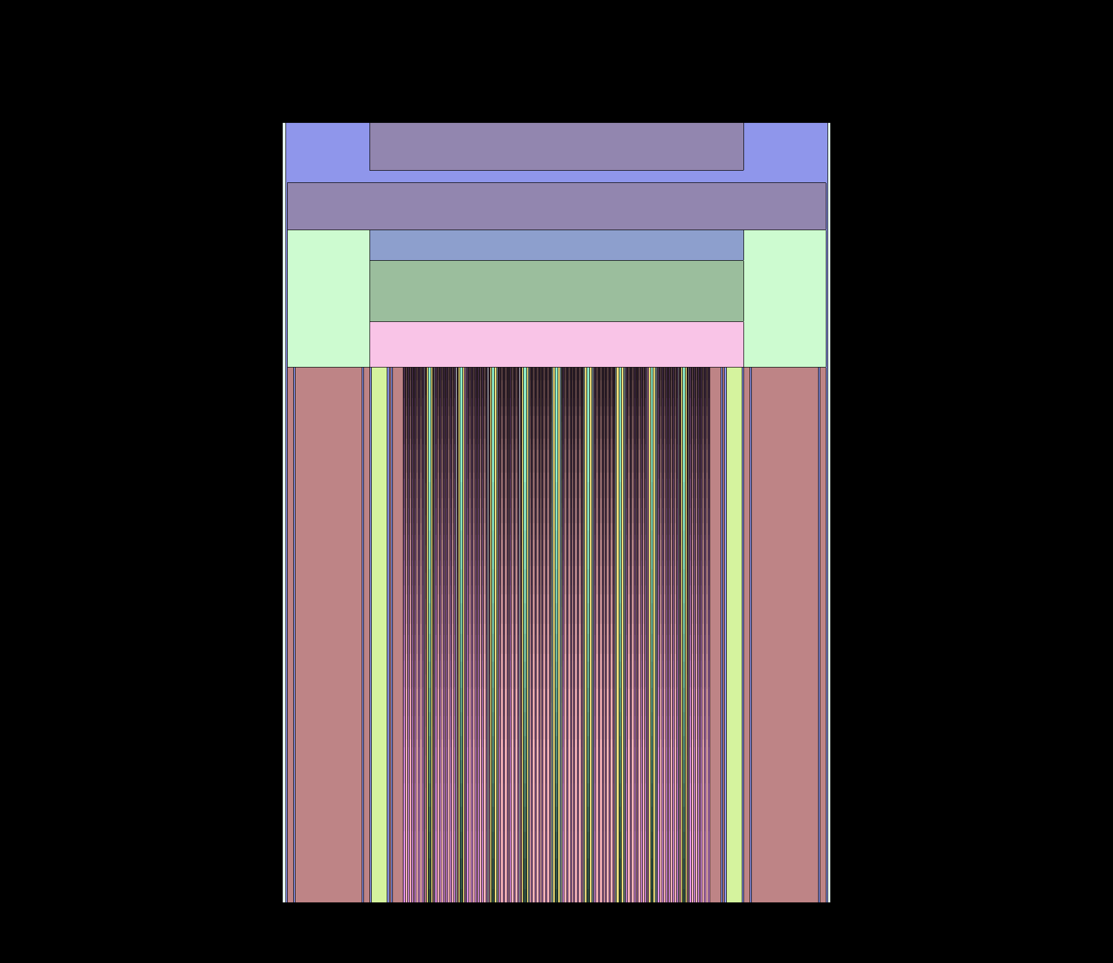
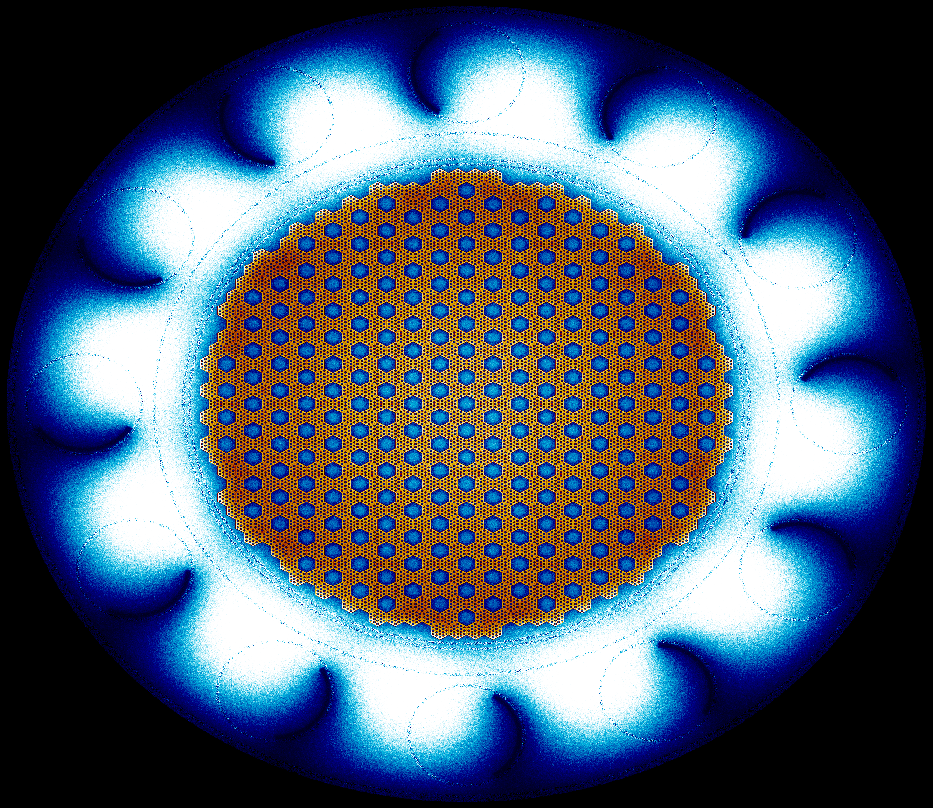
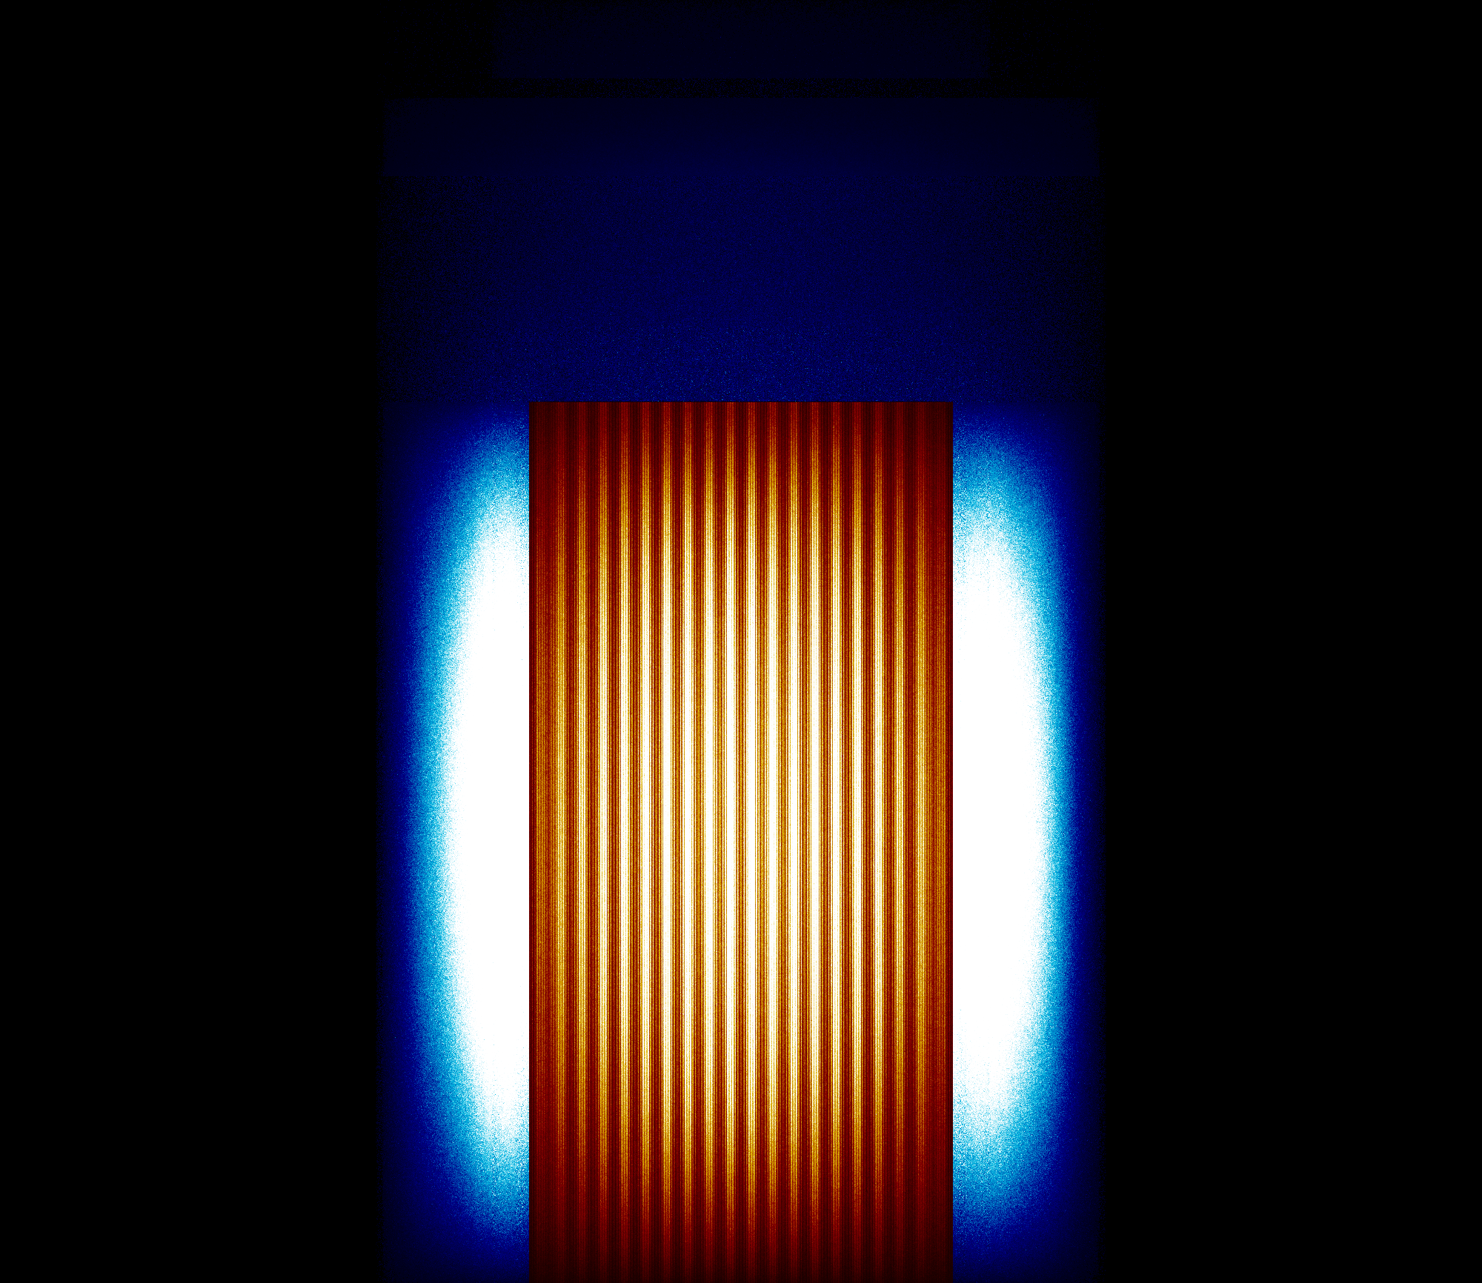
Reactor Benchmark: Small Nuclear Rocket Engine
The small nuclear rocket engine is a common benchmark case consisting of a HEU-composite fuel form, ZrHx containing tie-tubes for a 17.5 klbf thrust engine.
The AMA model matches the number of fuel elements, tie-tubes, and control drums, as well as the overall geometric dimensions of the reactor components (fuel element channel diameters, flat to flat, reactor diameter and length, reflector thickness, etc.). The reactor plenum and surrounding components use the reported attributes from the Schnitzler SNRE model. Key differences in the AMA model is the use of 19 axial temperature nodes for the reactor core and does not include hydride s(α,ꞵ) cross sections. Reported state point values assume average axial reactor power profile per assembly.
Parameter | SNRE reported | AMA Model | % Difference
Power (MWth) | 367 | 367 | - Boundary Condition
k_{eff} | - | 1.0655 | -
ṁ (kg/s) | 8.33 | 8.46 | 1.56%
Peak Fuel Temperature (K) | ~2800* Mean matrix temp. | 2824 | 0.86%
State Point | SNRE reported T (K), P (MPa) | AMA Model T (K), P (MPa) | % Difference
Reactor Inlet | 370, 3.96 | 364, 3.96 | - Boundary Condition
Reactor Exit | 2727, 3.10 | 2728, 3.49* | 0.04, 12.6%
Cross Section Views of the AMA SNRE Model
Output Serpent Mesh Plots for the AMA SNRE Model

Slide 15
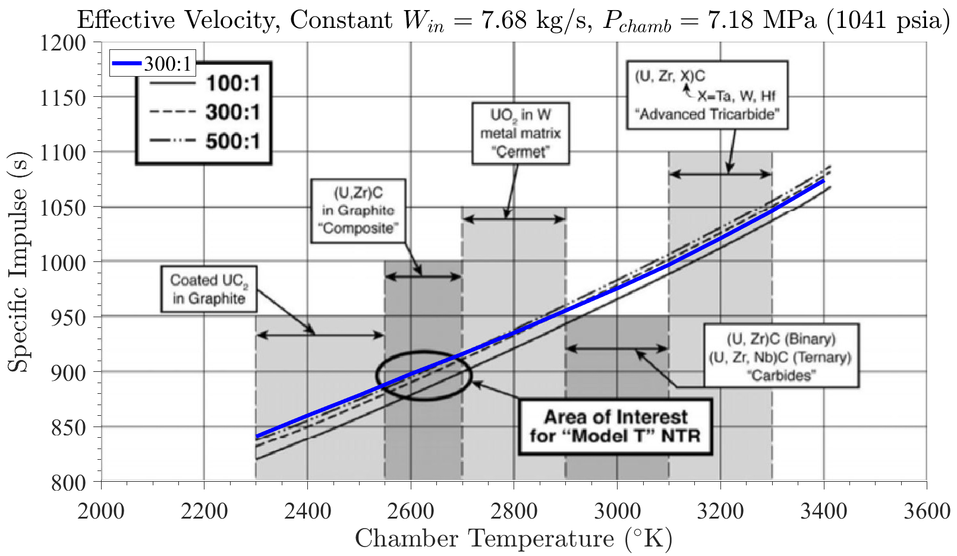
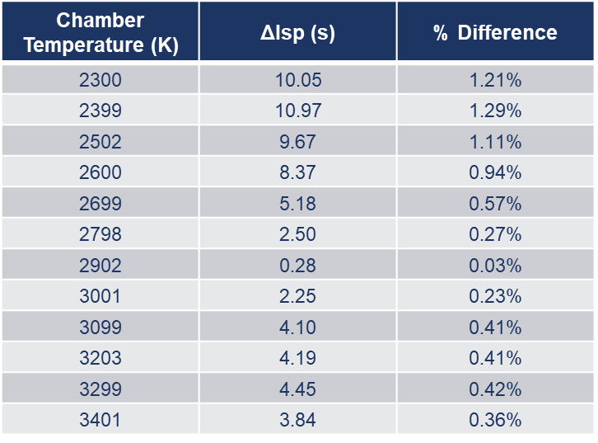
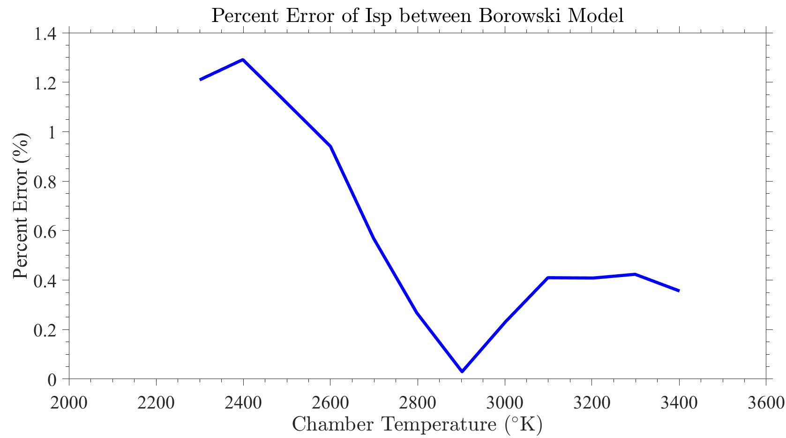
Engine Calculation Benchmark: Specific Impulse
Calculated specific impulse was in good agreement with that reported in Borowski et. al. (2012)
  Overall Percent Error: <1.5% (< 15 s)
  Specific impulse overpredicted at low exit temperatures (< 2900 K)
  Specific impulse underpredicted at high exit temperatures (> 2900 K)
Source of discrepancies between models is still being investigated
Modified from: Borowski, S., McCurdy, D., Packard, T., Nuclear Thermal Propulsion (NTP): A Proven Growth Technology for Human NEO / Mars Exploration Missions, 2012 IEEE Aerospace Conference
Isp vs. Chamber Temperature Trendline
Blue: NSSAM Updated physics as of 2/2021
Specific impulse was calculated for a constant exit pressure and propellant exit temperatures between 2300 – 3400 K
Nozzle assumptions: Steady state, isentropic & frozen flow, calorically perfect gas, power removed by nozzle regen is removed from nozzle flow

Slide 16
Conclusions and Future Work
Evaluating alternatives to conventional Monte Carlo nuclear physics codes
  Licensing lead times and cost of Serpent and MCNP present a barrier to wider use of NSSAM within our team
Finite Reactor Sizing and Analysis
Non-Nuclear System: Generic Engine
  Current engine component models are thrust rated
Non-Nuclear System: Power Cycle
Constant Updates and Verification
  Materials
  Unit Cell Geometries
  More Detailed Models and Special Use Cases
  Verification and validation for different benchmark cases and internal calculations (reactor physics)

