Slide 1

HRP Research Operations and Integration (ROI)
ISS Facilities Overview
REVISED August 2022
PUBLIC RELEASE APPROVED
NF-1676 20210013701
Trade names and trademarks are used in this report for identification only. Their usage does not constitute an official endorsement, either expressed or implied, by the National Aeronautics and Space Administration.

Slide 2
Current and Planned Flight Facilities*
Hardware Systems
  Actiwatch Plus
  Cerebral Cochlear Fluid Pressure Analyzer (CCFP)
  Distortion Product Otoacoustic Emissions Device (DPOAE)
  Electroretinograph (ERG)
  Falcon Goggles
  Gas Delivery System (GDS)
  Human Research Facilities 1 and 2 (HRF 1 & 2)
  HRF Centrifuge
  HRF Payload Drawer
  HRF Portable Computers
  Light Meter
  Pneumatonometer (PTM)
  Space Linear Acceleration Mass Measurement Device (SLAMMD)
  Ultrasound 2
  Vortex Mixer
Consumable Hardware **
  HRF Supply Kits (Purple and Green)
  Blood Collection
  Saliva Collection
  Urine Collection
  Fecal Sample Collection
  Microbial Sample Collection
Software
  Cognition
*Capabilities listed in the following slides as "currently available" are available and certified for ISS use, but may not necessarily be onboard the ISS at a given point in time depending on resupply and maintenance requirements
** Consumable Hardware is available only to HRP sponsored studies.

Slide 3
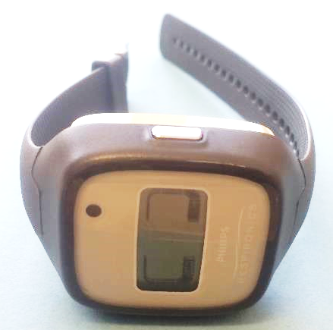
Actiwatch Plus
Currently available
Waterproof sleep-wake monitor worn on the wrist
Measures motion and ambient lighting
  3-axis accelerometer for motion
  Integrated RGB and white light sensor for ambient lighting
  Crew event marker recording with a button press
Can be used to analyze circadian rhythms, sleep-wake patterns and activity
Useful for the investigation of sleep quality, sleep onset, hyperactivity and other daily routines
Modified commercial-off-the-shelf (COTS) system consisting of the Actiwatch Plus, Actiwatch Plus Kit, Actiwatch Plus USB Cable, USB Hub, and Actiware Software (v. 6.0.9 or later).

Slide 4
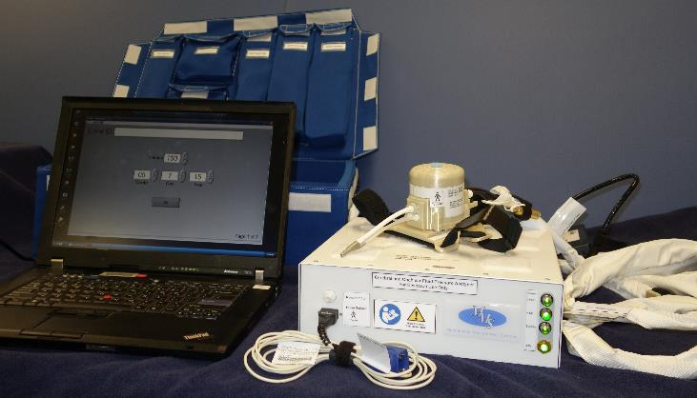
Cerebral Cochlear Fluid Pressure Analyzer (CCFP)
Currently available
Indirectly measures Intracranial Pressure (ICP) by measuring Tympanic Membrane Displacement (TMD) under various stimuli
  Can also perform Tympanometry
Sensors for CCFP analysis are in the CCFP Headset and will interface with crewmember's ear canal via tubing with an ear tip
Two other components work with the headset:
  The Pulse Oximeter is placed on the finger to measure Pulse and O₂ saturation
  The Cannula interfaces with the nostrils to monitor respiration

Slide 5
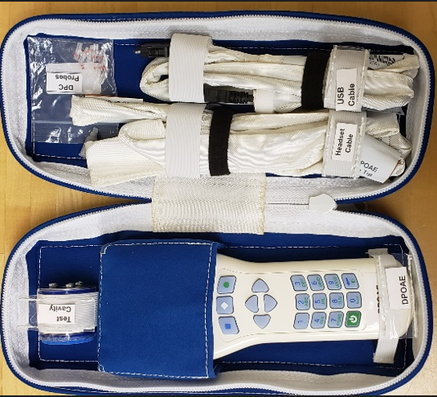
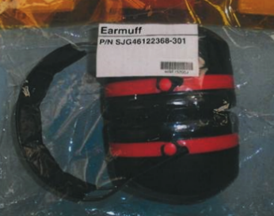
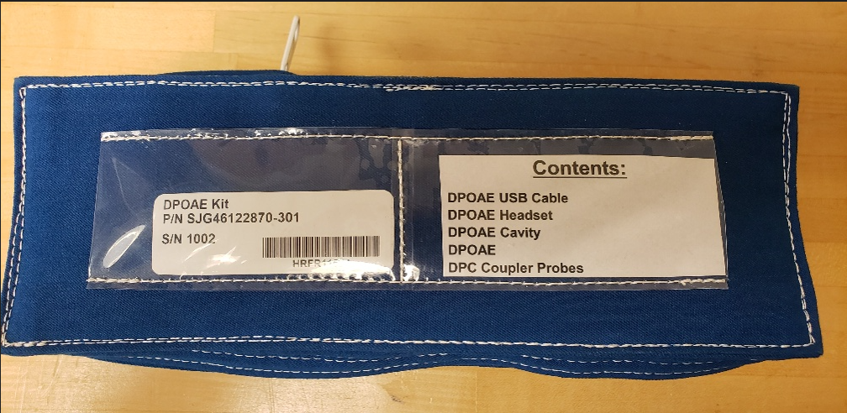
Distortion Product Otoacoustic Emissions (DPOAE)
Currently available
The DPOAE is a commercial off the shelf unit called Otoport Advance, produced by Otodynamics Audiology Systems
Used to take Otoacoustic Emissions (OAE) measurements
Handheld device with an ear probe fitted with a speaker and microphone
Measures cochlear response pairs of f1 and f2 frequencies used in turn to acquire emissions from areas along the cochlea
These measurements allow the first signs of deafness to be detected
Earmuffs used in conjunction with the DPOAE to isolate ISS noise during measurements
Earmuffs

Slide 6
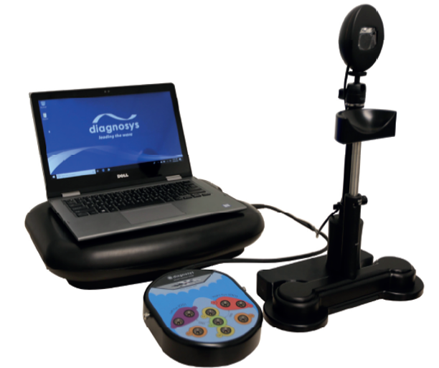
Electroretinograph (ERG)
Currently available
The ERG system is a measurement device based on the Diagnosys E³ System that supports a variety of visual electrophysiology modalities.
  The ERG is deployed and powered from an HRF Payload Drawer, with test protocols and databases managed from an HRF PC.
Available Accessories:
  Monocular Pattern Stimulator (EnvoyTM OLED Monitor)
  Monocular Flash Stimulator (ColorBurst Ganzfeld Stimulator)
  Chin Rest
The following modalities have been certified for operations:
  Photopic Negative Response (PhNR)
  Pattern ERG (PERG)

Slide 7
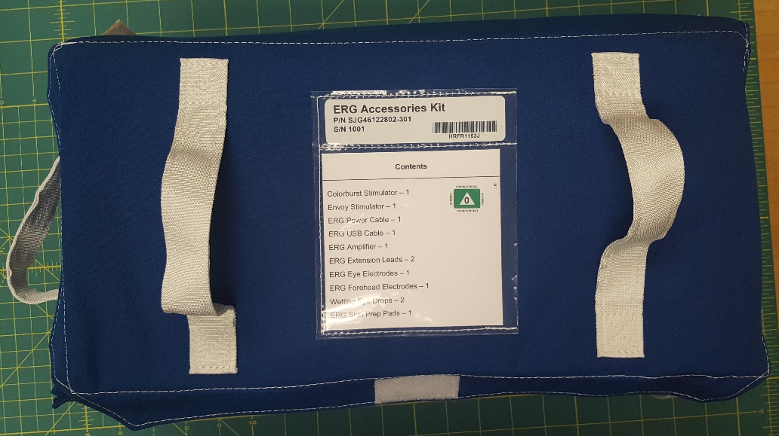
Electroretinograph (ERG): Accessories
Currently available
ERG Accessories Kit
Envoy Stimulator (1)
Colorburst Stimulator (1)
ERG Power Cable (1)
ERG USB Cable (1)
ERG Amplifier (1)
ERG Extension Leads (2)
ERG Eye Electrode (Ziploc of 25)
  DTL Plus Electrodes
ERG Forehead Electrodes (Ziploc of 10)
ERG Skin Prep Pad (Ziploc of 30)
Wetting Eye Drops (2 Ziplocs of 30 ea)
16.2 x 10.1 x 6.5 inches, 10.32 lbs

Slide 8
Falcon Goggles
Currently available
The Falcon Goggles, based on the Neuralign DX FalconTM, provide a system for capturing detailed high-speed video of the eyes to collect precise data on ocular alignment and assess vestibular function.
Available Features/Accessories:
  Supports 100 Hz and 250 Hz video oculography (VOG)
  Supports interpupillary distance (IPD) range of 50 to 75mm
  Blackout cover with built-in fixation light
  Built-in calibration laser for manual calibration.
  Goniometer for testing range of motion.
  ISS Cabin Video cameras and USB3.0 cables for high-speed data transfer (provided by ISS Program)
  Neurolign VESTTM Software for system operations and data analysis/export, and I-Portal® for digital eye tracking.

Slide 9
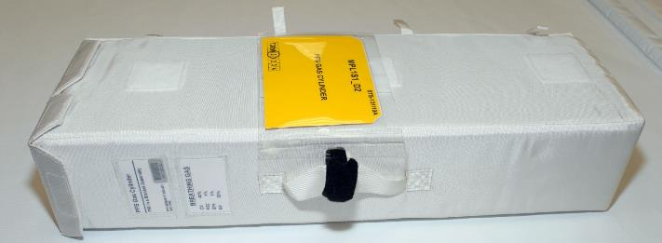
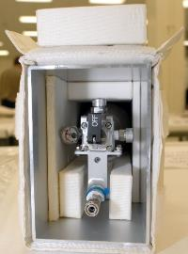
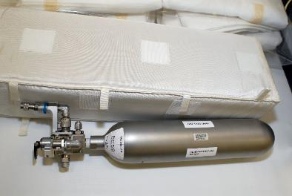
Gas Delivery System (GDS)
Currently available
The Gas Delivery System consists of 1.3L pressurized gas cylinders (GDS Tanks) provided as single-tank soft-stowed assemblies.
  The PFS Gas Cylinder is a single-tank protective container that can be used within different modules of the ISS.
The GDS Tanks can be filled with a variety of gas mixtures tailored to experiment requirements. Examples include Breathing and Calibration mixtures used to support ESA’s Portable Pulmonary Function System (PPFS) and Medical Operations Max CEVIS periodic fitness evaluations.
  PPFS Breathing Gas: O₂ (40%); R-22 (1%); SF₆ (1%); N₂ (58%)
  PPFS Calibration Gas: O₂ (15%); CO₂ (5%); N₂ (80%)

Slide 10
Human Research Facilities 1 and 2
(HRF-1, 2/HRF Rack 1, 2)
Currently available
Consists of items mounted in a rack [based on the EXpedite the PRocessing of Experiments to Space Station (EXPRESS) rack design] as well as equipment kept in stowage and brought out as needed
The HRF drawers provide power, command and data handling, cooling air and water, pressurized gas, and vacuum to experiments
The racks have front-panel access ports for the laptop, vacuum system, deployed payloads, and nitrogen delivery system
The International Space Station (ISS) moderate temperature cooling loop is extended into the HRF to keep the rack at ambient temperature
Payloads in HRF Racks can operate independently of each other regardless of their cooling and power needs and the flight schedule.
Each payload can use up to 500W of power and the sum of all payloads can use up to 2000 W of power. The HRF power converter delivers 120V of direct current (DC) power from the utility outlet panel to the rack and converts it to 28 Vdc for distribution to the payloads
The racks are connected to the ISS video services and Ethernet, which allow the ISS and ground operations crews to control payloads. Payload computer and video operations can be conducted from the ground or on the space station.

Slide 11
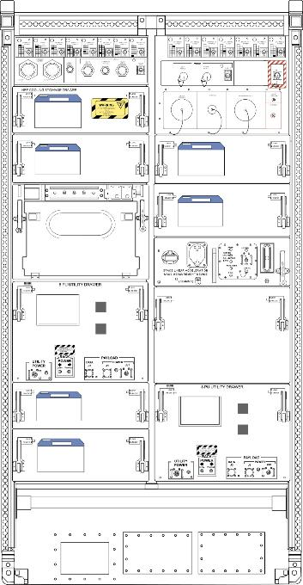
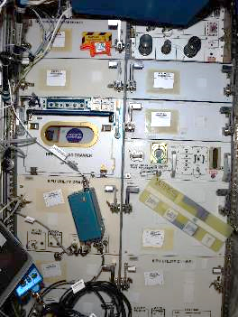
Human Research Facility 1
(HRF-1/HRF Rack 1)
Currently available
The hardware housed in HRF-1 Includes:
  Portable computer (HRF PC), which is used to install and execute software that supports the experiments. It is used to control equipment; to collect and store data, crew notes, and equipment notes; and to provide uplink and downlink capabilities.
  One HRF Payload Drawer with an integrated HRF Centrifuge
  One Cooling Stowage Drawer (CSD) to provide increased air flow over the heat exchanges in the Rack when needed to increase removal of heat generated by other payloads, in addition to providing stowage for equipment.
  Two HRF 8PU Utility Drawer provides stowage for consumables with added radio-frequency identification (RFID) that automates inventory of the tagged contents without crew intervention.
  Space Linear Acceleration Mass Measurement Device (SLAMMD)
  When deployed, the Ultrasound 2 may be connected to the front of HRF-1 for power and to allow real-time downlink of scan head video.
  For more information click here

Slide 12
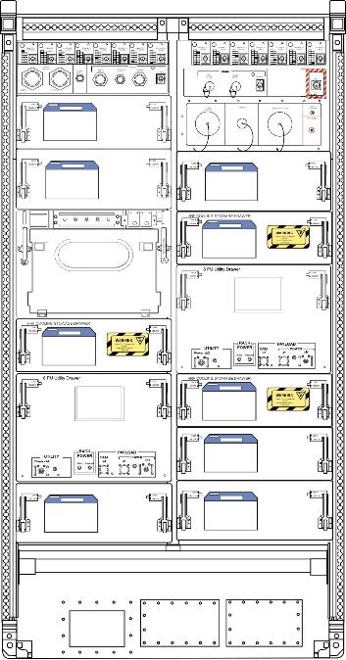
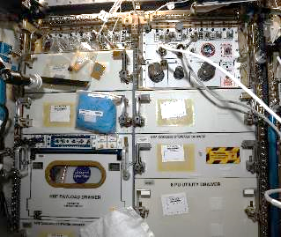
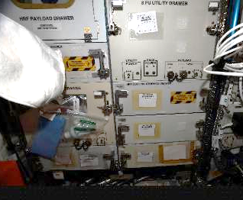
Human Research Facility 2
(HRF-2/HRF Rack 2)
Currently available
The hardware housed in HRF-2 includes:
  Portable computer (HRF PC), which is used to install and execute software that supports the experiments. It is used to control equipment; to collect and store data, crew notes, and equipment notes; and to provide uplink and downlink capabilities.
  One HRF Payload Drawer with an integrated HRF Centrifuge
  Three Cooling Stowage Drawers (CSD) can provide increased air flow over the heat exchanges in the Rack when needed to increase removal of heat generated by other payloads, in addition to providing stowage for equipment.
  Two HRF 8PU Utility Drawers provide stowage for consumables with added radio-frequency identification (RFID) that automates inventory of the tagged contents without crew intervention.
  When deployed, the Ultrasound 2 may be connected to the front of HRF-2 for power and to allow real-time downlink of scan head video.
  For more information click here

Slide 13
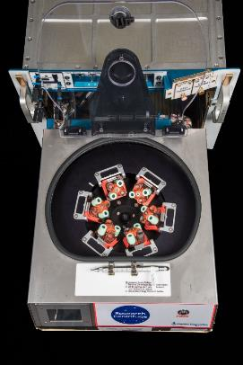
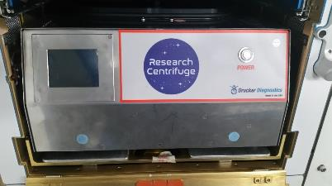
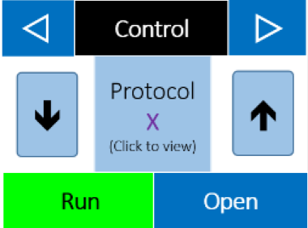
HRF Centrifuge
Currently available
HRF Centrifuge
  Swing-bucket centrifuge used to separate biological substances of varying densities by spinning at a high rate
  Rotor can hold 6 tube carriers
  Speed can be selected from 1000 to 4300 rpm for 1 to 99 minute durations with braking from 0-9
  A total of 10 operational protocols can be pre-programmed and saved
  Telemetry available to monitor spin parameters and status. Software on HRF PCs allows the system to be monitored, configured, and controlled from the ground.
HRF Centrifuge
Pre-programmed protocol

Slide 14
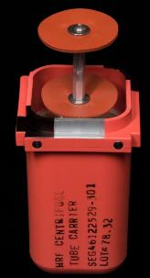
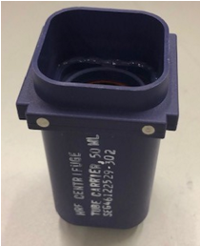
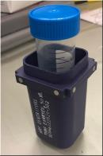
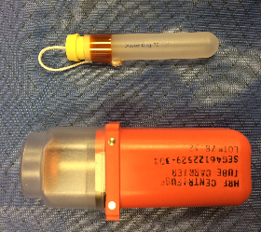
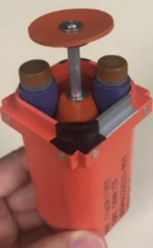
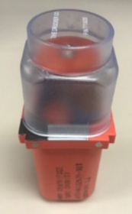
HRF Centrifuge Accessories
Currently available
HRF Centrifuge Tube Carrier
    Two 12-mm to 13-mm outer diameter (OD) centrifuge tubes and two 15-mm to 16-mm OD centrifuge tubes
    24 tubes total with 6 carriers installed
HRF Centrifuge Tube Carrier, 50 mL
    One 50-mL sample tube per carrier
    6 tubes total with 6 carriers installed
Blood Tube Carrier
    Modified HRF Centrifuge Tube Carrier with 15-mm to 16-mm OD slots replaced with one of two Vial Adapters for small sample tubes and with a tube carrier cap for added containment.
    Vial Adapter (yellow cap) can house and provide secondary containment for a single 1.5-2 mL tube (max 13-mm OD) with negligible reduction in spin radius for higher maximum relative centrifugal force (RCF)
    Vial Adapter (purple) can support a single 1.5 to 2-mL sample container with simpler loading and unloading, but with a significantly shorter radius and lower maximum RCF
HRF Centrifuge Tube Carrier
HRF Centrifuge Tube Carrier, 50 mL
Blood Tube Carrier
Vial Adapter (yellow cap)
Blood Tube Carrier
Vial Adapter (purple)

Slide 15
HRF Centrifuge Certified Use
Currently available
The HRF Centrifuge was originally certified to spin astronaut blood. Neither the centrifuge nor the tube carriers provide any level of safety containment.
Any use other than astronaut blood must be coordinated with the Payload Safety Review Panel and ROI.
Any samples containing items rated as toxic or with a biological safety level (BSL) of 1 or higher should plan on providing their own primary and secondary containment.
ROI reserves the right to approve or disapprove any use of the HRF Centrifuge

Slide 16
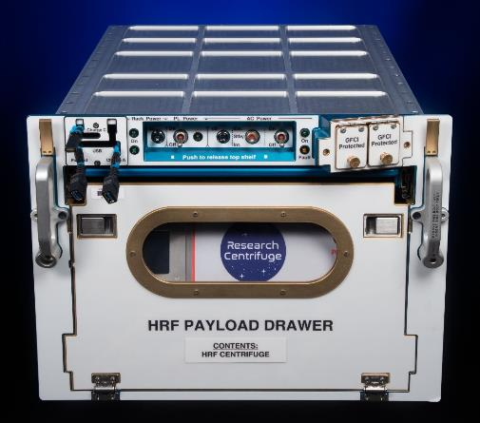
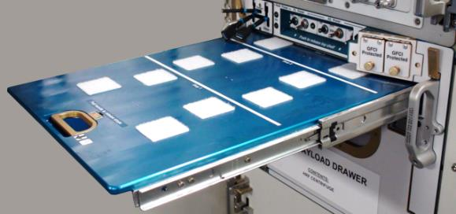
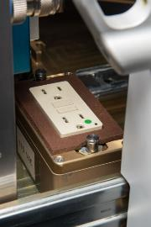
HRF Payload Drawer
Currently available
HRF Payload Drawer Capabilities
  Payloads internal to drawer:
    Power: 120V AC, 28V DC
    Data: RS-422, Ethernet, USB (over Ethernet)
    Mounting Interface: Sliding tray w/ fasteners
  Payloads external to drawer:
    Power: USB Type A (two), USB Type C, 120V AC
    Data: USB Type A (over Ethernet) to HRF PC 2
    Mounting Interface: Deployable shelf w/ Velcro

Slide 17
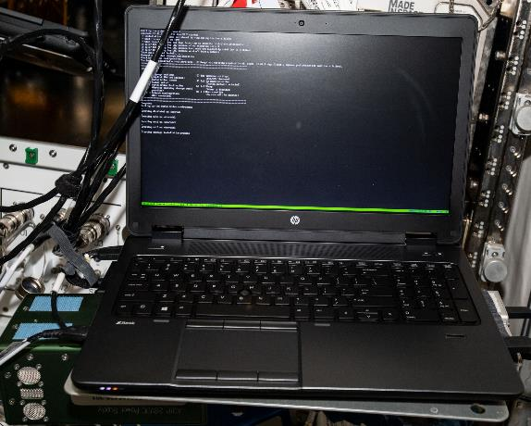
HRF Portable Computers
Currently available
There are two HRF PCs currently on-orbit
HRF PC1 and PC2: HP Z-Book 15 G2 Mobile Workstation - Windows 10
In addition to the software interfacing with the HRF rack hardware, HRP experiment-specific software may be used when necessary

Slide 18
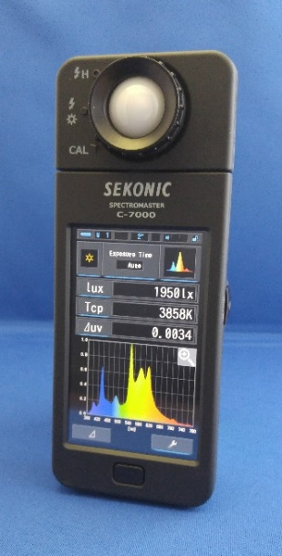
Light Meter
Currently available
Portable handheld spectrometer with stylus and distance guide designed to measure different light sources (e.g., LED, fluorescent, natural light) and provide data feedback via a USB connection.

Slide 19
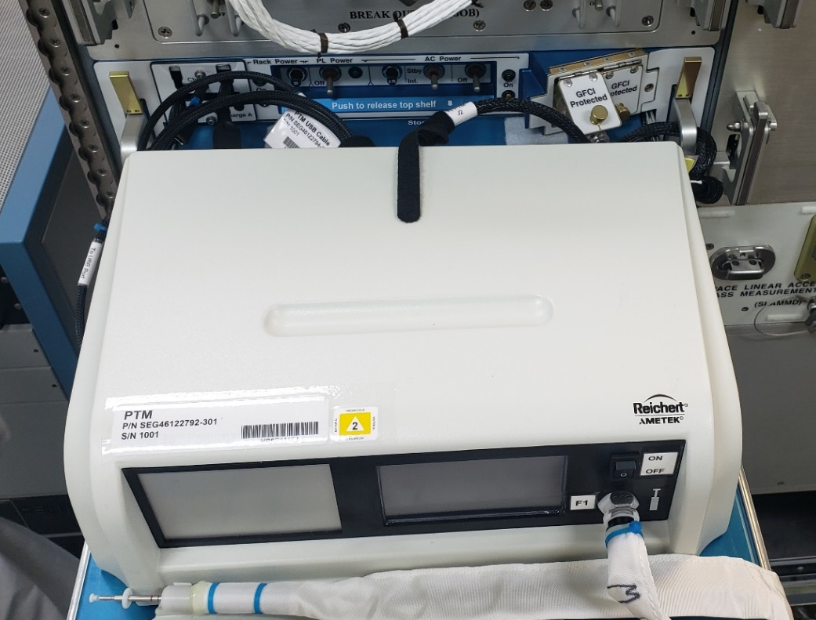
Pneumatonometer (PTM)
Currently available
The PTM is a device based on the Reichert Model 30TM Pneumatonometer for measuring intraocular pressure (IOP) in either manual or pulse mode, and tonometry.
  Only manual mode measurements are certified for operations.
The PTM is deployed and powered from an HRF Payload Drawer, with data streamed to an HRF PC for storage and downlink.
Supports IOP range of 5-80 mmHg
  Characterization testing has been performed to ~40 mmHg
Required consumables for flight data collection include probe tips.

Slide 20
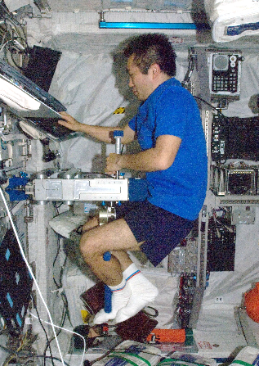
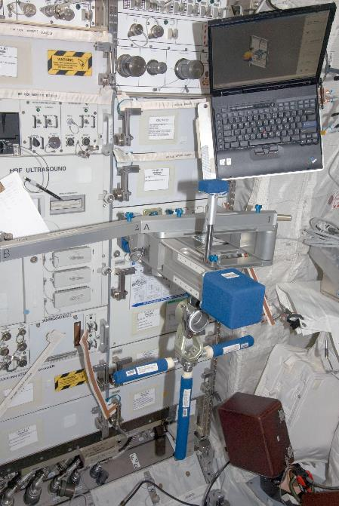
Space Linear Acceleration Mass Measurement Device (SLAMMD)
Currently available
Follows Newton's Second Law of Motion by having two springs generate a known force against a crewmember mounted on an extension arm, the resulting acceleration being used to calculate the subject's mass
Accurate to 0.5 pounds over a range from 90 pounds to 240 pounds
Intended to provide an accurate means of determining the on-orbit mass of humans between the 5th percentile Japanese female and the 95th percentile American male
For more information click here

Slide 21
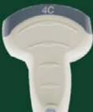



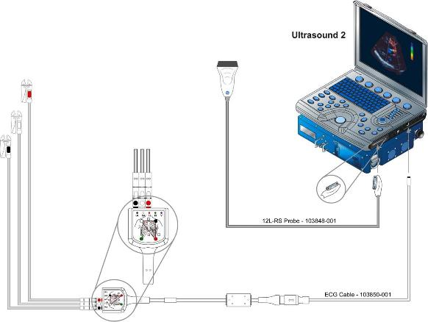

Ultrasound 2
Currently available
Modified General Electric (GE) Medical Systems Vivid-qTM model
Can be used for a variety of experiments for cardiac, muscle, vessel, and blood flow analysis
Includes additional features that allow for panoramic image construction to estimate muscle volume changes, speckle tracking functions to analyze cardiac stress-strain, and dynamic morphology
Available accessories:
  GE phased, linear, and curved array probes available
  (M4S-RS, 12L-RS, 4C-RS, and 8C-RS)
  Vein Press for non-invasive venous pressure measurement in conjunction with linear array imaging with integrated software display
  Manometer for measuring differential pressure across two sample ports with integrated software display
For more information click here
12L
Vein Press
Manometer

Slide 22
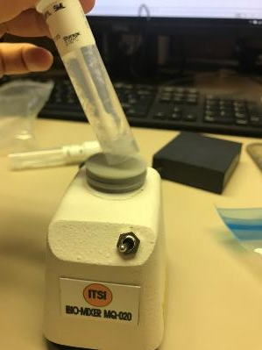
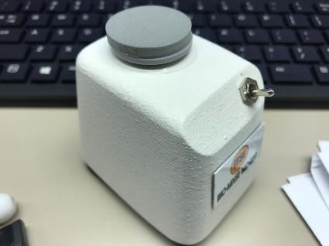
Vortex Mixer
Currently available
The Vortex Mixer is a commercial off the shelf unit called N-20M Mini-Vortex, produced by Nissin Instruments
Used to mix sample tubes in prep for sample storage or return
Powered via 4 AA batteries or 120 AC with power adapter (for ground support only)
Operational modes: continuous or touch
Mixer speed: 2600 rpm

Slide 23
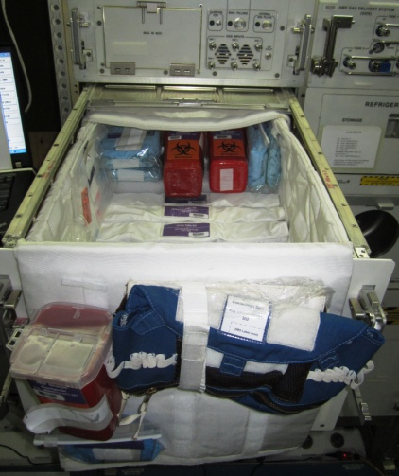
Consumables: HRF Supply Kit Purple
Currently available to HRP sponsored research. Consumables inventory is based on active and upcoming experiment complements.
Urine tube kits ⃰⃰
Blood tubes (vacutainers) ⃰⃰
Disposable gloves (Small, X-Large)
Blood collection belts
Sharps containers
Liner bags (biohazardous trash)
⃰⃰ Additional associated consumables on next two slides

Slide 24
Consumables: Blood Collection Tubes
Currently available to HRP sponsored research. Consumables launched as needed to support science activities
Processing | Name | Fill Volume (ml)
Ambient | Blood 10ml EDTA | 10
 | Blood 10ml Heparin | 8.5
 | Blood 8.5ml ACD | 8.5
 | Blood 6ml EDTA | 6
 | Blood 6ml Heparin | 6
 | Blood Sodium Heparin | 6
 | Blood 6ml ACD | 6
 | Blood 4ml EDTA | 4
Frozen or Ambient | Blood 4ml CPT | 4
Frozen | Blood 7ml Heparin | 4.5
 | Blood 7ml EDTA | 5
 | Blood 7ml Serum | 5

Slide 25
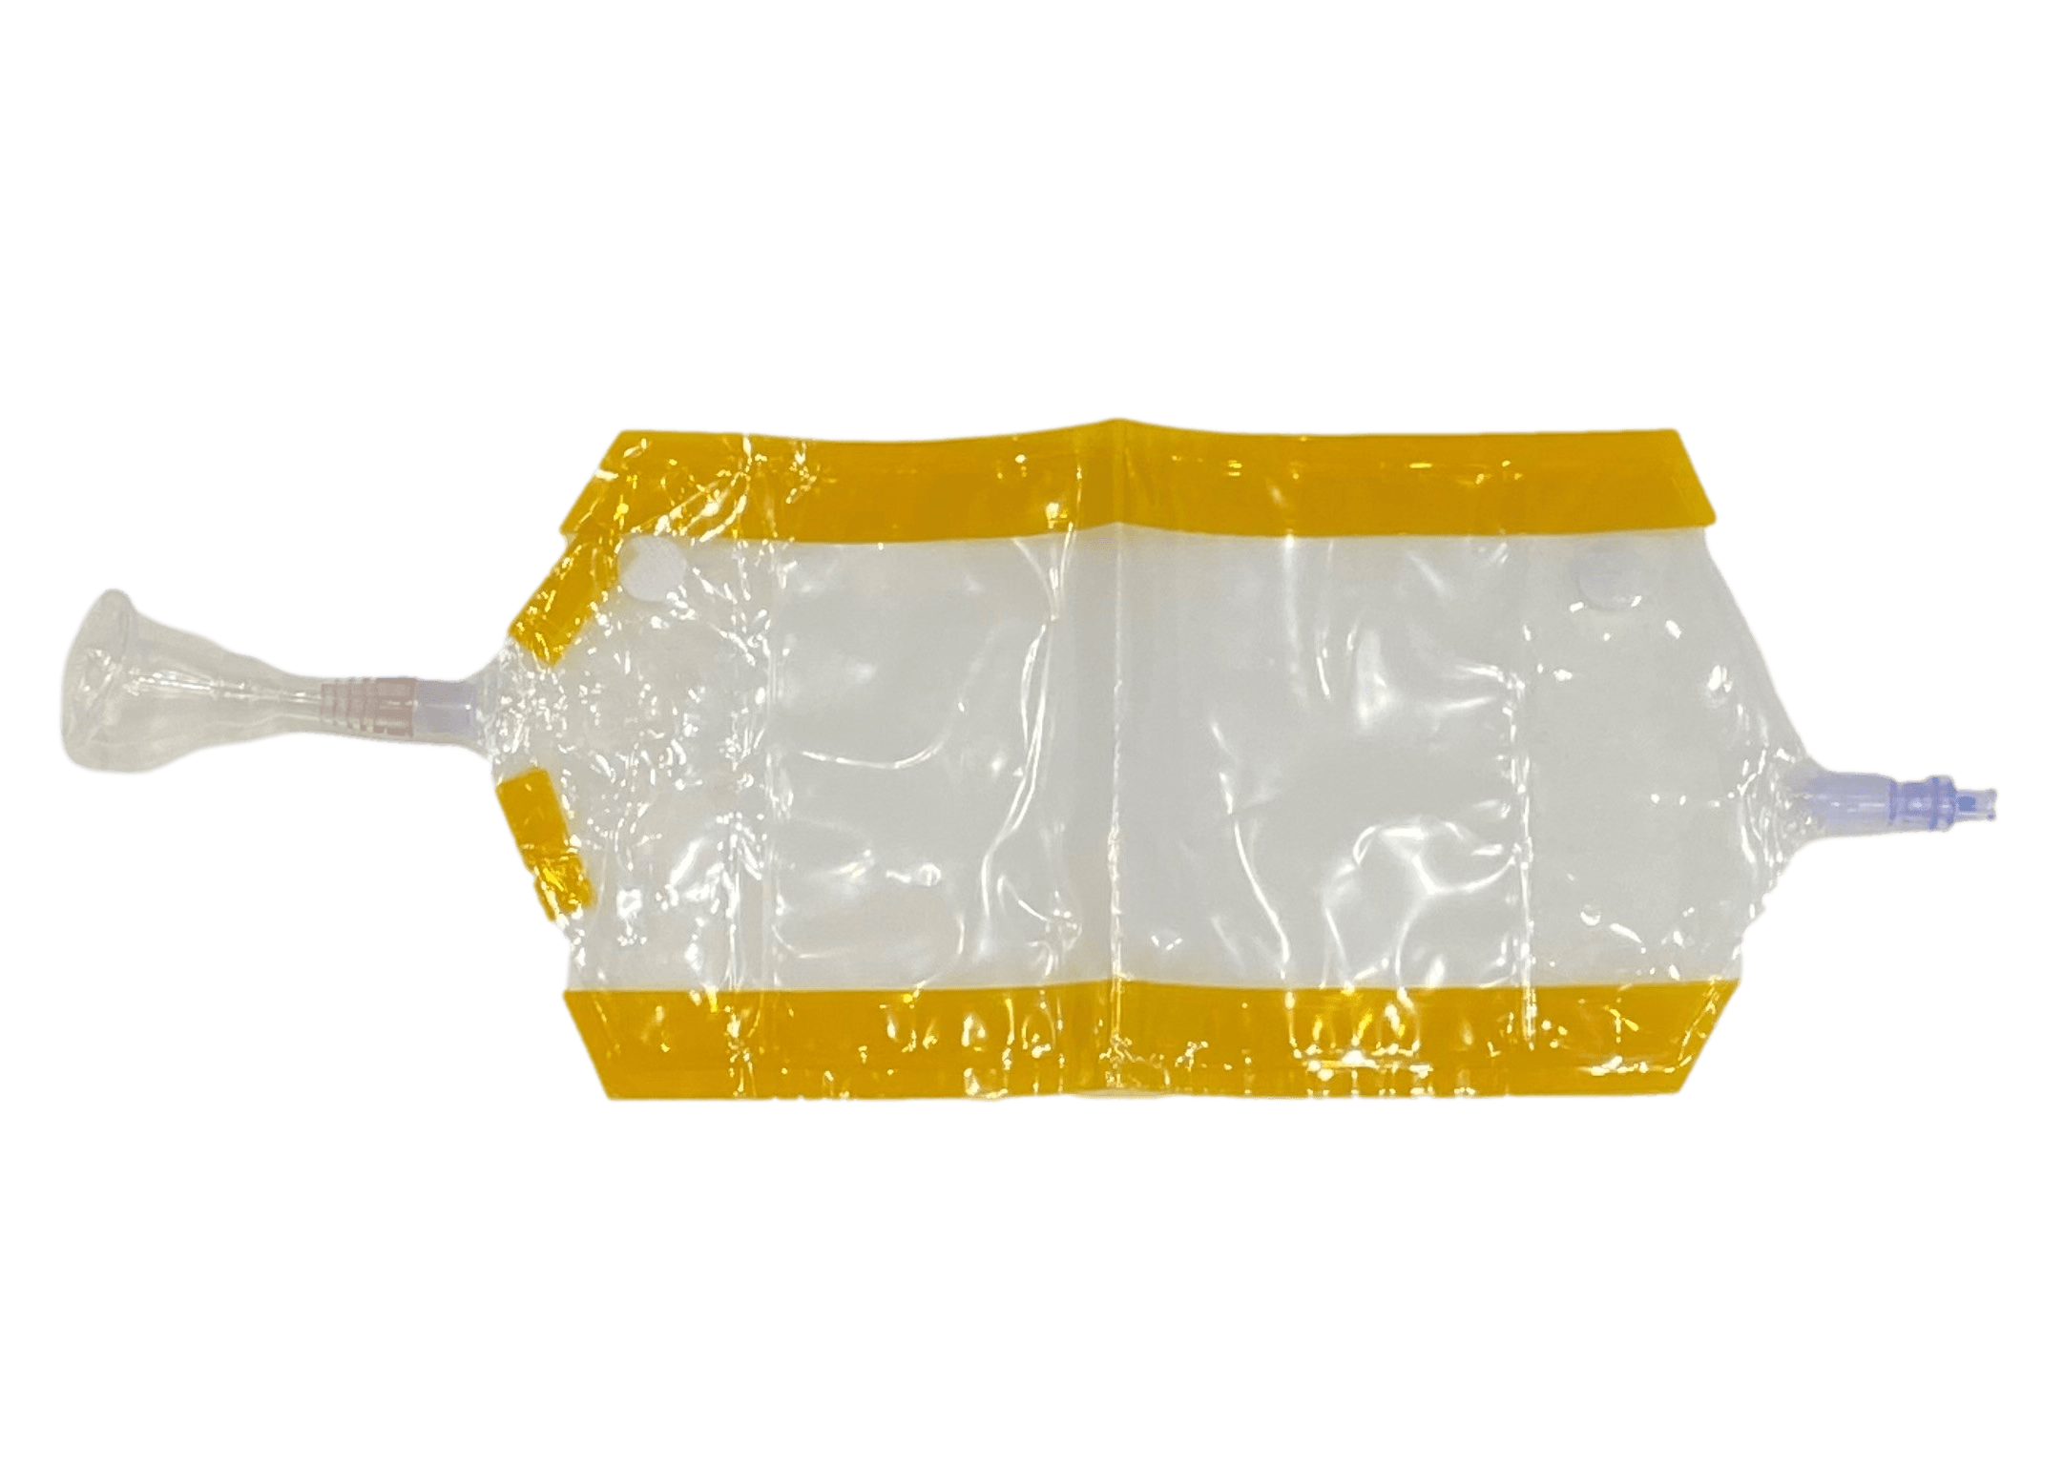
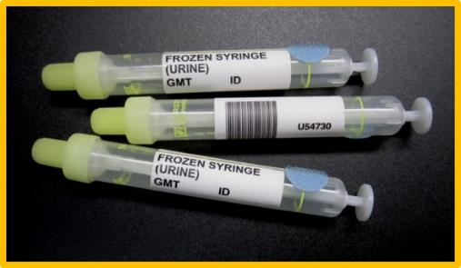
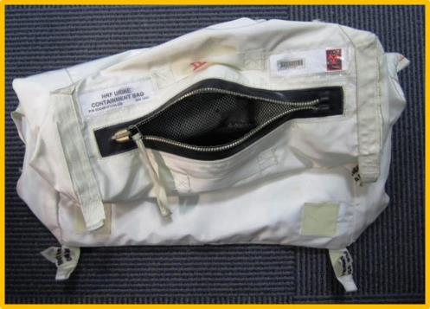
Consumables: Urine collection
Currently available to HRP sponsored research. Consumables launched as needed to support science activities
Urine collection device –
Male or female
Urine sample syringes
Urine containment bag

Slide 26
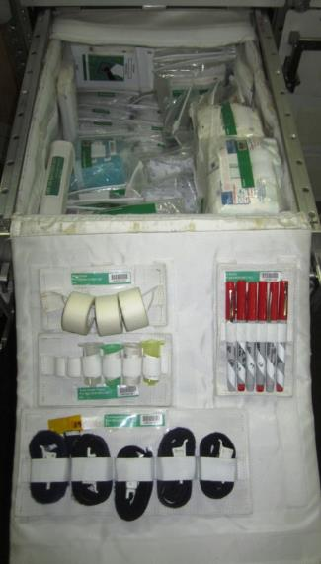
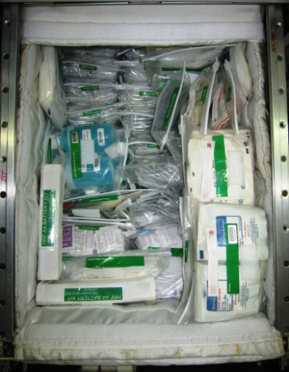
Consumables: HRF Supply Kit Green
Currently available to HRP sponsored research. Consumables inventory is based on active and upcoming experiment complements.
Band-Aids
Biocide Wipes
Butterfly Needles
Centrifuge Counterweight Tubes
Dry Wipes
Echo Gel
Electrodes
Gauze
Saliva Collection ⃰⃰
  Salivettes
  Dry Booklets
  Timed Sessions
Sharpie
Tape
Tourniquet
⃰⃰ Additional associated consumables on next two slides

Slide 27
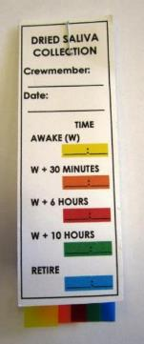
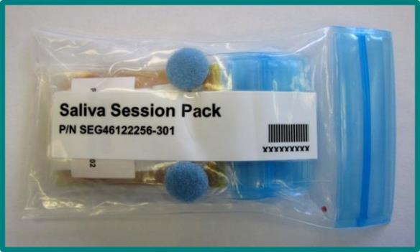
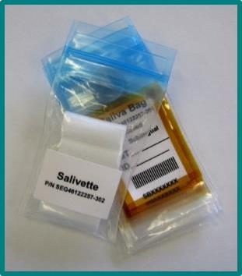
Consumables: Saliva Collection
Currently available to HRP sponsored research. Consumables launched as needed to support science activities
Rolled or sublingual saliva collection – Saliva Session pack
  Salivette bag - holds multiple salivettes
    Salivette - roll-shaped synthetic saliva collector
  Saliva bag - contains salivettes after sampling
Dried Saliva Collection Booklet
  5 filter strips separated by wax paper with a tab
Dried Saliva
Collection Booklet
Saliva Session Pack
Salivette bag and Saliva Bag

Slide 28
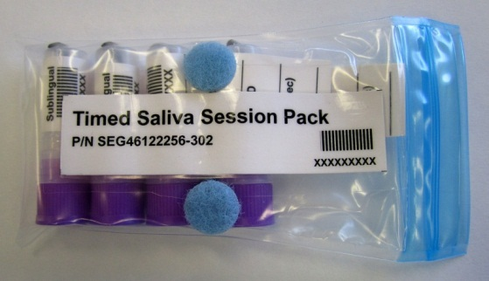
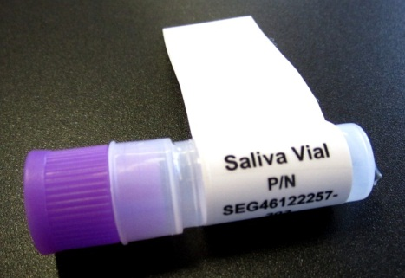
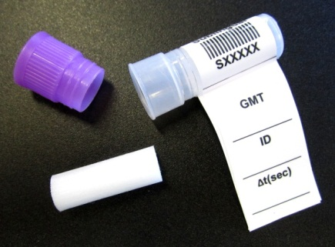
Consumables: Saliva Collection
Currently available to HRP sponsored research. Consumables launched as needed to support science activities
Timed Saliva Session Pack
  Supports timed sublingual saliva collection
  (< 3 minutes)
  Provides containment of salivette to prevent contamination before and after sample collection.
  Salivette may be transferred out of and returned to the container by subject without use of hands to prevent contamination.
  Pre-delivery mass recorded to an accuracy of 0.01g to facilitate accurate measurement of sample mass following sample return.
  Container supports ground centrifugation following frozen sample return without requiring removal of the salivette.

Slide 29
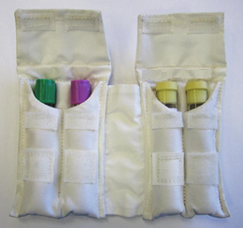
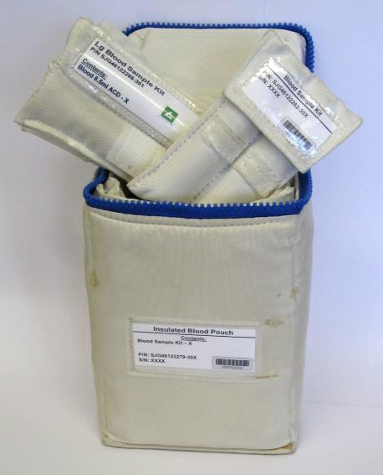


Consumables: Blood Collection Kits
Currently available to HRP sponsored research. Consumables launched as needed to support science activities
Large Blood Sample Kit
Blood Tube Kit (open)
Insulated Blood Pouch
Blood Sample Kit

Slide 30


Consumables: Fecal Sample Collection
Currently available to HRP sponsored research. Consumables launched as needed to support science activities
Fecal Swab – Used to collect and then store fecal samples in MELFI. Container includes 0.85% Saline buffer solution.
  Provided in Fecal Session Packs with containment bags.
Fecal Swab collection hardware
Provided by ISS Program: MELFI - Minus Eighty Laboratory Freezer for ISS

Slide 31




Consumables: Fecal Sample Processing
Consumables launched as needed to support science activities
Dry Fecal Tube – Used to collect samples for processing using DNA/RNA Shield Tubes as well as storage in MELFI.
  Provided in Dry Fecal Session Packs with containment bags.
DNA/RNA Shield Tubes – Used to process fecal samples using the Vortex Mixer prior to storage in MELFI. Provides additional protection and stability for nucleic acids in samples.
  Provided in Fecal Processing Packs with containment bags.
Provided by ISS Program: MELFI - Minus Eighty Laboratory Freezer for ISS

Slide 32

Consumables: Microbial Sampling
Currently available to HRP sponsored research. Consumables launched as needed to support science activities
Swab Kit – contains differently colored saline swabs for microbial collection of different body parts, for surface sample collection, and sweat sample collections
Swab Kit

Slide 33

Software: Cognition
Currently available (version 3)
Software system that delivers brief, computerized neurocognitive tests
Measures a wide range of cognitive functions
Each administration (~20 mins) has a battery of 10 computerized tests, as shown in the figure to the right, and additional surveys that can be configured into sequences and assigned to subjects
NOTE: Use of Cognition software (apart from data sharing) requires additional funding and/or laboratory support agreements for data processing. Additional cognitive test batteries not part of the current software version will require additional funding to purchase through the software developer.

