Slide 1
Balloon Data Readout via Free-Space Optical Communications
Don M Boroson, Bryan S. Robinson (MIT LL)
Shaul Hanany (UMn,) Eliot Young (SWRI,) Jessica Gaskin (NASA MSFC)
15 May 2021
Scientific Ballooning Technologies Workshop
DISTRIBUTION STATEMENT A. Approved for public release. Distribution is unlimited.
This material is based upon work supported by the National Aeronautics and Space Administration under Air Force Contract No. FA8702-15-D-0001. Any opinions, findings, conclusions or recommendations expressed in this material are those of the author(s) and do not necessarily reflect the views of the National Aeronautics and Space Administration .
© 2021 Massachusetts Institute of Technology.
Delivered to the U.S. Government with Unlimited Rights, as defined in DFARS Part 252.227-7013 or 7014 (Feb 2014). Notwithstanding any copyright notice, U.S. Government rights in this work are defined by DFARS 252.227-7013 or DFARS 252.227-7014 as detailed above. Use of this work other than as specifically authorized by the U.S. Government may violate any copyrights that exist in this work.

Slide 2
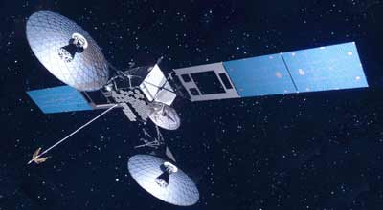
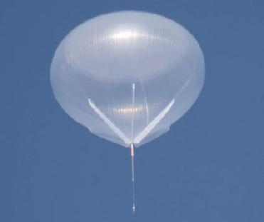
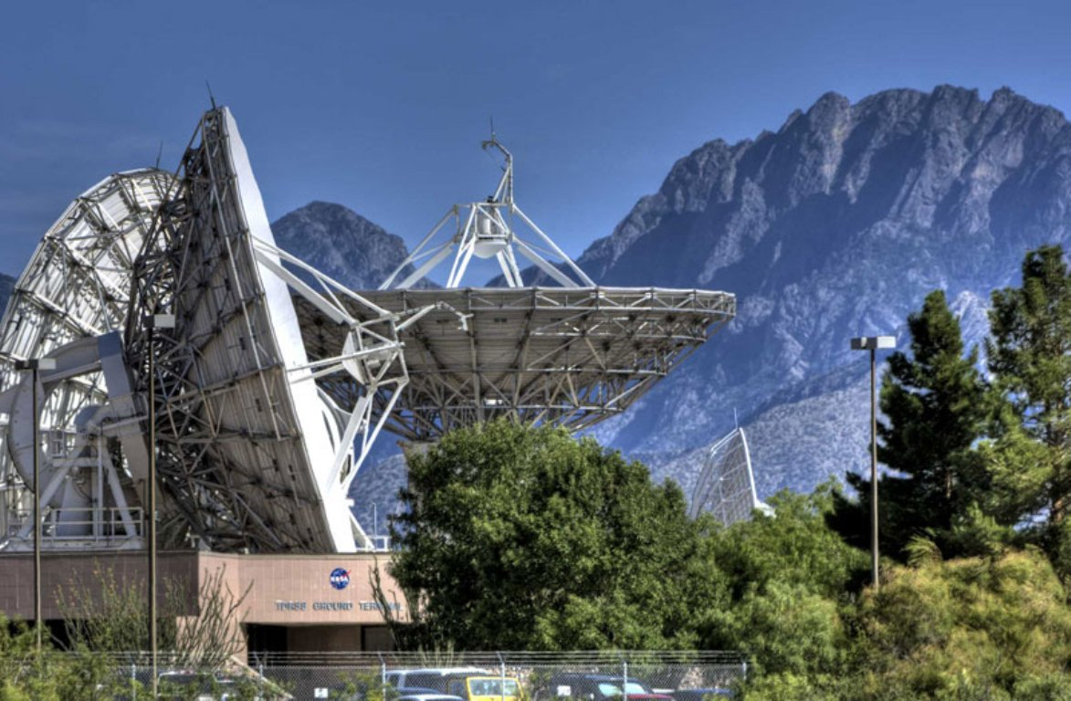
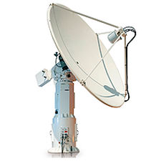
Present RF Balloon Communications Connectivities
GEO relay (TDRSS)
(essentially) continuous relay
(up to ~100 kbps)
Relay service also available using Iridium (~800 km)
Note: 24 hours at 100 kbps = 8.64 Gbits (~1.1 Gbytes)
Direct downlink
(Few 100 kbps)
NASA

Slide 3
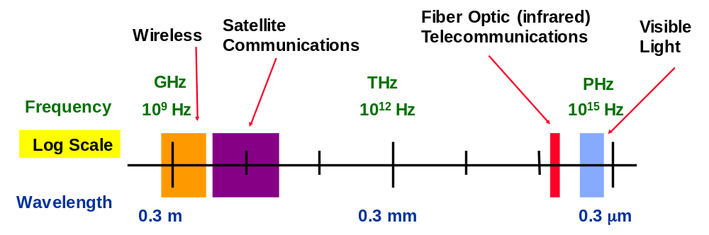
Optical as a New Comm Band
Also note:
Data rate can be proportional to received power
For fixed aperture* sizes, power delivery improves as frequency
(ie narrow beams)
Gain ~ frequency²
Noise ~1/frequency
Potential for 1e4-1e5 improvement over RF
Entire RF bands up to few Ghz wide
Highly congested
Requires frequency allocation – FCC, ITU...
User designations up to hundreds Mhz
Fiber telecom band > 12 Thz
Unregulated
Fiber telecom users 50-100 Ghz
Potential optical bands
(>2800 Thz)
*A telescope is the antenna in an optical system

Slide 4
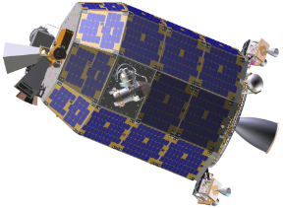
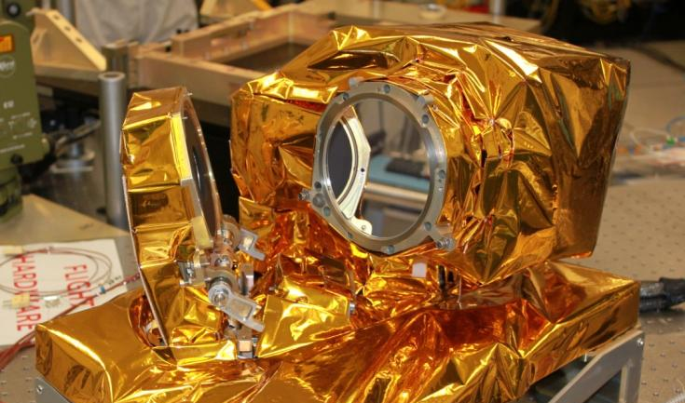
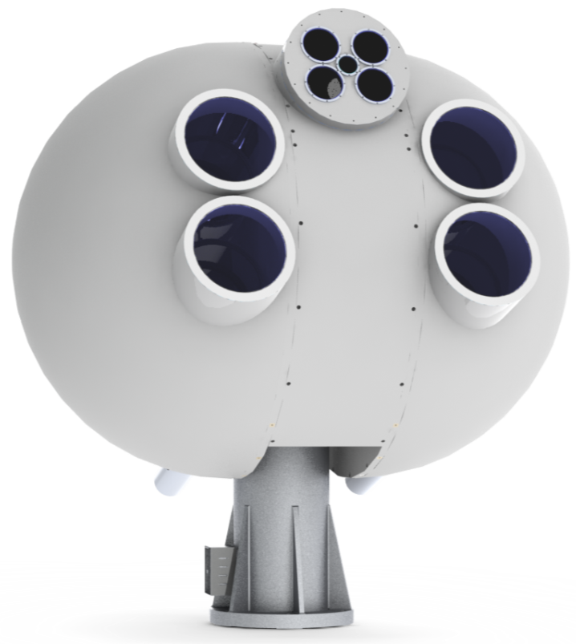
Readiness of Lasercom - I
Lunar Laser Comm Demo (LLCD) on LADEE (NASA 2013)
After 35 years of development, all technical facets of free-space links in the optical bands have been analyzed and demonstrated in many configurations
  Beam pointing, tracking, stabilization
  Flight-worthy lasers, modems, and telescopes
  Efficient signaling and receivers
Recent successful implementation – high rates to and from lunar orbit
Moon-to-Earth comm
at 622 Mbps
Uplink at 20 Mbps
Space Terminal
10-cm gimballed aperture
0.5 W eyesafe laser
Fiber-coupled modem
80-cm = 4@40 cm
Multi-mode fiber-coupled
Photon-ctg detectors
4@ eyesafe 10-W uplinks
Ground Terminal

Slide 5
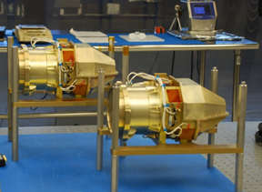
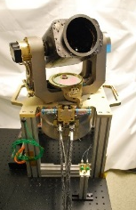
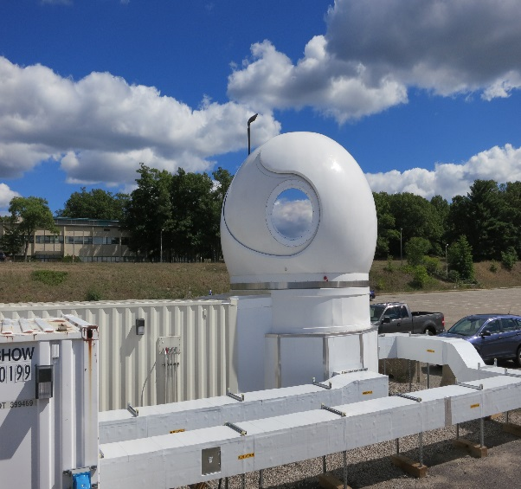

Readiness of Lasercom - II
Laser Comm Relay Demo (LCRD) at GEO
ILLUMA-T on ISS
(NASA 2022/2022)
NASA will be launching a GEO relay lasercom system soon
  Two heads at GEO
  Several supporting ground stations
GEO relay
“User” terminal
Continuous connections at 1.25 Gbps
Note: plans for high-rate relays for 10 Gbps users (2025)
Ground support

Slide 6
Data Volume Delivery is True Need
Traditionally, balloon comm connectivity has been near-continuous at a fixed data rate
Optical comm
  Can have data rates thousands of times higher than RF, when “on”
  But – may be intermittent due to geometry, clouds
  With large COTS memories and dynamic transmission protocols, can still deliver extremely high data VOLUMES
  Protocols have even demonstrated highly intermittent links
Quick survey of scientists has shown that immediacy is rarely needed
  That “delays” of data delivery of hours to days would be perfectly adequate
So:
“Data volume” delivered per day or week (say) could really be the metric of interest, instead of “data rate”

Slide 7
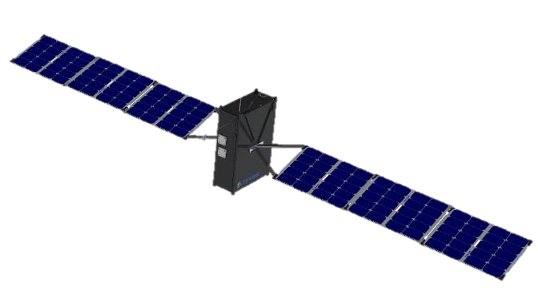

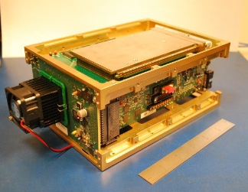
Readiness of Lasercom - III
TeraByte InfraRed Delivery (TBIRD)
(NASA 2021)
Fiber telecom industry has created lasers, detectors, modulators, controls, etc for many Tbits/sec in a single fiber
Even tiny telescopes have highly focused beams for efficient delivery of power
  Lasercom industry knows how to deal with these narrow beams
  Many systems can even take light received in a telescope and couple it efficiently and stably into a single-mode fiber!
MIT Lincoln Lab / NASA to fly multi-hundred Gbps LEO downlink system on a Cubesat
LEO-to-ground burst-mode comm at 200 Gbps
Low-rate uplink beacon & commands
40-cm transportable ground telescope
Multi-TB solid-state memory
Based on fiber-telecom modem
First demo to be on 6-U cubesat

Slide 8
Similar Potential Connectivities in Optical
But With Much Larger Data Return
Optical
GEO Relay
(essentially) continuous relay
(up to 10 Gbps)
Relay service also possible to optical LEO
Note: 24 hours at 1.25 Gbps = 108 Tbits (~13.5 Tbytes)
Optical
or Radio Ground Station
Direct downlink
10-200 Gbps
Optical
Ground, Sea, or Air Terminal
Note: 1 hour at 100 Gbps = 360 Tbits (~45 Tbytes)

Slide 9
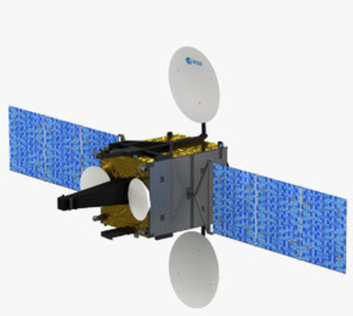
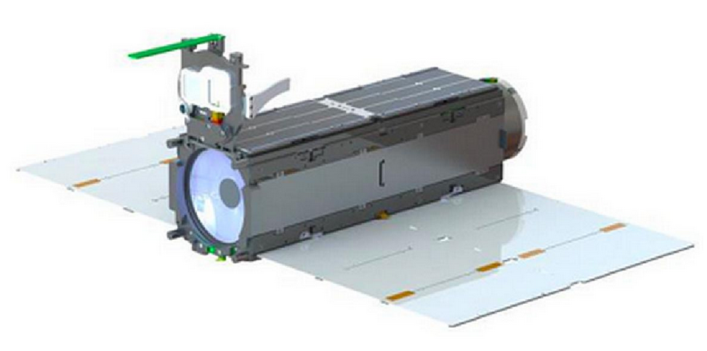
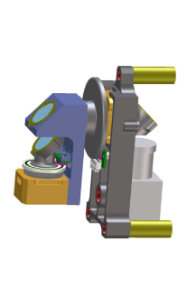
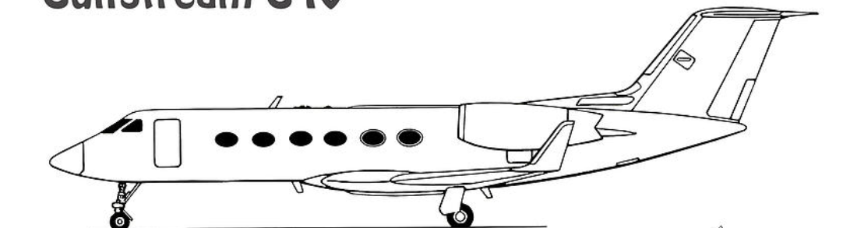
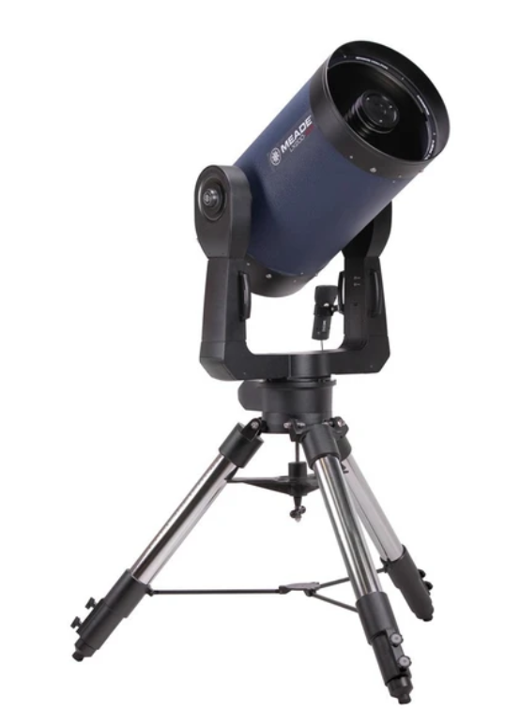
Possibilities for Lasercom-Enabled Balloon Missions:
GEO relay (e.g. LCRD)
Balloon Terminal
36000-40000 km
LEO relay
Small (1-3 cm*) steered aperture
Comm and support electronics and electro-optics
1200-1600 km
Aircraft relay
70-250 km
Ground or ship relay
70-100 km
*4-15 cm for much longer GEO link

Slide 10


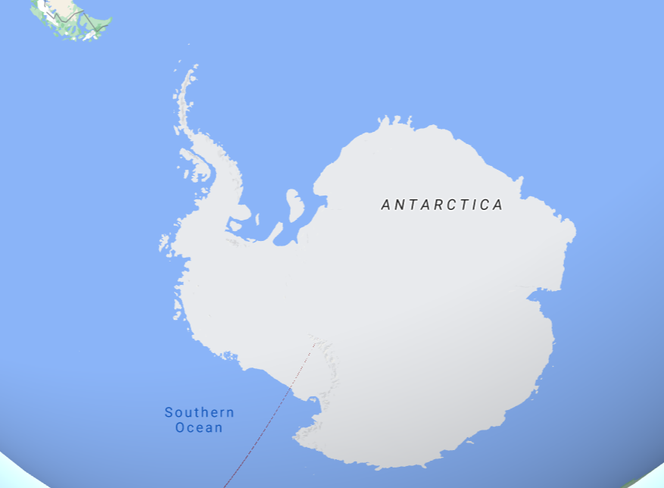
Some Example Flight Paths
Ground area visible from balloon
Area visible from aircraft
Longer aircraft flight (or ship) could get to near arbitrary readout areas
Tradeoff: potential for 1000x data volume!

Slide 11
Laser Communications for Balloon Readout
We presented a version of this talk at 2019 Workshop
Since then have held regular discussions between MITLL, UMn, SWRI, NASA MSFC
Goals:
  Try to survey/understand what features would be most useful to balloon scientists
  Think through the various connection architectures
  Better understand detailed mission requirements
Theme:
  Most lasercom has been done in space – very expensive NRE and components
    Balloon system should be able to use much lower cost parts
    Many COTS components/subsystems are now available that might be integrated to meet goals above
  Scientific balloon task is to survey what is available and creatively combine parts to give highest performance end-to-end link, keeping cost low

Slide 12
Example System Construction
  Balloon terminal
    Very small (1-3 cm), steered aperture
    Extremely high-rate transmitter with large COTS memory and user interface
    Balloon-based position and pointing information for initial link-up (self-contained after that)
    Autonomous spatial tracking (based on uplink beacon)
    Details about particular environments
    All with very low cost
  Ground (or partner) terminal
    6-15 cm steered aperture with base
    Inexpensive position and pointing information for initial link-up
    Extremely high-rate receiver with large COTS memory and user interface
    Beacon uplink
    All portable and relatively low cost

Slide 13
Summary
Lasercom links have potential to greatly increase amount of data that can be taken and returned from balloon science missions
There are viable options for reducing the costs of lasercom systems to be compatible with typical balloon science missions

