Slide 1
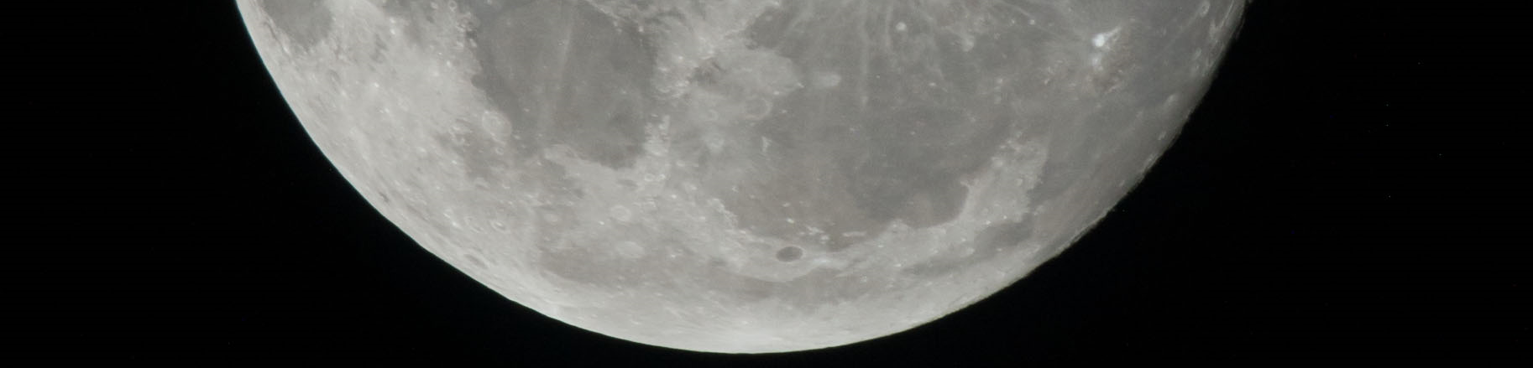

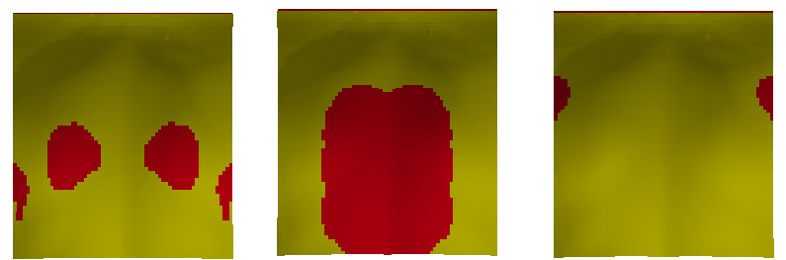
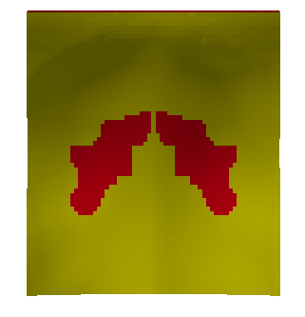
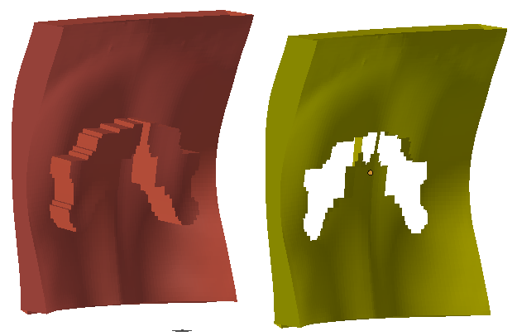
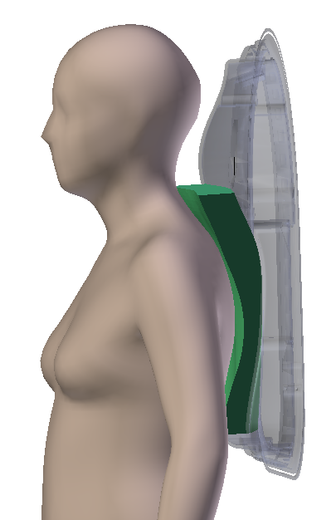
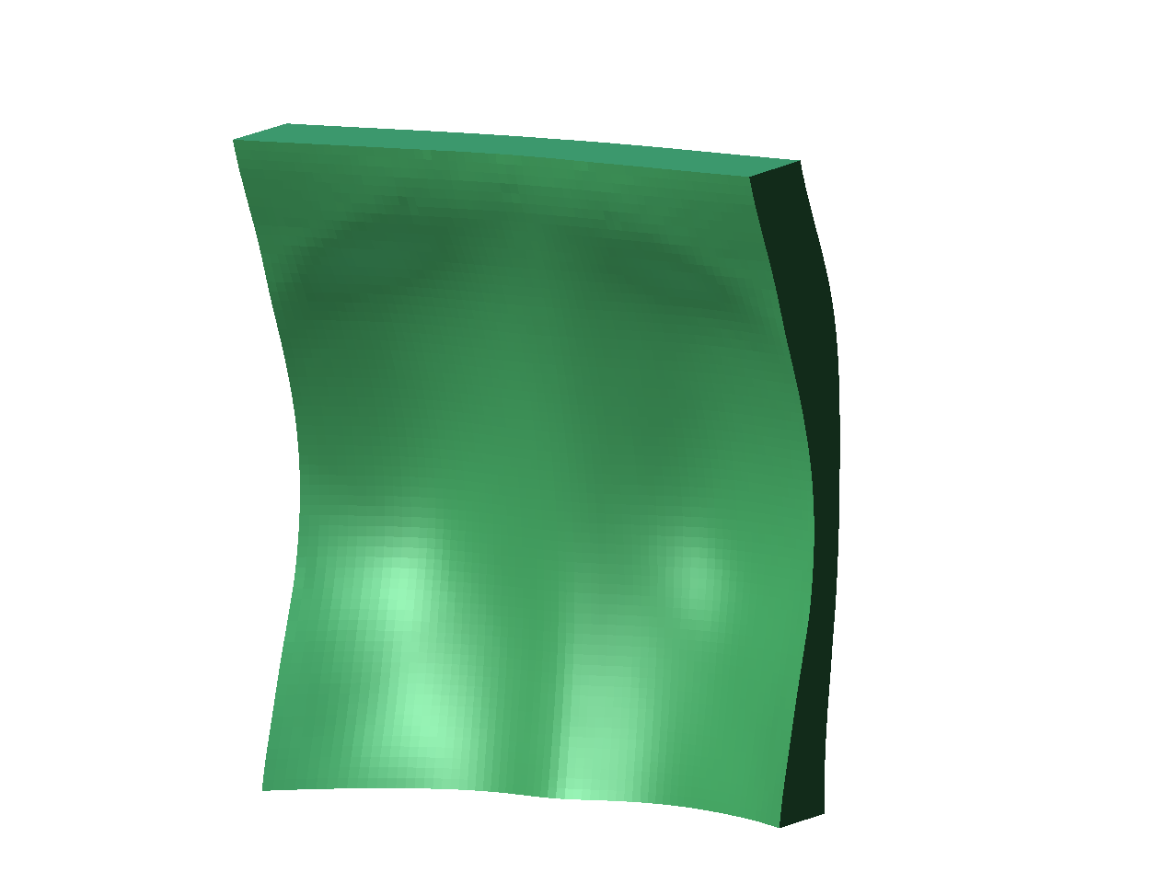
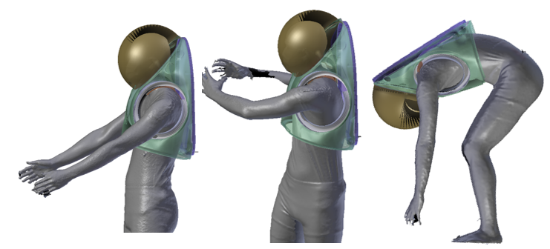
xEMU Padding Optimized for Body Mobility in Lunar EVAs
National Aeronautics and Space Administration
Johnson Space Center (JSC) / White Sands Test Facility (WSTF) 2020 JSC Technology Showcase: FY20 ICA
Yaritza Hernandez/ yaritza.bernal@nasa.gov, Alex Gordon, Sudhakar Rajulu, Kristine Davis
Technology Area (TA): 6.3.2 Prevention and Countermeasures
TRL: start 2 / current 3
FY20 ICA Overview
We developed a new design framework for padding in the xEMU hard upper torso (HUT) that will optimize the crewmembers’ mobility and comfort. The new padding was geometrically optimized for anthropometric body curvatures and motion dependent body deformations.
INNOVATION
An optimized padding geometry was created using 3-D body shapes virtually indexed in the xEMU HUT. 3-D body shape was scanned from a subject wearing a mockup suit performing different functional EVA postures. The body shape variations were modeled, and the corresponding body-to-suit spacing was calculated. The padding was designed on a multi-layer structure, with which each layer will be fabricated using materials with different firmness grades. Specifically, a firm material fills in the spacing where the contacting body surface requires support, whereas a compliant material is used where mobility is needed.
Outcome
3-D body scans (n=146) virtually indexed in the HUT were used to create the optimized padding geometry based on the subject’s back curvatures and suit-to-body indexing/spacing demands.
3-D body scans (n=12) of two subject performing EVA functional postures determined the body deformation and variations of body shapes.
Motion-dependent deformations from corresponding functional EVA postures
Final padding deformation based on average of all EVA functional postures
Fabrication and assembly of multi-layer padding
INFUSION SPACE / EARTH
The optimized padding design can be utilized during pressurized suit testing and analog training to maintain proper body-suit indexing/spacing and relieves contact stresses from the suit.
Partnerships/Collaborations
Future development has been collaboratively identified with NASA suit engineers and other stakeholders and is included as a FY21 project.
Papers / Presentations
A conference proceeding has been submitted to the 2021 Applied Human Factor and Ergonomics (AHFE) Conference.
Future Work
The framework will be further pursued for implementation of wide anthropometry and different EVA-like tasks postures.
Usability and comfort of the fabricated padding will be assessed using structure questionnaires from subjects performing simulated EVAs, while wearing the optimized padding. The outcome will be compared against traditional padding configurations.
Padding design framework will be applied and tested for different suit components, including the lower torso assembly and boots.
Optimized padding geometry based on 3-D body scans
3-D scans of subject performing functional EVA postures
The motion-dependent body deformations were applied to the geometry to create a multi-layer padding assembly to match the mobility and support demands of the body through the different functional EVA postures.
The framework enabled a streamlined design process, including 3-D body scan modeling, structure identification, and fabrication process.
26979-1

