Slide 1
Lessons Learned from Developing Web-based Data Visualizations in NASA
Tina Heinich, AST Data Systems

Slide 2



Who Am I (and What Do I Do?)
Education
  Texas State University (BS in Computer Science)
  Old Dominion University (MS in Computer Science)
NASA Langley Research Center – Office of Chief Information Officer
  Software Engineer and Web Developer
  Maintain traditional websites in ColdFusion and PHP
  Develop, prototype, and maintain “websites with a data science twist”
  Act as a local contact for data visualization and tooling
  Lead an agency data visualization community

Slide 3
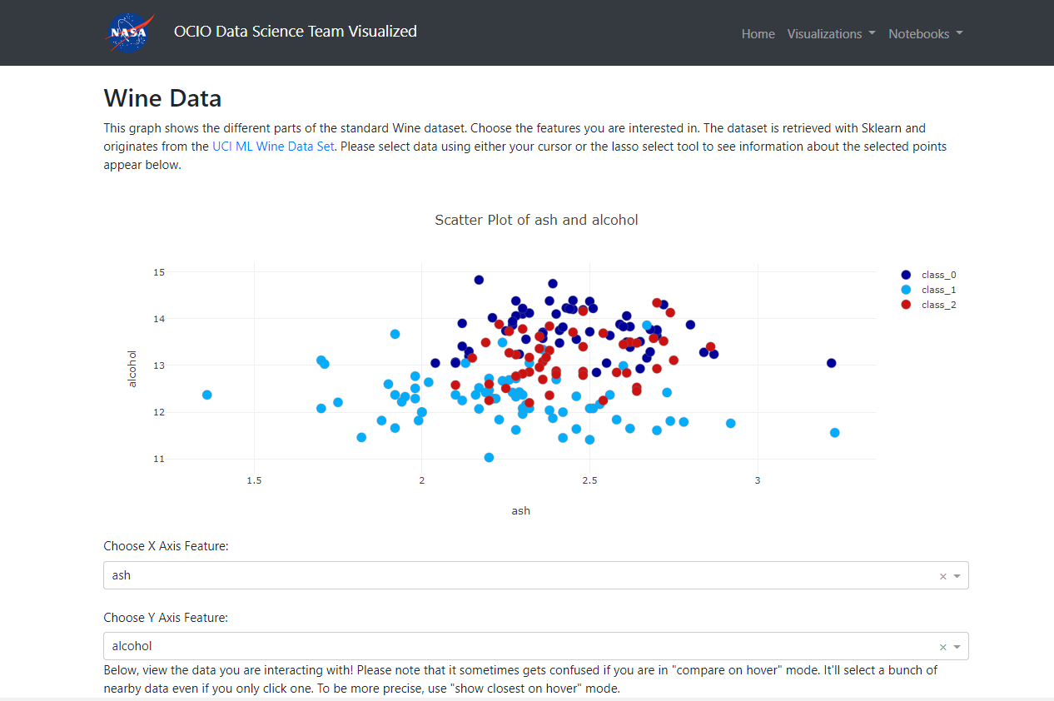
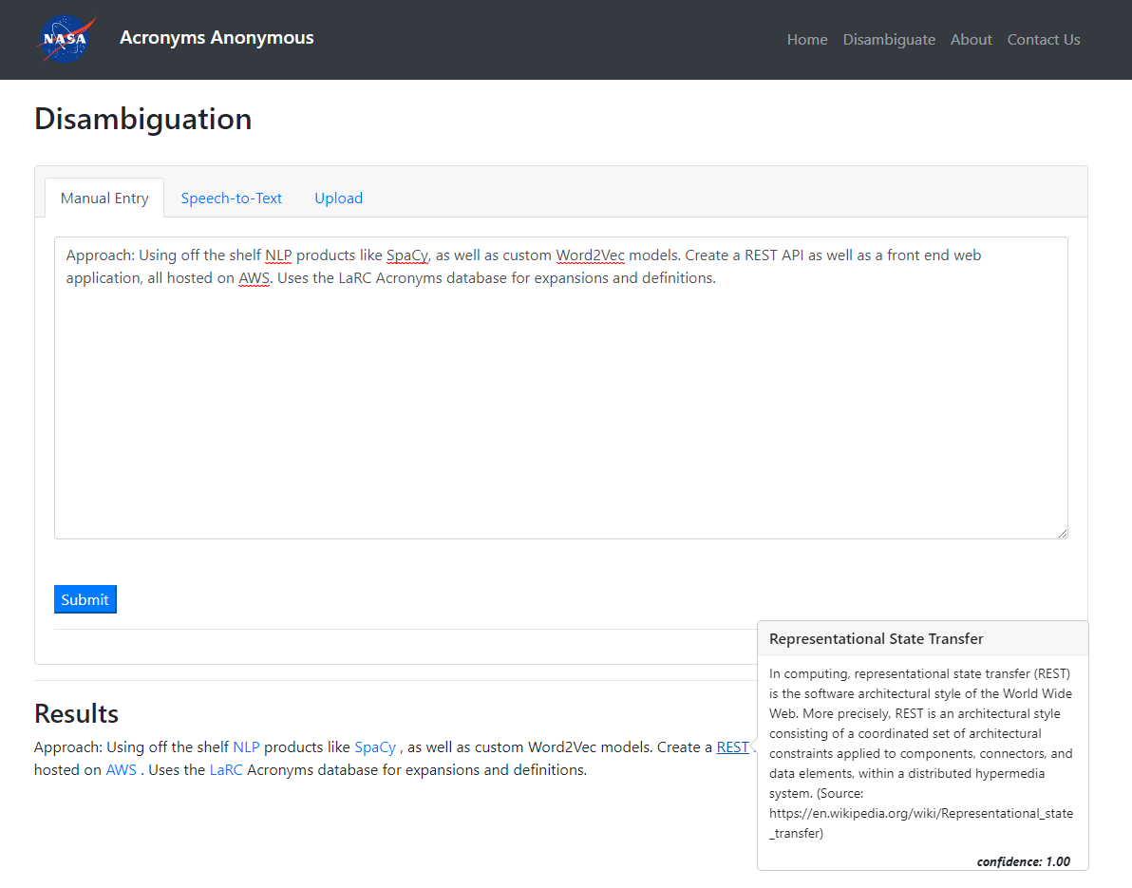
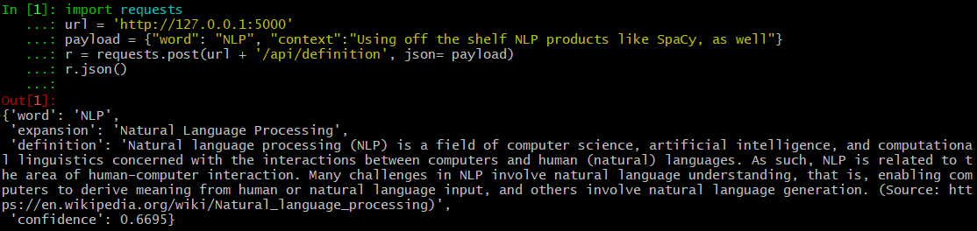
Specific Projects
  “OCIO Data Science Team Visualized”
    Internal site to host mini visualization apps
    Also hosts Jupyter notebook exports
    Dash application on top of an Apache web server
  “Acronyms Anonymous”
    prototype web app and REST API to find the definition of an acronym within context
    Provide the app with acronym-laden text
    Flask application, aiming to be public facing
  Local contact for data vis and tooling
    Lead an agency data visualization community of practice
    Maintain a COVID-19 tracking dashboard for leadership to make reopening decisions (Tableau)
    Maintain a project tracking dashboard (PowerBI)

Slide 4
Goals at NASA
Initiatives to better consolidate data sources and analysis architecture
  Both within-NASA and external-facing
  Better integration == better access to data == better data visualizations. ☺
  Consolidating analysis architecture leads to more uniformity across the agency
Explore new ways to make visualizations accessible/Section 508 compliant
  Ex: auto generating text captions for charts for non-visual users
  Exploring color palettes that are color-blind and print friendly
  Exploring how to create interactive dashboards that still make the data accessible
Share knowledge across disciplines
  Not just between different scientific/engineering groups, but also with human capitol, financial, etc.

Slide 5
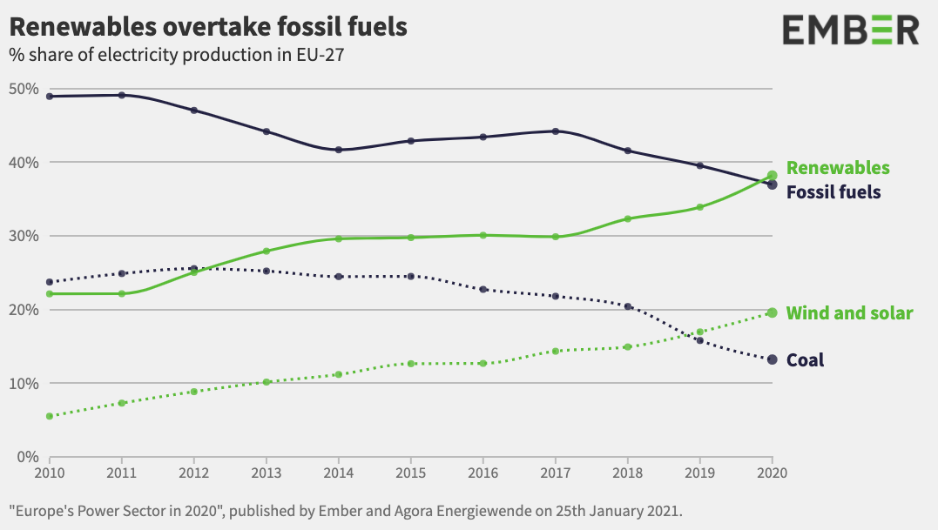
What’s a Good Visualization?
Built on correct data and calculations
Provides an answer to a question your audience has
  Example: what’s the state of COVID in my community? Example answer: COVID cases are rising, but not as fast as they did last week.
Designed in a language the audience will understand
  Choose charts you don’t have to explain
  Do the math for them
Brings attention to the most important thing, and doesn’t bury the lead
  Only show what you need to show, and highlight what’s important
Graichen, P., & Jones, D. (2021, February 15). EU power sector in 2020. Retrieved April 19, 2021, from https://ember-climate.org/project/eu-power-sector-2020/. (CC BY-SA 4.0)
https://creativecommons.org/licenses/by-sa/4.0/
Notes:
Built on correct data
If the data isn’t correct….this entire exercise is moot!
Provides an answer to a question your audience has
Question: what’s the state of COVID in my community? Answer: COVID cases are rising, but they aren’t rising as fast as they did last week.
Question: what was the temperature like yesterday? Answer: it was low in the morning, got hotter later in the day, before slowly dropping back down.
Designed in a language the audience can understand
Know your audience: most people can read line, bar and pie charts. Some charts require a more specialized audience. Some chart types are hard to read regardless.
Also important: do the math for the users! If you want to show the average difference between two variables…try showing the difference, not the two variables.
Brings attention to the most important thing, and don’t bury the lead
Only show what you need to show, and highlight the most important stuff! Use multiple charts if you truly have multiple things to show!

Slide 6
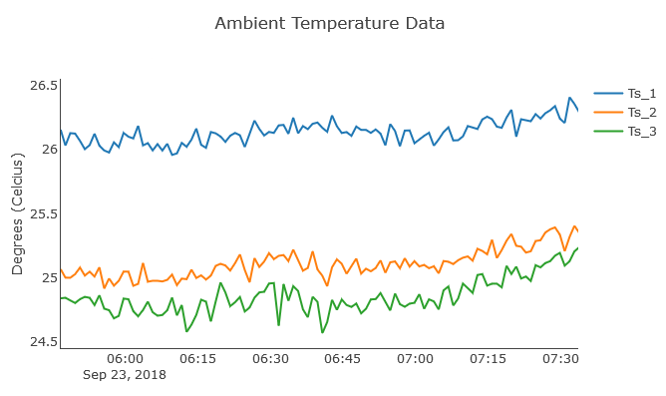
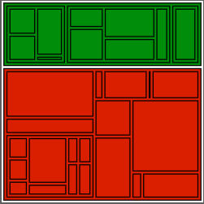
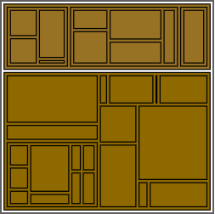
What About Bad Data Visualization?
Misleads or take an answer out of context
  Careful on zooming and summarization.
  Ensure you’re comparing apples to apples.
Overly complex
  Don’t make your users do math
  Don’t try to fit too many answers in one chart
Not accessible
  Hard to interact with; not color-blind friendly; doesn’t work on XYZ device
Interactivity not properly planned
  Need to be deliberate about interactivity to make sure it helps not hinders
This chart shows temperature readings of three sensors at NASA Langley Research Center. If we zoom in too much, the blue sensor looks significantly warmer than the others…even though the difference is only one degree.
Both tree maps show the same random data. First shows how some one with no color deficiency would see the chart. The second shows how somebody with Deurteranopia would see the chart. Try it out yourself at https://projects.susielu.com/viz-palette?colors=["#008d0a","#da1e00"]
Notes:
Don’t mislead or take an answer out of context
Careful on how close to zoom into the data, and ensure you’re comparing apples to apples. You can make a one degree temperature spike look huge if you zoom in close enough, or make two different line charts look the same by messing with their axes.
Overly complex
Don’t make your users do math! Don’t try to fit too many answers in the same chart! Your charts shouldn’t need a user manual.
Not accessible
Hard to interact with; not color-blind friendly; doesn’t work on XYZ device
Vis P

Slide 7
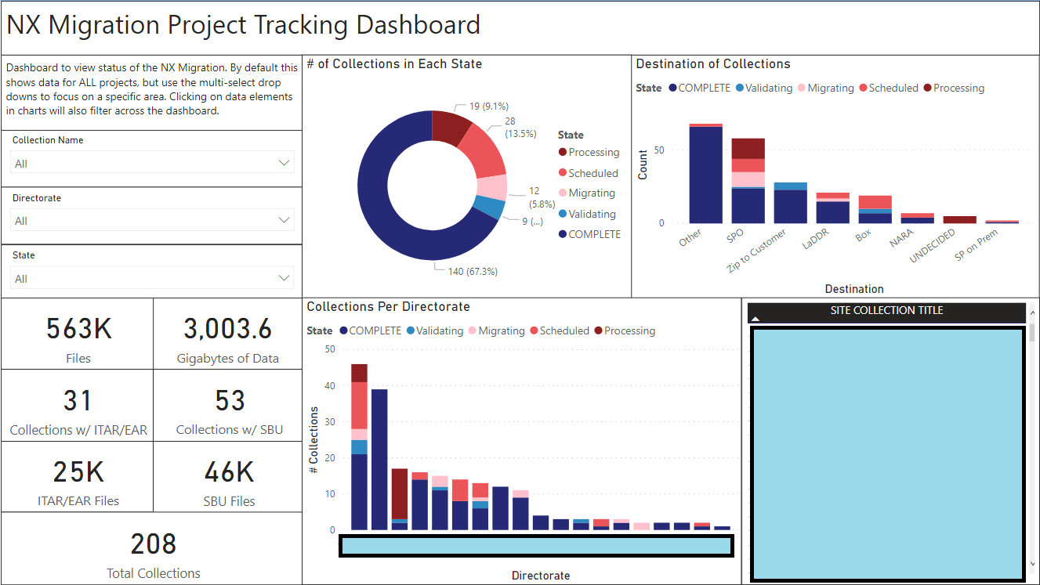
Example: NX Migration Dashboard (the Good)
NASA Langley is migrating 200+ collections from a legacy content management system (NX) to newer supported systems. Would like a dashboard to track where each collection is in the process.
Notes:
Good: charts are simple donuts and stacked bars, with a color scheme that’s easy to decipher. Reds mean that “we’re still working on the migration, or haven’t gotten to it”. Blues mean either “we’re done” or “we’re basically done, but just double checking to make sure there were no issues”. Interactivity is well defined: Users can use drop downs to drill down in specific categories, which updates the rest of the dashboard.
Answered the questions: “How far along are we in the project?” “How much do we have left to do?” “Where is the data going?” and “What’s the status of collections by directorate”?
Updates once a day, based on the project tracking spreadsheet used by the team.

Slide 8
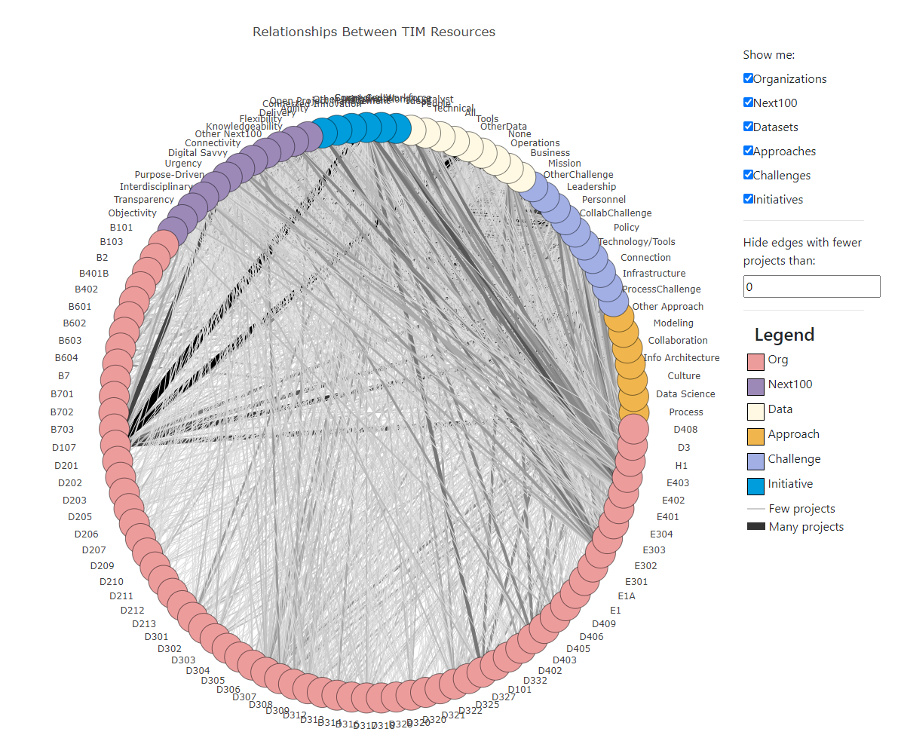
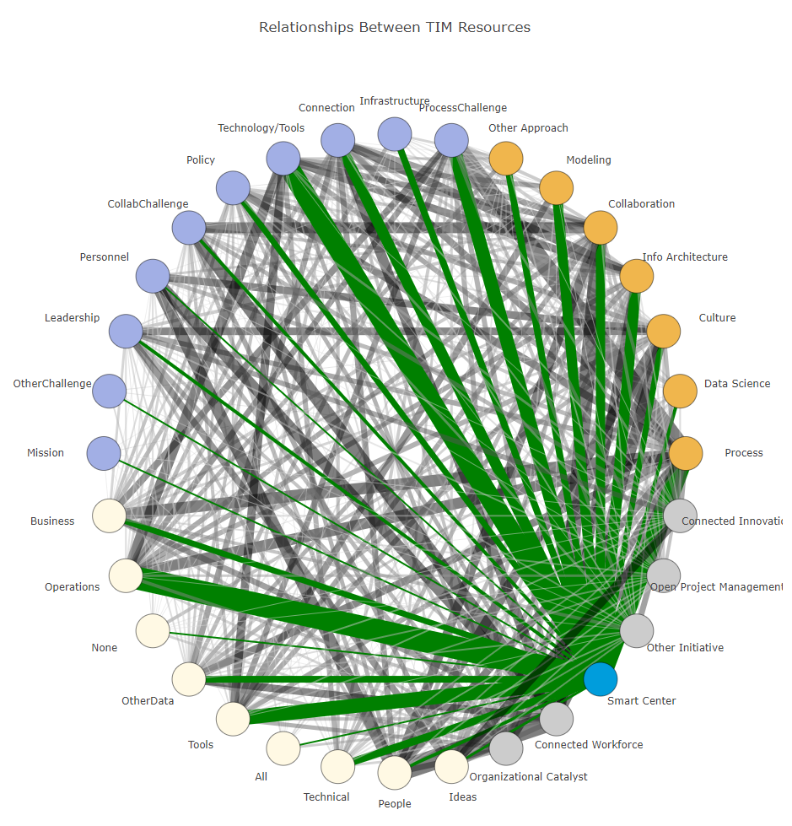
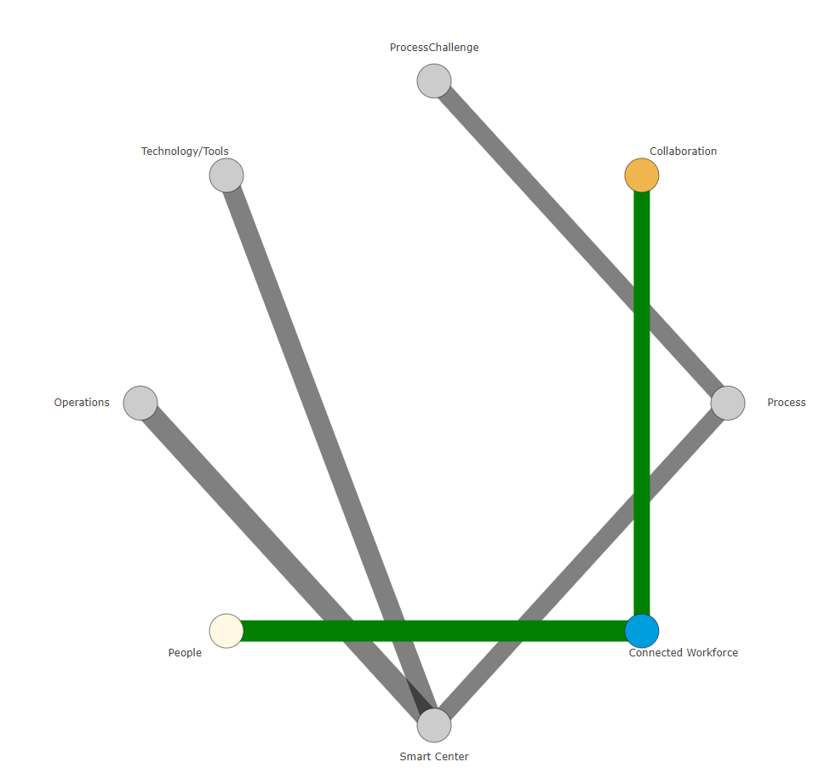
Example: TIM Relationships (the Bad)
In 2018, NASA Langley had a Technical Interchange Meeting (TIM) where employees could submit ideas on how to transform and improve how we work. A couple hundred ideas were collected. Would like to create a chart showing how these ideas relate to various center resources and initiatives.
Notes:
Visualization tries to do too much…and what it does show, it doesn’t show well.
Categories aren’t intuitive. What’s a Challenge? What’s an Approach? What’s Technical Data versus Tools Data versus Business Data?
Really doesn’t show you much other than “things are complicated” and “there are a lot of organizations”
When you start drilling down into it, you can start seeing some interesting things, like “Smart Center initiatives are connected to basically every other kind of resource” or “Connected Workforce initiatives have to do with People and Collaboration”. But are those really useful answers?
Overall, it really doesn’t do much other than overwhelm you.

Slide 9
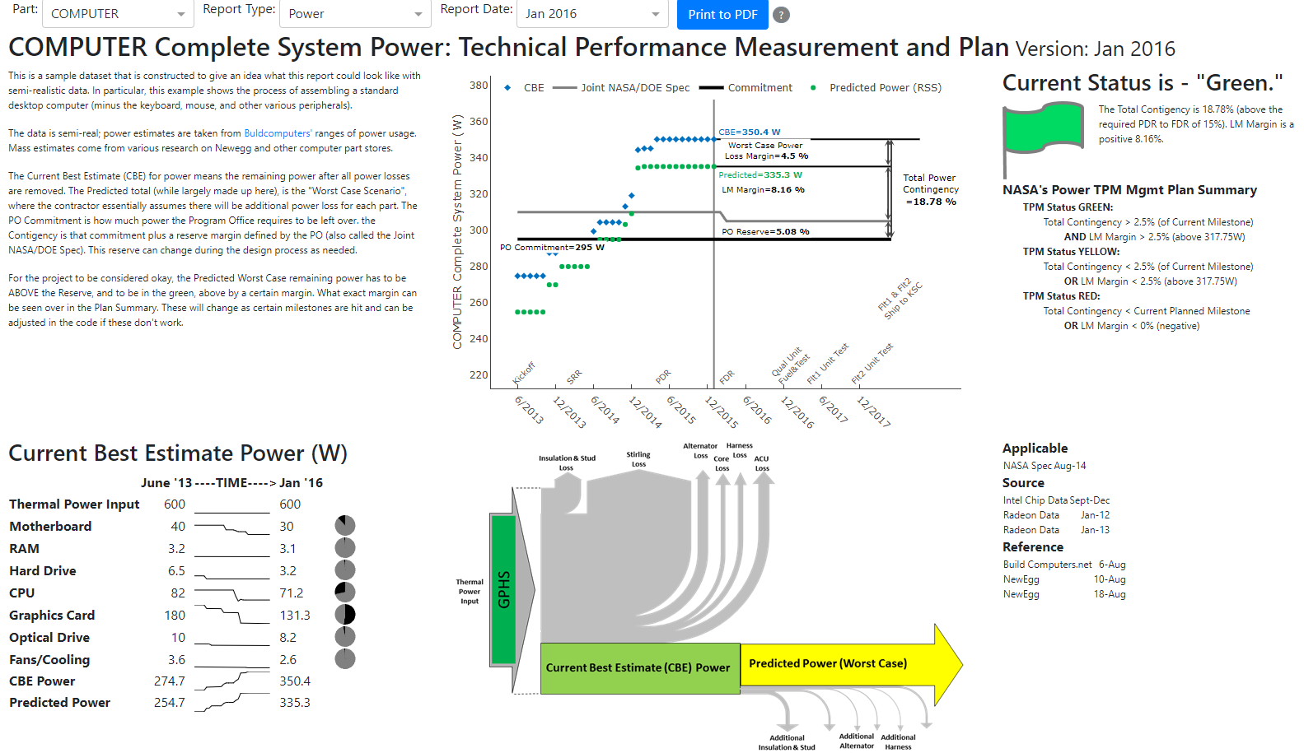
Example: Automated TPM Reports (the “Interesting”)
While designing vehicle parts, need to monitor key metrics to ensure part does not exceed power/mass thresholds
One engineer did this manually using Excel/Visual Basic to gather data, calculate current estimates, generate report with template, and export to PDF
Request: Automate with web application. Engineer inputs last month of data to database, and new report is automatically generated and published to site.
Notes:
While designing vehicle parts, system engineers need to monitor key metrics like estimated power usage or total mass to ensure the part does not exceed various thresholdsPreviously: system engineer did the manually by using Excel and Visual Basic scripting to gather all the data, calculate current mass/power estimates, generate a report using a specific template, and export to a PDF (which would be e-mailed around)Request: Automate this process by making a web based application that, if you input the latest month of data, would automatically generate a new report and publish it to the website, making it easier to create/distribute reports and adhere to 508 standards.

Slide 10
How to Learn
Visualization Analysis and Design (Tamara Munzner)
  https://www.cs.ubc.ca/~tmm/vadbook/
Look at sources that have good data visualizations
Look at sources that have BAD data visualizations (and think about how you would improve them)
  https://www.makeovermonday.co.uk/
Ask for feedback (from a trusted source ☺)
  Having somebody come in “fresh” to double check the charts make sense
Notes:
Keep it Simple Stupid
Sketch it out before developing
10 Second Rule: answer in obvious in 5-10 seconds
Have a specific question in mind when building the chart
Set of questions == set of charts
Don’t automatically accept the defaults
Be strategic about when to use color; gray is your friend!
Explore your data before making your final product
Be deliberate about interactivity

Slide 11
Thoughts?
Thank you for your time!

