Slide 1
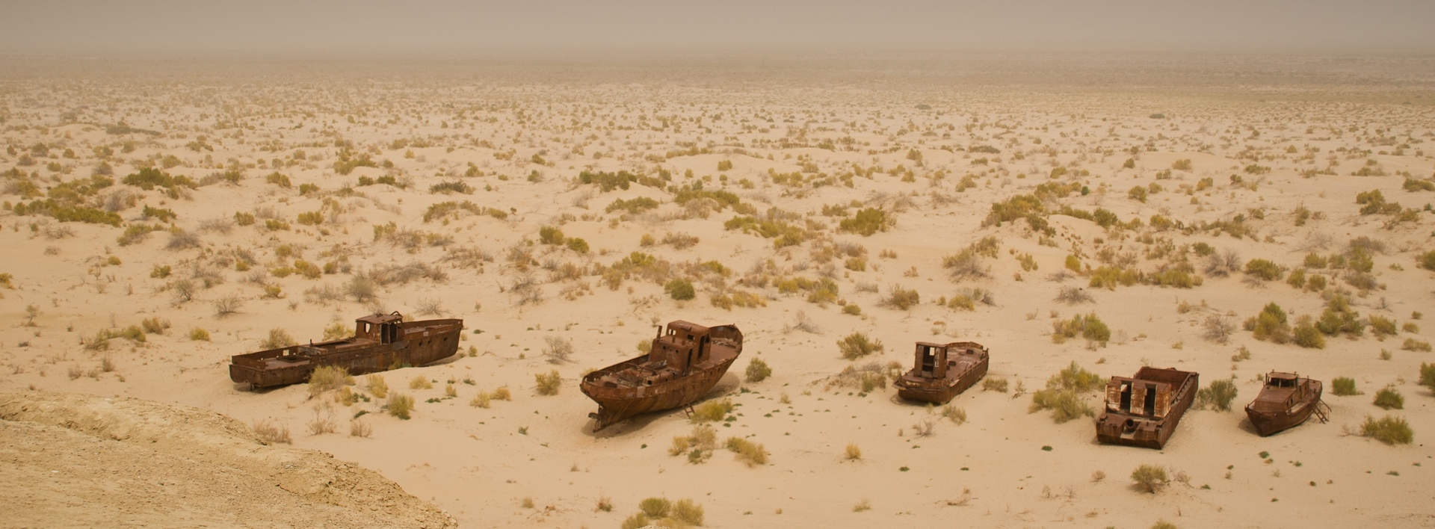
An Assessment of Irrigated Agriculture and Drought-related Hazard Risks for the Aral Sea Region
© NASA
Alex Ruane, Manishka De Mel, Jonas Jägermeyr, Meridel Phillips and Cynthia Rosenzweig

Slide 2
Outline
About the Columbia University Center for Climate Systems Research
Main aims of the CCSR/UNDP assessment
Seeking new insights about climate change impacts on agricultural yields and water demand in Uzbekistan
Creating information about potential adaptation pathways for planning
Need for local data and engagement to better represent local conditions and context

Slide 3
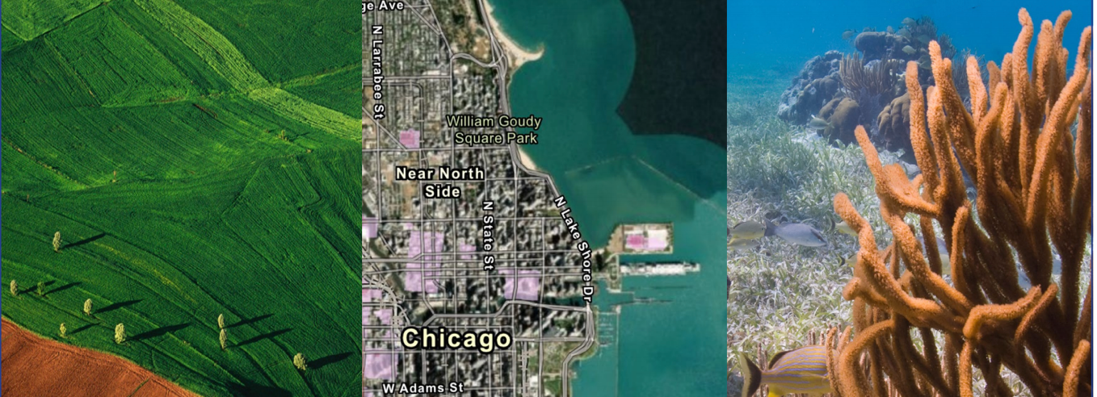
Columbia Center for Climate Systems Research (CCSR)
Center within the Columbia University Earth Institute
Located at NASA’s Goddard Institute for Space Studies in New York on Columbia’s campus
Climate Impacts Group carries out applied research for agriculture, cities and conservation and development sectors around the world

Slide 4
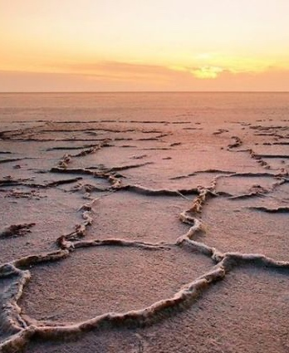
Collaboration with UNDP
Objectives
Assess Irrigated Agriculture and Drought-related Hazard Risks for the Aral Sea Region
Analyze these risks in the context of regional water demand and supply and future climate change
Identify priority development and adaptation pathways that can lead to a more resilient future
Locations
Aral Sea region with a focus on Republic of Karakalpakstan, Bukhara Region, and Khorezm Region
Some analyses may be carried out for a broader area
© Azer News

Slide 5
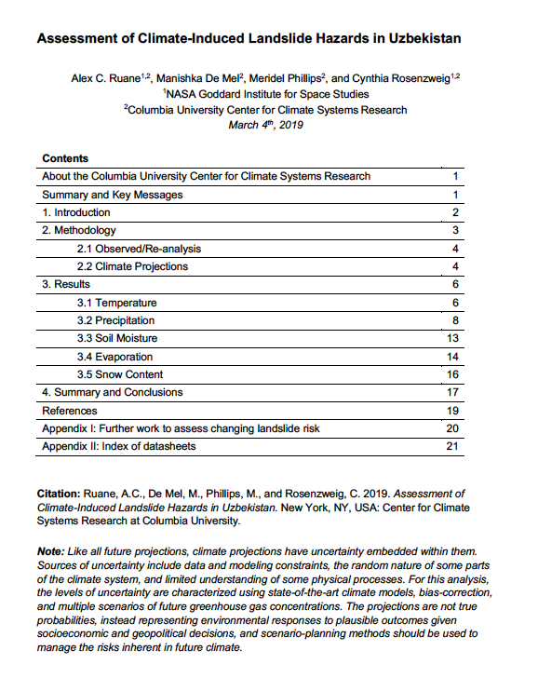
Previous work with UNDP in the region
In 2019, CCSR carried out an Assessment of Climate-Induced Hazards in Uzbekistan to support vulnerability assessment and resilience planning.
Climate projections for temperature, precipitation, soil moisture, evaporation, and snow content.
Results helped us analyze how climate change will alter the profile of climate-induced hazards, such as:
heat waves, drought, heavy rainfall, intense precipitation, loss of mountain snowpack, and potential landslides, mudflows, and snow avalanches

Slide 6
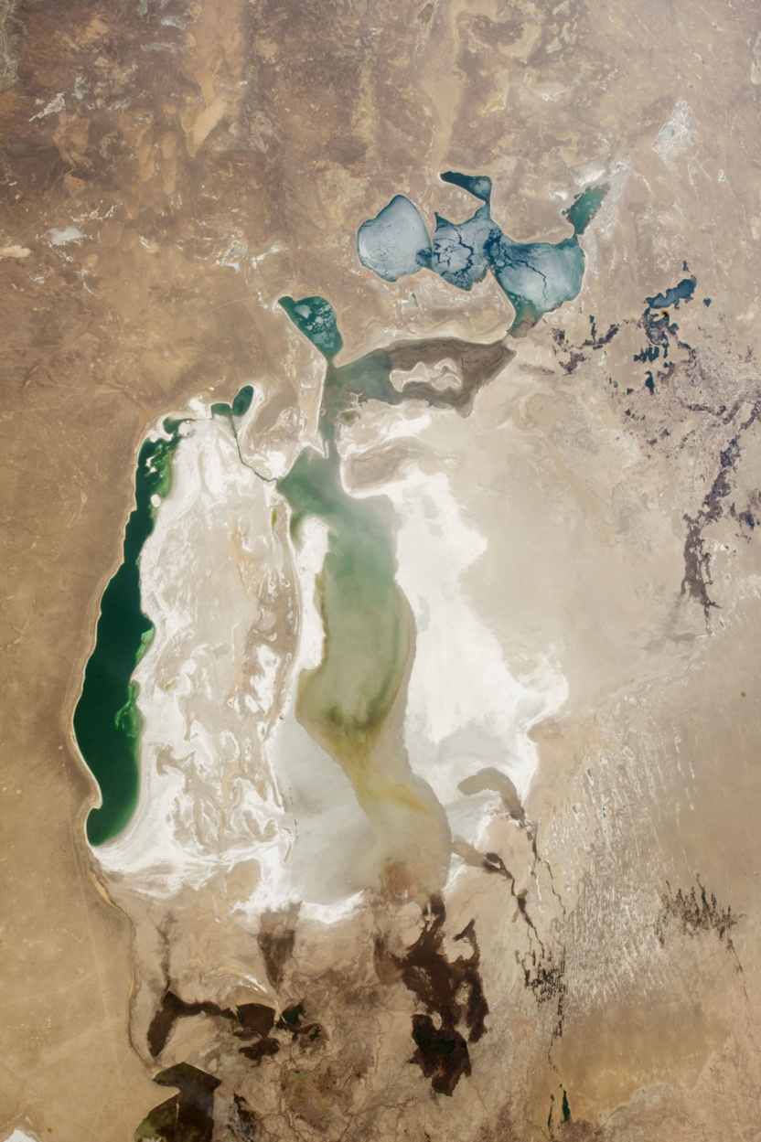
Context – Major challenges in the region
April 2018
Shrinking of the Aral Sea and resulting pressure on systems.
High dependence on irrigated water for agriculture (dominated by cotton and wheat).
Land degradation and desertification, competition for water resources, malnutrition, deterioration of health conditions, and loss of livelihoods.
Socio-economic and environmental consequences are further exacerbated by climate change.
The World Resources Institute has ranked Uzbekistan 25th in its water stress level (baseline water stress measure of the ratio of total water withdrawals to available renewable water supplies).
© NASA

Slide 7
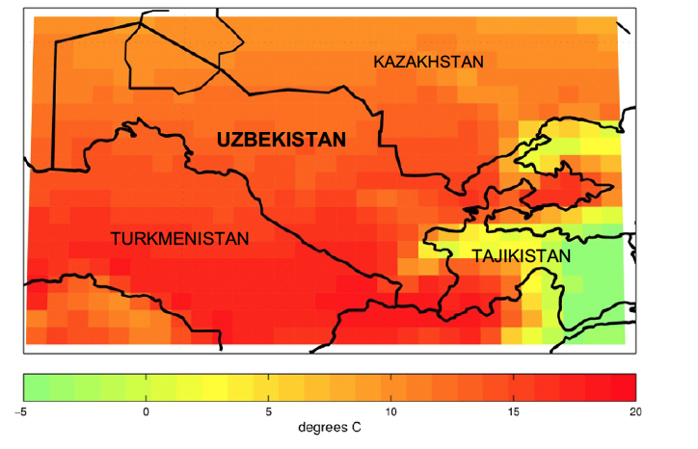
Main components and outputs of the assessment
Main components
Climate observations and projections
Effects of climate change on crop yields and water demand
Remote sensing analyses
Information for potential adaptation pathways
Main outputs
Synthesis report targeted at stakeholders capturing the analyses, methods and outputs produced in consultation with UNDP contributors (target release in September 2021)
Accompanying data and results, with GIS compatible coordinate information, will be shared with the UNDP team and could be used for additional analyses
Temperature climatology of Uzbekistan (1980-2005). Source: MERRA-2

Slide 8
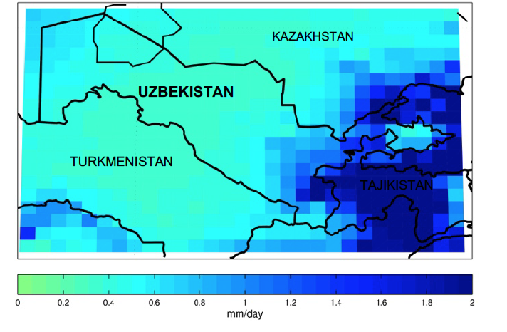
Climate observations and projections
Observed climate
Identification of historical climate trends and risks related to drought and irrigated agriculture.
Utilize combination of models, satellites and local weather station data.
Projected climate
Projections for temperature, extreme heat, and precipitation from a variety of climate models and downscaling products across future scenarios and time horizons.
Analysis of drought indices, soil moisture, evapotranspiration, winds and relative humidity as models and data allow.
Precipitation climatology of Uzbekistan (1980-2005). Source: MERRA-2

Slide 9
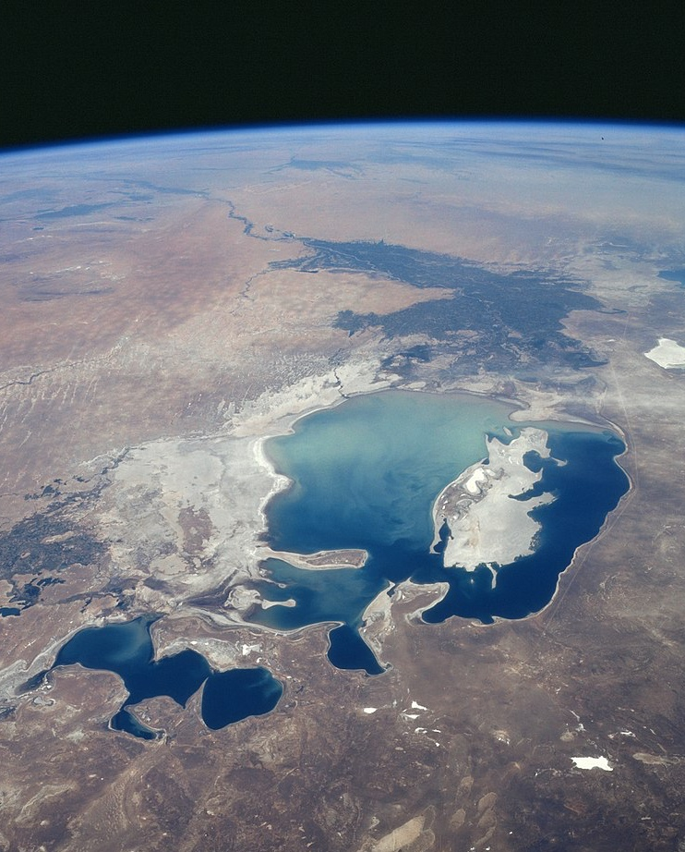
Remote sensing
Aral Sea in 1997
Satellite analyses provide additional contextual information to augment the identification and assessment of droughts and their effects on agricultural systems.
Land imagery – Visible imagery of Aral Sea extent and agricultural lands since ~1980.
Agricultural imagery – Vegetation indices to characterize agricultural areas and their response to drought.
Climatic information – Precipitation, soil moisture, and groundwater datasets
© NASA

Slide 10
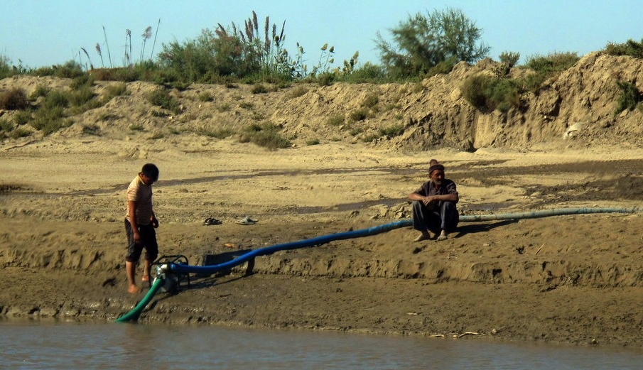
Effects of climate change on yields and water demand
We will apply crop models developed within the Agricultural Model Intercomparison and Improvement Project (AgMIP) to identify portions of the country where climate change may increase water stress and lower yields
We will combine climate change impact projections with local information about agricultural systems trends in order to understand changing irrigation water requirements, incorporating:
(i) Changes in water requirements for irrigation agriculture
(ii) Local observations of irrigation area changes
(iii) Yield gaps between irrigated and rainfed farms
(iv) Documented changes in water resources demand from other sectors
© Wikimedia Commons

Slide 11
Information for potential adaptation pathways
Engage with local experts to explore feasible adaptation pathways and understand current context for agricultural and water resources planning including official policies and governmental processes
Highlight illustrative water management adaptation pathways for agriculture
Identify strategies that benefit farm productivity and water use efficiency
Foster systems thinking to identify interactions with other development pressures and potential for cascading impacts and unintended consequences of action

Slide 12
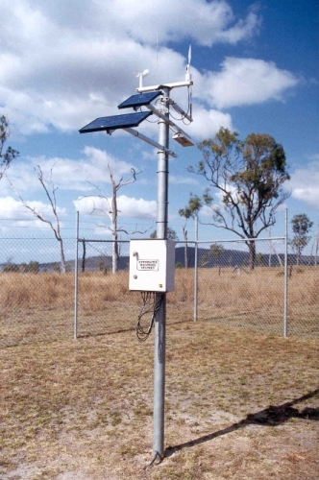
Local data needs – Climate
Weather station data within the region or broader catchment as available
At least 10 years of data of good quality and continuous data – a longer period is preferred (30 allows for a ‘climatology’)
Daily data needed, but also interested in monthly datasets (we understand that not all variables will be available daily at all sites)
Temperature: mean, maximum and minimum
Precipitation: total
Windspeed
Solar radiation
Relative humidity
Soil moisture
Data in harmonized digital format (excel, ASCII, netCDF etc)
© Jacarrah

Slide 13
Local data needs – Agriculture and hydrology
Time series of regional-scale production information (by crop, ideally distinguishing rainfed and irrigated conditions; focus on cotton and wheat):
Mean yield
Total production
Area planted and harvested
Planting and harvest dates
Fertilizer used
Farming system descriptions
Potential irrigation water applied
Information from research field data
Prominent agroclimatic hazards and their effects
Information about water management in Uzbekistan
Water system structure and trends
Water supply/demand by region and sector
Time series of river and reservoir levels
Water prices and/or allocation rules under normal and drought conditions
Information about disaster management and resilience planning related to drought

Slide 14
Variables
Variables
Temperature
Mean
Minimum
Maximum
Days over 40ºC
Precipitation rate
Mean
90th percentile
Number of 1mm days
Number of 10mm days
Soil moisture
Drought indices
Evapotranspiration
Winds
Relative humidity
Seasons
Annual
Growing seasons for wheat and other major crops
Time Slices
Climate model
Baseline
(1980-2015)
2050s
(2041-2070)
2080s
(2071-2100)
Scenarios
Two scenarios, a high and low scenario selected from the following:
SSP1 + RCP26 (SSP126)
SSP2 + RCP45 (SSP245)
SSP3 + RCP70 (SSP370)
SSP5 + RCP85 (SSP585)

Slide 15
Thank you!
Alex Ruane
alexander.c.ruane@nasa.gov
Manishka De Mel
manishka.demel@columbia.edu
https://ccsr.columbia.edu; https://www.giss.nasa.gov

