Slide 1

Rapid Nucleic Acid Isolation Method and Fluid Handling Devices Overview
NASA Ames Technology Transfer Health, Medicine and Biotechnology Webinar
Travis Boone, Ph.D.
Fluidics Lead, WetLab-2
NASA Ames Research Center
04/27/2021

Slide 2

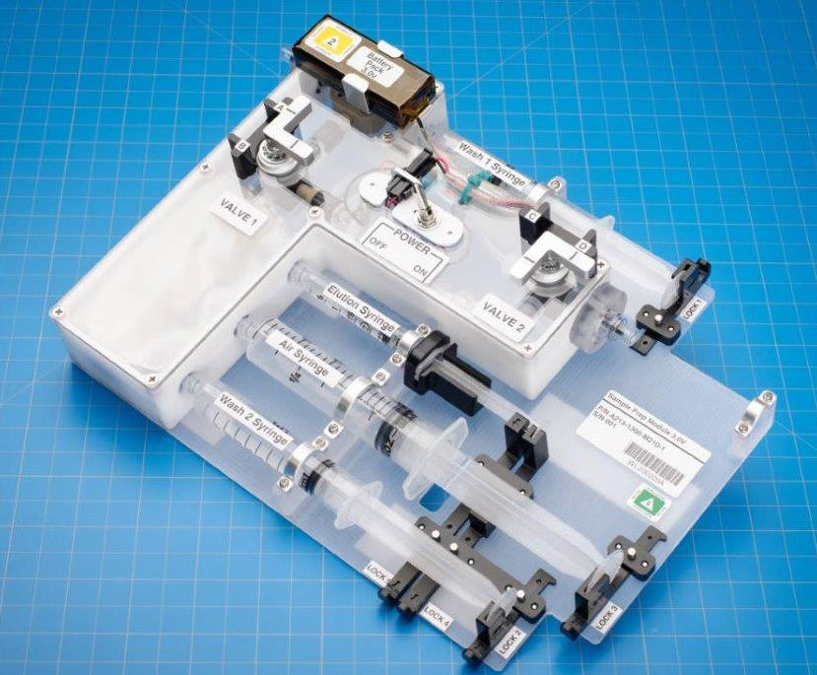
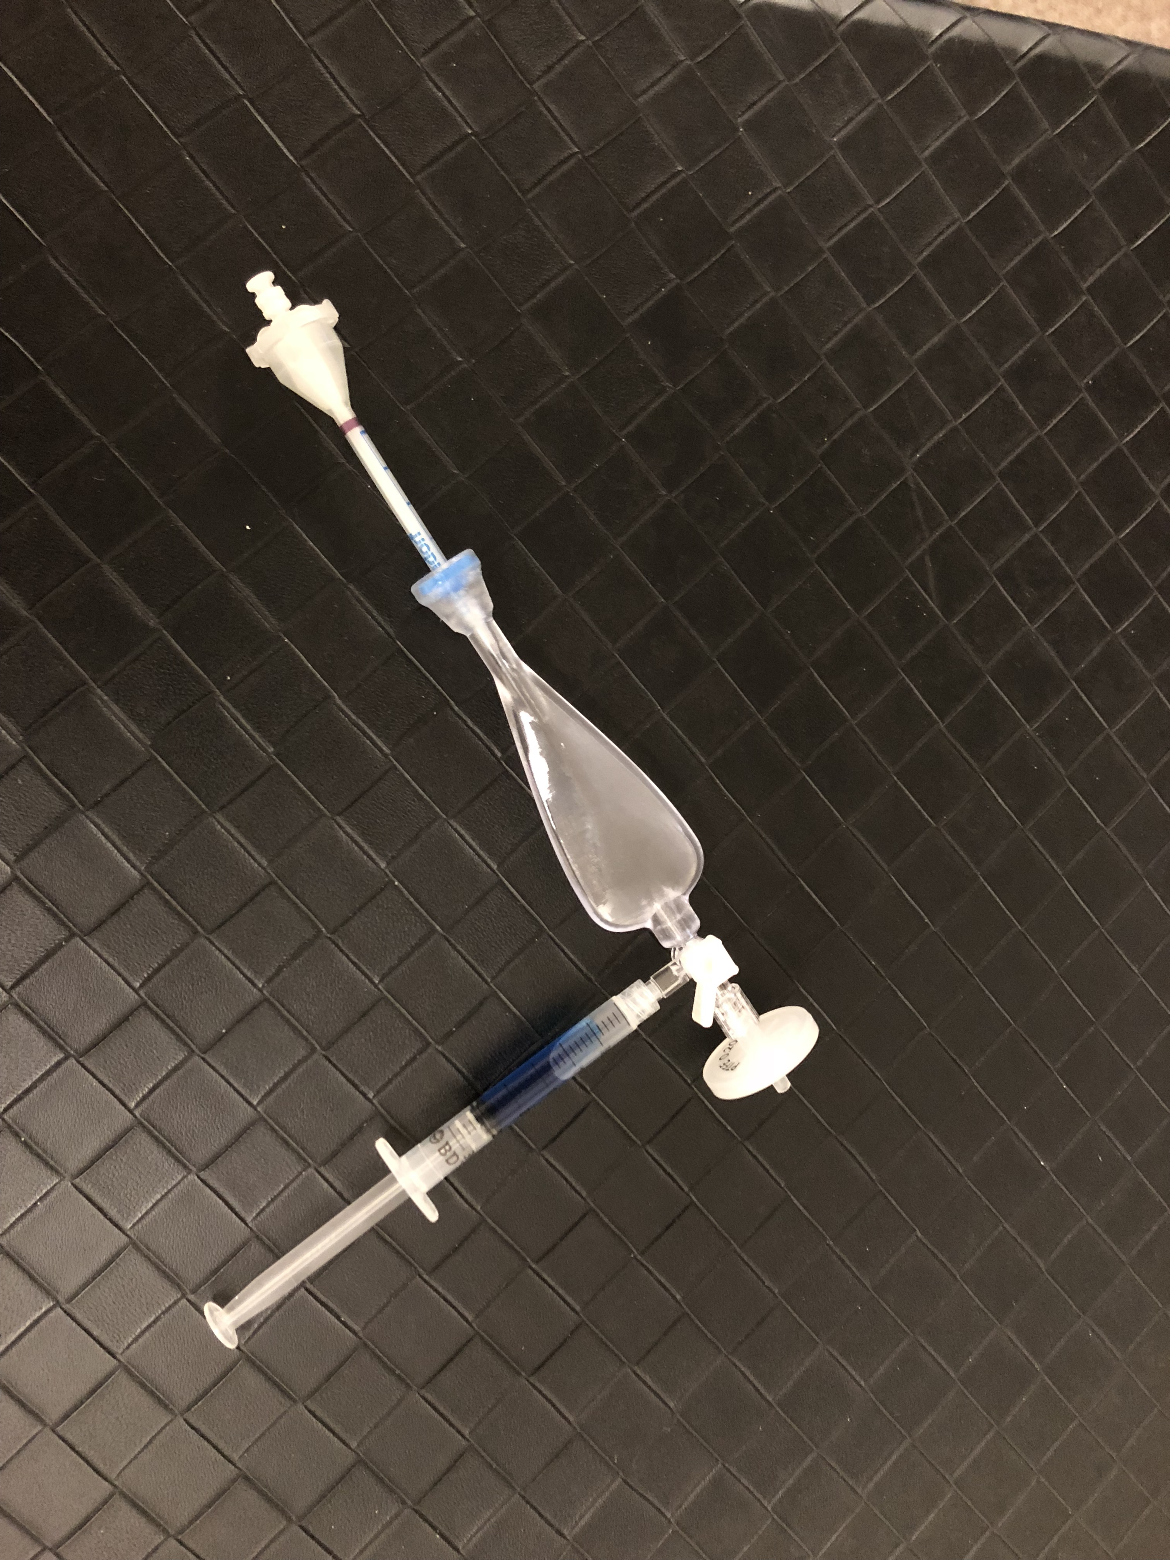
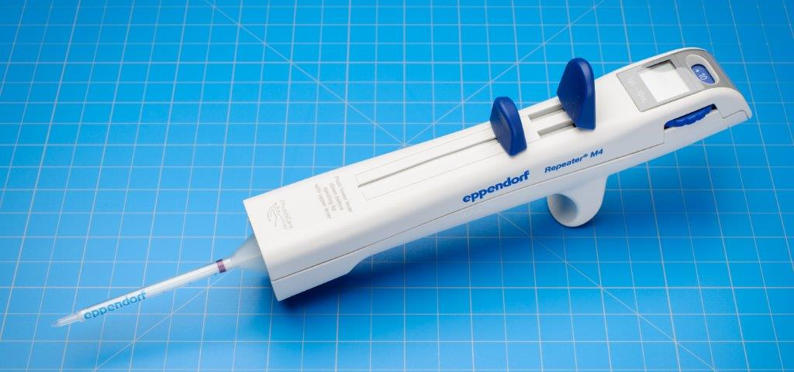
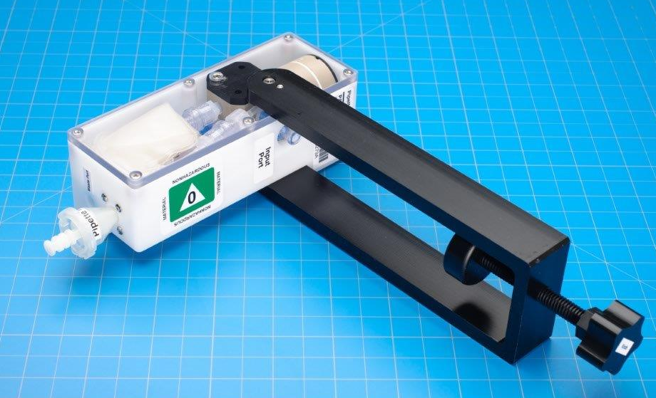
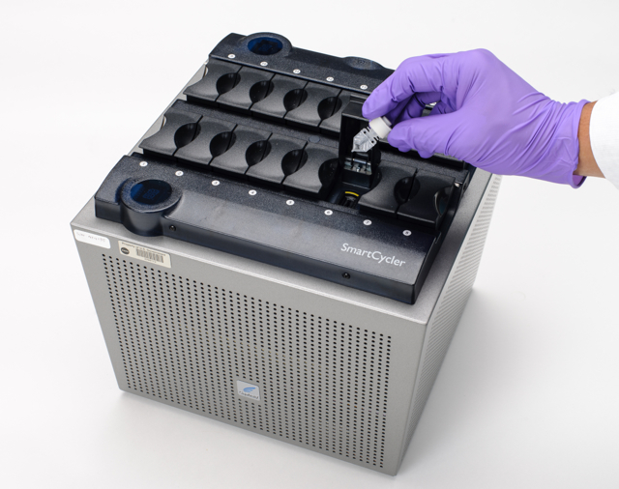
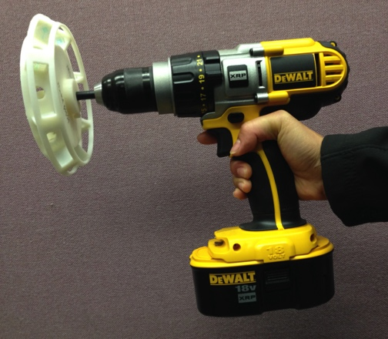
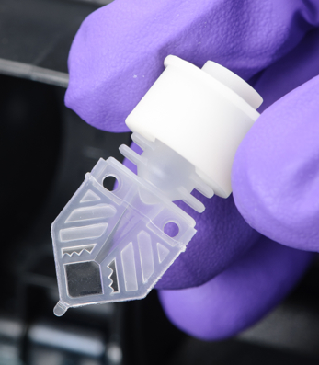
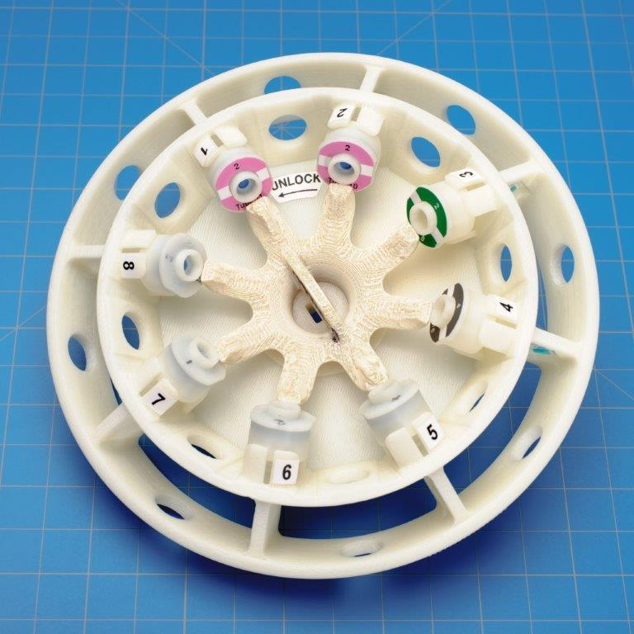
Rapid Nucleic Acid Isolation Method and Fluid Handling Devices
Technology Overview
RNA extraction + PCR reaction prep of custom target genes
Pre-loaded buffers and lyophilized RT/qPCR primers/probes
Single-use disposable; portable form factor
Low-toxicity (aqueous buffers; no alcohols/chaotropic salts)
Long-term storage at room temperature (or alternatively 4C)
RNA stabilization and DNase additives
< 1 hour sample preparation and PCR reaction assembly
Repeater
Pipette
Pipette
Loader
Debubbler
Sample
Prep
Reaction
Tube
Rotor
Drill
Centrifuge
SmartCycler™
Applications
Benefits
Portable
Pre-loaded, single-use disposables
Ambient long-term storage (or alternatively 4C)
User-defined target genes (vs fixed panel in most systems)
Rapid operation (< 1 hr)
Battery-powered prep → 110V AC thermocycler
Low-toxicity; no special safety handling required
Space research (gene expression, microbial monitoring)
Diagnostic industry including mobile diagnostics
Disease or microbial monitoring in remote areas
Cruise line pathogen detection
Food quality testing

Slide 3
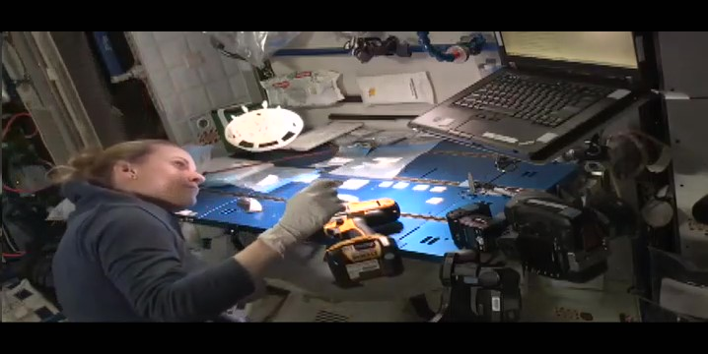
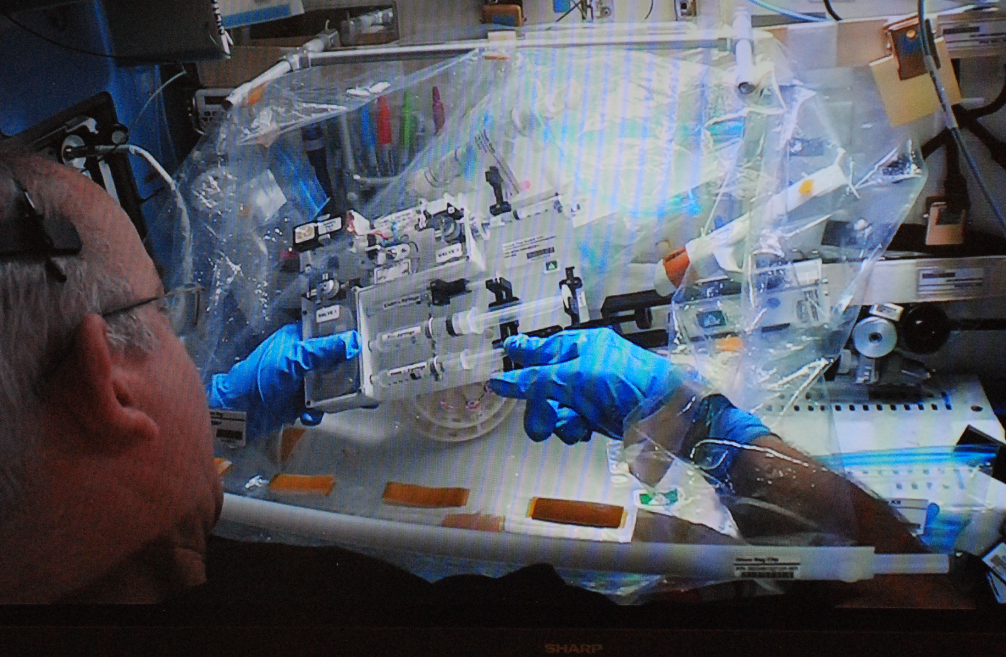
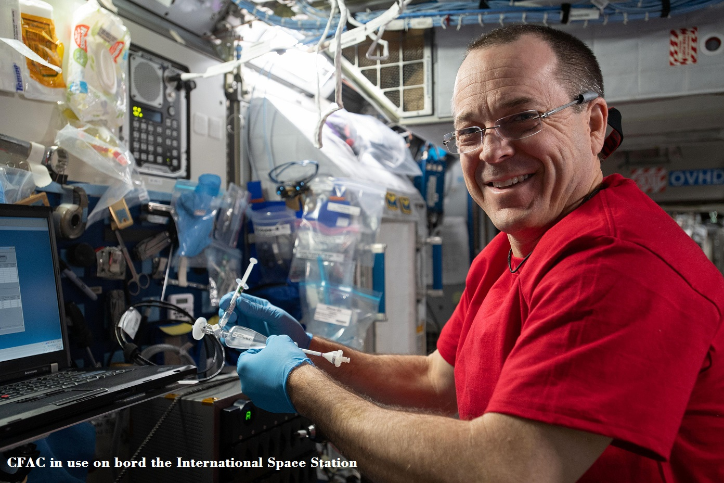
WetLab-2 Rapid Nucleic Acid Isolation and Fluid Handling Devices Use on ISS
Kate Rubins, Expedition 49, 10/04/16
Jeff Williams, Expedition 47, 04/29/16
Ricky Arnold, Expedition 56, 08/27/18

