Slide 1


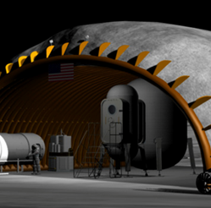
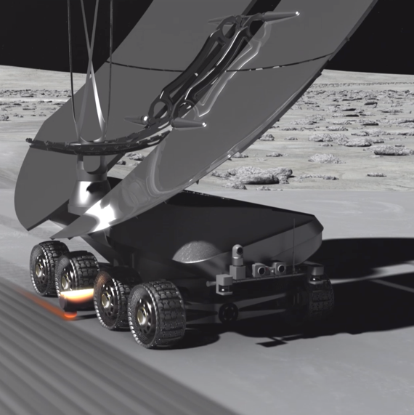
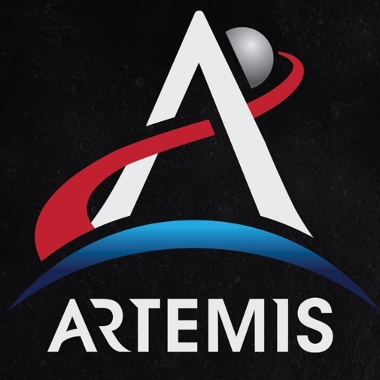
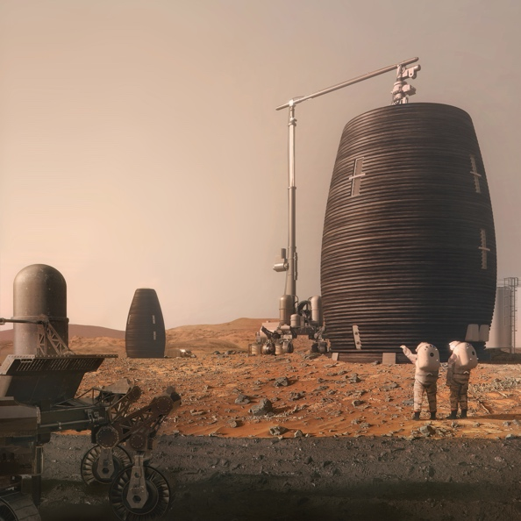
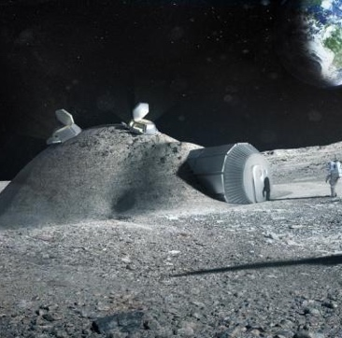
Lunar Safe Haven Seedling Study
Overview for LSIC Excavation and Construction Focus Group
Dr. Bob Moses, Melanie Grande | Lunar Safe Haven Seedling Study | 04.30.2021

Slide 2

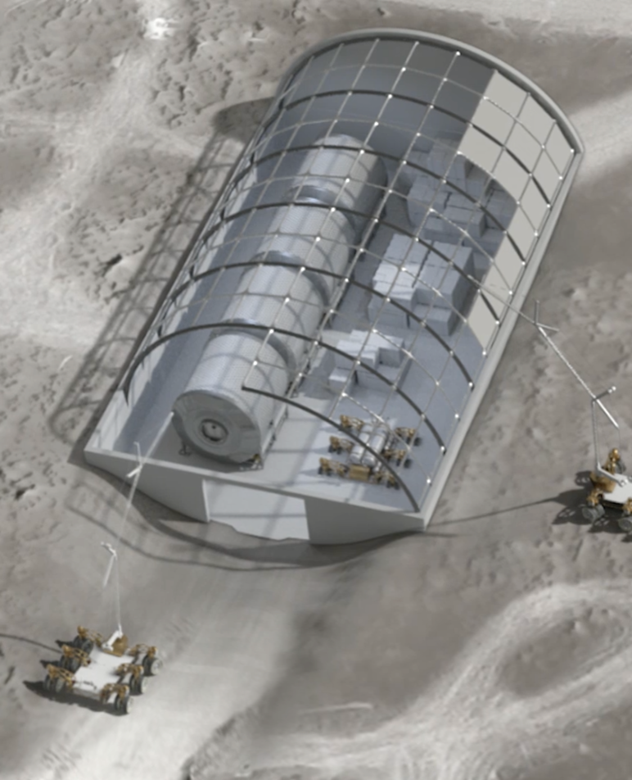
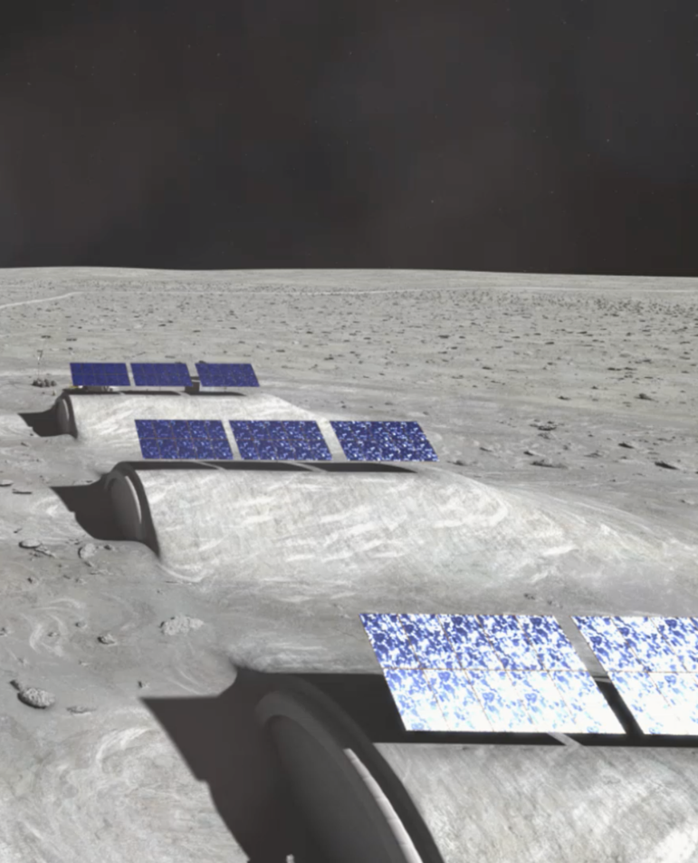
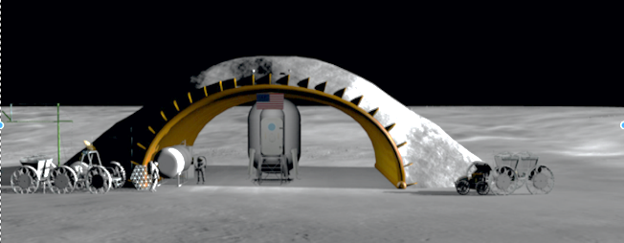
Lunar Safe Haven Seedling Study – Background
NASA’s Artemis program will include a “sustained” phase of lunar exploration, with longer duration missions and focus on sustainability and extensibility for Mars exploration
To enable a sustainable human lunar presence, NASA must provide a safe haven shelter to protect astronauts and equipment from radiation, thermal extremes, and micrometeoroids (MM).
Development of a Safe Haven should include examination of NASA activities in site preparation, excavation, regolith transfer, surface construction/assembly/deployment, autonomy, robotic servicing/repair, advanced manufacturing, and in situ resource utilization (ISRU) for identifying the best approaches for implementing a safe haven shelter.
HEOMD has declared development gaps in TX6 06-38 Radiation Shielding, and TX12 12-07 Construction of Unpressurized Structure for Protection; both of these gaps are the focus of the Lunar Safe Haven.
Source: NASA
Source: NASA
Source: NASA
Source: NASA

Slide 3
Game-Changing Nature of a Lunar Safe Haven
The Lunar Safe Haven Study is leveraging the substantial work of the Artemis program, such as the progress in habitat and rover development
  We are choosing to define “Lunar Safe Haven” to mean a continuous strategy for protection of crew and exploration systems
The Lunar Safe Haven concept is “game changing” because it provides:
  Shielding for crew to a degree that cannot be done via delivery from Earth, given constraints/costs of landing systems
  Protection with access, which directly burying habitats wouldn’t allow
  Shielding for electronics that can be a game-changer for autonomy, avionics, and communications—e.g., by extending their lifetime and reducing rad-hardening and thermal control requirements
  Protective shelter for mobile assets and potentially an area for servicing, both of which will extend their lifetime
  Scalability, if various sizes of safe haven shelters are possible
  Evolvability, if the safe haven concept is able to change and respond to new scenarios over time

Slide 4
Study Approach
Ultimate Goal: The trade study and identification of both high-level and derived, system-level requirements will provide a path to future technology investments plus synergy with existing and proposed programs
A multi-center team (LaRC, MSFC, and KSC) with a Steering Team consisting of two SMEs from each center
One-year effort in FY21 sponsored by STMD Game Changing Developments
Content areas for seedling trade study will include, but are not limited to:
  Site preparation and shelter preparation (e.g. deployment, assembly, and/or construction)
  Protection of crew and surface systems (i.e. from radiation, thermal extremes, micrometeoroid strikes)
  System / structural verification
  System maintenance for long duration use
Data will be collected from other NASA projects, OGA’s, industry, and academia on concept options and state of technology maturity

Slide 5
Study Scope and Progress
3 Main Deliverables:
  Identify high-level requirements for synergy with the Artemis program
  Define several safe haven shelter concepts and conduct a comprehensive trade study
  Derive system-level requirements for 1-2 chosen safe haven concepts, including requirements for surface radiation shielding, thermal extremes, and micrometeoroids
Current status:
  Level Zero Requirements – Completed
  Functional Decomposition and Ground Rules & Assumptions (GR&A) – Completed
  Decision Objectives and Attributes, to assess concept alternatives – Completed
  Concept generation of alternatives – Completed
  Concept evaluation and down-select – Coming in May
Notes:
After definition of the Level Zero Requirements, more detailed assumptions were made to constrain the trade study scope and understand drivers to the design solution
LSH team hosted internal discussions to write GR&A on the topics of:
Lunar Surface Conditions and Locations
Mobility and Autonomy
Protection Standards
Artemis Elements Manifest—i.e., the elements we assume will be present at the Base Camp
Artemis Functions—i.e., functions that the Artemis Base Camp elements will provide, and which the LSH will not be responsible for

Slide 6
Concept Alternatives

Slide 7
Concept Generation Process
The LSH team defined three morphological matrices for each system group with a large number of alternatives
  System groups: Shelter Physical Design, Establishment Systems, Sustained Operations Systems
Each concept combination of alternatives will be evaluated based on identified decision attributes to quantify how well each concept satisfies the main objectives
  Ultimately 1-2 concepts will be down-selected based on attribute scores
Morphological Matrix – Shelter Design
For the Shelter, we used the Physical Architecture method:
  One parameter per row
  Brainstormed to put one parameter setting alternative per column
Shelter protection | Idea 1 | Idea 2 | Idea 3
Shelter structure | Idea 1 | Idea 2 | Idea 3 | Idea 4
Shelter size/dimensions | Idea 1 | Idea 2
Shelter shape | Idea 1 | Idea 2
…
For the Establishment and Sustained Ops systems, we used the Function Decomposition method:
  One function per row
  Brainstorm to put one alternative for “means to achieve the function” per column
Morphological Matrix – Establishment Systems
Transport LSH systems | Idea 1 | Idea 2 | Idea 3
Survey the location | Idea 1 | Idea 2 | Idea 3 | Idea 4
Emplace, assemble, and/or construct the LSHC shelter | Idea 1 | Idea 2
…

Slide 8
Sample LSH Concepts – Physical Shelter Design
A concept combination is made up of at least one alternative in each row, and it includes a design (selection) for the physical shelter + establishment systems + sustained operations systems.
Parameters - SHELTER | Alternative 1 | Alternative 2 | Alternative 3
1. Shelter protection | Regolith, bulk covering | Layered polyethylene and regolith
2. Shelter structure | Inner metal structure delivered from Earth |  | Inflatable beams/form work, which could be empty or filled with water or gas, e.g. Vectran
3. Shelter size/dimensions | Accommodates all crew because big enough just for Surface Habitat (SH)
4. Shelter shape
4A. grade level | level with the grade
4B. plan profile (i.e. from aerial view) | rectangular
4C. section profile (i.e. view normal from the ground) | dome (circular, parabolic, or egg), for example: Quonset hut half cylinder, vertical arch, or geodesic dome
4D. means of ingress/egress | two open sides
4E. number of stories | single story
5. Dust management within (or under the footprint of) the shelter | Stabilized regolith (binder/epoxy mixed in) to develop floors and pathways under footprint of shelter
6. Thermal management/ protection | Thick enough regolith shielding causes controlled/ constant thermal environment Low CTE materials for shelter structure Sunshades (e.g. at door/openings)
Green cells = fixed variables
White cells = will vary between Alternatives

Slide 9
Sample LSH Concepts – Establishment Systems
Functions - ESTABLISHMENT SYSTEMS | Alternative 1 (continued) | Alternative 4 | Alternative 5
1. Transport LSH systems from lander off-loading site to establishment site | Crane with appropriate implements, such as LSMS on wheels, which can pick up cargo and transport it
1*. Degree of Autonomy | Completely autonomous
2. Prepare the site for installment of the shelter
2A. Remove rocks; Grade (level) the site; Build foundation (if needed) | RASSOR, an excavation robot used to clear area of rocks and level the site | LTV 2 (copy) with an attachment of a hoe/claw | Backhoe
2B. Rough compact the site and stabilize the surface of the compacted area | Compactor/Roller (has a smooth wheel roller to compact shallow layers of soil) | LTV 2 (copy) with an attachment of a Compactor/Roller (has a smooth wheel roller to compact shallow layers of soil)
2C. Verify compaction and grading | Verification sensors and imaging equipment built in to the Establishment rovers
2D. Transfer bulk regolith; Stockpile construction feedstock | Crane with appropriate implements, such as LSMS on wheels | LTV 2 (copy) with an attachment of a loader + dump truck-style container | Dump Truck + Loader
2*. Degree of Autonomy | Completely autonomous
3. Emplace, assemble, and/or construct the shelter
5A. Deploy the LSHC systems | Deployment of structure delivered from Earth
5B. Accept construction materials at the installment site | Dedicated area to pile up regolith
5C. Process construction materials | Use bulk regolith, remove large rocks (no additional processing? TBR)
5D. Construct/ assemble shelter structure and protection | Multiple assembly/construction agents | LTV 2 (copy) with robotic arms to do assembly, plugging stuff in, moving things around
5*. Degree of Autonomy | Completely autonomous
4. Receive distributed power from the Artemis surface power source | Rovers drive over to the surface power source when needed Wireless charging Onboard batteries for power storage
5. Manage/remove lunar dust for individual LSHC systems (not Artemis systems inside the shelter) | Combination of surface coatings to resist dust/abrasion and electrodynamic dust shield

Slide 10
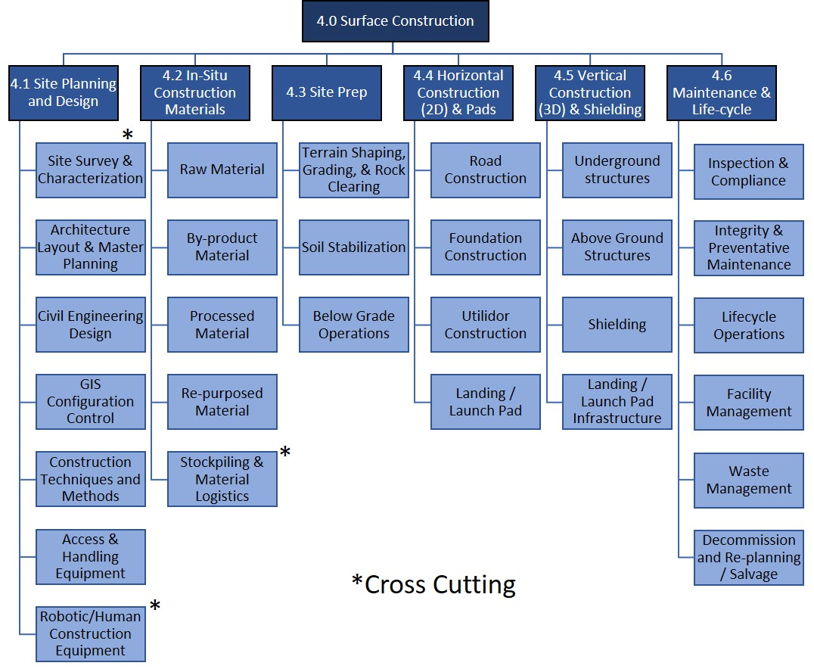
Functional Capabilities WBS – Surface Construction
Consistent with Construction
Industry Terminology
Rob Mueller presented this WBS at a previous LSIC E&C FG Meeting
Moses & Mueller, “Requirements Development Framework for Lunar In-Situ Surface Construction of Infrastructure,” ASCE Earth & Space Conference, 19-23 April 2021, Seattle, Washington

Slide 11
Functional Capabilities to be Addressed / Considered
Deploy Location Determination Reference Systems
  Reverse-Ephemeris Satellite Suite
  Ground Beacons
Preposition Related Equipment on the Lunar Surface
Site survey
  Topography
  Geology
Site preparation
  Rock removal
  Grading
  Stabilization/compaction
  Verify compaction
Foundation construction/emplacement (i.e., horizontal / footer / slab)
  Verify surface stabilization
  Verify structural performance
Off-loading any Earth-manufactured LSH components/equipment from Lander(s) (i.e., trusses may be manufactured in situ and aligned tightly so that panels are not needed)
Transportation of LSH components from landing site to construction site
Assembly/Construction of LSH Structural Elements
Deployment of service cables through structural “wall” with length available both “inside” (underneath/shadow of) and outside the LSH “final” configuration footprint
Emplacement of shielding material overtop LSH (sub)structure
Connection of (external) services as needed (such as power, communications, ECLSS, …)
V&V and other check out of the structure and monitoring systems

Slide 12
Concepts of Operations

Slide 13


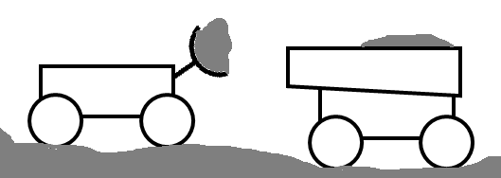



Concept of Operations : WBS 4.3 – Site Preparation
Site preparation
  Rock removal
  Grading
  Stabilization/compaction
  Verify compaction
Site Preparation Examples Include:
Obstacle/Rock Clearing
Bad Material Removal
Establish Rough Grade
Grade Fill and Cut Ops
Compaction
Establish Control Points
Primary Implements of Interest for Site Prep:
  Rock Removal
  Dozer Blade
  Load Haul Dump (LHD) Excavator
  Compactor
  Regolith Stabilization
  Use Un-Pressurized Rover (UPR) for mobility (>1,000 kg cargo)
Comm. for line of sight from lander
Take rocks to future berm location
Changing Topography and Geological Information for each grid location are continuously updated in the Digital Village
2
Excavate
3
Sub-Surface
Fill
3
Fill
2
3
4
1
4
Desired Site Topography
0
Install control points and continuously assess desired states
1
Deploy Un-pressurized Rover (UPR) with implements for rock removal, load, haul, dump, grade, stabilize surface
2
Excavate high areas, load, haul (trench for subsurface structures, if desired)
3
Dump regolith in depressions, to create a level site and rough grade the site
4
Rough compact the site and stabilize the surface of the compacted area
5
Stockpile construction feedstock pile and stage required construction equipment

Slide 14
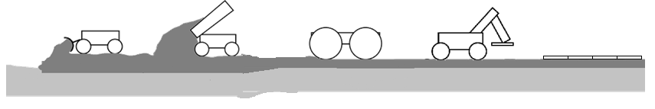
Concept of Operations : WBS 4.4 - Horizontal Construction
Foundation construction/ emplacement (i.e., horizontal / footer / slab)
  Verify surface stabilization
  Verify structural performance
Horizontal Construction Elements Include:
Launch and landing pads
Roads
Dust free zones
Foundations
Thermal wadis
General purpose pads
Primary systems/functions of Interest:
  Specialized Construction Implements/Systems
  Surface preparation systems
  Verification of structure
  Use Un-Pressurized Rover (UPR) for mobility (>1,000 kg cargo)
  Additional Power if making bricks / pavers / sintering / molten regolith printing
2
Changing Topography and Geological Information for each grid location are continuously updated in the Digital Village
Fine Grade
Surface
Compact/Stabilize
Surface
Horizontal
Construction
1
3
1
Bring surface to final grade
2
Complete surface preparation operations such as compaction and stabilization surface
3
Perform specialized construction operations
4
Verify as-built configuration and performance of surface and structures (not shown)

Slide 15
Concept of Operations : WBS 4.5 – Vertical Construction
Emplacement of shielding material overtop LSH (sub)structure
Connection of (external) services as needed (such as power, communications, ECLSS, …)
V&V and other check out of the structure and monitoring systems
Vertical Construction Elements include:
Blast Protection
Radiation Shielding (Nuclear Reactor and Space Radiation)
Unpressurized Hangars
Pressurized Habitats
Sun Shades for Thermal Control
Solar Power Farm
Primary systems/functions of Interest:
  Specialized Construction Implements/Systems
  Verification of structure
  Use Un-Pressurized Rover (UPR) for mobility (>1,000 kg cargo)
  Additional Power if making bricks / pavers / sintering / molten regolith printing
2
Rocks from cleared sites form base
Vertical Element
Construction
3
Berms
Shielding
Vertical Element
Construction
Connections to External Services
Changing Topography and Geological Information for each grid location are continuously updated in the Digital Village
2
1
1
Excavate & trenching (previously shown)
2
Structural (vertical element) construction (not shown – requires other systems currently not shown)
3
Transfer bulk regolith & bury support (“roof”) structure

Slide 16
Potential Collaboration

Slide 17
Potential Collaboration between LSH and LSIC FGs
Challenges and barriers
  Limited opportunity for demonstrations
  Low Technology Maturity Level (TRL) of certain construction technologies
  Autonomy capabilities need to be matured
  Power supply for construction (e.g., sintering)
  Amount of regolith to be moved
  Electrostatic environment (lunar surface is very charged, so electrostatic discharge is a risk to electronic systems)
  Limitations of material survivability in lunar environment
  Cargo delivery mass constraints
  Etc.
How do you see the LSIC FG helping to address these?

Slide 18
Back-Up

Slide 19
Sample LSH Concept #1 – Sustained Operations Systems
SUSTAINED OPS SYSTEMS | Alternative 1
1. Maintain successful operation of the LSHC
1A. Identify and respond to anomalies during the establishment of the shelter; Fix anomalies | LTV 2 (copy), with sensors/ imaging equipment specifically for construction
1B. Inspect and verify that the establishment of the shelter has completed successfully, and confirm operational readiness | LTV 2 (copy), with sensors/ imaging equipment specifically for construction
1C. Provide continuous health monitoring and fault identification the LSHC operations | imbedded sensors and digital twin
1D. Provide appropriate audits to verify operational readiness during LSHC operations | send rover to perform inspection + diagnostics
1E. Identify and respond to anomalies during operations lasting up to 10 (TBR) years | *Implement all anomaly type + response options listed in matrix*
1F. Perform repairs of systems | shared servicing robot (e.g. lunar rover also used for other surface systems)
1G. Support tool changes during repairs and operations | TBD
1*. Degree of Autonomy | Completely autonomous
2. Manage waste and trash, including waste from construction, maintenance, and operations (i.e., logistics wrappers and general trash) | Sort, separate, and classify waste types (e.g. using RFID system)
 | Areas to stage/store trash for pickup, transfer, and processing and/or disposal
 | In-space recycling of polymers
 | Waste collection system (e.g rover/WALL-E or LTV copy)
 | Design strategy to maximize reusability or repurposing (different than salvaging, focus on refurbishment)
3. Monitor the lunar environment to provide information on space weather conditions, radiation, seismic activity, and other conditions relevant to protection of crew and surface systems
3A. how/where you do the monitoring | Continuous sensor array on lunar surface and/or orbit to monitor for dangerous conditions
3B. what monitoring is being performed | Combination: mass spectrometer, seismometer, radiation monitors, dust monitor, space weather sensors
4. Receive distributed power from the Artemis surface power source | Can use the same/similar or different means as listed under the Establishment systems!
5. Communicate and provide sufficient command and data handling with other surface systems | Can use the same/similar or different means as listed under the Establishment systems!
6. Provide sufficient illumination for operations of the LSHC based on conditions at the lunar South Pole | Can use the same/similar or different means as listed under the Establishment systems!
7. Manage/remove lunar dust for individual LSHC systems (not Artemis systems inside the shelter) | Can use the same/similar or different means as listed under the Establishment systems!
8. Manage thermal control for individual LSHC systems (not Artemis systems inside the shelter) | Can use the same/similar or different means as listed under the Establishment systems!

Slide 20
Level Zero Requirements (1/2)
The Lunar Safe Haven Concept (LSHC) shall shield crew, electronics (such as computers providing command and control of autonomous systems), and other exploration and habitation systems that require radiation shielding as defined by HEOMD for at least 10 (TBR) years without exceeding the proxy dose limits for crew and electronics. [Functional]
The LSHC shall protect crew, electronics, and other exploration and habitation systems that require protection as defined by HEOMD from the hazards of the lunar environment—including but not limited to micrometeoroid impacts, thermal loads, seismic activity, electrical charging, dust, vacuum, and the sun—for at least 10 (TBR) years. [Functional]
The LSHC shall protect crew, electronics, and other exploration and habitation systems that require protection as defined by HEOMD from the impacts and damage from other external assets that could cause collisions or ejecta for at least 10 (TBR) years. [Functional]
The LSHC shall not negatively impact the crew performance, habitability, and safety requirements derived from NASA-3001 for crew—as defined in HSI requirements documents of the lunar exploration systems to be used by HEOMD—and for proximal EVA. [Technical]
Note: 10 years operational duration will include any maintenance/repair.

Slide 21
Level Zero Requirements (2/2)
The LSHC shall not negatively impact functionality nor negatively impact deployment and placement of heritage exploration habitation systems selected by HEOMD that require protection and shielding. [Technical]
The LSH concept shall utilize in situ resources, including both natural and repurposed resources. [Technical]
The LSH concept shall identify and define the surface equipment concepts necessary to emplace, assemble, and/or construct the safe haven shelter. [Programmatic]
The technologies included in the LSH concept shall be be ready to be deployed and operational on the lunar surface by 2026 (TBR), according to the Artemis Program. [Programmatic]
The Lunar Safe Haven shall be compatible with NASA's lunar lander systems to be selected by HEOMD. [Programmatic]
Note: L-0 Req. #5 was written with the intent to rule out any concepts that would expose habitats directly to regolith, such as by burying.

Slide 22
Functional Decomposition – Shelter (As of 2/23)
The Lunar Safe Haven Concept (LSHC) will consist collectively of: (A) a shelter, (B) systems to establish the shelter (whether via emplacement, assembly, construction, and/or manufacturing), and (C) systems to perform and maintain general operations of the shelter.
(A) The functions of the LSHC shelter must be to:
  Store the crew and some amount of electronics and other exploration and habitation systems, including:
    Allow shipping and receiving (in and out)
  Protect from radiation for at least 10 years without exceeding the proxy dose limits for crew and electronics, including: [Mapped to L-0 Req. 1]
    Protect the crew
    Protect some amount of electronics and other exploration systems
  Protect from the hazards of the lunar environment—including but not limited to micrometeoroid impacts, thermal loads, seismic activity, electrical charging, dust, vacuum, and the sun—for at least 10 (TBR) years, including: [Mapped to L-0 Req. 2]
    Protect the crew
    Protect some amount of electronics and other exploration systems
  Protect from the impacts and damage from other external assets that could cause collisions or ejecta for at least 10 (TBR) years, including: [Mapped to L-0 Req. 3]
    Protect the crew
    Protect some amount of electronics and other exploration systems
In addition, options for the shelter might include:
  Provide a protected area for servicing systems
  Manage/remove lunar dust for individual LSHC systems (not Artemis systems inside the shelter).

Slide 23
Functional Decomposition – Establishment Systems (As of 2/23)
According to Level Zero Requirement 7, the LSHC shall identify the concepts needed to emplace, assemble, and/or construct the LSHC shelter on the lunar surface. Collectively, the systems that will be identified in the emplacement/assembly/construction trade space will be known as the “LSHC establishment systems”. The list below represents the functions of the establishment systems that might be included—but are not required—to satisfy Level Zero Requirement 7.
(B) The functions of the LSHC establishment systems might be to:
  Transport LSH systems from lander off-loading site to the establishment site
  Deploy Location Determination Reference Systems
  Survey the installment location
  Prepare the site for installment of the LSHC shelter
  Emplace, assemble, and/or construct the LSHC shelter, including:
    Deploy the LSHC systems
    Accept construction materials at the installment site
    Process construction materials
    Construct shelter structure
    Install equipment
  Continued:
  Receive distributed power from the Artemis surface power source, OR generate power independently
  Communicate and provide sufficient command and data handling with other surface systems, including:
    Send and receive data to/from LSHC and other Artemis systems on the lunar surface
    Manage algorithms for autonomy
    Distribute commands among agents
    Connect to and accept internet from the Artemis Base Camp elements
  Manage/remove lunar dust for individual LSHC systems (not Artemis systems inside the shelter), including:
  Manage thermal control for individual LSHC systems (not Artemis systems inside the shelter)
Some functions are subsequently broken down into lower-level functions

Slide 24
Functional Decomposition – Operations Systems (As of 2/23)
According to Level Zero Requirements 1-3, the LSHC shelter shall operate for at least 10 years. Collectively, the systems that will be identified in the maintenance/repair trade space will be known as the “LSHC operations systems”. The list below represents the functions of the operations systems that might be included—but are not required—to satisfy the Level Zero Requirements 1-3.
(C) The functions of the LSHC sustained operations systems might be to:
  Maintain successful operation of the LSHC, including:
    Identify and respond to anomalies during the establishment of the shelter
    Inspect and verify that the establishment of the shelter has completed successfully, and confirm operational readiness
    Provide continuous health monitoring and fault identification the LSHC operations
    Provide appropriate audits to verify operational readiness during LSHC operations
    Identify and respond to anomalies during operations lasting up to TBD years
    Perform maintenance and repairs of LSHC systems
    Support tool changes during repairs and operations
  Manage waste and trash, including waste from construction, maintenance, and operations (i.e., logistics wrappers and general trash).
  Monitor the lunar environment to provide information on space weather conditions, radiation, seismic activity, and other conditions relevant to protection of crew and surface systems.
  Continued:
  Receive distributed power from the Artemis surface power source, OR generate power independently
  Communicate and provide sufficient command and data handling with other surface systems
  Manage/remove lunar dust for individual LSHC systems (not Artemis systems inside the shelter), including:
  Manage thermal control for individual LSHC systems (not Artemis systems inside the shelter)
#4-7 are the same functions as for Establishment Systems

Slide 25
Functional Capabilities WBS – Surface Construction
4.0 Surface Construction
4.1 Site Planning and Design
4.2 In-Situ Construction Materials
4.3 Site Prep
4.4 Horizontal Construction (2D) & Pads
4.5 Vertical Construction (3D) & Shielding
4.6 Maintenance & Life-cycle
Consistent with Construction
Industry Terminology
*
Site Survey & Characterization
Raw Material
Terrain Shaping, Grading, & Rock Clearing
Road Construction
Underground structures
Inspection & Compliance
Architecture Layout & Master Planning
By-product Material
Soil Stabilization
Foundation Construction
Above Ground Structures
Integrity & Preventative Maintenance
Civil Engineering Design
Processed Material
Below Grade Operations
Utilidor Construction
Shielding
Lifecycle Operations
GIS Configuration Control
Re-purposed Material
Landing / Launch Pad
Landing / Launch Pad Infrastructure
Facility Management
*
Construction Techniques and Methods
Stockpiling & Material Logistics
Waste Management
Moses & Mueller, “Requirements Development Framework for Lunar In-Situ Surface Construction of Infrastructure,” ASCE Earth & Space Conference, 19-23 April 2021, Seattle, Washington
Access & Handling Equipment
Decommission and Re-planning / Salvage
*Cross Cutting
*
Robotic/Human Construction Equipment

