Slide 1
Moderator Considerations for Space Nuclear Power and Propulsion
Nuclear and Emerging Technologies for Space Conference (NETS) 2021
Analytical Mechanics Associates Inc.
April XXth, 2021
Kelsa Palomares, Ph.D.
Notes:
Hi all,
I would like to take this time to overvoiw AMA\s approach to the SWOR assessment we are completing internally for thsi

Slide 2
Thank You!
The information included in this presentation summarizes contributions from the recent 2020 NASA Space Nuclear Technologies Moderator Insulator Technical Interchange Meetings.
Thank you for all of those who contributed, specifically recognized: DV Rao (LANL), Jonathan Witter (BWXT), Tarik Saleh (LANL), Aditya Shivprasad (LANL), Vedant Mehta (LANL), Caitlyn Taylor (LANL), Daniel Galicki (BWXT), Derek Quade (GRC), Justin Milner (GRC), Melissa Van Dyke (MSFC), Douglas Burns (INL), Ken Aschenbrenner (AMA, SNT)

Slide 3
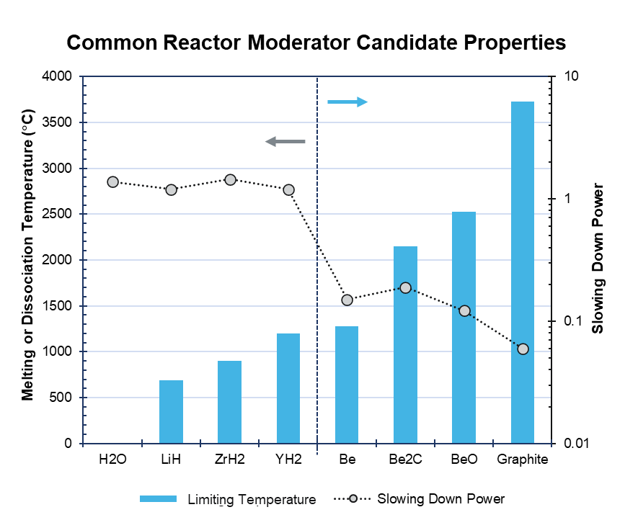
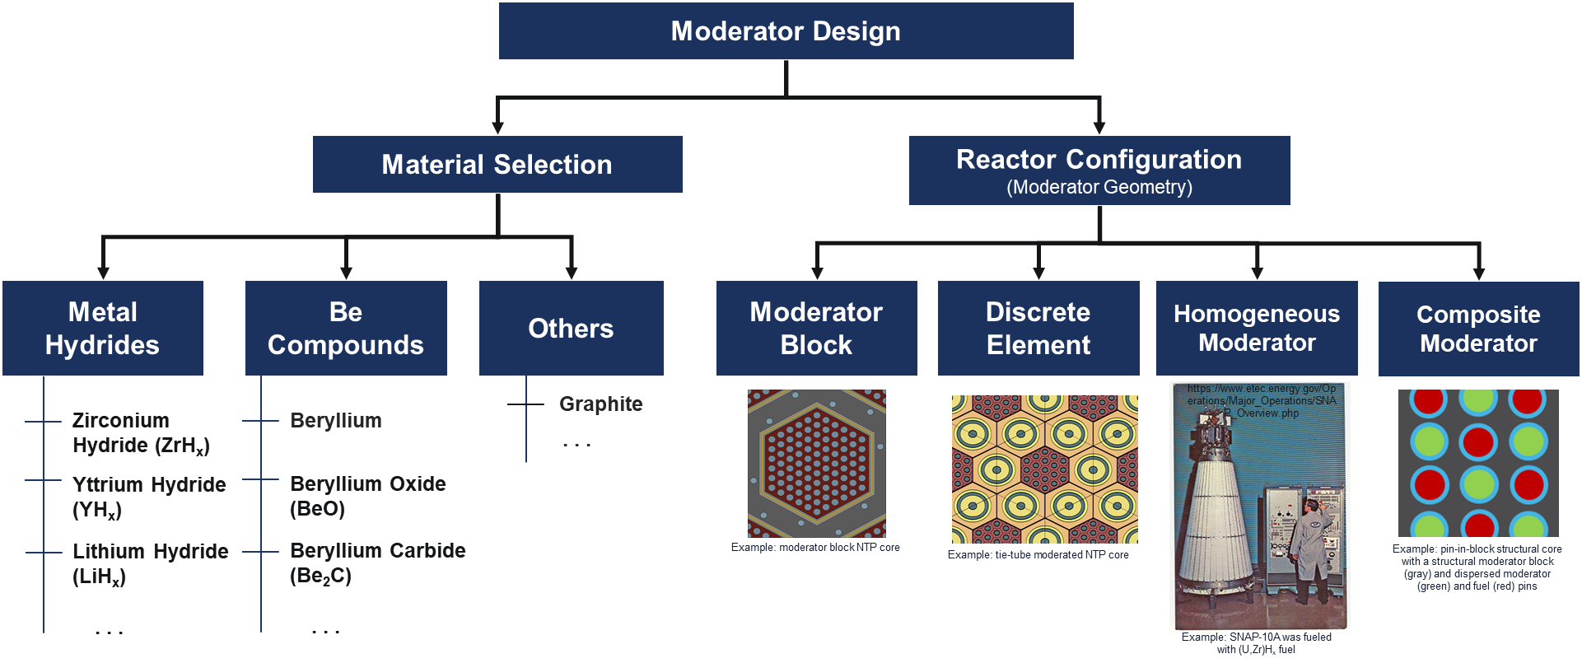
Moderation in Nuclear Reactors Enables More Efficient Use of Fuel
Moderators can play an important role in the development of HALEU-based space reactor technologies
High assay low enriched uranium (HALEU) reactors have reduced atom density of U²³⁵ which can result in increased mass compared to HEU reactors
Goal of moderator design is to optimize neutron economy to enable criticality and minimize mass
  High density, low atomic number materials allow for better slowing down of neutrons (neutron thermalization)
  Thermal neutrons increase the probability for fission
  Moderators should limit parasitic neutron capture
  Some “moderators” have special properties
    Be: n,2n reaction with low absorption
Moderators have heritage in space power and propulsion applications
  Also investigated for high performance (minimum mass) HEU NTP systems (SNRE, RD-410), ramjet (Tory), and space power systems (Topaz) … and other specialty reactor applications
  Moderators are not just for enabling criticality! Not all HEU reactors are fast, not all HALEU reactors are thermal

Slide 4
System Considerations for Moderators
In general, space reactor moderators must enable higher temperature operation without imposing significant complexity on the system
 | Nuclear Thermal Propulsion | Fission Surface Power | Nuclear Electric Propulsion
Operating Atmosphere and Pressure | Flowing Hydrogen > 3.5 MPa | Vacuum (Space) OR equilibrium with surface environment | Vacuum (Space) OR equilibrium with reactor working fluid
Operating Temperature | Minimum: 40 – 250+ K Maximum: (dependent on fuel assembly interface) | > 1000 K | > 1000 K
Total Reactor Thermal Power | ~100s MWth | ~100s kWth | ~10 MWth
Typical Reactor Heat Generation Rate/ Flux | 10 - 100 W/cm³ 0.5 – 10 W/cm² | 0.01 – 0.10 W/cm³ | 0.01 – 0.10 W/cm³
Total Lifetime | ~2 - 5 hours | up to 15 years | Up to 2 years*
Requires Active Cooling? | Yes | No | No
Largest Anticipated Implementation Hurdles | Retention of compositional and structural stability under intense heat fluxes and reducing environment | Retention of dimensional, compositional, and structural stability under long duration, high temperature irradiation
■ VHTR – very high temperature reactor
■ SCWR – supercritical water reactor
■ GFR – gas fast reactor
■ LFR – lithium fast reactor
■ SFR – sodium fast reactor
■ MSR – molten salt reactor
■ NEP/FSP – nuclear electric propulsion/ fission surface power
NTP Operational
Adapted from: S. J. Zinkle, Jeremy T. Busby
Structural Materials for Fission & Fusion Energy
Materials Today Vol. 12 Iss. 11 (2009)
NEP/FSP
VHTR
Fusion
GFR
MSR
SCWR
LFR
SFR
Current (Gen II) fission reactors
ITER fusion reactor
*power for propulsion operation, up to 4 years continuous power generation over lifetime
Space power reactors require higher moderator operating temperatures and longer lifetimes. Thermal reactors require a more dynamic range of operating conditions to be satisfied for much shorter lifetimes.

Slide 5


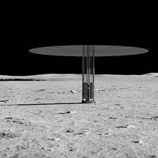
Moderator Considerations for Space Nuclear Power and Propulsion
Space reactors require a moderator which can minimize mass and satisfy demanding design requirements
Design needs for space reactor moderators
  Minimize the critical mass of the system
  Reactor integration: moderators may serve as a structural component (moderator block) or dispersed as individual elements (tie-tube or composite block moderators)
  Enable performance: Moderators must be capable of surviving the operating environment in the active core (differs between different systems)
    High performance moderators should be able to withstand intermediate to high operating temperatures (> 500 K) and long duration irradiation (years) with acceptable thermal performance
When selecting the optimal moderator for the system, four categories are traded during the design process:
  Nuclear Properties
  Thermophysical & Mechanical Properties
  Manufacture & Readiness
  Environmental Compatibility
nasa.gov
Nuclear Thermal Propulsion
Specific Impulse (reactor exit temperature)
Thrust (Thermal Power)
System mass
Lifetime (2 – 5 hours)
Nuclear Electric Propulsion
System Mass
Total Electric Power
System Efficiency (reactor exit temperature)
Lifetime (1 – 2 years propulsion mode, up to 4 years total)
nasa.gov
Fission Surface Power
System Mass
Total Electric Power
System Efficiency (reactor exit temperature)
Lifetime (up to 15 years)
nasa.gov

Slide 6
Moderator Figures of Merit
Moderator design seeks to optimize reactor performance under proposed conditions and minimize risk with technology development
  Nuclear Properties
  Thermophysical & Mechanical Properties
  Manufacture &
  Readiness
  Environmental Compatibility
Melting or Maximum Use Temperature
Density
Thermal Conductivity
Coefficient of Thermal Expansion
Heat Capacity
Recrystallization Temperature
Strength/Modulus
Stress/Strain Response
Softening Temperature
Manufacture Readiness
Materials Availability
Fabrication & Assembly Complexity
Material Performance Readiness/Database
Reactor Operation Readiness/Database
Total/Temperature Power Coefficient
Irradiation Stability
Thermal Cycle Stability
Thermal Shock Resistance
Chemical Compatibility with Reactor Components and Environment
Thermodynamic Stability (other)
Absorption Cross Section
Scattering Cross Section
Atom Density
Moderating Ratio
Slowing Down Power
Infinite Reflected k_{eff}
Minimum Critical Mass/Volume
*Listed attributes are representative not comprehensive
There are many figures of merit related to positive nuclear property attributes, in the actual design process, moderator designs which minimize reactor mass while enabling performance are driving.

Slide 7
Comparison of Some High Temperature Moderators
Two emerging classes of solid-state space moderators include metallic hydrides and beryllium compounds
Material | Melting / Maximum Operating Temperature | Density (g/cm³) | SDP (cm⁻¹) | ξ | Moder-ating Ratio | H2 Stability | Vacuum Stability | CO₂ Compat-ibility
H₂ | - | 8.988 x10⁻⁵ | 5 × 10⁻⁴ | 1 | 61.45 | - | - | -
H₂O | 100 | 0.997 | 1.38 | 0.7066 | 62.11 | - | - | -
ZrH_{2.0} | 900 | 5.56 | 1.66 | 0.6739 | 37.45 | Compat-ible | Poor | Incompat-ible
YH_{2.0} | 1200 | 4.28 | 1.22 | 0.6741 | 17.32 | Compat-ible | Poor | Incompat-ible
Be | 1287 | 1.85 | 0.17 | 0.2066 | 133.99 | Compat-ible |  | < 550 °C
BeO | 2527 | 2.85 | 0.13 | 0.1633 | 173.99 | < 2200 °C | <1930 °C | < 2200 °C
Be₂C | 2150 | 2.44 | 0.19 | 0.1903 | 149.15 | unknown | Poor | unknown
Graphite | 3727 | 2.266 | 0.07 | 0.1578 | 202.3 | < 700 °C | < 2800 °C | < 600 °C
Limiting Temperature
Metallic hydrides (zirconium and yttrium hydride) minimize critical reactor geometries, beryllium compounds (beryllium, beryllium carbide, and beryllium oxide) are capable of higher operating temperatures.

Slide 8


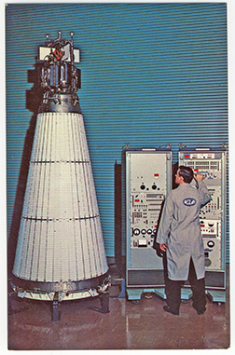

Additional Considerations for Moderator Selection and Development
Moderator design incorporates both material selection and geometric configuration
Moderator Design
Material Selection
Reactor Configuration
(Moderator Geometry)
Metal Hydrides
Be Compounds
Others
Moderator Block
Discrete Element
Homogeneous Moderator
Composite Moderator
Graphite
https://www.etec.energy.gov/Operations/Major_Operations/SNAP_Overview.php
Zirconium Hydride (ZrH_{x})
Beryllium
. . .
Yttrium Hydride (YH_{x})
Beryllium Oxide (BeO)
Lithium Hydride (LiH_{x})
Beryllium Carbide (Be₂C)
Example: moderator block NTP core
Example: tie-tube moderated NTP core
Example: pin-in-block structural core with a structural moderator block (gray) and dispersed moderator (green) and fuel (red) pins
. . .
. . .
Example: SNAP-10A was fueled with (U,Zr)H_{x} fuel
Material selection and related geometries used in component design impact the overall nuclear and thermal performance of the system based upon fundamental nuclear and thermophysical properties.

Slide 9
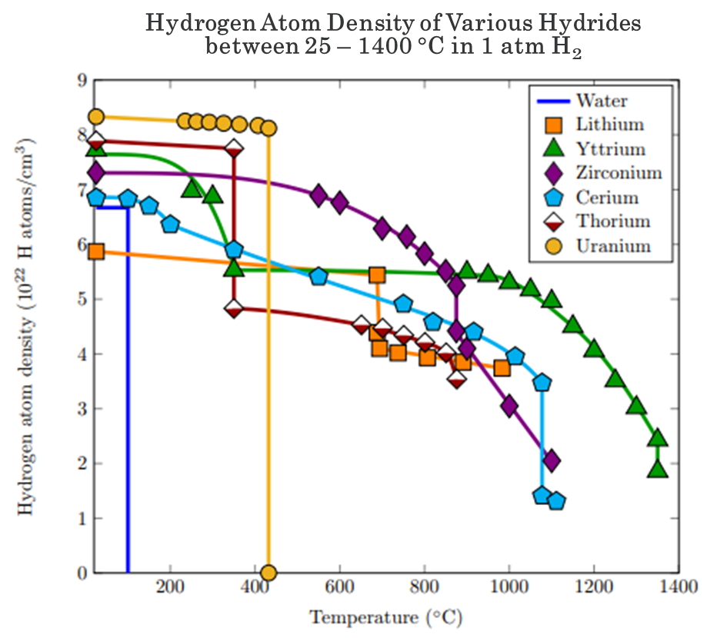
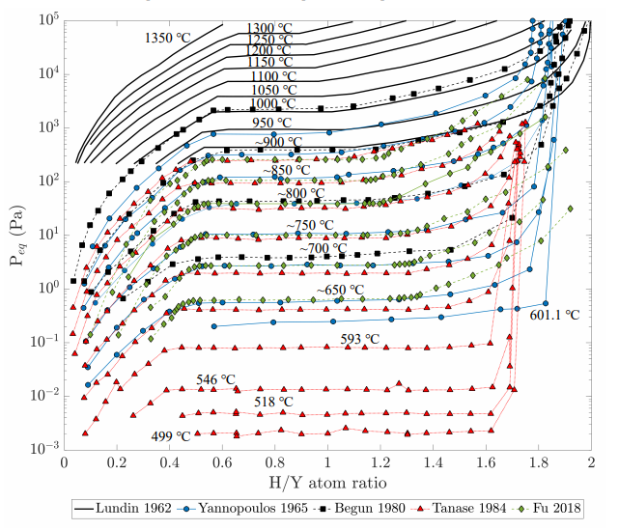
Metallic Hydrides for Space Nuclear Power and Propulsion
Metallic hydrides offer the potential for the lowest volume critical mass reactors by providing high hydrogen density for more efficient moderation
Technology development challenges: 1) net shape fabrication methods, 2) designing for hydrogen retention/migration and it’s possible impact on reactor operability
The stability of different YH_{x} stoichiometries at high temperatures
Shivprasad, A., et. al. Advanced Moderator Material Handbook. Rep. No. LA-UR-20-27683, Los Alamos National Laboratory. 2020.
Shivprasad, A., et. al. Advanced Moderator Material Handbook. Rep. No. LA-UR-20-27683, Los Alamos National Laboratory. 2020.
Zirconium hydride and yttrium hydride provide high hydrogen densities, relatively high dissociation temperatures, and established fabrication processes

Slide 10
System Considerations for Moderators: Hydrides
Significant space reactor heritage exists for metallic hydrides, mitigating hydrogen migration or loss is necessary to ensure reliability
 | ZrH_{x} | YH_{x}
Theoretical Density (g/cm³ @ RT) | 5.62 | 4.24
Thermal Conductivity | 47 @ 300 K 35 @ 600 K | 70-80 @ 300 K 30 – 40 @ 773 K
T_{melt} (K) | - | -
Max Use T (K) | 800 – 900 | 1173 – 1673
Slowing Down Power | 1.45 | 1.2
Neutron Fermi Age (cm²) | 31 | 27
Moderating Ratio | 55 | 25
Manufacturability & Readiness | Some Technology Development Required (more heritage) | Some Technology Development Required (more synergy with ongoing DoE efforts)
Pros | Known manufacture process, best slowing down power | Higher temperature than ZrH_{x}, known manufacture process
Cons | Not commercially available, environmental stability limiting | Not commercially available, environmental stability limiting
Nuclear thermal propulsion will require hydride stability for short lifetimes under a wide range of use conditions including: multiple thermal cycles, high pressure hydrogen working fluid, cool down/decay heating.
Space power reactors will require hydrogen retention for long lifetimes (years) under steady state power operation, possibly without cooling.

Slide 11
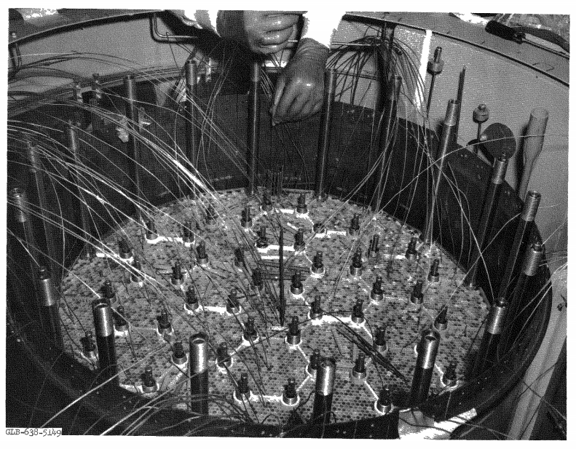
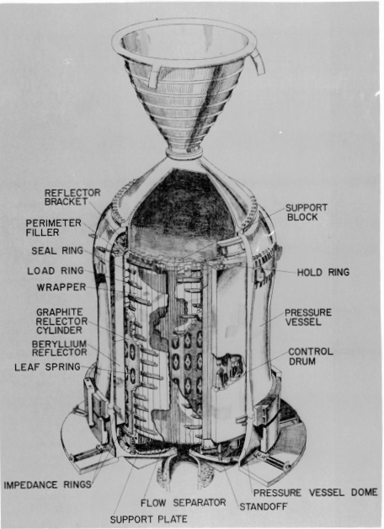
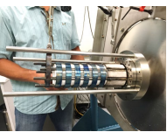
Beryllium Compounds for Space Nuclear Power and Propulsion
Beryllium compounds offer excellent hydrogen resistance, the potential for high temperature operation, and low density
Comparison of Beryllium Compound Melting Temperatures and Atom Densities
Technology development challenges: 1) characterization of irradiation phenomena over reactor lifetime, 2) demonstration space reactor operation with Be-based moderators
Hadley, J W. Tory II-A reactor tests. Final report. Lawrence Livermore National Laboratory Rep. No. UCRL-7249. 1963.
Zeigner, V. L. Survey Description of the Design and Testing of KIWI-B-4E-301 Propulsion Reactor. Los Alamos National Laboratory Rep. No. LA-3311-MS. 1965.
Poston, D. I., McClure, P. R. From DUFF to KRUSTY - The Path to Successful Reactor Development. Los Alamos National Laboratory Rep. No. LA-UR-20-27613 2020.
Beryllium compounds are less efficient at slowing down neutrons compared to hydrides but can contribute additional neutrons to the core through the Be(n,2n) reaction, are excellent neutron reflectors, and have demonstrated fabrication methods.

Slide 12
System Considerations for Moderators: Be Compounds
Be and BeO are available commercially in limited quantities, safe handling / irradiation stability should be considered for technology development
 | Be | Be₂C | BeO
Theoretical Density (g/cm³ @ RT) | 1.85 | 2.44 | 3.01
Thermal Conductivity | 190 @ 273 K 90 @ 973 K | 20.9 @ RT* | 275 @ 273 K 41 @ 1073 K
T_{melt} (K) | 1558 | 2100 - 2200 | 2843
Max Use T (K) | 823 | unknown | 2000 - 2300
Slowing Down Power | 0.15 | 0.19 | 0.12
Neutron Fermi Age (cm²) | 98 |  | 110
Moderating Ratio | 126 | 149 | 158
Manufacturability & Readiness | Established and commercial supply chain Available | Significant Technology Development Required | Some Technology Development Required
Pros | High TRL, commercial supply chain available | High temperature, highest Be compound moderating power | High temperature, commercially available
Cons | Requires specialty materials handling, expensive | Requires specialty materials handling, significant additional tech. dev. needed | Requires specialty materials handling, additional tech. dev. needed
Nuclear thermal propulsion will require beryllium stability under high neutron fluxes, high heat fluxes, and multiple thermal cycles.
Space power reactors will require beryllium irradiation stability for long lifetimes (years) under steady state power operation, possibly without cooling.

Slide 13
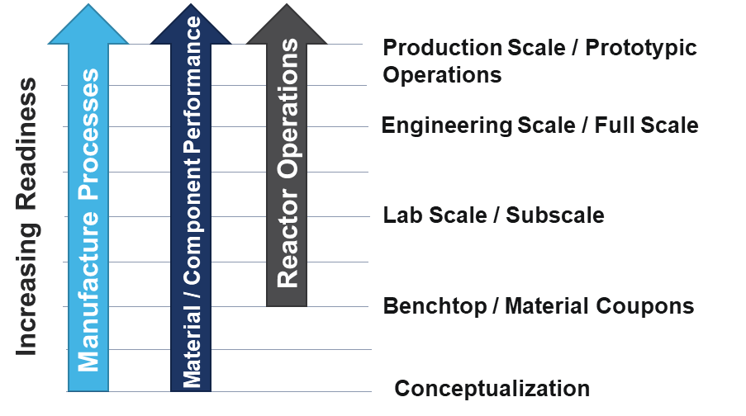
Manufacturability and Readiness
When assessing moderator readiness, three categories were considered: manufacture, material performance, and reactor operations
Readiness Considerations
  Fabrication Process Readiness for Material & Component Level Design
  Moderator Performance Readiness for Proposed Operating Conditions
  Reactor Operability / Demonstration for Proposed Reactor Configuration
Metallic Hydrides
  ZrH_{x} and YH_{x} fabrication has been previously demonstrated in historic space and terrestrial reactor programs. SNAP reactors were fueled with (U,Zr)H_{x} and have an established performance database. Topaz reactors utilized a ZrH_{x} moderator block.
Solid State Beryllium Compounds
  Be and BeO fabrication processes are well established and have been used as reflectors in historic space reactors. Space reactor operation with Be compounds as an in-core moderator has not been previously demonstrated.
Other Considerations
  Disposal of irradiated materials used to demonstrate performance or reactor operations
  Composite moderator options may provide “the best of both worlds” but may add system complexity
 | Manufacture | Performance | Reactor Operation
ZrH_{x} | Well Established (Lab Scale) | Well Established | Most Experience
YH_{x} | Well Established (Lab Scale) | Some Experience | Not Demonstrated as a Space Reactor Moderator
Be | Most Experience | Well Established | Not Demonstrated as a Space Reactor Moderator
BeO | Most Experience | Some Experience | Not Demonstrated as a Space Reactor Moderator
Be₂C | Least Established | Least Established | Least Experience

Slide 14
Moderator Candidate Comparison
 | ZrH_{x} | YH_{x} | Be | Be₂C | BeO
Nuclear Properties | Best SDP, reduced absorption compared to YH_{x} | Great SDP, increased absorption compared to ZrH_{x} | Low absorption, order of magnitude lower SDP than metallic hydrides | Low absorption, best Be compound thermalization properties | Low Absorption, worst Be compound thermalization properties
Thermophysical & Mechanical Properties | Lowest high temperature stability, brittle ceramic | Increased high temperature stability compared to ZrH_{x}, brittle ceramic | Lowest Be compound high temperature capability, high thermal conductivity and mechanical strength | Increased high temperature stability compared to Be, brittle ceramic | Highest Be compound high temperature capability, high thermal conductivity and mechanical strength
Manufacture & Readiness | Laboratory manufacture processes well established, in-reactor performance database available (limited to lower temperatures) | Laboratory manufacture processes well established, material property collection and separate effects testing ongoing | Production scale manufacture processes well established, significant heritage as a reflector component for space reactor systems | Low manufacture and performance readiness | Production scale manufacture processes well established, significant heritage as a reflector component for space reactor systems
Environmental Compatibility | Good irradiation stability, hydride dissociation and migration may limit operation temperatures and use conditions | Hydride dissociation and migration may limit operation temperatures and use conditions, similar irradiation performance to ZrH_{x} anticipated | Irradiation results in anisotropic swelling and loss of thermal/mechanical properties, good compatibility with operating environments | Irradiation stability unknown, high vapor pressure limits uncoated application at high temperatures | Irradiation results in anisotropic swelling and loss of thermal/mechanical properties, good compatibility with operating environments to high temperatures
Pros | Known manufacture process, best slowing down power | Higher temperature than ZrH_{x}, known manufacture process | High TRL, commercial supply chain available | High temperature, highest Be compound moderating power | High temperature, commercially available
Cons | Not commercially available, environmental stability limiting | Not commercially available, environmental stability limiting | Requires specialty materials handling, expensive | Requires specialty materials handling, significant additional tech. dev. needed | Requires specialty materials handling, additional tech. dev. needed

Slide 15
Conclusions
For any space system, the goal of moderator development is to satisfy performance requirements and enable the minimum critical reactor size.
  Moderator design can enable reactor criticality and minimize the mass / volume of the reactor subsystem.
Four categories are traded during the moderator design / selection process:
  Nuclear Properties
  Thermophysical & Mechanical Properties
  Manufacture & Readiness
  Environmental Compatibility
No material candidate excels universally in all categories and no material has yet been fully matured to meet current reference mission performance parameters
  Hydrides: high performance, space nuclear system heritage, hydrogen migration must be managed
  Be-based materials: good thermophysical properties, acceptable performance, high manufacture readiness
Materials which enable the best blend of performance properties while ensuring reliable component operation and minimizing additional technology development for each of the unique power and propulsion environments will look most advantageous for selecting common moderator design features for nuclear space power and propulsion.

