Slide 1
H5Coro: The Cloud-Optimized Read-Only Library
HDF Group Webinar
JP Swinski/NASA/GSFC
May 14, 2021

Slide 2
Consider…
Python scripts written by researchers that read H5 files stored locally
Fortran programs run on supercomputer clusters that generate the official ICESat-2 H5 data products
Science product services running in AWS that access H5 data in S3
…all use the same underlying HDF5 library.

Slide 3
Historically, the application’s use of the HDF5 library was tuned for each environment the application ran in.
But that is not working well for cloud environments;
to address this challenge, various efforts are looking to:
Restructure the H5 data inside the file (repack)
Overlay cloud optimized indexes on the H5 files
Reformat the data into cloud native formats

Slide 4
This presentation argues to add a fourth option to the mix:
instead of changing the data, change the library
Given that there is currently only a single implementation of the HDF5 format in use – the HDF5 library, it becomes the de facto standard; and the limitations of the library become the limitations of the format. If the library performs poorly in a cloud environment, it is said that the format is not suited to the cloud environment.

Slide 5
A path forward for HDF5 data in the cloud:
Identify a small set of common data models for HDF5 cloud-based systems.
Develop and support optimized implementations of the HDF5 specification for each of those common data models.
Standardize a subset of the HDF5 specification for each implementation.
Continue to use and support the existing HDF5 library. It becomes the reference implementation for the specification and the catchall utility for HDF5 tooling.

Slide 6
The HDF5 Cloud-Optimized Read-Only (H5Coro) library is a first attempt at this new approach, undertaken by ICESat-2’s SlideRule project.

Slide 7
Agenda
SlideRule Project Background
Obstacles in Our Initial Design
The H5Coro Library

Slide 8
ICESat-2 Program Information
Mission
Ice, Cloud, and land Elevation Satellite (ICESat-2) launched on September 15, 2018, with a three-year minimal mission life
The Advanced Topographical Laser Altimetry System (ATLAS) is the sole instrument; it fires a laser towards earth 10,000 times a second and measures the amount of time it takes individual photons to reflect of the earth’s surface and return back to the spacecraft.
The individual photon time measurements are used to calculate surface elevations to a cm-level resolution.
Data
ICESat-2 produces about 150 TB/year of low-level data.
At 100Mbps egress, it would take 4.5 months to retrieve one year of data.
Continuous aggregated egress rate varies depending on the network infrastructure. Over Internet2, rates as high as 400Mbps can be achieved, which still puts the time needed to retrieve the data at about five weeks.
Algorithms
ICESat-2 has two low-level data products – one used to study surface elevations, and one used to study atmospheric layers
NASA provides seven Level-3A ICESat-2 data products covering a range of anticipated science applications
NASA provides nine Level-3B ICESat-2 data products that target more specific science applications

Slide 9
SlideRule Project Objectives
Project Objective: Promote new scientific discovery by lowering the barrier of entry to using the ICESat-2 data.
Tie-In to NASA’s Mission: To make NASA datasets which are publicly available, practically accessible.
Problem Statement: The amount of data produced by ICESat-2 and the computational resources required by the algorithms that process the data, creates an often insurmountable barrier of entry to using the lower-level ICESat-2 data products. As a result, the typical use of ICESat-2 data is constrained to the pre-launch predicted science applications for which higher-level data products are generated.
Proposed Solution: Develop and deploy a publicly accessible ICESat-2 science data service that provides science data products generated on-demand using parameters supplied by researchers at the time of the request.
Key Benefits:
There is a one-to-one mapping between resources spent producing data products and which data products are being used by the community.
Unforeseen science applications are supported, with no additional cost, by the same system that supports the primary science objectives of the mission.
The service-based architecture promotes integration with other agencies and organizations to improve the products and services they provide.
Improvements to the algorithms that process the lower-level science data are immediately made available to the user communities (there is no longer a need to reprocess hundreds of terabytes of data, host the new version, and require users to re-download the data when a change is made in the processing algorithms).

Slide 10
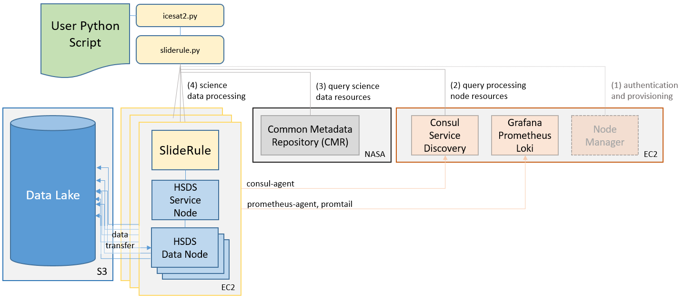
SlideRule Initial Architecture
SlideRule is a server-side framework implemented in C++/Lua that provides REST APIs for processing science data and returning results.
SlideRule communicates with a back-end data service implemented in HSDS with data stored in AWS S3.
The initial target application for SlideRule is processing the lower-level ICESat-2 point-cloud and atmospheric datasets for seasonal snow depth mapping and glacier research.

Slide 11
SlideRule’s Integration with HDF5
AWS EC2
AWS EC2
AWS S3
*.h5 files stored as objects
AWS S3
*.h5 files stored as objects
SlideRule Application
SlideRule Application
HDF5 Library
HDF5 Library
(service node)
HSDS
(service node)
HSDS
(service node)
HSDS
(service node)
HSDS
(service node)
HSDS
(data node)
HTTP
HSDS
(data node)
REST-VOL
HTTP
REST-VOL
HSDS
(data node)
HSDS
(data node)
S3 Gets
S3 Gets
docker
docker
docker
docker
docker

Slide 12
Project Goals
Cost effective
  Near zero costs incurred when not in use
  Ability to scale in a cost-controlled way to handle processing demand
Responsive Results
  For interactive sessions, the results for areas like Grand Mesa should be returned quickly enough that the user doesn’t go off and do something else
  For integrated services (other software systems using our system as a service), the results for very small areas should be returned quickly enough that they can integrate it into their systems without losing the attention of their users.
Simple, well documented API
  Public sliderule-python repository with packages available in PyPI (pip), and Conda
  Very small learning curve with behavior matching expectations
(4) Ability to easily integrate other large datasets
  GLAH12, Tan-DEM-X, Hi-MAT DEM
(5) Highly configurable processing engine
  Able to target a wide range of science use-cases without becoming overly complex

Slide 13
Limitations of Initial Design

Slide 14
Limitations of Initial Design
Using the HDF5 library presented certain obstacles to us achieving our goals – namely reaching a balance between having a cost effective system and a responsive system.
All read calls into the HDF5 library are serialized
HSDS issues multiple HTTP requests per H5 dataset chunk
HSDS requires a metadata repository

Slide 15
Obstacle 1: HDF5 Serializes Requests
All read calls into the HDF5 library are serialized inside the library due to a global API lock.
Even though SlideRule issues many dataset read requests concurrently, and HSDS is capable of tremendous parallelism, the number of actual concurrent reads to S3 was limited to those associated with one dataset at a time due to those requests being serialized at inside the HDF5 library.

Slide 16
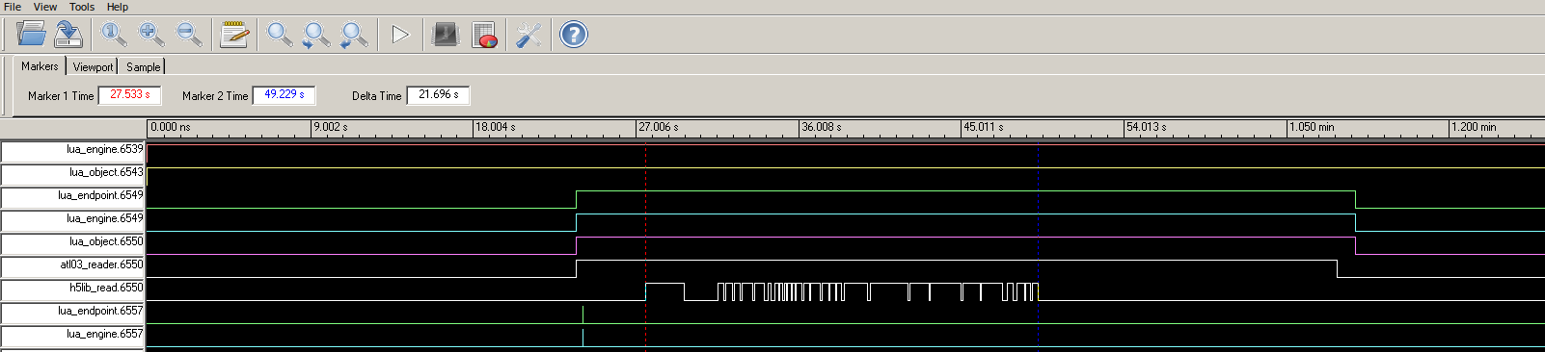
HDF5 Serialization of Reads – 1 Thread

Slide 17
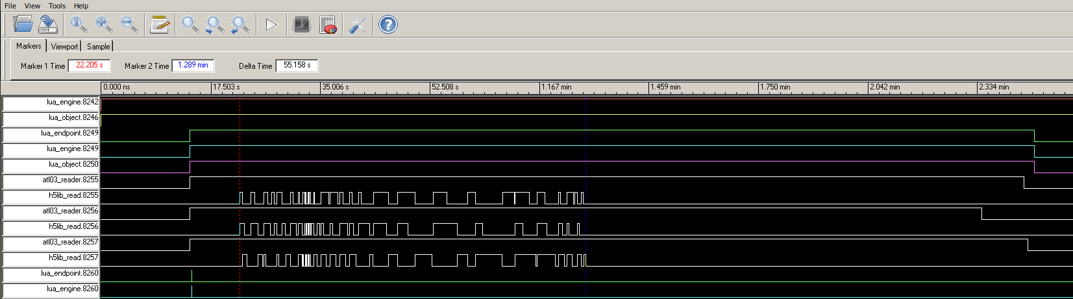
HSF5 Serialization of Reads – 3 Threads

Slide 18
The Cost of Parallelism
Resource intensity
Asynchronous
Thread
Process
Distributed
The HDF5 library prevents an application from using an asynchronous or multithreaded model to achieve parallelism, and forces a process or distributed model.
While large systems will still typically grow at the process and instance (distributed) level, ignoring gains in parallelism at the lower levels is inefficient and costly.
We found it an order of magnitude more complex to replace one or two call-backs or threads in our server code with dozens of Docker containers.

Slide 19
Obstacle 2: Chunk Size Dependency
HSDS issues multiple HTTP requests per H5 dataset chunk being read.
The chunk size of the dataset is the single greatest factor in how performant the read is.
Datasets that consist of many small chunks explode the number of TCP/IP socket connections that are needed and the per-read latencies dominate overall performance.

Slide 20
HSDS Performance Test Results
Format | Layout | Instance Type | Data Nodes | Http Compression | Duration (seconds)
Local File | Chunk:10000 | c5.xlarge | n/a | n/a | 10
Native Ingest | n/a | c5.xlarge | 4 | Yes | 60
Link Option | Chunk:10000 | c5.xlarge | 4 | Yes | 990 to 1050
Link Option | Chunk:10000 | c5.xlarge | 4 | No | 1150
Link Option | Chunk:10000 | c5.xlarge | 8 | Yes | 990
Link Option | Chunk:10000 | c5.4xlarge | 16 | Yes | 620
Link Option | Chunk:143000 | c5.xlarge | 4 | Yes | 370
Link Option | Chunk:(50MB) | c5.xlarge | 4 | Yes | 60
Link Option | Continuous | c5.xlarge | 4 | Yes | 30 to 50
Notes:
Read a total of 718MB of data out of 72 different datasets inside a large (~2GB) h5 file.
The c5.xlarge instance has 4 cores, 8GB of RAM, and up to 10Gbps of network connectivity.
All test runs used only one service node.
No caching was used, all data was fetched fresh from S3

Slide 21
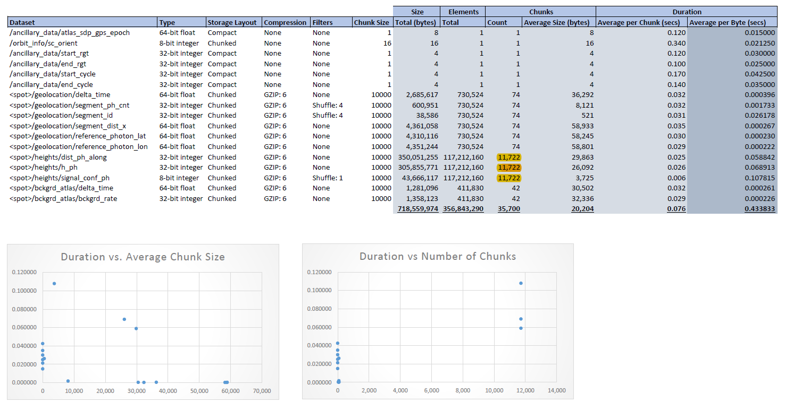
HSDS Performance w/ Chunk:10000 Layout
Performance is dominated by the number of chunks being read. This suggests that the per-chunk overhead drives performance.

Slide 22
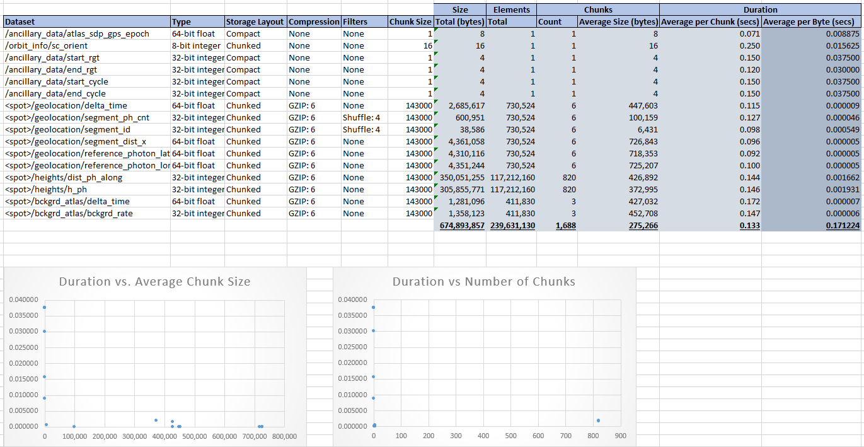
HSDS Performance w/ 14x Chunk Size
By reducing the number of chunks per dataset by 14x there are no longer any outliers driving the performance.
empty
empty

Slide 23
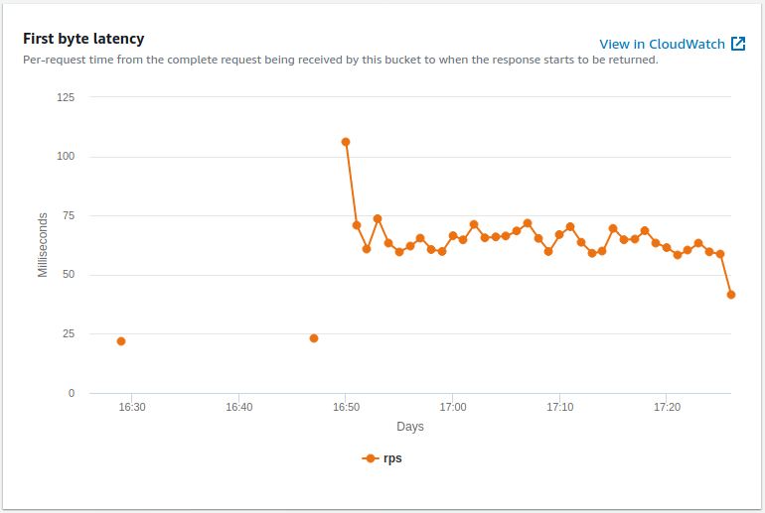
First Byte Latency Measurements
AWS is showing ~60ms of latency per request to S3; but internal HSDS logs show closer to ~50ms of latency.

Slide 24
Challenges in Chunk Size Selection
Optimizing for a given spatial extent is not possible because the ICESat-2 data is dynamic – 10MB of photons in one part of the file may represent 1Km and in another part of the file may represent 10Km.
Optimizing for request size is not possible because we are a driven on-demand data processing system. One user may be looking at a narrow spatial region that benefits from smaller chunk sizes, while another user may be sweeping large areas looking for features in the data.
We attempted to use the “break-even” size, which is when the amount of time it takes to read the data matches the request latency penalty (e.g. if your data throughput is 1Gbps and latency is 50ms per request, the chunk size is the amount of data that can be read at 1Gbps over 50ms → 50Mbits). When a chunk size matches this size, then the worse case penalty paid for a request is 2x.
  How do you determine what the expected latency and throughput are?
  AWS S3 and lower-tier EC2 instance can experience large variations in network performance.

Slide 25
Obstacle 3: Metadata Repository
A metadata repository is needed to hold pointers into the original H5 files which HSDS uses to know how to read the various datasets in the file.
Before any H5 file in S3 can be read by our system, it must first be loaded through an HSDS pipeline to build and store the metadata for it. A typical region of interest consisting of 60 granules can take over 8 hours to load using a single c5.xlarge EC2 instance.
The metadata repository must be maintained in order to use HSDS. A gap in funding which could result in the loss of the S3 bucket would required the entire repository to be rebuilt.

Slide 26
The Need for a Data Pipeline
Building, maintaining, and running a data pipeline is expensive and time consuming:
  read ICESat-2 data hosted by NASA
  re-chunk it to optimize its chunk sizes for S3 access
  upload it to our own S3 bucket
  load it into HSDS to build and store the metadata HSDS needed
With tooling we had at the time, we were able to fully load about 5GB of data per hour per EC2 instance.
Assuming ICESat-2 produces 150TB of data each year, this would require us to fully automate, maintain, and continuously run a pipeline consisting of four EC2 instances 365 days a year, just to keep up with the new data ICESat-2 produces; that doesn’t take into account historical data backlogs and re-releases due to version updates.

Slide 27
The HDF5 Cloud-Optimized Read-Only Library
(H5Coro)

Slide 28
What is H5Coro
H5Coro is a C++ module inside the SlideRule server that was written from scratch and implements a performant HDF5 reader for H5 files that reside on the local file system or in S3.

Slide 29
Architectural Change
H
5
C
O
R
o
Replacing HDF5/REST-VOL & HSDS with and internal, statically linked module that directly reads H5 files from S3

Slide 30
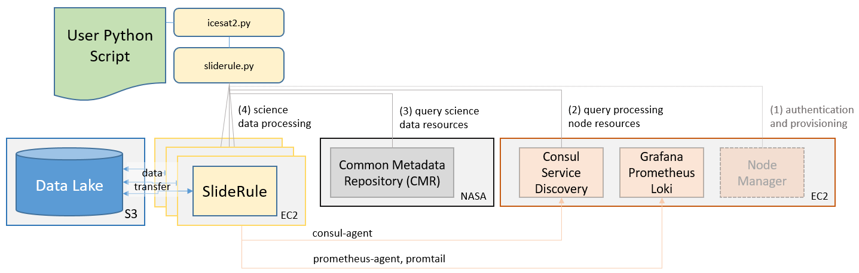
Architecture with H5Coro

Slide 31
Where H5Coro Fits In
Previous Architecture
SlideRule Application
HSDS
(service node)
HDF5 Library
(service node)
HSDS
(data node)
HSDS
(data node)
HSDS
(service node)
REST-VOL
AWS S3
docker
docker
docker
New Architecture
h5 file metadata
repository
SlideRule Application
h5 files stored as objects
H5Coro
docker

Slide 32
Key Features
All reads are concurrent. Multiple threads within the same application can issue read requests through H5Coro and those reads will get executed in parallel.
Intelligent range gets are used to read as many dataset chunks as possible in each read operation. This drastically reduces the number of HTTP requests to S3 and means there is no longer a need to re-chunk the data (it actually works better on smaller chunk sizes due to the granularity of the request).
The system is serverless. H5Coro is linked into the running application and scales naturally as the application scales. This reduces overall system complexity.
No metadata repository is needed. Instead of caching the contents of the datasets which are large and may or may not be read again, the library focuses on caching the structure of the file so that successive reads to other datasets in the same file will not have to re-read and re-build the directory structure of the file.

Slide 33
Performance Test
A series of side-by-side performance tests were run against SlideRule using HSDS and H5Coro.
  The tests were run from a local, US east coast, home computer
  A Python script made four concurrent processing requests to a single SlideRule instance running in AWS us-west-2.
  The processing request was to calculate elevations for the Grand Mesa region and required a total of 66 granules to be read from S3.
  HSDS was deployed on the same EC2 instance as SlideRule and consisted of a single service node and eight data nodes.

Slide 34
Performance Comparisons
Library | File Storage | File Structure | Cached | Instance | Time (secs)
HDF5/REST-VOL | S3 | Original | Yes | c5.2xlarge | 9559
HDF5/REST-VOL | S3 | Original | No | c5.2xlarge | 9029
HDF5/REST-VOL | S3 | Repacked | No | c5.2xlarge | 3215
HDF5/REST-VOL | S3 | Repacked | Yes | c5.2xlarge | 3157
H5Coro | S3 | Repacked | No | c5.xlarge | 368
H5Coro | S3 | Repacked | Yes | c5.xlarge | 336
HDF5 | Ext4 | Original | No | desktop | 154
H5Coro | S3 | Original | No | c5.xlarge | 116
H5Coro | S3 | Original | Yes | c5.xlarge | 72
H5Coro | Ext4 | Original | No | desktop | 56

Slide 35
Performance Results
For test runs where no caching was used, H5Coro performed 77x faster.
For test runs where caching was used, H5Coro performed 132x faster.
It is typical for us to now process regions that used to take 1 ½ hours, in 25 seconds.

Slide 36
H5Coro API
info_t H5Coro::read (const char* url,
const char* datasetname,
RecordObject::valType_t valtype,
long col,
long startrow,
long numrows,
context_t* context=NULL)
where
url the fully qualified path to the H5 file (i.e. s3:///mybucket/folder/myfile.h5)
datasetname the full path to the name of the dataset within the H5 file
valtype the data type of the data to be returned; the recommended type is DYNAMIC, which tells the library to return the data in the type it is stored as in the file
col the column to be read from multi-dimensional datasets; in order to read from multiple columns, multiple reads are needed
startrow the starting row in the dataset to read from
numrows the number of rows in the dataset to read
context an opaque handle to a context structure which holds cached information about the file so that future read operations do not have to re-read metadata portions of the file
info_t a structure holding the contents of the data read from the H5 file along with useful metadata like the data type

Slide 37
Caching
A local file cache is used to store blocks of the H5 file being read. A minimal cache line size is configured at compile time and works on the assumption that the fields being read from the internal structures of the H5 file are often near each other. The local file cache is maintained in the context pointer optionally passed to the H5Coro::read call. This allows applications which read multiple datasets from a single file to re-use the local file cache between those reads. It is also important to note that dataset contents are not cached, this maximizes the available memory in the cache for file structure metadata.
A global dataset cache is used to store the metadata information of a dataset. Given there are only a few pieces of information needed in order to know how to read a dataset, the H5Coro library maintains a large set of the most recently read datasets. If the dataset is requested again, the library does not need to re-traverse the H5 file structure in order to arrive at the necessary data object, but can skip directly to the step where the start and stop addresses of the data are guessed at and the data contents are read.

Slide 38
HDF5 Specification NOT Supported
The following portions of the HDF5 format specification are intentionally not implemented:
  All write operations
  File free space management
  File driver information
  Virtual datasets
The following portions of the HDF5 format specification are intentionally constrained:
  Datasets with dimensions greater than 2 are flattened to 2 dimensions and left to the user to index.
  Only sequentially stored data can be read at one time, hyperslabs are not supported.
  Data type conversions are supported for fixed and floating point numbers only, but the intended use of the library is to return a raw memory block with the data values written sequentially into it, allowing the user to cast the memory to the correct array type.

Slide 39
Support for HDF5 File Structures
Format Element | Supported | Contains | Missing
Field Sizes | Yes | 1, 2, 4, 8 bytes
Superblock | Partial | Version 0 | Version 1, 2, 3
B-Tree | Partial | Version 1 | Version 2
Group Symbol Table | Yes | Version 1
Local Heap | Yes | Version 0
Global Heap | No |  | Version 1
Fractal Heap | Yes | Version 0
Shared Object Header Message Table | No |  | Version 0
Data Object Headers | Yes | Version 1, 2

Slide 40
Support for HDF5 Messages
Format Element | Supported | Contains | Missing
Shared Message | No |  | Version 1
NIL Message | Yes | Unversioned
Dataspace Message | Yes | Version 1
Link Info Message | Yes | Version 0
Datatype Message | Partial | Version 1 | Version 0, 2, 3
Fill Value (Old) Message | No |  | Unversioned
Fill Value Message | Partial | Version 2 | Version 1, 3
Link Message | Yes | Version 1
External Data Files Message | No |  | Version 1
Data Layout Message | Partial | Version 3 | Version 1, 2
Bogus Message | No |  | Unversioned
Group Info Message | No |  | Version 0
Filter Pipeline Message | Yes | Version 1
Attribute Message | No |  | Version 1
Object Comment Message | No |  | Unversioned
Object Modification Time (Old) Message | No |  | Unversioned
Shared Message Table Message | No |  | Version 0
Object Header Continuation Message | Yes | Version 1, 2
Symbol Table Message | Yes | Unversioned
Object Modification Time Message | No |  | Version 1
B-Tree ‘K’ Value Message | No |  | Version 0
Driver Info Message | No |  | Version 0
Attribute Info Message | No |  | Version 0
Object Reference Count Message | No |  | Version 0

Slide 41
Support for HDF5 Storage, Types, Filters
Format Element | Supported | Contains | Missing
Compact Storage | Yes
Continuous Storage | Yes
Chunked Storage | Yes
Fixed Point Type | Yes
Floating Point Type | Yes
Time Type | No
String Type | No
Bit Field Type | No
Opaque Type | No
Compound Type | No
Reference Type | No
Enumerated Type | No
Variable Length Type | No
Array Type | No
Deflate Filter | Yes
Shuffle Filter | Yes
Fletcher32 Filter | No
Szip Filter | No
Nbit Filter | No
Scale Offset Filter | No

Slide 42
H5Coro Implementation Limitations
The H5Coro library was written to optimize access to numerical time-series datasets which are chunked, compressed, and stored sequentially in memory. This layout is exploited in order to quickly determine the start and stop location of the data to be read.
The H5Coro library, as written, would not work well subsetting image data. Subsetting to a spatial region is likely to cause the requested data chunks to be located in non-sequential memory locations within the file. Such a layout is not anticipated by the heuristics used inside H5Coro for constructing read requests to S3, and would result in non-optimal performance.
While the current implementation of H5Coro is poorly suited for such applications, the overall approach taken by the H5Coro still applies, and minor modifications to the internal heuristics used by H5Coro could produce drastic improvements in performance for image data.

Slide 43
Acronyms
API Application Program Interface
AWS Amazon Web Services
EC2 Elastic Compute Cloud
GSFC Goddard Space Flight Center
HDF5 Hierarchical Data Format version 5
HTTP Hypertext Transfer Protocol
ICESat-2 Ice, Cloud, and land Elevation Satellite, 2nd generation
IO Input / Output
IP Internet Protocol
NASA National Aeronautics and Space Administration
NSIDC National Snow and Ice Data Center
REST Representational State Transfer
S3 Simple Cloud Storage Service
TCP Transmission Control Protocol

