Slide 1
Presence of Metal Aerosols on the International Space Station
Amanda Rodell

Slide 2
Overview
Passive Aerosol Samples
Methods
Analysis
Locations
Calculations
Comparison to OSHA Regulations
Notes:
Stop using question intonation

Slide 3
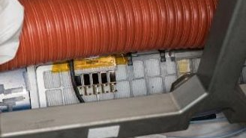
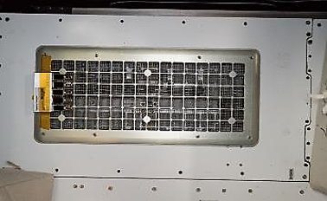
Passive Aerosol Samplers (PAS)
2018 PAS-D US LAB Bay 3
Positioned on Bacterial Filter Elements (BFEs)
Placed only in the US orbital section
PAS Sample Size: 3.75 cm²
Typical Filter Size: 751.74 cm²
Ratio: ≈1:200
2018 PAS-B NOD2D3

Slide 4
Sampler Description
7 Passive Aerosol Samplers
5 samples inside each sampler
2018 Samples were taken over a 26-day period
2016 Samples were taken over 2,4-,8-,16-,and 32-day periods with each duration being taken over samples 1 through 5 respectively
For analysis, the data was modified to units per day to simplify the comparison process

Slide 5
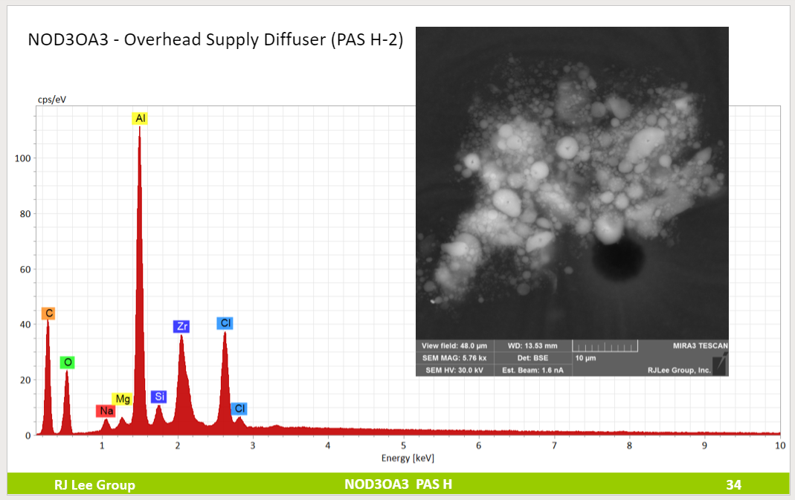
Sample Analysis
Analyzed by Scanning Electron Microscopy (SEM) and Energy Dispersive X-Ray Spectroscopy (EDS)
Particle Information Collected: Composition, Size, Weight, and Shape
RJ Lee Group, prepared for Meyer, M. E., Ph.D., “NASA ISS Sampling and Particle Characterization Study - Payload 2 Passive Aerosol Samplers (PAS),” Unpublished Data, 2018

Slide 6
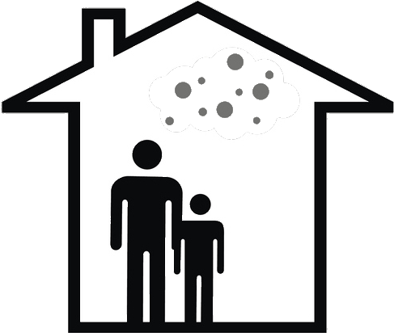
Occupational Air Pollution Limits
Presented in milligrams per cubic meter for an 8-hour workday
Also presented less commonly in parts per million (ppm)
Highest level of a given pollutant an employee can be exposed to without increasing the risk of adverse health effects

Slide 7
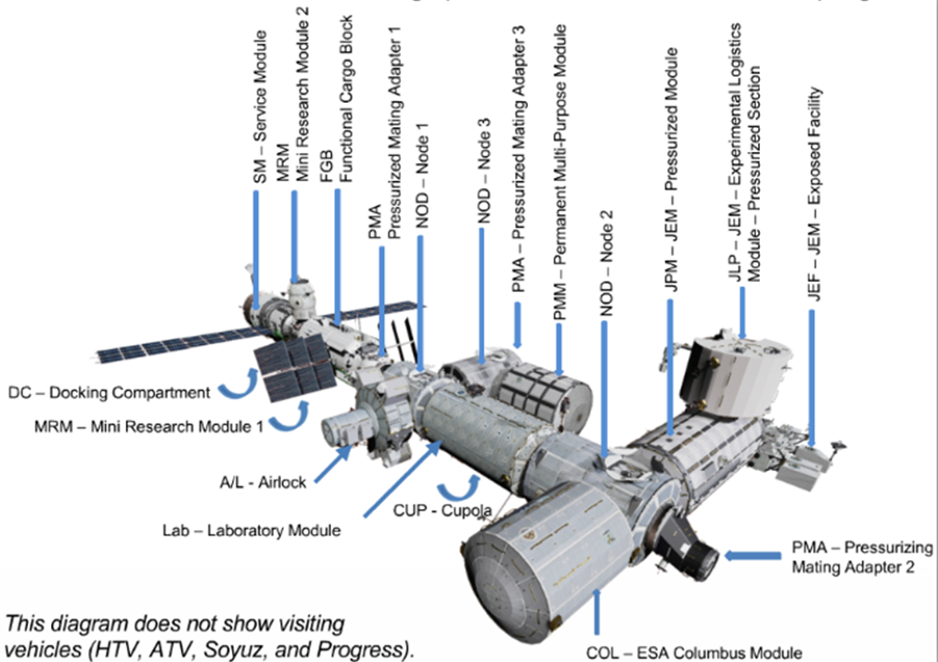
Sampler Locations 2016
Node 1 – Eating
Node 2 – Docking
Node 3 – Exercise and Hygiene
US Lab – Lab Experiments
Permanent Multipurpose Module (PMM) – Storage

Slide 8
Sampler Locations 2016
Passive Sampler ​ | Location​ | Relevant Activity​ | Date of Active Sampling​
PAS B​-16 Day Sample | Node 1 Deck 1​ (NOD1D3) | Eating​ | 12/8/16​
PAS D​-16 Day Sample | Node 3 Deck 3​ (NOD3D3) | Exercise & Hygiene ​ | 12/15/16​
PAS E -32 Day Sample | Permanent Multipurpose Module (PMM​) | Storage​ | 12/22/16​
PAS F​-32 Day Sample | Node 2 Deck 2​ (NOD2D3) | Docking ​ | 11/29/16 & 12/15/16​
PAS G​-8 Day Sample | Node 3 Forward 3​ (NOD3F3) | Exercise & Hygiene​ | 11/29/16​
PAS J​-32 Day Sample | US Lab Bay 1 Starboard Deck​ (LAB1SD1) | Experiments​ | 12/8/16 & 12/22/16​
PAS K-16 Day Sample | US Lab Bay 3 Port/Deck (LAB1PD3) ​ | Exercise & Hygiene​ | N/A​

Slide 9
Sampler Locations 2018
Node 1 – Eating
Node 2 – Sleeping and Docking
Node 3 – Exercise and Hygiene
US Lab – Lab Experiments

Slide 10
Sampler Locations 2018
Passive Sampler ​ | Location​ | Relevant Activity​
PAS B (NOD2D3)​ | Mid-bay HEPA Return​ | Sleeping & Docking​
PAS D (LAB1PD3)​ | US Lab Bay 3 Port/Deck ​ | Lab Experiments ​
PAS E (NOD1D3)​ | ​ | Eating​
PAS F (NOD3D3)​ | Mid-bay HEPA ​ | Exercise & Hygiene​
PAS G (NOD3F3)​ | ​ | Exercise & Hygiene​
PAS H (NOD3OA3)​ | Overhead Supply Diffuser​ | Exercise & Hygiene​
PAS K (NOD3O2)​ | Upper Plenum Assembly​ | Exercise & Hygiene​

Slide 11
Results

Slide 12
Aluminum Passive Aerosol Sampler 2018
B NOD2D3 (Sleeping)
D LAB1PD3 (Experiments)
E NOD1D3 (Eating)
F NOD3D3 (Hygiene)
G NOD3F3 (Hygiene)
H NOD3OA3 (Hygiene)
K NOD3O2 (Hygiene)
Notes:
Al-Cl-Zr: PAS F-1 has 1134 particles, this is not the most several other locations have >1000 particles (like E-5 and E-4), so the particles from this section might be larger in comparison to the others. For PAS G, the total particle count is between 300 and 500, and for PAS D it goes from 100 to 500 (D-3 has 292 particles)

Slide 13
Elemental Summaries
The values for each sampler were averaged to minimize the effect of any outliers.
With Elemental Summaries, we can locate dominating species or locations
Example: Al-Cl-Zr dominate Aluminum particles

Slide 14
Calculation Overview
Goal: Estimate concentration of aerosols from PAS mass per unit area
Information used:
Duration of sample: Assume that deposition occurs at a constant rate throughout the sample period
Surface Area of Filters: Assuming that the samples are a valid estimate for particle distribution and there would be a uniform distribution over the entire filter
Average Volumetric Flow Rate: Assuming that particles are evenly distributed through the air and a well mixed environment

Slide 15
OSHA Comparison Conversion
Duration of sample. This allows us to get a theoretical ug/cm2/day
Average volumetric flow rate of air per filter per day. Assuming that particles are evenly distributed through the air
Surface area of filters. Assuming that the samples are a valid estimate for particle distribution and there would be a uniform distribution over the entire filter.
Exposure that will be compared to OSHA limitations.
Concentration of particles bearing a given element on the sample
Notes:
Bring up the uncertainty
Explain the rational behind it, be more specific , point out assumptions and why we did, what we did
-air flow is different in every filter
-ug/cm2 that are used are averaged

Slide 16
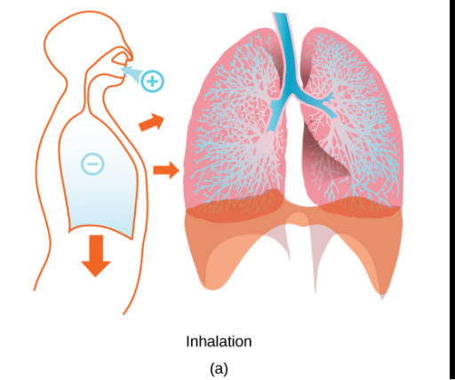
8 Hour Exposure ≠ 24 Hour Exposure
12 Breaths Per Minute
Tidal Volume: 0.5 L per Breath
Volume Per Day: 8.64 m³
Volume Per 8 Hours: 2.88 m³
Multiply OSHA limits by volume per 8 hours
Multiply ISS levels by volume per 24 hours
Biology. Authored by: OpenStax. Provided by: OpenStax College. Located at: http://cnx.org/contents/185cbf87-c72e-48f5-b51e-f14f21b5eabd@9.44:1/Biology. License: CC BY: Attribution
Notes:
Assume that the air is evenly mixed throughout the ISS, even though they spend 8 hours in NODE 2 sleeping

Slide 17
Element vs Percent of OSHA Limit

Slide 18
Notes:
Put in a bonus slide with elements where there are no osha limits/no data
Look into elements where there are “no data” and see if they might be a concern to human health
For paper, put in future work/possibilities
-error bars, sources of error,

Slide 19
Cadmium
OSHA 8-hour Limit: 0.005 mg/m³
ISS Estimated Levels:
2016: 0.0016 ug/m³
2018: 0.0024 ug/m³
51% increase from 2016 to 2018
Possible Sources
Electroplating Steel
Rechargeable Ni-Cd Batteries
Plastic Stabilizer
Notes:
Try to put the graphs in the same order (NOD1, NOD2, etc.)
State 1000 difference between mg to ug
Put possible sources of elements

Slide 20
Cadmium
RJ Lee Group, prepared for Meyer, M. E., Ph.D., “NASA ISS Sampling and Particle Characterization Study - Payload 2 Passive Aerosol Samplers (PAS),” Unpublished Data, 2018

Slide 21
Nickel
OSHA 8-hour Limit: 0.05 mg/m³
ISS Estimated Levels:
2016: 0.011 ug/ m³
2018: 0.0072 ug/ m³
34% decrease from 2016 to 2018
Possible Sources
Steel Production
Electroplating
Household uses
Jewelry, Clothing Buttons, Cooking Utensils
Notes:
Get pictures from analysis of particles to get some idea
Round to 2 numbers after the 0’s
Put estimate down

Slide 22
Nickel
RJ Lee Group, prepared for Meyer, M. E., Ph.D., “NASA ISS Sampling and Particle Characterization Study - Payload 2 Passive Aerosol Samplers (PAS),” Unpublished Data, 2018

Slide 23
Silver
OSHA 8-hour Limit: 0.01 mg/m³
ISS Estimated Levels:
2016: 0.00060 ug/ m³
2018: 0.0020 ug/ m³
225% increase from 2016 to 2018
Possible Sources
Water Disinfection
Thermal and Electrical Conductor
Notes:
Check in

Slide 24
Silver
RJ Lee Group, prepared for Meyer, M. E., Ph.D., “NASA ISS Sampling and Particle Characterization Study - Payload 2 Passive Aerosol Samplers (PAS),” Unpublished Data, 2018

Slide 25
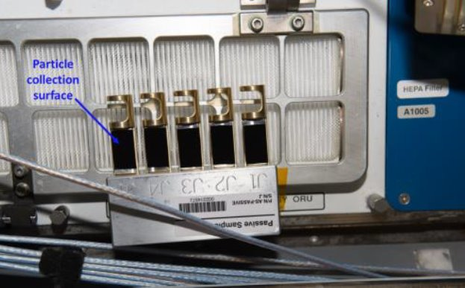
Conclusions
Cadmium, Nickel, and Silver are the elements closest to their OSHA limits
All elemental estimated concentrations are below 1% of their OSHA permissible exposure limits
Causes of increases or decreases in concentrations are unsure and will need further investigation.
Sampling will be repeated in December 2021

Slide 26
Acknowledgments
Dr. Luz Marina Calle
Dr. Wenyan Li
Dr. Marit Meyer
NASA Office of STEM Engagement
Internship Coordinators
Exploration Systems and Development Office
RJ Lee Group

Slide 27
Thank You
Amanda Rodell
Amanda.J.Rodell@Nasa.gov
Arzf5@mst.edu

Slide 28
Additional Graph Information
All metals listed in graphs were detected on an ISS PAS
Analysis data wasn’t available, or OSHA limit not established
Metals without OSHA Limits: Neodymium, Lanthanum, Tungsten,& Strontium
Metal's data unavailable: Vanadium, Manganese, Cobalt, Hafnium, Indium, & Gold

Slide 29
Elements without regulations
Possible Health Affects
Neodymium:
Lanthanum:
Tungsten:
Strontium:

