Slide 1
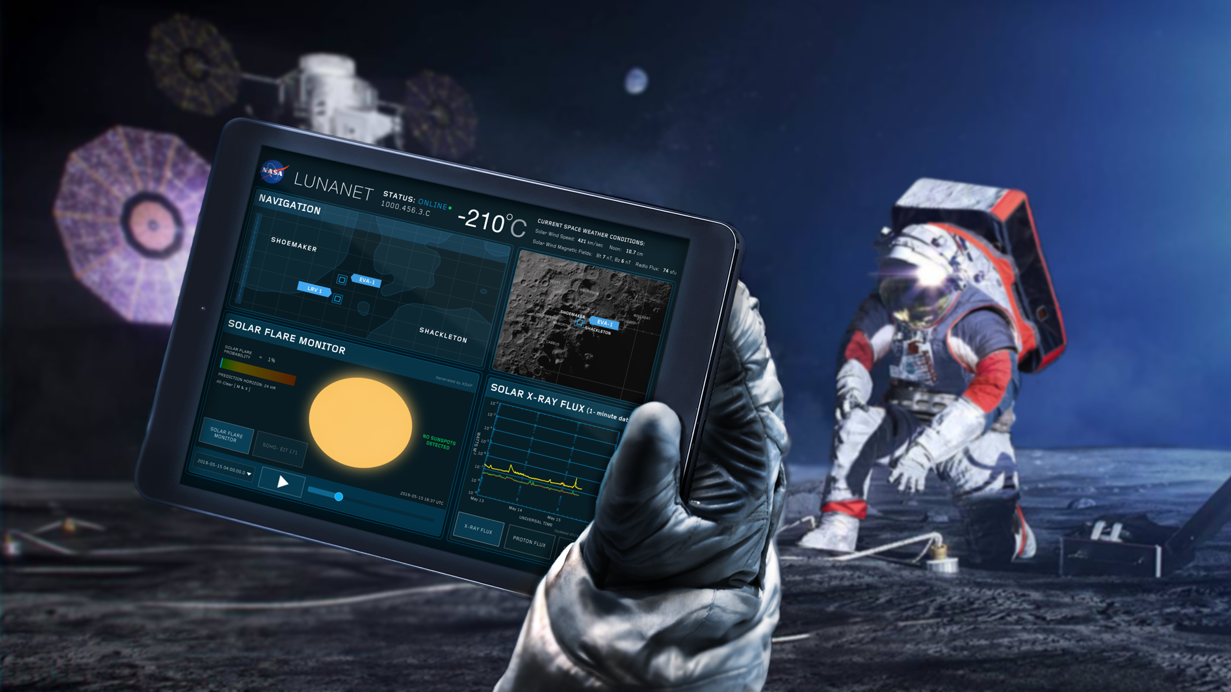
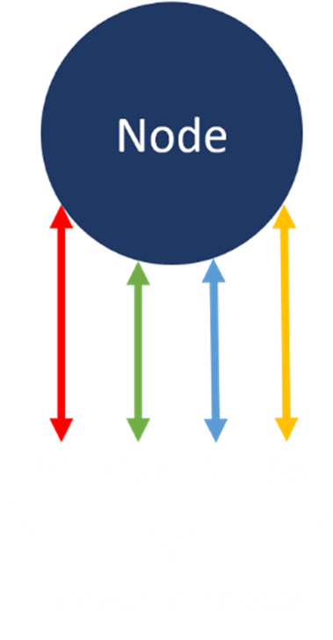
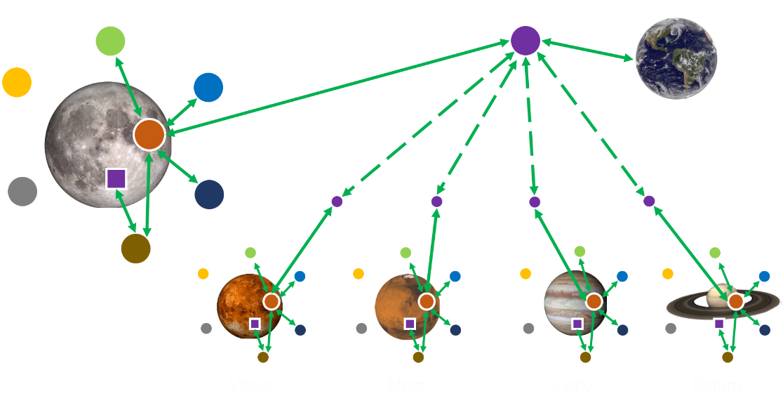
LunaNet
LunaNet Service Types
Communications Services (Com): Data transfer services capable of moving addressable and routable data units between nodes in a single link or over a multi-node, end-to-end path via communications or networking services.
Position, Navigation, and Timing Services (PNT): Services for position and velocity determination, and time synchronization and dissemination. This includes search and rescue location services.
Detection and Information Services (Det): Services providing detection of events in order to generate timely alerts for human and asset safety and protection. These services publish other beneficial information to users as well.
Science (Sci): Services that use the RF and/or optical capabilities of the node as a science instrument or part of an instrument.
A flexible scalable architecture for providing communications and navigation services to all lunar missions
Disaggregated approach allows for phased implementation of infrastructure as driven by user needs and technology developments
Architecture implementation comprised of NASA, International, and Commercial interoperable lunar surface, lunar orbiting, and earth-based elements
Incorporates in-situ capabilities to detect events and distribute situational alerts
Is fully compatible with future deployments at Mars or any other destination
Just as the Internet and GPS have transformed our lives on Earth, LunaNet will transform lunar science and exploration.

