Slide 1


National Aeronautics and Space Administration
Artemis Geology Tools
Lunar Surface Science Workshop
Adam Naids
Deputy Project Manager
4/29/2021

Slide 2
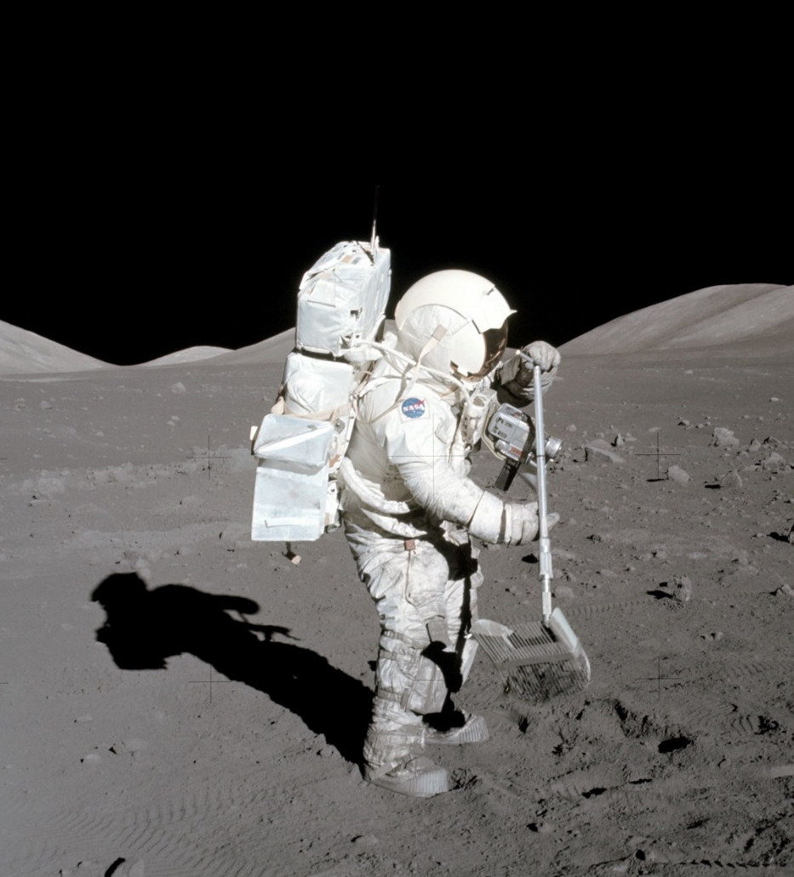
Purpose
Inform the science community that there is a team working on geology sampling tools for Artemis.
Provide a status to the science community on this effort.
Talk about future development.
A lot has happened since we last briefed this community in May 2020!

Slide 3
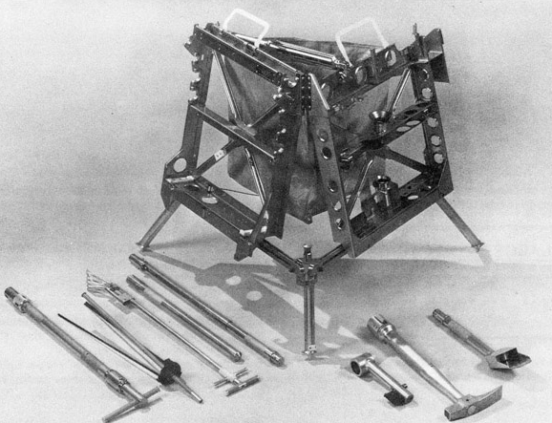
Current Work
The Exploration EVA Tools Team at NASA JSC is developing the next generation, flight-ready, geology tools for Artemis.
FY20: 8 tools were taken through a Preliminary Design Review.
FY21: 8 new tools began development. Requirements TIM held 3/10/21
The following tools began development through a Phase 3 SBIR with a commercial partner.
Geology Hammer | Extension Handle
Rake | Contingency Sampler
Scoop | Drive Tubes
Tongs | Sample Bag
Chisel | Tool Belt
Sample Markers | EPG Tool Holder
Collection Pack | Tool Carrier
Sample Return Pack | Sample Bag Dispenser
Apollo EVA Tools and Carrier
Vacuum Sealed Containers | Powered Core Drill

Slide 4
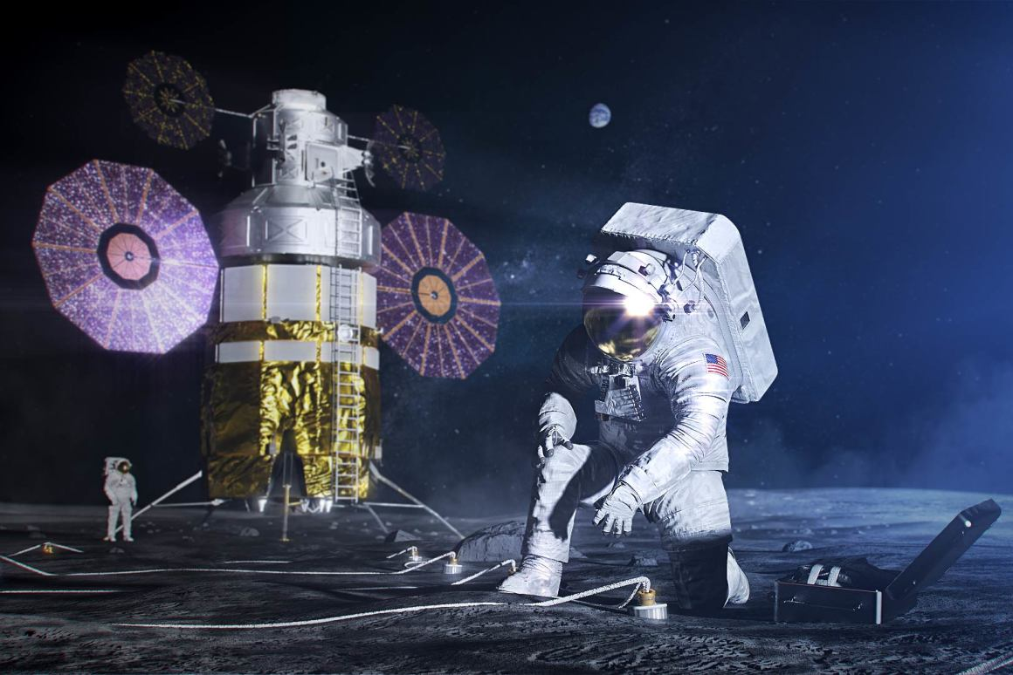
Notional Concept of Operations
Tools will be transported to the lunar surface via Human Landing System (HLS), Commercial Lunar Payload Services (CLPS) or a combination of these options.
The Contingency Sampler will be used to take a sample as soon as possible during the first EVA.
Crew will have a Tool Belt to carry small tools and may carry small tools on the legs of the xEMU.
Tools will be transported across the lunar surface by a Tool Carrier and later the Lunar Terrain Vehicle (LTV).
Tools will be used to obtain samples and be placed into sample containers.
  Have plans to capture samples with volatiles and properly preserve them.
The samples collected on the EVAs will be weighed after each EVA.
Samples will be placed into a bulk sample return pack and transported back to Gateway, onto Orion, and back to Earth.
To save up mass and enable the return of as many lunar samples as possible, all tools (minus Sample Return Packs) will remain on lunar surface at conclusion of mission.
  Potential to reuse tools on future missions.

Slide 5
Major Updates
Early prototypes have been manufactured and tested in various facilities with suited and unsuited subjects.
  Testing of prototype mechanisms in lunar simulant also occurs frequently.
Started working with HLS partners to determine how to transport the tools to the lunar surface.
We’ve drafted a preliminary Contamination Control Plan with help from experts in the field.
  There are still many open questions but the community is working together to resolve them.
The Contamination and Research Integrity (CaRI) Rapid Response Team was created to help answer Artemis science questions. Early packages being submitted to the CaRI team will include but not be limited to:
  What materials can sample intimate hardware be made from?
  What materials can non-sample intimate hardware be made from?
  What are the contamination control and contamination knowledge requirements?

Slide 6
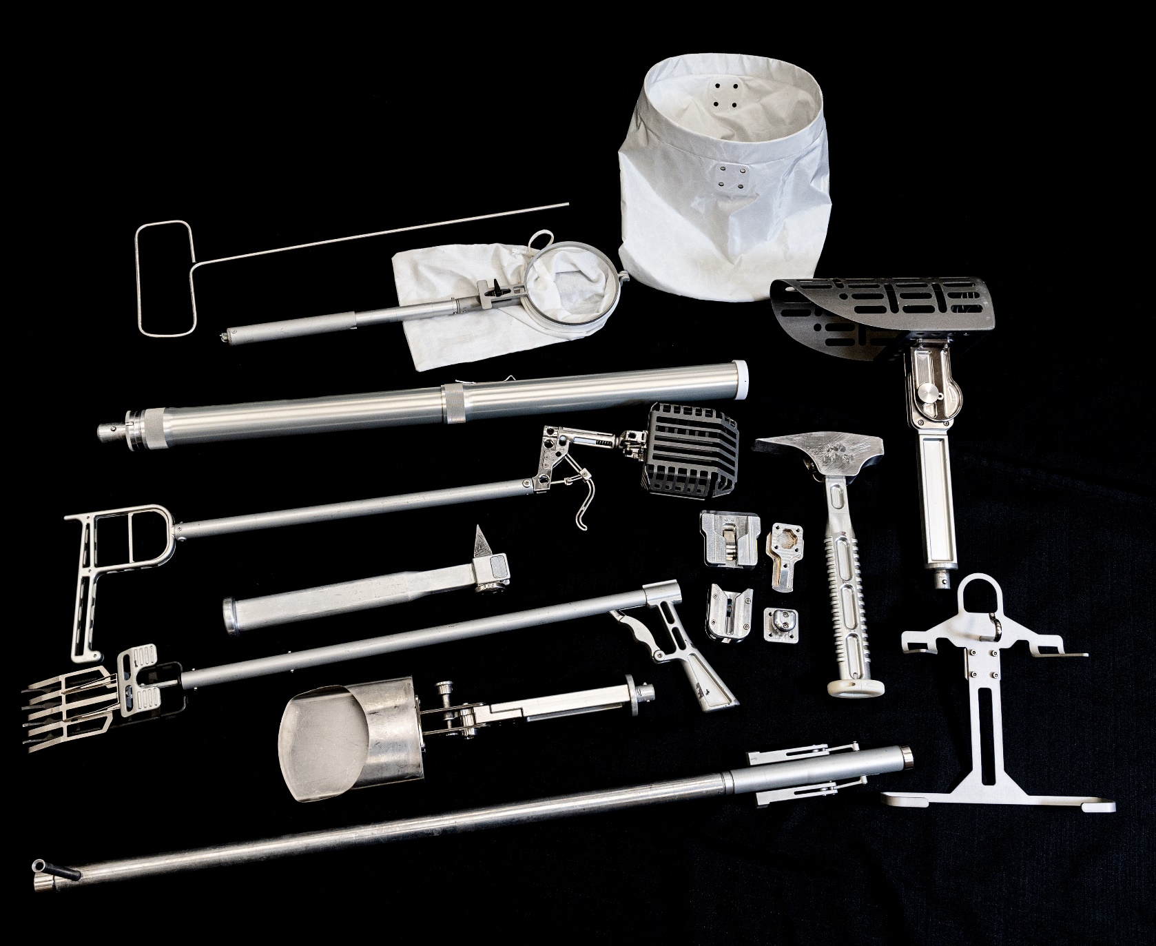
Current Prototypes of Tools

Slide 7
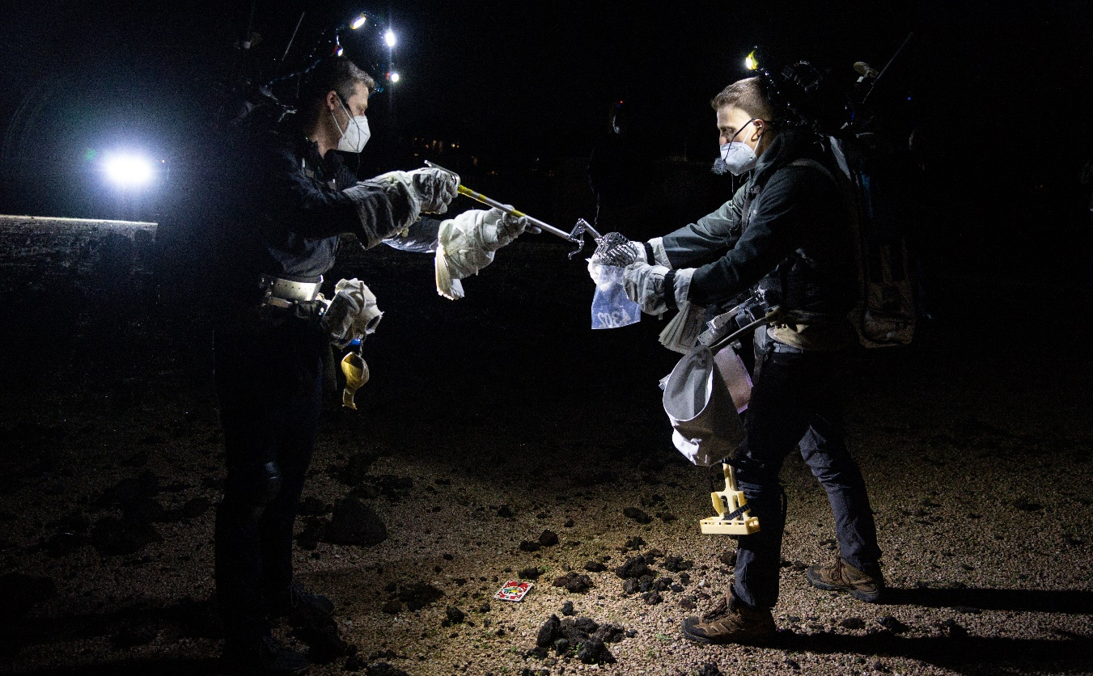
Testing
The team has created early concepts to evaluate in testing to aid in requirements development.
These tests have been critical to learn how science driven EVAs will occur during Artemis.
There have even been early tests to get a first look at doing EVAs in a lighting environment similar to the lunar south pole.
An integrated team across NASA has organized and executed these tests including: Tools, EVA Operations, Astronauts, Science, Photo/TV, Lighting, xEMU and more.
The following slides show pictures from testing that has occurred in various facilities.
Two test subjects put a float sample into a Sample Bag during a dark test at the JSC Rock Yard.

Slide 8
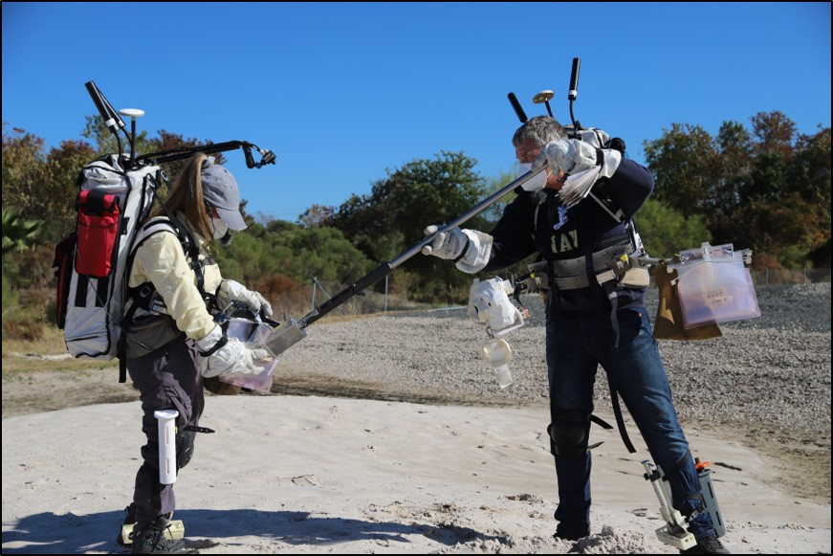
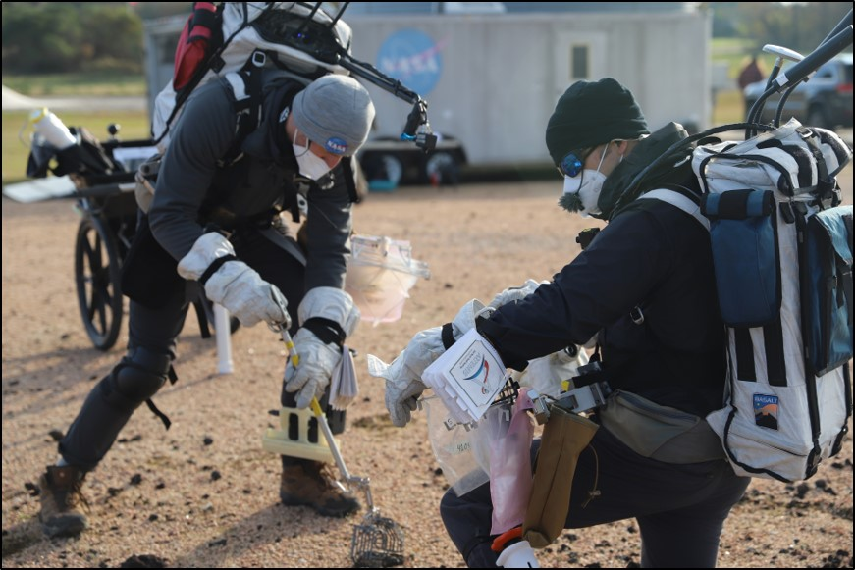
Testing
Two test subjects put a regolith Scoop sample into a Sample Bag during a test at the JSC Rock Yard.
Two test subjects work together to retrieve a float sample during a test at the JSC Rock Yard.

Slide 9
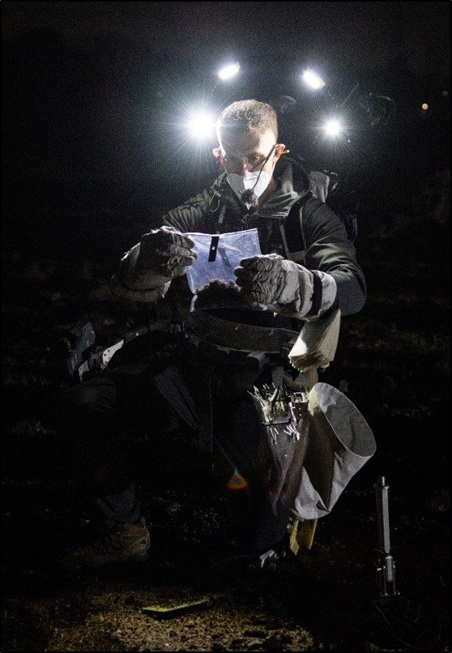
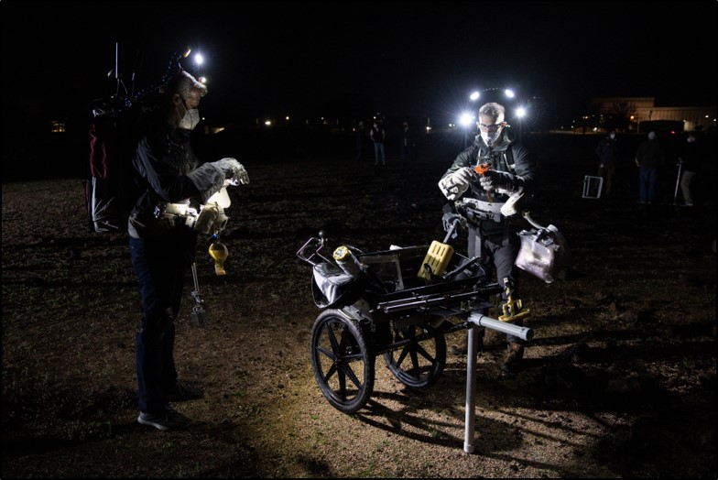
Testing
Test subjects prepare to translate a Tool Carrier to the next station at the JSC Rock Yard.
Test subject inspects a sample.

Slide 10
Upcoming Schedule Milestones
Dec 2021
  Preliminary Design Review for Tool Carrier
Mar 2022
  Critical Design Review for 7 tools
May 2022
  Critical Design Review for 8 tools
Nov 2022
  Critical Design Review for Tool Carrier
Dec 2023
  Delivery of hardware for Artemis III Mission
Note: These are milestones as they currently stand in our baseline schedule and are subject to change pending funding profiles.

Slide 11
Future Plans
There are numerous other EVA Tools and Equipment that need to be developed in future years to support a mission in 2024 and beyond.
While some of these tools will be developed by the JSC EVA Tools Team, others will be developed by this community.
  Dust mitigation tools
  Volatile sampling system
  Contact Soil Sampler
  Slide Hammer
  Scale
  Geotechnical tools
  Field portable instruments
  Incapacitated crew rescue hardware
  Generic maintenance tools (pliers, crescent wrench, sockets, ratchet, compound cutters, etc.)
  Deployable science payloads
  Portable lighting
  …

Slide 12
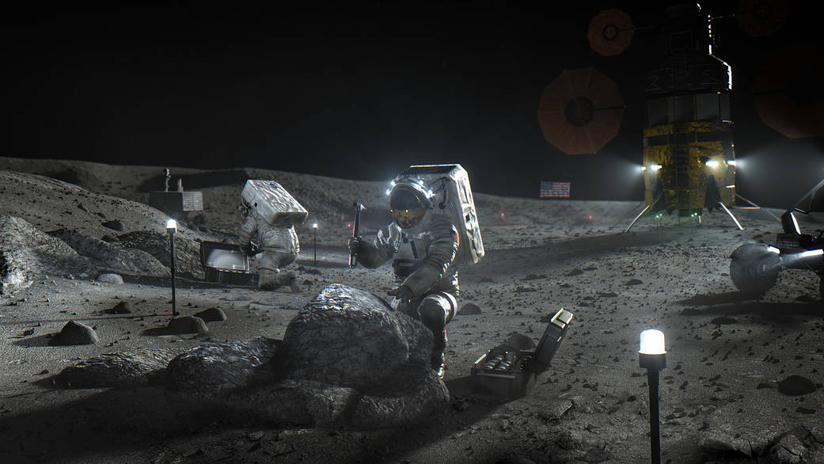

Questions/Discussion

