Slide 1
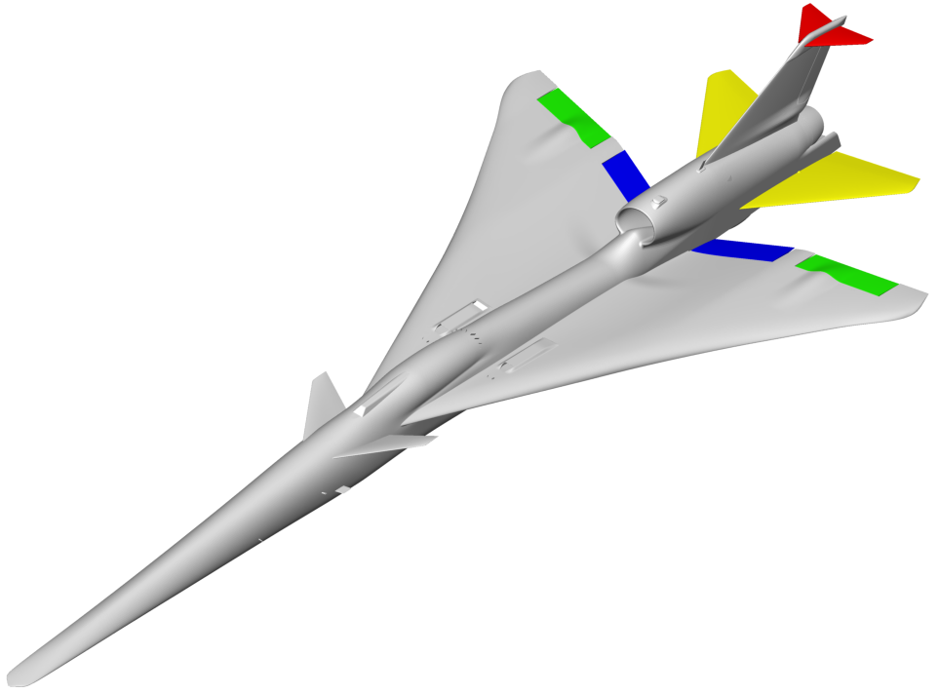
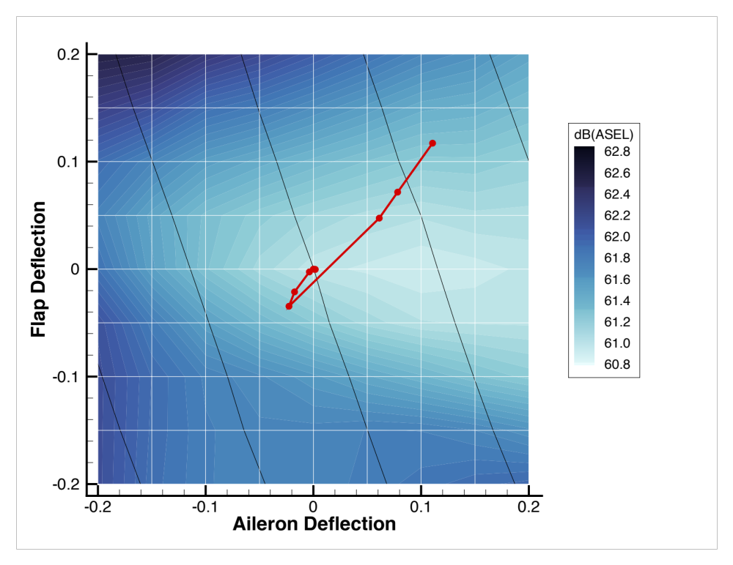
Optimizing Aircraft Configurations to Minimize Boom Loudness
Cartesian Methods Group at NASA Ames is developing new aerodynamic shape optimization tools that directly minimize ground noise metrics (PL, A/B/C/D SEL)
  Multiphysics problem: requires coupling of nearfield CFD and farfield propagation
    Tight integration of NASA’s Cart3D and sBOOM solvers
  Multipoint problem: full boom carpet analysis
  Many flight constraints
    Trim for lift and pitch, hinge moment limits, altitude …
  Efficient gradient-based approach with safeguards
Baseline
Recent results involve fine-tuning control surface deflections of the X-59 Low Boom Flight Demonstrator
  Aircraft is overcontrolled (flaps, ailerons, stabilator, T-tail)
  Optimization finds new control surface deflections that reduce noise metrics while simultaneously satisfying all flight constraints
Optimal
Design
Target CL
Contour
M. Aftosmis, D. Rodriguez, M. Nemec (NASA ARC)

Slide 2
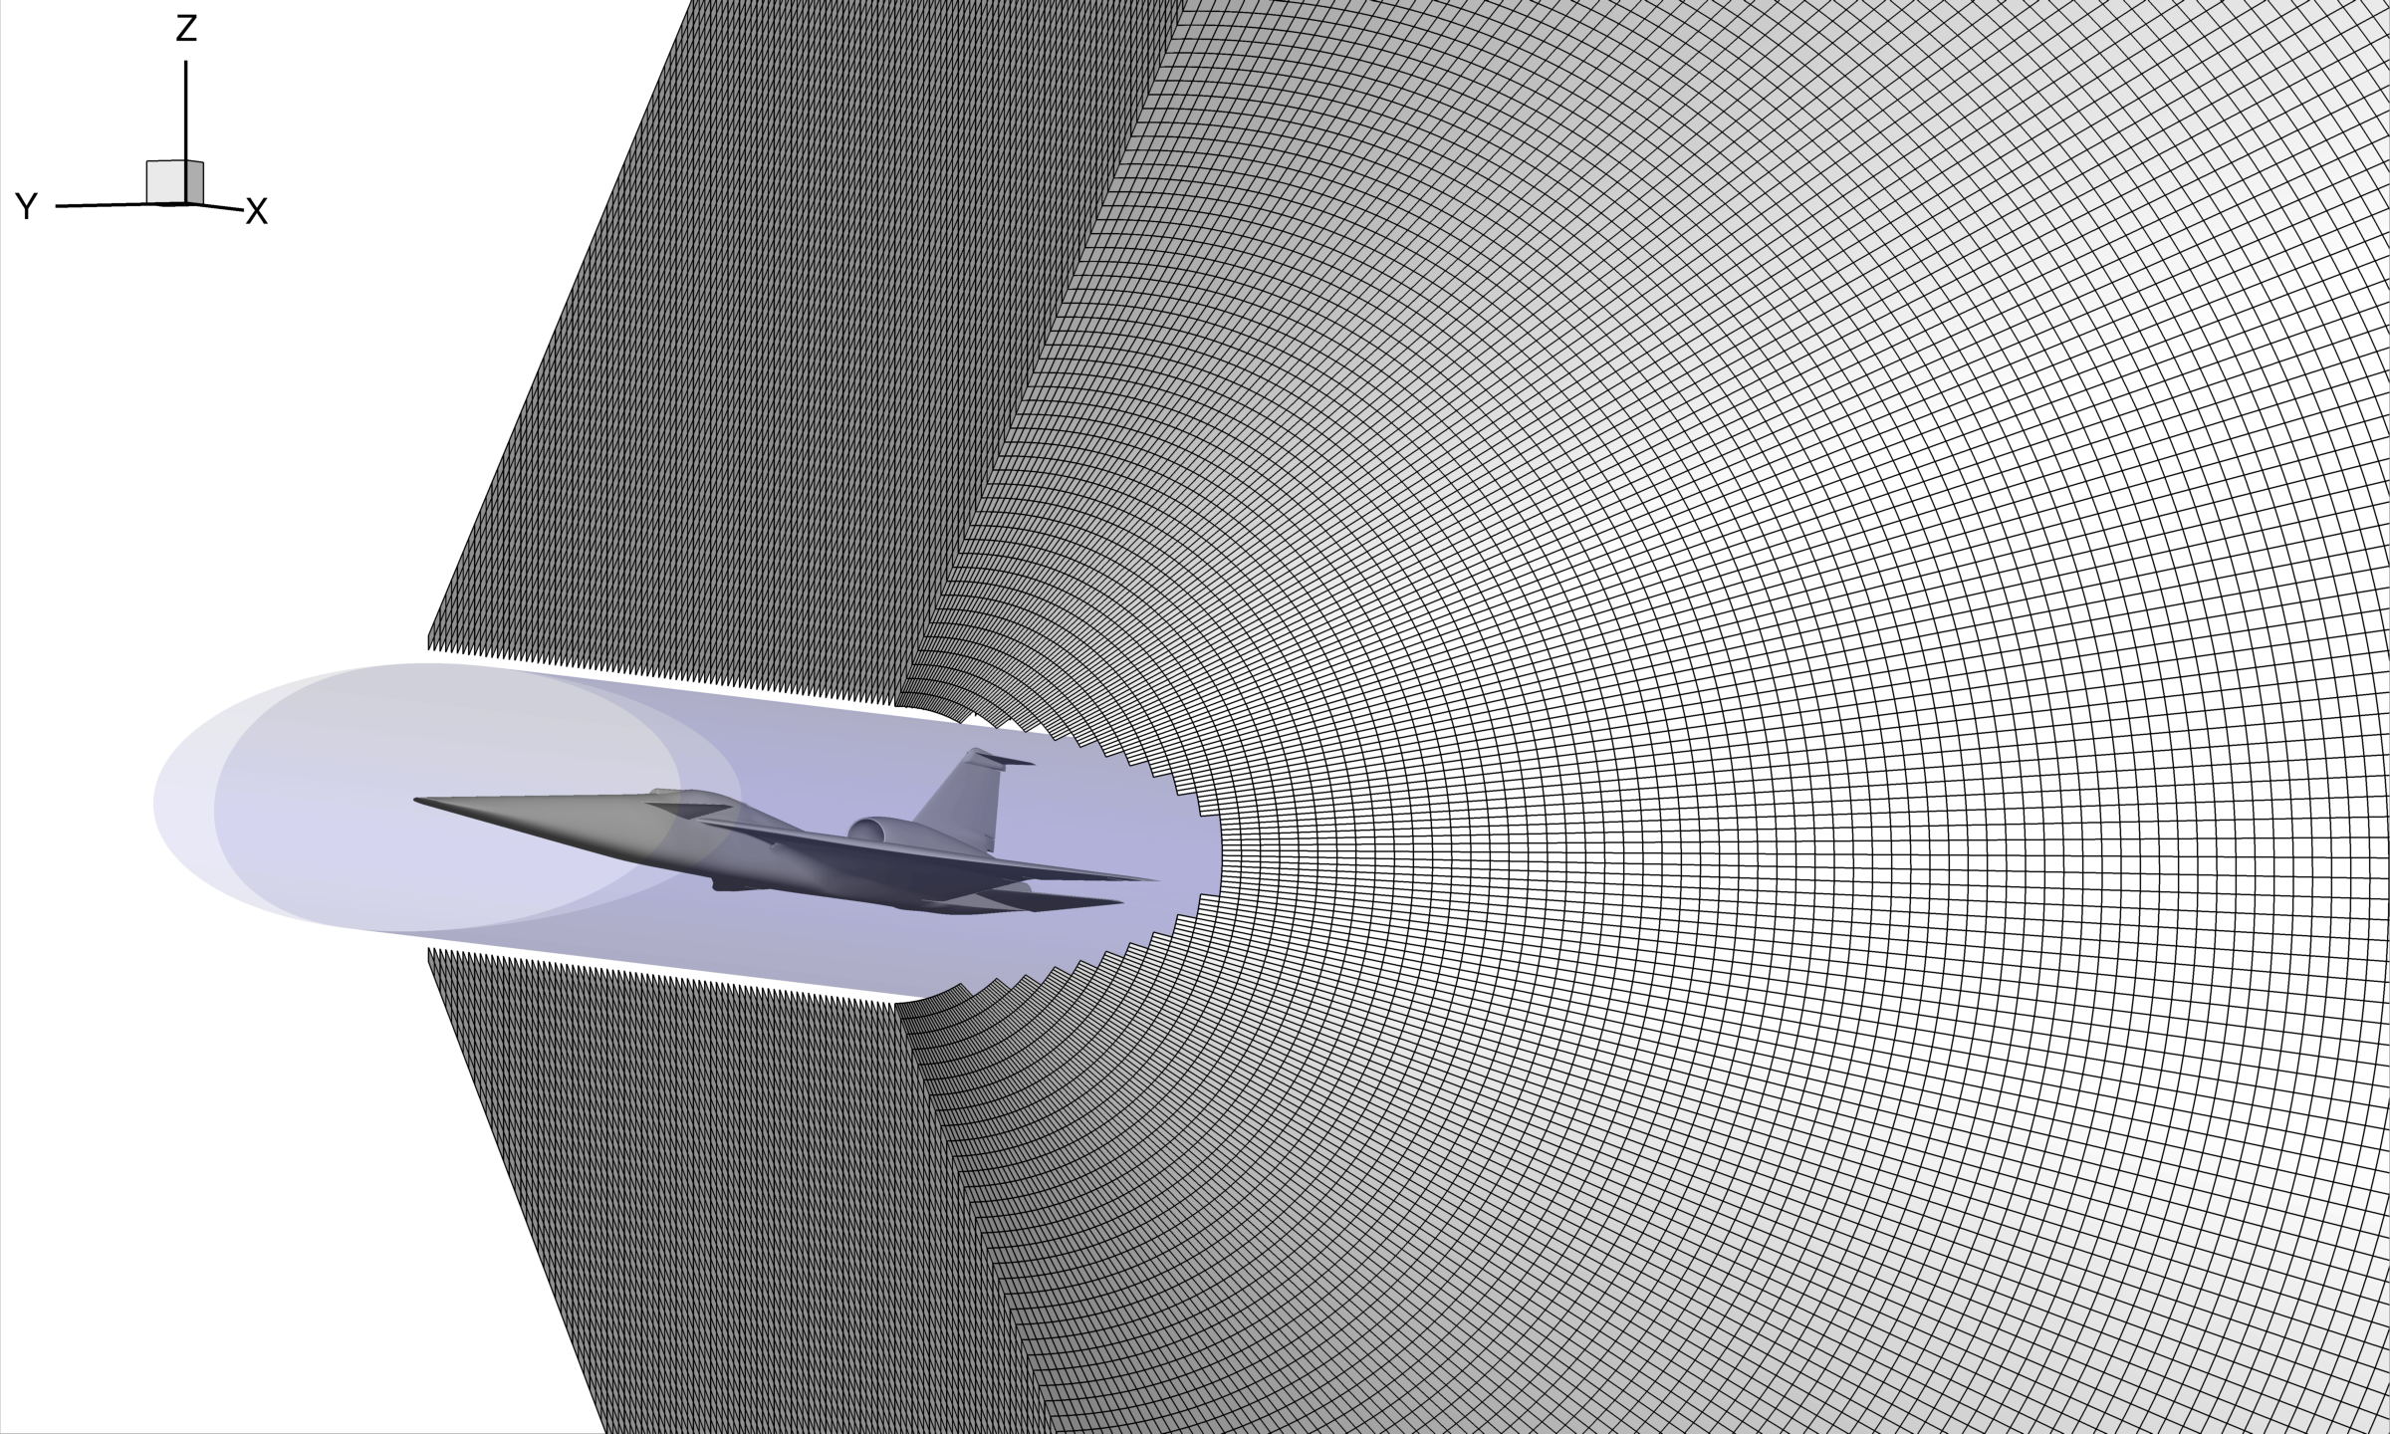
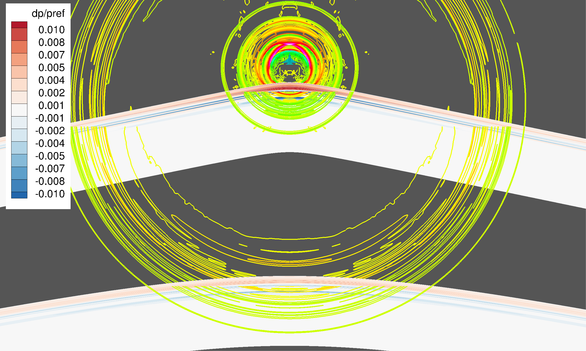
LAVA High-Order Space Marching for Fast Mid-Field Boom Propagation
Developed a high-order space marching solver within LAVA framework to propagate near-field CFD solutions to the mid-field in orders of magnitude less CPU time than standard CFD solutions
Allows reduction of near-field CFD domain from r/L of 4-6 to r/L ~ 0.6, which results in a 50-60% reduction in CFD turnaround time for steady-state RANS
Removes restrictions on interface location with far-field propagation codes, such as SBOOM and PCBOOM, allowing extractions at r/L ~ O(10)-O(100)
Enables consistent mesh refinement, up to billions of grid-points, to be evaluated for solution accuracy (1 billion grid point mesh is solved in less than 1 hour on a workstation)
References
AIAA Aviation 2019, “Efficient Near-Field to Mid-Field Sonic Boom Propagation using a High-Order Space Marching Method,” Housman et al
AIAA SciTech 2021, “Structured Overset and Unstructured Grid Simulations for the Third AIAA Sonic Boom Prediction Workshop”, Duensing et al
Automatically generated Mach cone aligned grids appropriate for space marching
J. Housman, G. Kenway, J. Jensen, C. Kiris (NASA ARC)
Propagates boom 100 body lengths using O(100 million) grid points in 2 minutes on multicore workstation

