Slide 2

Introduction
Diversity - Entire universe of differences and similarities
Inclusion - Full participation, belonging, and contribution of organizations and individuals
Our nation derives strength from the diversity of its population and from its commitment to equal opportunity for all
We are at our best when we draw on the talents of all parts of our society, and our greatest accomplishments are achieved when diverse perspectives are brought to bear to overcome our greatest challenges

Slide 3
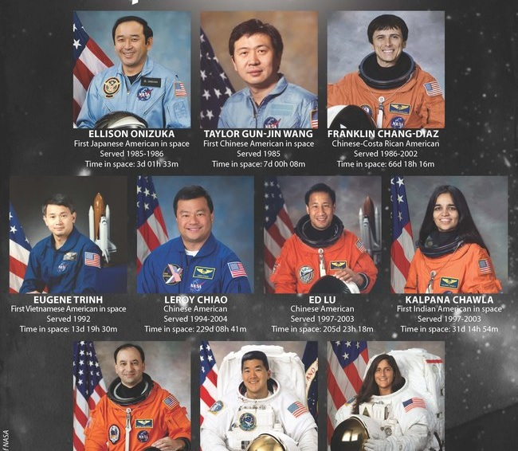


Value of Diversity and Inclusion
NASA has long recognized diversity and inclusion as vital components of mission success
NASA aims to foster an atmosphere of inclusion and respect for all to drive innovation, creativity, and engagement
NASA must attract, fully utilize, and retain the best talent to design creative and innovative technical and organizational solutions to achieve its mission
Agency stakeholders include the U.S. Congress, the commercial space industry, the American public, and ultimately all of humankind

Slide 4
HRP New Investigator Award
Introduced in 2014 as Basic Investigations for New Investigators in Omnibus Appendix
Intent is to solicit novel research ideas that might not be directly aligned with HRP’s identified risks from new investigators to HRP
Renamed in 2020 to New Investigator Award
Requests proposals focusing on any aspect of human adaptation to space flight
Particularly interested in innovative proposals and the potential for results to deliver new tools, techniques, or knowledge that could lead to novel breakthroughs
Funding opportunity is open to new investigators only
  PI must not have had HRP, NSBRI, NASA Established Program to Stimulate Competitive Research (EPSCoR), or TRISH funding in last ten years
  Does not apply to other team members

Slide 5
HRP New Investigator Award (contd.)
Award - $150,000 for one year
Eligible for a one-year costed extension dependent on exceptional progress and results
Budget provided by the investigator in the proposal should only be for one year, not two
Sample Projects
  Effects of Acute and Protracted Galactic Cosmic Radiation on Bone Strength
  Sensory Manipulation as a Countermeasure to Robot Teleoperation Delays

Slide 6
HRP Early Career Investigator Award
Introduced in 2020 as part of Omnibus Appendix to help more junior scientists contribute to the HRP mission
Restricted to PIs who have completed their terminal research degree or end of post-graduate clinical training, whichever date is later, in the last ten years and have not previously been a PI on HRP, NSBRI, NASA EPSCoR, or TRISH grant
Solicits research on any aspect of human adaptation to spaceflight
Award - $150,000 for one year
Eligible for a one-year costed extension dependent on exceptional progress and results

Slide 7
Minority University Research and Education Project (MUREP)
NASA provides financial assistance via competitive awards to Minority Serving Institutions such as:
  Historically Black Colleges and Universities
  Hispanic Serving Institutions
  Asian American and Native American Pacific Islander Serving Institutions
  Alaska Native and Native Hawaiian-Serving Institutions
  American Indian Tribal Colleges and Universities
  Native American-Serving Nontribal Institutions
Four pillars of investment and engagement:
  Research infrastructure and capacity building
  Curriculum development and service provider resources
  Student engagement
  Partnerships and sustainability

Slide 8
MUREP (contd.)
Solicitations posted on NASA Solicitation and Proposal Integrated Review and Evaluation System (NSPIRES)
Calls are general, but proposals must address research priorities of the Mission Directorates and Centers
  “Engagement Opportunities in NASA STEM” (EONS) Omnibus
  “MUREP Institutional Research Opportunity” (MIRO)
Internships and Fellowships for students

Slide 9
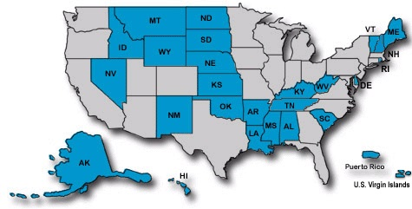
Established Program to Stimulate Competitive Research (EPSCoR)
Establishes partnerships with government, higher education and industry that are designed to effect lasting improvements in a state or region's research infrastructure, research and development capacity and its national R&D competitiveness
Program is directed at those jurisdictions that have not participated equably in competitive aerospace and aerospace-related research activities
Five federal agencies, including NASA, conduct EPSCoR programs

Slide 10
EPSCoR Objectives
Contribute to and promote the development of research capability in NASA EPSCoR jurisdictions in areas of strategic importance to the NASA mission
Improve the capabilities of the NASA EPSCoR jurisdictions to gain support from sources outside the NASA EPSCoR program
Develop partnerships among NASA research assets, academic institutions, and industry
Contribute to the overall research infrastructure and economic development of the jurisdiction

Slide 11
Dual-Anonymous Peer Review
NASA is strongly committed to ensuring that the review of proposals is performed in an equitable and fair manner that reduces the impacts of any unconscious biases
To this end, and motivated by a successful study conducted for the Hubble Space Telescope, NASA’s Science Mission Directorate is conducting a pilot program to evaluate proposals using dual-anonymous peer review
Under this system, not only are proposers unaware of the identity of the members on the review panel, but the reviewers do not have explicit knowledge of the identities of the proposing team during the scientific evaluation of the proposal
  The primary intent of dual-anonymous peer review is to eliminate “the team” as a topic during the scientific evaluation of proposal, not to make it absolutely impossible to guess who might be on that team
  This creates a shift in the tenor of discussions, away from individuals and towards a discussion of the scientific merit proposal

Slide 12
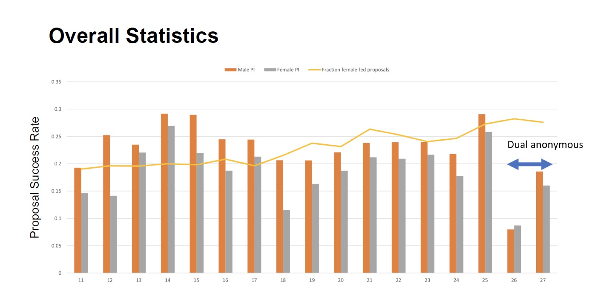
Dual-Anonymous Peer Review (contd.)

Slide 13

Dual-Anonymous Peer Review (contd.)
Feedback from pilot program has been positive
  Proposal discussions were characterized as more collegial and efficient
  Focus was squarely on the science rather than scientists
  Peer review discussions focused predominantly on whether the science was novel, impactful, and feasible, not on whether the proposers had expertise to carry out proposals
HRP is eager to participate in dual-anonymous peer review once it rolls to the whole Agency
Ultimate goal is to level the playing field for everyone during peer review

Slide 14
Improve Proposal Review Transparency for Young Investigators
Include junior investigators on peer review panels
  Provide input
  Experience the process
Potential Mock Peer Review and Program Relevancy Review at annual HRP Investigators’ Workshop
  Provide outline/breakdown of the process
  Targeted feedback

Slide 15
Resources
NSPIRES - https://nspires.nasaprs.com/external/
Current HRP solicitation - https://tinyurl.com/HERO20OVERVIEW
NASA MUREP - https://www.nasa.gov/stem/murep/home/index.html
NASA EPSCoR - https://www.nasa.gov/stem/epscor/home/index.html

Slide 16
Conclusion
NASA is committed to fostering diversity and getting the best ideas from a variety of sources to solve challenging problems
HRP is very interested in bringing in fresh perspectives, from all backgrounds, to mitigate risks to human spaceflight
NASA processes will continue to be adjusted to increase participation and diversity

