Slide 1
Digital Twins
Strategic Impact and Future Capabilities for NASA's 21st Century Missions
John Vickers, Principal Technologist, Advanced Manufacturing 05.05.2021

Slide 2
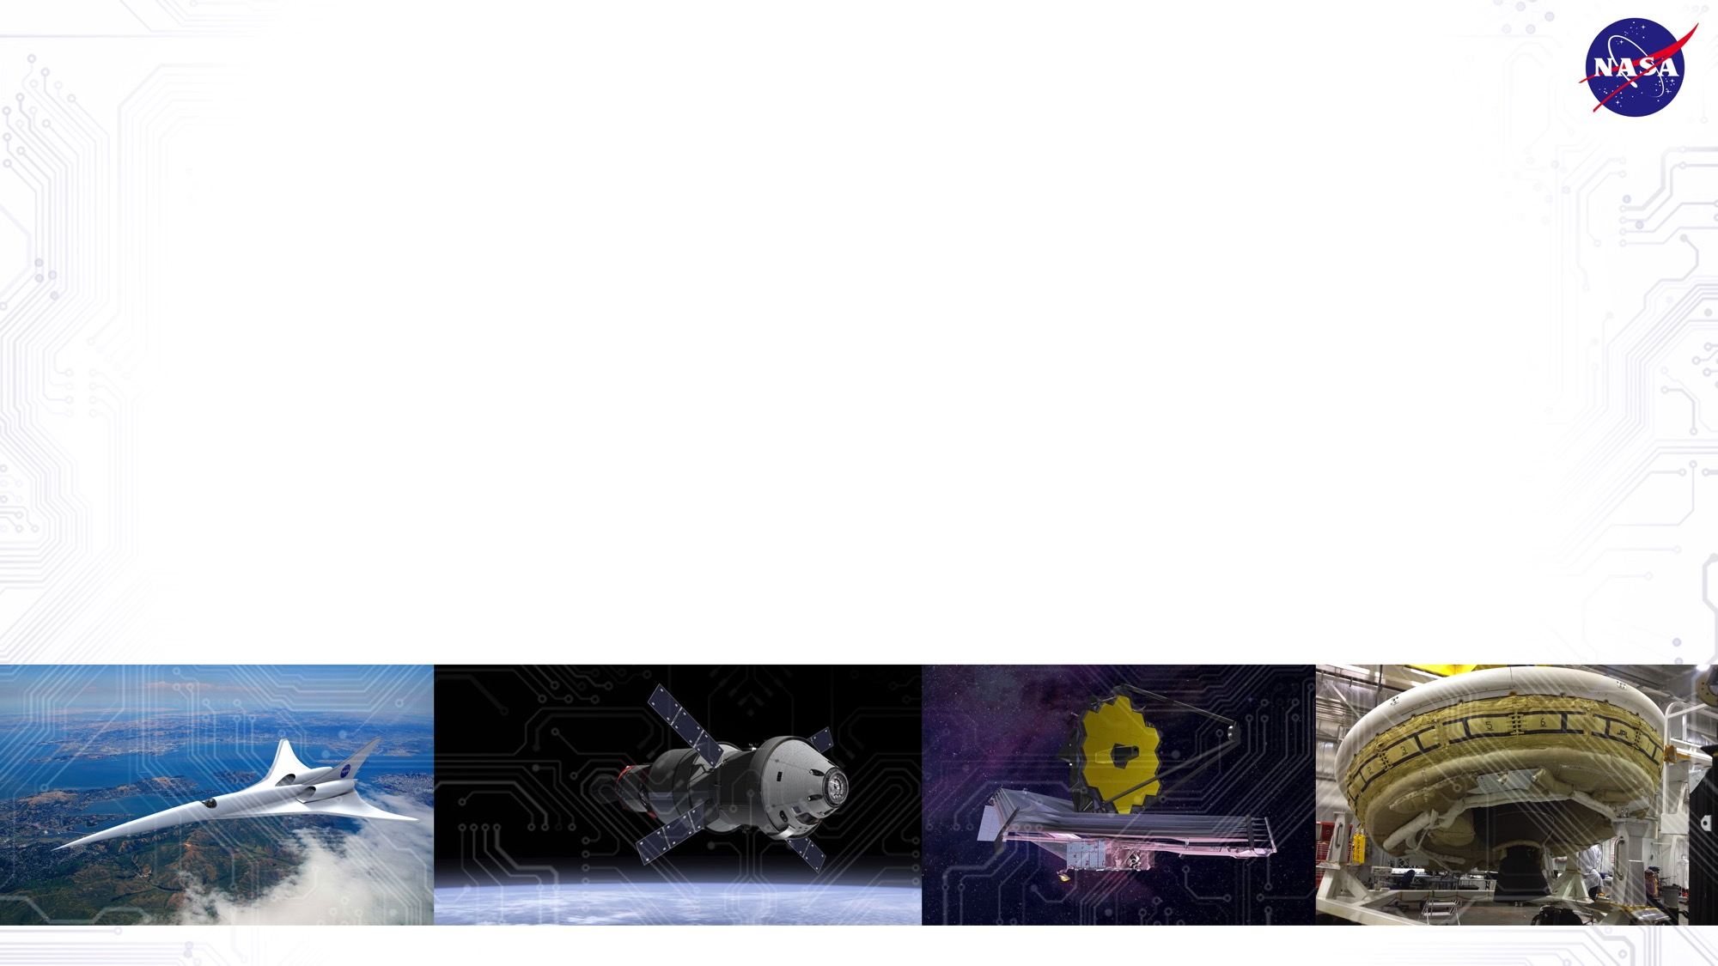
NASA Digital Transformation Initiative
Mission
Impact
Transformation
products, processes, capabilities
Organization
Strategic Thrust: Culture & Workforce
Approach: Catalyze DT
Developing enterprise DT strategy and roadmaps
Supporting stakeholder implementation of roadmap projects
Sponsoring/co-sponsoring pilot projects
Brokering DT partnerships
Advocating for DT and disseminating DT knowledge
Tracking the state of DT across Agency
Digital Technologies
Strategic Thrusts: Collaboration, Model-based Work, Process Transformation, AI/ML
Foundation
Strategic Thrust: Data
Dramatically enhances NASA’s mission impact by engaging digital convergence by reinventing mission and mission support processes, products, and capabilities

Slide 3
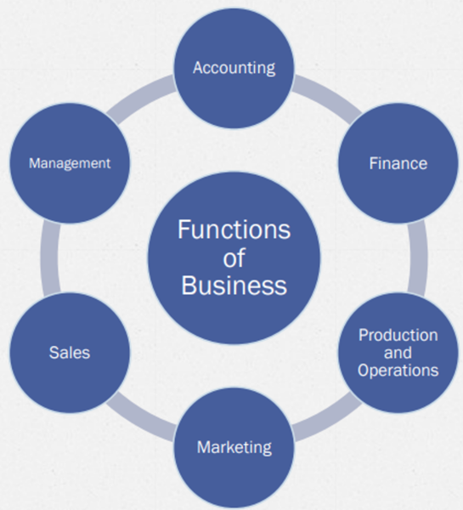
Digital Twin Business Transformation
Digital Twin

Slide 4
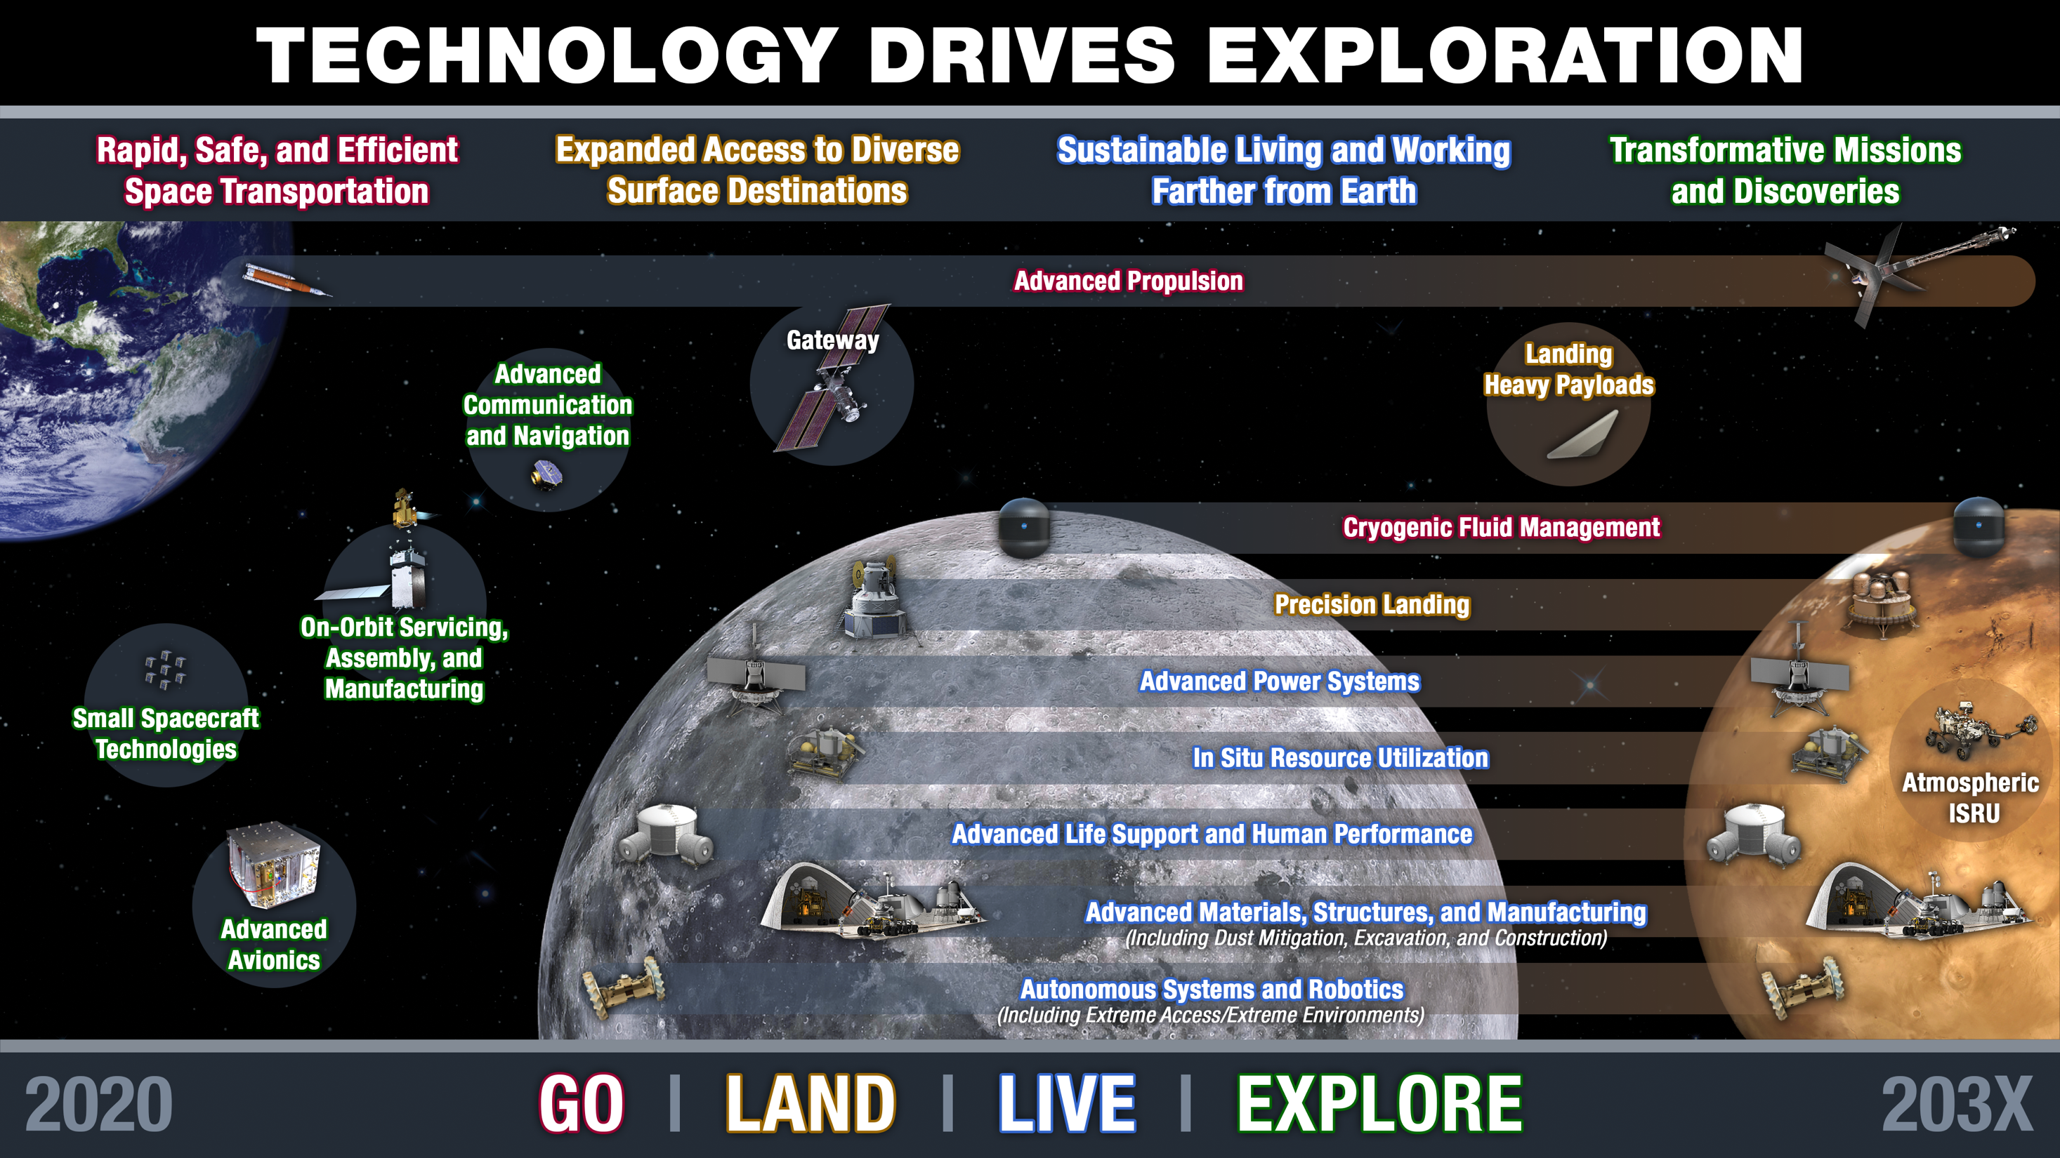

Slide 5
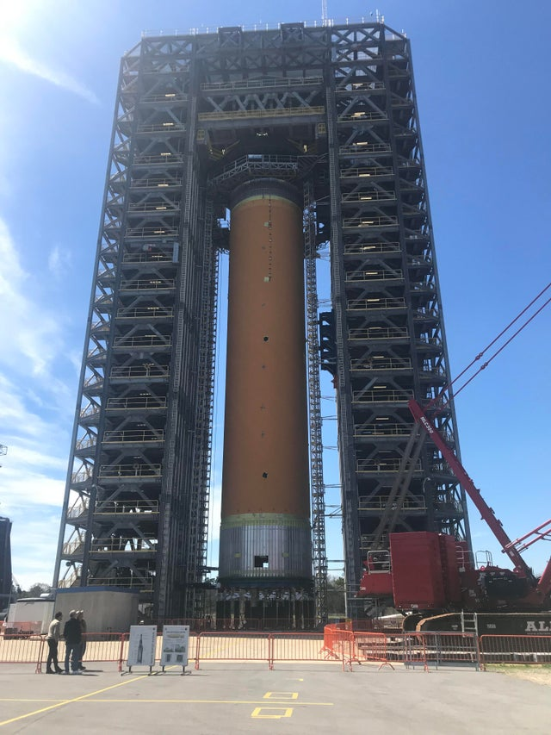
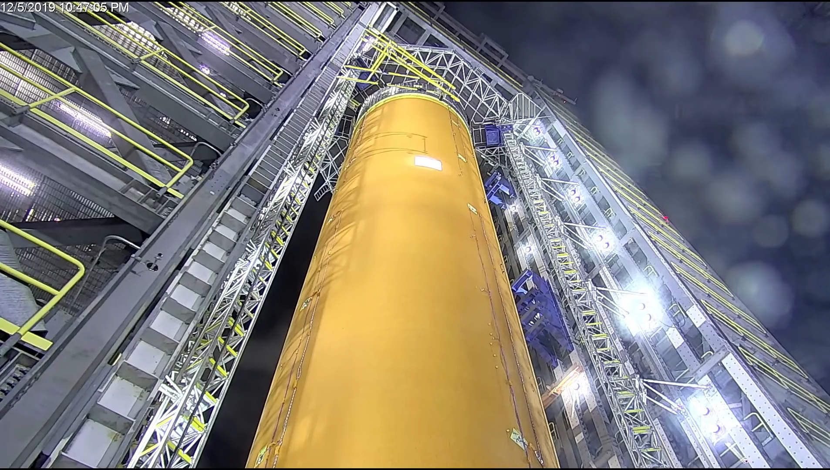
Testing and Certification, Today

Slide 6
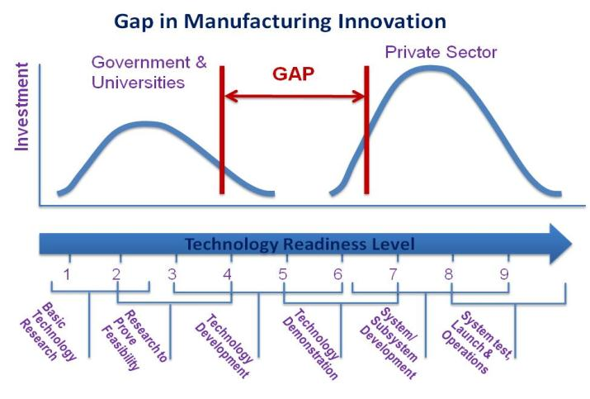
Digital Twin! “A Little Less Conversation
A Lot More Action Please”
Product Development, Testing and Certification Today
“It takes too long and costs too much to certify aerospace structures” - Exhaustive testing done to support analysis

Slide 7
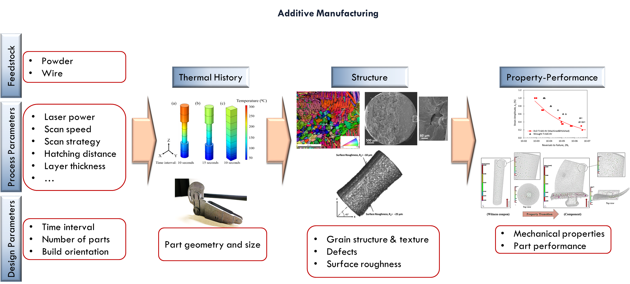
Testing and Certification, Today
Credit: Auburn University

Slide 8
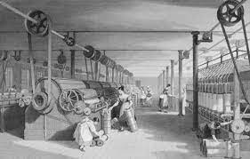
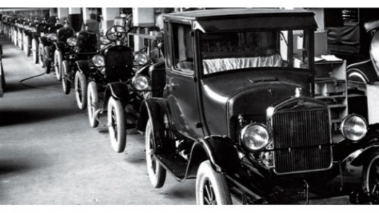
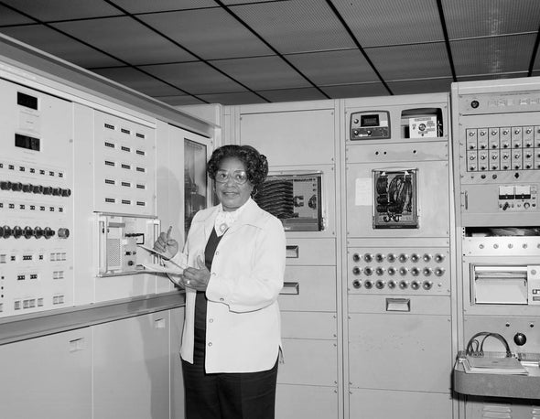
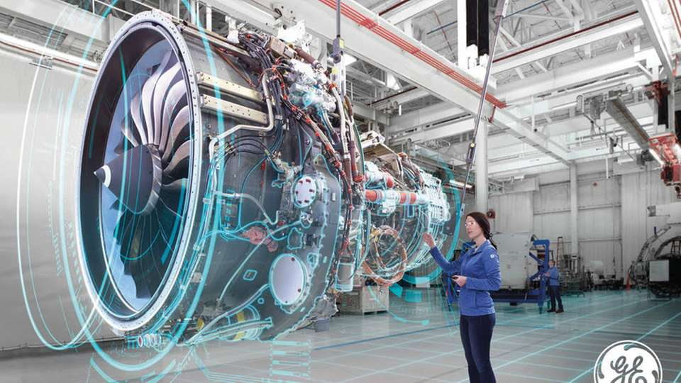
Past is Prologue
Linkages between Science, Technology and Commerce
A nation which depends upon others for its new basic scientific knowledge will be slow in its industrial progress and weak in its competitive position in world trade, regardless of its mechanical skill. Vannevar Bush, head of the U.S. Office of Scientific Research and Development during World War II

Slide 9
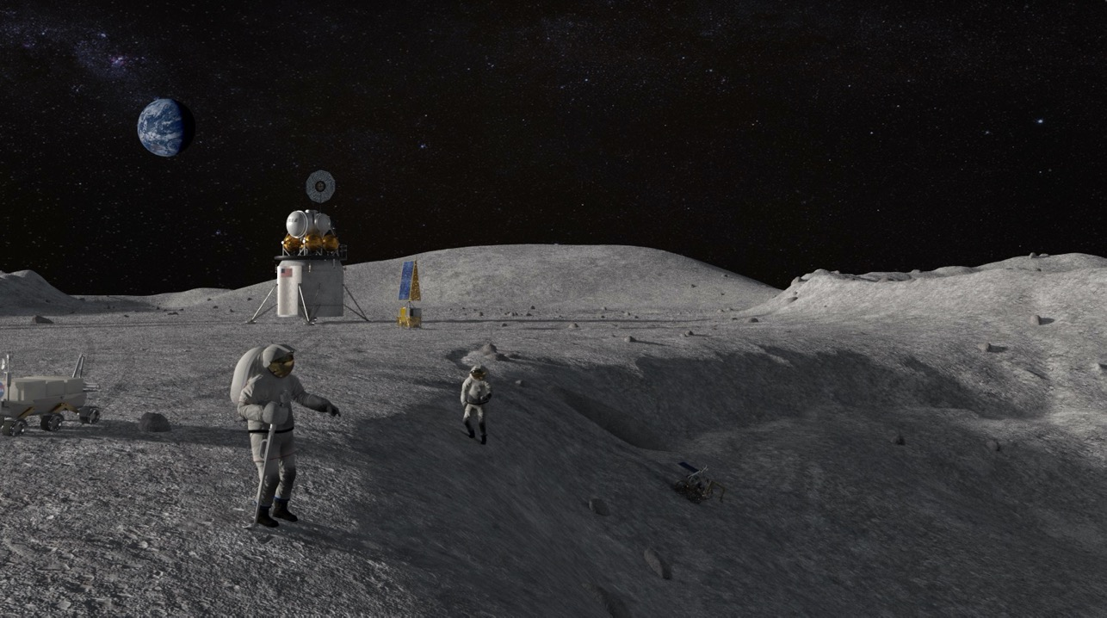

Technology Drives Exploration
Thank You!
john.h.vickers@nasa.gov
9

