Slide 1
3D Construction of Biologically Derived Materials NASA Ames Technology Transfer Environment Webinar
Diana Gentry
Bioengineering & Instrumentation Group Lab
NASA Ames Research Center
04/27/2021

Slide 2
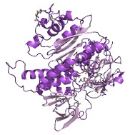
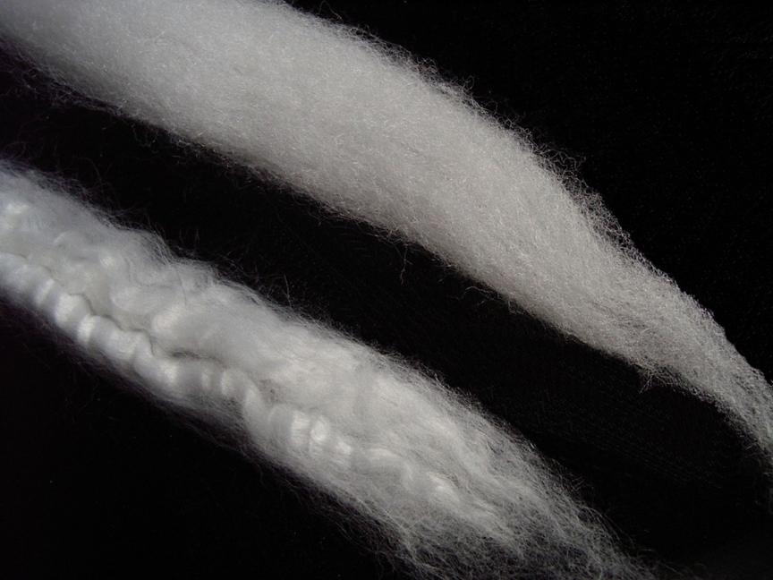
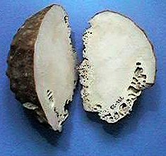
3D Construction of Biologically Derived Materials
Technology Overview
Biomaterials are natural materials produced by or incorporated into living systems, or human-made materials which mimic the same
Living cells are very good at making complex, hierarchical microstructures to give rise to lightweight, robust, highly functional materials (wood, bone, silk)
To influence the final material product, need to control both cell production capability (genetic engineering) & cell physical environment (3D printing)
nacre
wood
proteins
complexity
microbial mats
wool
sugars
biogenic silica
biogenic calcite
size

Slide 3
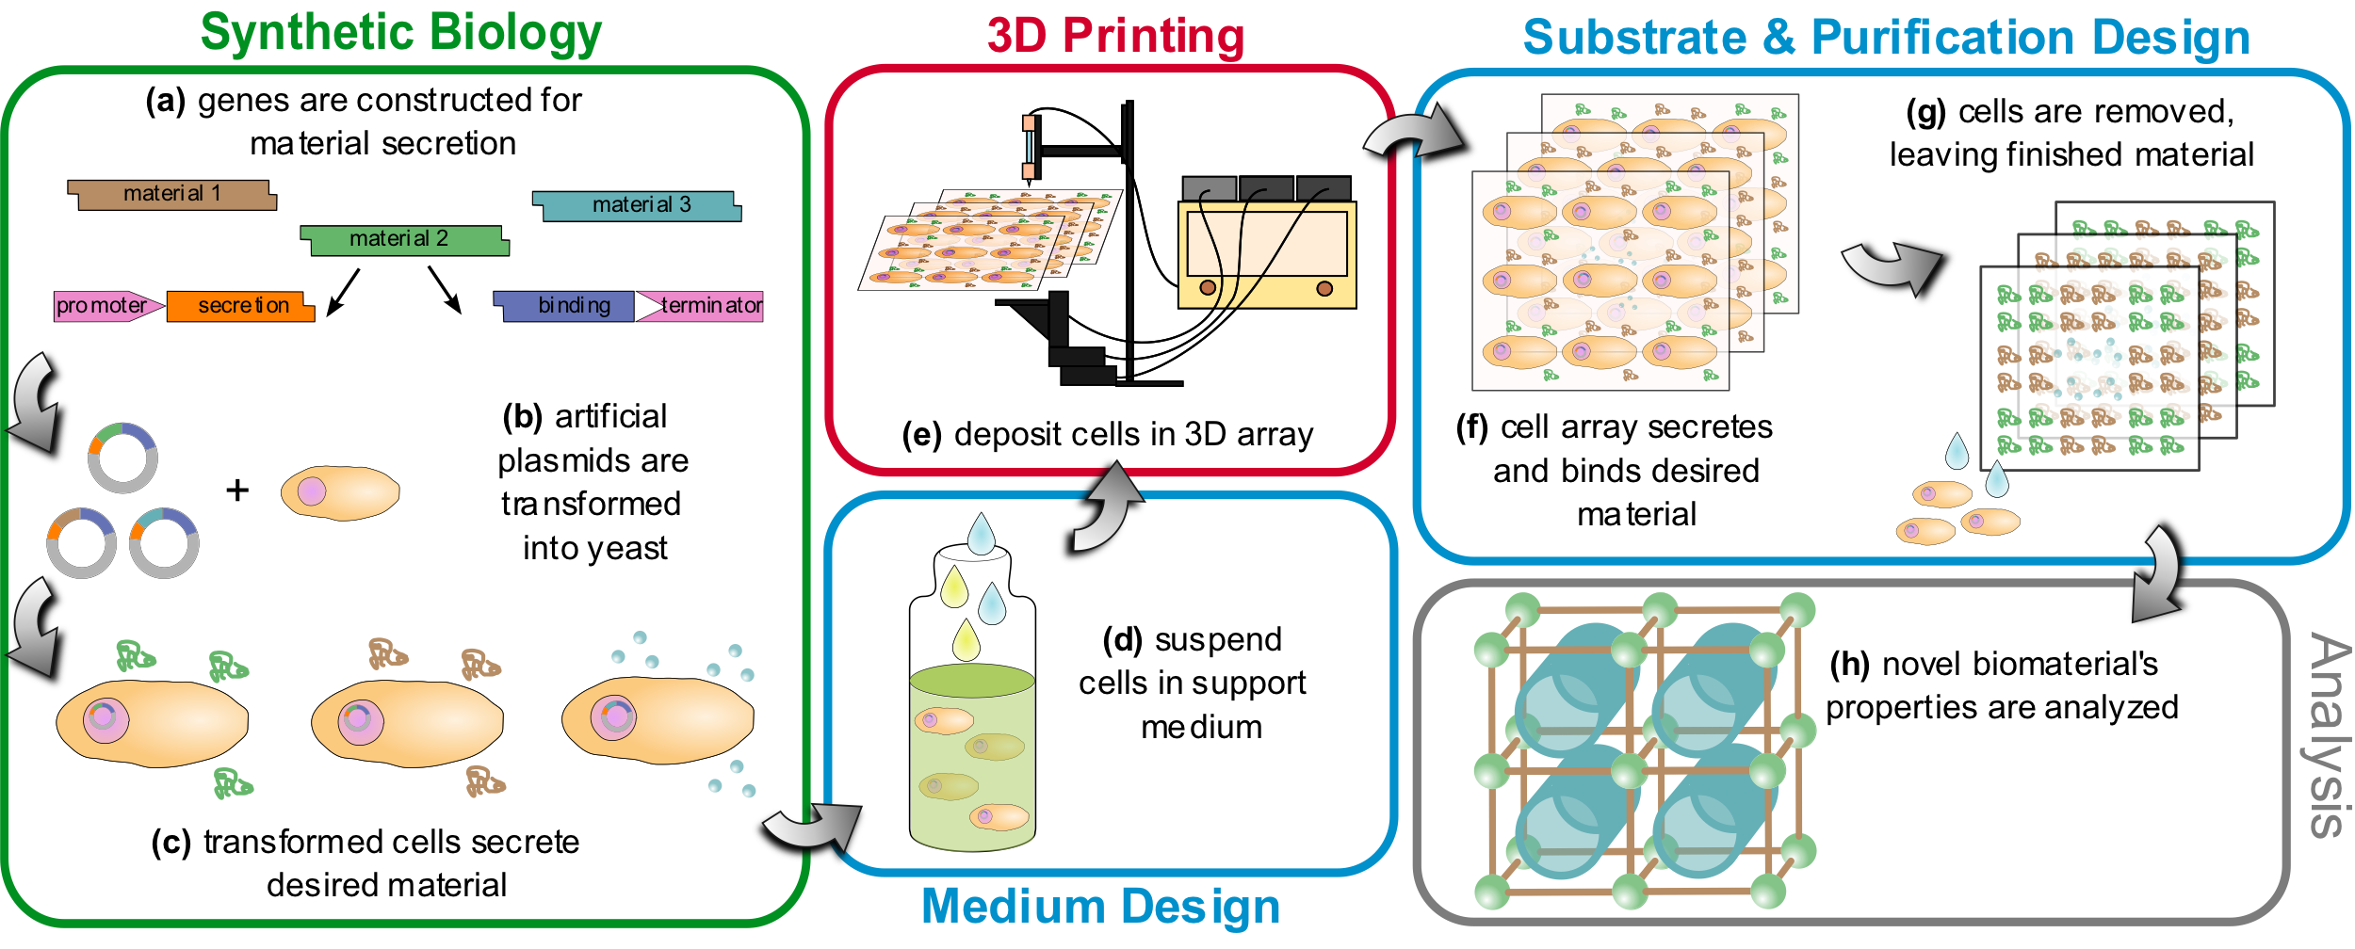
3D Construction of Biologically Derived Materials
Proof-of-concept end-to-end system: living cell chassis, suppressor ‘bio-ink’, expressor substrate, & micropositioning/deposition hardware

Slide 4
3D Construction of Biologically Derived Materials

Slide 5
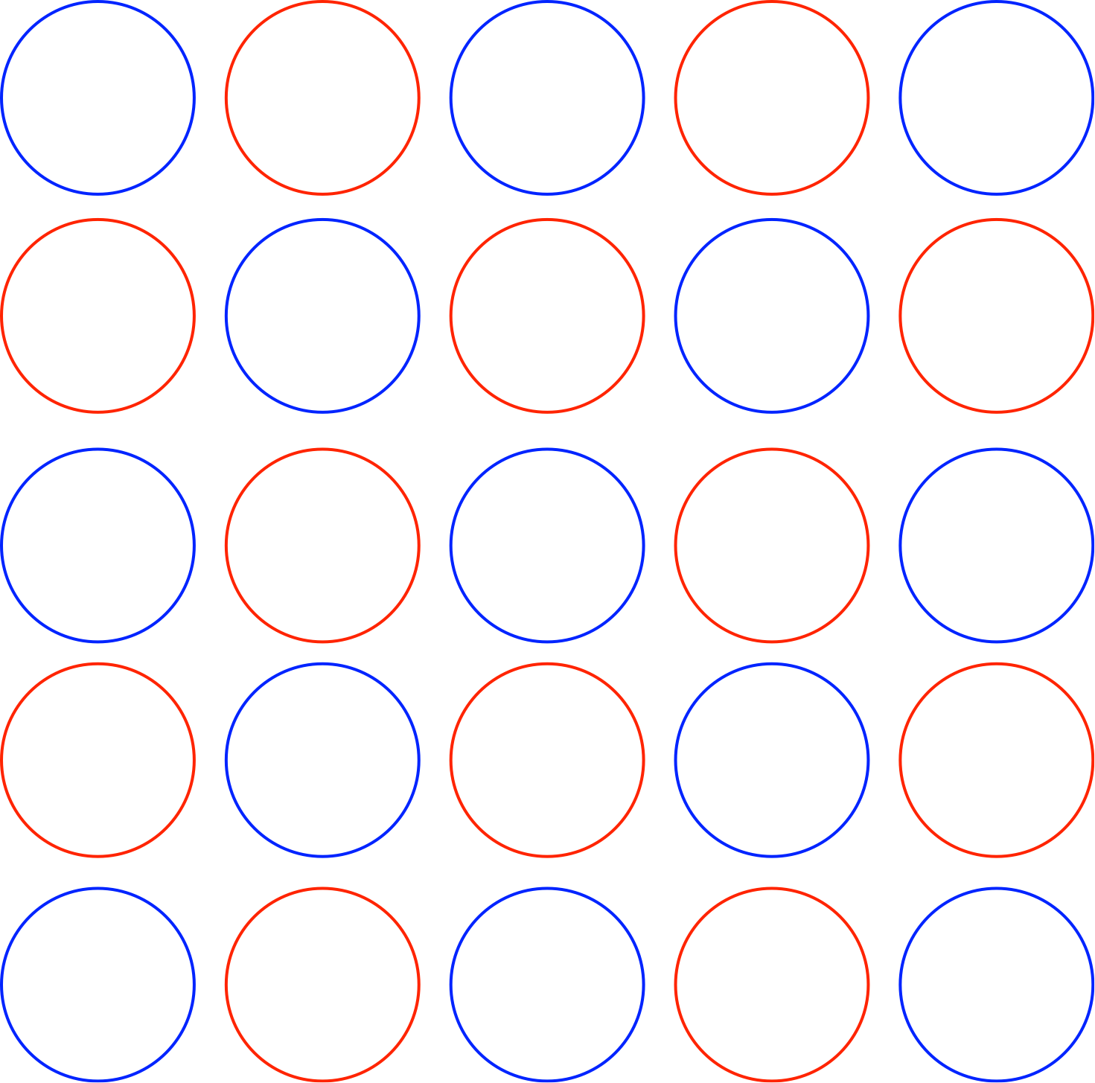
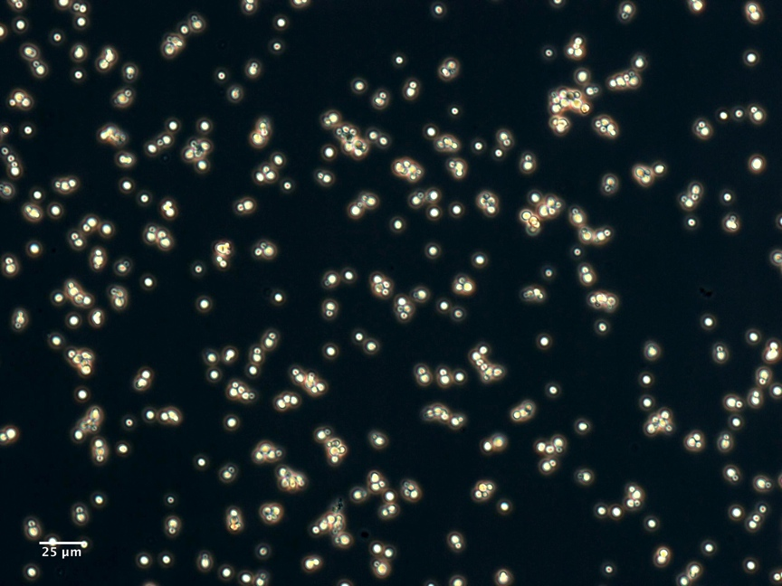
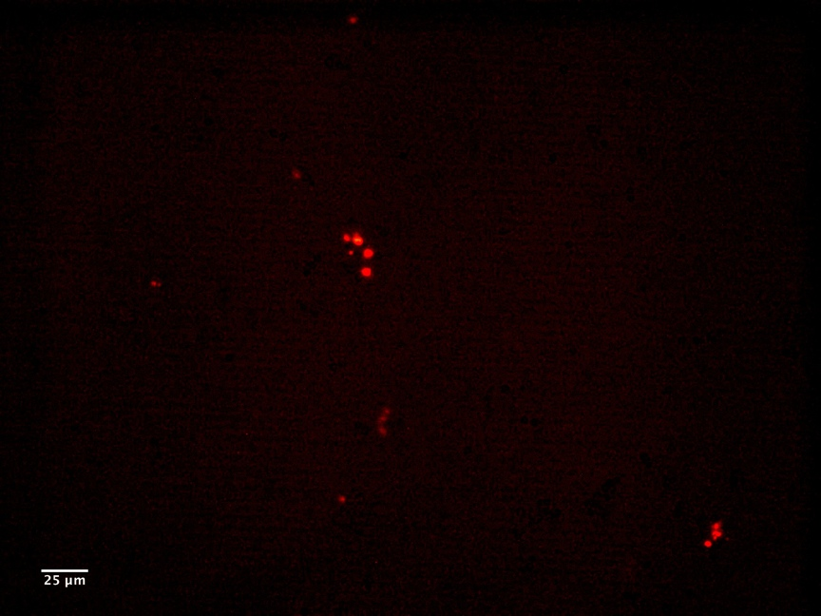
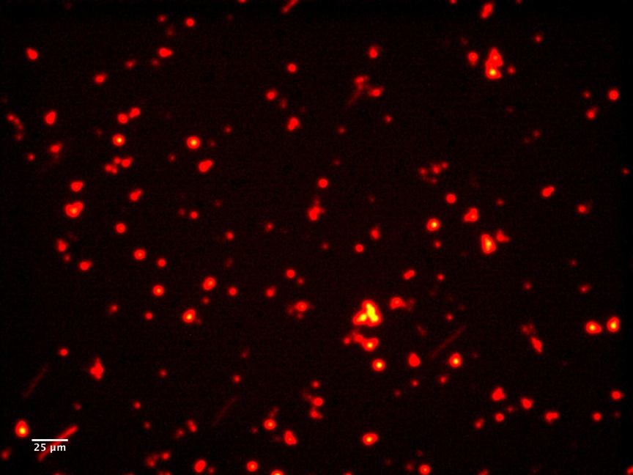
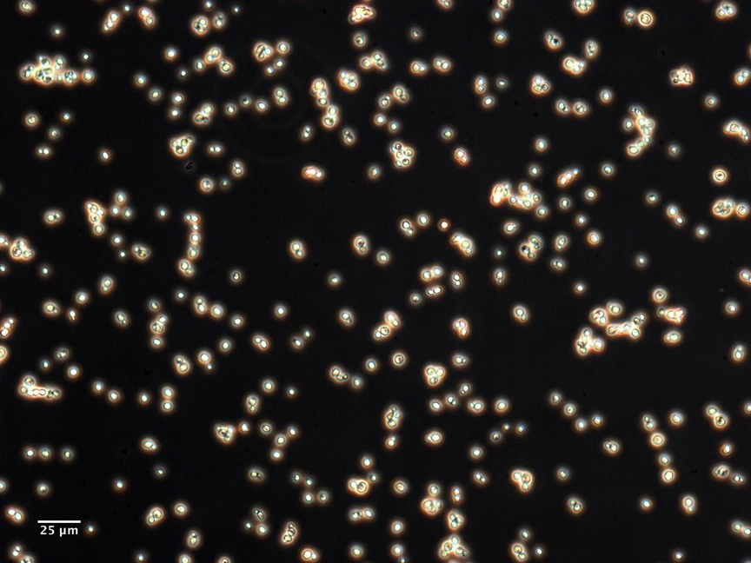
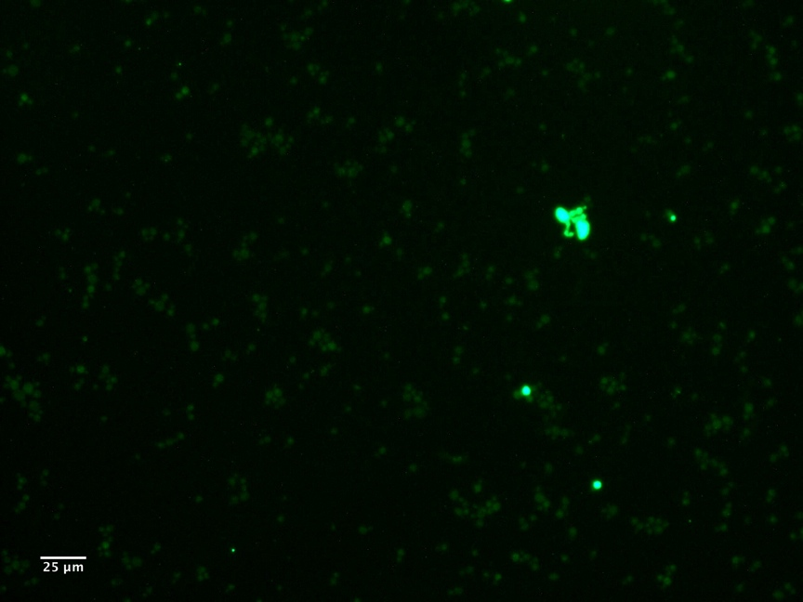
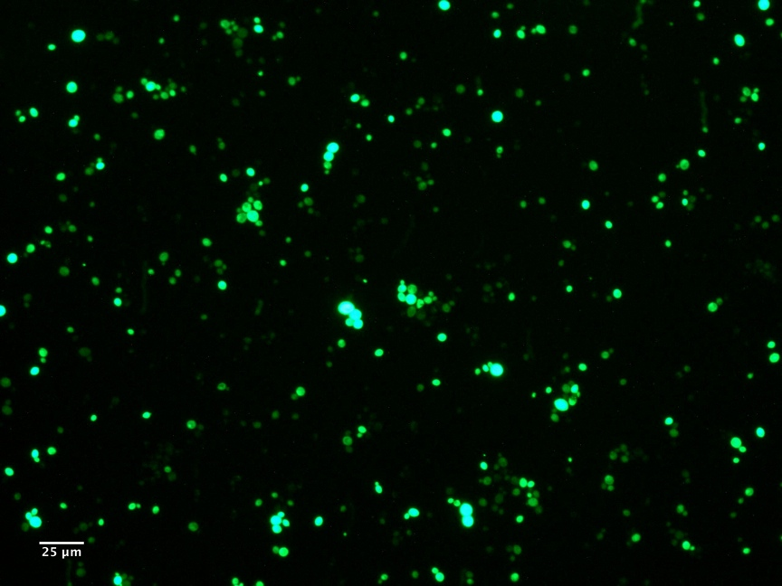
3D Construction of Biologically Derived Materials
Benefits
Doesn’t require that the feedstock be the same as the final material (as in traditional 3D printing)
Is not limited to bulk, homogeneous materials (as in most current microbial material production)
Allows cells’ existing material production capabilities to be manipulated even before pathways are fully characterized (as in traditional synthetic biology)
dextrose
dextrose
galactose
RFP cells
phase contrast
red fluorescence
red fluorescence
GFP cells
phase contrast
green fluorescence
green fluorescence

Slide 6
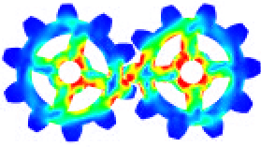
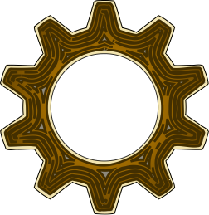
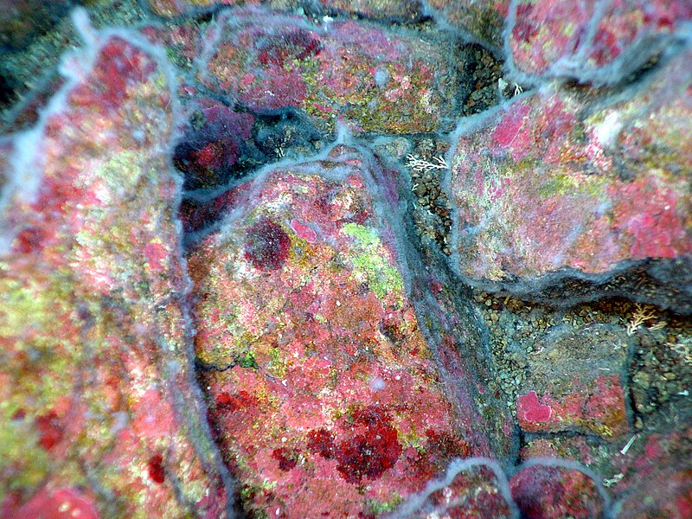
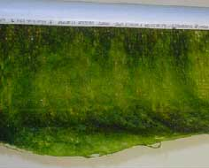
3D Construction of Biologically Derived Materials
Future Work
improve dispensing parameter tuning
most significant opportunity for immediate improvement
explore alternate binding methods
explore more supportive print substrates
Applications
Original design goal: demonstrate ability of approach to produce a novel structural biomaterial
Original application: advanced manufacturing of functionally optimized structural materials
New possible applications:
reproduction of 3D-structured cell cultures (biofilms, microbial mats, bio-enabled filters)
enabling research into cell response to microenvironments in 3D

