Slide 1
Hot-fire Testing on LOX/Methane
Components for In-Space Engines
Sandy Elam Greene
NASA – Marshall Space Flight Center, Alabama
JANNAF In-Space Chemical Propulsion Technical Interchange Meeting
Huntsville, AL
August 29, 2018

Slide 2
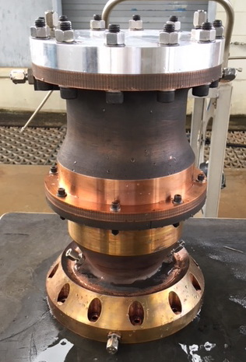
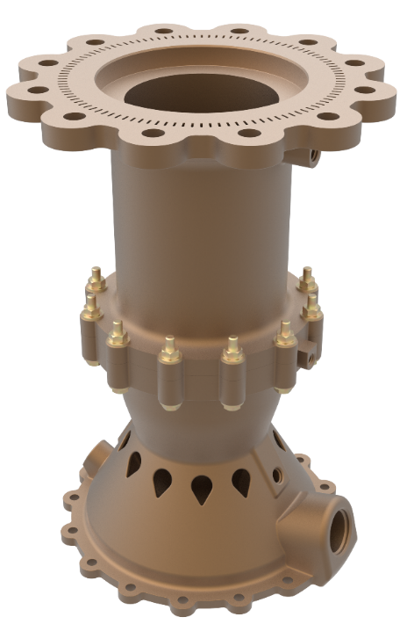
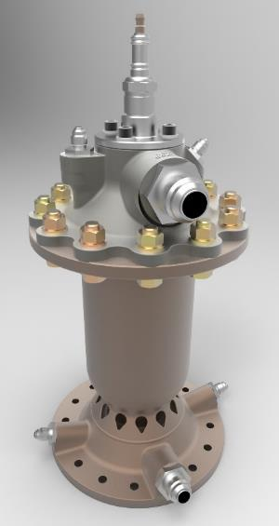
NASA-MSFC Regen LOX/Methane Hardware Assemblies
META4
Methane Engine Thrust Assembly
for 4K lb_{f}
META4x4
META4 w/
4” I.D. Chamber
MET1
Methane Engine Thruster
for 1K lb_{f}
8/29/18
SEG/ER36
2 of 17

Slide 3
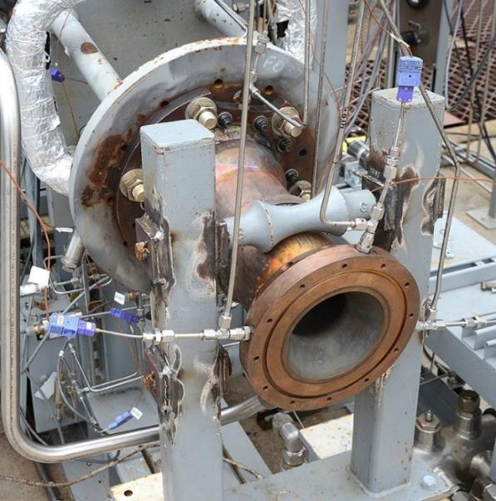
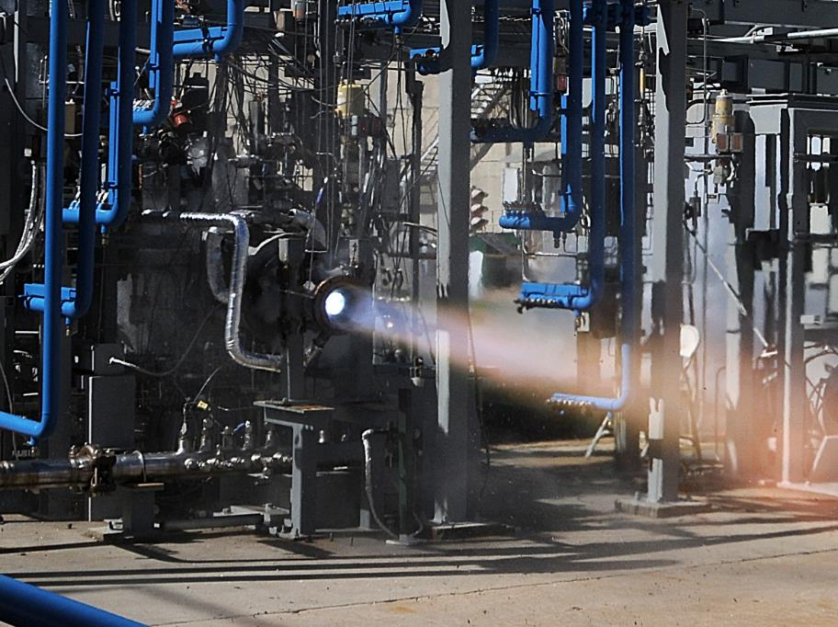
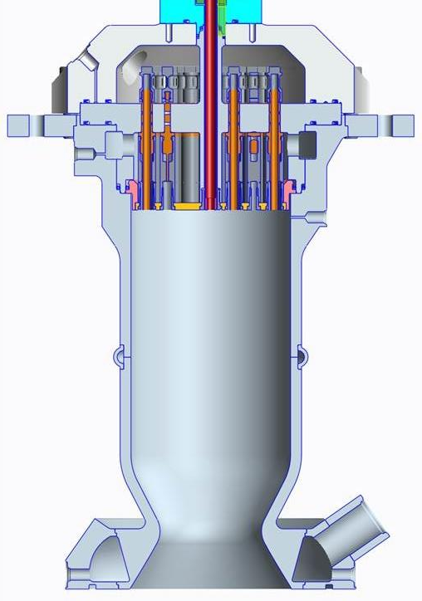
META4 #1 Successfully Tested in March 2017
Swirl Coax Injector
AM (SLM) Regen Cooled GRCop-84 Chamber
Φ5.66”
P_{c} ~ 300 psig
16.3”
Even at high MR,
chamber remained well cooled
- GRCop-84 works well with SLM &
offers lots of thermal margin
Φ3.50”
8/29/18
SEG/ER36
3 of 17

Slide 4
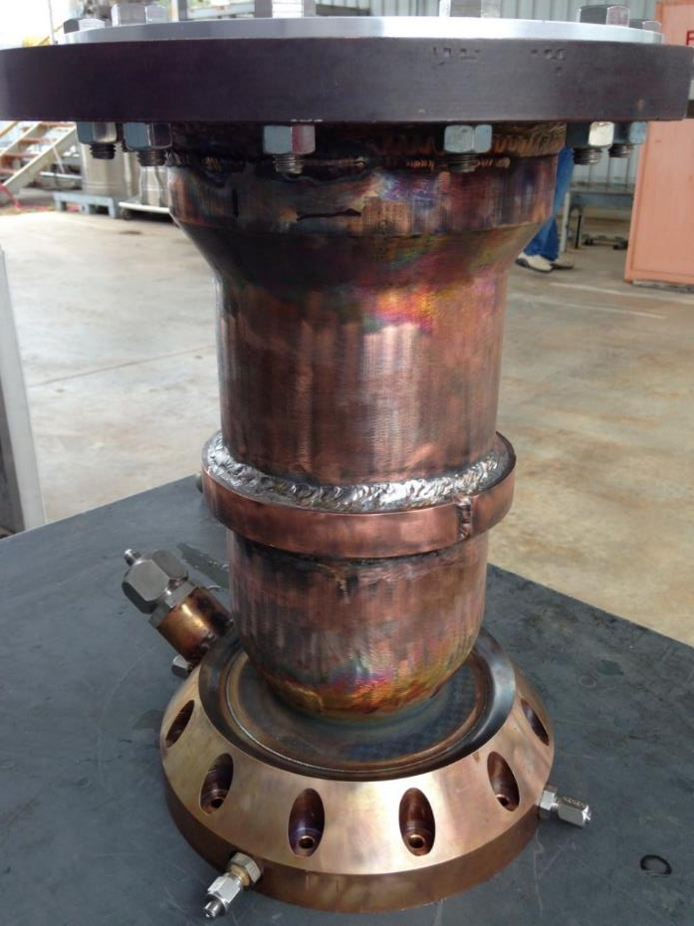
META4 Chamber #2/#3 vs #1
Unit #1
Separate fuel manifold
designed for #2/#3…
easier assembly +
eliminated 2 forward end welds
Unit #2
Mid-section redesigned
w/bolted interface
- eliminated 5 welds
for crossover joint
- provides flexible design;
same chamber barrel
can be used w/other
throat sections
Instrumentation
added to critical locations
8/29/18
SEG/ER36
5 of 17

Slide 5
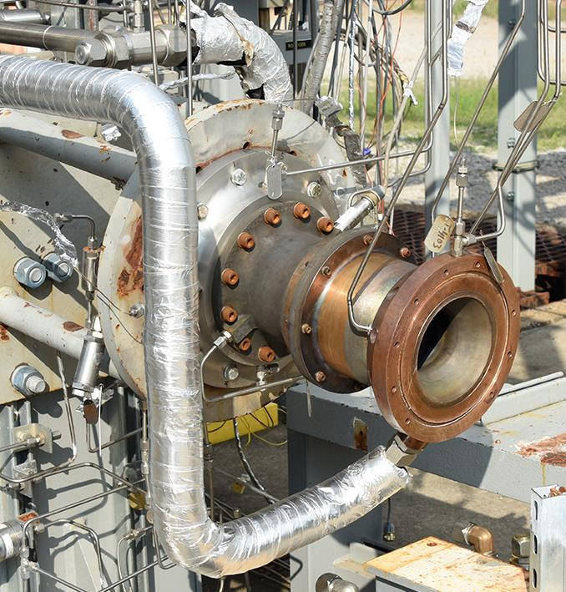
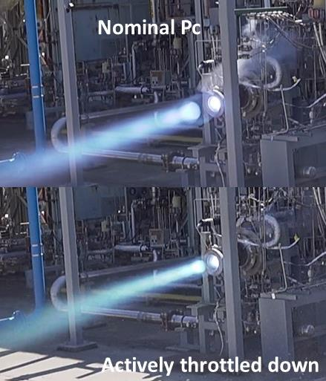
META4 #2 Hot-fire Testing in March 2018
META4 #3 Hot-fire Testing in July 2018
Pc’s ~ 265-375 psig
Actively throttled to 130 psig
MR’s = 2.7-3.8
C* efficiency = 95-100%
Thrust = 1740-5515 lb_{f}
Subcritical fuel flow
remained stable even
w/active throttling
Chamber ΔP:
50% lower than META4 #1
8/29/18
SEG/ER36
6 of 17

Slide 6
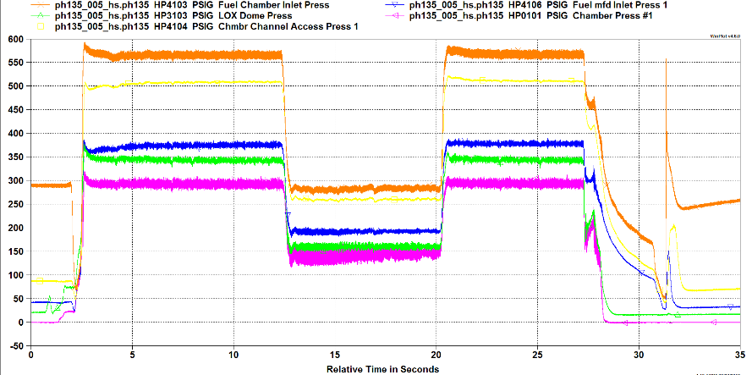
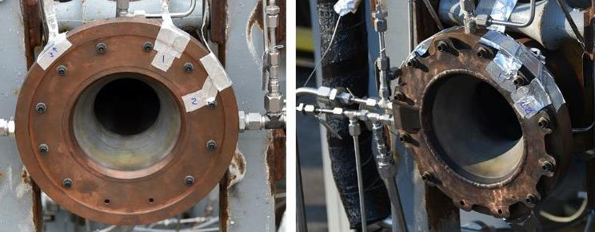
META4 #2 Hot-fire Testing in March 2018
No oscillations observed
on the fuel side,
even with
subcritical coolant phase change.
Potential chug mode – still under investigation
Similar observation for META4 #3 testing
Two Helium Cooled Heat Exchangers
(developed w/NASA-JSC) also demonstrated…
1 – AM design,
1 – Machined/welded design
Both performed well
8/29/18
SEG/ER36
7 of 17

Slide 7
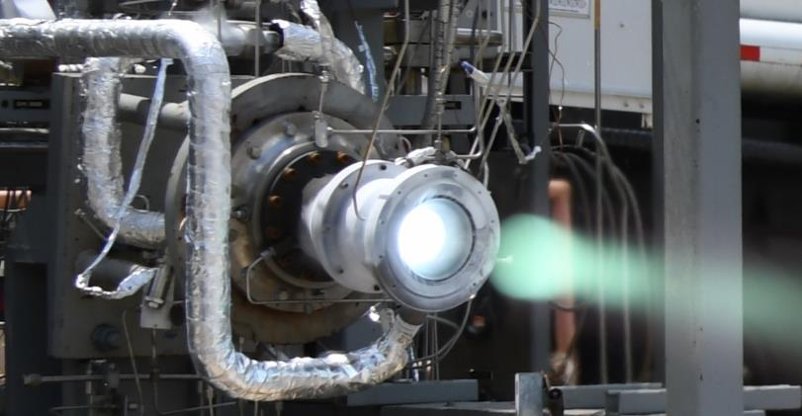
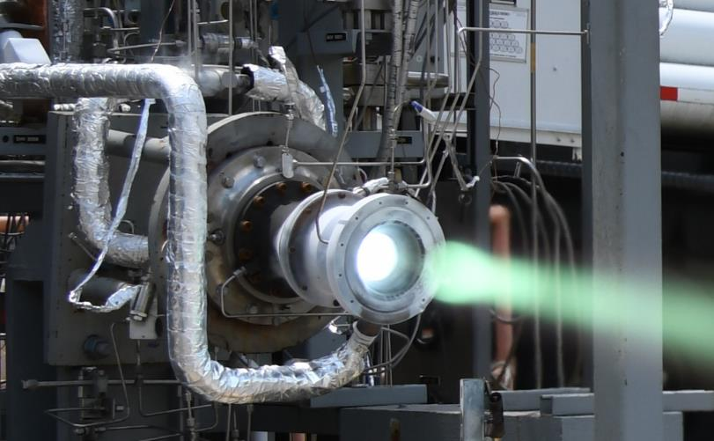
META4 #2 Hot-fire Tested with LOX/LH2
August 2018
No changes made to injector or chamber hardware prior to testing with LH2…
Pc’s ~ 155-294 psig
Actively throttled to Pc = 92 psig
MR’s = 5.4-7.6
C* efficiency = 100%
Thrust = 1266-4050 lb_{f}
Fuel flow remained stable
even w/active throttling
Ignition: TEA/TEB
Facility leak prevented higher Pc’s
from being attempted
Nominal Pc
Results Showed Versatility
of META4 Design
Actively
Throttled Down
8/29/18
SEG/ER36
8 of 17

Slide 8
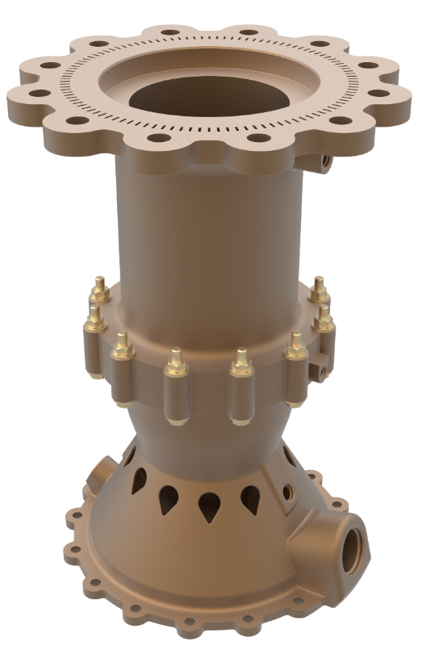
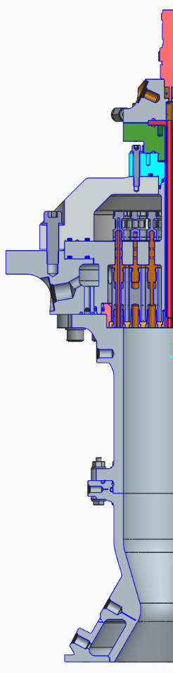
META“4x4” – Same Thrust, Smaller Package
Similar Design to META4
P_{c} ~ 435 psig, nominal
Conceived, designed, fabricated &
hot-fire tested in 10 months
Initial testing…
META4 Injector
w/outer element row blocked
Optimum, lightweight AM injector being
designed based on initial test results
Φ4.00”
Aft end designed for nozzle extensions
Chamber sections
printed @ Arctic Slope
Technical Services (ASTS)
Φ2.50”
8/29/18
SEG/ER36
9 of 17

Slide 9
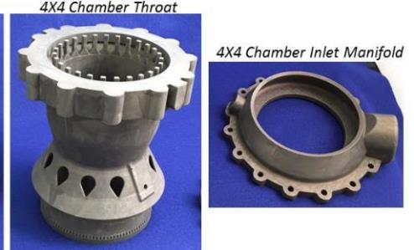
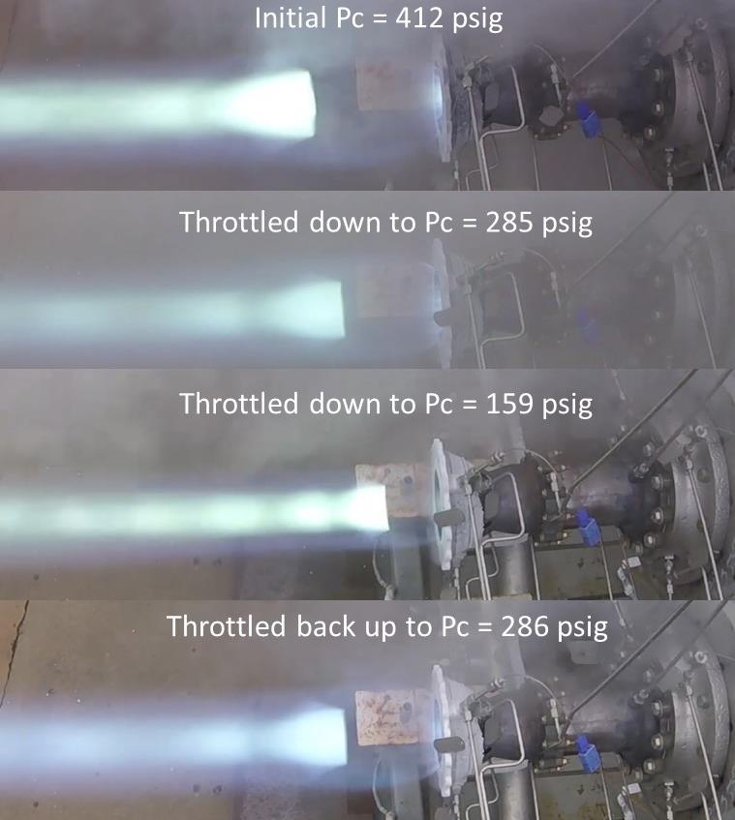
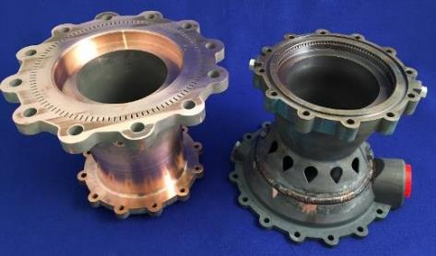
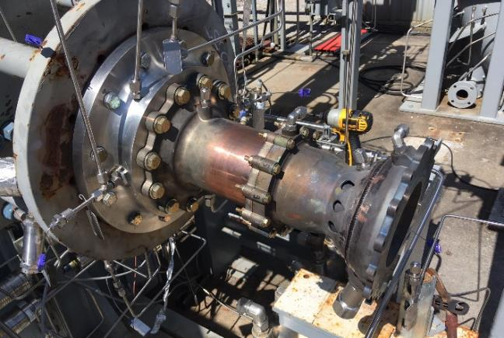
META“4x4” Hot-Fire Tested May 2018
AM parts
from ASTS
Welding/
Machining
@ MSFC
Pc = 159-453 psig,
MR = 2.7-5.3
High performance
(nominal η_{C*} ~ 98.5%)
Stable combustion
Active throttling demonstrated
8/29/18
SEG/ER36
10 of 17

Slide 10
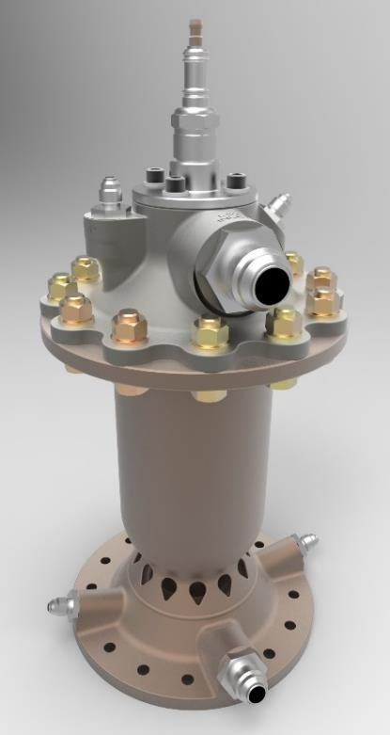
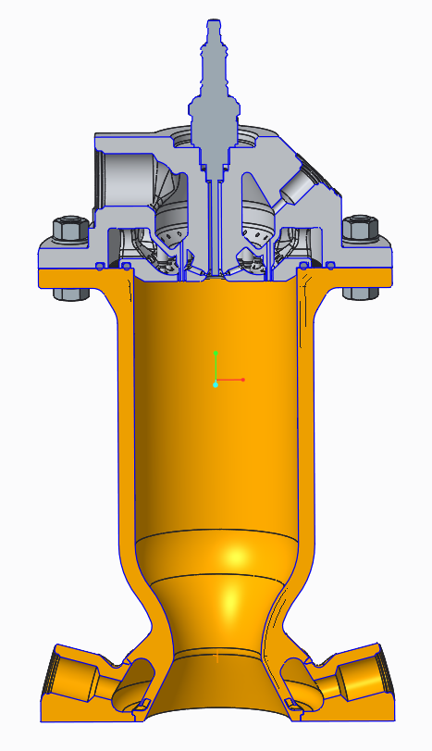
MET1 – Methane Engine Thruster for 1K lb_{f}
Small package for lower thrust or clustered for higher thrust…
Direct Spark
Igniter
AM Inco718
shear coaxial
injector
(printed
@ MSFC);
spark igniter
Pc ~
300 psia
Thrust (SL) =
500-1500 lb_{f}
10.7”
D_{c} = 3.0”
D_{t} = 1.6”
Aft end
accommodates
nozzle extensions
Regen Cooled AM
GRCop-84 chamber
printed @ MSFC
8/29/18
SEG/ER36
11 of 17

Slide 11
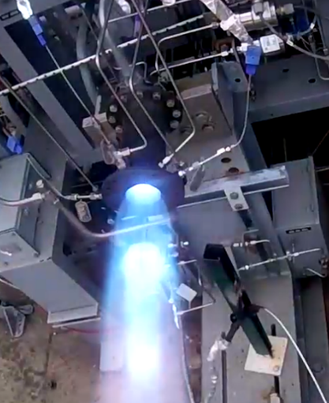
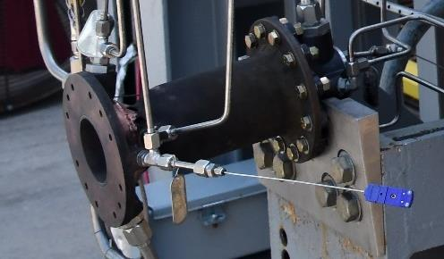
MET1 – Unit #1 Hot-fire Tested September 2017
Conceived, designed, fabricated, & hot-fire tested in less than 1 year
7 Mainstage Tests
Pc ~ 280-330 psig
MR ~ 1.7 – 3.4
Successful spark ignition even
with initial MR ~ 1.0
Easy ignition, smooth transition to mainstage
No instabilities observed
Performance - lower than desired…
8/29/18
SEG/ER36
12 of 17

Slide 12
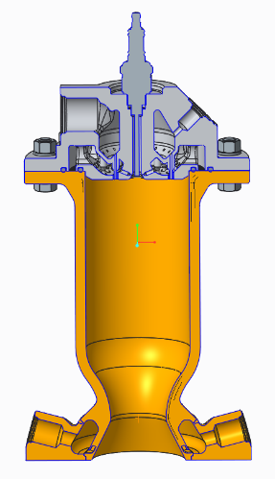

MET1 Modified Hardware - Available in 2018
Objective of Design Mods:
increase performance
w/enhanced mixing &
chamber that absorbs more heat
Testing planned on new assemblies:
Injector w/higher element density
+ 3 new chambers
+ separate GRCop-84 chamber
spool section, if necessary
MET1-A Injector,
50 elements
(vs 32 for unit #1)
Boundary layer cooling holes eliminated
Testing scheduled
in late 2018
MET1-A
Slightly longer;
More instrumentation
MET1-B
Same as MET1-A,
but modified channels
MET1-C
Same as MET1-A,
but scalloped hot wall for
additional heat pick-up
8/29/18
SEG/ER36
13 of 17

Slide 13
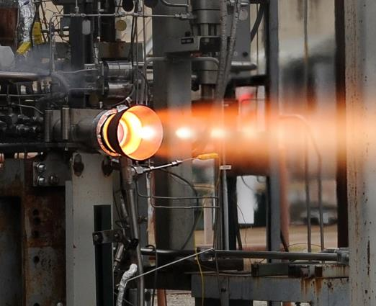
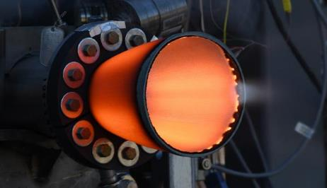
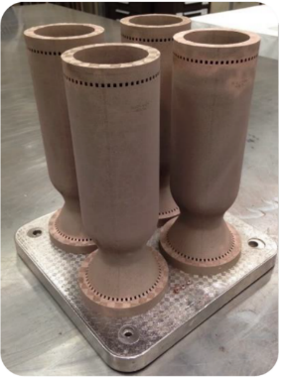
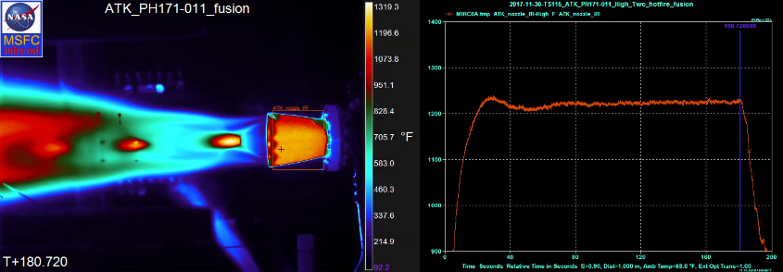
Subscale Nozzle Testing with LOX/CH4
MSFC’s Low Cost Subscale Nozzle Test Rig
Used since 2015 to screen subscale nozzle designs with LOX/H2 (1500 lb_{f} thrust)
New AM LOX/LCH4
impinging injector
fabricated in early 2018
Test rig will screen
specific carbon/carbon
options in Sept 2018
LOX/H2 subscale nozzle testing at
MSFC w/AM coaxial injector
Support hardware:
water cooled AM GRCop-84/-42 chambers
8/29/18
SEG/ER36
14 of 17

Slide 14
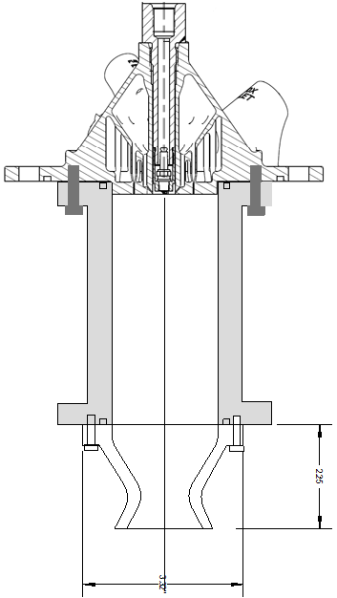
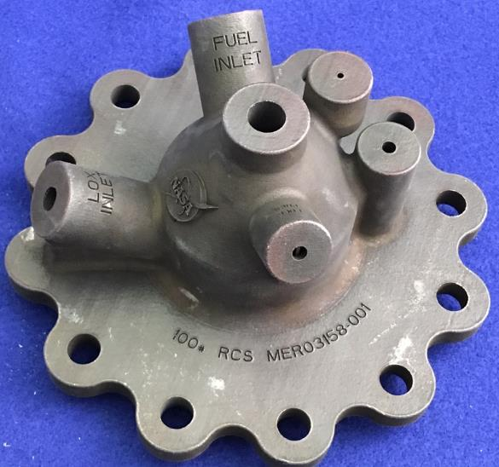
100 lb_{f} LOX/LCH4 RCS Thruster/Test Rig
3D printed
Impinging Injector
Simple spark igniter
Modular Assembly:
to evaluate
multiple nozzle
materials
(e.g., refractory metals
+ coatings
Vendors: TBD
Close coupled
valves (not shown)
Testing planned late
2018/early 2019
Previous GOX/GCH4
100# RCS thruster
8/29/18
SEG/ER36
15 of 17

Slide 15
Summary
MSFC has a variety of LOX/Methane Components
for In-Space Applications
- Versatile Designs
▪ Features Scale to Different Thrust Levels
▪ No Issue for Subcritical Regen Cooling w/Methane
▪ Demonstrated Compatibility with LOX/H2
▪ 100-7000 lb_{f} Thrust Levels
- AM: Easy Fabrication & Quick Turnarounds
- High Performance, Easy Ignition, Active Throttling
- Components are being further optimized for potential
engine weight requirements.
8/29/18
SEG/ER36
16 of 17

Slide 16
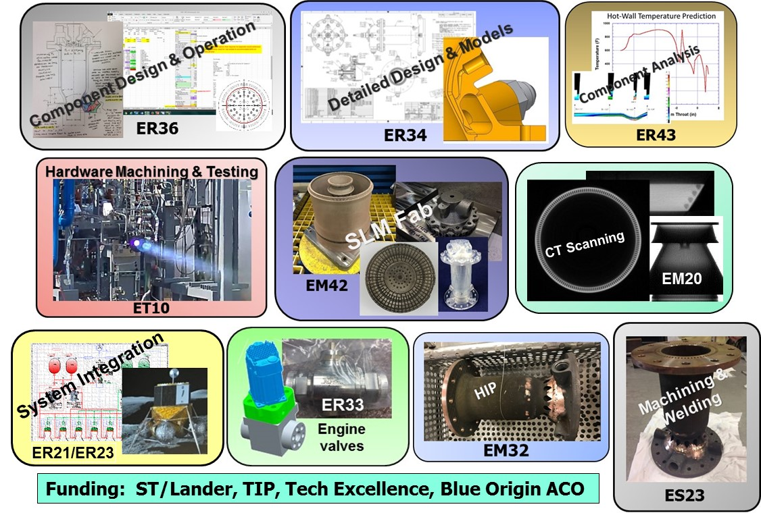
MSFC LOX/CH4 Team
8/29/18
SEG/ER36
17 of 17

