Slide 1
Aqua Spring 2021 IAM Series Results
May 17 – May 20, 2021
Brian Woodson Jr, Pearl River Technologies
EOS FDS, gsfc-eos-fds@eoc.ecs.nasa.gov, +1.301.614.5050
Notes:
4

Slide 2
Agenda
Aqua Spring 2021 Inclination Adjust Maneuver (IAM) Campaign
  Series Summary
  Maneuver Results
  Post-Spring 2021 IAM Mean Local Time (MLT) Evolution
Aqua’s IAM Performance Trends
Aqua’s Recent IAM Performance
Summary

Slide 3
Aqua Spring 2021 Series Summary
This was Aqua’s final IAM Series
Aqua performed 4 IAMs, #74-77, on February 25th, March 4th, March 11th, and March 18th.
The first IAM used a 200-second burn duration with the following 3 using the 560-second burn duration set in 2018
  Keeps Aqua within the “mission goal” MLT constraints.
Aqua continued to use the Reaction Wheel Assembly (RWA) to slew for each maneuver.
  Results from 2020 RWA-slewed IAMs were used in predictions.
The total IAM series performance was 2.172% cold

Slide 4
Aqua Spring 2021 Series Results
IAM# | Date | Commanded Yaw (deg) | Achieved Yaw (deg) |  | Delta Velocity (m/s) |  | Delta Inclination (deg) |  | Delta RAAN*
 |  |  | Predicted | Definitive | Predicted | Definitive | Predicted | Definitive | Predicted | Definitive
74 | Feb 25 | -78.92 | -78.0449 | -78.4630 | 0.2866 | 0.2797 | -0.002172 | -0.002115 | 0.00000 | 0.00007
75 | Mar 4 | -78.83 | -77.9549 | -77.9653 | 0.8015 | 0.7897 | -0.005943 | -0.005875 | 0.00078 | 0.00074
76 | Mar 11 | -78.83 | -77.9562 | -78.0204 | 0.7957 | 0.777 | -0.005933 | -0.005790 | 0.00047 | 0.00044
77 | Mar 18 | -78.81 | -77.9433 | -77.9434 | 0.7946 | 0.7793 | -0.005942 | -0.005815 | 0.00016 | 0.00006
*Right Ascension of the Ascending Node (RAAN) |  |  |  |  |  |  | Total: | -0.019595 | Total: | 0.00131
 |  |  |  |  |  |  | %Error | 2.172 (Cold)
Final % Error based on pre-series predicted total inclination change (-0.02003 deg)
Mid-series planning slightly changed total predicted delta inclination from the pre-series plan to -0.019990 deg, with respect to which the series was 1.98% COLD

Slide 5
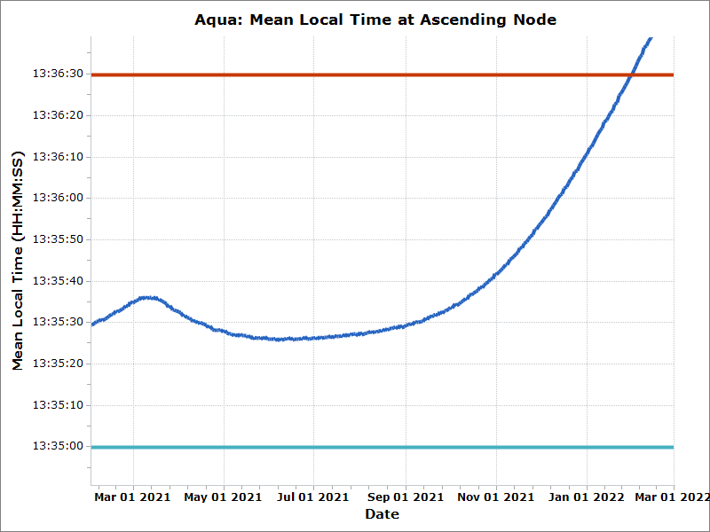
Aqua post-2021 Series Predicted MLT
Operational Upper Limit (13:36:30)
The achieved MLT rate changes will maintain Aqua within operational MLT requirements until CEMs and PLMs in January 2022; delta-I performance matched predictions closely.
Jan 30
2022
Spring 2021 IAM Series
CEMs begin Jan 04 2022
Operational Lower Limit (13:35:00)

Slide 6
Aqua Spring 2021 Performance Trends
Aqua continued using the Reaction Wheel Assembly (RWA) when slewing for the Spring 2021 IAM series.
  RWA slews allow the spacecraft to center burns on the node for all IAMs in the series and save fuel when slewing, increasing fuel efficiency.
Aqua’s series performance continued to follow RWA-slewed IAM trends
  IAM #74 was excluded from trending due to out-of-family performance caused by its significantly shorter burn duration (200 sec) than the following burns (each at 560 sec)
The roll and pitch attitude errors during the burn have continued the trend of previous maneuvers

Slide 7
Aqua’s IAM Performance (1/2)
RWA IAMs
Observed roll & pitch errors and calibrated yaw offset are all consistent with previous RWA IAMs. IAM#74’s spike in yaw and pitch offsets is out-of-family due to the short burn duration (200 sec).
IAM #74
Spring 2021 Series
RWA-slewed IAMs have two values for yaw offset: The yaw error from telemetry (gray) and the calibrated yaw (red). The calibrated yaw is the angle necessary to achieve the observed ΔSMA.

Slide 8
Aqua’s IAM Performance (2/2)
RWA IAMs
Spring 2021 Series
ΔINC efficiency is consistent with previous RWA IAMs.

Slide 9
Summary
This was Aqua’s final IAM series
Aqua continued to use the Reaction Wheel Assembly to slew to the necessary attitude for IAMs #71-74
Aqua’s IAM performance continued to follow the trends of previous RWA IAMs
Aqua’s maneuver performance for the 2021 Spring IAM series was 1.98% Cold, based on B-1 planning predictions (-0.01999 deg)
Aqua is predicted to remain within the “mission goal” MLT constraints through CEMs in January 2022

