Slide 1

Assessing GOES-16 cloud products using ICICLE aircraft observations
Zhujun Li, William L. Smith Jr., and Douglas Spangenberg
NASA LaRC, Hampton VA USA

Slide 2
Motivation
Satellite cloud retrievals are a critical dataset for supporting aviation activities and provide icing threat warning.
Satellite cloud retrieval evaluation is challenging due to the lack of in-situ observations over CONUS.
ICICLE provides an unprecedented dataset to assess satellite observations.
In this study, we evaluate:
  A satellite-based cloud product that provide probability of icing threat.
  Satellite cloud retrievals from GOES-16: microphysics, cloud height and liquid water path.
  A novel nighttime cloud product determined using a machine learning technique.

Slide 3
Data

Slide 4
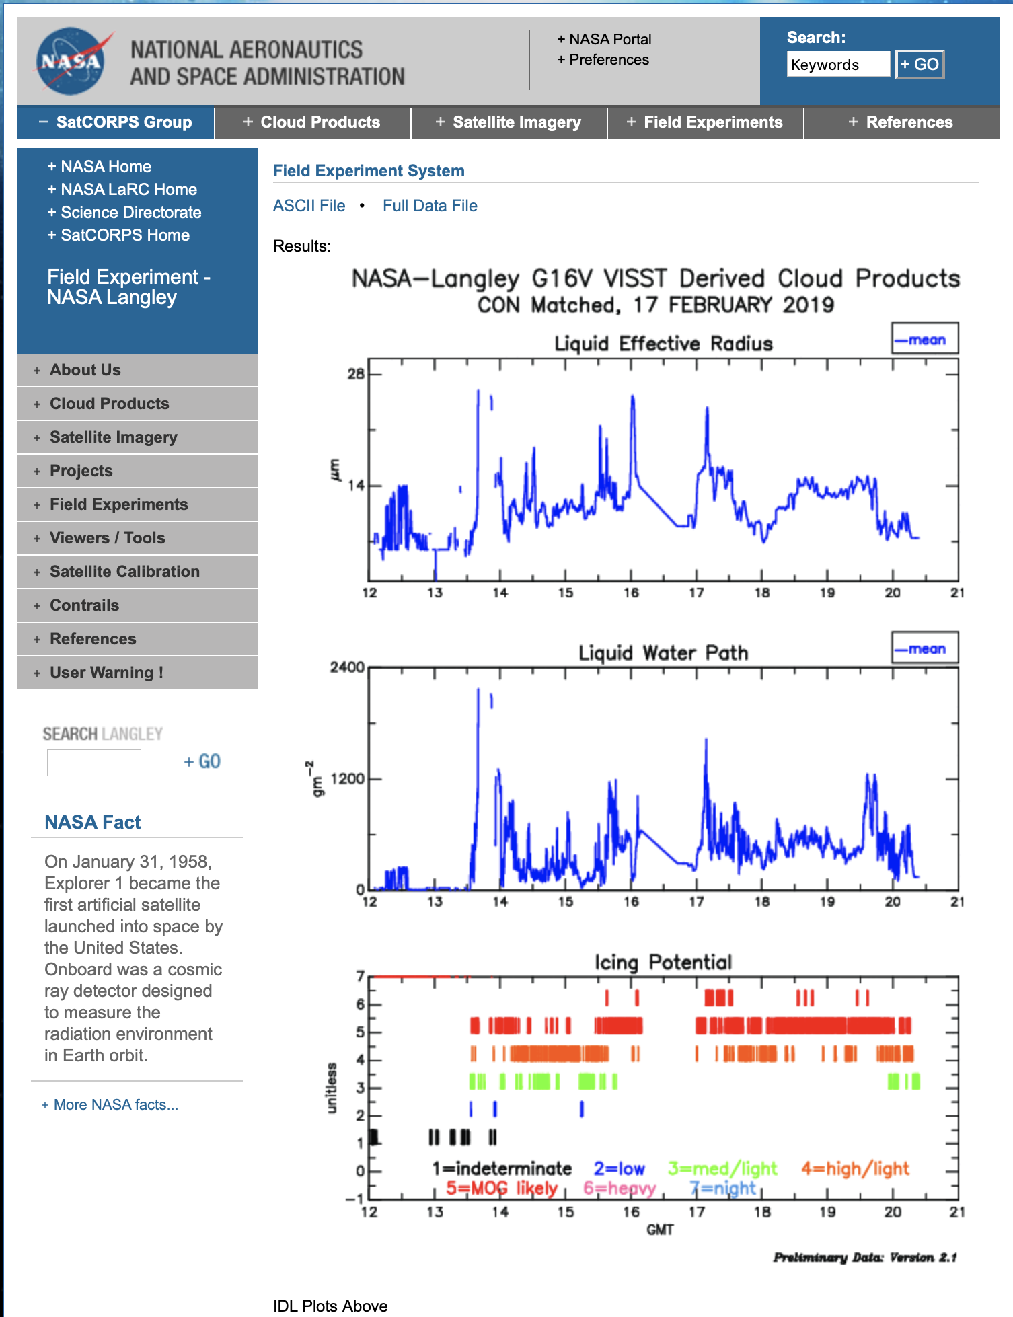
Along-track GOES-16 data
Geostationary cloud retrievals are produced every 20-min, and available at SatCORPS’ site. https://satcorps.larc.nasa.gov/ICICLE-2019
Icing threat , cloud phase, effective radius, optical depth, water path, top height, etc.
Satellite-aircraft collocation
Nearest 4 pixels along the aircraft track. Satellite data is weighted-averaged according to their distance to the aircraft track.
Satellite-aircraft temporal mismatch < 13-min
GOES-16 data is parallax-corrected
Convair track
oo
oo
oo
oo
oo
oo
oo
oo
4-pixel means

Slide 5
ICICLE in-situ data
Parameter | Sensor | Data | Rference
Flight altitude | GPS | NRC | Bala et al. 2020
Air temperature | Rosemount Temperature Sensor | NRC | Bala et al. 2020
Liquid water content | Nevzorov 1 | ECCC | Korolev et. al. 2020
Cloud particle size distribution | Composite from FSSP, OAP-2DC and HVPS | ECCC&NRC | Korolev et. al. 2020
Icing | Rosemount icing detector | ECCC&NRC | Korolev et. al. 2020
LWP | G-Band water vapor radiometer | ECCC | Bliankinshtein et al. 2020

Slide 6
Icing comparison (daytime only )

Slide 7
Icing condition comparison
GOES-16 icing threat determined from the Satellite ClOud and Radiation Property retrieval System (SatCORPS) icing algorithm (Smith et al., 2012; Smith 2014)
  Identify possible supercooled liquid water layer, the top and base of the layer
  Determining bulk index for icing threat probability and intensity:
    No icing: No icing; Indeterminate;
    Icing: Low; Med/light; High/light; moderate or greater (MOG) likely; Heavy;
    Night
Daytime only (solar zenith angle < 82° )

Slide 8
Icing comparison method
 | GOES-16 icing threat
In-situ icing | Yes | No
Yes | A | C
No | B | D
Probability of detection:
  Icing : A/(A+C); No icing : D/(B+D)
Accuracy: (A+D)/(A+B+C+D)
False alarm rate : B/(A+B)

Slide 9
Icing comparison for individual point
Match the nearest 1-sec resolution in-situ measurement to the GOES-16 along track data
In-situ “icing” is identified as T_{air} < 0 °C and LWC > 0.01 g m⁻³
 | GOES-16 icing threat
In-situ icing | Yes | No
Yes | 4268 | 322
No | 6238 | 2779
Probability of detecting icing: 93%
Probability of detecting no icing: 31%
Accuracy : 52%
False alarm rate: 59%
Satellite icing threat is determined for the identified supercooled liquid water layer, 80% of the 9017 in-situ “no icing” cases correspond to flight altitude outside of the GOES-16 identified icing boundaries

Slide 10
Flight ascent/descent segment for icing comparison
Identify flight segments corresponding to the deepest possible vertical profile, using each segment as one sample case for the comparison
1) apply a Savitzky–Golayfilter with a 1-hour window to the time series of the flight altitude
2) identify continuous ascent or descent segments of flight time based on the smoothed time series of altitude from step 1)

Slide 11
Identified flight segments
In total 312 segments are identified during 23 of the ICICLE flights
263 segments occurred during daytime
An example shows 8 segments identified during Flight #12 (Feb. 12)
1
2
4
5
3
6
7
8
Date | 1/18 | 1/27 | 1/28 | 1/29 | 1/31 | 2/4 | 2/6 | 2/6 | 2/7 | 2/8 | 2/11 | 2/12 | 2/12 | 2./14 | 2/15
Flight# | 1 | 2 | 3 | 4 | 5 | 6 | 7 | 8 | 9 | 10 | 11 | 12 | 13 | 14 | 15
#of segments |  |  | 7 | 6 | 12 |  |  | 15 | 11 | 3 | 11 | 8 | 7 | 18 | 9
Date | 2/15 | 2/17 | 2/17 | 2/22 | 2/23 | 2/24 | 2/24 | 2/26 | 2/26 | 2/28 | 3/2 | 3/2 | 3/5 | 3/7 | 3/8
Flight# | 16 | 17 | 18 | 19 | 20 | 21 | 22 | 23 | 24 | 25 | 26 | 27 | 28 | 29 | 30
#of segments |  | 24 | 20 | 26 | 11 |  | 9 | 12 | 17 | 18 | 13 | 12 | 23 | 20

Slide 12
GOES-16 vs in-situ icing for flight segments
GOES-16 icing: most common icing threat index during the segment
In-situ icing: the maximum supercooled liquid water content > 0.01 g m⁻³
 | GOES-16 icing threat
In-situ icing | Yes | No
Yes | 186 | 30
No | 13 | 34
Probability of detecting icing: 86% (liquid top 94%; ice top 73%)
Probability of detecting no icing: 72%
Accuracy : 83%
False alarm rate: 7%

Slide 13
GOES-16 vs Rosemount icing detector for flight segments
 | GOES-16 icing threat
In-situ icing | Yes | No
Yes | 155 | 16
No | 44 | 48
De-icing cycle dead time
Probability of detecting icing: 90%
Probability of detecting no icing: 52%
Accuracy : 77%
False alarm rate: 22%
The detection of “no icing” by the RID is less reliable due to sensitivity limits in some low LWC conditions and/or at warmer supercooled temperatures.

Slide 14
GOES-16 icing threat category for flight segments as grouped by the maximum supercooled LWC of each segment
Less light and more MOG and heavy icing estimates from satellite as the maximum supercooled LWC increases.

Slide 15
Icing comparison with PIREP
GOES-16 parallax-corrected pixels surrounding the aircraft reported location are used to derive mean values and dominant icing index. Center of each GOES-16 pixel must be inside the circle. Allowed maximum time difference: 13-min
ooooooooooooo
ooooooooooooo
ooooooooooooo
ooooooooooooo
ooooooooooooo
ooooooooooooo
GOES-16 pixel field
oooooo
ooooooooo
ooooooooo
ooooooo
Convair location
X
20-km radius
For 42 daytime events GOES-16 identifies icing in 38 of them (91%).
For “light” PIREP, satellite analysis indicated light icing 73% and MOG icing 20% of the time.
For higher PIREPS severities, the satellite indicated light icing 39%, MOG and Heavy icing 61% of the time.

Slide 16
GOES-16 effective radius and the occurrence of Supercooled large droplets (SLD) (D > 50 µm)
Convair track
50-sec segment for in-situ observation
GOES-16 along-track r_{e}
# conc of SLD >0
# conc of SLD / total # conc > 0.1%
9.2 μm
14.4 μm
10.7 μm
13 μm

Slide 17
Cloud properties comparison (daytime only)

Slide 18
Identify cloud profiles for comparison on cloud properties
Identify cloud profiles and cloud tops from the in-situ data to better compare with satellite observation
Find flight segments with continuous ascent/descent
Identify cloudy points with LWC > 0.01 g m⁻³
Determine the cloud top (at least 200 m away from the highest non-cloudy point)
Identify cloud layers with two cloudy points within the same layer less than 100 m in altitude
Use only cloud profiles with top cloud layer optical depth larger than 1
Top layer
54 cloudy profiles, 42 occurred during daytime
Date | 1/18 | 1/27 | 1/28 | 1/29 | 1/31 | 2/4 | 2/6 | 2/6 | 2/7 | 2/8 | 2/11 | 2/12 | 2/12 | 2./14 | 2/15
Flight# | 1 | 2 | 3 | 4 | 5 | 6 | 7 | 8 | 9 | 10 | 11 | 12 | 13 | 14 | 15
#of segments |  |  | 4 |  | 3 |  |  | 3 | 2 |  |  | 2 | 2 | 1 | 3
Date | 2/15 | 2/17 | 2/17 | 2/22 | 2/23 | 2/24 | 2/24 | 2/26 | 2/26 | 2/28 | 3/2 | 3/2 | 3/5 | 3/7 | 3/8
Flight# | 16 | 17 | 18 | 19 | 20 | 21 | 22 | 23 | 24 | 25 | 26 | 27 | 28 | 29 | 30
#of segments |  | 7 | 5 | 7 | 1 |  | 1 |  | 1 | 2 | 3 | 4 | 2 | 1

Slide 19
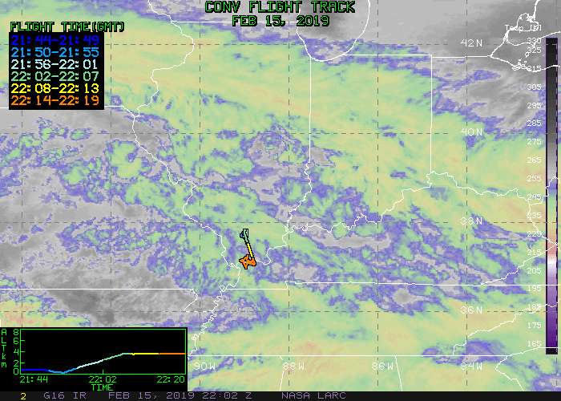
Cloud top temperature
Large difference in cloud top temperature between GOES-16 and in-situ may indicate that the two datasets are detecting different cloud tops
We focus on cloudy profile with cloud top temperature difference < 4 ℃ (22 profiles)

Slide 20
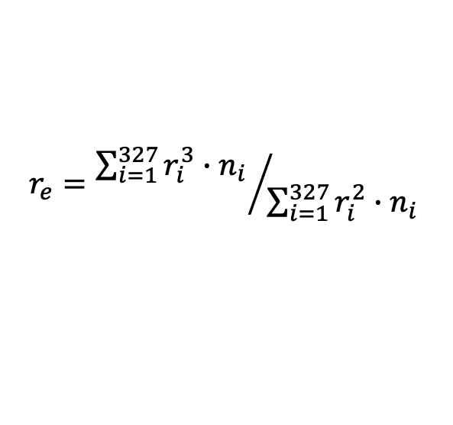
Cloud top effective droplet radius
$$r_{e}={\sum_{i=1}^{327}{r_{i}^{3}}∙n_{i} }/{\sum_{i=1}^{327}{r_{i}^{2}}∙n_{i}}$$
Exclude the cases with scattering angle larger than 160 degree.

Slide 21
Cloud top height
Possible causes for the bias:
Spatial heterogeneity, time/space mismatches
The height assignment approach that uses temperature profiles from model analyses in the vicinity of boundary layer inversions.

Slide 22
GOES-16 LWP vs vertically integrated LWC of cloudy profiles
GOES-16 LWP=5/9 * r_{e} * Optical Depth
If remove the re bias of 3.58 μm: r=0.47, diff=79 m

Slide 23
GOES-16 LWP vs GVR LWP
GVR LWP:
Only ”good data”
Averaged over 60 sec centered at each GOES-16 along-track mean
10 g m⁻²<LWP<500 g m⁻², to exclude clear air and instrument saturation
Airplane pitch and roll less than 5 degree
Airplane altitude less than 1 km
If remove the re bias of 3.58 μm: r=0.27, diff=98 m
The heterogeneity of the cloud field, time/space mismatch of the along-track GOES-16 data contribute to the bias
We note that GVR LWP is also prone uncertainties: precipitation, signal saturation, algorithm assumptions. A better understanding of the GVR uncertainties is needed before interpreting these results.

Slide 24
Nighttime icing comparison
Producing nighttime icing threat is challenging due to the lack of visible information.
We are currently implementing a new method for deriving nighttime icing threat based on a KDTree algorithm.

Slide 25
Nighttime GOES-16 and in-situ icing comparison for flight segments with updated GOES-16 cloud product
The probability of GOES-16 detecting nighttime icing increases from 34% to 66%
Replace “night” icing category with the same daytime categories
Need more data to better evaluate the quality of nighttime icing intensity categorization
 | GOES-16 icing threat
 | Old | New | Old | New
In-situ icing | Yes |  | No
Yes | 16 | 31 | 31 | 16
No | 0 | 1 | 2 | 1
OLD
NEW

Slide 26
Summary
The GOES-16 icing threat product is capable of detecting icing in 86% of the in-situ icing condition, and 72% of in-situ no icing condition
The probability of GOES-16 detecting icing is higher in liquid water cloud top (94%) than ice cloud top (73%)
The good icing detection rate is confirmed by GOES-16 comparison with RID signals (90%)
The GOES-16 effective r_{e} is to some extend a good indication of the occurrence of SLD
The cloud top r_{e} is well correlated between the satellite and in-situ observation, despite significant positive bias from satellite
The updated GOES-16 cloud products include nighttime icing threat with the same icing intensity categorization as the daytime product, that compares significantly better with the in-situ observation than the previous version,

Slide 27
Discussion
The limitations of matching satellite and aircraft observations, the inherent sampling differences, and uncertainties in the satellite algorithms all contribute to the discrepancies between the two datasets
The discrepancies are especially significant in some of the cloud property comparisons, such as cloud top height and LWP. LWP is a more difficult parameter to evaluate using the current data.
Further investigation is required to better discern the causes for the discrepancies

Slide 28
References
Bala, K., et al., 2020: NRC Convair 580 Aircraft State Parameters. Version 1.0. UCAR/NCAR - Earth Observing Laboratory. https://doi.org/10.26023/PCSX-97D8-4S0Y.
Bliankinshtein, N., Wolde, M. 2020. NRC Convair-580 GVR (G-band radiometer) Data. Version 1.0. UCAR/NCAR - Earth Observing Laboratory. https://doi.org/10.26023/G2DD-1QG8-4B14.
Korolev, A., Heckman, I., 2020: NRC Convair 580 Bulk Parameters. Version 0.4 [PRELIMINARY]. UCAR/NCAR - Earth Observing Laboratory https://data.eol.ucar.edu/dataset/570.045.
Minnis, P., S. Sun-Mack, Y. Chen, F.-L. Chang, C. R. Yost, W. L. Smith, Jr., P. W. Heck, R. F. Arduini, S. Bedka, Y.Yi, G. Hong, Z. Jin, D. Painemal, R. Palikonda, B. Scarino, D. A. Spangenberg, R. Smith, Q. Z. Trepte, P. Yang, and Y. Xie, 2020: CERES MODIS cloud product retrievals for Edition 4, Part 1: Algorithm changes. IEEE Trans. Geosci. Remote Sens., doi: 10.1109/TGRS.2020.3008866.
Smith, W.L., Minnis P., Fleeger C., Spangenberg D., Palikonda R., and Nguyen L., 2012: Determining the flight icing threat to aircraft with single-layer cloud parameters derived from operational satellite data. J. Appl. Meteor. Climatol., 51, 1794–1810, doi:10.1175/JAMC-D-12-057.1.
Smith, W. L., Jr, 2014: 4-D cloud properties from passive satellite data and applications to resolve the flight icing threat to aircraft. PhD Dissertation, University of Wisconsin-Madison, 165 pp.

