Slide 1



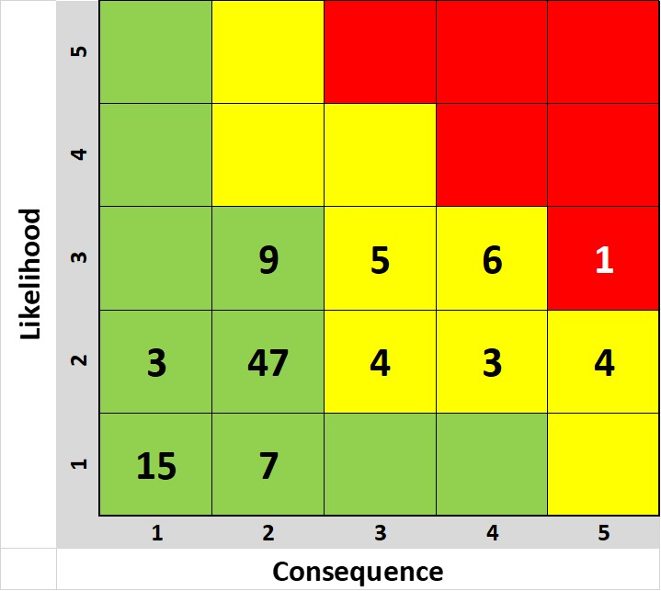
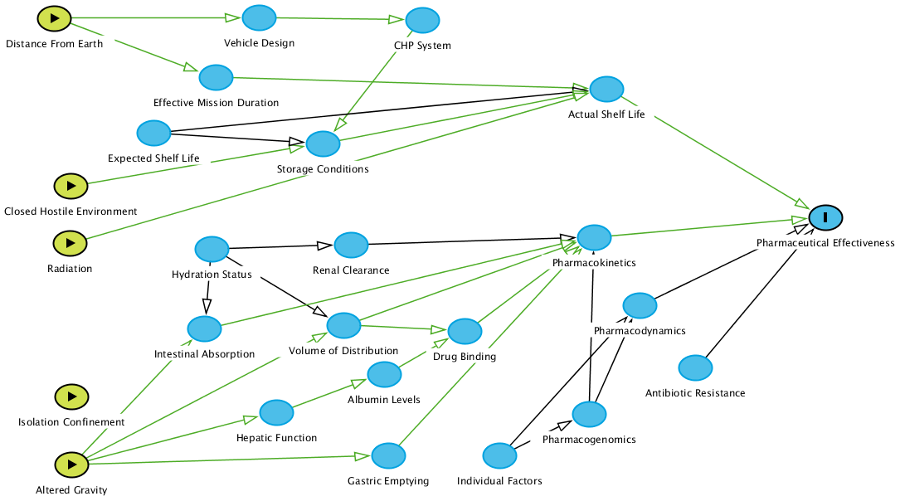
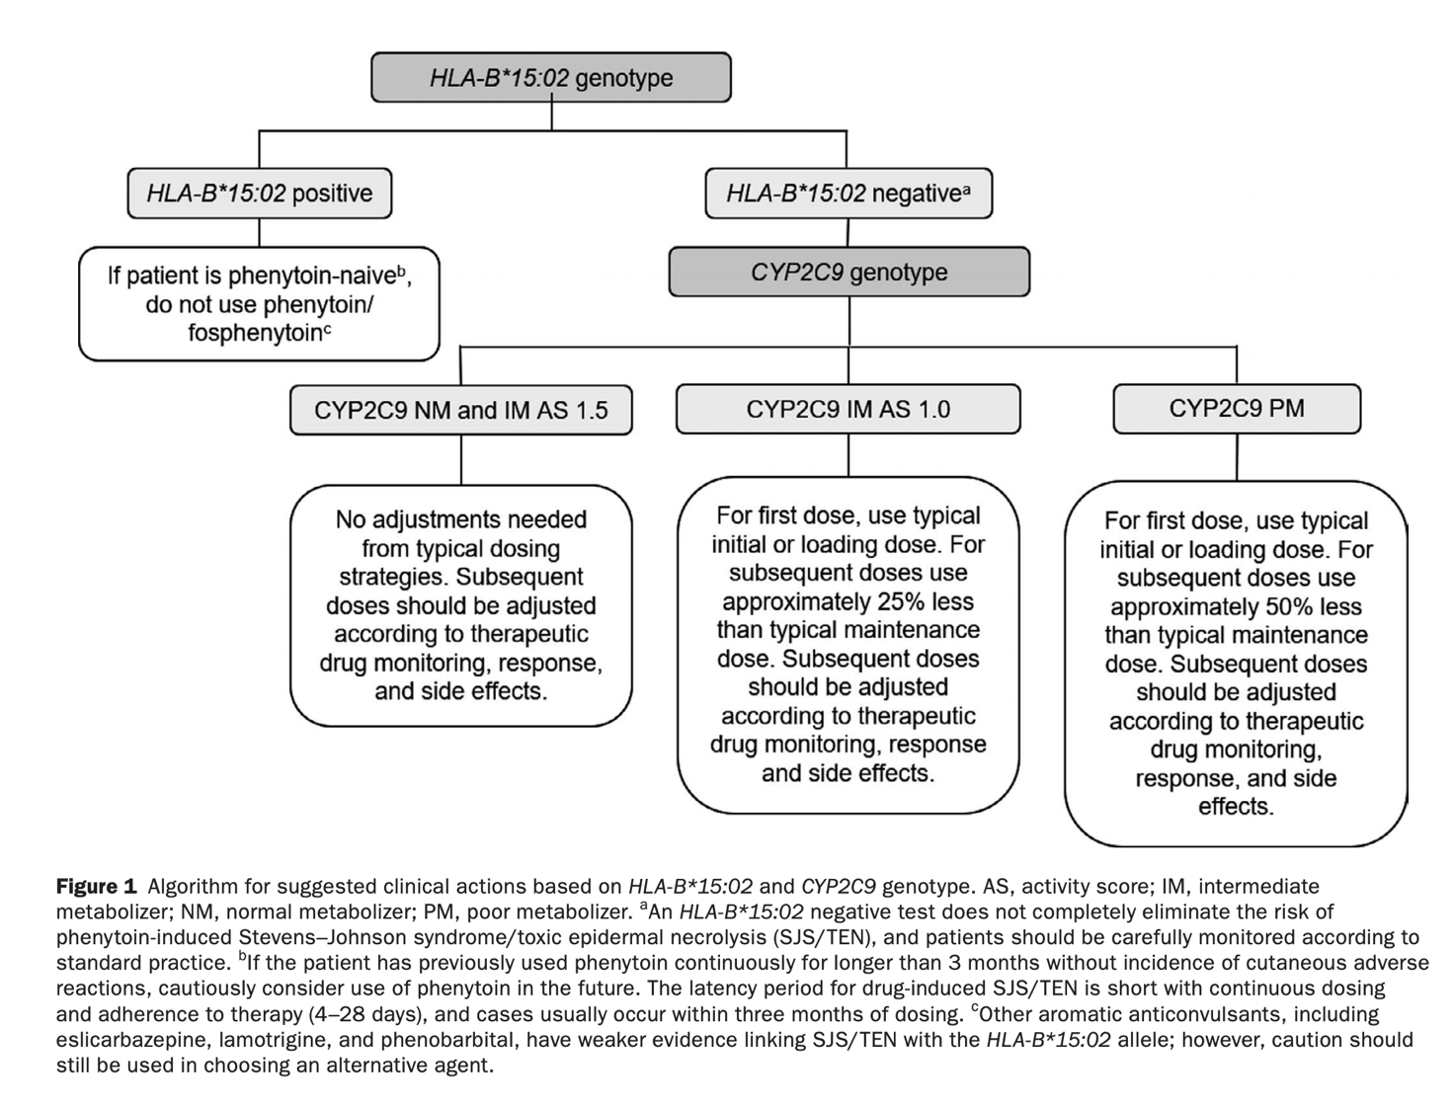
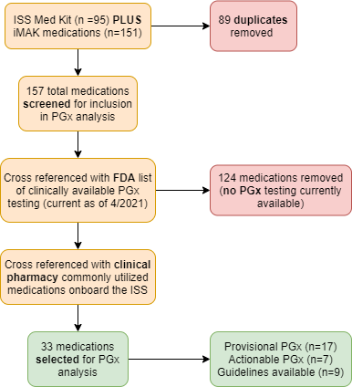
Pharmacogenomics and precision medicine in human spaceflight and deep space exploration.
Alice Ruo Wei Tang¹, Carol Mullenax², Corey Theriot², Jancy McPhee²
¹Department of Internal Medicine, Brigham and Women’s Hospital, Boston, MA;
²Human Research Program, Precision Health Initiative, Johnson Space Center, Houston, TX
Background
Results
Discussion
Preflight PGx testing for ISS/IMAK precision health
Phenytoin (anticonvulsant medicine) has 2 clinically actionable PGx genes
HLA-B*15:02: risk of SJS-TEN (safety concern), most prevalent in Asian populations (allele frequency 1-20%)
CYP2C9: *2 and *3 alleles reduced function (efficacy concern)
Terrestrial recommendation: prior to treatment, consider PGx testing to aid in drug selection and dosing reductions between 25-50%
For the additional drug classes and drugs listed in Fig. 5, dosing annotations can be used pre-flight to reduce risk and guide drug tailoring to the individual astronaut
Benefits of PGx testing
Avoid adverse drug reactions, maximize drug efficacy, and select medications
Preemptive sequencing rather than reactive “just in time” sequencing to avoid delays in treatment, able to identify variants changing care within the immediate and 1-3 year time horizon with updated predictions based on future new discoveries
Allelic frequency tables exist, able to risk stratify with some pre-test probability as more diverse populations will undergo spaceflight in future
Barriers and limitations
Lack of PGx data interpretation training, provider uncertainty
Insufficient clinical evidence for utility
Despite PGx tailoring, further unknown PK/PD changes in spaceflight may change safety/efficacy. Beyond LEO, unknown effect of radiation on drugs
Disclosure and availability of information to astronauts
Terrestrial analog case study:
Azathioprine is an immunologic/oncologic drug, it is a prodrug of mercaptopurine which is metabolized by thiopurine methyltransferase (TPMT) to methylmercaptopurine (less active)
Prior to starting drug, PGx testing is obtained; 9 US labs available for blood or saliva samples
If an individual inherits 2x loss-of-function TPMT genes, they are at risk of significant myelosuppression secondary to increased levels of active thioguanine nucleotides (TGN)
Recommendation for poor metabolizers: for malignancy, start with drastically reduced doses (reduce daily dose by 10-fold and dose thrice weekly instead of daily)
References
Karnes JH, Rettie AE, Somogyi AA, et al. Clinical Pharmacogenetics Implementation Consortium (CPIC) Guideline for CYP2C9 and HLA-B Genotypes and Phenytoin Dosing: 2020 Update. 2021;109:302. doi:10.1002/cpt.2008
Antonsen EL, Reed RD. POLICY CONSIDERATIONS FOR PRECISION MEDICINE IN HUMAN SPACEFLIGHT. _JCI; 2019.
Genes-Drugs – CPIC. https://cpicpgx.org/genes-drugs/. Accessed April 27, 2021.
Stingl JC, Welker S, Hartmann G, Damann V, Gerzer R. Where failure is not an option - Personalized medicine in astronauts. PLoS One. 2015;10(10):1-11. doi:10.1371/journal.pone.0140764
Pharmacogenomics (PGx) = genetic variation in medication response (safety and efficacy). Used to guide therapy, avoid adverse drug events (ADE), and maximize efficacy to reduce burden to the patient and system
Limited mass and volume for spaceflight resupply, especially for Mars missions and expansion of human spaceflight beyond low Earth orbit (LEO) will necessitate further tailoring of medications
PGx tests with direct links to clinical therapeutic guidelines or recommendations exist, with FDA drug labelling recommendations
Fig. 3 LxC 5x5 risk table for current ISS MedKit and IMAK medications showing risk of drug failure (as defined by composite of risk to safety and efficacy)
Likelihood: 1-5 (very low to very high) existing processes sufficient to prevent events up to very likely occurrence that cannot be prevented with no alternative approaches
Consequence: 1-5 (very low to very high) assessment criteria include safety, schedule, cost, technical
Fig. 6 Proposed workflow for pre-flight terrestrial phenytoin PGx testing
Fig. 1 DAG showing PGx in relation to hazards of spaceflight
Consent astronaut for PGx testing
Blood or buccal swab sample obtained for send-out analysis
Integrate PGx report into EHR
Dose adjust or alternative drug in IMAK
Fig. 4 Pie chart showing ISS MedKit and IMAK medication PGx actionability
Fig. 7 Phenytoin PGx algorithm
‘
Clinical interpretation: “1 or 2 copies of HLA-B*15:02, they are at increased risk of severe adverse reactions, including SJS/TEN”. Areas for further study:
Evaluate number of subjects with actionable variants
Percent, number and type of PGx guidelines fired
Number of participants taking the drug. Made dose or drug change per genome-guided recommendations
Number of, and reason for, dismissed PGx rules
21% of total medications in the ISS and IMAK have PGx impact
Of these, 9 medications have final, clinically actionable PGx guidelines available →
  Phenytoin
  Aspirin, ibuprofen, naproxen, celecoxib, diclofenac
  Hydrocodone, hydromorphone
  Omeprazole
Commercially available testing exists for all listed genes: deletion/duplication analysis and targeted gene analysis using a microarray via blood or saliva sample
Actionable
Provisional
Final guidelines
14%
Supplements or non-systemically absorbed
Methods
No evidence for PGx testing
Literature review of PGx clinical testing and ISS MedKit/IMAK data
Selection of candidate medications and commercially available PGx testing for pre-flight dose adjustment recommendations
Risk assessment and workflow proposal
Fig. 2 Flow chart showing drug/PGx selection process
Fig. 5 Table showing PGx recommendations by drug class. Green boxes denote current drugs the ISS MedKit/IMAK positioned in class
Ethics
GINA (Genetic Information Nondiscrimination Act) prohibits genetic selection for employment or insurance coverage
Clinical or operational use of genomic data to inform clinical care, mitigate space hazards, and tailor individual health countermeasures
Cost and technological maturity are no longer barriers to use
Notes:
Process flowchart!

