Slide 1
Aura Landsat-8 Crossing Safety Analysis
May 18, 2021
Jon Halpin, Omitron Inc.
EOS FDS, gsfc-eos-fds@eoc.ecs.nasa.gov
Notes:
4

Slide 2
Contents
Introduction
Lifetime Options
Aura Landsat-8 Crossing
  Radial Separation and Phasing
  Close Approaches
  DMU Adjustment Summary
  Adjusted DMU Plan Example
Conclusion

Slide 3
Introduction
In the Fall 2020 Aura lifetime analysis two plans were presented, a baseline plan that allows for an Aura Landsat-8 crossing and a contingency plan in which Aura exits the constellation before passing 100 seconds of phasing at the orbit intersections.
  The baseline plan extends Aura's life in the afternoon constellation (A-Train) by a predicted 259 days compared to the contingency plan.
This analysis evaluates the safety of an Aura Landsat-8 close approach and the feasibility of coordinating drag make-up maneuvers (DMUs) to maintain a sufficient radial separation at the orbit intersections on the crossing dates.

Slide 4
Lifetime Options (1/3)
Previous Aura lifetime analyses have shown that mission life could be extended if Aura is given freedom to move around in its mean local time (MLT) control box rather than staying within a tighter requirement by maintaining phasing with the virtual Aqua after Aqua’s exit.
Furthermore, it was found that performing more inclination adjust maneuvers (IAMs) in Fall 2021, pushing the MLT lower and then drifting, allowed Aura to operate in the A-Train for longer than executing an IAM series at later dates or spreading out the IAMs over the remainder of Aura’s lifetime.
  Consequently, Aura’s last IAM series is planned for Fall 2021, after which Aura’s MLT will no longer be maintained with IAMs.
Due to MLT drift, Aura will cross Landsat-8 if it does not exit the constellation beforehand.

Slide 5
Lifetime Options (2/3)
Baseline
Constellation Exit Date
Jul 23 2024
Contingency
L8 Crossing
Aug 31 2023
100-sec Threshold
Nov 15 2023
Constellation Exit Date
Nov 14 2023
The contingency plan has Aura exit the constellation on November 14th, 2023 right before passing a self-imposed 100-sec phasing threshold with Landsat-8.
  Could be used in the event that future discussions and analyses deem crossing unsafe.
  The phasing threshold limits Aura’s life in the A-Train because it necessitates using up fuel on performing otherwise unnecessary IAMs to keep Aura’s MLT lower in the control box, which pushes back the date when the phasing threshold is crossed.
The baseline plan, which allows Aura to cross Landsat-8 and drift to the top of its MLT control box, executes one less IAM than the contingency plan, using that fuel instead on perigee lowering maneuvers (PLMs).
  This extends the life of the mission by making it possible for Aura to exit at a later date while still meeting the 25-year reentry requirement.

Slide 6
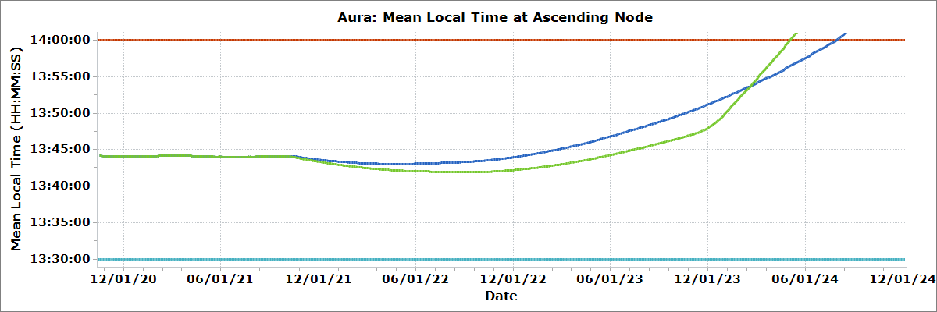
Lifetime Options (3/3)
L8 Crossing
Aug 31 2023
Turnaround
MLT: 13:43:01
Date: Apr 15 2022
MLT Violation
Jul 28 2024
Constellation Exit Date
Jul 23 2024
100-sec Threshold
Nov 15 2023
Fall 2021 IAM Series
Baseline: 4 IAMs
Contingency: 5 IAMs
Turnaround
MLT: 13:41:56
Date: Sep 8 2022
Constellation Exit Date
Nov 14 2023
Baseline
Contingency
Lifetime Plan | Fall 2021 IAMs (#) | L8 100-Sec Threshold | L8 Crossing | Constellation Exit | Passivation
Baseline | 4 | May 13 2023 | Aug 31 2023* | Jul 23 2024 | Aug 2025
Contingency | 5 | Nov 15 2023 | - | Nov 14 2023 | Jul 2025**
* Crossing date at Northern intersection. Southern intersection crossing will lag behind by a day or two.
**Aura’s passivation date is dependent on power generation. Jul 2025 passivation assumes Aura’s minimum required power can be reduced from 3177 W to 3140 W. Otherwise the passivation would be in Oct 2024.
For the baseline plan, Aura’s exit is determined by when it reaches the top of the MLT control box, and is set to the Tuesday beforehand on July 23rd, 2024.
Both plans meet all orbit requirements and the 25-year reentry requirement.
While the baseline plan adds a predicted 259 days of life in the A-Train, the passivation dates for the two options are within 1 month of each other.

Slide 7
Aura above Landsat-8
Baseline Plan – Radial Separation and Phasing
Landsat-8 in front of Aura
Until late-2022, the radial separation at the orbit intersection follows a regular oscillating pattern.
After that, drag picks up and larger DMUs need to be executed for the missions to maintain ground track error (GTE) requirements.
  The larger maneuvers have a much greater impact on radial separation, making the oscillations choppier.

Slide 8
Radial Separation and Phasing – Zoomed-In
Southern Intersection Crossing
Sep 2
Landsat-8 DMU
Landsat-8 DMU
Aura DMU
Oct 18
AOL: 240° (Frozen Orbit)
Duration: 46 sec
Aura DMU
Aug 18
AOL: 187°
(Frozen Orbit)
Duration: 25 sec
Aura DMU
Sep 18
AOL: 240°
(Frozen Orbit)
Duration: 35 sec
Northern Intersection Crossing
Aug 31
While there is sufficient radial separation at the Southern intersection, the radial miss oscillations at the Northern intersection are crossing 0-m near the predicted Aug 31st Northern crossing date.

Slide 9
Close Approaches
Date | Intersection | Miss Distance | Radial | In-Track | Cross-Track
(--) | (--) | (m) | (m) | (m) | (m)
8/31/23 01:36:29 | Northern | 286 | -88 | -130 | -240
8/31/23 03:15:22 | Northern | 240 | -135 | -93 | -175
8/31/23 04:54:15 | Northern | 154 | -125 | 47 | 77
8/31/23 06:33:08 | Northern | 432 | -29 | 209 | 377
9/2/23 08:49:08 | Southern | 379 | -216 | -145 | 275
9/2/23 10:28:01 | Southern | 306 | -268 | 68 | -130
Note: The radial separation in this table is considered positive if Landsat-8 is above Aura in order to follow CARA conventions. This is the opposite of what is shown in the plot, which considers Aura above Landsat-8 as positive radial separation
This table shows close approaches with miss distances of less than 500 m.
Since this is a systematic conjunction due to overlapping orbit requirements, some repeating events can be expected unless there is sufficient radial separation at the crossing dates.
The miss distances and RIC components will be completely different closer to TCA, but a scenario like this with low miss distances would require some coordinated work between Aura and Landsat-8.

Slide 10
DMU Adjustment Summary
To create radial separation at the crossings, the DMU burn date, duration, and argument of latitude (AOL) can be adjusted.
  Aura DMUs result in an earlier crossing, while Landsat-8 DMUs delay the crossing.
  DMU burn duration contributes to both the rate of the crossing time difference and the magnitude of the change in radial separation.
  DMUs half an orbit before a given orbit intersection will result in the largest change in the radial separation at that intersection.
    The Northern and Southern intersections occur when Aura is at an AOL of 74 and 254 degrees respectively.
  Aura DMUs can only push the radial separation curve in the positive direction (Aura above Landsat-8), while Landsat-8 DMUs can only push the curve in the negative direction.
  Higher drag means that larger maneuvers can be performed to create radial separation without a GTE control box violation.

Slide 11
Aura Adjusted DMU Plan Example - Radial Separation & Phasing
Northern Intersection Crossing
Sep 11
Landsat-8 DMU
Aura DMU
Oct 14
AOL: 238° (Frozen orbit)
Duration: 45 sec
Aura DMU
Sep 11
AOL: 76°
(~Half-Orbit Before Southern Intersection)
Duration: 33 sec
Aura DMU
Aug 18
AOL: 186°
(Frozen Orbit)
Duration: 20 sec
Southern Intersection Crossing
Sep 12
The plot above shows an example of how tweaking the DMUs can create a larger radial separation at crossing.
With this adjusted DMU plan, the lowest miss distance is now 554 m.
The actual coordinated DMU scheme to ensure a safe crossing will need to be evaluated continuously in the months leading up to the crossing.
This example does not result in a GTE control box violation, but there could be scenarios where coordinating DMUs to create radial separation is not feasible without one.

Slide 12
Conclusion
The Aura team would like to be able to proceed with the baseline plan so that Aura can remain in the A-Train for longer, but discussions with the Landsat-8 team and subject matter experts will be needed to decide whether the crossing in the baseline plan is safe and acceptable for all parties involved.
  If the crossing is deemed too risky, Aura can instead follow the contingency plan.
If Aura proceeds with the baseline plan, Aura will coordinate closely with Landsat-8 in the months leading up to the crossing.
Through coordinating DMUs, there is potential to create sufficient radial separation at the crossing dates.
Events will show up in the Collision Risk Management System (CRMS) screening reports when we get close to TCA.
  Aura and Landsat-8 are well tracked objects with accurate state predictions.
  If necessary, the nominal collision avoidance process can be used to mitigate high interest events.

Slide 13
Backup

Slide 14
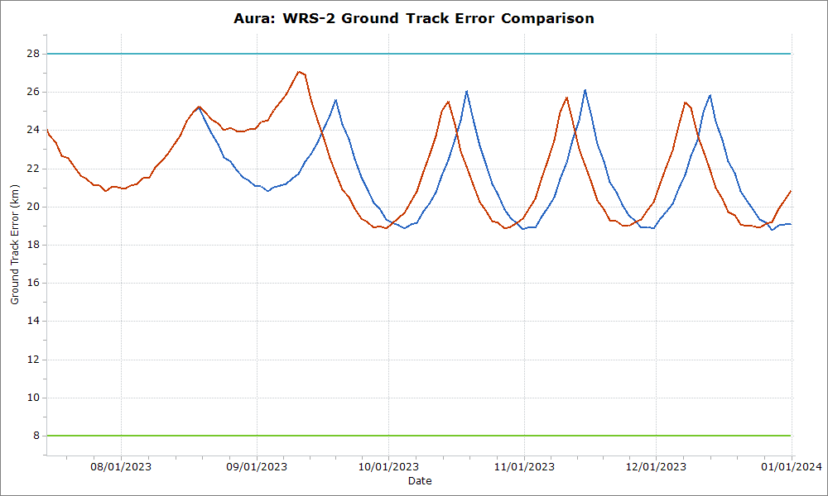
GTE Comparison – Baseline vs. DMUs Adjusted
Baseline
DMUs Adjusted

Slide 15
Miss Distance and RIC Components
Due to the relatively slow rates of change, it is possible for there to be multiple events with in-track and cross track components less than a couple hundred meters.

Slide 16
The baseline plan is predicted to have sufficient power for operations through August 1st, 2025.
  Reducing the minimum required power would not extend this date by any significant amount.
  The baseline plan has a passivation date that is ten months later than the contingency plan. However, if the minimum required power could be reduced to 3140 W, the passivation date would only be a month apart.
  While the baseline plan predicts a 259 day gain in A-Train operations, the passivation date would be very similar provided the minimum required power could be reduced for the contingency plan.

Slide 17
Aura Landsat-7 Crossing
Aura above Landsat-7
Landsat-7 in front of Aura
Aura DMU
May 5
Frozen Orbit
Duration: 12.1 sec
Crossing at the Northern and Southern Intersections
May 19
Landsat-7 DMU
May 4th or 5th

Slide 18
Aura Landsat-7 – Large DMU Before Crossing
Crossing at the Northern and Southern Intersections
May 18
Aura DMU
May 13
Half Orbit Before North Intersection
Duration: 15.8 sec
Turnaround: 9.3 km
Aura DMU
Apr 29
Frozen Orbit
Duration: 7.3 sec
Landsat-7 DMU
May 4th

Slide 19
Aura Landsat-7 Miss Distance & RIC
Epoch | Description | Intersection | Miss Distance (m) | Radial (m) | In-Track (m) | Cross-Track (m)
5/19/2021 12:06:01 | Orbit Before TCA | Northern | 1550.2 | -119.3 | -857.3 | -1286.1
5/19/2021 01:44:54 | TCA | Northern | 319.6 | -9.2 | -173.1 | -268.5
5/19/2021 03:23:47 | Orbit After TCA | Northern | 1007.5 | -6.4 | 566.1 | 833.4

Slide 20
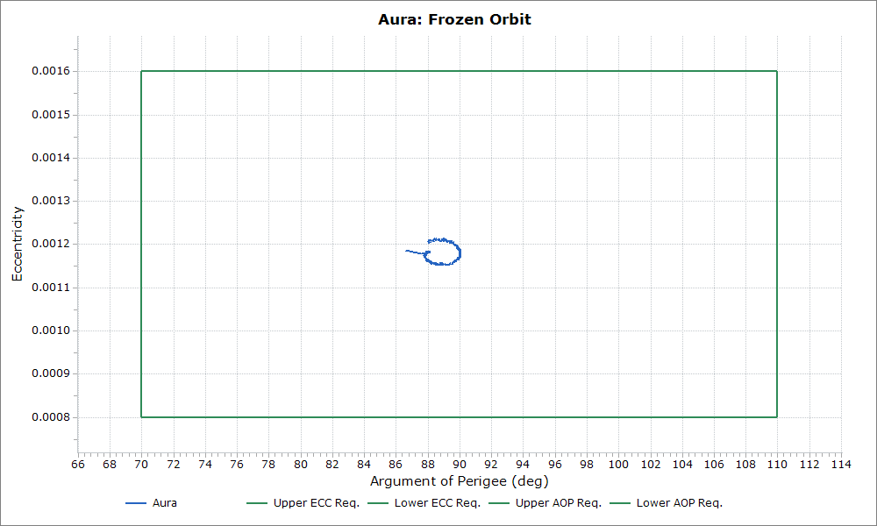
Aura Frozen Orbit

Slide 21
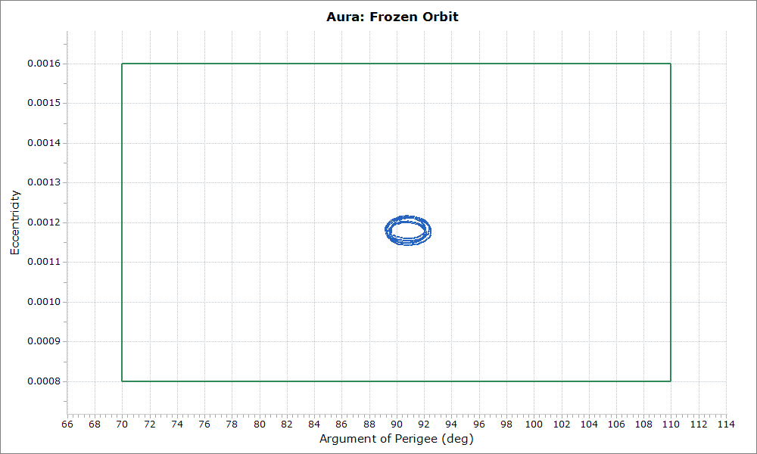
Landsat-8 Frozen Orbit

Slide 22
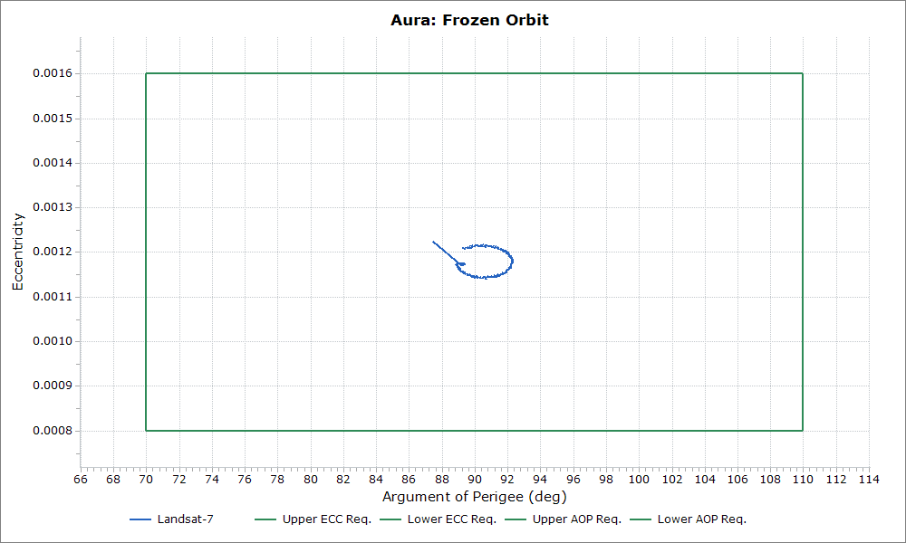
Landat-7 Frozen Orbit

