Slide 1
Optimizing Multilayer Shielding Designs
Using OLTARIS
Heather Hare
Dr. Cheol Park and Dr. Sang-Hyon Chu
2021 Spring Student Research Symposium

Slide 2
Challenge
High doses of radiation found in space can be extremely deadly for astronauts if exposure is prolonged and can cause serious issues for astronauts and electronics, so optimizing radiation shielding is of primary concern
Sources of radiation in space include:
  Solar Particle Events (SPE) are charged particle eruptions from the Sun comprised of high energy ions
  Galactic Cosmic Ray (GCR) radiation that comes from outside the solar system and are formed by explosive events such as supernovae, neutron stars, pulsars or other sources inside our own galaxy, composed primarily of fully ionized protons and heavier nuclei
  Van Allen Belts are regions of trapped radiation where the outer belt contains energy particles from the Sun trapped in Earth’s magnetic field and the inner Belt contains interactions of GCR with Earth's atmosphere
  Secondary particles are produced when radiation interacts with matter, and they carry the transferred high energy from the initial incident particle deeper into or entirely through shielding materials

Slide 3
Challenge
The challenge this project focused on is what causes some shielding configurations of aluminum (A) and polyethylene (P) to be better than others? (I.e., AAPP vs PPAA, PAPA vs APAP, etc.)
Certain configurations with less mass yielded better results than other configurations with more mass
To address this challenge in the past, OLTARIS runs and literature reviews have been done to explore why this phenomenon occurs
50 g/cm²
50 g/cm²
50 g/cm²
50 g/cm²
P
A
P
A
A
P
A
P
50 g/cm²
50 g/cm²
50 g/cm²
50 g/cm²

Slide 4
Objective
The objective of the entire research project is lower radiation doses to humans and equipment by finding a multifunctional material and controlling various materials related factors that affect radiation dose
The objective of this portion of the project is to understand how to ordering of certain materials and the interaction of materials with space radiation impacts radiation doses
Understanding why the ordering causes certain increases and decreases in dose equivalent in a radiation shield can help when it comes to ordering materials in a spacecraft, which is one factor which affects radiation dose

Slide 5
Approach
Ran analyses to evaluate material layer ordering and thickness effects on radiation dose, and researched trends
Used OLTARIS to generate the data and then graphed results to analyze the data and compared it with previous studies on multilayer shielding designs
This contributes to research objectives since it helps to understand why the order matters and what else affects dose equivalent, such as thickness, types of incoming radiation, and the energies of incoming radiation (GCR vs SPE)

Slide 6
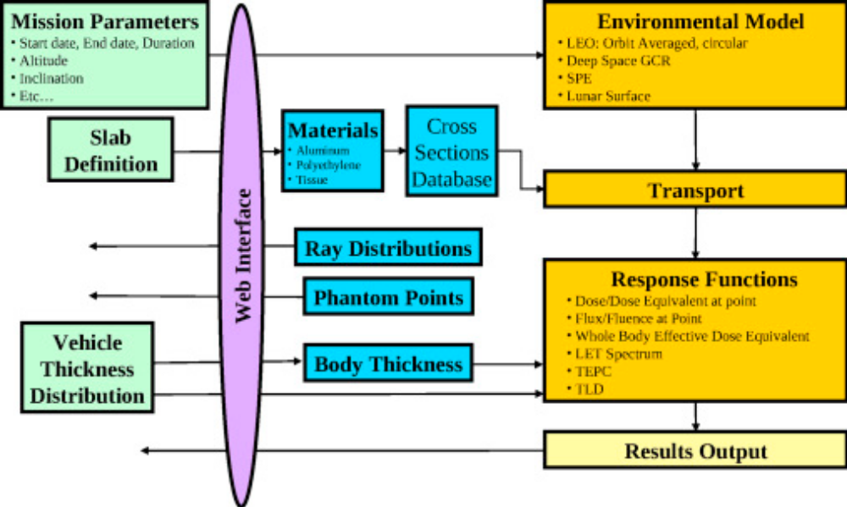
Approach: Using OLTARIS
OLTARIS is an online system used for the analysis of in space radiation
Transport based on HZETRN (High charge (Z) and Energy TRaNsport) code and the input nuclear physics model NUCFRG2 (NUClear FRaGmentation)
For this project, the tool was used to model varying orders of layers for a shielding slab while keeping thickness and the environment constant to compare effectiveness of layering order
Singleterry, Robert. “OLTARIS: On-Line Tool for the Assessment of Radiation In Space.” AIAA SPACE 2009 Conference & Exposition, 2009, doi:10.2514/6.2009-6645.

Slide 7
Approach: Literature Review
Order of materials matters
  The first layer shielding material with the higher atomic number absorbs the primary energy of the incident radiation
  The next shielding material with the lower atomic number effectively absorbs the residual energy of incident radiation
  Reversing this order will cause the dose equivalent to be worse
Consideration of backscatter in aluminum and polyethylene
  More shielding will not always produce a lower dose equivalent
  thicker shielding material will generate more backscattered emissions due to forward (straight ahead) scattering of secondary emissions
  aluminum produces a larger secondary emission spectrum than polyethylene
Warden, D., Bayazitoglu, Y. (2021). Consideration of backscatter radiation from galactic cosmic rays in spacecraft shielding design. Journal of Thermophysics and Heat Transfer. doi: 10.2514/1.T6223

Slide 8
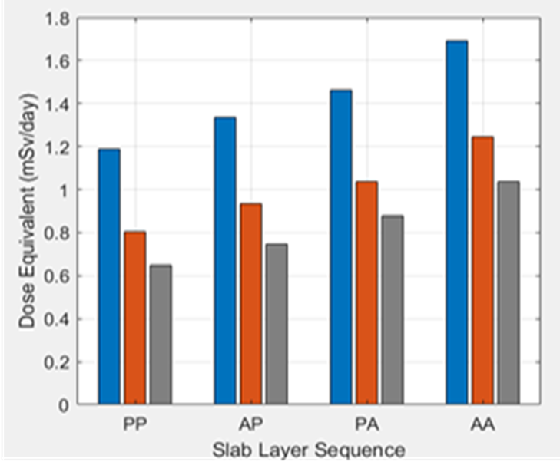
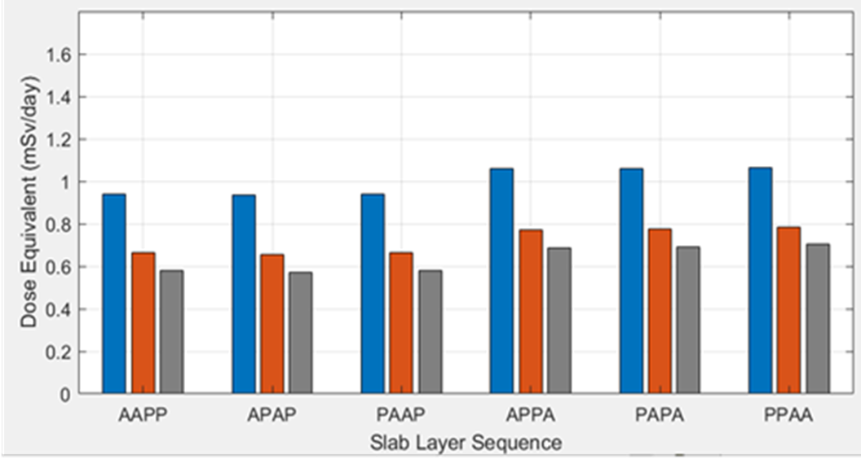


Results
Configurations are ordered in terms of increasing layer thickness (5 g/cm² increments)
For variations ending in A, the dose equivalent is worse than those ending in P

Slide 9
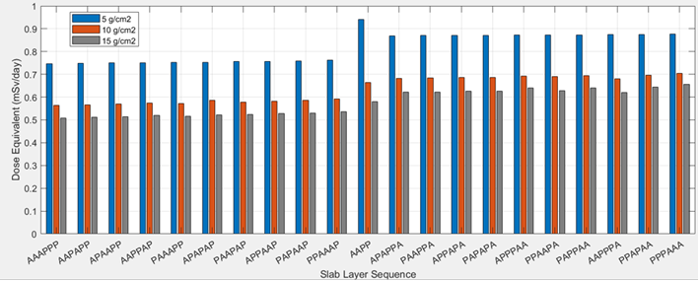
Results
AAPP, which only has four layers, yields a lower dose equivalent than the configurations ending in A with six layers only for 10 and 15 g/cm² cases
The 6-layer version of this same configuration (AAAPPP) has the lowest dose equivalent of all configurations

Slide 10
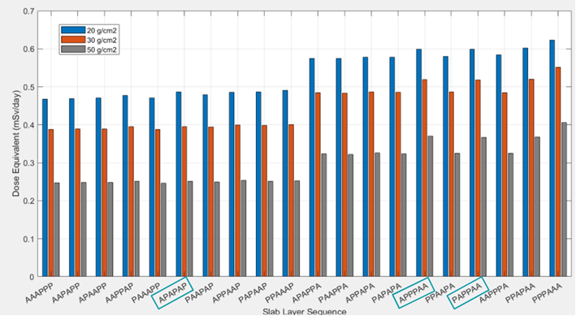
Results
When put in the same order with the same environment as the previous graph with 5,10, and 15 g/cm² thickness, the configurations which no longer follow that order for 20 g/cm² are boxed
However, when reaching 50 g/cm², the difference is less noticeable since the distribution appears more uniform for configurations ending in P
These differences are more noticeable for configurations ending with A, and the trend becomes more apparent since the configurations with more aluminum as the last layers have the higher dose equivalent, except for PAAPPA and PPAAPA cases with 2 internal A layers

Slide 11
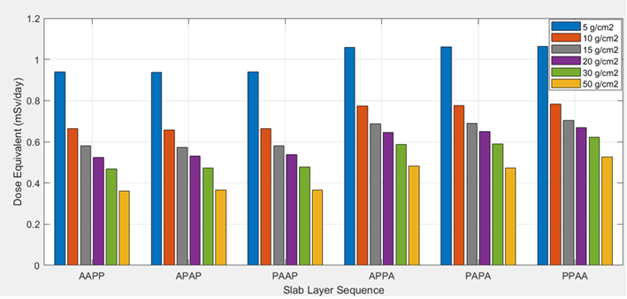


Results
When thickness is increased, the trend is consistent except for APPA and PAPA at 50 g/cm²
Dose equivalent is dependent on not only order of materials, but also thickness

Slide 12
Analysis/Summary
When aluminum is the last layer, the dose equivalent will always be higher since aluminum produces a larger secondary emission spectrum than polyethylene
  Worse stopping power of aluminum makes it easier for GCR ions to escape the shield when aluminum is the last layer, and since there are more secondaries produced by aluminum but no hydrogen containing polyethylene to absorb them, dose equivalent is higher
  Thicker shielding makes this trend more apparent, as effectiveness decreases with more shielding
The results agree with the properties of aluminum and polyethylene, but more work is needed to understand why this varies at different thicknesses

Slide 13
Next Steps/Outlook/Future Work
Future work may include finding a way to model the interactions of radiation with the material in real time to visualize how secondary emissions cascade and result in a higher dose equivalent in a layer-by-layer cross section of the shield
The future of this work is narrowing since the answer appears to be close and more factors like backscatter and order are considered, but more work is needed to understand what occurs layer by layer in worsening dose equivalent to allow for better optimization of a multilayer shield, and understanding of the free space environment is just scratching the surface

Slide 14
Acknowledgements
NIFS program coordinators:
Jessica Gangitano, Jalisa Thomas, Patricia Sanchez
External interactions:
Space Grant Recipient
Group Members:
Andrew O’Conner, Umar Padela, Eunice Seo
Special thanks to Chris Sandridge for OLTARIS

