Slide 1
Quantification of Void Defects in Composite Overwraps for 3D Printed Rocket Engines
Umar Padela
Dr. Cheol Park & Dr. Sang-Hyon Chu
2021 Spring Student Research Symposium

Slide 2
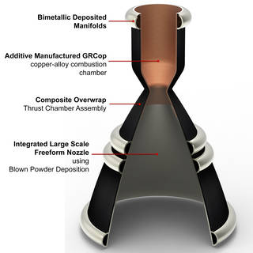
RAMPT Overview
Rapid Analysis and Manufacturing Propulsion Technology (RAMPT)
Combustion chamber and nozzle 3D printed
Bimetallic joints fuse combustion chamber directly onto nozzle
Composite overwrap provides structural support
Improved performance and reduced production costs
Image Credit: NASA

Slide 3
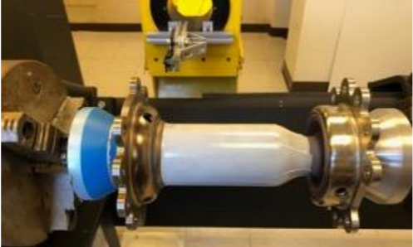
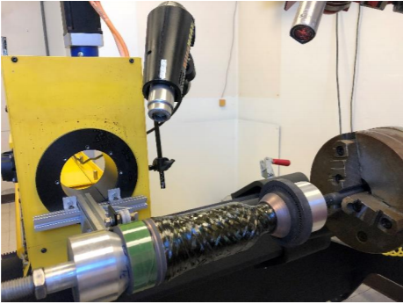
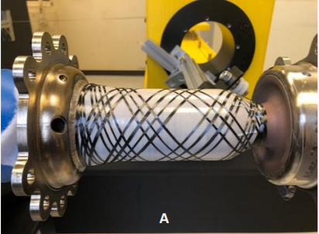
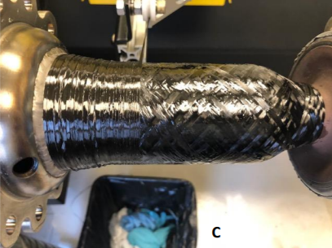
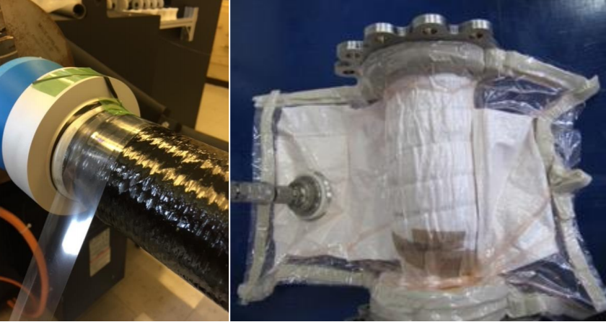
Composite Overwrap
Reduced weight compared to traditional metal jacket
Reduced distortions from bimetallic cladding
Reduced cost and fabrication schedule
Surface Preparation
Grit blasted, washed in phosphoric acid solution, and rinsed with ethanol
Resin Application
To reduce viscosity, resin heated on hot plate and chamber heated with hot-air guns
Curing
Curing process varied at each of the NASA centers based on available facilities
Film adhesives tested
Filament Winding
Helical orientation with 40-degree fiber angle relative to chamber axis
Hoop wound over helical and repeated for total of 4 plies
Bismaleimide (BMI) resin evaluated
As an early practice, Glenn Research Center applied shrink-wrap and vacuum bagged and autoclaved part
Thermal requirements of resin range from cryogenic to 450°F
Gradl, P., Protz, C., Fikes, J., Clark, A., Evans, L., Miller, S., Ellis, D., and Hudson, T. Lightweight Thrust Chamber Assemblies using Multi-Alloy Additive Manufacturing and Composite Overwrap. AIAA Propulsion and Energy Forum. 2020-3787 (2020)

Slide 4
Challenge
Optical Microscopy (OM) images showing voids
Voids are the most common defects induced by the composite manufacturing
Voids form due to air entrapment during impregnation or during laying up, volatiles arising from resin during cure, and moisture dissolved in resin
Analysis must account for void content, shape, size, and location
Voids impact mechanical properties such as interlaminar shear strength, longitudinal compressive strength, and transverse tensile strength
0.5 mm
0.5 mm
Image credit: NASA Marshall Space Flight Center
Notes:
air entrapment either during impregnation (intra-laminar void) or during laying up (inter-laminar void)

Slide 5
Void Characterization Methods
Density Determination
Void content obtained by relative difference between theoretical and composite density
Microscopy
Ultrasonic Testing
Reveals nothing about other void characteristics like size and shape
Destructive
Applicable to large samples and fast
Velocity and attenuation of ultrasonic pulse traveling through composite depends on void content
Need for coupling agent (water or oil) between composite and transducer
Issue for composites where mechanical properties are sensitive to moisture uptake
Image analysis method
Allows characterization of void size, shape, and distribution
Non-destructive
Results are section-biased and location-biased
Destructive
Mehdikhani, M., Gorbatikh, L., Verpoest, I., Lomov, S. Voids in Fiber-reinforced Poly Composites: A Review on their Formation, Characteristics, and Effects on Mechanical Performance (J. Comp. Mater. 53 1579 (2019)

Slide 6
Literature Review
According to Zhang et al., voids increase moisture absorption into composites¹
De Almeida and Neto suggest that voids have strong detrimental effect on composites if void content is above a critical value²
Lie et al. found 6% reduction in interlaminar shear strength, 7% decrease in flexural strength, and 4% decrease in tensile strength with each 1% increase in void content³
¹A. Zhang, D. Li, H. Lu, D. Zhang. Qualitative separation of the effect of voids on the bending fatigue performance of hygrothermal conditioned carbon/epoxy composites. Materials and Design, 32 (10) (2011), pp. 4803-4809.
²S.F.M de Almeida, Z.S.N Neto. Effect of Void Content on the Strength of Composite Laminates. Composite Structures, 28 (1994) pp. 139-148.
³Liu L, Zhang B-M, Wang D-F, et al. Effects of cure cycles on void content and mechanical properties of composite laminates. Compos Struct 2006; 73: 303–309.

Slide 7
Objective
To conduct literature review to learn about effects of voids on mechanical properties of composites
To develop and test methods to identify voids from OM and SEM images of composite overwrap using ImageJ
To quantify and characterize voids
  Shape
  Size
  Orientation

Slide 8
Approach
Original Image
Gaussian Blur,
Sigma = 2 pixels
Enhance Contrast,
Saturated Pixels = 0.3%,
Normalize
Apply Threshold
Void Fraction = 6.51%
Area fraction
Centroid
Feret’s diameter
Fit Ellipse
Aspect Ratio
Results
Set Measurements
Despeckle
Watershed Separation

Slide 9
Verification
Simple starting case
Ensure that ImageJ functions properly for simple images

Slide 10
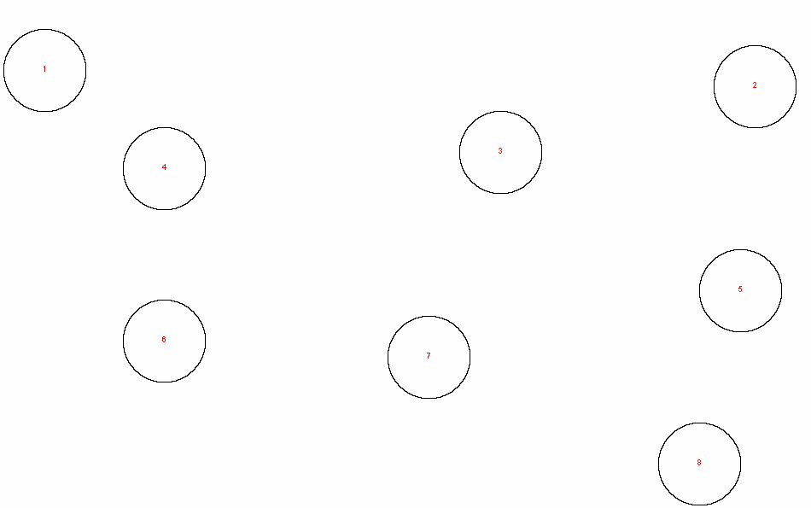
Verification
Known Area Fraction: 0.0628
ImageJ Area Fraction: 0.0624

Slide 11
Verification
3 small, 3 medium, and 3 large circles
Ensure analysis recognizes different sizes correctly

Slide 12
Verification
Known Area Fraction: 0.1649
ImageJ Area Fraction: 0.16455

Slide 13
Verification
Overlapping circles
Checking watershed separation method

Slide 14
Verification
Known Area Fraction: 0.1327
ImageJ Area Fraction: 0.13131
Watershed separation method inserts lines between particles that the algorithm predicts to be overlapped
Separation working as intended

Slide 15
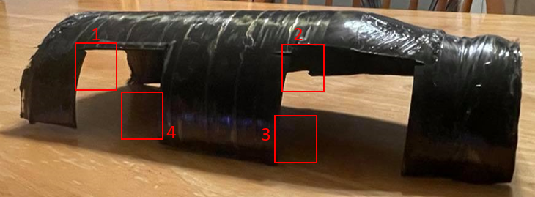
Results
Specimen 1 (axial)
Specimen 2 (axial)
Image credit: NASA Marshall Space Flight Center
Specimen on Composite Overwrap
Specimen 4 (hoop)
Specimen 3 (hoop)

Slide 16
Results
Specimen 1 and 3 have higher porosity than specimen 2 and 4
A small range of porosity values obtained from all specimen
Based on literature review, reductions in shear strength, flexural strength, and tensile strength can be expected based on these porosity values
Specimen 1
Specimen 2
Specimen 3
Specimen 4

Slide 17
Results
Specimen 1 and 3 have more large voids, while specimen 2 and 4 have more small voids
Previous results showed that specimen 1 and 3 had higher overall porosity, while specimen 2 and 4 had lower porosity
Suggests correlation between overall porosity and void size

Slide 18
Results
Specimen 1 and 4 have largest peak around 138 degrees
Specimen 2 and 3 have largest peak around 116 degrees
None of the specimen have voids with orientation of 75-98 degrees

Slide 19
Analysis/Summary
Specimen 1 and 3 higher porosity and larger voids
Specimen 2 and 4 lower porosity and smaller voids
Correlation between overall porosity and void size
Small overall range in porosity between specimen
Based on literature review, reductions in shear strength, flexural strength, and tensile strength can be expected based on these porosity values
Void formation can potentially be reduced by varying cure pressure

Slide 20
Next Steps/Outlook/Future Work
Automate image analysis using ImageJ macro
  Explore automated segmentation
  Test macro to verify accuracy
Explore X-ray Computed Tomography for 3D visualization of voids and better understanding of void characteristics
Determine acceptable level of porosity for composite overwrap
  Literature does not agree on one value for acceptable level of porosity
  Evaluate effects of porosity on mechanical properties to determine value

Slide 21
Acknowledgements
Research Group
  Andrew O’Connor
  Heather Hare
  Eunice Seo
Intern Coordinators
  Valerie Ellis
  Patricia Sanchez
  Jalisa Thomas
  Jessica Gangitano
Massachusetts Space Grant Consortium

