Slide 1
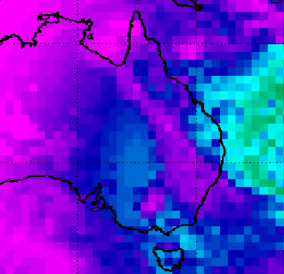
CERES Data Production Status
Katie Dejwakh
SIPS Workshop
May 6, 2021

Slide 2

Outline
Brief overview
Changes since last workshop
Recommendations for improvements
Issues, challenges & concerns

Slide 3
Brief Overview

Slide 4
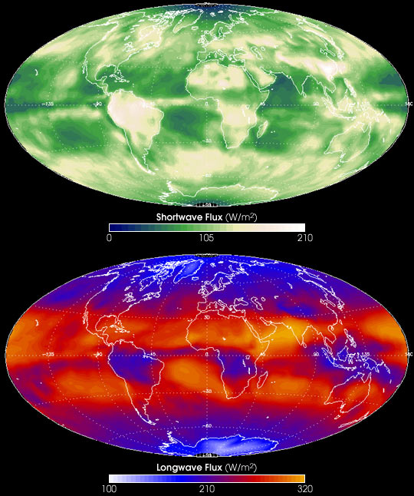
CERES Measurements
Radiances (SW, LW, WN)
Shortwave Flux
Longwave Flux
Notes:
CERES has a 20 km footprint at nadir.

Slide 5
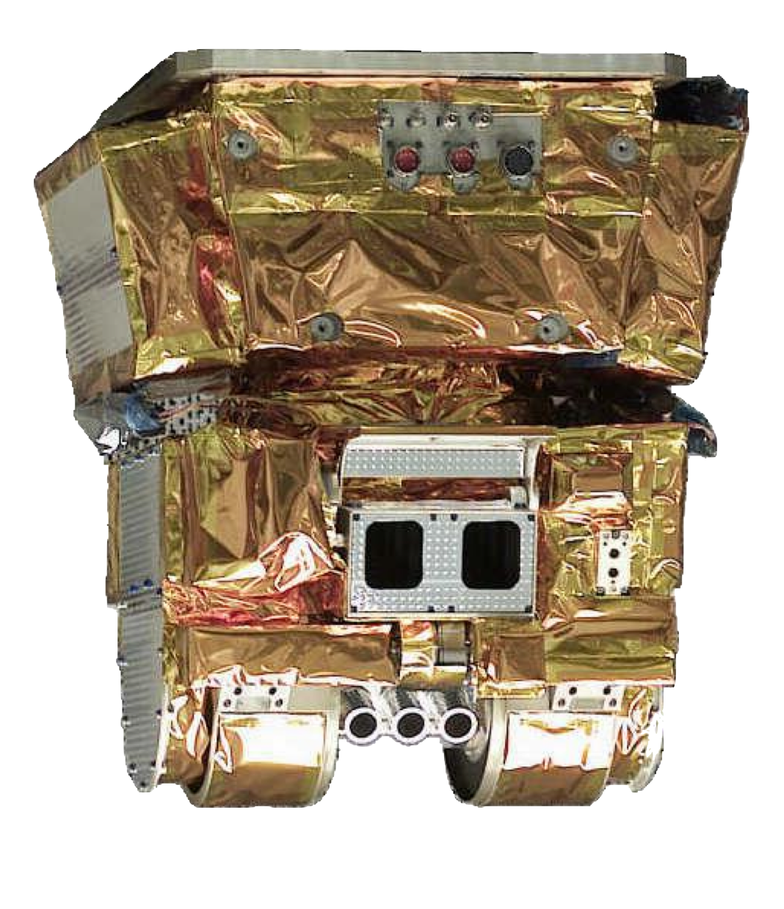

CERES Overview
Produce a long-term record of
Earth’s radiation budget from:
Top-of-atmosphere (ToA)
Within atmosphere
At Earth’s surface
with consistent cloud and aerosol properties at climate accuracy

Slide 6
Data Management Team (DMT)
Science research
DMT /
ASDC
User community

Slide 7
Changes Since Last Workshop

Slide 8
Interface Change –
Compressed S-NPP VIIRS Data
Land SIPS – MODIS & VIIRS L1B radiance subset files for CERES
Using HDF compression on VIIRS subsets prior to product delivery
Reduces file size by ~66%
468 MB → 154 MB per granule

Slide 9
Interface Change – CrIS Fusion Subset
CERES-produced subsetting code
LandSIPS runs subsetter
ASDC pulls subsetted data
Similar to VIIRS L1B radiance subsets arrangement with Land SIPS:

Slide 10
Interface Change – CrIS Fusion Subset
CERES-produced subsetting code
Atmosphere SIPS runs subsetter
ASDC pulls subsetted data
Arrangement with Atmosphere SIPS:
creating CrIS Fusion subsets
MOU creation in progress
Notes:
I had attempted to test data subsetting and download using OPeNDAP service from MODAPS but discovered a bug with all netCDF data there. Sunny reached out to Atm. SIPS for an alternate means of getting this data quickly. (Expediency is key; HQ looking for FM6 results.) In the meantime, MODAPS fixed the netCDF OPeNDAP bug. This may be a means towards data acquisition in the future.

Slide 11
CERES Instrument Data from EDOS
Product | Granule Size (MB) | Number of Granules Per Day | Average Volume per Month (MB)
Terra Level 0 | 88.00 | 8 (FM1 and FM2) | 5,354
Terra Ephemeris | 0.46 | 12 | 168
Terra Attitude | 0.88 | 12 | 321
Aqua Level 0 | 88.00 | 8 (FM3 and FM4) | 5,354
Aqua Ephemeris | 5.30 | 1 | 161
Aqua Attitude | 0.46 | 12 | 168
NPP Level 0 | 88.00 | 4 | 2,677
NPP Ephemeris and Attitude | 0.50 | 12 | 178
JPSS-1 Level 0 | 88.00 | 4 | 2,677
JPSS-1 Ephemeris and Attitude | 0.50 | 12 | 178

Slide 12
MODIS & VIIRS Data
Source | Product | Granule Size (MB) | Number of Granules Per Day | Average Volume per Month (MB)
MODAPS | MOD02_SS | 12 - 65 | 288 | 340,300
MODAPS | MOD03 | 28 | 288 | 245,150
MODAPS | MOD04 | 1.5 | 130 | 6,000
MODAPS | MYD02_SS | 12 - 65 | 288 | 340,300
MODAPS | MYD03 | 28 | 288 | 245,150
MODAPS | MYD04 | 1.5 | 130 | 6,000
Land SIPS | VIMD_SS | 160 - 360 | 288 | 2,141,000
Land SIPS | VNP04E_L2.A | 0.8 | 288 | 7,000
Land SIPS | VNP0203IMD_SS | 330 - 470 | 240 | 2,736,000
Atmosphere SIPS (pulled from LAADS) | VAERDT | 38 | 130 | 150,000
Atmosphere SIPS (pulled from LAADS) | VAERDB | 15 | 130 | 59,280

Slide 13
MODIS & VIIRS Data
Source | Product | Granule Size (MB) | Number of Granules Per Day | Average Volume per Month (MB)
MODAPS | MOD02_SS | 12 - 65 | 288 | 340,300
MODAPS | MOD03 | 28 | 288 | 245,150
MODAPS | MOD04 | 1.5 | 130 | 6,000
MODAPS | MYD02_SS | 12 - 65 | 288 | 340,300
MODAPS | MYD03 | 28 | 288 | 245,150
MODAPS | MYD04 | 1.5 | 130 | 6,000
Land SIPS | VIMD_SS | 160 - 360 | 288 | 2,141,000
Land SIPS | VNP04E_L2.A | 0.8 | 288 | 7,000
Land SIPS | VNP0203IMD_SS | 330 - 470 | 240 | 2,736,000
Atmosphere SIPS (pulled from LAADS) | VAERDT | 38 | 130 | 150,000
Atmosphere SIPS (pulled from LAADS) | VAERDB | 15 | 130 | 59,280
Notes:
VIMD is the radiance subset file.
VNP… is the aerosol file.
will discontinue these when we have all the version 002 data.
VNP04 only comes in for daytime granules, so they are naturally “patchy” in the DPO.

Slide 14
MODIS & VIIRS Data
Source | Product | Granule Size (MB) | Number of Granules Per Day | Average Volume per Month (MB)
MODAPS | MOD02_SS | 12 - 65 | 288 | 340,300
MODAPS | MOD03 | 28 | 288 | 245,150
MODAPS | MOD04 | 1.5 | 130 | 6,000
MODAPS | MYD02_SS | 12 - 65 | 288 | 340,300
MODAPS | MYD03 | 28 | 288 | 245,150
MODAPS | MYD04 | 1.5 | 130 | 6,000
Land SIPS | VIMD_SS | 160 - 360 | 288 | 2,141,000
Land SIPS | VNP04E_L2.A | 0.8 | 288 | 7,000
Land SIPS | VNP0203IMD_SS | 330 - 470 | 240 | 2,736,000
Atmosphere SIPS (pulled from LAADS) | VAERDT | 38 | 130 | 150,000
Atmosphere SIPS (pulled from LAADS) | VAERDB | 15 | 130 | 59,280

Slide 15
MODIS & VIIRS Data
Source | Product | Granule Size (MB) | Number of Granules Per Day | Average Volume per Month (MB)
MODAPS | MOD02_SS | 12 - 65 | 288 | 340,300
MODAPS | MOD03 | 28 | 288 | 245,150
MODAPS | MOD04 | 1.5 | 130 | 6,000
MODAPS | MYD02_SS | 12 - 65 | 288 | 340,300
MODAPS | MYD03 | 28 | 288 | 245,150
MODAPS | MYD04 | 1.5 | 130 | 6,000
Land SIPS | VIMD_SS | 160 - 360 | 288 | 2,141,000
Land SIPS | VNP04E_L2.A | 0.8 | 288 | 7,000
Land SIPS | VNP0203IMD_SS | 330 - 470 | 240 | 2,736,000
Atmosphere SIPS (pulled from LAADS) | VAERDT | 38 | 130 | 150,000
Atmosphere SIPS (pulled from LAADS) | VAERDB | 15 | 130 | 59,280

Slide 16
MODIS & VIIRS Data
Source | Product | Granule Size (MB) | Number of Granules Per Day | Average Volume per Month (MB)
MODAPS | MOD02_SS | 12 - 65 | 288 | 340,300
MODAPS | MOD03 | 28 | 288 | 245,150
MODAPS | MOD04 | 1.5 | 130 | 6,000
MODAPS | MYD02_SS | 12 - 65 | 288 | 340,300
MODAPS | MYD03 | 28 | 288 | 245,150
MODAPS | MYD04 | 1.5 | 130 | 6,000
Land SIPS | VIMD_SS | 160 - 360 | 288 | 2,141,000
Land SIPS | VNP04E_L2.A | 0.8 | 288 | 7,000
Land SIPS | VNP0203IMD_SS | 330 - 470 | 240 | 2,736,000
Atmosphere SIPS (pulled from LAADS) | VAERDT | 38 | 130 | 150,000
Atmosphere SIPS (pulled from LAADS) | VAERDB | 15 | 130 | 59,280

Slide 17
MODIS & VIIRS Data
Source | Product | Granule Size (MB) | Number of Granules Per Day | Average Volume per Month (MB)
Atmosphere SIPS | FSNRAD_*_SS_NOAA-20 | 26 | 240 | 375,000
Will be receiving this Version 1.1 data any day now…

Slide 18
Other Ancillary Data
Source | Product | Granule Size (MB) | Number of Granules Per Day | Average Volume per Month (MB)
NSIDC | NISE | 2.1 | 1 | 64
CLASS | 1/8th mesh Snow/Ice (DMSP EDR) | 9.6 | 8 (NH and SH) | 2,335
557 WW (Air Force) | 1/16th mesh Snow/Ice (SNODEP) | 2.3 | 2 (NH and SH) | 140
GMAO | GEOS 5.4.1 Met-Reanalysis | varies | 8 files / day | ~83,000
U. of Wisc SSEC | Geostationary Weather Satellite (area files) | 5 – 37 | 120 (5 GEO) | ~84,000
SSAI | MATCH Model Aerosols from MODIS | varies | 2 files / day | 5.3

Slide 19

Interface Change – Libera Interactions
Libera – follow-on to CERES for Earth Radiation Budget measurements
Will fly on JPSS-3
Formed a Data Management Working Group
  L1B data format
  CERES processing paradigm – long-term
ASDC selected – DAAC of record
  PLR baselined
  Two upcoming ICDs by November:
    ASDC ↔︎ Libera
    ASDC ↔︎ CERES

Slide 20
CERES Code Re-Architecture
CERESlib – internal library used in production
  Cleaned, tightened up
  Candidate “useful algorithms” for inclusion in updated version
Clouds –
  Diagrammed entire cloud retrieval and footprinting in Magic Draw
  Created hook into C with C++ code
TISA –
  Preliminary end-to-end, re-architected code in place
  Largely object-oriented, Fortran and C++

Slide 21
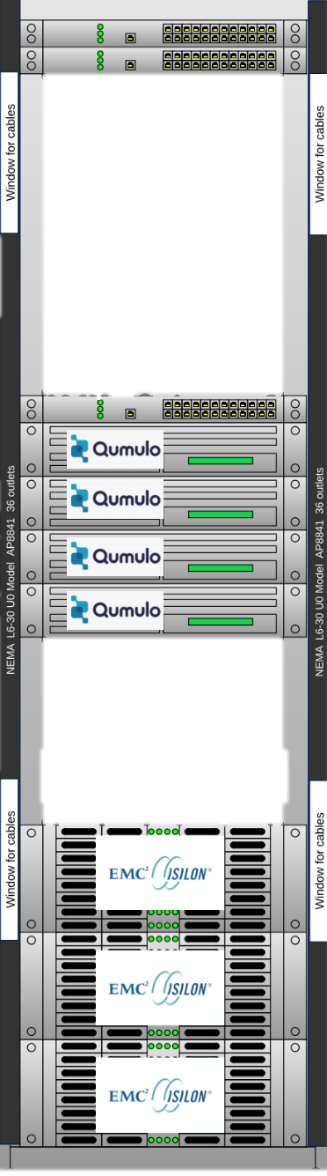
System Changes
OS Upgrades:
  RHEL7 – ANGe (Ingest system at ASDC)
  RHEL8 – AMI-P (CERES production system)
“Offline” Storage:
  Science work storage – aged, insecure posture
  Refreshed with HPE Scale-Out NAS storage w/ Qumulo

Slide 22
Current Processing Status
Edition 4 Terra/Aqua
  Nominal, produced through February 2021
  Mitigated August Aqua anomaly by substituting NOAA-20 data
Edition 1 S-NPP
  Nominal, produced through March 2021
  No L3 products from 9/2019 onward,
  while S-NPP in biaxial mode
Edition 1-CV NOAA-20
  Nominal, produced through March 2021
  First edition of all standard products coming this Summer
Notes:
Ed 2 S-NPP: Need VIIRS data; assuming our test data is good enough that production can start immediately, will take two months of just Clouds processing. Gains and SRFs have been delivered through May 2020.
Ed 1 NOAA-20: Record starts from May 2018. Gains and SRFs have been delivered through July 2020.

Slide 23
Forthcoming Data Product Editions
Edition 2 S-NPP (delayed)
  Reprocessed first two years: 2012-2014
  Available Summer 2021?
  Pace of C2 VIIRS data receipt driving schedule
  No L3 products from 9/2019 onward,
  while S-NPP in biaxial mode
Edition 1 NOAA-20 (delayed)
  Available late Summer 2021? – improved Clouds!
  Will use Version 1.1 or 1.2 CrIS Fusion data for water vapor info.
Notes:
Ed 2 S-NPP: Need VIIRS data; assuming our test data is good enough that production can start immediately, will take two months of just Clouds processing. Gains and SRFs have been delivered through May 2020.
Ed 1 NOAA-20: Record starts from May 2018. Gains and SRFs have been delivered through July 2020.

Slide 24
FLASHFlux
CERES’ near-real time stream
  Footprint (SSF): ~4 days
  Gridded data (TISA): ~7 days
  Needs CERES + imager data within 2 days of real time
Edition 4A operational
1-2-year plan:
  Terra, then Aqua drifts
  Develop NOAA-20 + GEO configuration
INCORPORATING INTO CERES PRODUCTION – FALL 2021
Notes:
All core products produced:
Footprint: Terra, Aqua SSFs (within 4 days)
Gridded: Time- and space-averaged (within 7 days)
Superseded by CERES edition product when available, then removed from public access

Slide 25
Issues, Challenges, Concerns

Slide 26
Availability of
S-NPP/NOAA-20 VIIRS Radiance Files
Missing real-time (~5 days back from current)
VIIRS L1B radiance files
  Collection1 S-NPP
  Collection 2 NOAA-20
  entire data days
  many granules from individual data days
Missing reprocessed data (Collection 2 S-NPP)
ASDC investigating
Impacts forward/re-processing

Slide 27
“Cloud-ready” Posture
CERES PGEs have successfully been containerized
  Docker – 100%
  OpenShift/Kubernetes – 0%
AMI-P != ASDC OpenShift environment
Algorithms probably quicker to the cloud than our ancillary data needs
Hefty data:
  MODIS
  VIIRS
  GEO satellites

Slide 28
MODIS C7
Schedule will partially determine our Edition 5 schedule
Update on timeline?

