Slide 1
NASA-STD-6030 Qualified Material Process Requirements for Joint Non-Metallic SDO Forum
Sam Cordner
April 27, 2021

Slide 2
Quick Look
NASA 6030 Principals (6030 to be published soon)
Applicability (Human Spaceflight and critically levels)
Qualified Material Process (the basics)
There is much, much more to NASA 6030, but this is a quick look at only one of the principals.

Slide 3
AM Certification: Governing Principles
Understanding and Appreciation of the AM process
Integration across disciplines and throughout the process
Discipline to define and follow the plan
Have a plan
Integrate a Quality Management System (QMS)
Build a foundation
  Equipment and Facility
  Training
  Process and machine qualification
  Material Properties / SPC
Plan each Part
Design, classification, Pre-production articles
  Qualify and lock the part production process
Produce to the plan – Stick to the plan

Slide 4
NASA approvals required
NASA-STD-6030 requires the following deliverables:
  Additive Manufacturing Control Plan (AMCP)
  MUA to approve the Material Property Suite (MPS)
    Class A and B parts only
  Part Production Plan (PPP)

Slide 5
Applicability
Adaptive technologies—where process parameters change based on active feedback during the manufacturing process—are not allowed without a tailored, point-design methodology.
  e.g. Electron beam powder bed fusion (E-PBF)

Slide 6
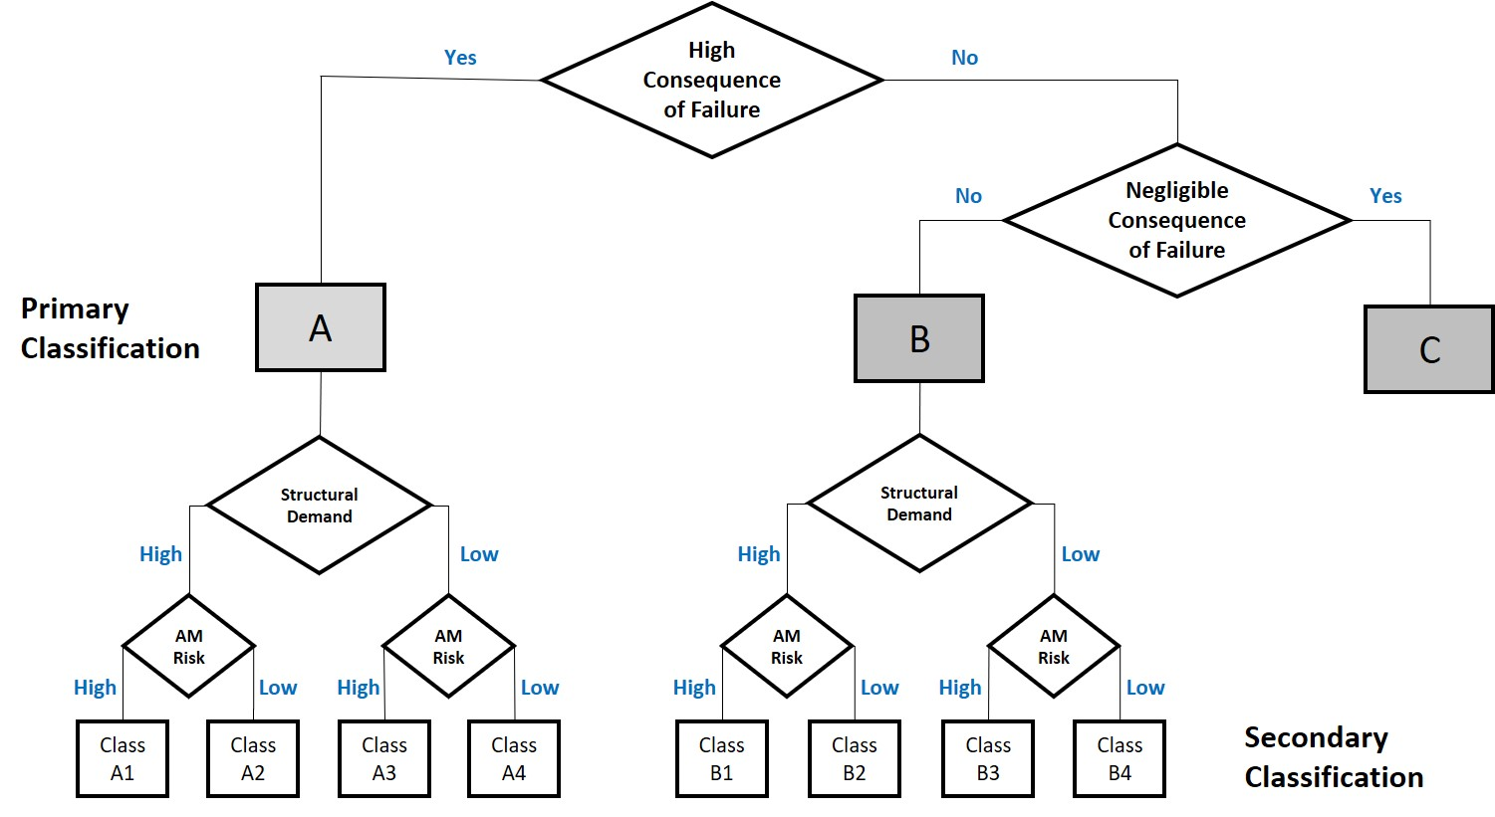
Classification

Slide 7
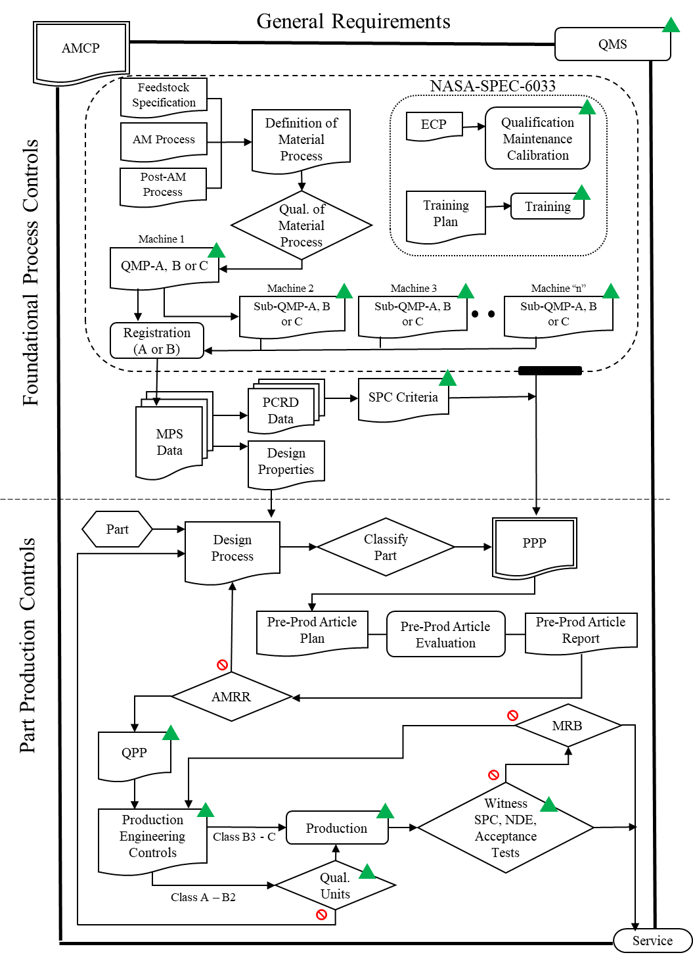
Summary of Methodology

Slide 8
General Requirements
General Requirements
Additive Manufacturing Control Plan (AMCP)
  Critical to define implementation policies for program or project
  Describes implementation of all requirements
    Includes tailoring of requirements
  Becomes governing document in place of standards
Quality Management System (QMS)
  Critical to maintain consistent implementation policy
  Ensures you stick to your plan and tailoring
  Ensures consistent training, processes and procedures
AMCP
QMS
Feedstock
Specification
NASA-STD-6033
Definition of
Material Process
ECP
Qualification Maintenance Calibration
AM Process
Post-AM Process
Qual. of Material Process
Training Plan
Training
Machine 1
QMP-A, B or C
Foundational Process Controls
Machine 2
Machine 3
Machine “n”
Sub-QMP-A, B or C
Sub-QMP-A, B or C
Sub-QMP-A, B or C
Registration
(A or B)
MPS
Data
PCRD
Data
SPC Criteria
Design
Properties
Design Process
PPP

Slide 9
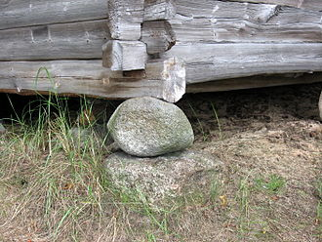
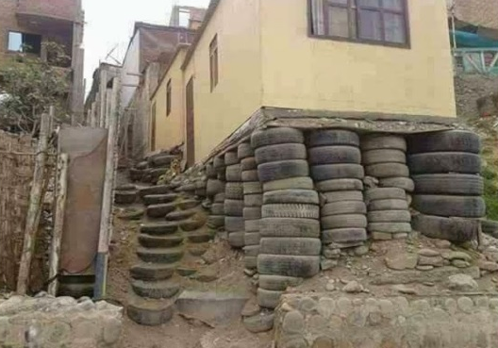
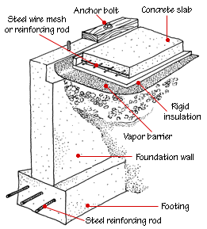

Building a Foundation
Planning for AM certification does NOT start with a part
AM Control Plan should define how the foundation for certification is structured and how it operates
  Equipment and Facility Controls
  Personnel Training
  Process/Machine Qualification
  Material Properties
  Statistical Process Controls

Slide 10
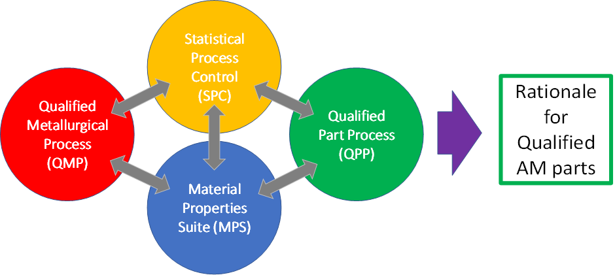
Qualified Material Process (QMP)
Begins as a Candidate QMP
Defines aspects of the basic, part agnostic, fixed AM process:
  Feedstock
  Fusion Process
  Thermal Process
Enabling Concept
  Machine qualification and re-qualification, monitored by…
  Process control metrics, SPC, all feeding into…
  Design values
Feedstock
Specification
NASA-STD-6033
Definition of
Material Process
ECP
Qualification Maintenance Calibration
AM Process
Post-AM Process
Qual. of Material Process
Training Plan
Training
Machine 1
QMP-A, B or C
Foundational Process Controls
Machine 2
Machine 3
Machine “n”
Sub-QMP-A, B or C
Sub-QMP-A, B or C
Sub-QMP-A, B or C
Registration
(A or B)
MPS
Data
PCRD
Data
SPC Criteria
Design
Properties
Design Process
PPP

Slide 11
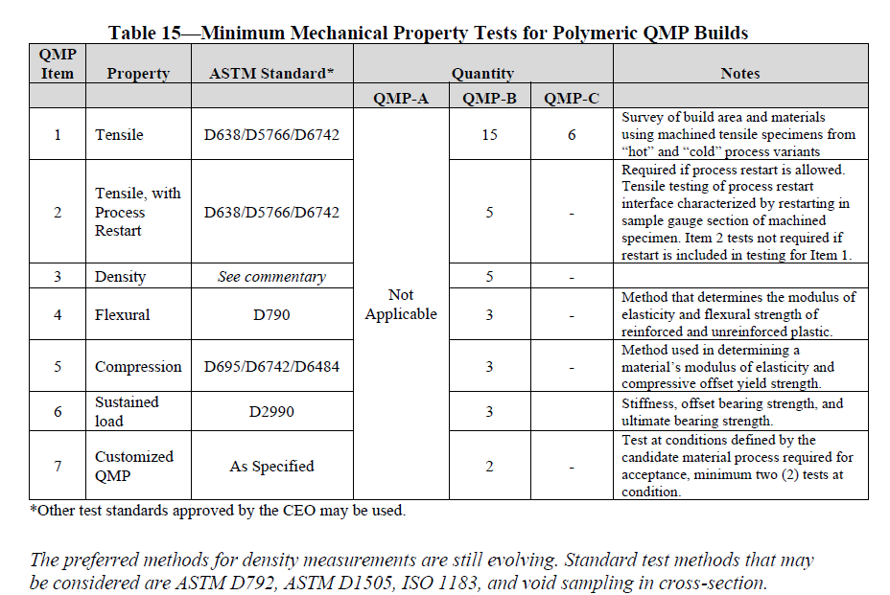

Slide 12
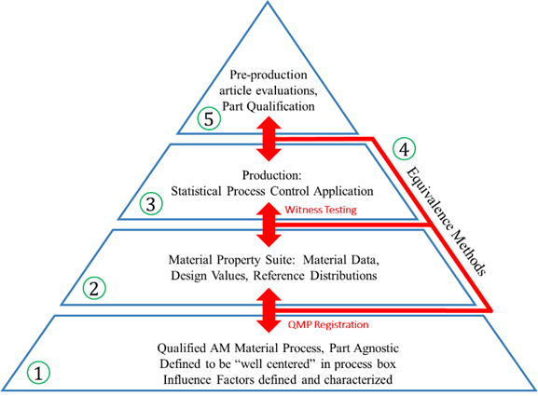
The QMP becomes the Foundation!

Slide 13
Conclusions
NASA 6030 is for all additive manufacturing. There are some specifics to applicability.
Process control is what defines a good process. This control comes from several places including an AMCP, QMS, and QMP.
A test matrix to evaluate QMP has been presented.
Control what you do::Evaluate what you get

Slide 14
Additional for the M&P Group

Slide 15
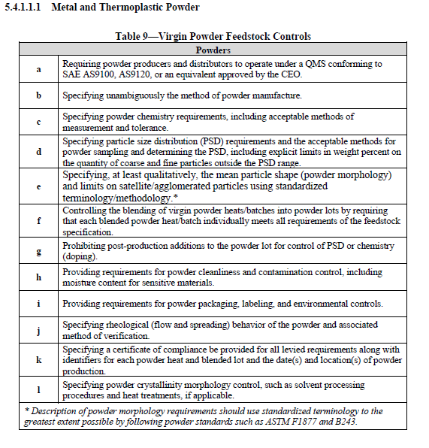

Slide 16
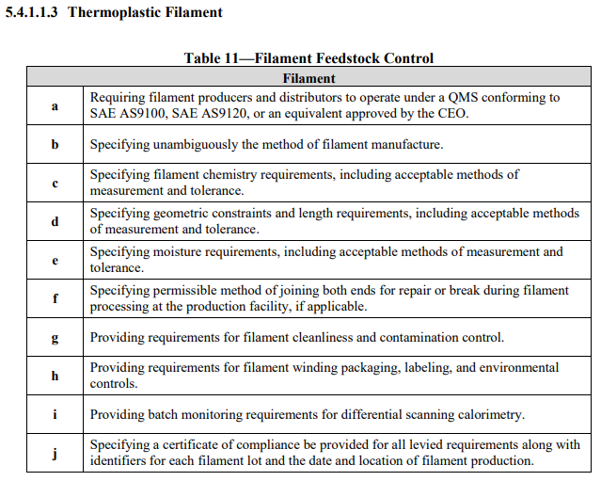

Slide 17
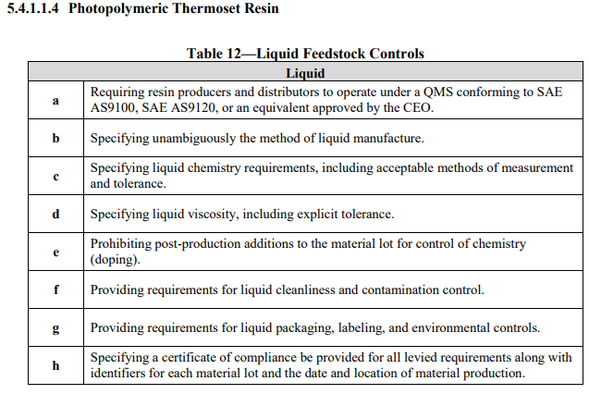

Slide 18
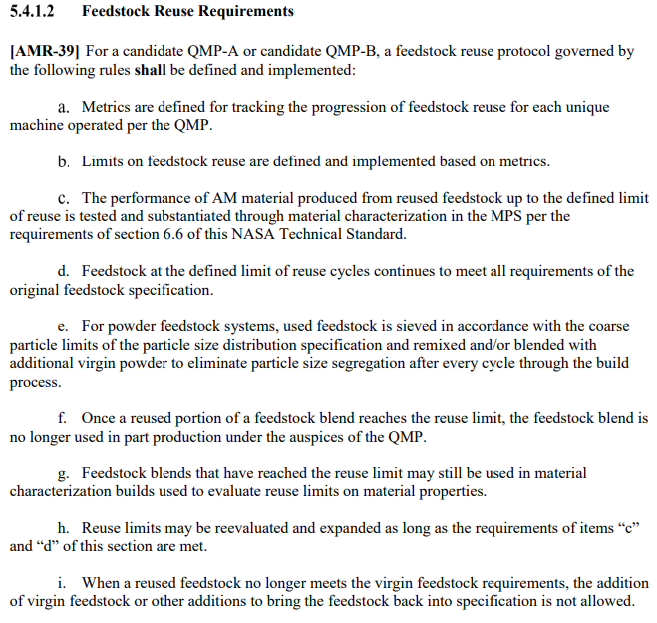

Slide 19
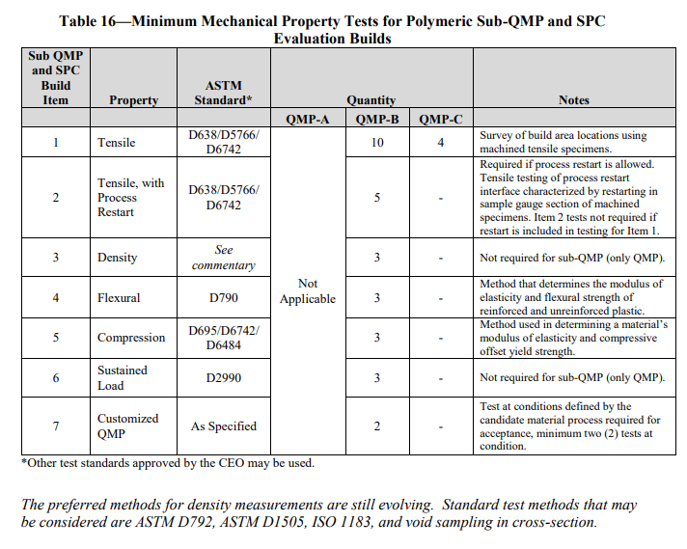

Slide 20
