Slide 1
A-Train Cornerstone Mission Discussion
May 19, 2021
Discussion facilitated by Michael Machado
NASA GSFC Code 584.0
Earth Science Constellation Mission Operations Manager
301-974-7668 (mobile)
Notes:
4

Slide 2
Background
A-Train orbital safety has been maintained through the implementation and use of a Phasing Control Box as well as other tools in the Constellation Coordination System (CCS).
The CCS was built and is being maintained under ESMO funding to meet MOWG requirements.
The Constellation Operations Coordination Plan document describes the Phasing Control Box:
  The Phasing Control Box is centered on the mission’s Reference Virtual Satellite and has an agreed upon tolerance in terms of Relative Equator Crossing Time (also known as Phasing) with respect to the anchor satellite. The anchor satellite for the Afternoon Constellation is Aqua. Although it is called a “box”, the only dimension of consequence is in the along-track direction. The CCS uses the Phasing Control Box to determine whether a satellite is “in or out of its box.” There is a Buffer between the Phasing Control Boxes of two adjacent satellites.

Slide 3
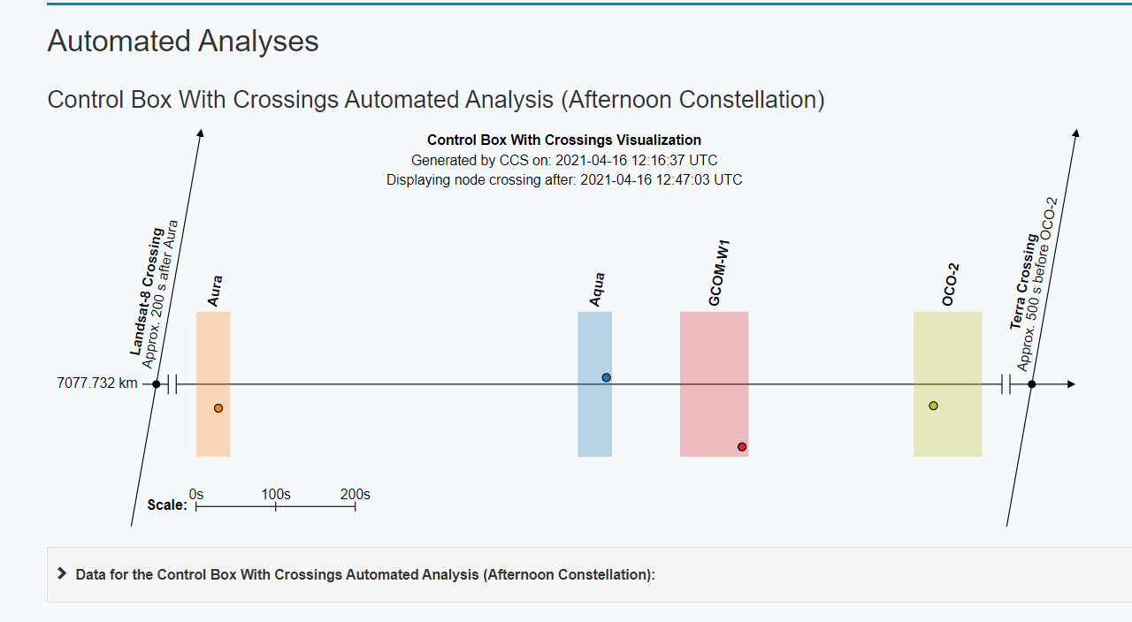
Background cont’d
CCS has several automated analyses that utilize Aqua as the reference (i.e. Control Box With Crossings Visualization)
https://ccs.esmo.nasa.gov/#/Home

Slide 4
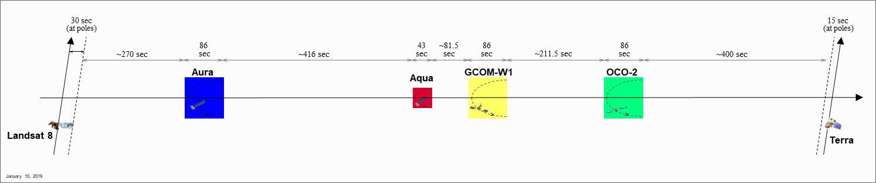
Background cont’d
Aqua performed the final IAMs for the mission in Spring 2021
Approved End Of Mission (EOM) Plan has Aqua exiting the Constellation in January 2022
With Aqua exiting, is there still a need for a cornerstone mission?
Remaining A-Train missions (Aura, GCOM-W1 and OCO-2)
Action Item: What are the impacts to each mission if CCS is no longer maintained or goes away after Aqua and Aura exit the Constellation?

Slide 5
Timeline for choosing the next A-Train cornerstone mission
Planned events (such as IAMs) may affect a decision
Aura plans to conduct it’s last series of IAMs in Fall 2021 to maximize it’s ability to stay in the A-Train (until ~mid 2024)
GCOM-W1 & OCO-2 do not plan to perform Fall 2021 IAMs
OCO-2 is considering IAMs in January 2022 (Aqua exit)
Decisions are largely driven by science goals (coordinated science vs individual mission science) as well as orbital safety
At this stage of the NASA Senior Review cycle, NASA missions have already proposed their plans for the next several years

Slide 6
Current A-Train Scenario
Aura performs IAM series in Fall 2021, Aqua Exits Constellation in Jan 2022, OCO-2 performs IAM series in January 2022 (TBC), GCOM-W1 performs IAM series TBD
  Each mission does what is needed to maximize mission science and mission lifetime (some perform IAMs, some do not, or IAMs performed at different seasons – will need to monitor for orbital safety)
  Regardless of which mission is chosen as the next cornerstone mission, can a phasing control box be accurately implemented for safety and situational awareness if the A-Train missions do not match Inclination and MLT?
  OCO-2 would like to maintain the Mission Goal MLT (14:00:45 +/- 30s)
  ESMO recommends Aura be the next cornerstone mission lasting until Aura exits the A-Train (mid 2024). After that, CCS will be decommissioned unless other funding is determined. However, Aura can no longer maintain MLT after the Fall 2021 IAMs are performed.
  Does the cornerstone mission need to maintain MLT?
Discussion

Slide 7
Backup

Slide 8
Questions that may drive cornerstone decision
How much does it cost to maintain CCS?
What is best from an overall science perspective?
Does best overall science cause a negative impact to an individual mission (i.e. significantly shorter mission life)?
Any coordinated science with OCO-2 , GCOM-W1 and Aura?
Are there any other future missions coming to the A-Train that would benefit from coordinated science?

Slide 9
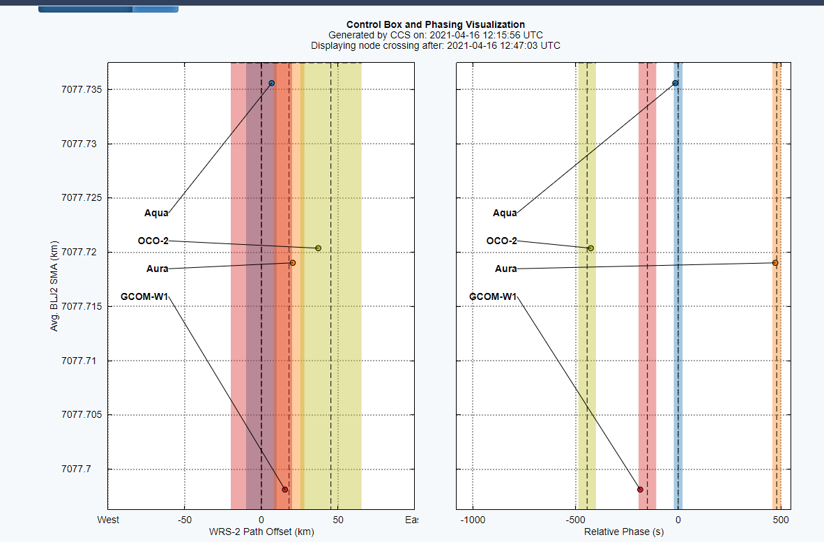

Slide 10
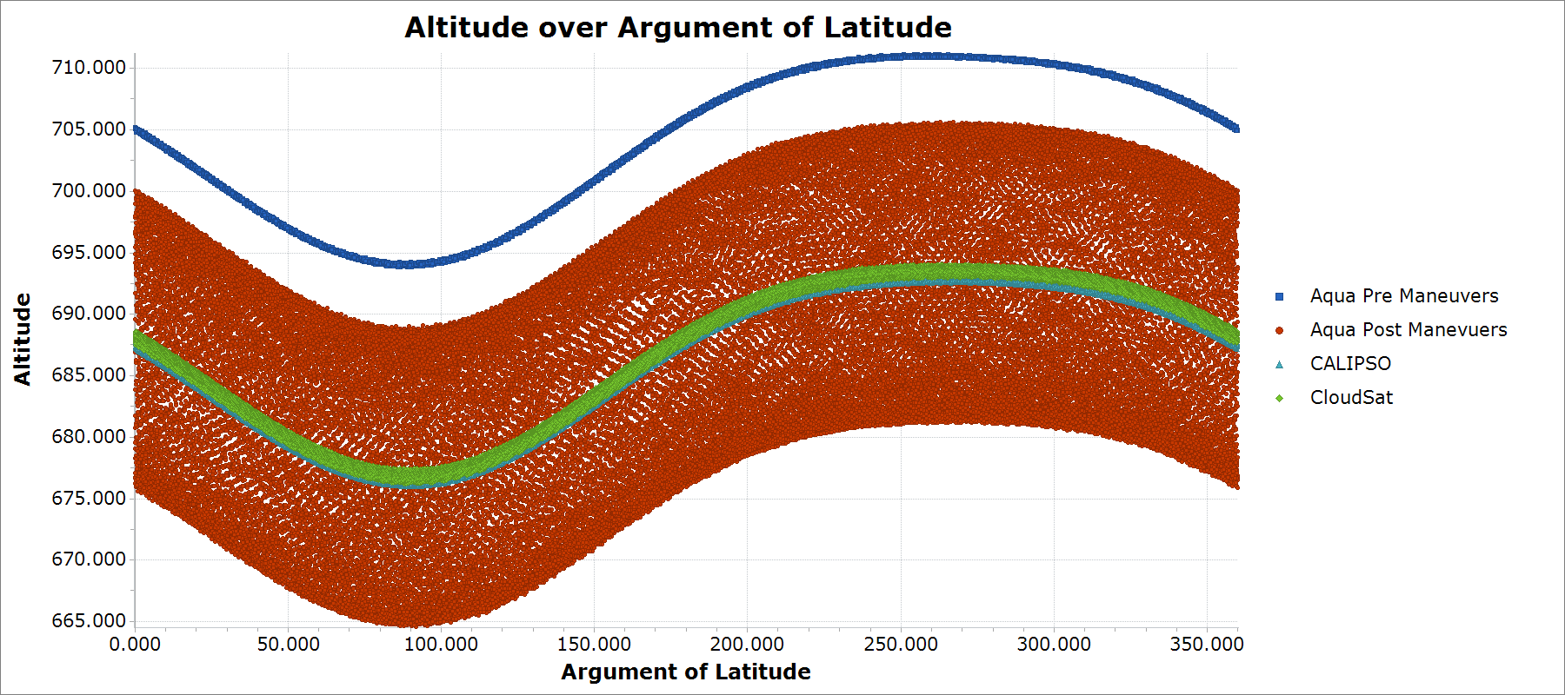
Aqua orbit before and after exit from constellation and CloudSat / CALIPSO orbits

