Slide 1



SMD AI WORKSHOP DAY2
Open Science: Tools, services, Workflows, and platforms to catalog and share ML data and model
Dr. Rahul Ramachandran
Manager | Inter-Agency Implementation and Advanced Concepts Team (IMPACT)
Senior Research Scientist | Earth Science Branch (ST11)
Marshall Space Flight Center/NASA
Huntsville, Alabama 35812, USA

Slide 2
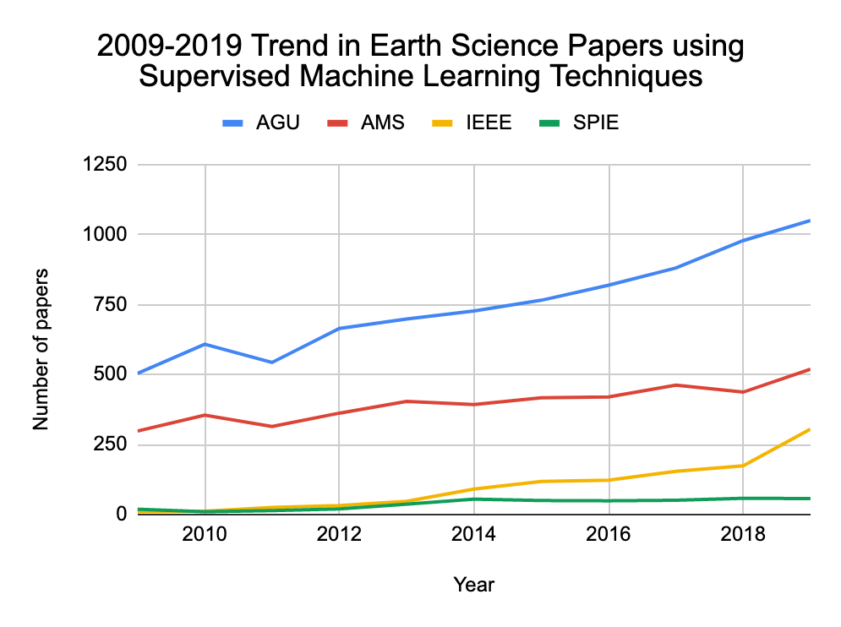
New (old) Tool for Analysis
The use of supervised machine learning techniques in Earth science research has increased significantly in the last decade. The number of atmospheric science papers (i.e., from AMS journals) using ML approaches has increased by over 60%. Across all of Earth science even larger changes have occurred, including a >90% increase in AGU papers and a >10-fold increase in IEEE papers using ML.

Slide 3
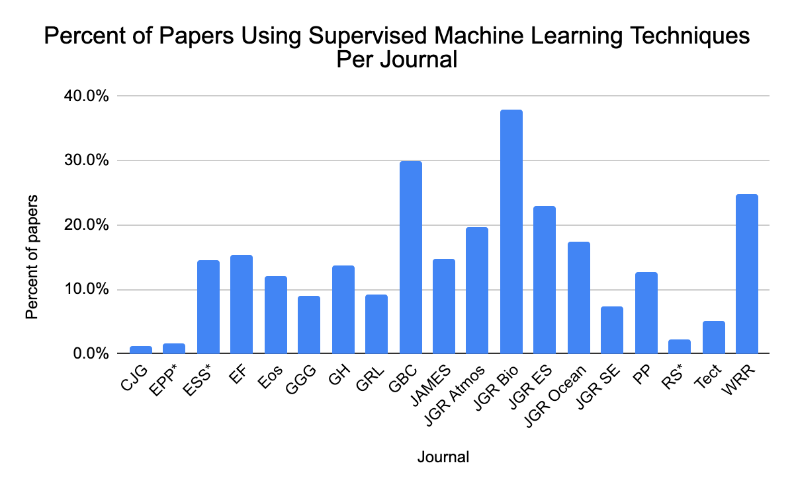
New (old) Tool for Knowledge Extraction
In this chart, the number of supervised ML papers from the previous chart is divided by the total number of papers published in each journal during the 10-year window covered by the literature survey. This gives a view of the prevalence of the use of supervised ML in each research domain. The biogeoscience and land surface research communities lead in this area: over 20% of papers published in Global Biogeochemical Cycles, JGR Biogeosciences, JGR Earth Surface, and Water Resources Research use supervised ML techniques, including over 35% of the papers in JGR Biogeosciences.

Slide 4
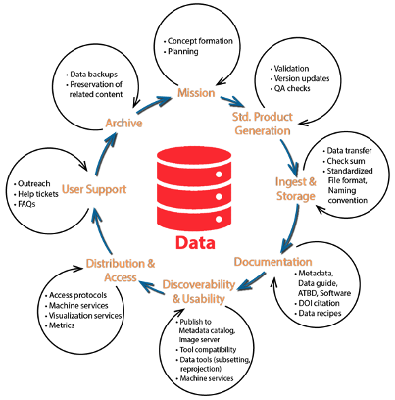
Role of AI in the Data Life Cycle
Potential Applications:
Automate and improve data quality checks
Optimize compute costs
Augment metadata and document generation
Optimize storage strategies for improved access while reducing costs
Automated user desk support
Implications:
Data storage structures optimized for ML
Cataloging ML models, code, training data
Improve overall efficiency, quality of data and metadata while reducing cost of data production

Slide 5
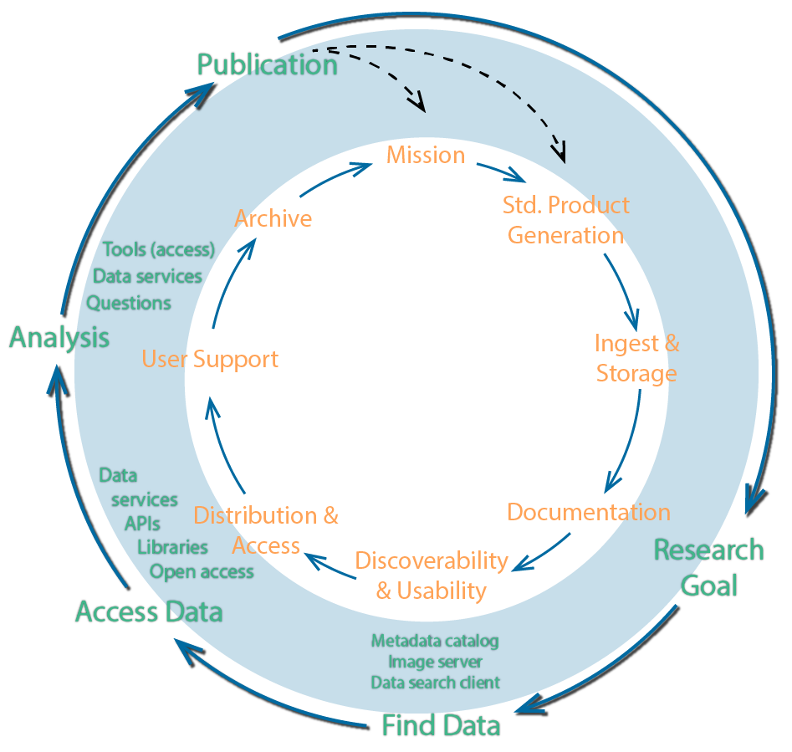

Role of AI in the Knowledge Life Cycle
Potential Applications/Implications:
Improved data discovery capabilities
Knowledge discovery
  Automated data/infomation curation and semantic aggregation
Analysis (Knowledge Extraction)
Enable new means of extracting new information and knowledge from data

Slide 6
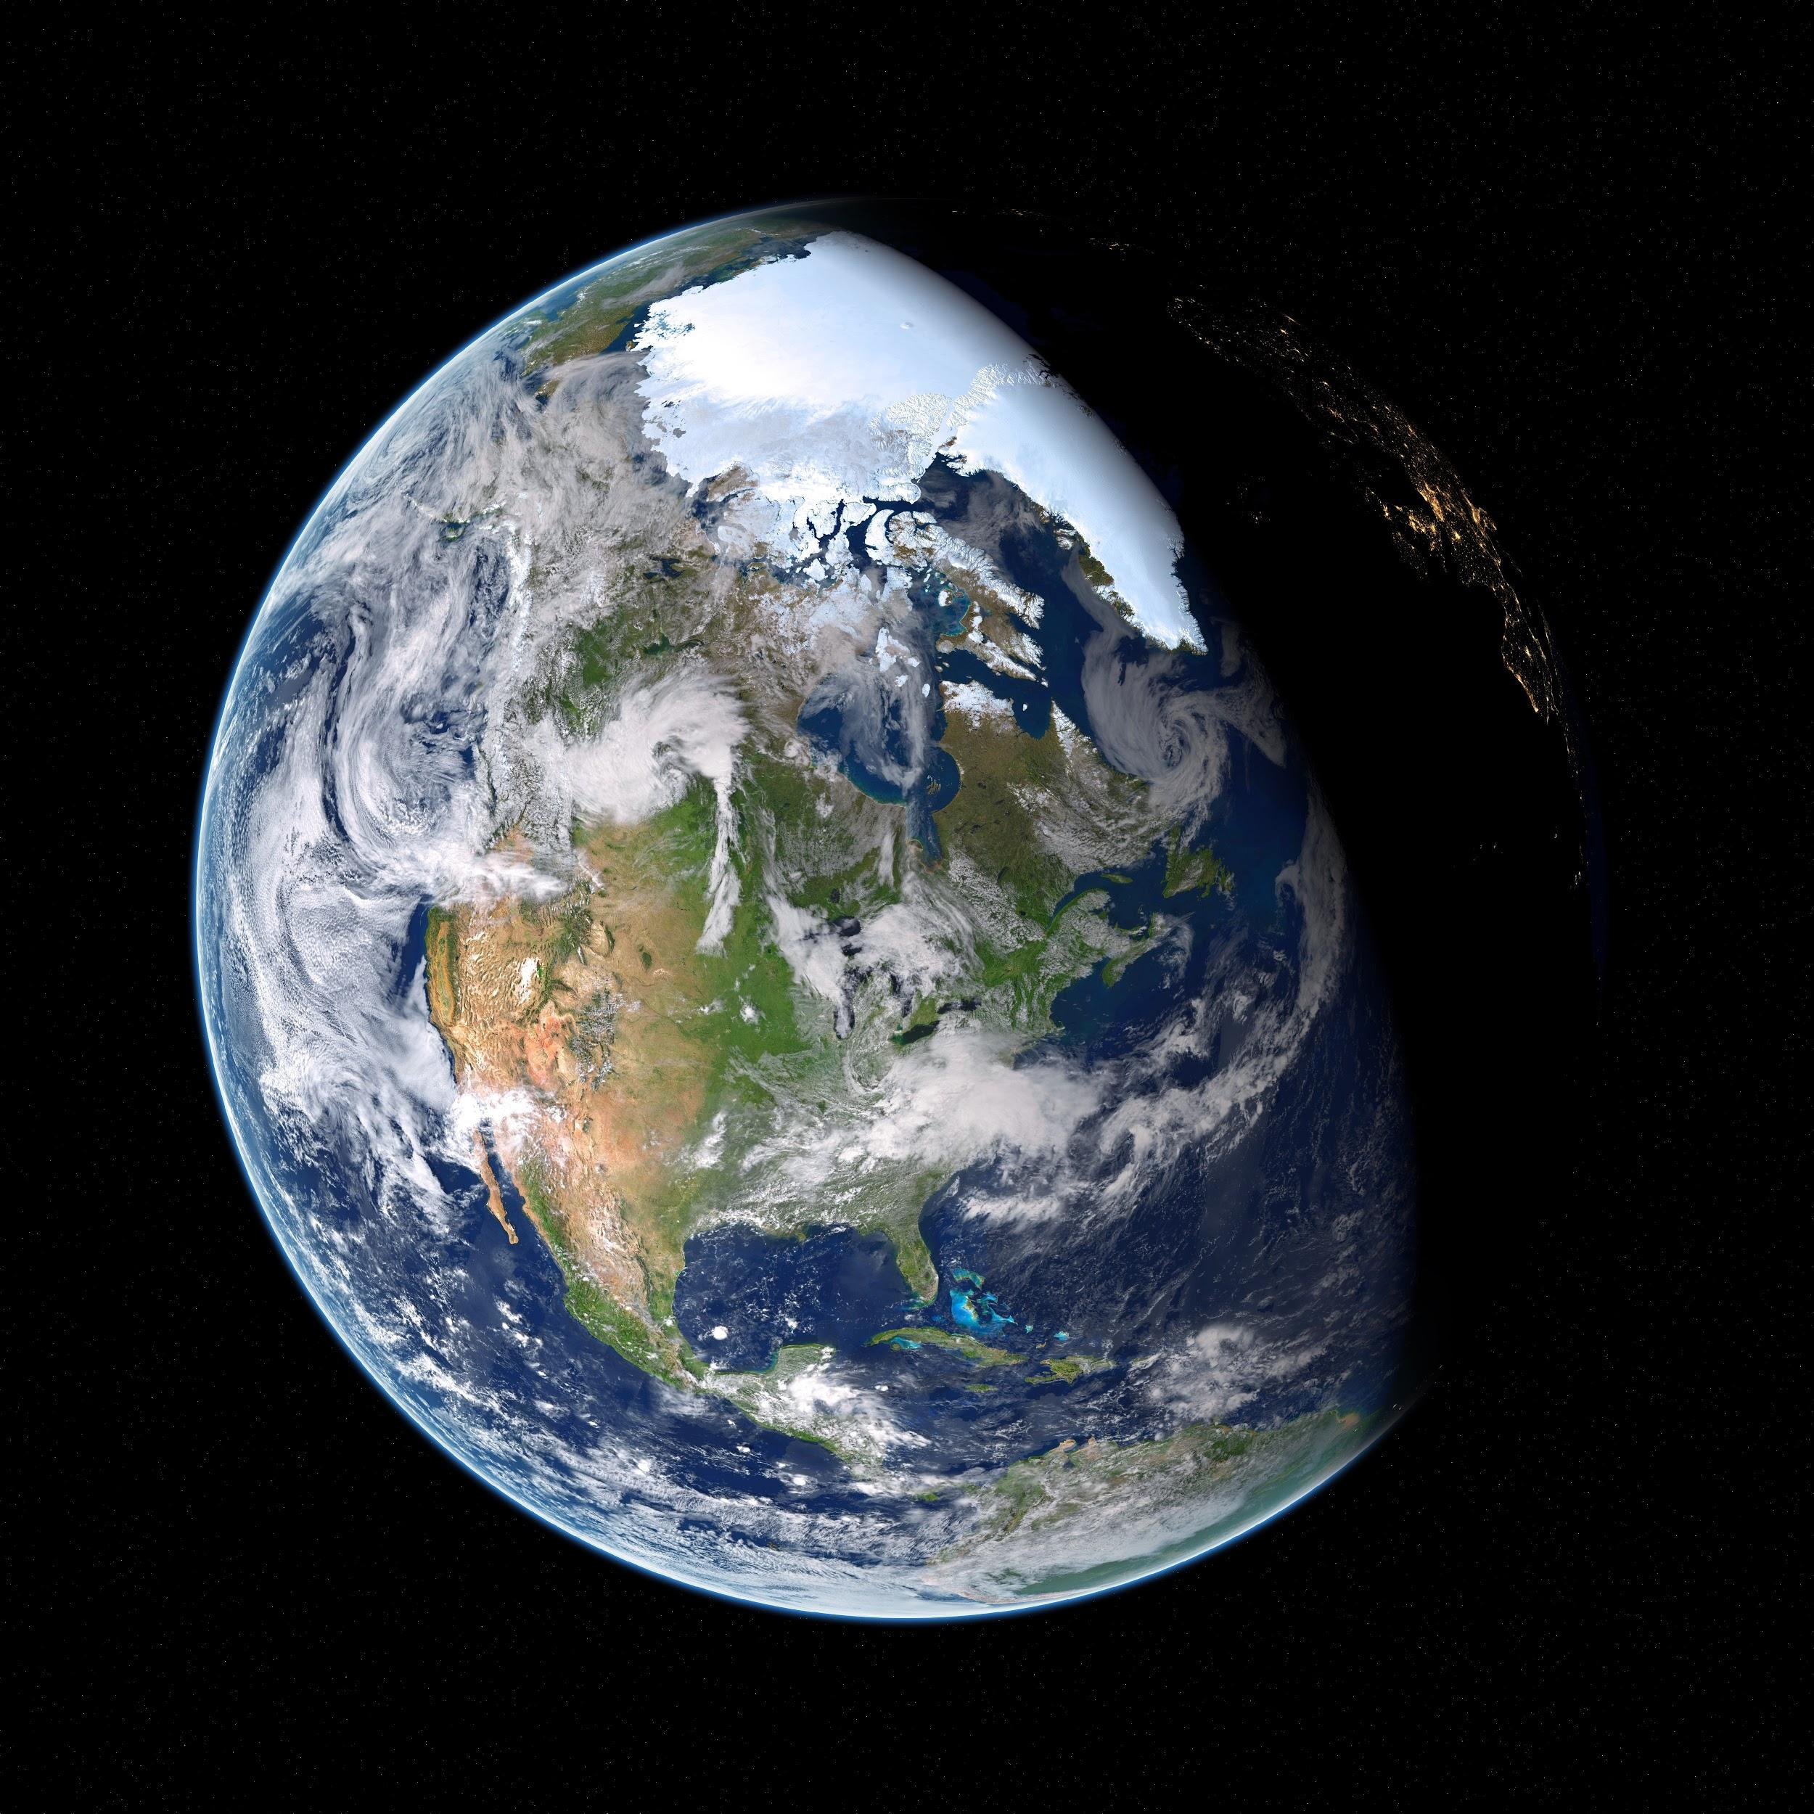
Open Science Definition(s)
Open science definitions
Open science is the idea that scientific knowledge of all kinds be openly shared as early as it is practical in the discovery process (Narrow)
Open science can be defined as any activity that covers anything about the future of knowledge creation and dissemination (Broad)
“open science as a collaborative culture enabled by technology that empowers the open sharing of data, information, and knowledge within the scientific community and the wider public to accelerate scientific research and understanding”
- Ramachandran, R., Bugbee, K., & Murphy, K. J. (Accepted 2021). Moving from Open Data to Open Science. Earth and Space Science, Wiley Publication (https://agupubs.onlinelibrary.wiley.com/doi/10.1029/2020EA001562)
https://www.pexels.com/photo/astronomy-cosmic-cosmos-dark-355935/

Slide 7
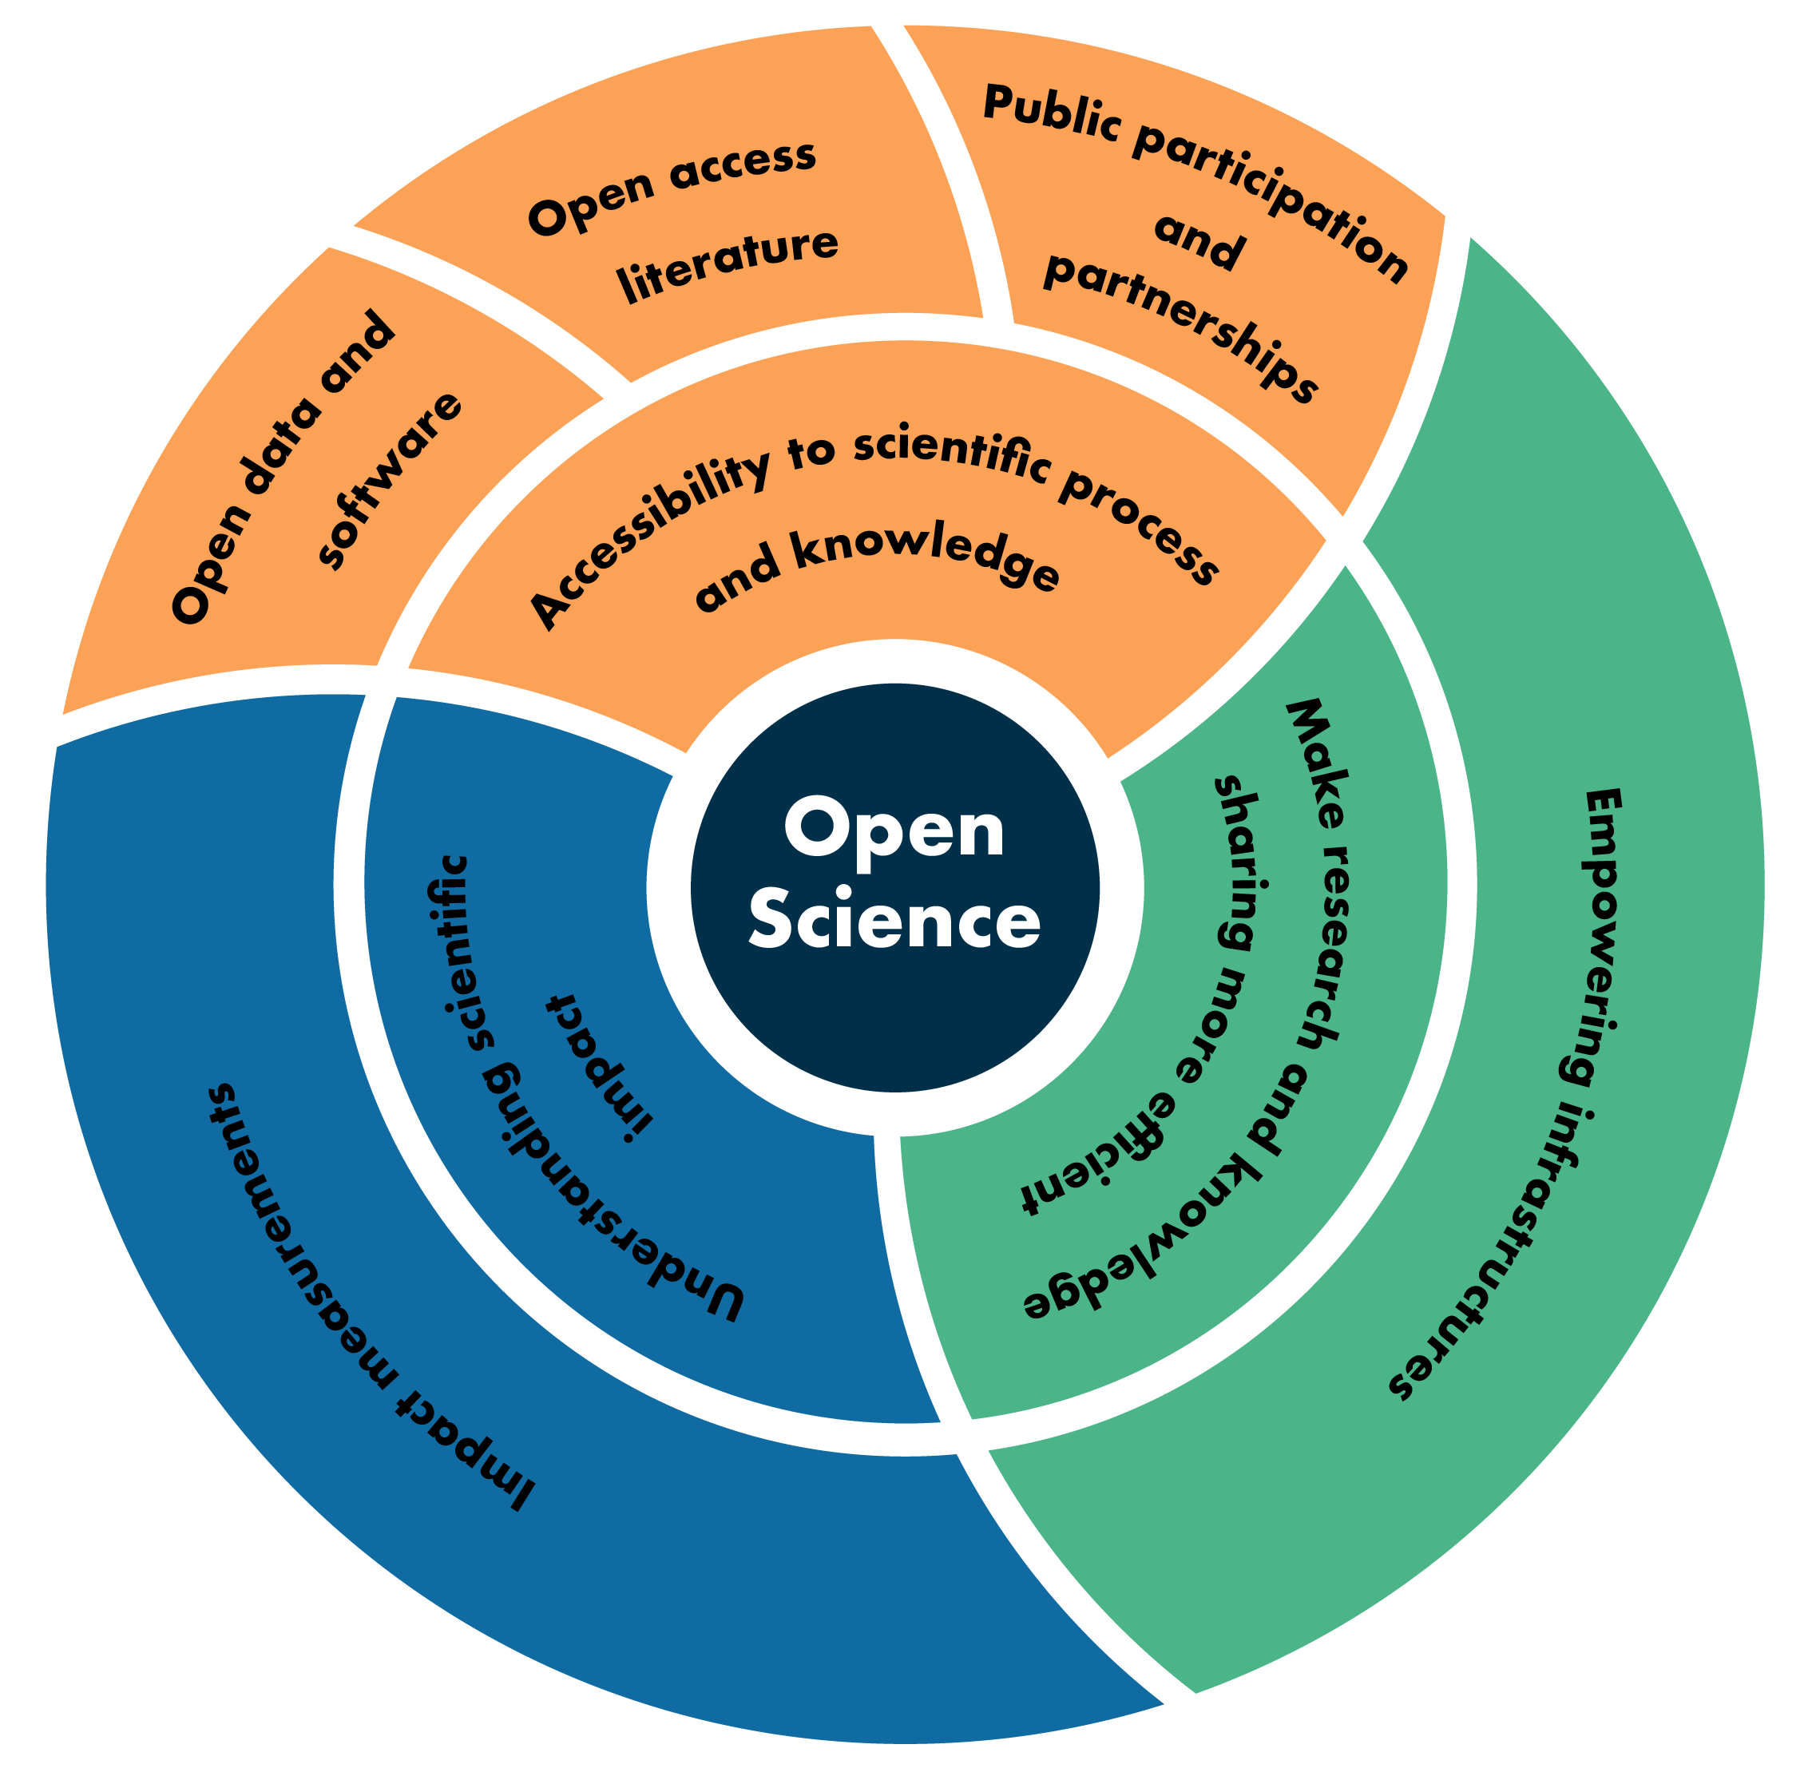
Open Science Areas
Accessibility to Science
Science as a way of thinking
  Participation of non-scientists and amateurs in research
  Enabling broader comprehension of research results
Science as a body of knowledge
  Open data, open source software and open access literature (Gold/Green)
Efficient research processes and knowledge dissemination
  Cyberinfrastructure to support science
  Free a researcher from the constraints of limited local resources
  Abstract away the data management, wrangling and scaling complexity
  Collaborations
  Facilitate the management and sharing of research objects, support actionable research
Understanding Scientific Impact

Slide 8
Agenda
Accessibility to Science
Science as a way of thinking
  Participation of non-scientists and amateurs in research
  Enabling broader comprehension of research results
Science as a body of knowledge
  Open data, open source software and open access literature (Gold/Green)
Efficient research processes and knowledge dissemination
  Cyberinfrastructure to support science
  Free a researcher from the constraints of limited local resources
  Abstract away the data management, wrangling and scaling complexity
  Collaborations
  Facilitate the management and sharing of research objects, support actionable research
Understanding Scientific Impact
Reproducibility
Cataloging and sharing AI ready data and models
Computational Platforms

Slide 9
Thank you.
rahul.ramachandran@nasa.gov
https://impactunofficial.medium.com/

