Slide 1
Ground Elevation and Wind Profiles at Pad 39B
Frank Leahy
Nathan Curtis
MSFC/EV44/Natural Environments Branch
NE DOLWG, May 12, 2021

Slide 2
Agenda
Ground winds
Vertical datum (NAVD 88)
Ground height relative to vertical datum
Impacts
Forward work

Slide 3
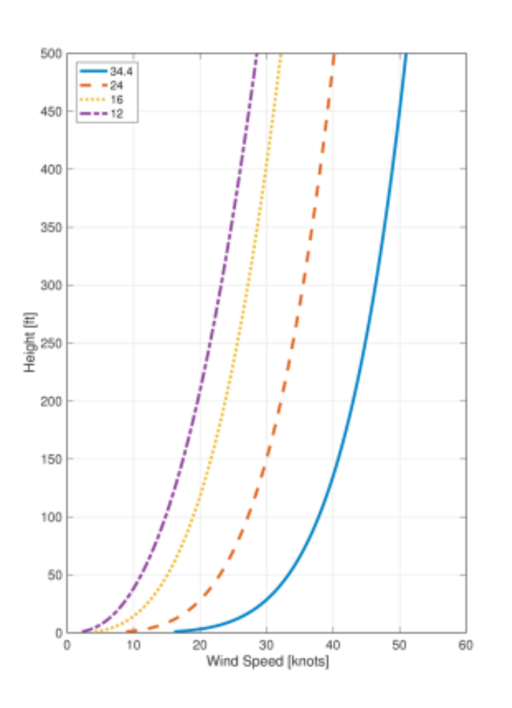
Ground Winds
All ground winds for design assessments are relative to height above ground level (AGL)
  This includes all ground wind design values provided in SLS-SPEC-159 and SLS-SPEC-044-07
In engineering assessments, it is important to apply the appropriate wind at the desired height on the vehicle/ML
For Exploration Systems Development (ESD), heights on the vehicle/ML are relative to the NAVD 88 vertical datum
Since wind profiles are AGL, the ground height relative to the NAVD 88 must be known

Slide 4
NAVD 88/Ground Elevation Offset
Original ground elevation assessment:
  KSC drawing 79K38780 (CX 39 Area Benchmark Site Control) showed NAVD 88 elevations at benchmarks around the perimeter of Pad 39B are between 16.5 and 17 ft
  Clarification was added to both SLS-SPEC-159 and SLS-SPEC-044-07 that all wind profile heights need to add 16 ft to the AGL heights to represent heights relative to the NAVD 88
  It was later learned that the benchmarks were on 10 ft posts
  Therefore, the stated NAVD 88 offset of 16 ft is 10 ft too high
KSC Drawing 79K36769 shows the ground height around the lightning towers ranges from 5 to 8 ft above the NAVD 88
  Average of 5.8 ft

Slide 5
Lightning Tower Heights
Reported heights on the lightning towers are relative to NAVD 88
  132.5 ft
  257.5 ft
  382.5 ft
  457.5 ft
Assumption has been these heights are relative to the ground
Reported heights on the lightning towers need to be ~6 ft lower to be relative to ground level

Slide 6
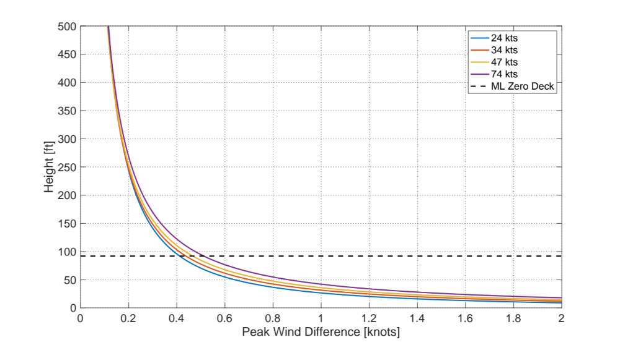
Lightning Tower Heights

Slide 7
Impacts
Ground wind profiles are mostly used for structural loads and liftoff assessments
SLS analyses show height discrepancy has a small impact
Wind related LCCs and OMRs are based on design profiles, and therefore relative to ground level
The Pad 39B towers are used to evaluate the following LCCs/OMRs:
  WIND-001 (LCC 386): uses all 4 heights
  ML/CT Wind Limits for Transfer Operations (OMRS 7345): uses 132 ft level
  SLS/MPCV Wind Constraints for Tanking (OMRS 4472): uses 132 ft level
  Collect loads data during SLS liftoff (OMRS 5486): uses all 4 heights
  Collect loads data while vehicle is on the pad (OMRS 5487): uses all 4 heights
  Collect loads data during rollout/rollback (OMRS 5488): uses 132 ft level

Slide 8
Forward Work
For SLS, determine if additional sensitivity assessments need to be done
What to do about LCCs/OMRs? Update heights (subtract 6 ft)?
Any other documentation that is impacted? PRD, etc?
Update SLS-SPEC-159 and SLS-SPEC-044-07 to change height offset from 16 ft to 6 ft

