Slide 1
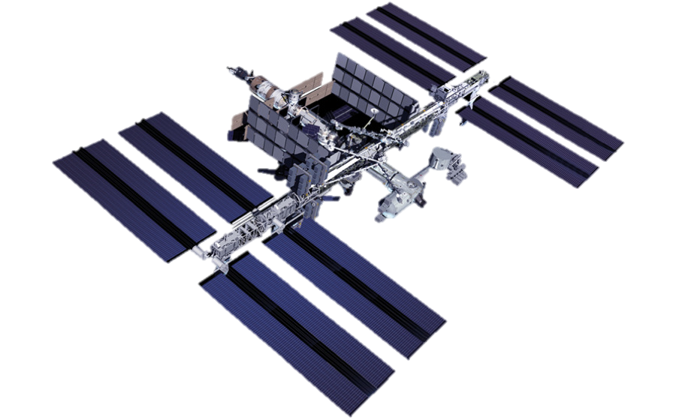



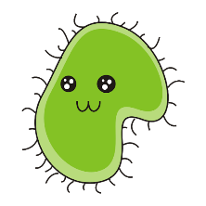
EVA Swab Project: A Tool to Collect Microbiological Samples from the Outside of the International Space Station
LPI/OU Symposium 5/11/2021
Aaron B. Regberg PhD
Mary Sue Bell PhD
Michelle Rucker
Figure Courtesy Julie Mitchell PhD

Slide 2
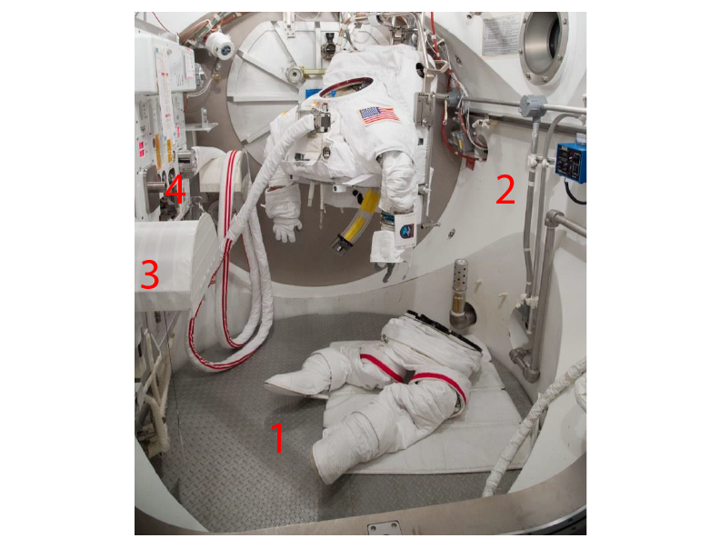
Outline
Project Objectives / Research Questions
Previous Testing
Scientific Results & Recently Published Russian Results
Notional Sampling Objectives

Slide 3
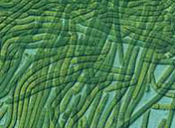
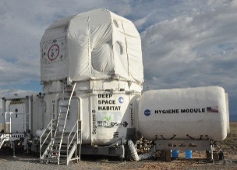
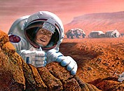
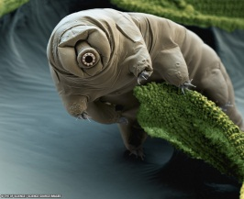
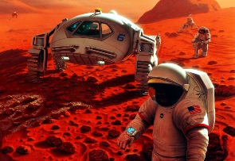
Investigation Objectives
BACKGROUND
Some organisms can survive exposure to space!
ISSUE
But we don’t know what’s actually leaking/venting from our current systems, how long those organisms could survive, or how far they may travel under destination conditions
  Cyano-bacteria survived 500+ days outside ISS
  Does proximity to a warm spacecraft matter?
  Tardigrades survived extended ISS exposure…and then reproduced
  How close can crew get without compromising science?
  How far could our hitchhikers spread?
  The answers will drive element design (i.e. closed vs. open ECLS), where we place elements, and who/how we collect science samples
  We also know that all crewed, pressurized volumes will leak or vent

Slide 4
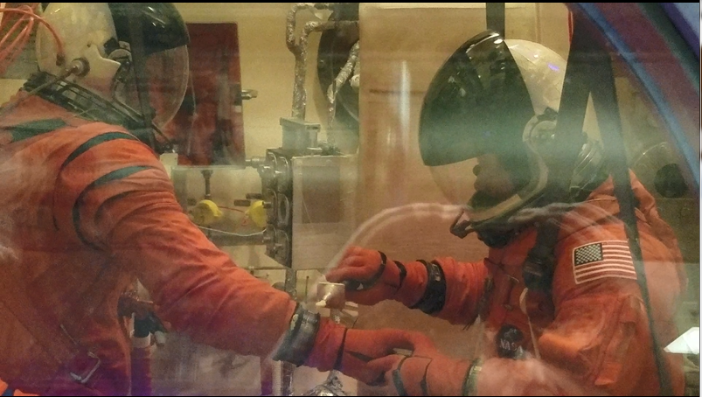
Research Questions
Can we collect an uncontaminated sample during EVA?
What if any ecosystems exist outside ISS?
Are microbes outside ISS evolving?
Are these evolved microbes being carried back into ISS?

Slide 5
Outline
Project Objectives / Research Questions
Previous Testing
Scientific Results & Recently Published Russian Results
Notional Sampling Objectives

Slide 6
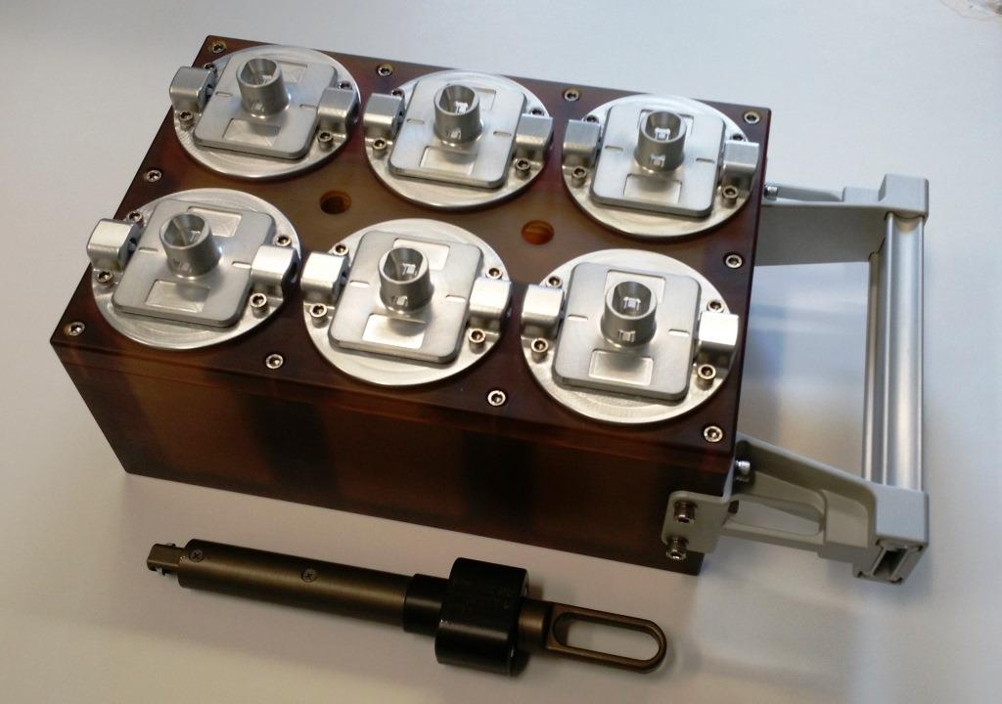
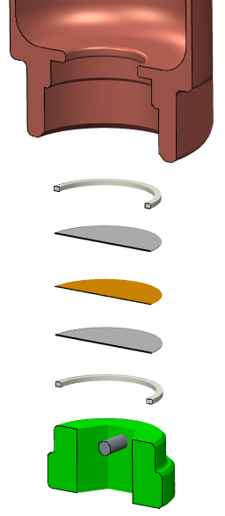

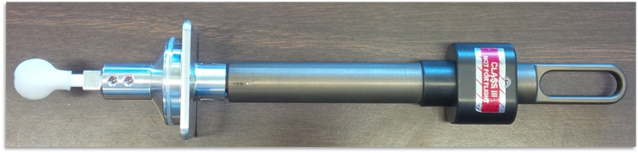
Payload Overview
8-Sample EVA Swab Kit
6 on top, 2 on bottom (not shown)
0.22 micron pore Microbial filter in bottom of each container to accommodate pressure changes
CAUTION
Functional Sharp Edge
Repurposed Shuttle tile repair handle
Rucker, Michelle A., Drew Hood, Mary Walker, Kasthuri J. Venkateswaran, and Andrew C. Schuerger. 2018. “EVA Swab Tool to Support Planetary Protection and Astrobiology Evaluations.” In 2018 IEEE Aerospace Conference, 1–9. IEEE. https://doi.org/10.1109/AERO.2018.8396381.

Slide 7
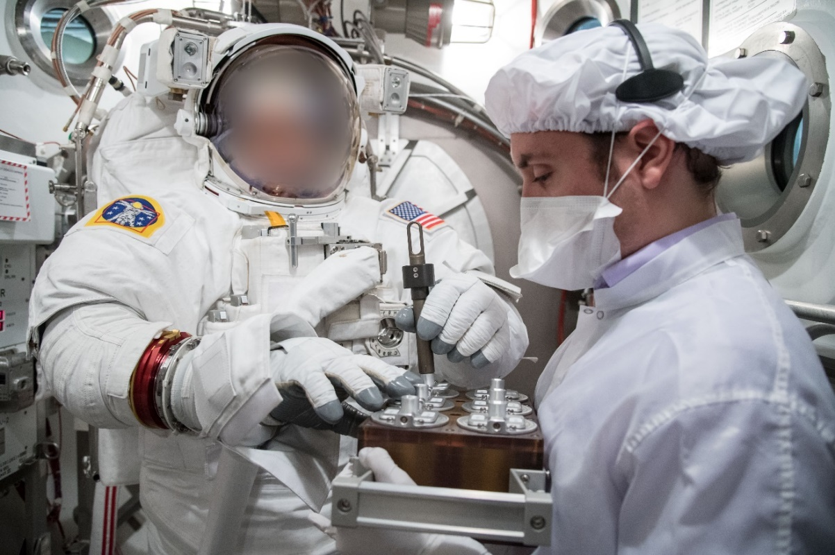
Tested the tool at Vacuum by piggybacking on Engineering Tests and Training Operations
OCSS
  Orion Crew Survival System
Swab Tool
EMU sampling during pre-breathe while the astronaut acclimatizes
Sample Caddy
OCCS sampling at vacuum
Some microbes were still viable after ~6 hrs vacuum exposure

Slide 8
Outline
Project Objectives / Research Questions
Previous Testing
Scientific Results & Recently Published Russian Results
Notional Sampling Objectives

Slide 9
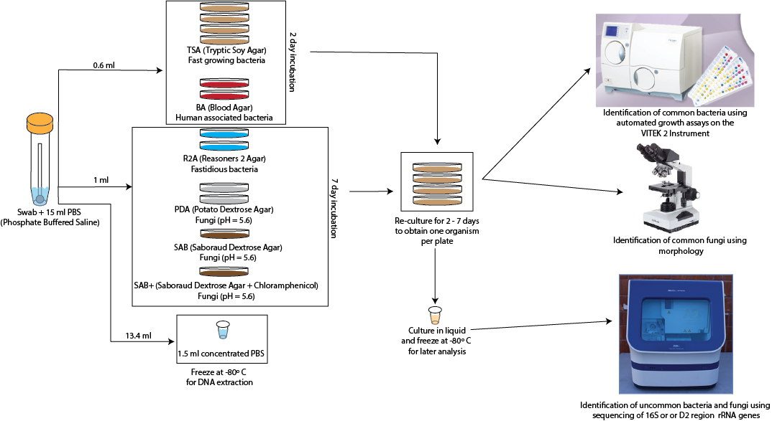
Culture Based Identification

Slide 10
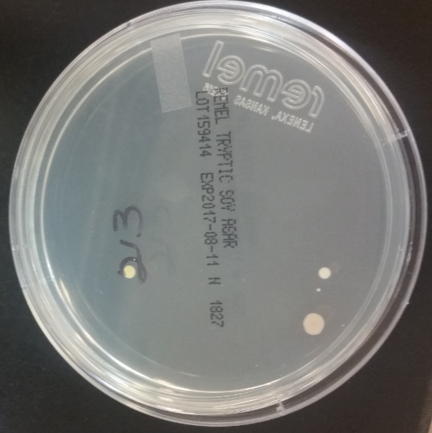
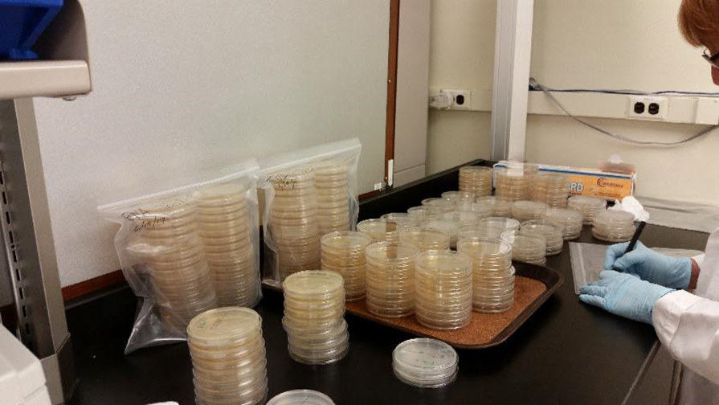
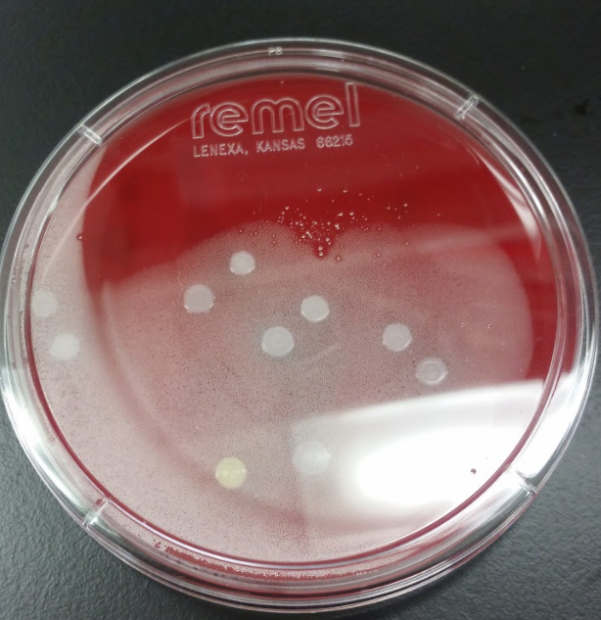
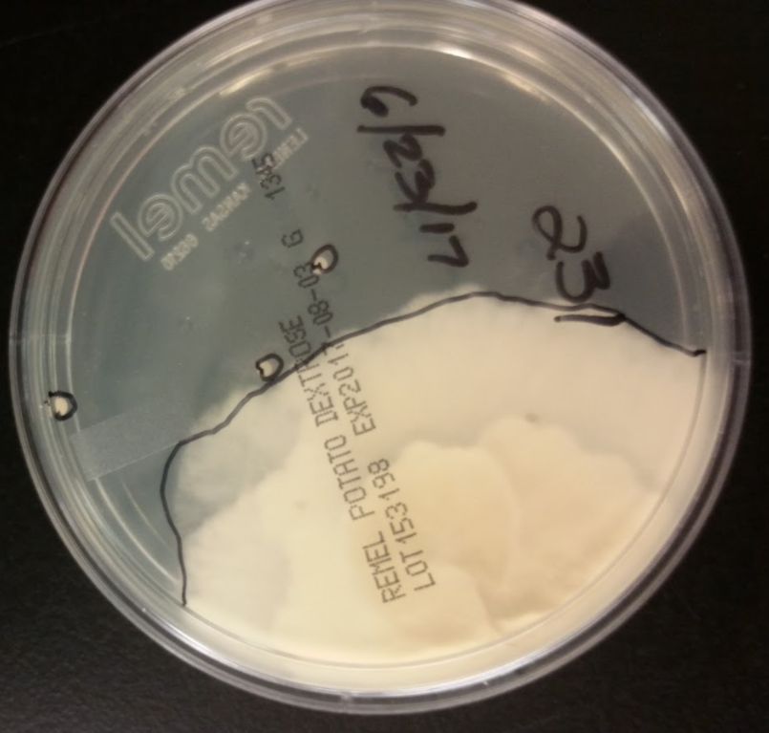
Ground test results demonstrate that microbes are on external suit surfaces and can survive several hours at vacuum

Slide 11
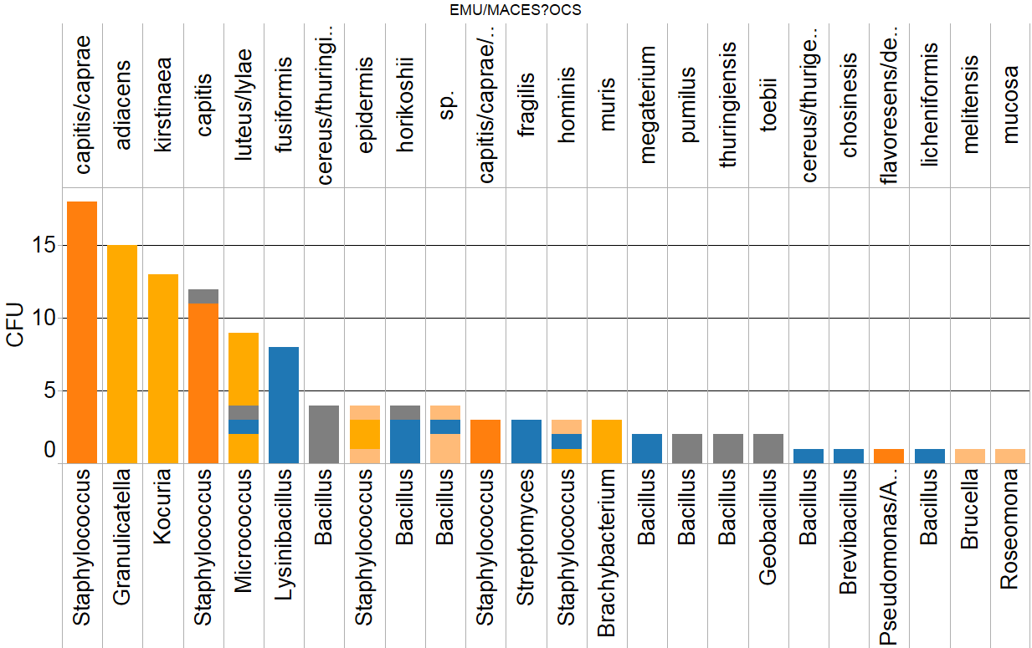
No dangerous organisms identified during pressurized suit tests: 24 organisms identified
Species
OCCS
MACES
EMU
Pre-Test Chamber
Post-Test Chamber
Typical human habitat and soil bacteria found
Genus

Slide 12
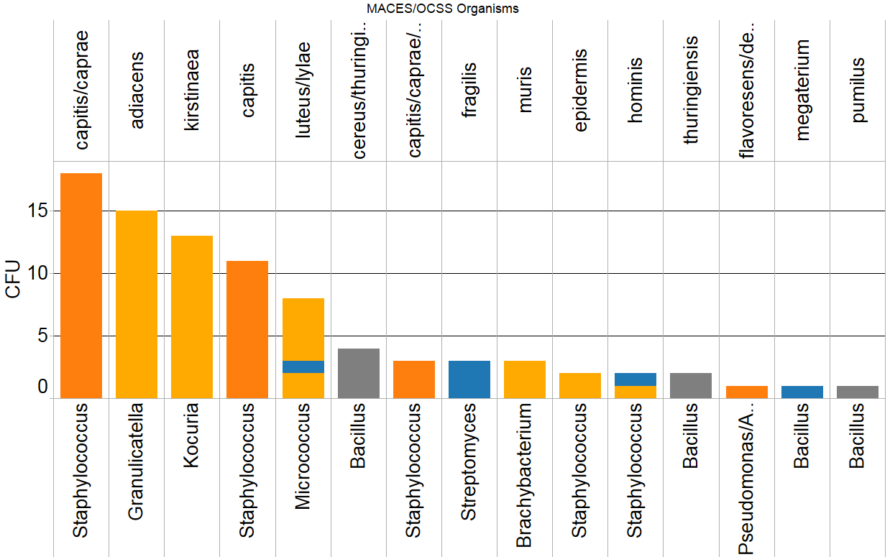
Non-spore-forming bacteria (10 species) can survive at least 4 hours of vacuum
Species
OCCS
MACES
Pre-Test Chamber
Post-Test Chamber
Genus

Slide 13
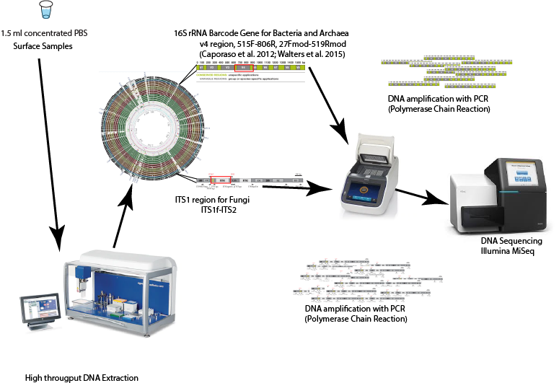
Culture Independent Workflow Allows us to identify Organisms we can’t currently grow

Slide 14
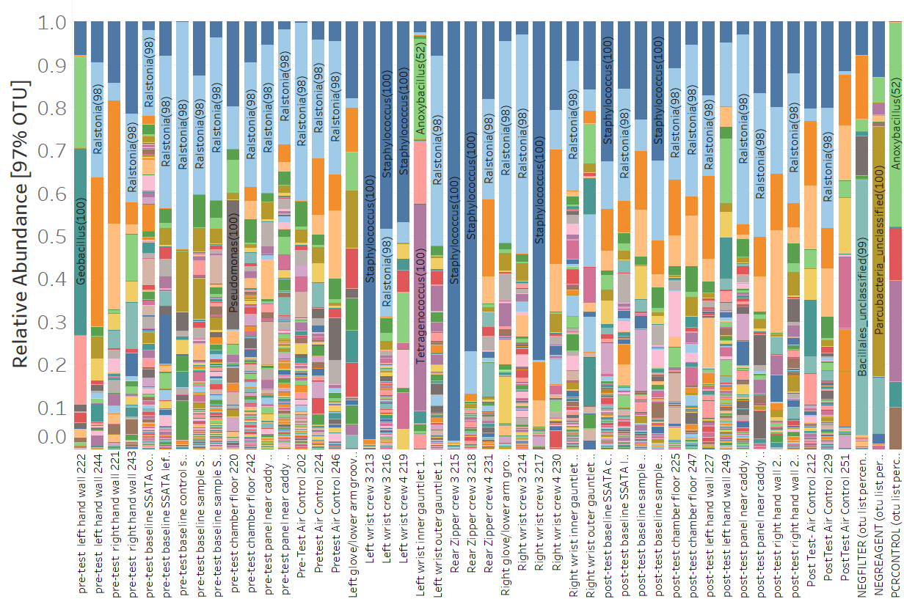
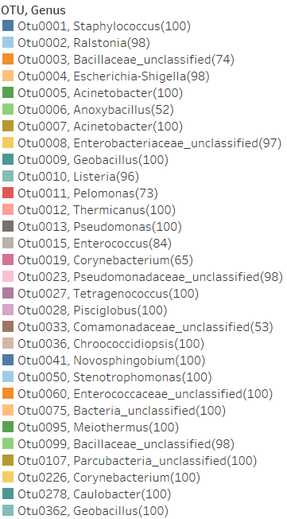
DNA from 2,464 different bacteria was identified
Pre-Test Chamber Samples
Suit Samples
Post-Test Chamber Samples
Blanks

Slide 15
Staphylococcus is the most abundant organism on the suits
Common Skin Bacteria
Pre-Test Chamber Samples
Suit Samples
Post-Test Chamber Samples
Blanks
Consistent with culture based results

Slide 16
Ralstonia is abundant on the suits and in the chambers
Pre-Test Chamber Samples
Suit Samples
Post-Test Chamber Samples
Blanks
Ralstonia was there, but we were not able to culture it—only found through DNA sequencing
Ralstonia has also been identified in the EMU water lines

Slide 17
Ground Test Conclusions to Date
Current cleaning procedures keep the suits relatively clean and free of potentially hazardous microorganisms
  Surprisingly few fungi detected
Current cleaning/handling procedures do not allow us to distinguish microbes leaking from the suits vs. microbes present in the test chambers or from suit technicians handling the suits
  If we can tweak processes, we may be able to determine whether microbes are coming from inside the suits or during pre-test handling, or whether gauntlets help mitigate contamination
  Clean suit joints/gauntlets prior to test, Techs wear gloves during suit donning, etc.
Lots of organisms can survive exposure to vacuum
  We cannot rely on vacuum to sterilize suit surfaces

Slide 18
Outline
Project Objectives / Research Questions
Previous Testing
Scientific Results & Recently Published Russian Results
Notional Sampling Objectives

Slide 19
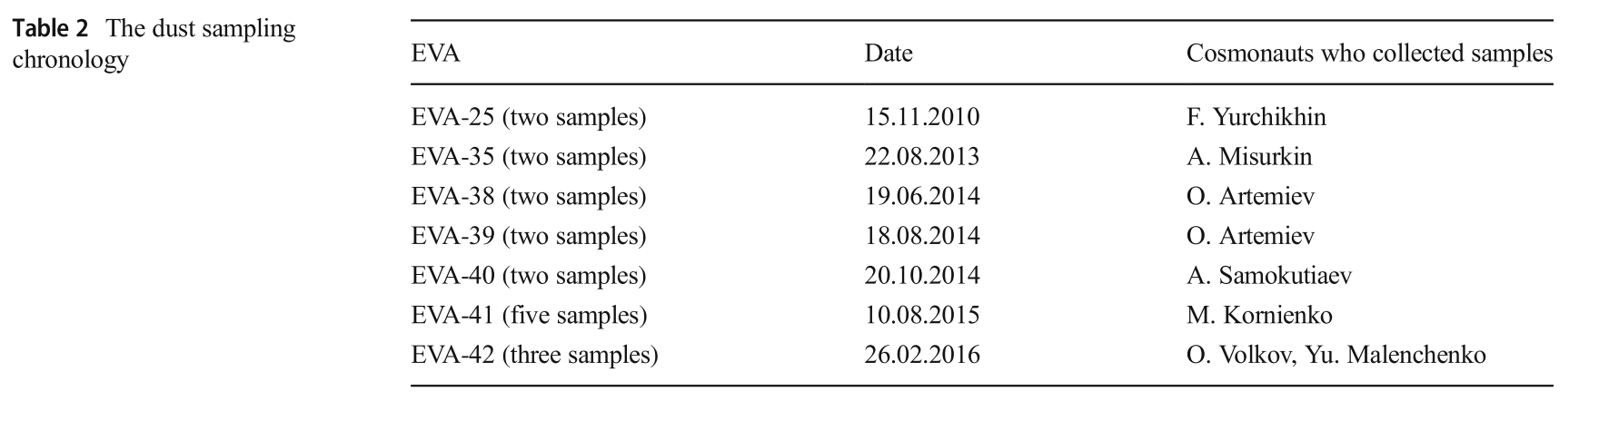
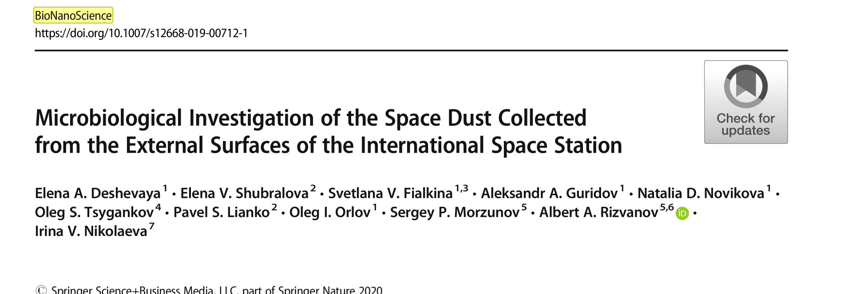
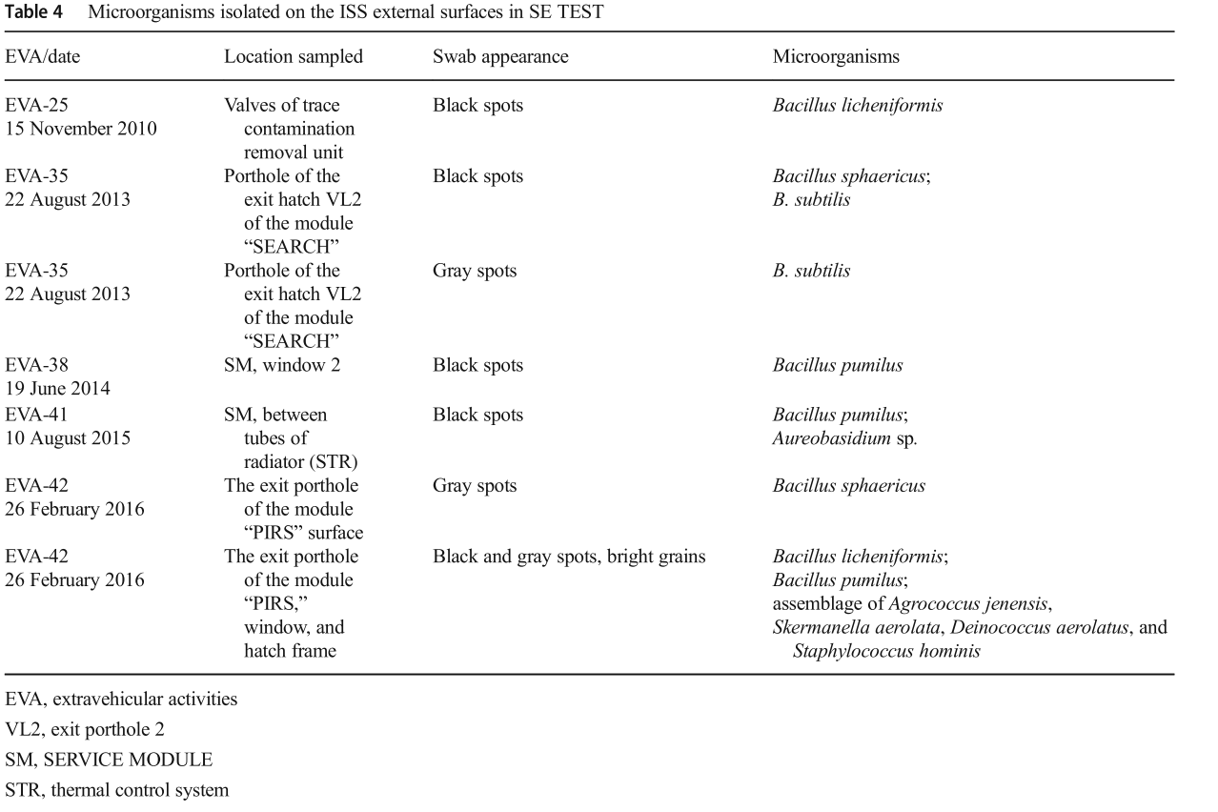
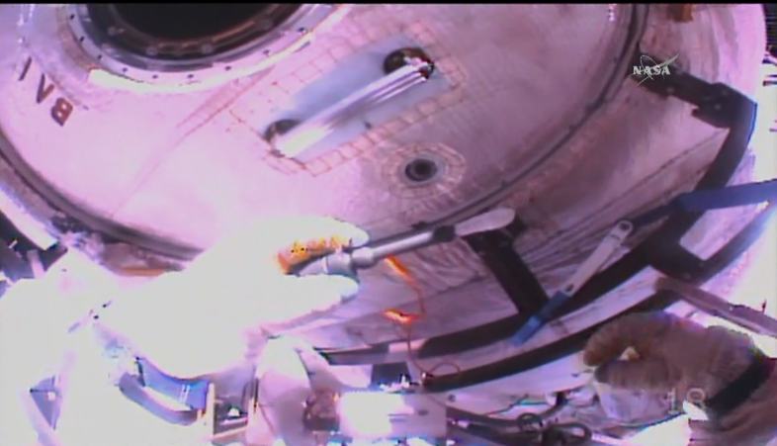
Cosmonauts Have Sampled Russian Segments of ISS
All identified organisms also found inside ISS
Only able to culture organisms from stained samples
Not able to cultivate microorganisms from beneath thermal blankets

Slide 20
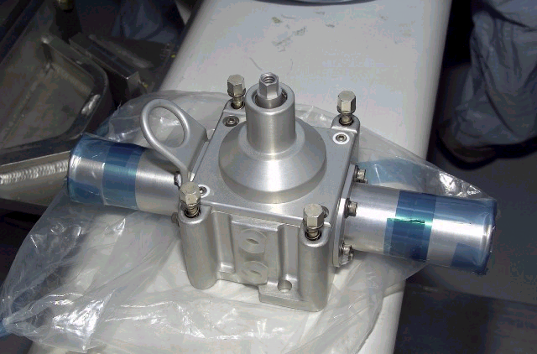
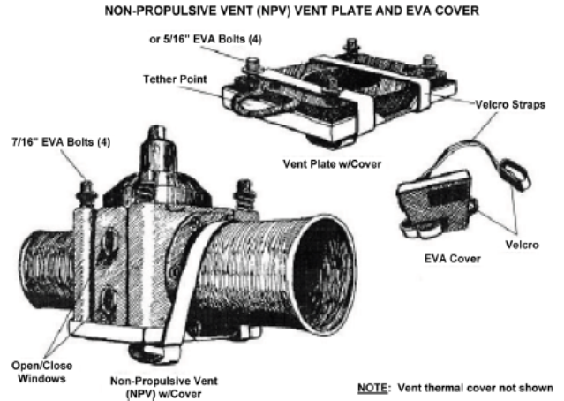
Next Steps: Sample ISS external surfaces
Piggyback onto planned EVA(s)
Sample ISS hull, handrails, hatches along translation path
  Areas near ECLS Non-Propulsive Vents (NPVs) are of particular interest
Optional: EVA suit wrist gauntlets (outer surface) – to compare w/ground tests
Samples will be returned at -80˚C for DNA sequencing

Slide 21
What Else Could we Sample?
Astronauts and robots could use this tool on the Moon, Mars and other locations?

Slide 22
Trade names and trademarks are used in this report for identification only. Their usage does not constitute an official endorsement, either expressed or implied, by the National Aeronautics and Space Administration.

