Slide 1
Science Highlights
Dave Winker

Slide 2
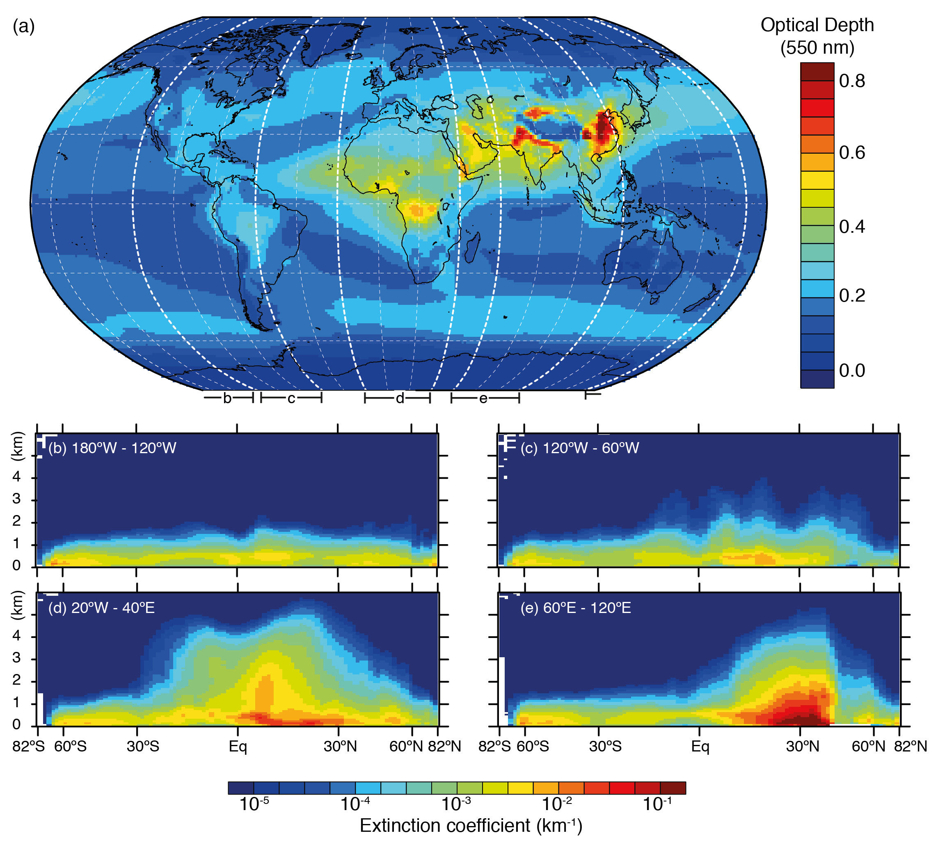
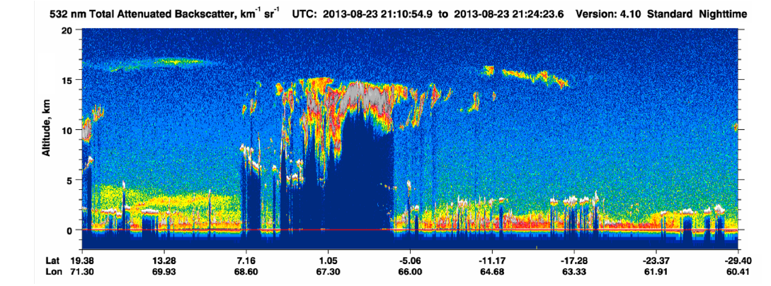
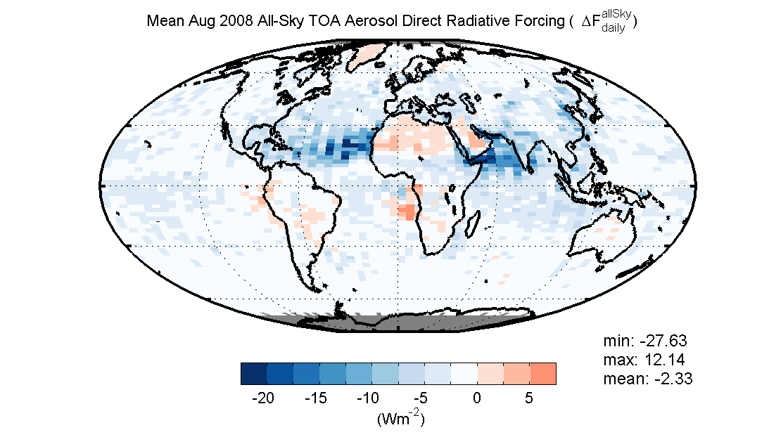
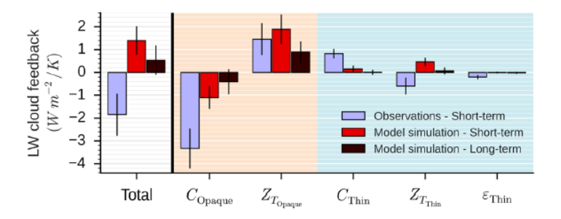
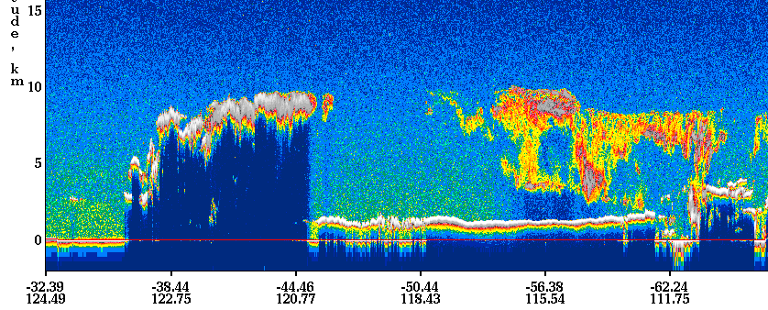
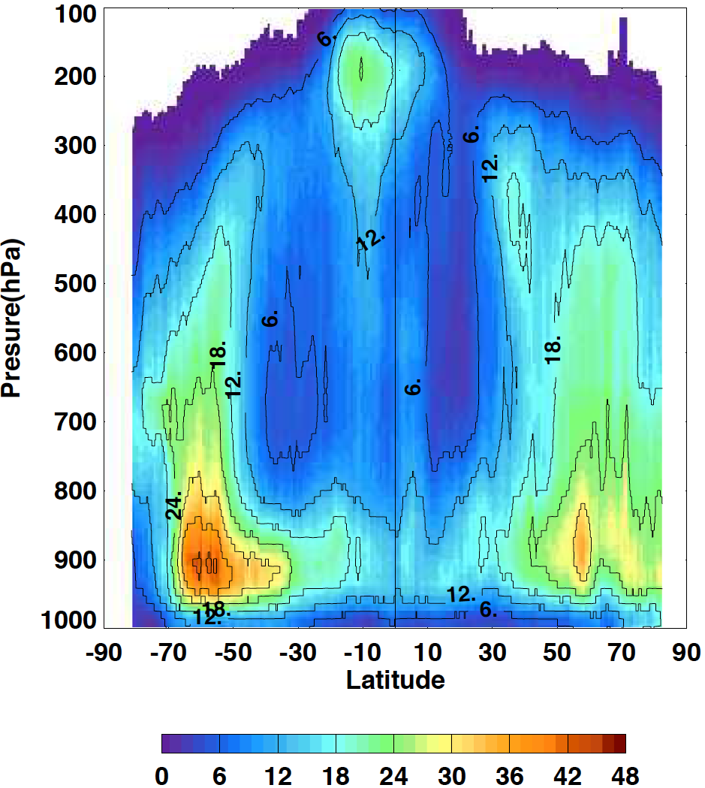
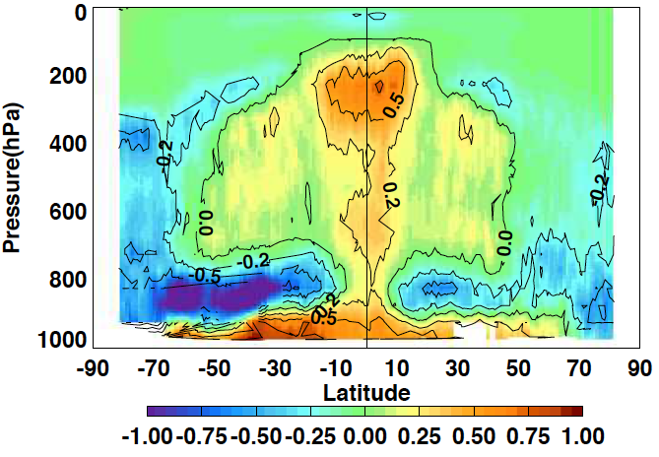
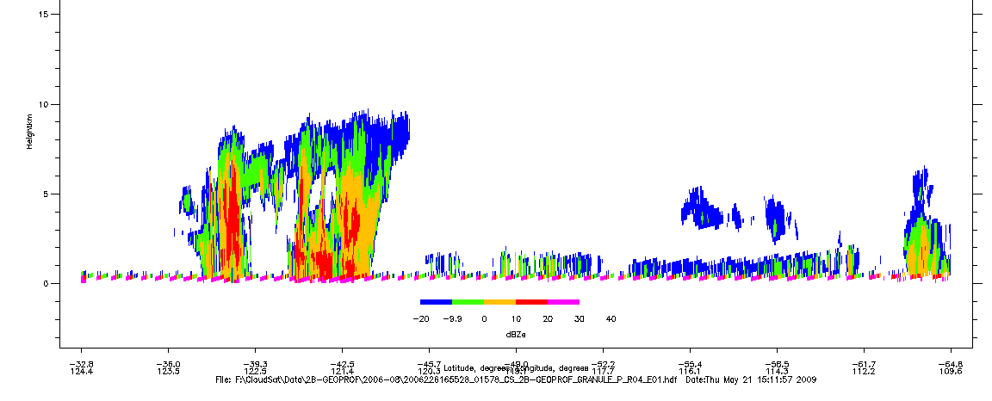
Science Highlights
Vertically-resolved aerosol climatology
(IPCC AR5)
All-sky aerosol radiative effects
LW Cloud Radiative Feedbacks
(Vaillant de Guelis et al., 2019)
Cloud Climatology &
Radiative Heating Profiles
(Kato et al, 2019)

Slide 3
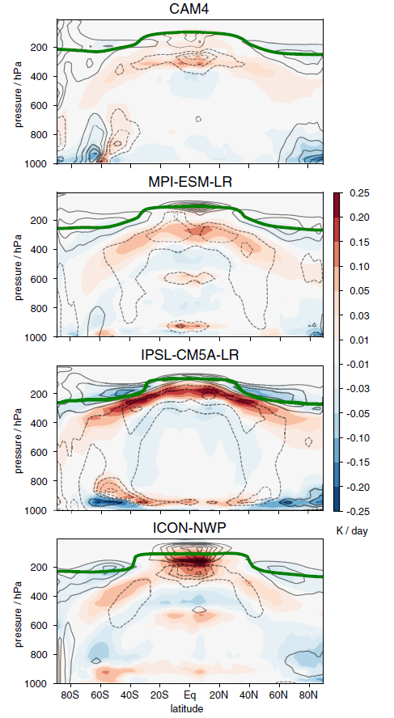
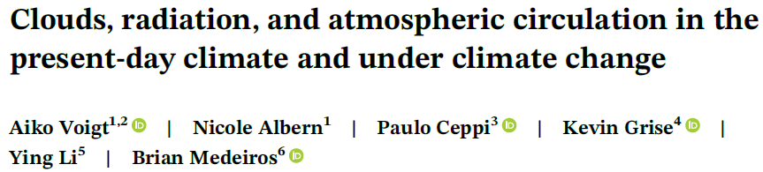
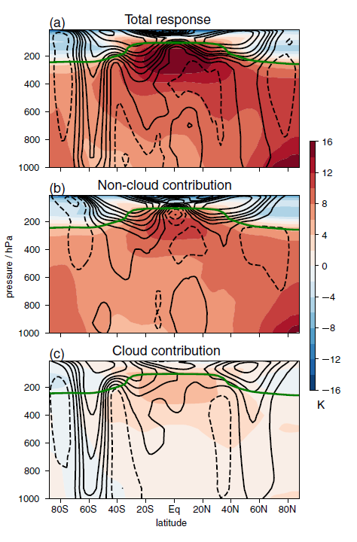
Cloud-Climate Coupling from CALIPSO-CloudSat
Vertically resolved heating profiles are necessary to diagnose the coupling of clouds and the large-scale circulation of the atmosphere, which determines regional responses to climate change.
Joint CALIPSO-CloudSat observations provide the first observational constraints on cloud impacts on the general circulation.
(Voigt et al 2020)
Diagnosis of cloud radiative impacts on zonal circulation in MPI-ESM
Modelled cloud-induced change in atmospheric heating
in four climate models
(Voigt et al 2020)

Slide 4
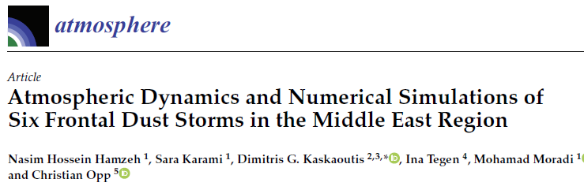
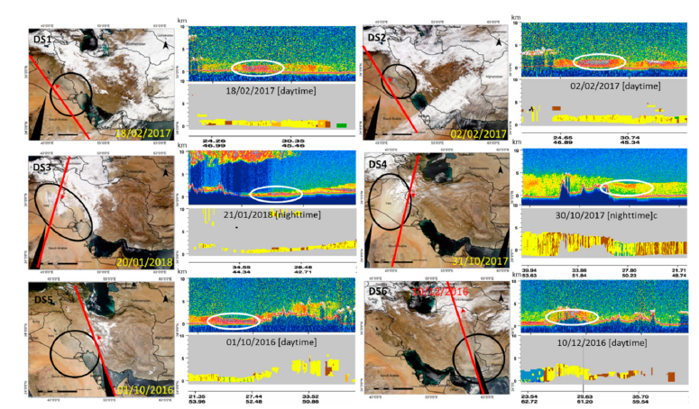
Dust storms are natural hazards which affect the formation of hurricanes, monsoon circulations, and human health.
“The modelling of dust storms can be challenging due to complex terrain, uncertain dust sources and soil characteristics, and complex meteorology”
This paper examines the atmospheric dynamics which trigger wintertime dust storms in the Middle East and uses CALIOP and MODIS to evaluate the ability of several models to simulate these storms.
They find the mechanisms triggering winter dust storms are different from spring and summer storms: winter storms tend to be very shallow (< 2 km) while spring and summer storms are much deeper (6-8km).
(Hamzeh et al., Atmosphere, 2021)
None of the models were able to accurately simulate the distribution and magnitude of dust. Problems were due to the parameterization of dust mobilization and the models’ ability to represent the local meteorology in complex terrain, especially the strong near-surface winds triggering the storms

Slide 5
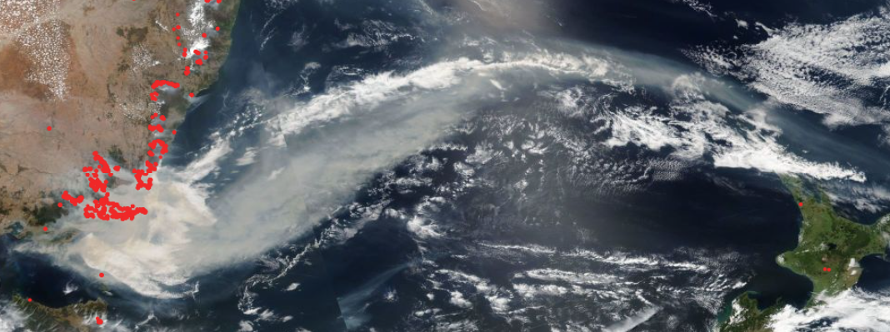
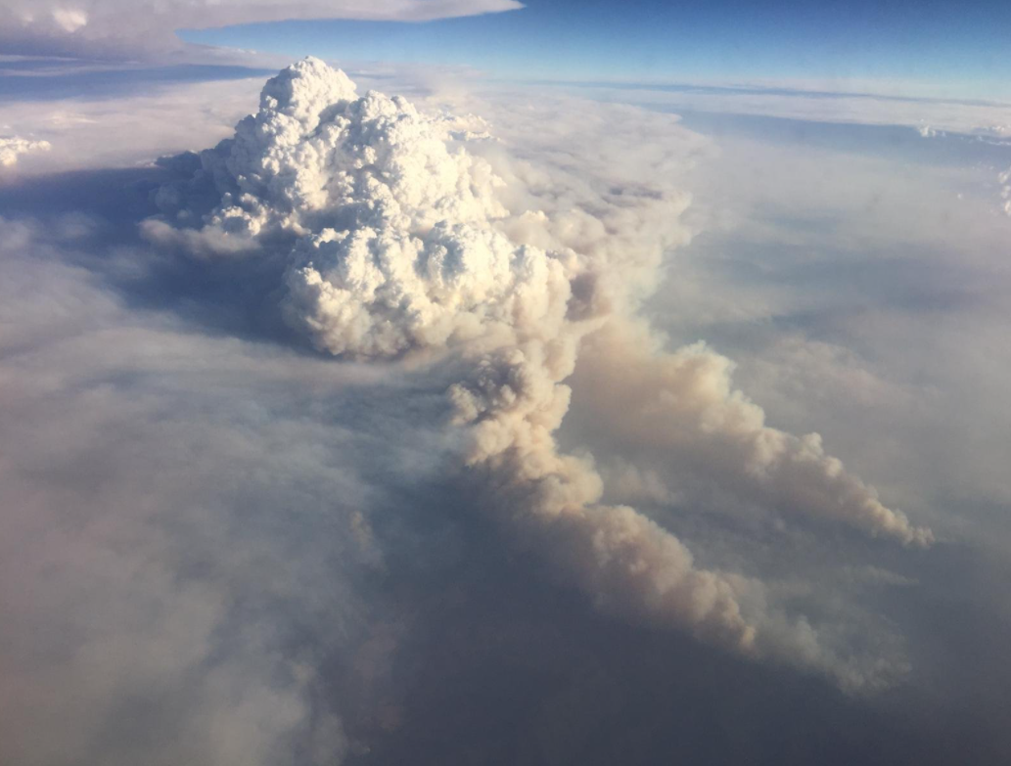
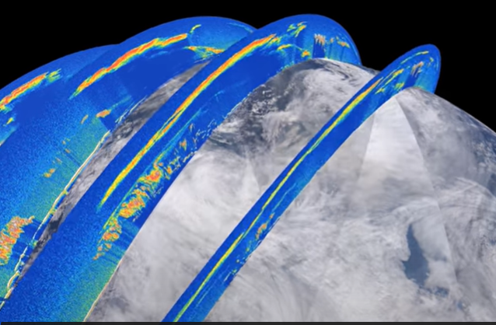
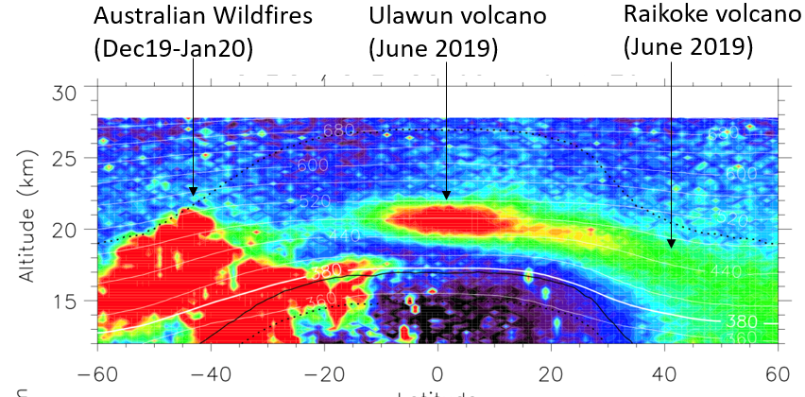
CALIOP tracks Australian smoke plume 1000’s km downwind
CALIOP profiles averaged over 3-12 Jan 2020
Australian bush fires in January 2020 initiated pyrocumulus, which injected smoke into the upper troposphere
(Visualization by Roman Kowch, LaRC/SAIC)
(courtesy Jean-Paul Vernier, LaRC/SAIC)

Slide 6
Mitigation of Low Energy Laser Pulses
Dave Winker, Jason Tackett, Xia Cai,
and
the CALIOP algorithm development team

Slide 7
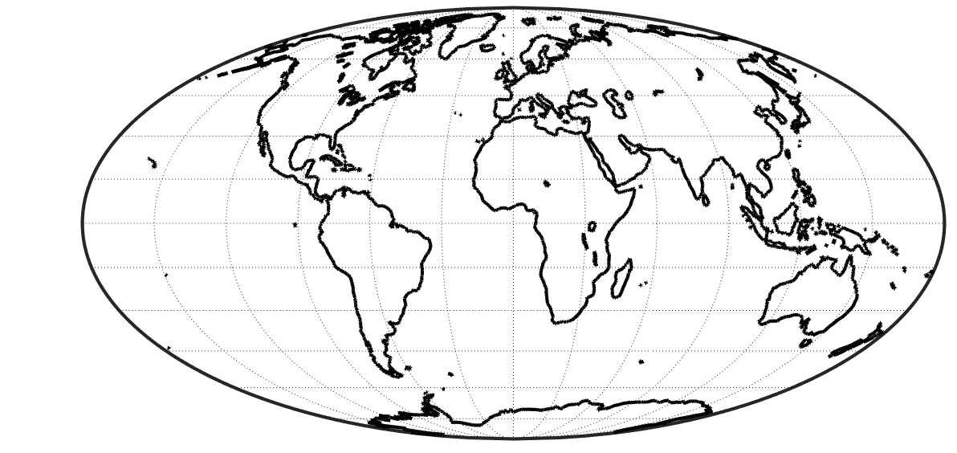
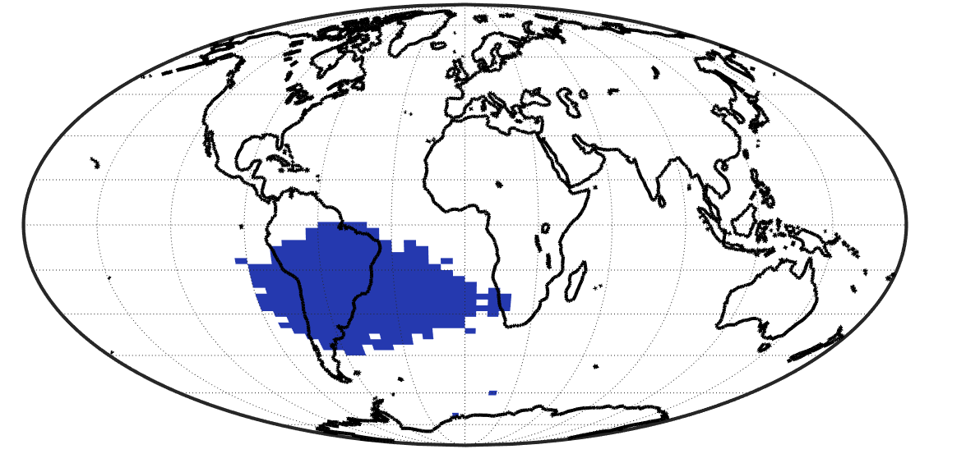
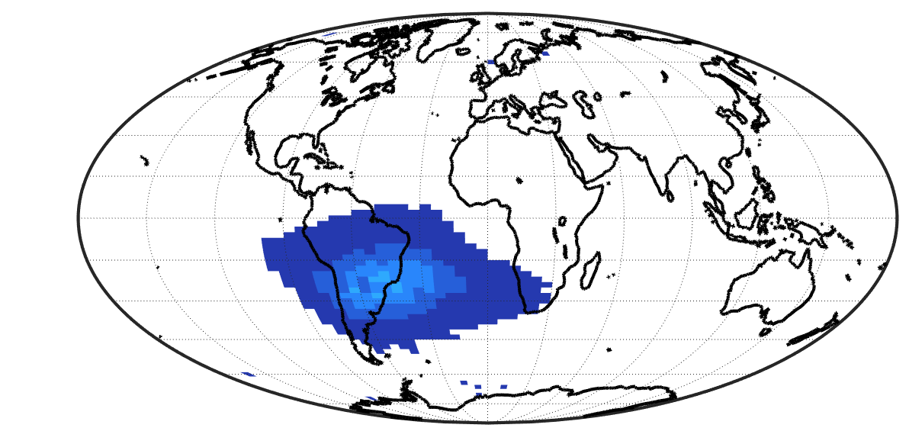
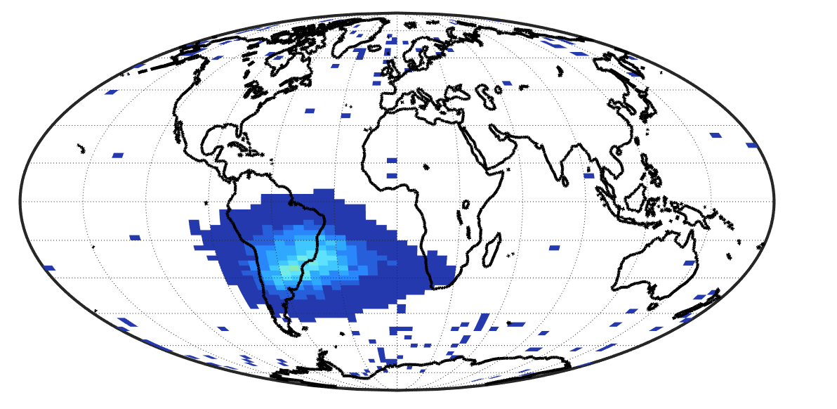
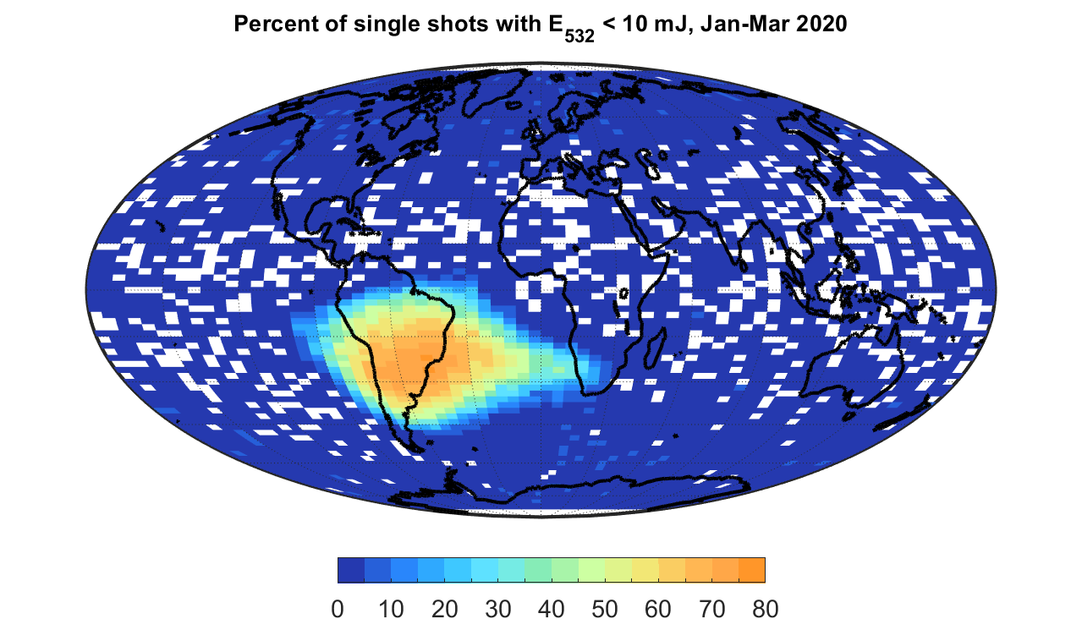
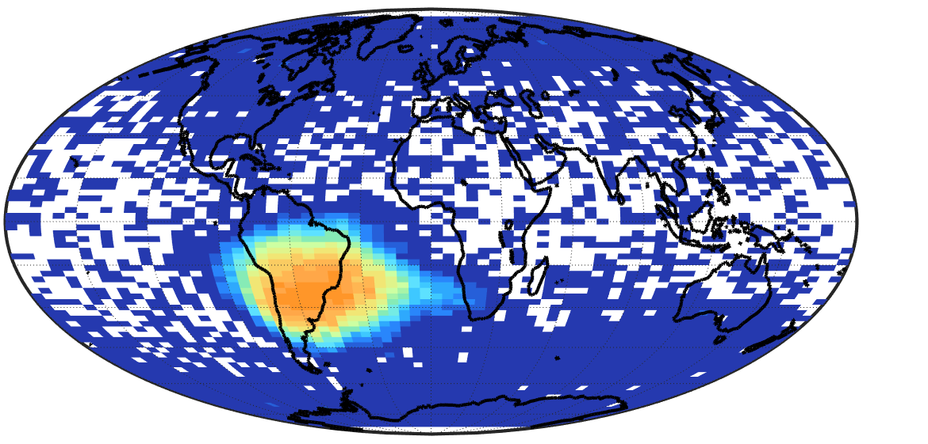
Evolution of Low Energy (< 10 mJ) Laser Shots
Jan-Mar 2016
Jan-Mar 2017
Jan-Mar 2018
Jan-Mar 2019
Jan-Mar 2020
Jan-Mar 2021
frequencies < 0.1% are white
Frequency (%)

Slide 8
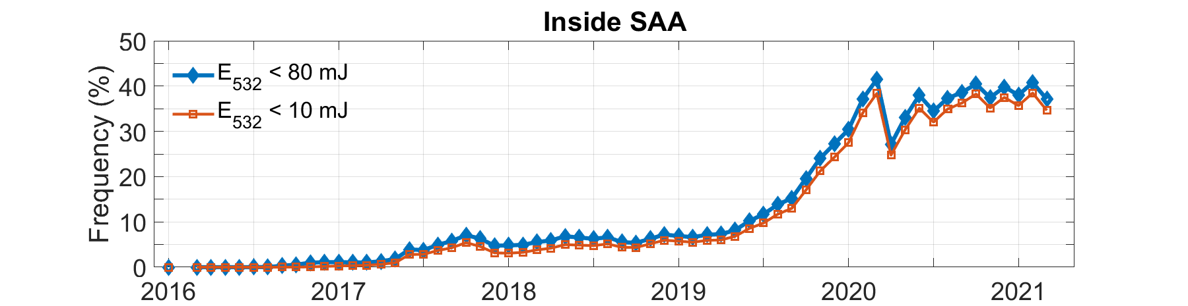
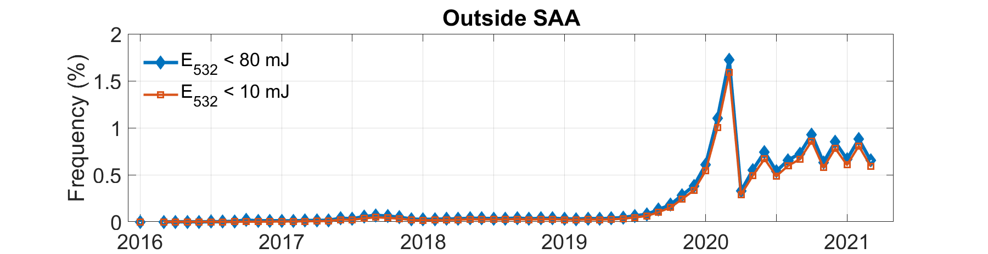
Trends in Low Energy Shots
(frequency becomes > 5% in late 2017)
Avg. ≈ 38.9 %
Last 6 months
Avg. ≈ 0.8 %
Last 6 months
(frequency mostly < 1% so far)

Slide 9
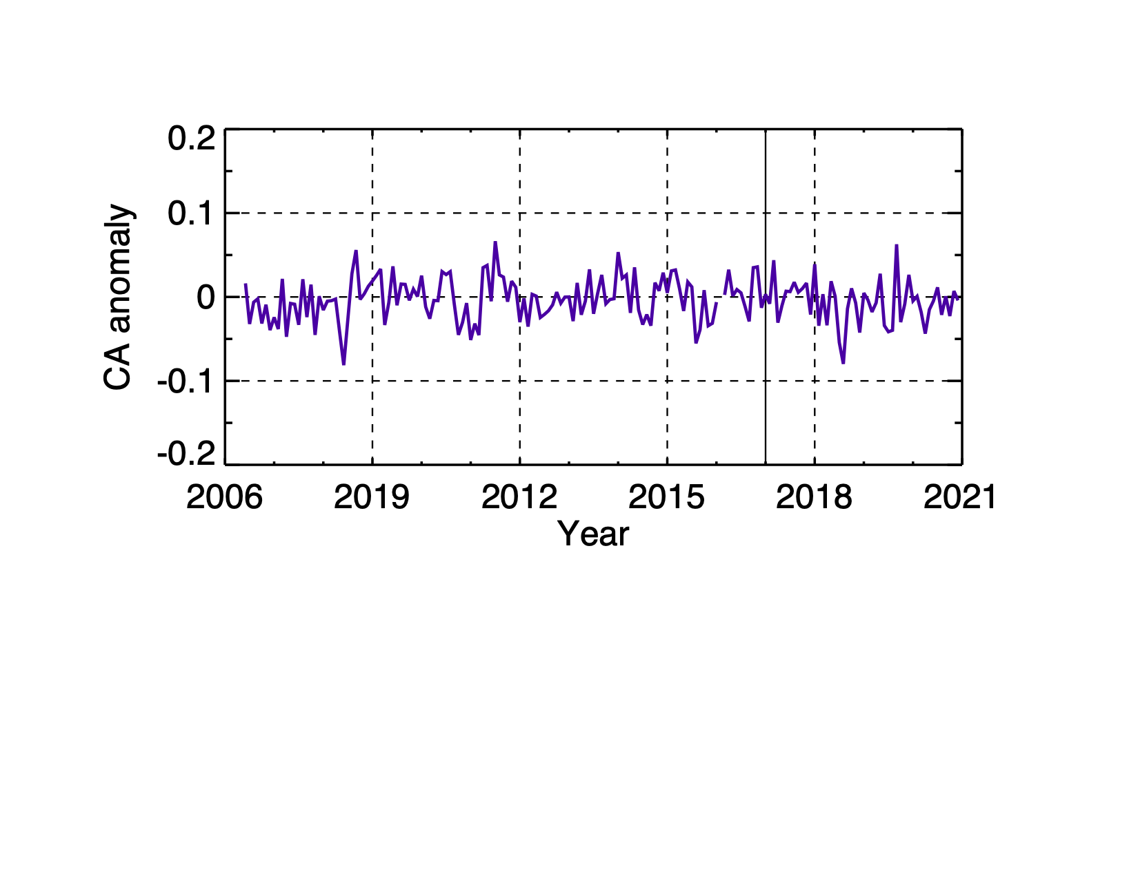
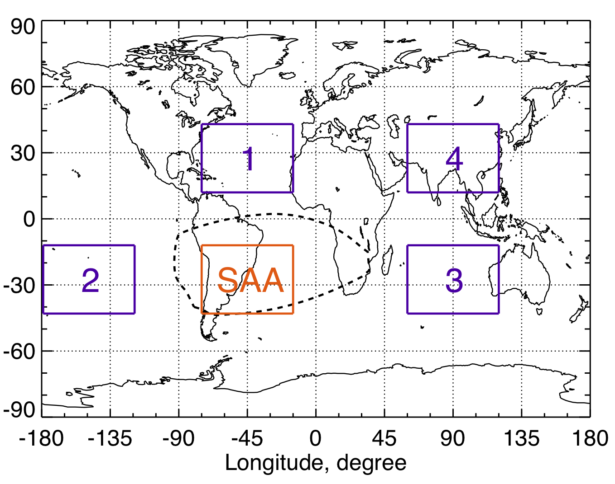
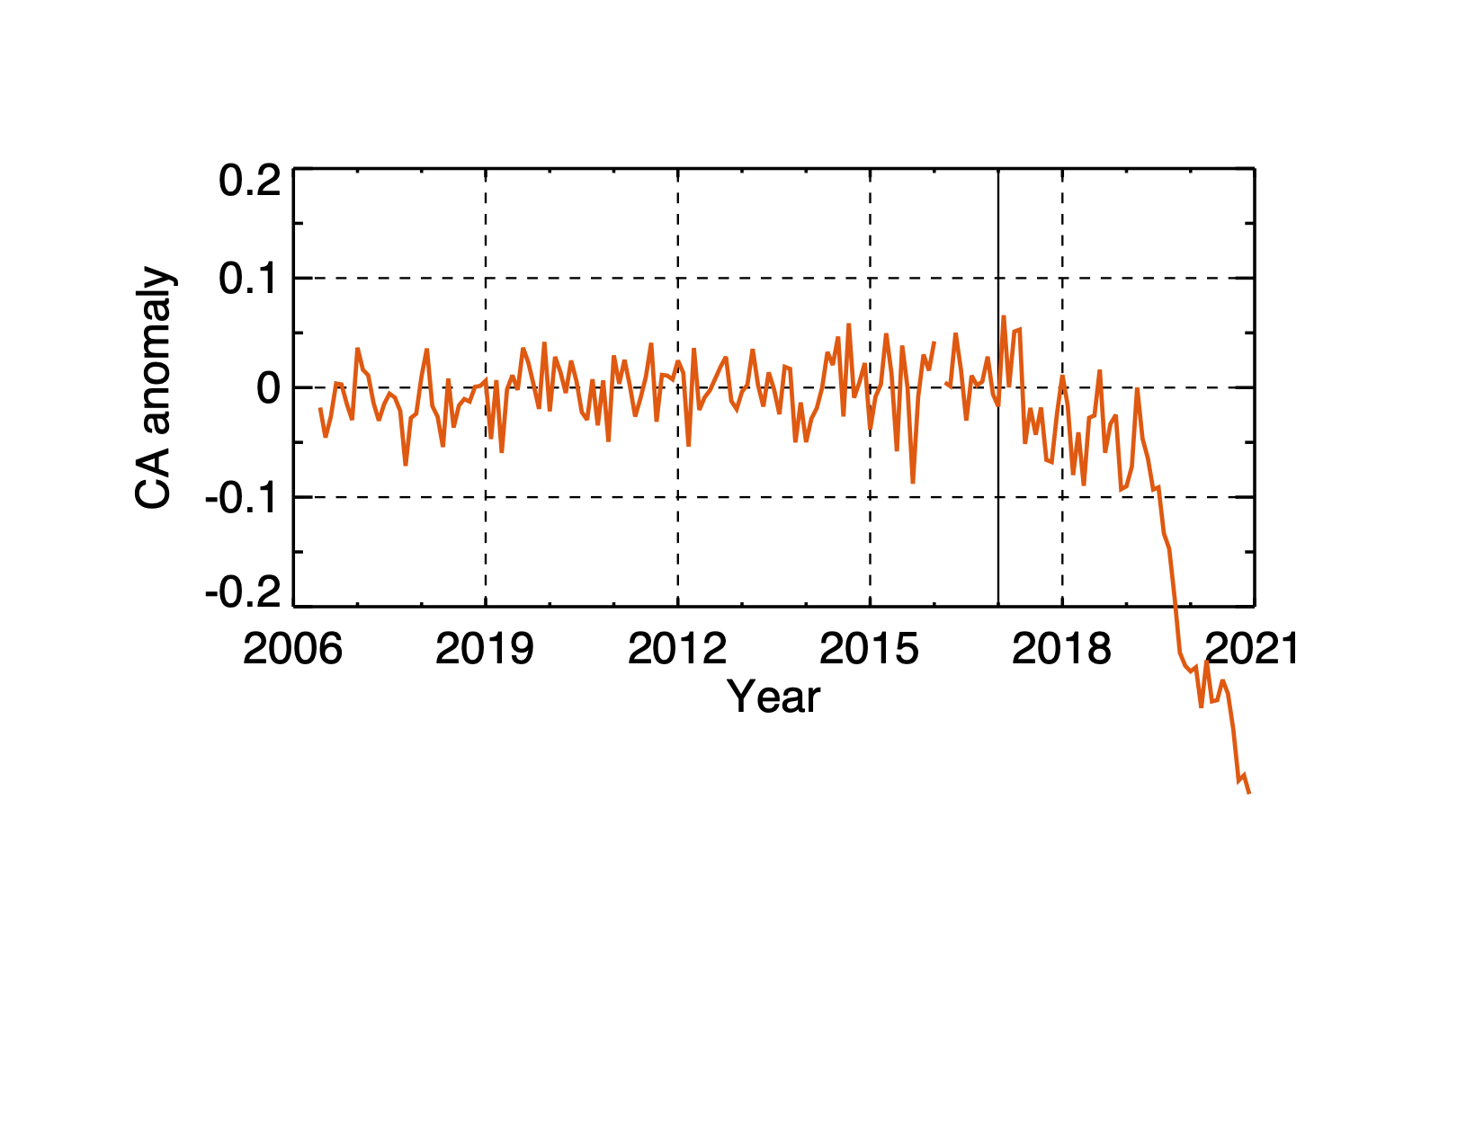
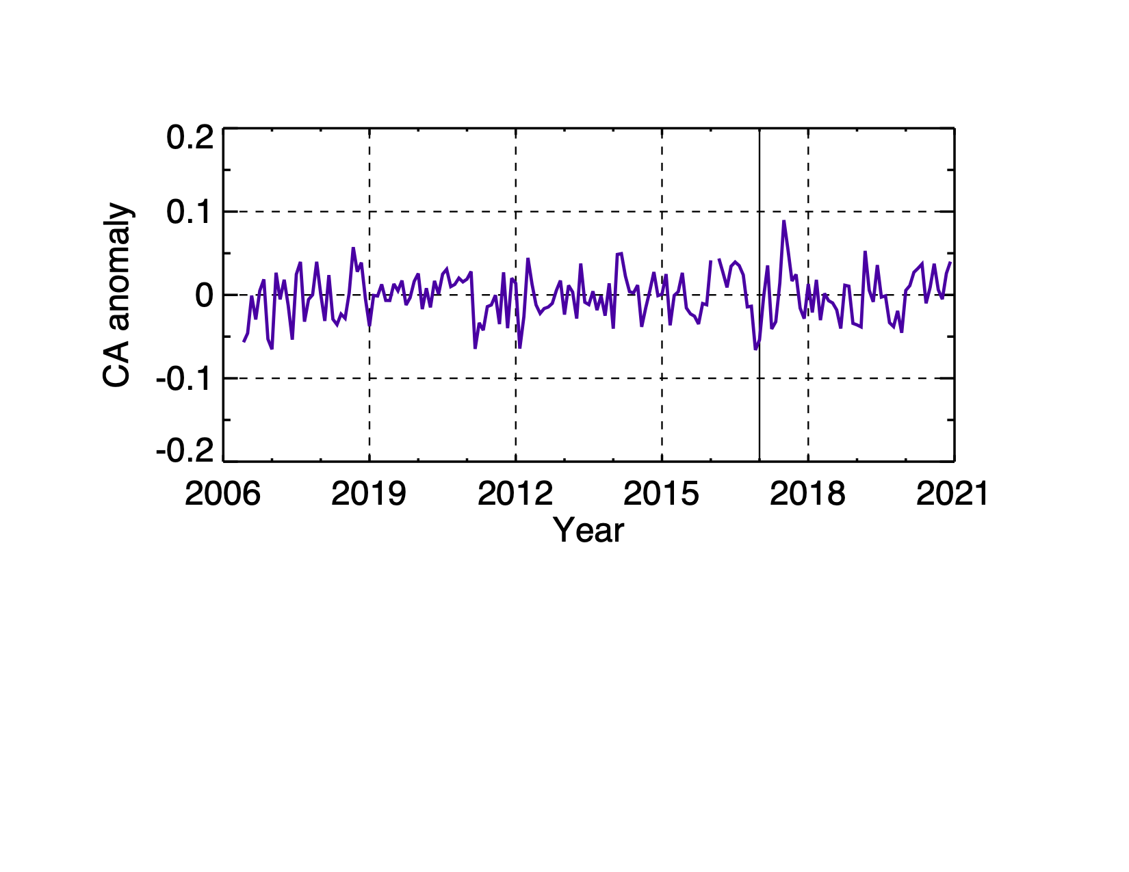
Impacts on Monthly Regional Cloud Amount
Within SAA: impacts since mid-2017
Outside SAA: no impacts thru 2020
Region 1
SAA
Region 3

Slide 10
CALIOP Data Processing Fundamentals
One 5-km frame
The basic data unit for Level 2 processing is a 15-shot “frame”
Profiles above 8.2 km altitude are averaged before downlinking
40
30
20
8.2
Altitude (km)
-0.5
One low-energy shot can potentially corrupt an entire 80-km chunk
An 80 km ‘chunk’ is composed of 16 5-km frames
Frame 1
Frame 2
Frame 3
Frame 4
…
40
30
20
8.2
Altitude (km)
→
-0.5
…

Slide 11
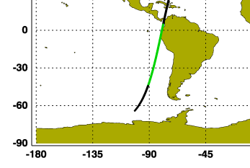
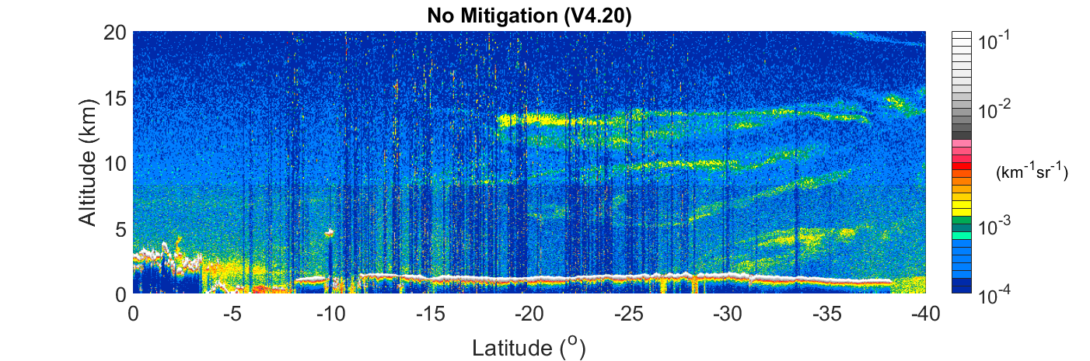
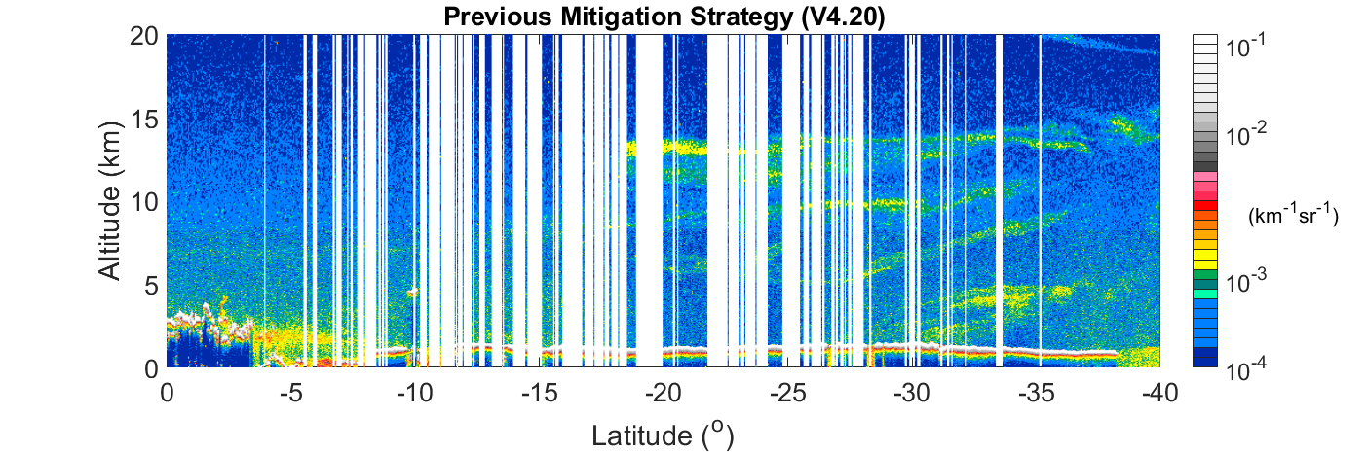
Low Energy Shots in L1 Data
SAA
L1 532 nm
Black streaks are regions with low-energy pulses
80 km ‘chunks’ containing ≥ 1 low energy shot masked out
January 17, 2020

Slide 12
Level 2 Processing
Example: One low energy shot
Profile retrievals are linked by the 5-km average at 30-40 km altitude
A single low-energy shot can impact retrievals from other shots in the frame
But nominal shots can be recovered by rescaling signals above 20 km
Schematic of 15 shot frame (5 km)
Backscatter rescaled
Altitude (km)
40
30
20
8.2
-0.5
1 low energy shot
Subframes with E₅₃₂ > 60 mJ have sufficient SNR to be recovered
Subframes with E₅₃₂ < 60 mJ must be excluded

Slide 13
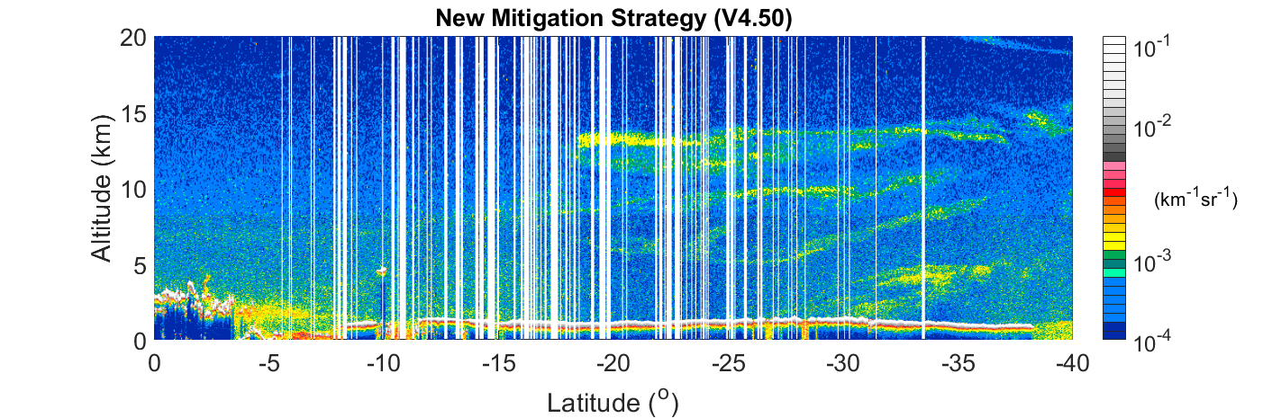
Mitigation Algorithm Applied
L1 532 nm
Black streaks are regions with low-energy pulses
After masking out 80 km ‘chunks’ containing ≥ 1 low energy shot
After recovery of recoverable frames
January 17, 2020

Slide 14
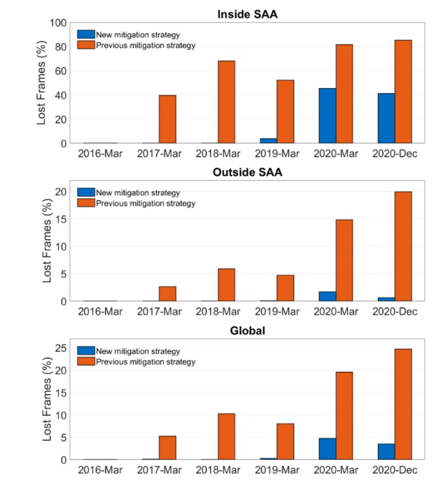
Many frames are recoverable
Contaminated (red) vs Unrecoverable (blue)
Red bars: fraction of frames lost if contaminated 80-km chunks are rejected (current recommendation)
Blue bars: fraction of frames not recoverable by low energy mitigation algorithm

