Slide 1
CERES Data Management Team
Working Group Report
Katie Dejwakh
CERES Science Team Meeting
May 11, 2021

Slide 2
Outline
DMT Overview
Product Availability
Code Re-architecture
Systems & CM
DMT Activities

Slide 3
DMT Overview

Slide 4

Data Management Team (DMT)
Science research
DMT /
ASDC
User community
Katie Dejwakh (NASA)
Walt Miller (SSAI)

Slide 5
Data Management Team (DMT)
Instrument
Clouds
Inversion
SARB
TISA
ERBE-like
Systems
& CM
Denise Cooper
Thomas Grepiotis
Hunter Winecoff

Slide 6
Data Management Team (DMT)
Instrument
Clouds
Inversion
SARB
TISA
ERBE-like
Systems
& CM
Dale Walikainen
Jeremie Lande

Slide 7
Data Management Team (DMT)
Instrument
Clouds
Inversion
SARB
TISA
ERBE-like
Systems
& CM
Sunny Sun-Mack
Ricky Brown
Steve Kohler
Yan Chen
Liz Heckert
Rita Smith

Slide 8
Data Management Team (DMT)
Instrument
Clouds
Inversion
SARB
TISA
ERBE-like
Systems
& CM
Victor Sothcott
Igor Antropov

Slide 9
Data Management Team (DMT)
Instrument
Clouds
Inversion
SARB
TISA
ERBE-like
Systems
& CM
Tom Caldwell

Slide 10
Data Management Team (DMT)
Instrument
Clouds
Inversion
SARB
TISA
ERBE-like
Systems
& CM
Josh Wilkins
Cathy Nguyen
Ed Kizer
Beau Branch

Slide 11
Data Management Team (DMT)
Instrument
Clouds
Inversion
SARB
TISA
ERBE-like
Systems
& CM
Nelson Hillyer
Tammy Ayers
Dennis Keyes
Joanne Saunders

Slide 12
Data Management Team (DMT)
Instrument
Clouds
Inversion
SARB
TISA
ERBE-like
Systems
& CM
PR Tool
Ordering Tool
Carla Grune
Elizabeth Heckert

Slide 13
Data Management Team (DMT)
Instrument
Clouds
Inversion
SARB
TISA
ERBE-like
Systems
& CM
PR Tool
Ordering Tool
Churngwei Chu
Pamela Mlynczak
Babak Samani

Slide 14
Data Management Team (DMT)
Responsibilities:
  Algorithm implementation
  Software:
    Maintenance
    Configuration management
    Processing
  Output validation

Slide 15
DMT-ASDC Interface
Science
Team
Data Management
Team (DMT)
Atmospheric Science Data Center (ASDC)
Funded by
Radiation Budget Measurements WBS
Funded by ESDIS

Slide 16
Product Availability

Slide 17
Edition 4 Terra & Aqua
Product | Platform | Processed Thru | Publicly Available?
BDS | Terra, Aqua | Feb. ‘21 | Yes
SSF
SSF1deg-Hour |  | Feb. ‘21
SSF1deg-Day/-Month
SYN1deg-Hour/3Hour/MHour | Terra+Aqua
SYN1deg-Day/-Month

Slide 18
Edition 4 Terra & Aqua
Product | Platform | Processed Thru | Publicly Available?
CldTypHist | Terra+Aqua | Dec. ’20 | Yes
FluxByCldTyp |  | Feb. ‘21
EBAF |  | Nov. ’20
EBAF ToA |  | Feb. ‘21
Notes:
GEO clouds for CldTypHist are optional. CldTypHist is low-demand, so they haven’t run it yet. Tend to wait til everything’s there before they run it on the three-four month timeframe. i.e. Jan.-Mar.

Slide 19
Edition 1 S-NPP
Product | Platform | Processed Thru | Publicly Available?
BDS | S-NPP | Mar. ‘21 | Yes
SSF |  | Mar. ‘21
SSF1deg-Hour |  | Sep. ’19*
SSF1deg-Day/-Month |  | Sep. ’19*
SYN1deg-Hour/3Hour/MHour | Terra+S-NPP | Nov. ’17*
SYN1deg-Day/-Month |  | Nov. ’17*
* L3 processing is paused. Instrument in RAPS mode

Slide 20
Forthcoming Data Product Editions
Edition 2 S-NPP
  Reprocessed first two years: 2012-2014
  Pace of C2 VIIRS data receipt driving schedule
  No L3 products from 9/2019 onward,
  while S-NPP in biaxial mode
  Available Summer 2021
Edition 1 NOAA-20
  Improved Clouds!
  Will use Version 1.1 or 1.2 CrIS Fusion data for water vapor info.
  Available late Summer 2021
Notes:
Ed 2 S-NPP: Need CrIS Fustion data; assuming our test data is good enough that production can start immediately, will take two months of just Clouds processing. Gains and SRFs have been delivered through January 2021.
Ed 1 NOAA-20: Record starts from May 2018. Gains and SRFs have been delivered through March 2021.

Slide 21
DMT Activities

Slide 22
DMT-Libera Interface
University of Colorado LASP – Libera
Data Management Working Group
Science
Team
Data Management
Team (DMT)
Radiation Budget Science Project
EVC-1

Slide 23
CrIS Fusion Data
CERES-produced subsetting code
Atmosphere SIPS runs subsetter
ASDC pulls subsetted data
From Atmosphere SIPS:
“FSNRAD” product
CO₂ channels
Water vapor data
Coming soon!
Notes:
I had attempted to test data subsetting and download using OPeNDAP service from MODAPS but discovered a bug with all netCDF data there. Sunny reached out to Atm. SIPS for an alternate means of getting this data quickly. (Expediency is key; HQ looking for FM6 results.) In the meantime, MODAPS fixed the netCDF OPeNDAP bug. This may be a means towards data acquisition in the future.

Slide 24
Granular Data Availability Display
Level 3 data – hours of data can be missing
New table – displays days missing data:
In development; prototype nearly complete
 | 0-5% of the data are missing
 | 5-10% of the data are missing
 | 10% or more of the data are missing

Slide 25
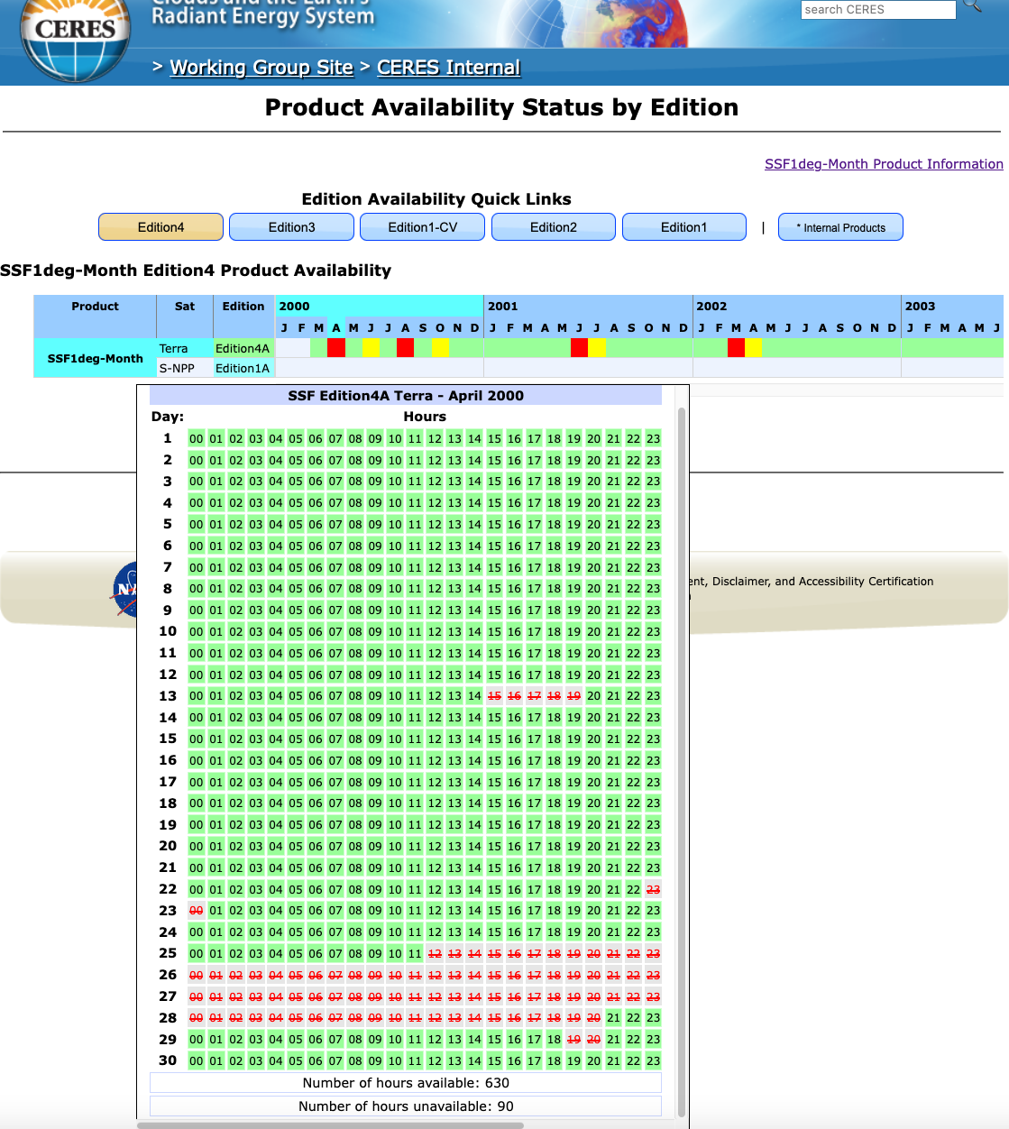
Granular Data Availability Display

Slide 26
Granular Data Availability Display

Slide 27
Accelerated processing timeline
CERES data
  Need first day of next month for overlap
  Before – 3 weeks into next data month
  Now – No delay; use gains and sibiMap from first data month
MATCH data
  Before – 6 weeks after data month
  Now – 2 weeks after data month
  (extrapolating last few hours of last day’s data)

Slide 28
FLASHFlux
CERES Production absorbing FLASHFlux production
2.5 PGEs / 8 – proof of concept runs
No negative latency impacts
Increased:
  Production oversight
  Testing
  Scalability
Anticipated Fall 2021 – transparent to users

Slide 29
CERES Ordering Tool, Virtualized
Firewall
DMZ
Behind the Firewall
ceres-subset-ptest-1
ceres-subset-ptest-1
ceres-subset-ptest-1
VM ordering tool web servers/subsetter
ceres-subset-ptest-1
ceres-subset-ptest-1
ceres-subset-ptest-1
ceres-subset-ptest-1
VM ordering tool web servers/subsetter
ceres-subset-ptest-1
ceres-subset-ptest-1
subsetting VMs
EMC Isilons
Host
Qumulo
filesystem
production archive
Notes:
ceres-subset-prod-pub-1: Web server/Level 3 subsetter 1
ceres-subset-prod-pub-2: Web server/Level 3 subsetter 2
ceres-subset-prod-ss-1: Production subsetter VM 1
ceres-subset-prod-ss-2: Production subsetter VM 2
ceres-subset-ptest-dm-1: Data mover simulation VM
ceres-subset-ptest-ss-1: Subsetting machine - testing "14-like" support
ceres-subset-ptest-1: Pre-production test VM 1
ceres-subset-ptest-2: Pre-production test VM 2
ceres-subset-dev-1: Dev VM 1 ceres-subset-dev-2: Dev VM 2

Slide 30
CERES Ordering Tool, Bare Metal
Firewall
DMZ
Behind the Firewall
x
x
internal host / subsetter 1
internal host / subsetter 2
supplemental subsetter 1
supplemental subsetter 2
x
x
x
web server 1
web server 2
ASDC host
legacy host
x
x
production archive
L2 subsetting
legacy disk
legacy disk
Notes:
Connections to disk not shown so as not to make diagram unreadable.
SciFlo head node is jb103, but subsetting and bundling occurs on SGE.

Slide 31
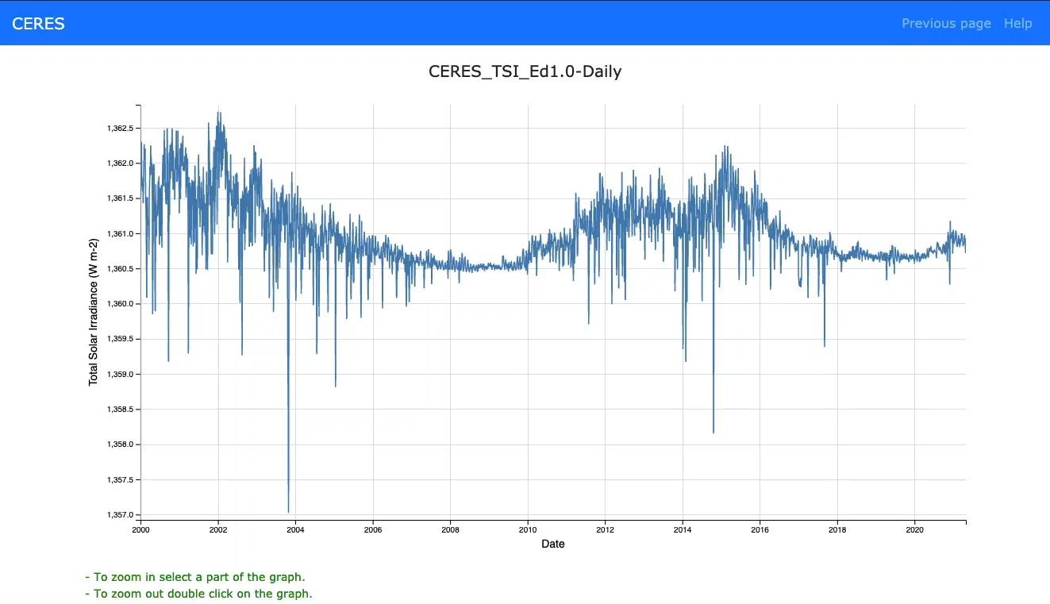
CERES Ordering Tool – TSI Plotter
Notes:
Internal capability but indicative of look-and-feel possibilities.

Slide 32
CERES Ordering Tool
Upcoming:
  Internal logging dashboard
  Improved FluxByCldTyp visualizer
  Virtualization of internal/pre-production version
  Redesign
Questions/comments:
larc-CERES-Help@mail.nasa.gov

Slide 33
Code Re-architecture

Slide 34
Clouds
Diagrammed using Magic Draw
  Inputs
  Retrieval
  Footprint
  Outputs
Next step: outline new system flow

Slide 35
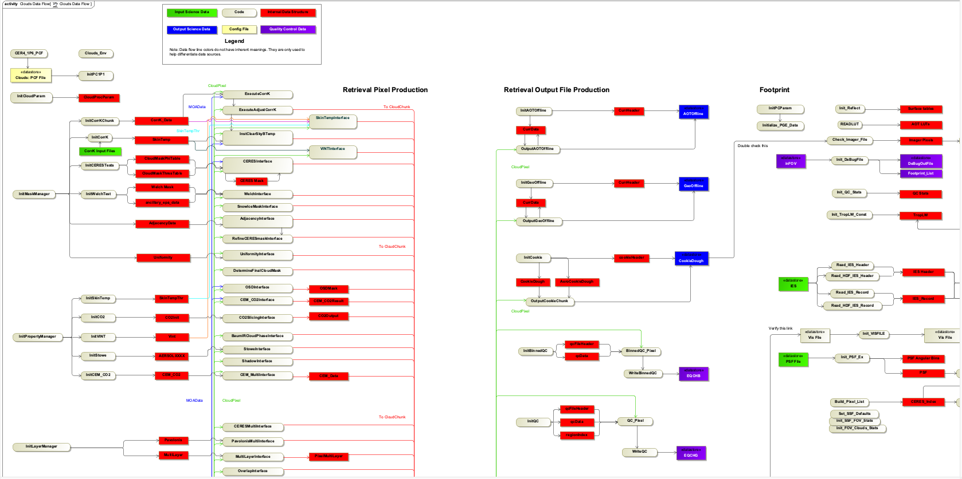
Clouds

Slide 36
Clouds
Configured Jenkins to run Clouds on VM
  Rapid development
  “build-test-deploy”
Hybrid development
    Cloud mask – C++
    Dovetail with current codebase
Hook into C with C++

Slide 37
TISA
New Code Development
Object-Oriented-"like” Interpolation & Averaging
Fortran
Object-Oriented Gridding
C++
Property containers
Gridding containers, zones, regions
Property data structures
Unit testing

Slide 38
TISA
New Code Development
Object-Oriented-"like” Interpolation & Averaging
Fortran
Object-Oriented Gridding
C++
Property containers
Gridding containers, zones, regions
Property data structures
Unit testing

Slide 39
TISA
myConfig.json
myCode.f90
myCode.f90

Slide 40
TISA
Spatial Averaging
myConfig.json
myCode.f90

Slide 41
TISA
Temporal Interpolation
myConfig.json
myCode.f90

Slide 42
TISA
Flexible:
  Spatial resolution
  Platform (satellite) combinations
  Temporal
    Format
    Interpolation
Unit testing
Property introspection library
Reduced legacy code by another ___%

Slide 43
Systems & CM

Slide 44
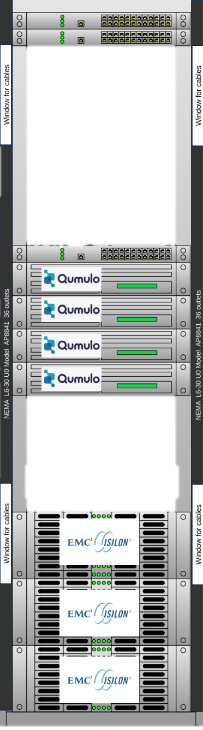
Systems
ANGe configuration for CrIS Fusion
OS Upgrades:
  RHEL7 – ANGe (Ingest system at ASDC)
  RHEL8 – AMI-P (CERES production system)
“Offline” Storage:
  Science work storage – aged, insecure posture
  Refreshed with HPE Scale-Out NAS storage w/ Qumulo

Slide 45
Documentation
Data Quality Summaries:
  PDF-only
  Consistency/terminology
All documentation:
  Current editions first
  Historical editions second
New site continuously evolving & improving

Slide 46
CERESlib
Internal code library – I/O, Toolkit routines, etc.
Needed a refresh
Pared down by ~5%
Evaluating other functionality for inclusion, like:
  Constants
    Thermodynamic
    Solar
  Digital elevation map API
  Physical equations
  Ephemeris data
  and more!

Slide 47
CERESlib
Continuing to test PGE compilation and running
Tentative subsystem test-by date: May 31, 2021
Tentative release date: July 31, 2021
Up next: enhancement with additional, useful routines

Slide 48
Summary
Anticipated new releases
Emphasis on user experience
Cloud storage and processing on horizon
Coordination with Libera team – seamless continuity

