Slide 1
Insights and Lessons Learned from the NASA Juncture Flow Experiment
Chris Rumsey
NASA Langley Research Center

Slide 2
Acknowledgments
Thank you to the many Juncture Flow Team members, past and present
NASA Langley:
  Mike Kegerise, Dan Neuhart, Judi Hannon, Nashat Ahmad, Jan Carlson, Luther Jenkins, C.-S. Yao, P. Balakumar, Sam Gildersleeve, Scott Bartram, Cathy McGinley, Mujeeb Malik, Joe Morrison, Bil Kleb, Andrew Leidy, Shelly Sadowski, Balaji Venkatachari, Sandy Webb, Mark Cagle, Kevin Disotell, Brian Mahan, Mark Fletcher, Dick Campbell
NASA Ames:
  Tom Pulliam, Henry Lee, Mike Olsen, James Bell, Greg Zilliac, Nettie Roozenboom, Laura Simurda
Boeing:
  Philippe Spalart, Ashley Jones, Tony Sclafani, Mike Beyer, John Vassberg, Abdi Khodadoust, Peter Hartwich, Neal Harrison
AUR:
  Roger Simpson, Gwibo Byun
U Tenn Knoxville:
  Jim Coder
Va Tech:
  Aurelien Borgoltz, Todd Lowe, Matt Kuester, William Devenport
WLO Consulting:
  Bill Oberkampf

Slide 3
Outline
Introduction
Wind tunnel characterization
CFD studies
  Influence of wind tunnel walls
  Summary of CFD’s Capability to Accurately Predict Juncture Flow
Summary and future directions

Slide 4
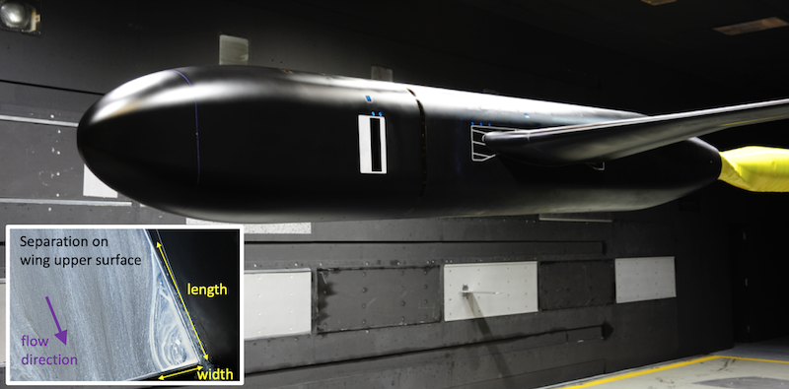
Introduction
The NASA Juncture Flow (JF) experiment has been an ongoing effort for at least 6 years
  Concerted effort to obtain measured wind tunnel data for a separated corner in subsonic flow conditions
  Of interest to the aerospace community because it can occur on many vehicles where two surfaces intersect to form a junction
  Most of today’s state-of-the-art CFD methods typically do not predict the onset and progression of this type of junction separation correctly or consistently

Slide 5
CFD validation
Validation is clearly defined as “the process of determining the degree to which a model is an accurate representation of the real world from the perspective of the intended uses of the model” (AIAA-G-077-1998(2002))

Slide 6
CFD validation experiment
Some definitions:
  “A validation experiment is a physical realization of a properly posed applied mathematics problem with initial conditions, boundary conditions, material properties, and external forces” (AIAA-2016-3811)
  “Validation experiments are performed to generate data for assessing the accuracy of the mathematical model via simulation outcomes produced by the verified computational model” (AIAA-2016-3811)
  “A validation experiment is conducted for the primary goal of determining the predictive capability of a mathematical model of a physical process” (Journal of Verification, Validation and Uncertainty Quantification, Vol. 2, 031002, 2017, pp. 1-14)

Slide 7
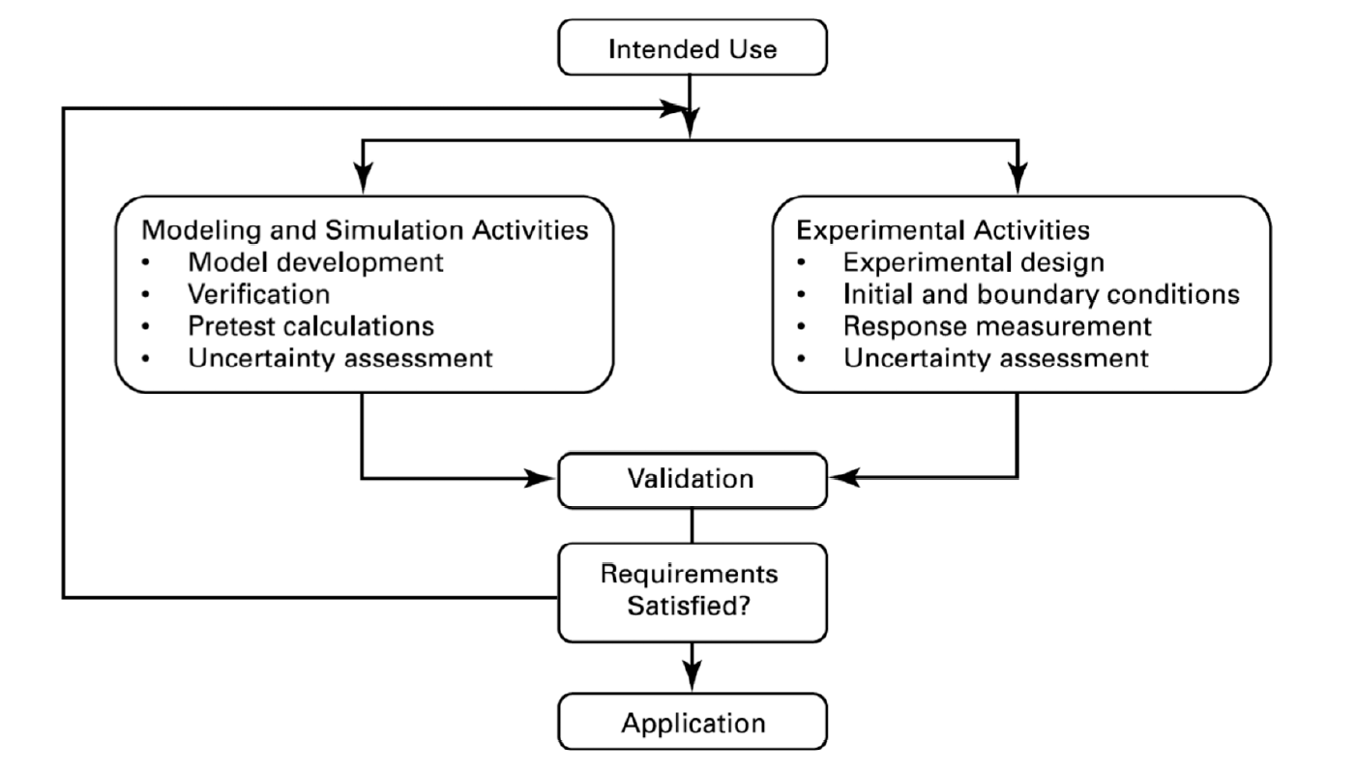
CFD validation experiment
From ASME V&V 10-2019 “Standard for Verification and Validation in Computational Solid Mechanics”

Slide 8
CFD validation experiment
COORDINATION
(validation dialog*)
From ASME V&V 10-2019 “Standard for Verification and Validation in Computational Solid Mechanics”
*AIAA-2021-1933

Slide 9
CFD validation experiment
Experiment: a scientific procedure undertaken to make a discovery, test a hypothesis, or demonstrate a known fact.
COORDINATION
(validation dialog*)
Measurement
*Both CFD and WT measurements are part of the “experiment” (AIAA-2021-1933)
From ASME V&V 10-2019 “Standard for Verification and Validation in Computational Solid Mechanics”

Slide 10
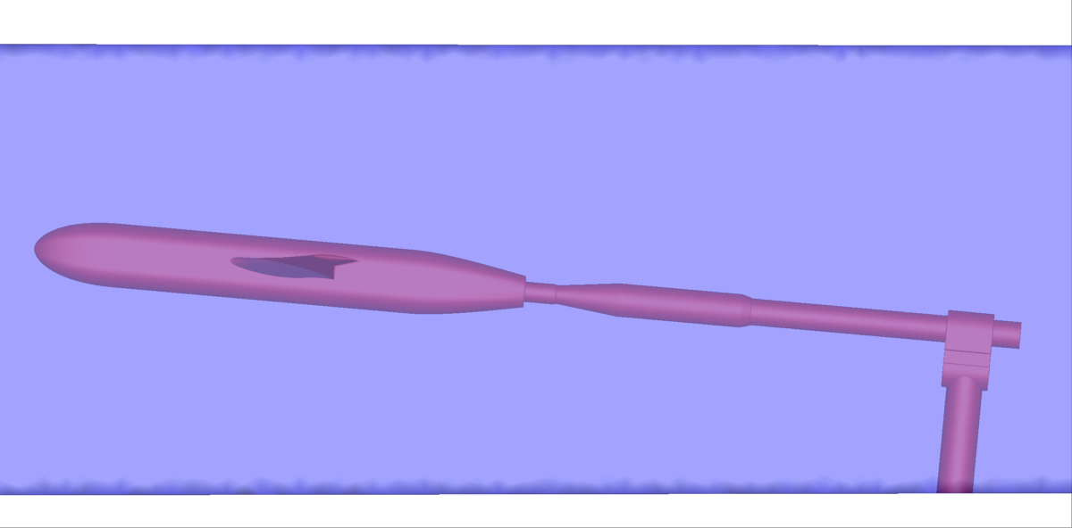
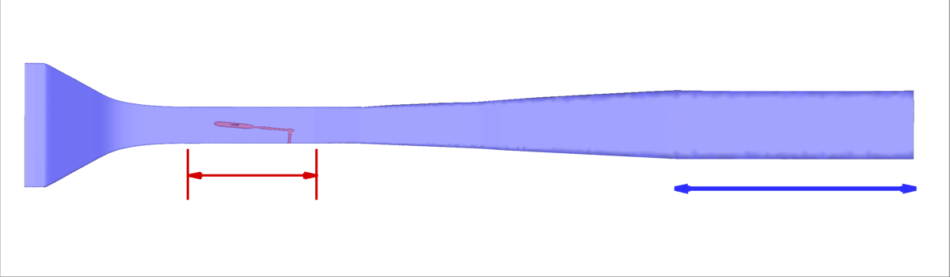
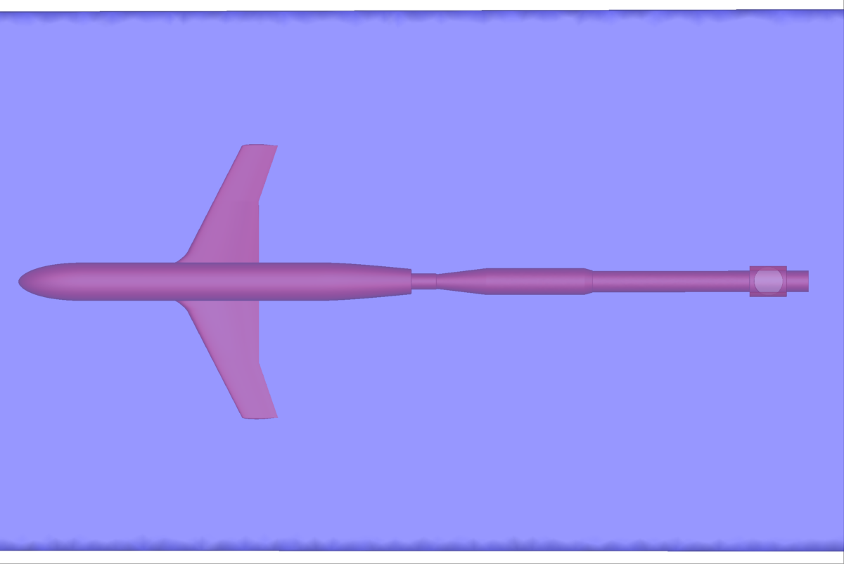
JF test article in the Langley 14x22 wind tunnel
contraction
diffuser
sting
mast
Test section
Extension added to aid CFD run
Special fuselage with flat sides (with windows for LDV)
Truncated DLR-F6 wings

Slide 11
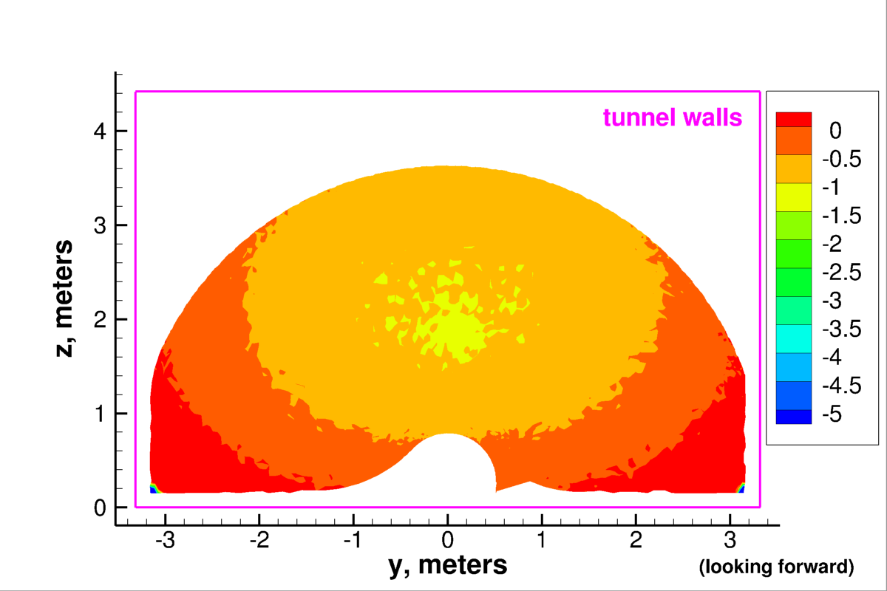
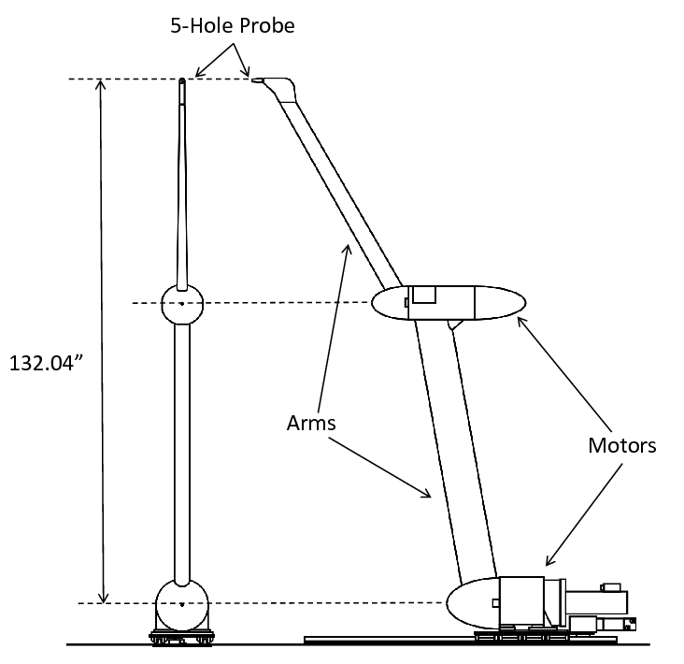
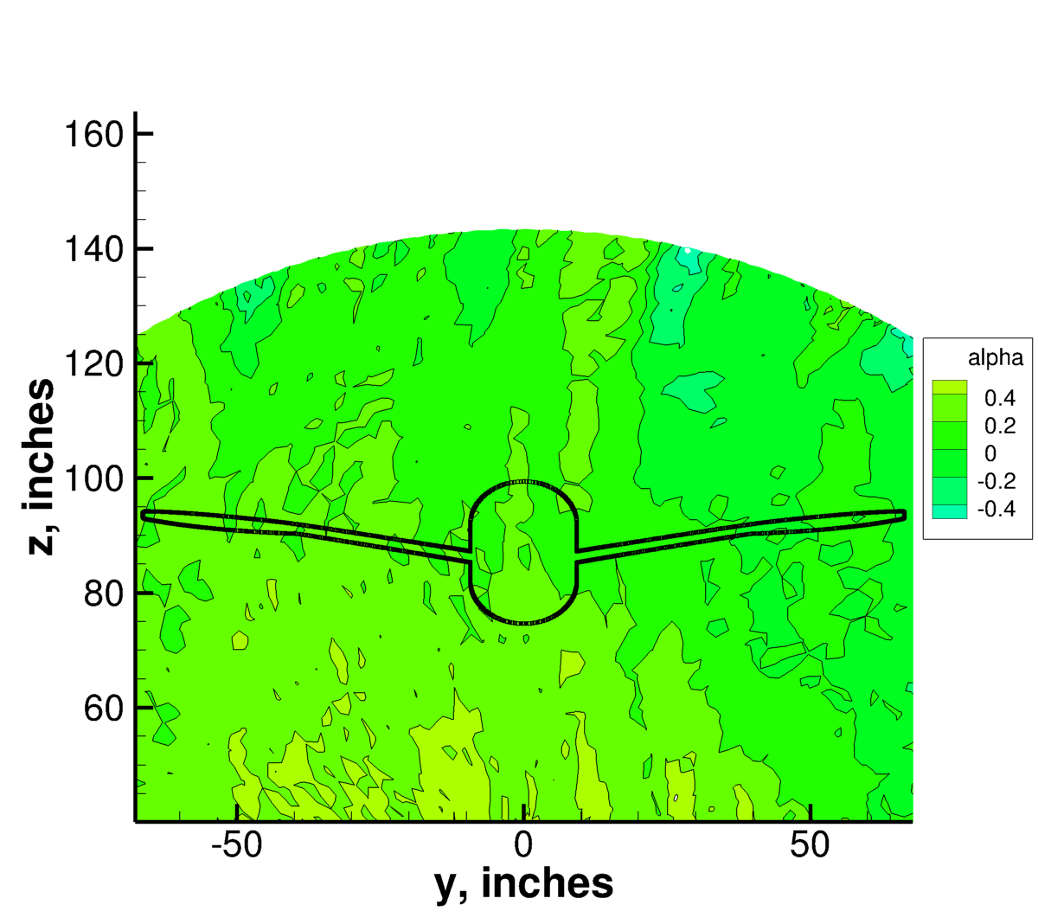
Wind tunnel characterization - inflow
(near start of test section)
Initial attempts made to model this P_{t} behavior in the CFD, but not carried into production runs yet
Total Pressure Deficit (psf)
Accuracy of flow angularity measurements still under investigation
Boeing’s Quantitative Wake Survey System (QWSS)

Slide 12
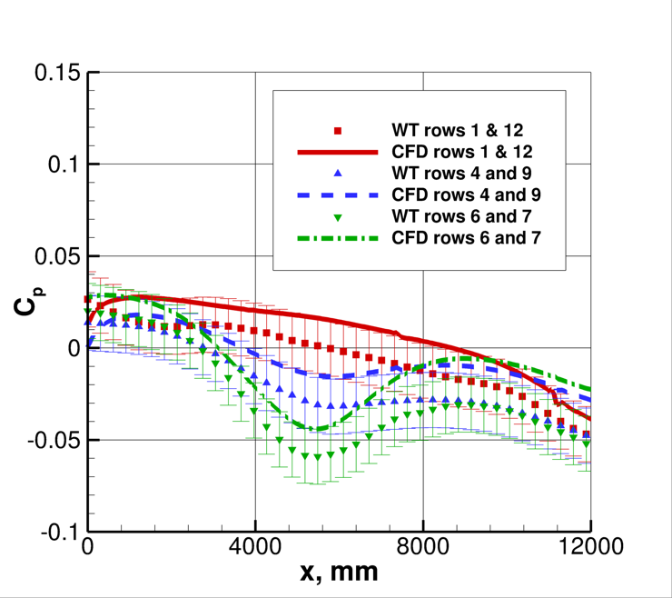
Wind tunnel characterization – side walls & outflow
(wall pressures)
Side wall measurements provide a check on the character and quality of the CFD wind tunnel simulations
  CFD shows similar trends, but C_{p} slightly high
  Difference may be due to tunnel’s 1 psf total pressure deficit at these conditions (not currently accounted for in the CFD)
Measured back pressure not as useful for CFD, because CFD sets its own back pressure in order to obtain flow conditions in the test section that are consistent with the experiment
Spurious separation in diffuser often occurs in the CFD, which alters the required back pressure to achieve desired flow conditions

Slide 13
Wind tunnel characterization - geometry
Shape of the 14x22 high-speed leg extracted from laser scan data
  Simplified to some degree: notches, grooves, windows, and other relatively small deviations in the tunnel walls were smoothed over
  Demonstrated in AIAA-2015-2022 to predict upwash angles in the test section better than as-designed geometry
In situ laser scans of JF test article
  Not entirely helpful to date
  RMS deviation compared to as-designed shape:
    0.472 mm in 2018 scan
    0.597 mm in 2020 scan
  Paint thickness only 0.254-0.356 mm
  Claimed accuracy of scan: 0.1 mm
  Have not yet been able to use laser scan data to create a usable CAD surface
  Scans HAVE helped characterize precise locations of trip dot placement
Aeroelastic wing deflections measured
GIS laser scans have been very useful for determining precise positioning of the test article in the wind tunnel

Slide 14
CFD: Strategies for wind tunnel simulations
(Run both with and without mast/sting)
Add a constant-area extension to the downstream exit of the diffuser (this “contains” any diffuser separation, keeping it from the outflow boundary of the CFD domain)
Remove the diffuser altogether, leaving only the contraction and test section
Remove the diffuser and extend the test section (making it longer)
Employ inviscid walls in the diffuser section only
To date, no clear difference for the JF quantities of interest, but 2 and 3 cause the computed tunnel wall pressures to differ significantly from the measured results over the rear half of the test section

Slide 15
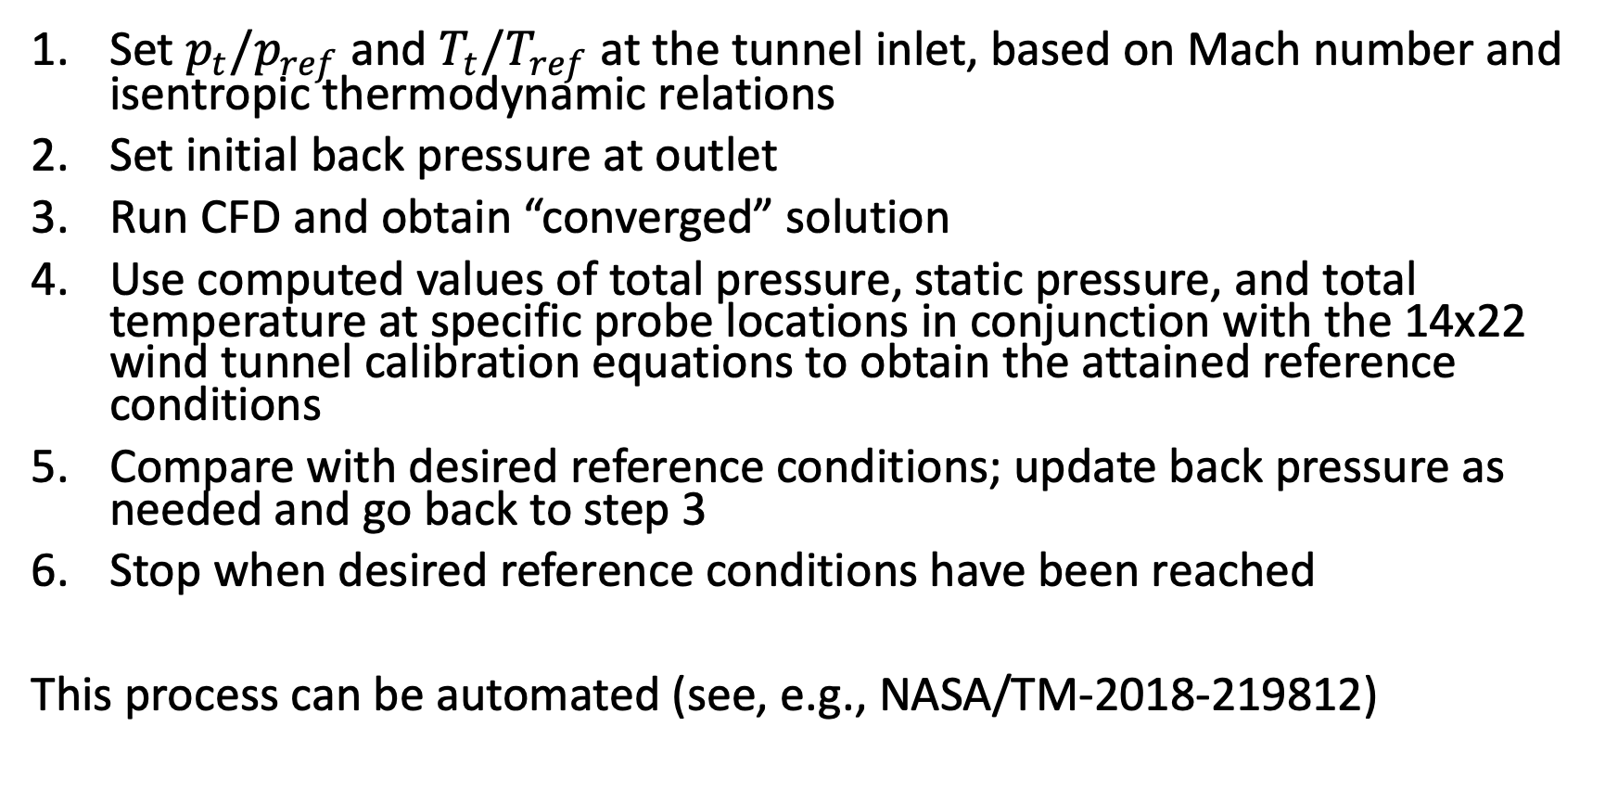
CFD: Strategies for wind tunnel simulations (cont’d)
Set $p_{t}/p_{ref}$ and $T_{t}/T_{ref}$ at the tunnel inlet, based on Mach number and isentropic thermodynamic relations
Set initial back pressure at outlet
Run CFD and obtain “converged” solution
Use computed values of total pressure, static pressure, and total temperature at specific probe locations in conjunction with the 14x22 wind tunnel calibration equations to obtain the attained reference conditions
Compare with desired reference conditions; update back pressure as needed and go back to step 3
Stop when desired reference conditions have been reached
This process can be automated (see, e.g., NASA/TM-2018-219812)

Slide 16
CFD: Strategies for wind tunnel simulations (cont’d)
Problems associated with in-tunnel CFD runs:
  Lack of consistency: different CFD codes may perform this iterative procedure differently, yielding different results (even with the same turbulence model)
  Programming this nontrivial procedure in different CFD codes may introduce errors or differences
  It is more difficult to iteratively converge in-tunnel CFD computations, compared with free-air computations, especially when including the support hardware (sting and mast)

Slide 17
CFD: Influence of wind tunnel walls
A primary question for the JF team was: “Are the errors associated with free-air CFD small enough for our quantities of interest, so that we can still confidently use it to validate and improve our turbulence models?”
Main influence of WT walls:
  Slightly more pronounced suction peaks near the wing leading edge
  The w component of edge velocity near the test article is sometimes shifted a very small amount
  Main quantities of interest for us in the junction region – the separation bubble size and general flowfield details such as mean flow and Reynolds stress components – are not affected too significantly

Slide 18
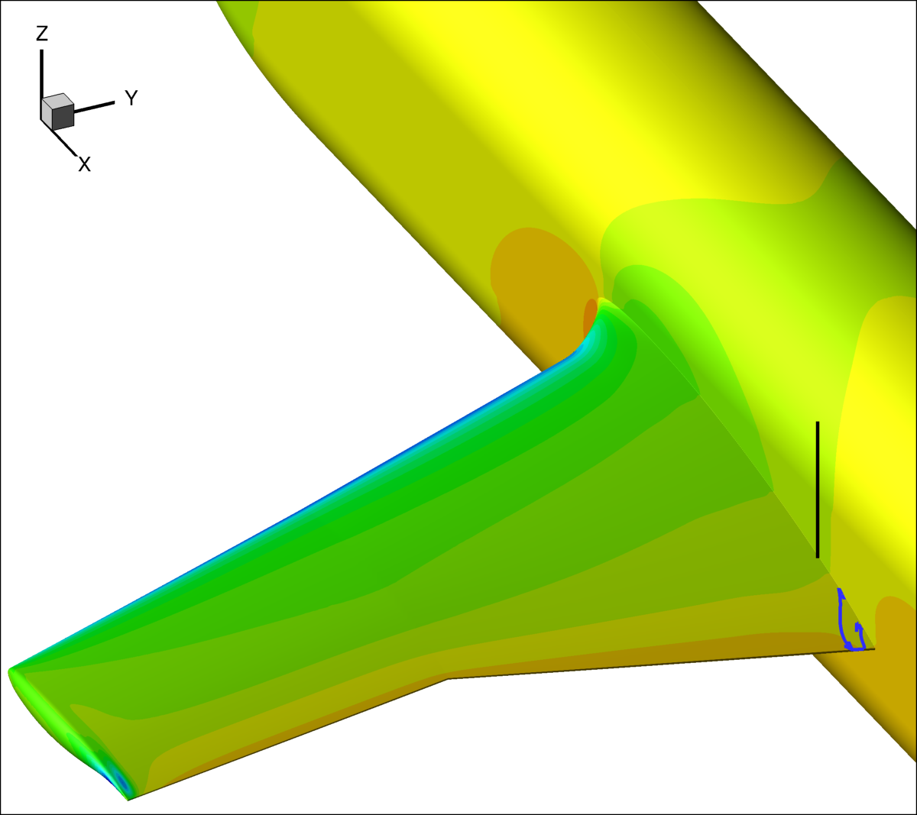
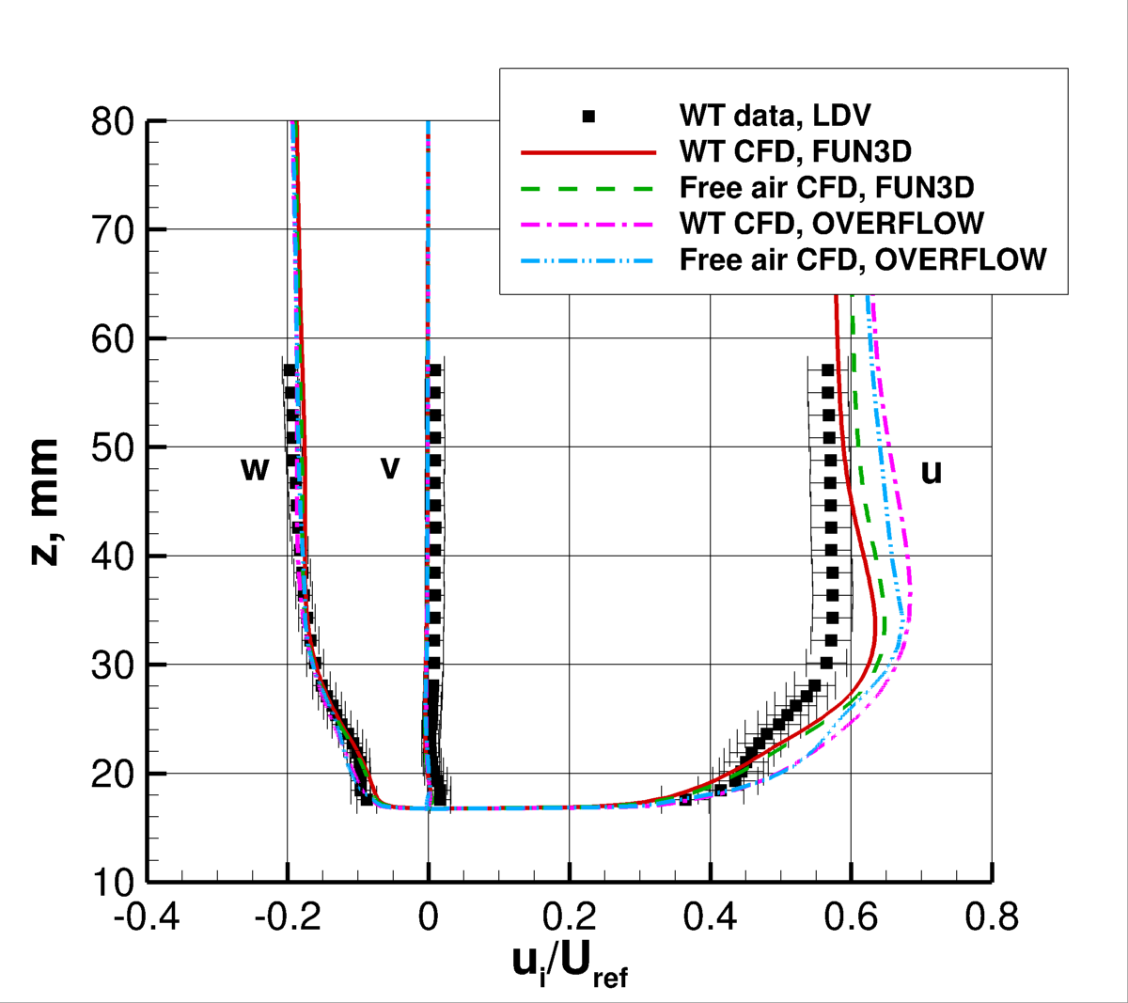
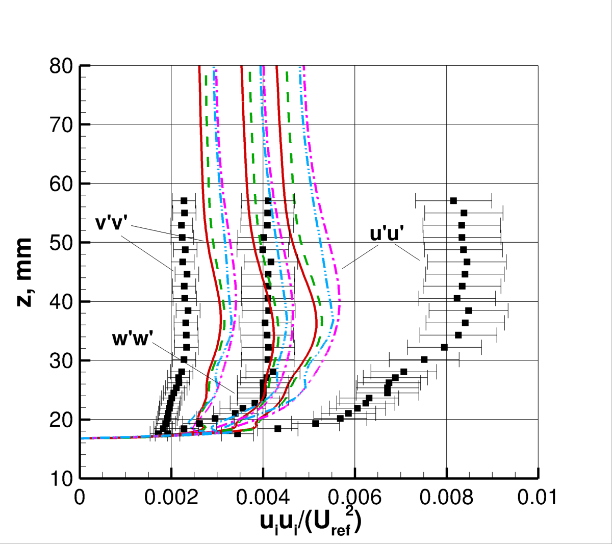
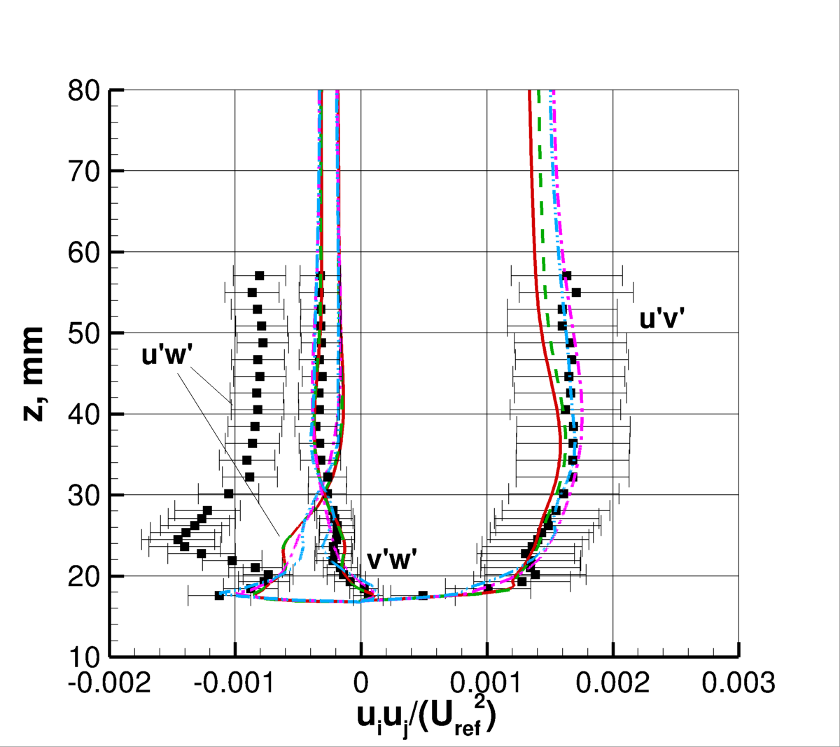
CFD: Influence of wind tunnel walls

Slide 19
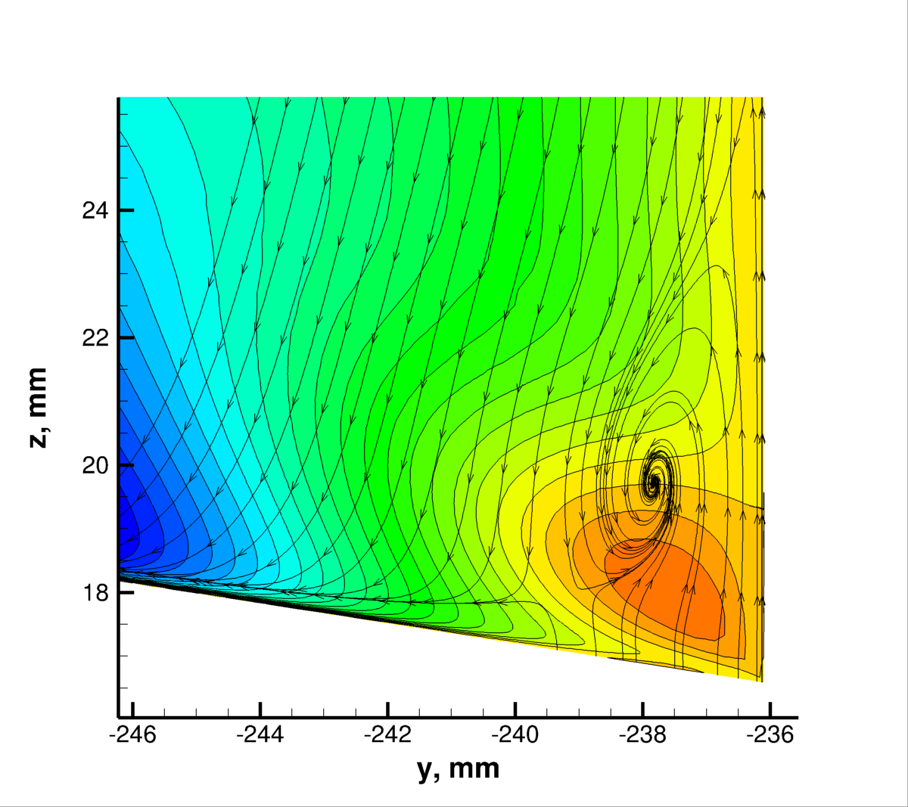
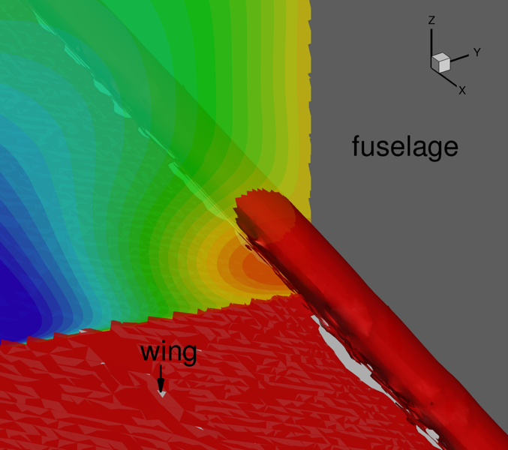
CFD’s Capability to Accurately Predict JF (RANS)
A key enabler is capturing the stress-induced vorticity near the corner
This vorticity helps the flow to resist the corner separation
Vortical flow near corner well upstream of separation
Isocontour of Q-criterion
This flowfield characteristic upstream of separation is also clearly visible in the NASA JF LDV data!

Slide 20
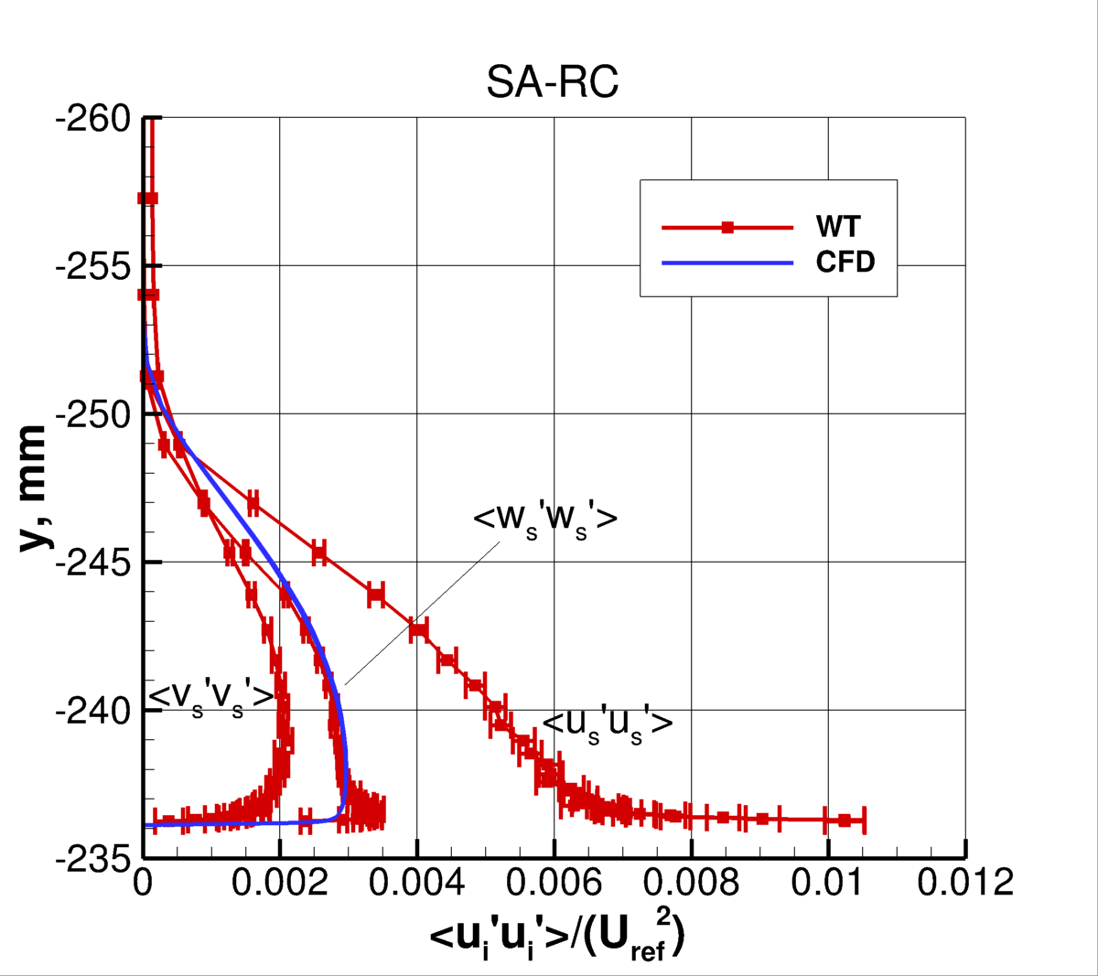
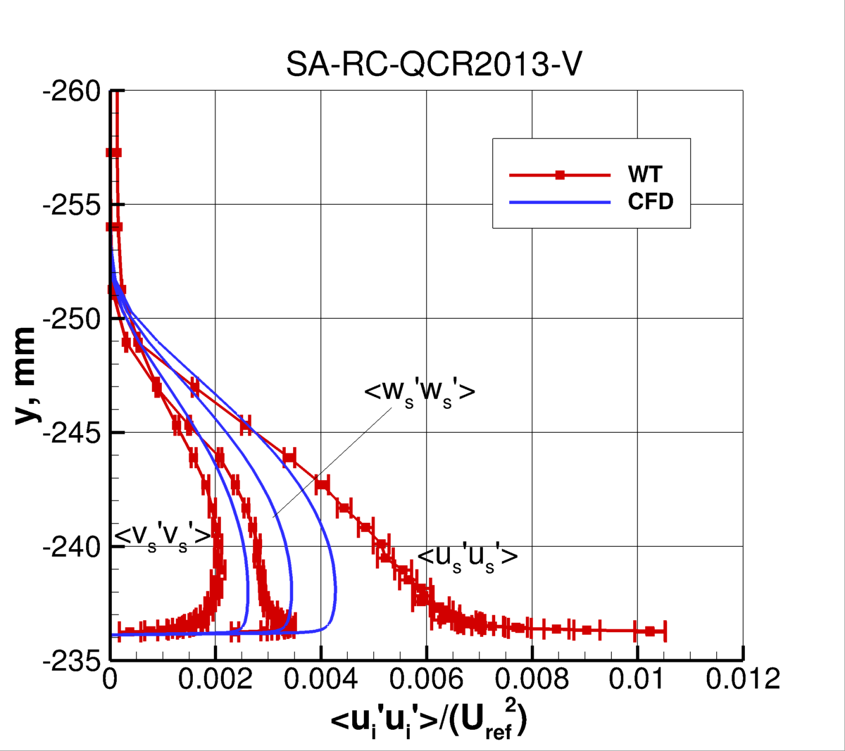
CFD’s Capability to Accurately Predict JF (RANS)
Normal stress differences are a driver of the corner stress-induced vorticity (Perkins, JFM Vol. 44, Part 4, 1970, pp. 721–740)
It is well known that linear eddy viscosity RANS cannot predict normal stress differences (see also Bordji et al., AIAA Journal, Vol. 54, No. 2, 2016, pp. 386–398)
Nonlinear modeling is required
  E.g., Reynolds Stress Transport (RST), Quadratic Constitutive Relation (QCR), or other nonlinear constitutive relation
Linear Model
Nonlinear Model (QCR)
(examples using SA-RC)

Slide 21
CFD’s Capability to Accurately Predict JF (RANS)
Normal stress differences are a driver of the corner stress-induced vorticity (Perkins, JFM Vol. 44, Part 4, 1970, pp. 721–740)
It is well known that linear eddy viscosity RANS cannot predict normal stress differences (see also Bordji et al., AIAA Journal, Vol. 54, No. 2, 2016, pp. 386–398)
Nonlinear modeling is required
  E.g., Reynolds Stress Transport (RST), Quadratic Constitutive Relation (QCR), or other nonlinear constitutive relation
Linear Model
Nonlinear Model (QCR)
(examples using SA-RC)
Predicted JF separation sizes too large by as much as 100% using this method
Predicted JF separation sizes much better using this method (although still too large by as much as 30%)

Slide 22
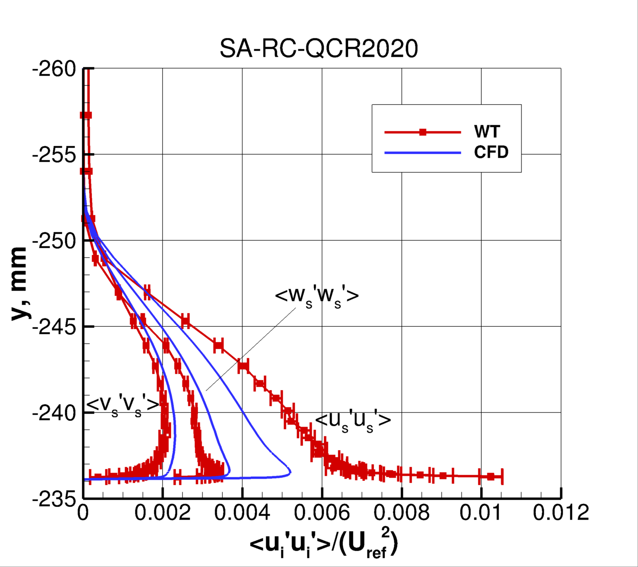
CFD’s Capability to Accurately Predict JF (RANS)
NASA JF data directly led to an improved version of QCR (Rumsey et al., AIAA Journal, Vol. 58, No. 10, 2020, pp. 4374-4384)

Slide 23
CFD’s Capability to Accurately Predict JF (RANS)
NASA JF data directly led to an improved version of QCR (Rumsey et al., AIAA Journal, Vol. 58, No. 10, 2020, pp. 4374-4384)
Key improvement here

Slide 24
CFD’s Capability to Accurately Predict JF (RANS)
NASA JF data directly led to an improved version of QCR (Rumsey et al., AIAA Journal, Vol. 58, No. 10, 2020, pp. 4374-4384)
Some improvement here

Slide 25
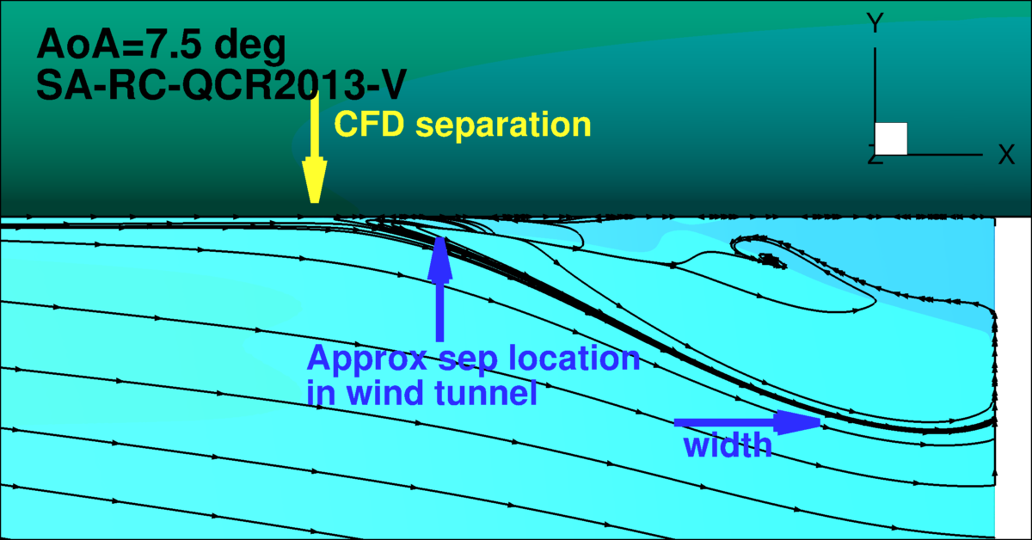
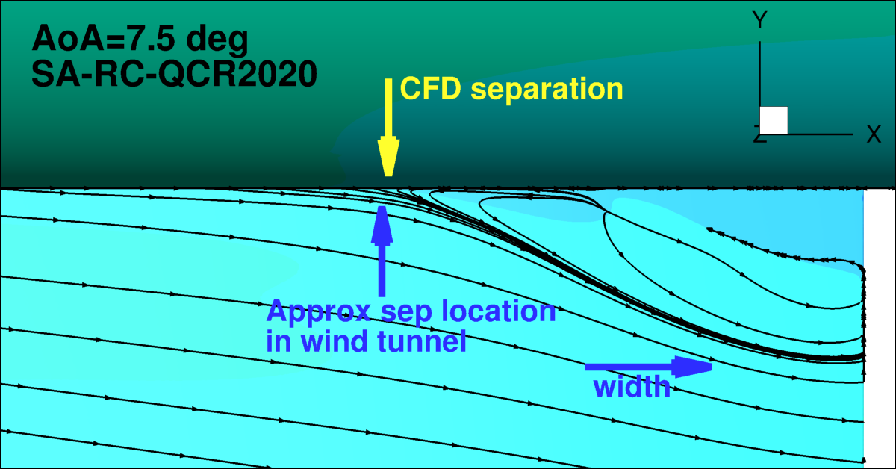
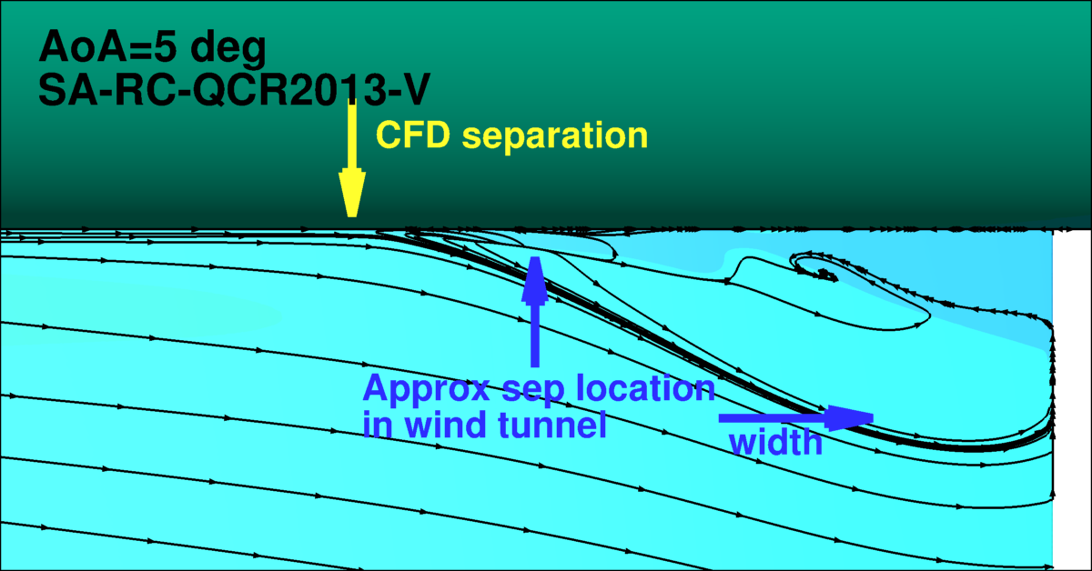
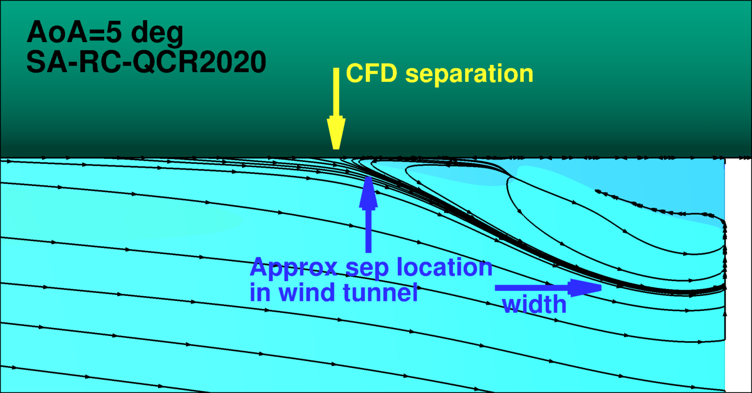
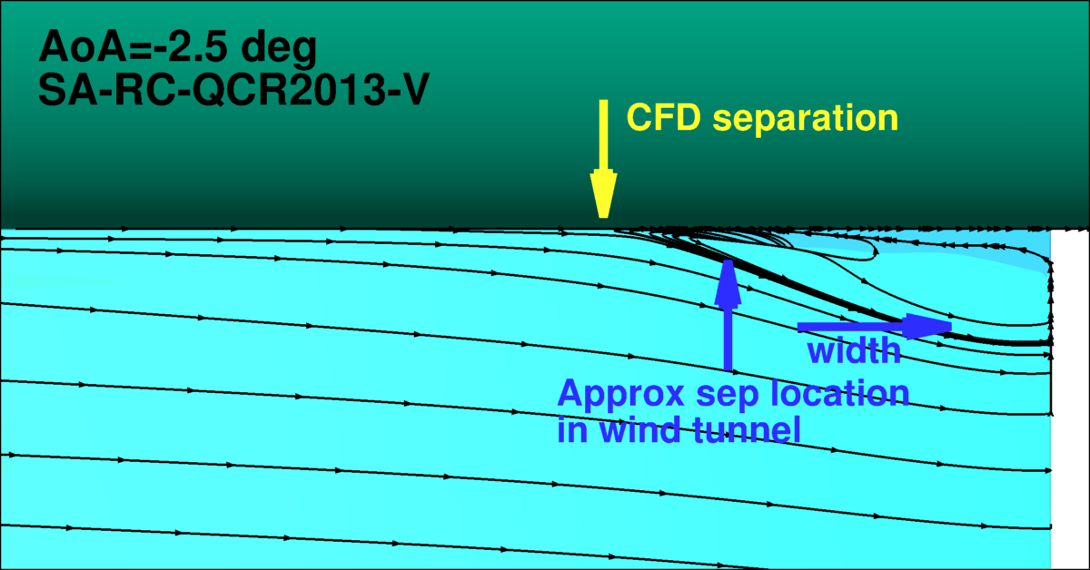
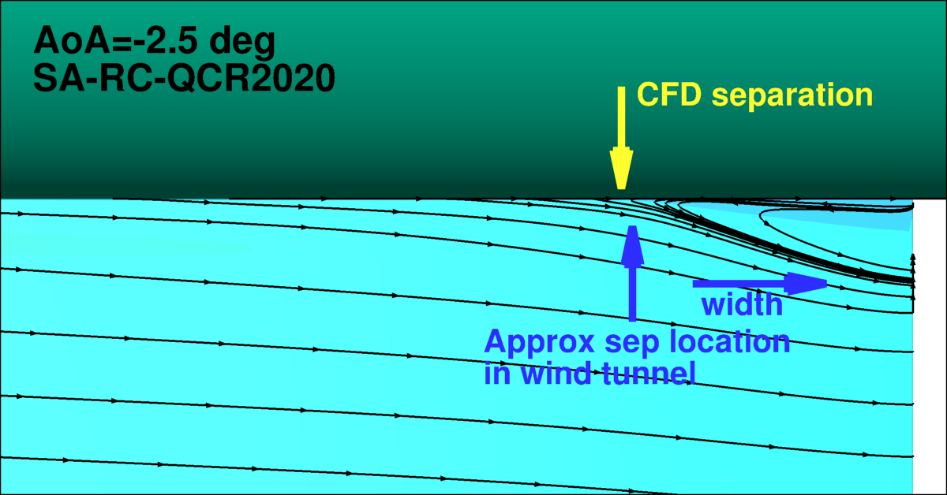
CFD’s Capability to Accurately Predict JF (RANS)
QCR2013-V
QCR2020
Note: other diagnostic measures – including Cp, velocities, and Reynolds stresses – are shown in other papers
(QCR2020 also improved results for an independent square duct test case)
See, e.g., AIAA-2021-1427

Slide 26
CFD’s Capability to Accurately Predict JF
Other independent CFD efforts have been conducted (particularly in AIAA Special Sessions in 2020)
RANS:
  RST can predict separation well, although some details missed
  Different brands of RST models yielded very different results
  Linear RANS models tend to predict separation far too early
  Most nonlinear RANS models (with exception of QCR2020) tend to predict separation somewhat too early
  Some RANS results were inconsistent (lack of verification?)
  Tendency to severely underpredict near-wall <u’u’>
  Tendency to predict excess streamwise momentum (u-velocity component) in corner
Scale Resolving (WMLES, hybrid RANS-LES, LB):
  Tendency to predict separation too late
  Because of expense, difficulty demonstrating grid convergence
  A strategy for boundary layer tripping is typically required
  Captures the unsteady, chaotic nature of the flow separation

Slide 27
Summary
CFD validation experiment = CFD and measurement experts working hand-in-hand
  CFD is a key component of the “experiment”
In any CFD validation experiment, it is crucial that CFD and wind tunnel measurements are “comparing apples with apples,” in the sense that all boundary conditions and geometric details are as identical as possible
  Expending a significant effort on wind tunnel characterization (including test article characterization) is a necessary component of a well-run CFD validation experiment
  Inflow wind tunnel characterization is not always easy or possible
  Even if it was, nonuniform CFD inflow BCs are not always readily or consistently available
Running CFD with wind tunnel walls is the best way to try to closely match wind tunnel measurement conditions
  But running “free air” CFD is currently far easier and more consistent (code to code)
  If free-air runs can be demonstrated to be “close enough” to in-tunnel runs, then free-air runs are by far the best method for learning/exploring how to improve CFD models
State-of-the-art CFD capability to predict JF separation was summarized
  No method is ideal

Slide 28
Future directions
Continue the strong validation dialog between CFD and measurement experts on JF Team
Different wing shape (0015-based) to be tested December 2021 – February 2022 in 14x22
  Attached flow -> incipient separation will further challenge CFD
  CFD has already been run using our “best” model: SA-RC-QCR2020 (blind evaluation)
https://turbmodels.larc.nasa.gov/Other_exp_Data/junctureflow_exp.html

