Slide 1
Orion MPCV Nonlinear Dynamic Correlation and Model Updating using Quasi-Static Modal Analysis
Matt Griebel¹, Adam Johnson¹, Brent Erickson¹, Joel Sills², Matt Allen³
¹Quartus Engineering Incorporated
²NASA Engineering and Safety Center
³Brigham Young University

Slide 2
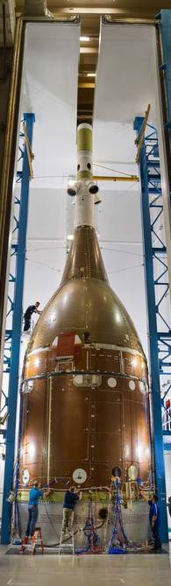
Background
Vibration testing of Configuration 4 (C4) Structural Test Article (STA) for the NASA Orion Multi-Purpose Crew Vehicle (MPCV) modal correlation program was performed in the reverberant acoustic chamber at Lockheed Martin
  C4 = “full stack” launch configuration
  Fixed base with varying stinger shakers
Significant nonlinear behavior and response deviation from pre-test FEA predictions
  Frequency and damping variations
  Nonlinear FRF shapes

Slide 3
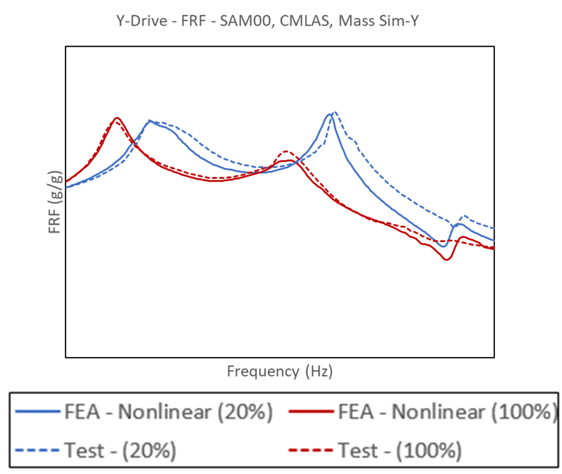
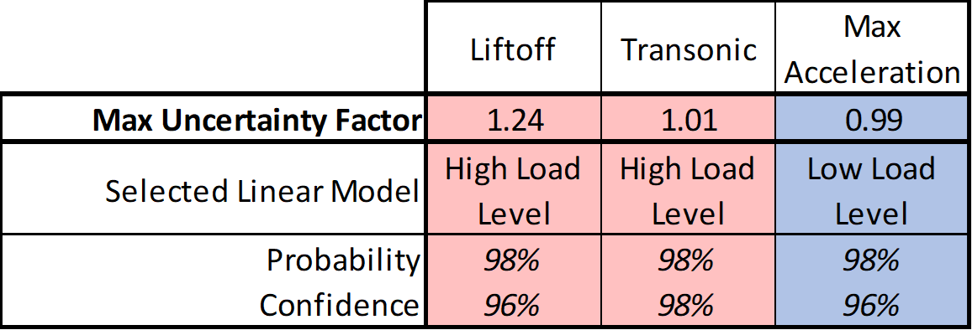
Motivation
Previous work by Quartus/NESC showed that a nonlinear correlation of the MPCV European Service Module STA (E-STA) could be used as a truth model for quantifying linearization uncertainty [1,2]
  Using a single linear FEM in coupled loads analysis (CLA)
Allen et al. proposed that Quasi-Static Modal Analysis (QSMA) could be used to drastically decrease model updating time during the nonlinear correlation phase and QSMA + Bouc-Wen (BW) could extend the method into the time domain [3]
[1] Griebel et al. “Orion MPCV E-STA Nonlinear Correlation for NESC,” SCLV 2019.
[2] Griebel et al. “Orion MPCV E-STA Nonlinear Dynamics Uncertainty Factors,” IMAC 2020
[3] Allen et al. “Leveraging Quasi-Static Modal Analysis for Nonlinear Transient Dynamics,” SCLV 2019

Slide 4
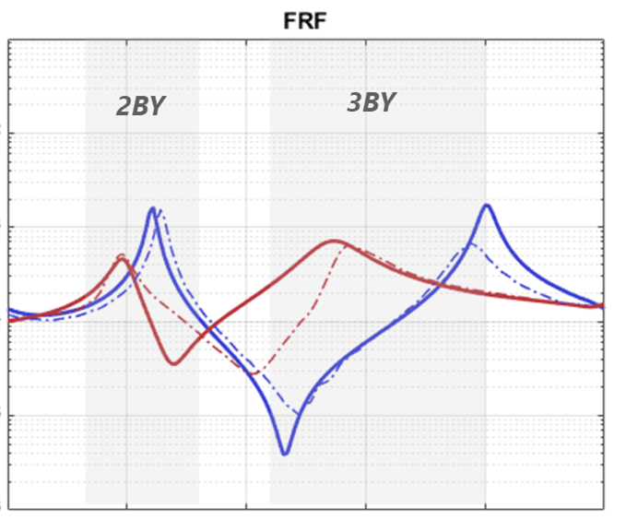
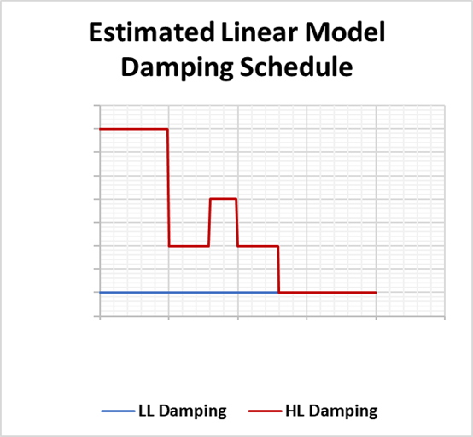
Linear Correlation
Similar to E-STA, 2 linear FEMs were correlated to C4 STA
  Low-level (LL) and high-level (HL)
  7 joints identified as impactful through sensitivity studies
  Linear correlation performed entirely in the frequency domain
LL FEM
LL Test
HL FEM
HL Test

Slide 5
Nonlinear Model Setup
Performed Hurty/Craig-Bampton (HCB) reduction of LL linear model
  Retain
    Drive points, instrumentation locations, joint interfaces, modes
  Includes nominal modal damping from LL linear correlation effort
    Modal damping is converted to viscous damping
      Since all DOF are CSET, except base constraint, component modes ≈ system modes
  Converted Nastran HCB to Abaqus
Updated joints to Abaqus connector elements with Coulomb friction
  Started with stuck stiffness = LL linear stiffness and slip stiffness = HL linear stiffness
  Frequency, x-ortho, and FRF checks done on Abaqus model to validate conversion

Slide 6
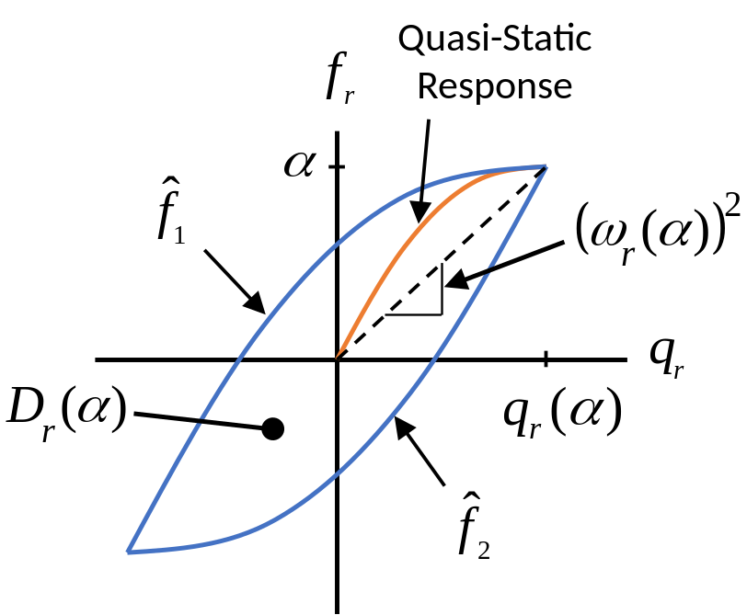
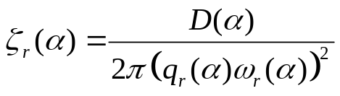
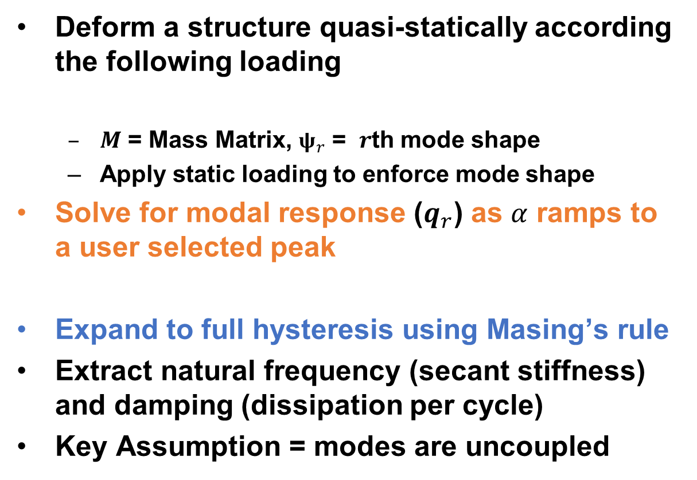


QSMA Overview
Deform a structure quasi-statically according the following loading
  $M$ = Mass Matrix, $ψ_{r}$ = $r$th mode shape
  Apply static loading to enforce mode shape
Solve for modal response ($q_{r}$) as $α$ ramps to a user selected peak
Expand to full hysteresis using Masing’s rule
Extract natural frequency (secant stiffness) and damping (dissipation per cycle)
Key Assumption = modes are uncoupled
$$f=Mψ_{r}α → x(α)$$
$$q_{r}=ψ_{r}^{T}Mx$$
[4] R. M. Lacayo and M. S. Allen, “Updating Structural Models Containing Nonlinear Iwan Joints Using Quasi-Static Modal Analysis,” Mechanical Systems and Signal Processing, vol. 118, 1 March 2019.

Slide 7
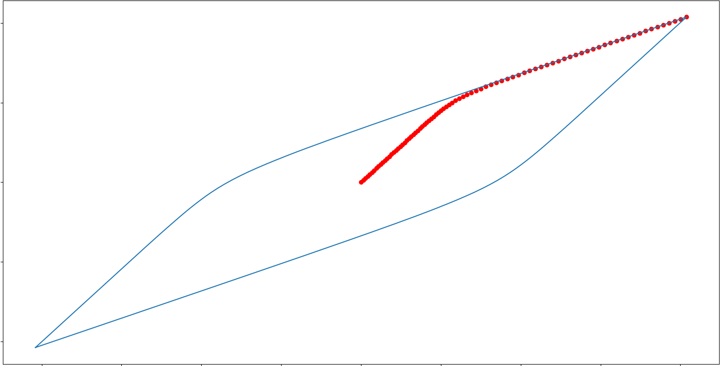
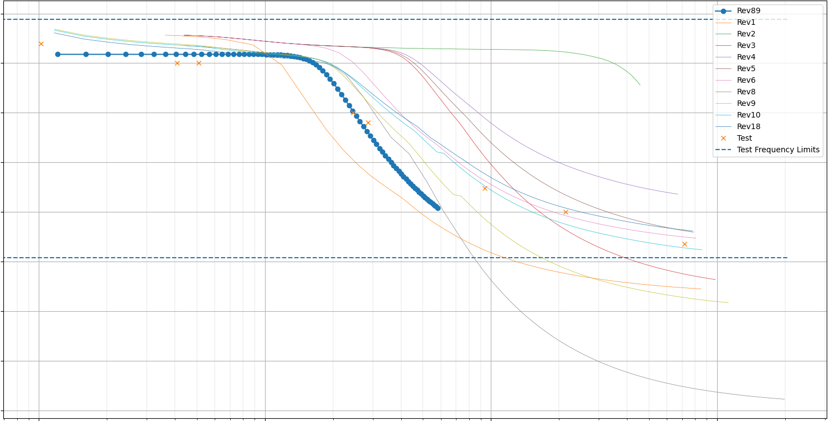
QSMA Workflow & Example Results
ω₂²
ω₁²
Frequency
f₁
q₁
q₂
Modal Response
Workflow:
  Update Abaqus model parameters
    Stick stiffness, slip stiffness, critical slip load
  Run nonlinear static analysis
  Convert force/displacement back to modal space and construct hysteresis
    Calculate frequency and plot against physical response
f₂
Frequency
x₁
x₂
Physical Response

Slide 8
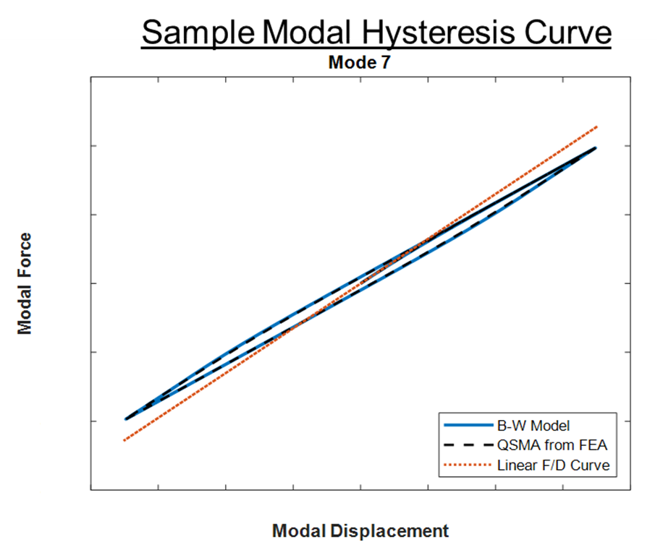
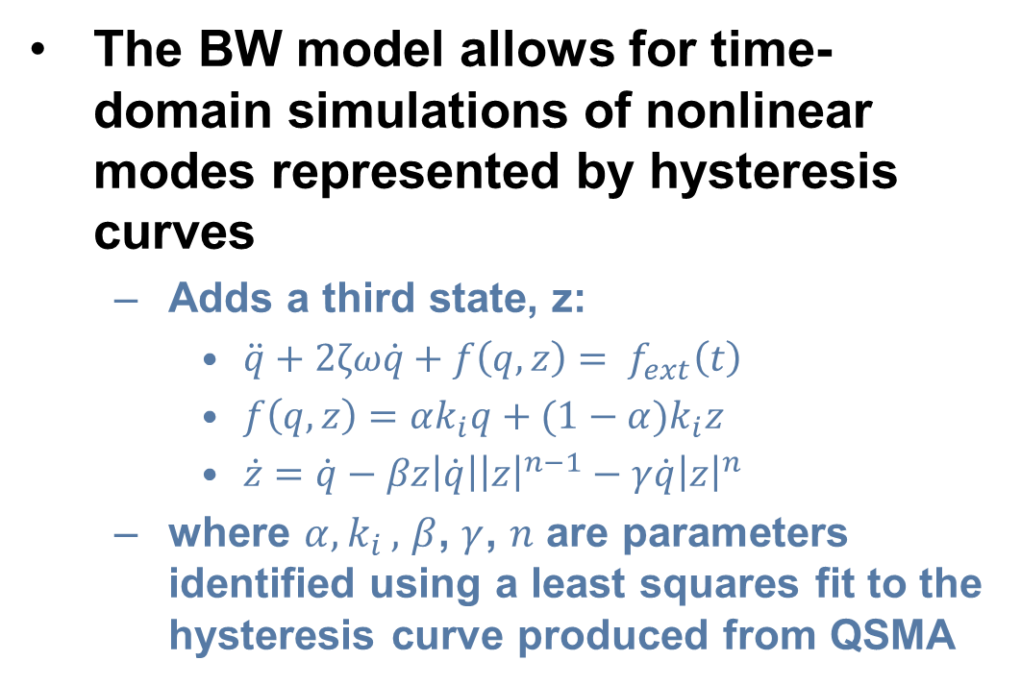

Bouc-Wen Overview
The BW model allows for time-domain simulations of nonlinear modes represented by hysteresis curves
  Adds a third state, z:
    $\ddot{q}+2ζω\dot{q}+f\left(q,z\right)= f_{ext}\left(t\right)$
    $f\left(q,z\right)=αk_{i}q+(1−α)k_{i}z$
    $\dot{z}=\dot{q}−βz\left|\dot{q}\right|{\left|z\right|}^{n−1}−γ\dot{q}{\left|z\right|}^{n}$
  where $α{,k}_{i},$ $β$, $γ$, $n$ are parameters identified using a least squares fit to the hysteresis curve produced from QSMA
Bouc-Wen Parameters
$k_{i}, α, β, γ,n$

Slide 9
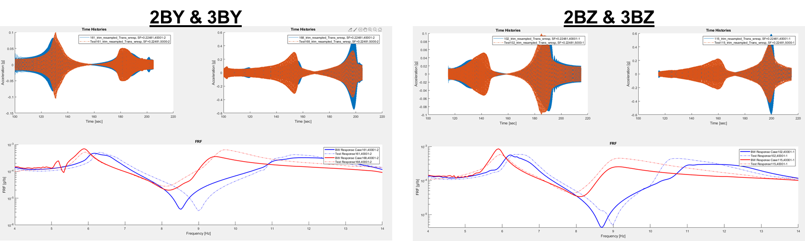
BW Workflow & Example Results
Workflow:
  Fit BW hysteresis to QSMA hysteresis
    Mode being studied represented by hysteresis; other modes remain linear
  Run modal transient and compute FRFs
2BY & 3BY
LL Test
BW Model, LL Input
HL Test
2BZ & 3BZ
BW Model, HL Input

Slide 10
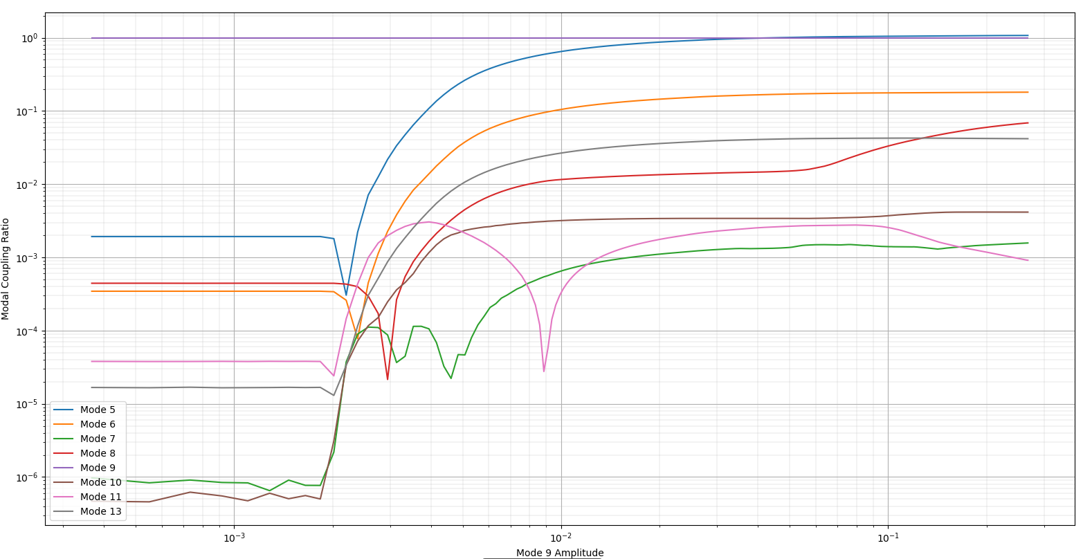
Modal Coupling
Current limiting assumption of both QSMA and BW is that each mode remains uncoupled
Initial implicit dynamic correlation of the 3rd bending modes did not match the BW response
Investigation of modal coupling showed significant coupling between the the 3rd (Mode 9) and 1st (Mode 5) modes
  This would cause the QSMA/BW predictions of the response to be inaccurate.
Efforts are underway to extend QSMA to account for modal coupling [5]
Coupling Ratio
Modal Amplitude
[5] Singh, Allen & Kuether, “Multi-mode Quasi-static Excitation for Systems with Nonlinear Joints,” MSSP, (Submitted May 2021).

Slide 11
Implicit Dynamic Correlation – Overview
Performed many iterations to improve joint parameters using QSMA + BW
Nonlinear correlation finished using Abaqus implicit dynamics
Time slices of transient test data used as input
  Only analyzed slice of transient data exciting mode of interest to reduce run times
  Transient responses were stitched back together when multiple modes were analyzed from a single test
Spectral processing of transient responses performed to compare FRF
  Due to the time slice/response stitching, spurious dynamic content outside the frequency range of interest and in between modes can be neglected

Slide 12
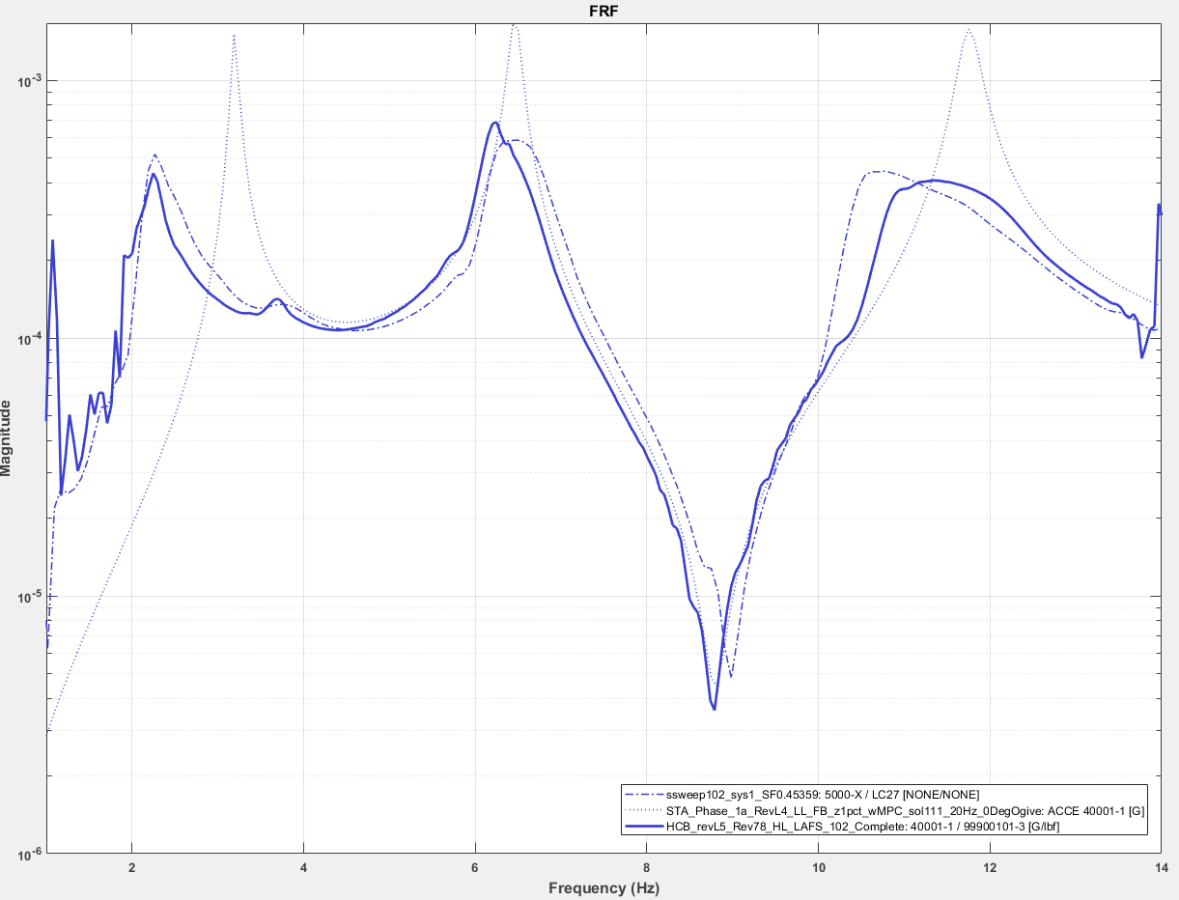
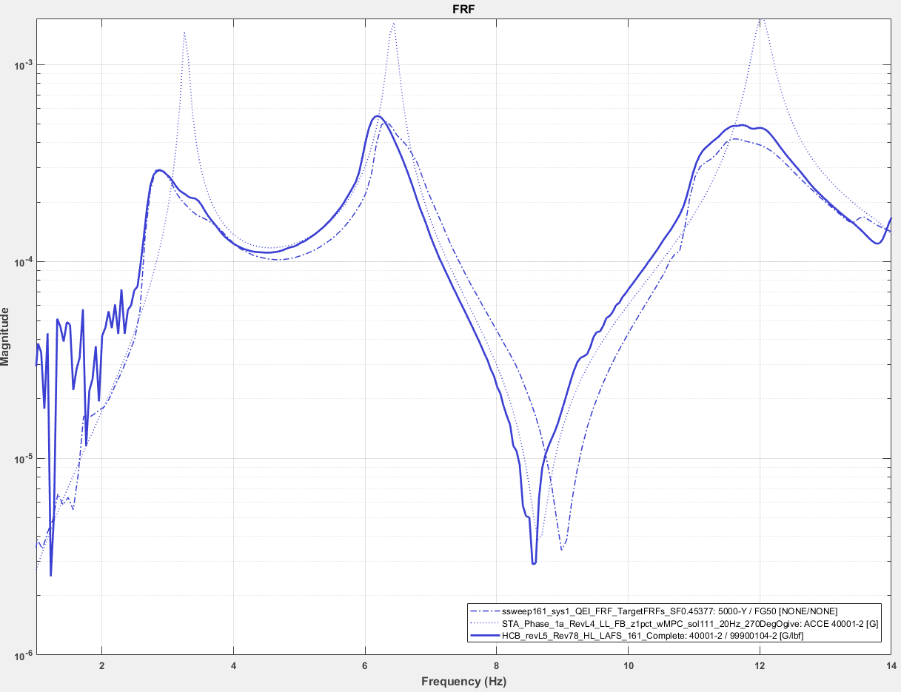
Final Nonlinear Correlation – 1B, 2B, 3B LL
NL model shows excellent frequency, damping, and shape correlation to the first three LL bending modes, especially compared to the linear correlation
  Even for relatively low-level inputs significant nonlinear behavior is exhibited in test
  NL model accurately captures frequency shifts, changes in damping, and nonlinear transitions in primary resonant responses
Z Bending
Y Bending
Magnitude
LL Test
LL Linear FEM
Magnitude
NL FEM, LL Input
Frequency
Frequency

Slide 13
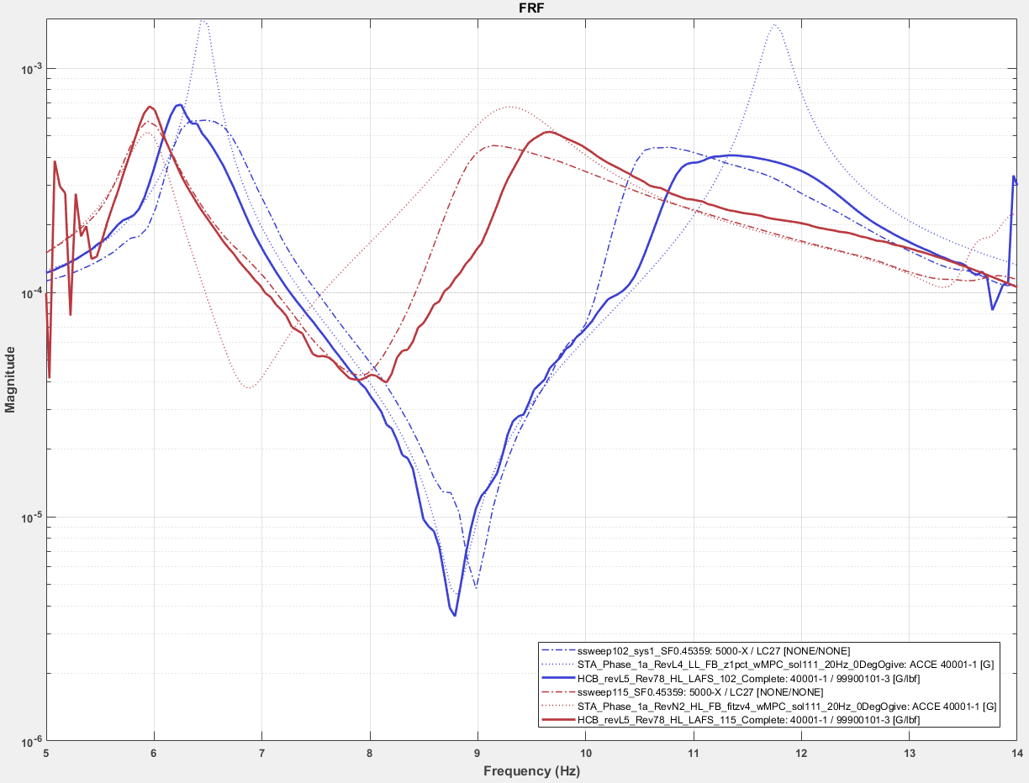
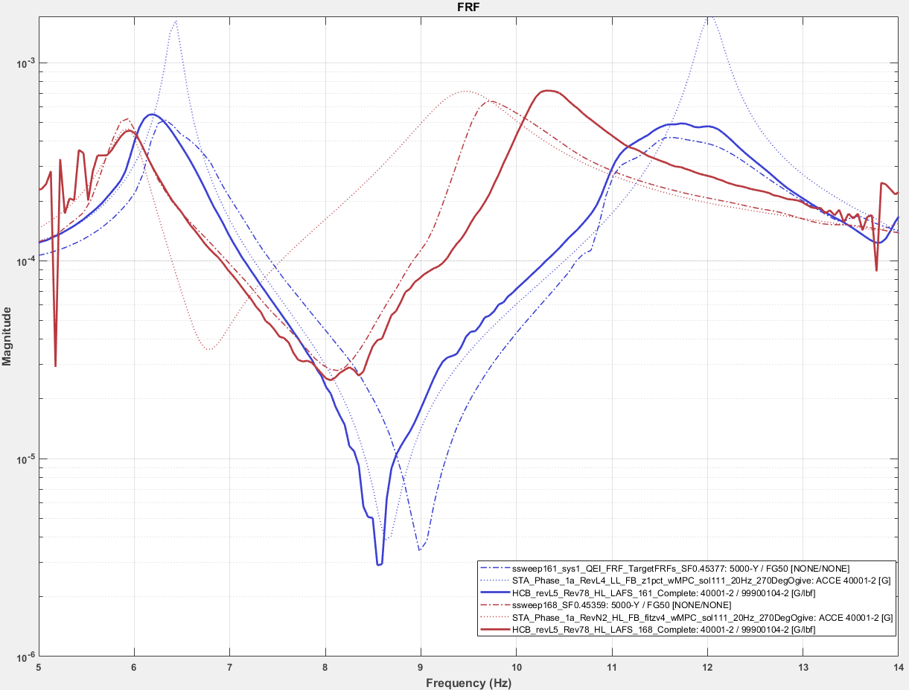
Final Nonlinear Correlation – 2B & 3B LL & HL
NL correlation provides better amplitude and shape correlation to the LL and HL 2nd and 3rd bending modes, particularly the shape and transition of the 3rd bending mode, over the linear correlation
  Low and high level responses captured in single model with increased accuracy for both (varying load level inputs)
Z Bending
Y Bending
LL Test
LL Linear FEM
NL FEM, LL Input
Magnitude
Magnitude
HL Test
HL Linear FEM
NL FEM, HL Input
Frequency
Frequency

Slide 14
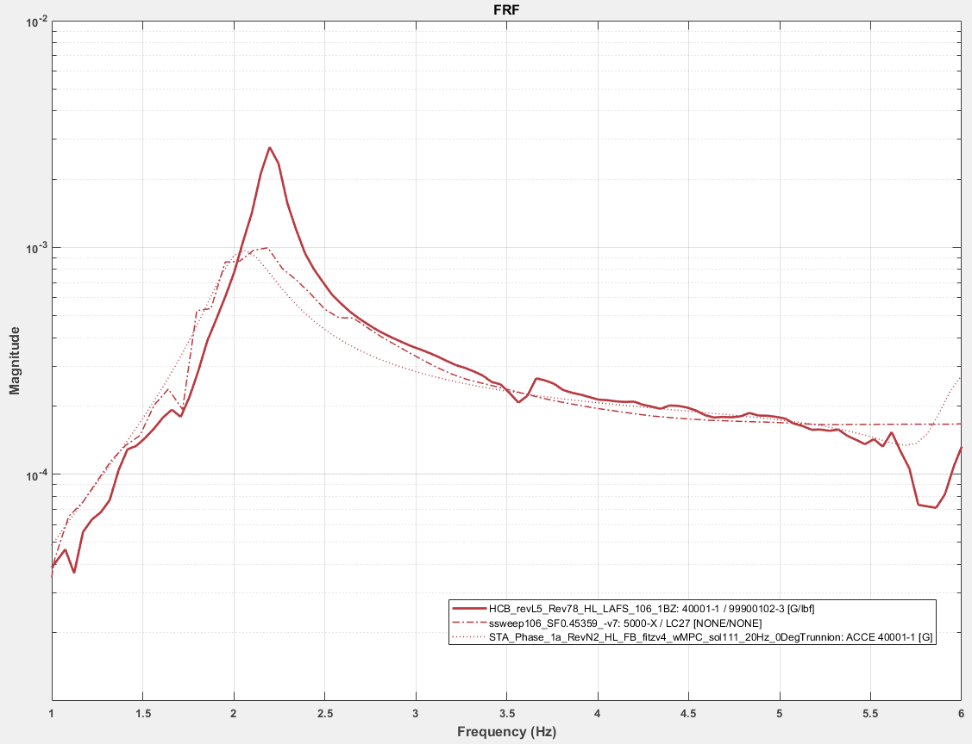
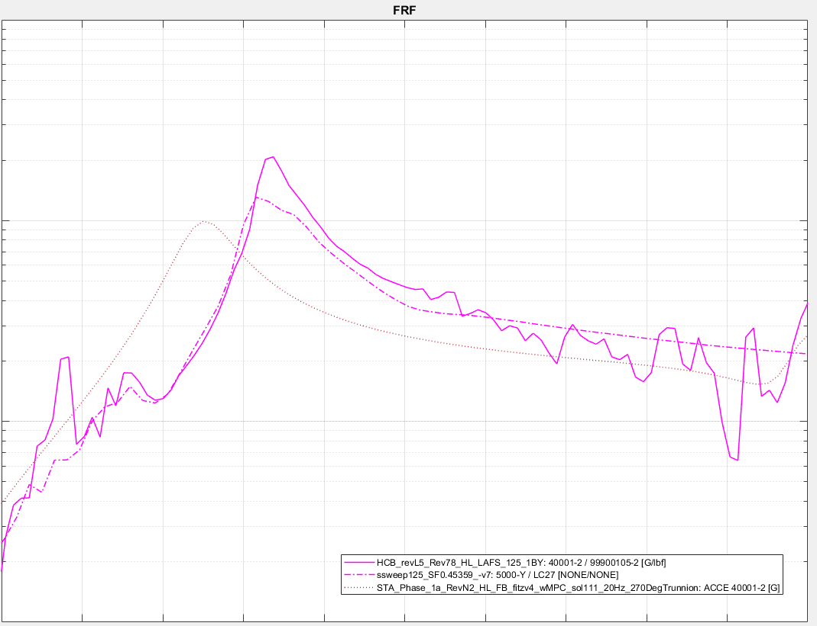
Final Nonlinear Correlation – 1B HL
Due to time constraints, this effort proceeded with CLA/Uncertainty steps before 1B transient correlation runs were complete
NL correlation provides accurate frequency correlation, but under-predicts damping for the first HL bending mode (over-predicts response amplitude)
  Testing was not able to excite the 1BY mode at as high level as 1BZ, so correlation was performed to a “mid level” (ML) input
  Since current model over-predicts high load level 1B responses, initial uncertainty factor calculations are conservative
Z Bending
Y Bending
HL Test
HL Linear FEM
NL FEM, HL Input
Magnitude
Magnitude
ML Test
ML Linear FEM
NL FEM, ML Input
Frequency
Frequency

Slide 15
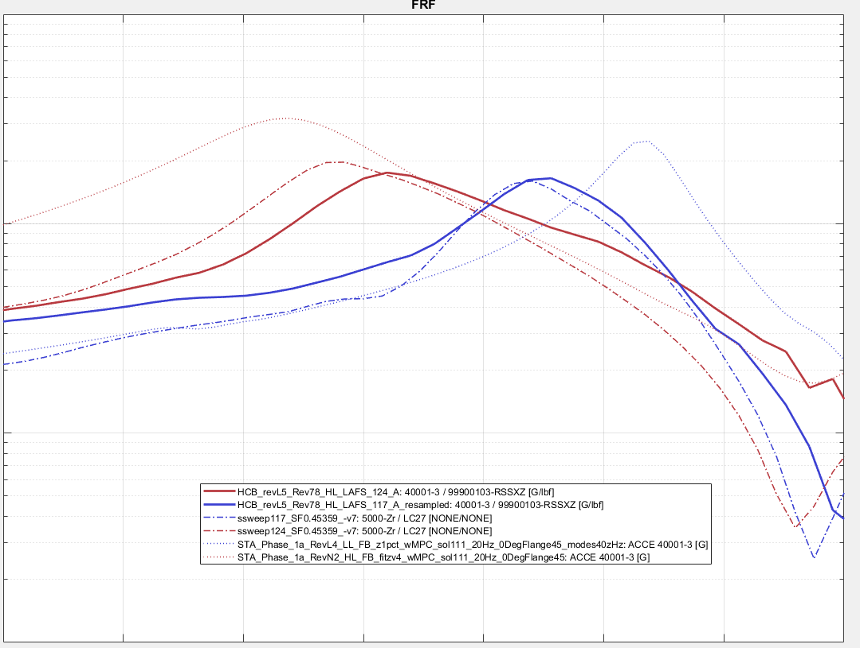
Final Nonlinear Correlation – 1A HL & LL
Axial correlation was not explicitly performed in this effort
  Primary axial response exhibits minor nonlinearities compared to lateral responses
However, the final model parameters showed excellent correlation to frequency, damping, shape and transition from LL to HL
  Correlation driven by lateral response resulting in good predictions for axial
LL Test
LL Linear FEM
NL FEM, LL Input
Magnitude
HL Test
HL Linear FEM
NL FEM, HL Input
Frequency

Slide 16
Conclusions
QSMA + BW were successfully leveraged in nonlinear correlation and model updating for the current NESC MPCV C4 effort
  QSMA + BW significantly reduced schedule and improved results
Current QSMA and BW methodologies rely on the assumption that modes remain uncoupled
  Modal coupling is present for this test article; full implicit dynamics simulations were required to finish nonlinear correlation
Using modern computational tools (Hurty/Craig-Bampton Reduction, Abaqus, QSMA, BW) it is now possible to perform nonlinear modeling and model correlation within realistic computational/time constraints
The final nonlinear correlated model was used as a “truth” model for subsequent CLA studies & uncertainty analysis

