Slide 1


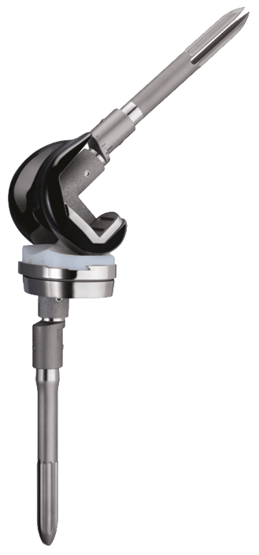
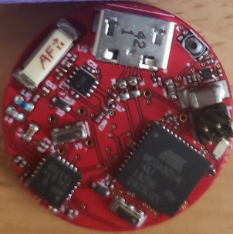
Wireless Sensing Knee Preliminary Concept
Strain gauges
Wireless
Microcontroller
and sensor interface
circuitry.
3-axis accelerometer
Wires from sensors
to microcontroller
- not shown.
1” diameter
(currently)

Slide 2


